Slide 1
Exploratory Data Analysis
Jan’17 Batch – Group 7

Slide 2
Team info
Vutukuru Siva Santosh Kumar
Praveen Kumar S Naidu
Madhu Gurram
Tejomayi Madugula
Venkata Naga Prasad Chinthalapudi
Ananda Sampurna Bharadwaj Tadikonda
Srinivas Pillalamarry
Srinivasa
Radhika Devi Annamgi

Slide 3
Domain & topic of project
Domain: Automobile
Topic: Automobile data (Cars)

Slide 4
Introduction
The data contains information about Cars, and comprises of several aspects of automobile design and performance.
This application helps for understanding the dataset by exploring each parameters in the dataset.
Data Set Characteristics: | Multivariate | Number of Instances: | 205
Attribute Characteristics: | Categorical, Continuous | Number of Attributes: | 26
Period of data: | N/A | Missing Values? | Yes

Slide 5
Attribute information
symboling: : -3, -2, -1, 0, 1, 2, 3 (A value of +3 indicates that the auto is risky, -3 that it is probably pretty safe.)
normalized-losses: continuous from 65 to 256.
make: alfa-romero, audi, bmw, chevrolet, dodge, honda, isuzu, jaguar, mazda, mercedes-benz, mercury, mitsubishi, nissan, peugot, plymouth, porsche,renault, saab, subaru, toyota, volkswagen, volvo
fuel-type: diesel, gas.
aspiration: std, turbo.
num-of-doors: four, two.
body-style: hardtop, wagon, sedan, hatchback, convertible.
drive-wheels: 4wd, fwd, rwd.
engine-location: front, rear.
wheel-base: continuous from 86.6 120.9.
length: continuous from 141.1 to 208.1.
width: continuous from 60.3 to 72.3.
height: continuous from 47.8 to 59.8.
curb-weight: continuous from 1488 to 4066.
engine-type: dohc, dohcv, l, ohc, ohcf, ohcv, rotor.
num-of-cylinders: eight, five, four, six, three, twelve, two.
engine-size: continuous from 61 to 326.
fuel-system: 1bbl, 2bbl, 4bbl, idi, mfi, mpfi, spdi, spfi.
bore: continuous from 2.54 to 3.94.
stroke: continuous from 2.07 to 4.17.
compression-ratio: continuous from 7 to 23.
horsepower: continuous from 48 to 288.
peak-rpm: continuous from 4150 to 6600.
city-mpg: continuous from 13 to 49.
highway-mpg: continuous from 16 to 54.
price: continuous from 5118 to 45400.

Slide 6
Business questions identified
Preference in buying – low cost or more cost cars?
Is risk rating impacting the buying ?
Does fuel type play a role in car purchase?
Is mileage better in cities or highway ?
Which body style is preferred ?
Which cars are safe ?
For same mileage cars, which fuel type cars are costlier ?
Which drive wheels is preferred and why ?
What factors impact automobile pricing ?
What factors impact mileage ?
What is the Best car in terms of both price and mileage ?

Slide 7
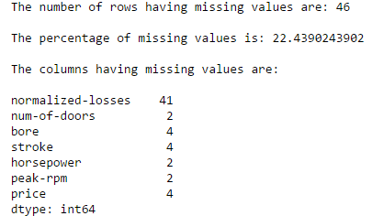
Loading and Cleaning of data
To-do: Handle missing values
Approach:
Identify the columns and rows having missing values
Since the % is 22.43 and hence decided to handle instead of dropping those rows.
The column “normalized-losses” is having the highest number of missing values. So decided to drop the column
“Num-of-doors” is a categorical variable. Hence replaced the missing values with mode corresponding to make and body-style

Slide 8
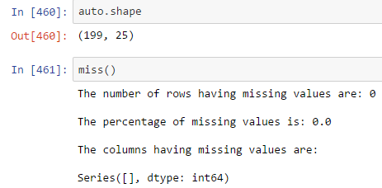
Continued….
Replace missing values in “bore” and “stroke” with mean corresponding to make (as its continuous variable)
“Horsepower” and “peak-rpm” are both having missing values for make 'renault‘. Moreover only 2 observations are corresponding to ‘renault’. Hence dropped the rows.
“Price” has lots of variations and not able to identify a specific pattern in which price is decided. Hence dropped the rows.

