Slide 1
Hibernate mapping
The mapping of associations between entity classes and the relationships between tables is the soul of ORM.
An association mapping can be unidirectional as well as bidirectional.

Slide 2
One to One Mapping
Login(id,
username,passeord)
Trader(id,name)
A one-to-one relationships occurs when one entity is related to exactly one occurrence in another entity.
One trader obj is associated with one login obj

Slide 3
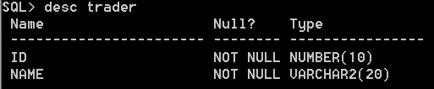
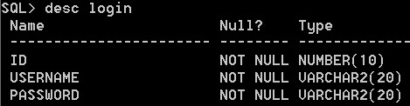
Create table
Trader (ID, Name)
Login (ID, Username, Password; ID as FK)
both are assigned the same primary key

Slide 4
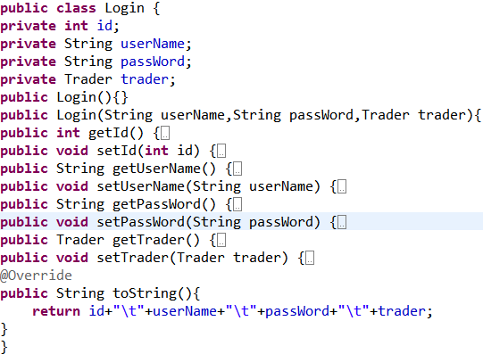
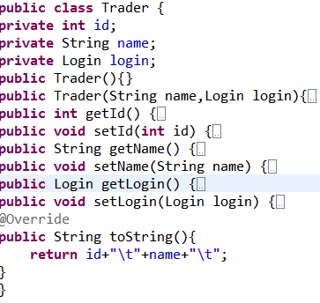
Create model class
Create class Trader(id, name, login)
Login(id, username, password, trader)

Slide 5
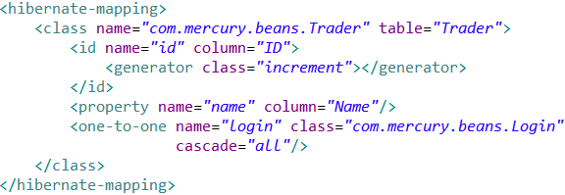
XML mapping file
Trader.hbm.xml
increment-generates identifiers of type long, short or int that are unique only
when no other process is inserting data into the same table. Do not use in a cluster.
cascade (optional): specifies which operations should be cascaded from the parent object to the associated object.
All - save / delete / update / evict / lock / replicate / merge / persist

Slide 6
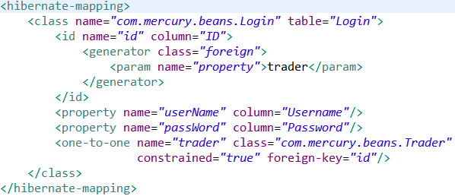
Login.hbm.xm
a special foreign identifier generator is declared, it will know get the primary key
value from Trader. With constrained=”true”, it ensure the Trader must exists.
If any parameters are required to configure or initialize the generator instance,
they are passed using the <param> element.

Slide 7
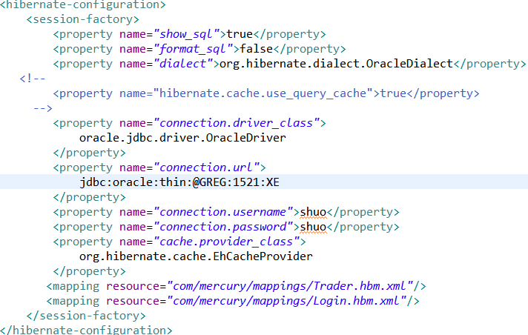
Hibernate Configuration File

Slide 8
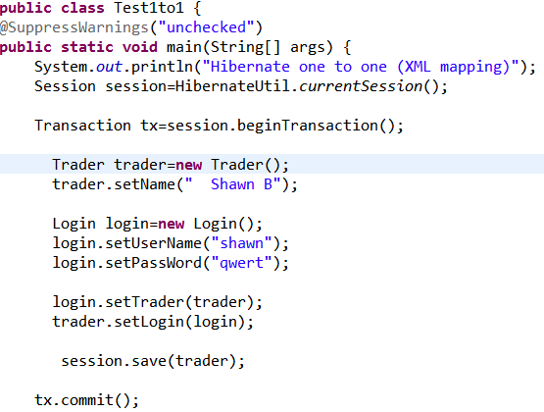
Test result

Slide 9
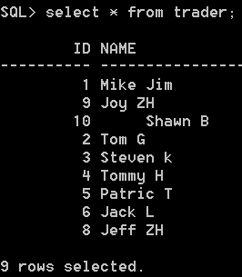
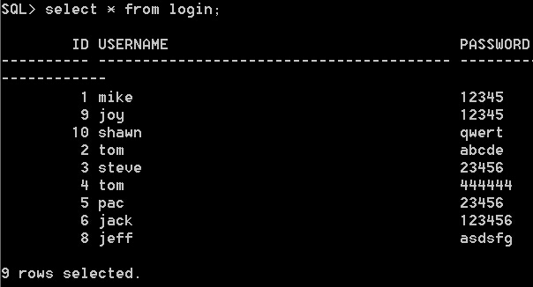
Test result

Slide 10
Mapping with annotation
Do not need mapping files
Hibernate Model Class with annotation
Hibernate Configuration File
Use AnnotationConfiguration()

Slide 11
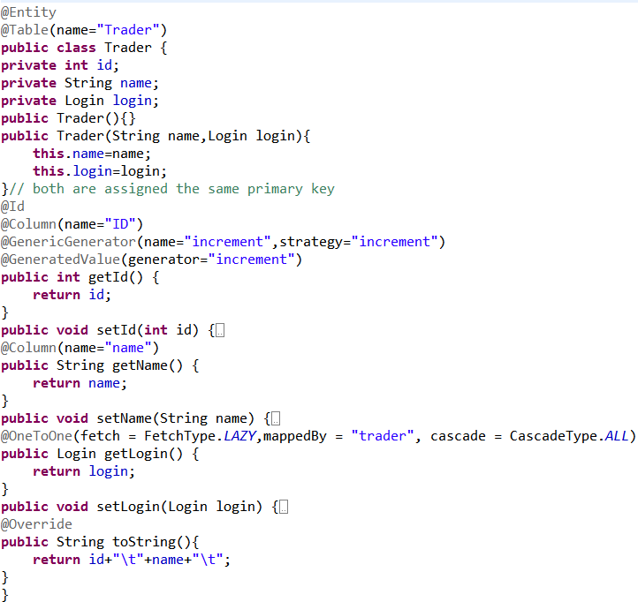
Notes:
increment will be used to obtain the primary key value.

Slide 12
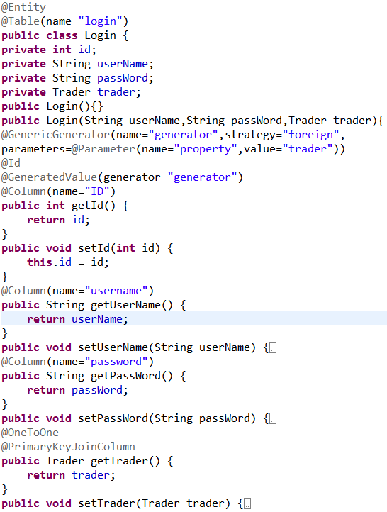
Notes:
The @GeneratedValue annotation denotes that value for a column, which must be annotated with @ID is generated. The elements strategy and generator on the annotation describe how the generated value is obtained.

Slide 13
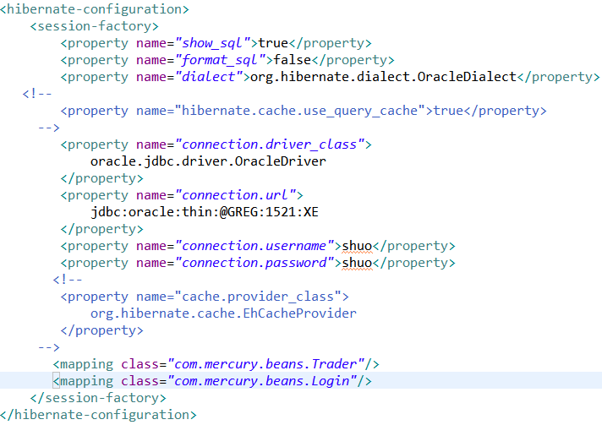
Hibernate Configuration File
<mapping class="com.mercury.beans.Trader"/>
<mapping class="com.mercury.beans.Login"/>

Slide 14
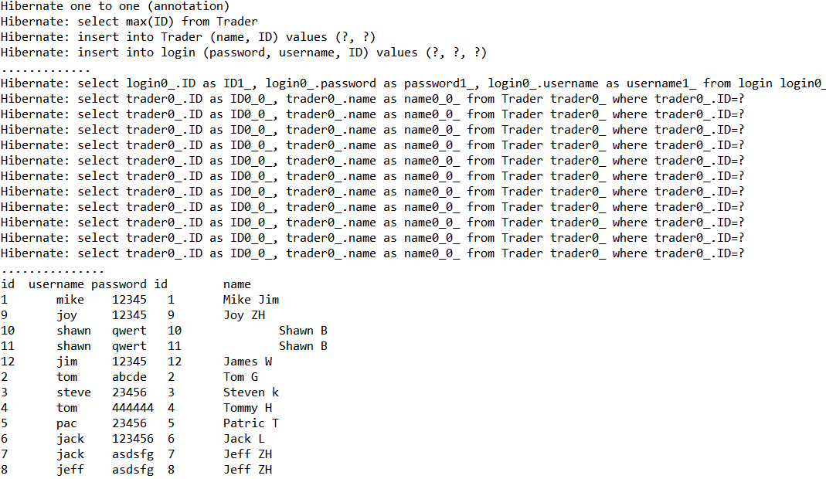
Test result

