Slide 1
YAHOO FINANCE TRADING SYSTEM
ZED ZHANG
BRAD LIU
IRIS CHEN

Slide 2
Presentation Outline
Functionalities
Core of the Project
Details
Demo
Summary

Slide 3
FUNCTIONALITIES

Slide 4
WHAT IS YFTS
YAHOO FINANCE TRADING SYSTEM) IS A REAL-TIME TRADING SYSTEM THAT RETRIEVES REAL-TIME MARKET DATA FROM YAHOO FINANCE.
ROLES:
  TRADER: LOGIN/OFF, BUY, SELL, CHECK HISTORY TRANSACTIONS, WATCH REAL-TIME MARKET DATA, VIEW PORTFOLIO
  ADMIN: LOGIN/OFF, ADD NEW STOCKS, REMOVE EXISTING STOCKS, COMMIT ALL TRANSACTIONS

Slide 5
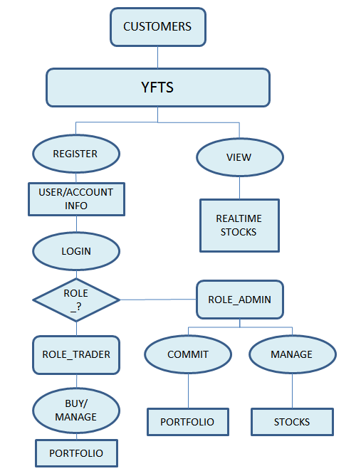

Slide 6
IN DEPTH
TRADER MAKES TRANSACTIONS
  ALL TRANSACTIONS ARE ON PENDING STATUS WILL BE SAVED IN A CSV FILE
ADMIN CONFIRM TRANSACTIONS
  ADMIN VIEW TRANSACTIONS BY READING CSV FILE
  COMMITTING TRANSACTIONS WILL SAVE ALL TRANSACTIONS AS COMPLETE INTO DATABASE, AND THE CSV FILE WILL BE DELETED

Slide 7
TECH DETAILS

Slide 8
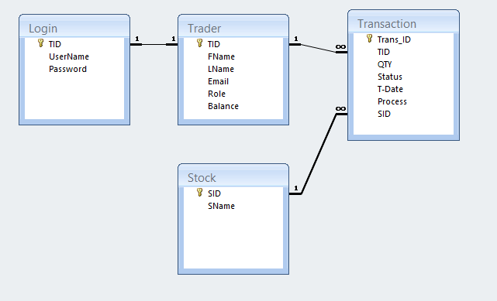
E-R DIAGRAM

Slide 9









Slide 10
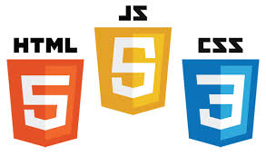


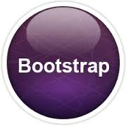

Slide 11
TECHNOLOGY DETAILS(FRONT END)
 | Functionality | Benefits
AngularJS | A JavaScript framework | Is perfect for Single Page Applications
RESTful Web Service | Web. Representational State Transfer | An architecture style that enable services to work best on the Web
JQuery | A JavaScript library | Simplifies JavaScript Programming
AJAX | Asynchronous JavaScript and XML | The art of exchanging data with a server, and updating parts of a web page

Slide 12
TECHNOLOGY DETAILS(FRONT END)
 | Functionality | Benefits
HTML5 | A markup language for describing web documents | For creating web sites
CSS3 | Cascading Style Sheets | to control the style and layout of multiple Web pages all at once.
Bootstrap | A HTML,CSS, and JS framework | For developing responsive, mobile first web projects
Java Script | Programming language of the web | Allow Client-side scripts to interact with the user, to control browser, to alter displaying doc.
Presentation Outline

Slide 13
TECHNOLOGY DETAILS(BACK END)
 | Functionality | Benefits
Core Java | A object-oriented programming language | Implemented most of the functionalities
Spring Security | An official Spring sub-project | A Java framework provides authentication, authorization and other security features
Spring MVC | A Middle Tier Technology | DispatcherServlet dispatches requests to handlers, with configurable handler mappings, view resolution.
Spring IOC | Spring Inversion of Control | A process whereby objects define their dependencies.

Slide 14
TECHNOLOGY DETAILS(BACK END)
 | Functionality | Benefits
Spring DAO Support | Spring Data Access Object | Making it easy to work with data access technologies like JDBC, Hibernate, etc.
Hibernate | An object-relational mapping library | Are portable to supported SQL databases with little performance overhead

Slide 15
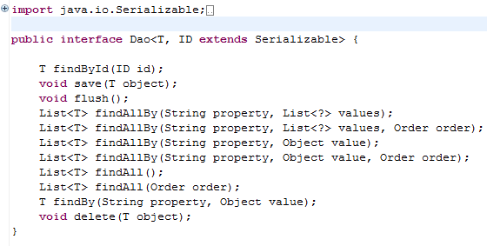
GENERIC DAO ACCESS DATABASE
GenericDao is an interface for all the dao methods, allow the service to choose the correct parameters and methods.
Can implement different beans with one dao class
the services gets all the benefits of type safety without needing to create multiple daos for each entity

Slide 16
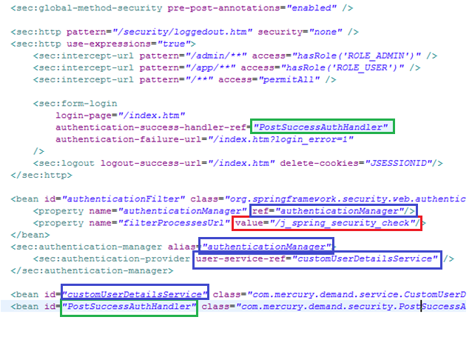
SPRING SECURITY FOR LOGIN
Spring Security is a java/javaee framework that provides authentication, authorization and other security features for enterprise applications

Slide 17
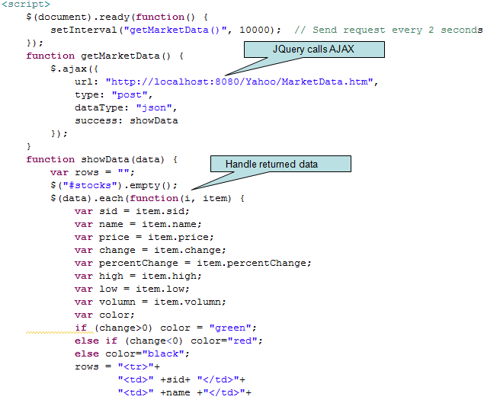
AJAX CALL

Slide 18
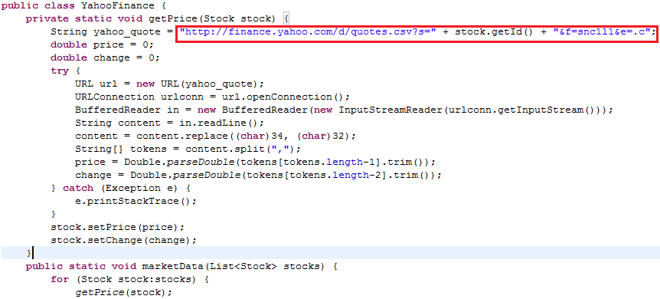
YAHOO FINANCE WEB SERVICE

Slide 19
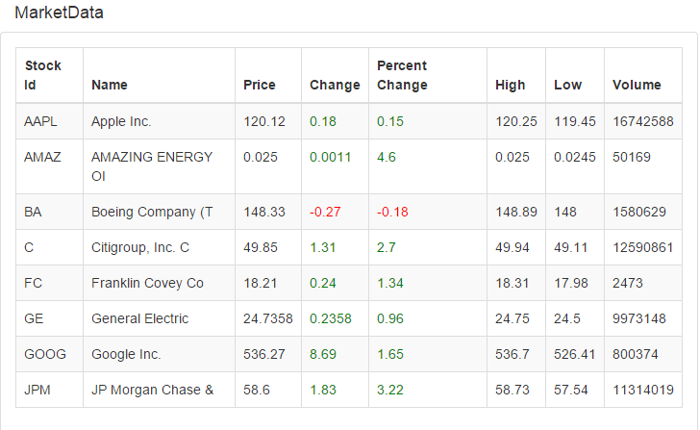
REAL TIME MARKET DATA
market data: the trader can watch the real-time market data which is refreshed every two seconds

Slide 20
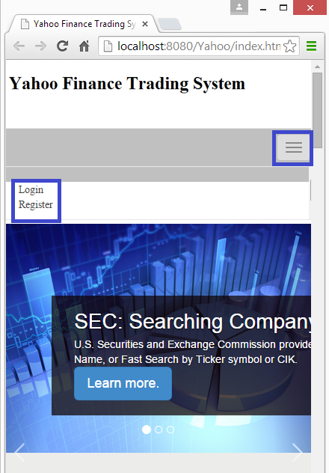
RESPONSIVE DESIGN
Use bootstrap to realize responsive design website

Slide 21


FEATURES
USER INFORMATION SECURED
LOGIN AND REGISTER VALIDATION
REMEMBER ME

Slide 22

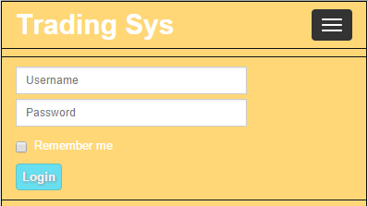
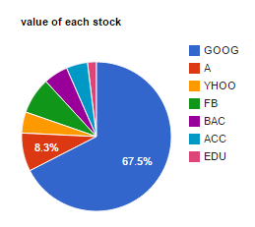
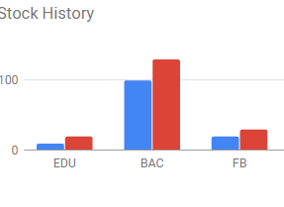
FEATURES
RESPONSIVE DESIGN
GOOGLE CHART

Slide 23
DEMO!

