Slide 1
Advanced Arduino
Workshop
Brad Kelly
Matt Plavcan

Slide 2
Third in a Series
Getting Started With Arduino
Arduino Development Workshop
Advanced Arduino Workshop

Slide 3
Slides Available Online
https://github.com/bradakelly

Slide 4
Learning Objectives
Improve reading of Arduino sketches
Explore hardware devices for Arduino
Build confidence in creating new Arduino sketches
Notes:
3 min

Slide 5
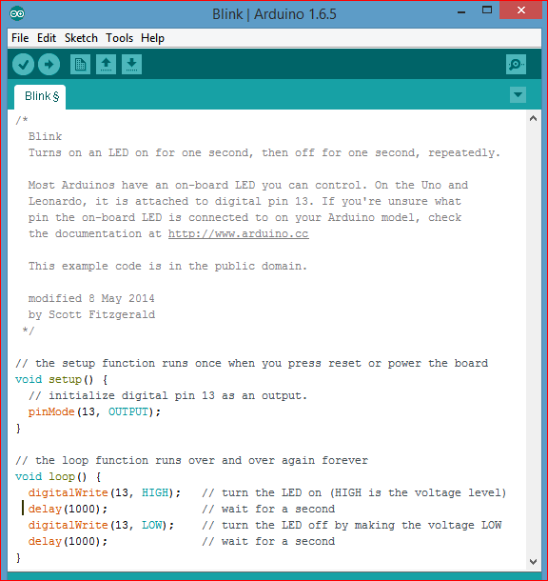
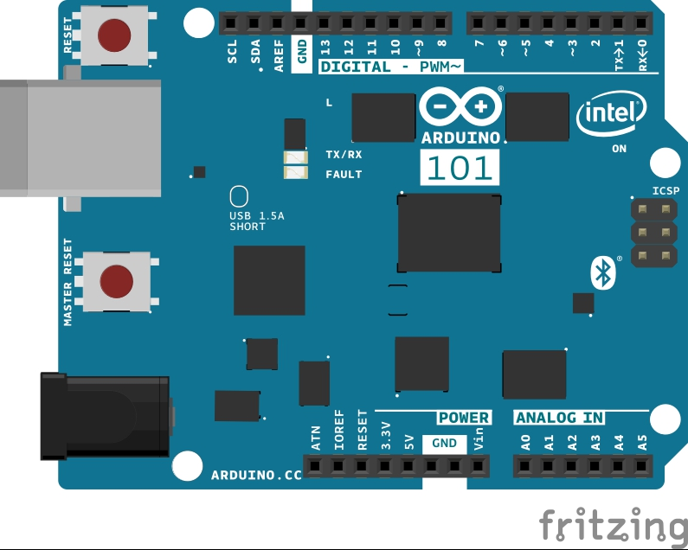
Test Your Arduino: Load Blink Sketch!
Notes:
1 min (no troubleshooting)
5 min (with troubleshooting)

Slide 6
Open Example LCD Sketch
File → Examples → Grove-LCD_RGB_Backlight → Hello World
Run sketch and see "hello world" and time on display
GOAL:
Connect different devices and make the LCD display their values

Slide 7
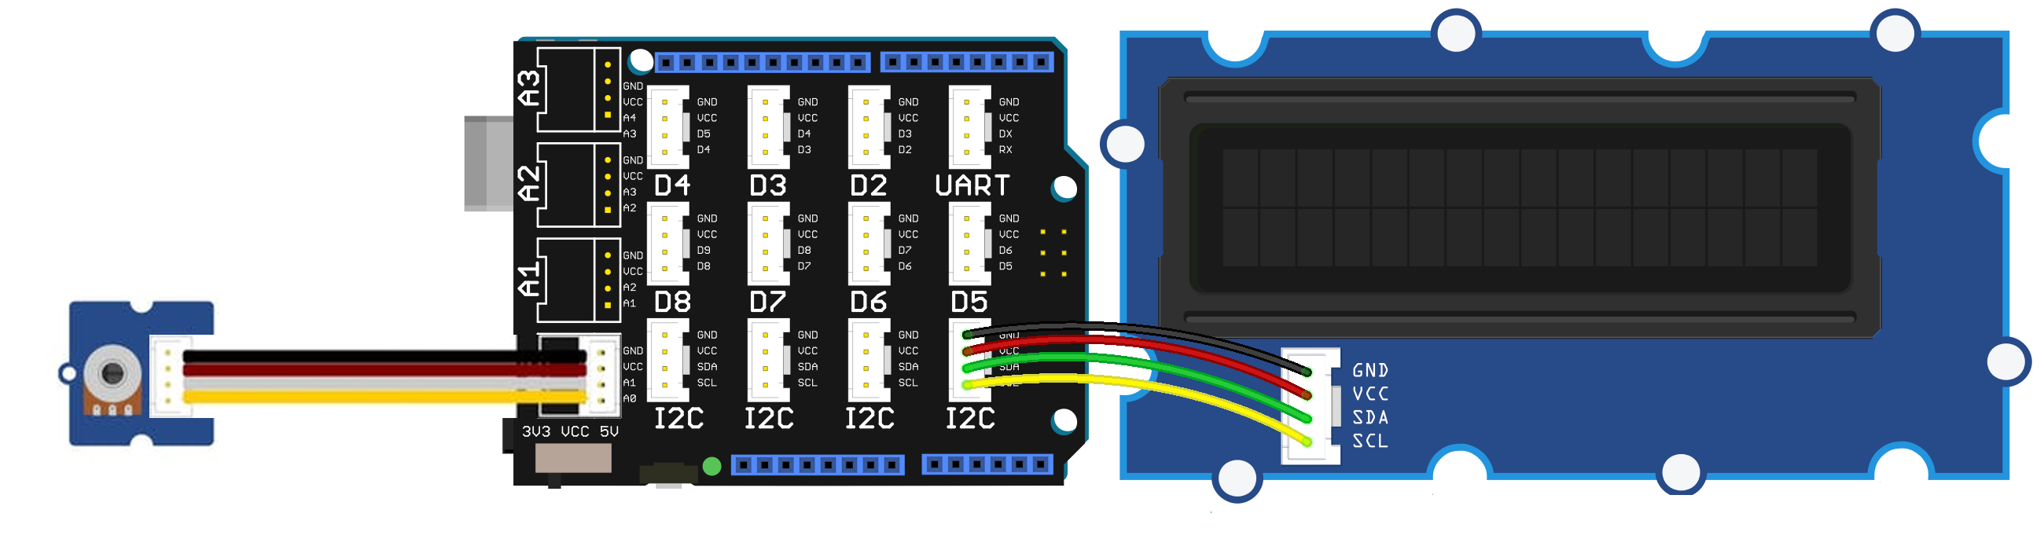
Connecting New Grove Devices
Angle Grove Shield LCD RGB
Sensor

Slide 8
Open Example LCD Sketch
void loop()
{
// set the cursor to column 0, line 1
// (note: line 1 is the second ...
lcd.setCursor(0, 1);
// print the number of seconds ...
lcd.print(millis()/1000);
delay(100);
}
void loop()
{
// set the cursor to column 0, line 1
// (note: line 1 is the second ...
lcd.setCursor(0, 1);
// print the value of the A0 input
int a0_value = analogRead(A0);
lcd.print(a0_value);
// erase old text
lcd.print(“ “);
delay(100);
}

Slide 9
Experiment with Devices!
Try adding different sensors:
  See how they respond to input using “Hello World“
  Look for example sketches that access them

Slide 10
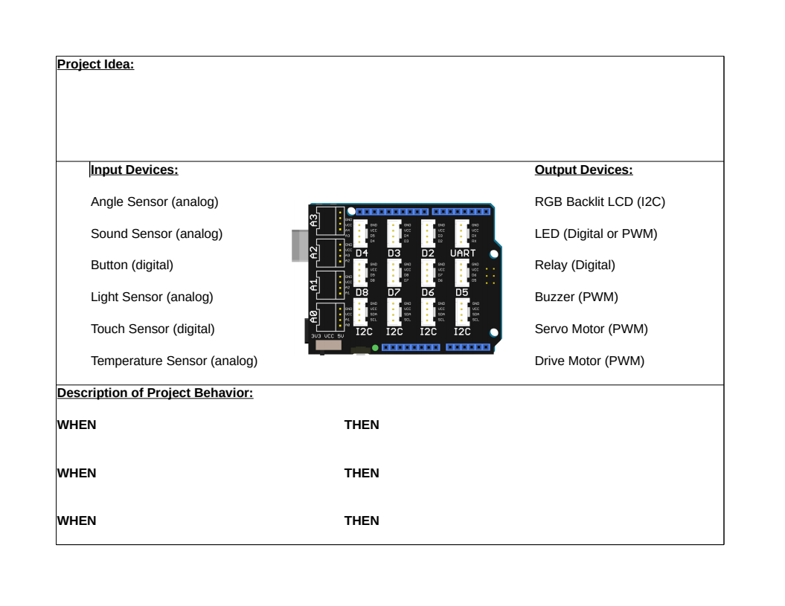
Build Your Own Project
Use the provided worksheet to plan your project:
Concept
Hardware connections
Software behavior

Slide 11
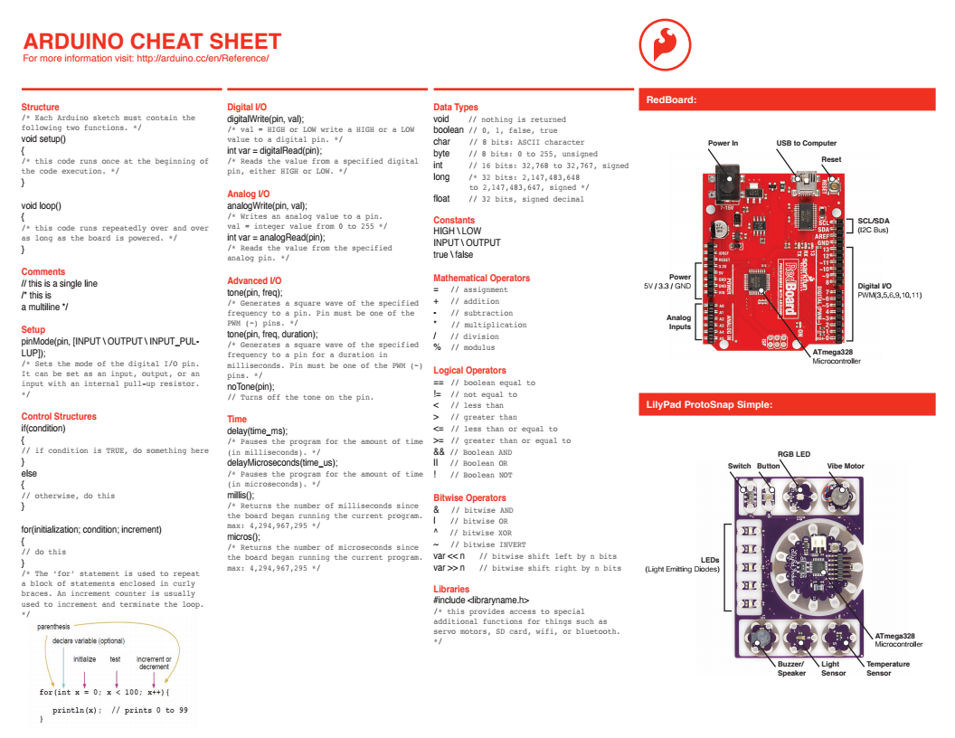
Coding Cheatsheet
(Click on image to download PDF)

Slide 12
fin
brad.a.kelly@gmail.com
mwplavcan@gmail.com

