Slide 1
Arduino Development Workshop
Brad Kelly
Matt Plavcan

Slide 2
Second in a Series
Getting Started With Arduino
Arduino Development Workshop
Advanced Arduino Workshop

Slide 3
Slides Avalailable Online
https://github.com/bradakelly

Slide 4
Learning Objectives
Understand digital circuit wiring basics
Be able to read simple schematics
Be able to add external devices to an Arduino
Know how to structure Arduino sketches
Learn basic Arduino debugging techniques
Notes:
3 min

Slide 5
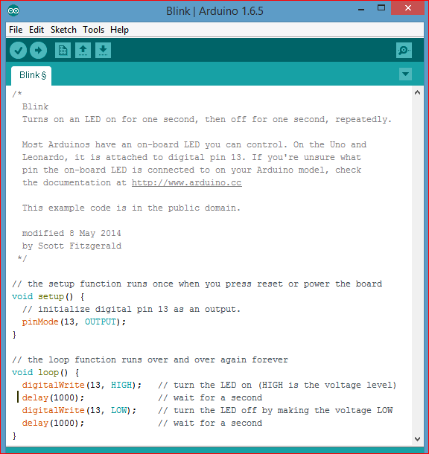
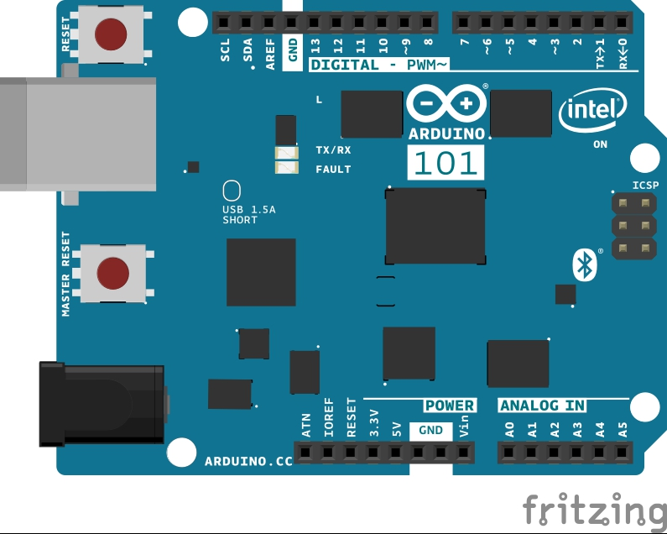
Test Your Arduino: Load Blink Sketch!
Notes:
1 min (no troubleshooting)
5 min (with troubleshooting)

Slide 6
Control LED with Button
Examples → 02.Digital → Button

Slide 7
Ups and Downs of Digital Circuits
Pulldowns!
Pullups!
INPUT_PULLUP

Slide 8
LED Output Circuits
Examples → 02.Digital → Button

Slide 9
Want to Connect Other Stuff?
Need transistors, relays, etc, beyond this course

Slide 10
Done for You: GroveKit
Connect Shield
Talk about diferent port types:
  Analog
  Digital
  I2C
  SPI
  RS232 Serial

Slide 11
Grove RGB LCD
Connect to shield I²C
Add Grove-LCD_RGB_Backlight library
(Sketch →Include Libraries → Manage Libraries)
Examples → Grove - LCD_RGB_Backlight → HelloWorld

Slide 12
Serial Port on USB host
Serial.print()
Serial.println()
Use for feedback / debug

Slide 13
Using Functions (C++ style)

Slide 14
Variable Scope

Slide 15
Change Text on Button Press
Attach Grove button
Examples → 02.Digital → Button

Slide 16
Wipe Text Left to Right
On button press, text appears one character at a time

Slide 17
Open Experimentation

Slide 18
fin
brad.a.kelly@gmail.com
mwplavcan@gmail.com

