Slide 1
Getting Started With Arduino
Brad Kelly
Matt Plavcan

Slide 2
Learning Objectives
Understand what is an Arduino
Understand what Arduino can do
Learn how to program an Arduino
Using an Arduino to monitor a real-world device
Using an Arduino to drive a real world device

Slide 3
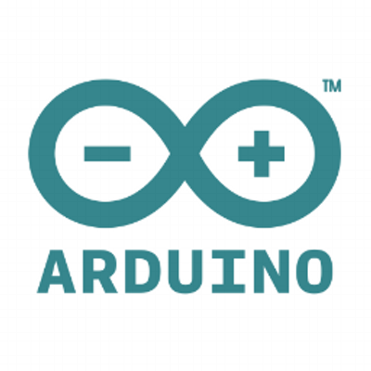
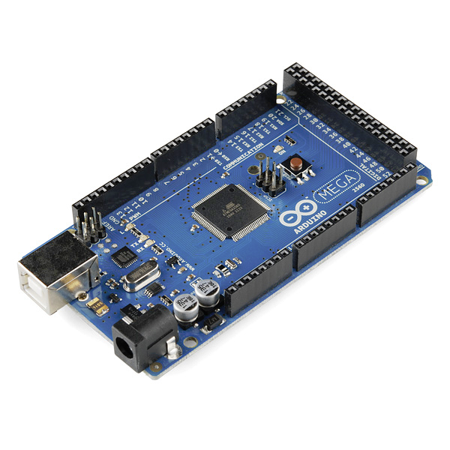
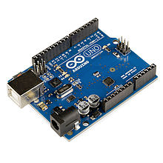
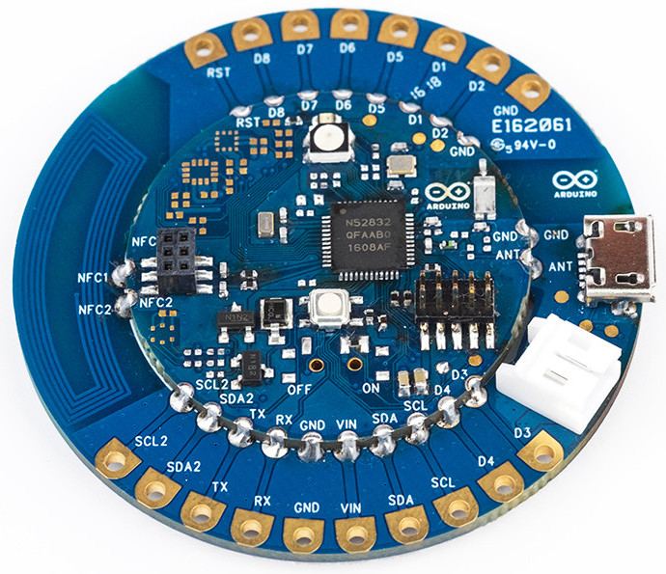
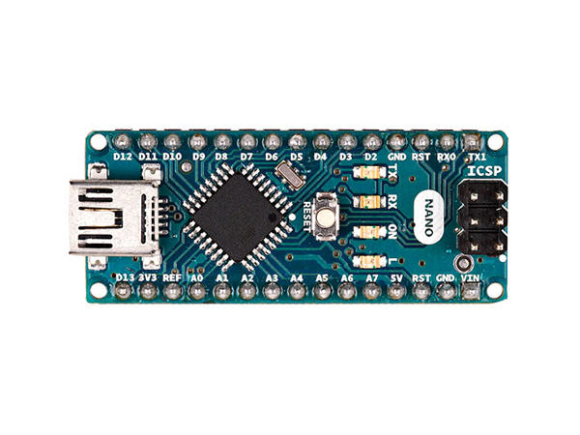
What is Arduino?
Microcontroller-based kits
Building digital devices and interactive objects
Can sense and control physical devices
Open-source project
Trivia:
The name Arduino comes from a bar in Ivrea, where some of the founders of the project used to meet.
The bar was named after Arduin of Ivrea, who was the King of Italy from 1002 to 1014.

Slide 4

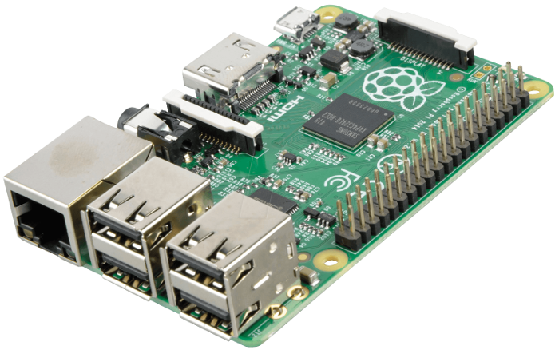
Arduino vs Raspberry Pi
Arduino
  Digital Input/Output
  Analog Input
Raspberry Pi
  Runs Linux
  Digital Input/Output
  USB ports
  Ethernet
  Audio Output
  Monitor Display

Slide 5
