Slide 1
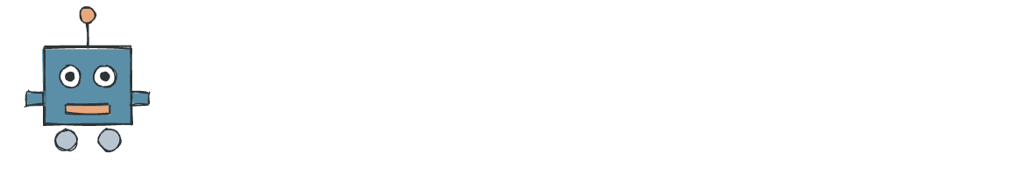
MODULE 3 · LESSON 1
Introduction to the Grid
Learning Objectives
Agenda
Describe the physical grid layout and how intersections are formed
Explain how cross detection maps to grid intersections
Use LineTrack to drive to the first intersection
Reuse existing code on a new surface
From circle to grid (10 min)
Review: LineTrack methods (5 min)
Guided: Drive to first intersection (15 min)
Practice (15 min)

Slide 2
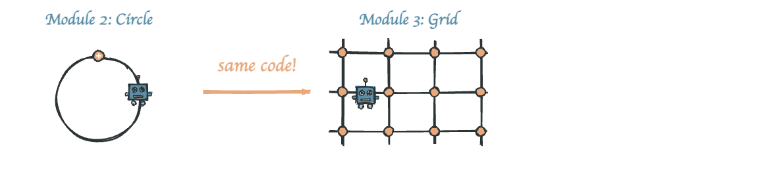
From Circle to Grid
Remember Module 2?
You built a LineTrack class that follows lines and detects crosses
"Can your Module 2 code work on this grid without changes?"
Yes! That's the power of code reuse.

Slide 3
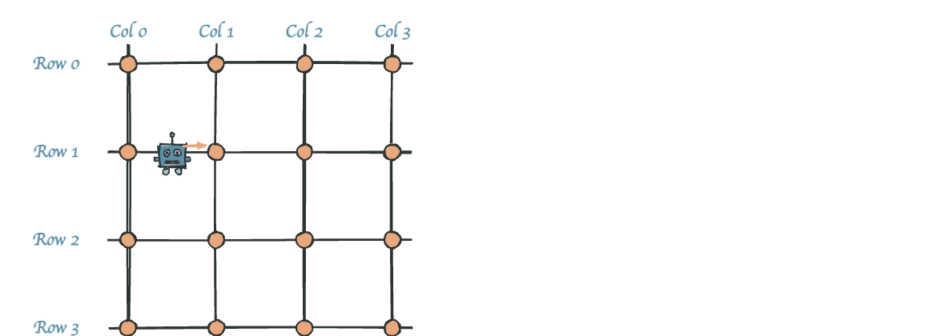
The Grid Layout
A grid is a network of taped lines
Each orange dot is an intersection
Lines connect them horizontally and vertically
The robot follows lines between intersections
Cross detection tells the robot "you've arrived!"

Slide 4
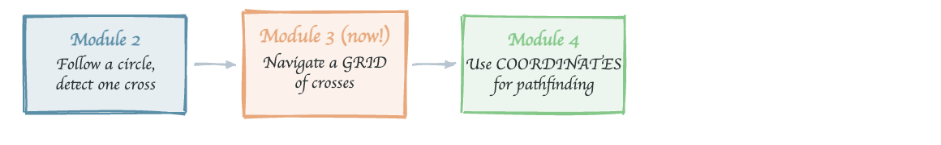
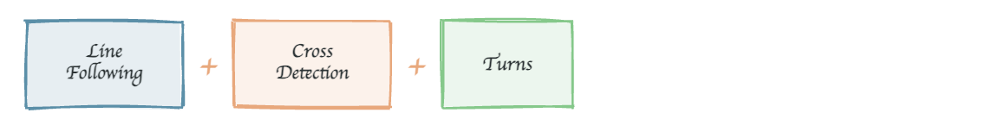
Why the Grid Matters
The grid is a stepping stone
Grid navigation = line following + cross detection + turns
You already have all three from Module 2!

Slide 5
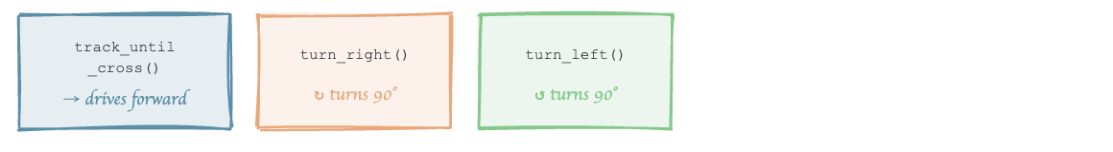
Review — LineTrack Methods
Your LineTrack class has three key methods:
tracker = LineTrack()
# Follow the line until an intersection
tracker.track_until_cross()
# Turn right onto perpendicular line
tracker.turn_right()
# Turn left onto perpendicular line
tracker.turn_left()
These three methods are ALL you need for grid navigation!

Slide 6
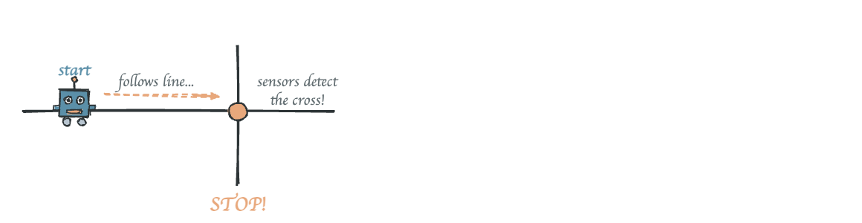
Driving to the First Intersection
Setup: Place robot on a grid line, behind an intersection
board = Board.get_default_board()
tracker = LineTrack()
board.wait_for_button()
print("Driving to first intersection...")
tracker.track_until_cross()
print("Intersection reached!")
What happens:
1. Robot follows the line using proportional control
2. When both sensors detect the cross → stops
3. Robot is now AT the intersection

Slide 7
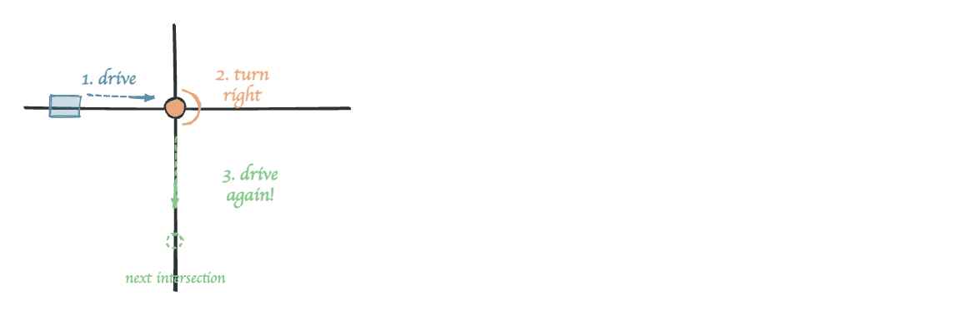
Drive and Turn
After reaching an intersection, you can turn:
board.wait_for_button()
tracker.track_until_cross()
print("At intersection!")
tracker.turn_right()
print("Turned right!")
tracker.track_until_cross()
print("At next intersection!")

Slide 8
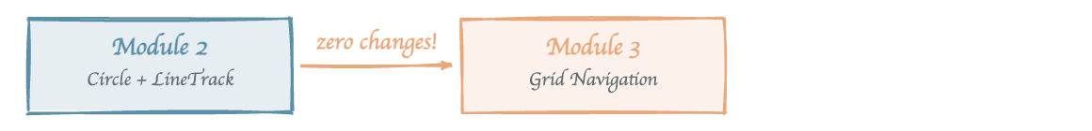
Code Reuse in Action
Module 2 | Module 3
Follow circle | Follow grid lines
Detect cross on circle | Detect grid intersection
Turn at cross | Turn at intersection
track_until_cross() | Same method, same code!
turn_right() | Same method, same code!
Good code works in new situations without modification.

Slide 9
Your Turn!
Activity
Checkpoints
1. Copy your LineSensor and LineTrack classes from Module 2
2. Write a program that drives to the first intersection and stops
3. Verify the robot stops at the right place
4. Add a turn_right() after reaching the intersection
5. Add another track_until_cross() to drive to the next intersection
Does the robot stop at the first intersection?
Does the turn line up with the perpendicular line?
Does the robot reach the second intersection after turning?

Slide 10
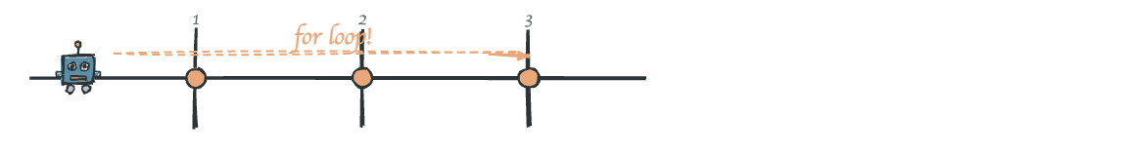
What's Next
What you did today
Next lesson (Lesson 2)
Saw how the grid relates to Module 2's cross detection
Drove to the first intersection using LineTrack
Added a turn at the intersection
Drive PAST an intersection to reach the next one
Learn the "clear the intersection" technique
Use for loops to drive multiple intersections
Challenge: What if you need to go 3 intersections forward? That's next!

