Slide 1
Module 4: Manhattan Navigation
Coordinates on the Grid
Learning Objectives
Understand the (row, column) coordinate system
Map physical grid positions to coordinate pairs
Count intersections to determine robot position
Read and write coordinates accurately
Agenda
What is a coordinate system? (10 min)
The grid and (row, col) convention (10 min)
Mapping exercise (25 min)

Slide 2
Hook — How Does a Robot Know Where It Is?
Question: "You can look around a room and know where you are. How does a robot know its position?"
Discussion: GPS uses coordinates (latitude, longitude). Street addresses use a grid (5th Ave & 3rd Street).
Today: We'll create a coordinate system for our robot's grid — so it always knows where it is.

Slide 3
What Is a Coordinate System?
Definition: A way to describe any position using numbers
Examples Students Know:
Battleship: "B4" = column B, row 4
Chess: "e5" = column e, row 5
Maps: latitude and longitude
Spreadsheets: cell A1, B3, etc.
Key Idea: Two numbers uniquely identify any position on a 2D surface.

Slide 4
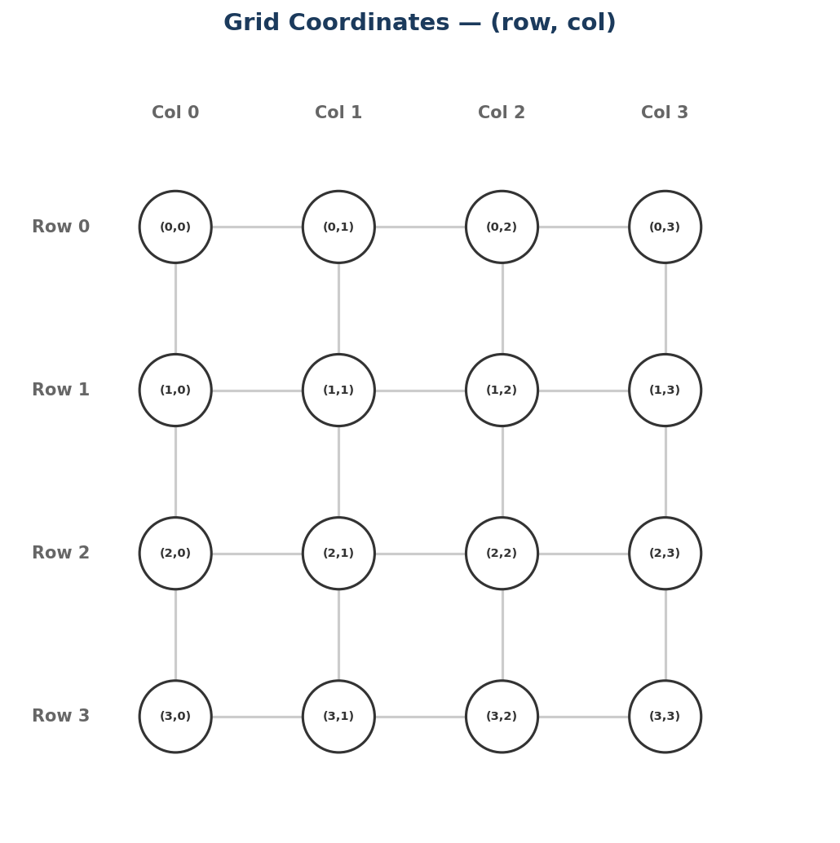
Our Grid Convention — (row, col)
The XRP grid uses (row, column):
 | Col 0 | Col 1 | Col 2 | Col 3
Row 0 | (0,0) | (0,1) | (0,2) | (0,3)
Row 1 | (1,0) | (1,1) | (1,2) | (1,3)
Row 2 | (2,0) | (2,1) | (2,2) | (2,3)
Row 3 | (3,0) | (3,1) | (3,2) | (3,3)
Convention:
First number = row (how far down)
Second number = column (how far right)
Start at (0, 0) in the top-left corner

Slide 5
Reading Coordinates
Practice: What are the coordinates?
Top-left corner: (0, 0)
One row down, two columns right: (1, 2)
Bottom-right of a 4x4 grid: (3, 3)
Third row, first column: (2, 0)
Common Mistake: Mixing up row and column order!
(2, 3) means row 2, column 3
(3, 2) means row 3, column 2
These are DIFFERENT positions!

Slide 6
The Physical Grid
Your robot drives on a physical grid:
Black tape lines form a grid on the floor
Each intersection is a coordinate
The robot uses line-following (Module 2) to travel between intersections
How to count:
Start at (0, 0) — the home position
Moving forward increases the row
Moving right increases the column
Show: Photo/diagram of taped grid with labeled intersections

Slide 7
Why Coordinates Matter for Navigation
Without coordinates:
"Go forward, turn right, go forward, turn left..."
Hard to plan, hard to change destination
With coordinates:
"Go from (0, 0) to (2, 3)"
The robot can CALCULATE the path
Change destination? Just change the numbers!
This is the foundation for Modules 4 and 5:
Module 4: Manhattan pathfinding using coordinates
Module 5: Dijkstra's algorithm using coordinates

Slide 8
Coordinates in Python
We'll represent positions as pairs of numbers:
Next lesson preview — Tuples:
Key Idea: Python has a data type called a "tuple" that's perfect for storing coordinates. That's Lesson 2!
row = 2
col = 3
print("Position: row", row, "col", col)
position = (2, 3)
print("Position:", position)
print("Row:", position[0])
print("Col:", position[1])

Slide 9
Your Turn!
Activity: Map the Grid
Look at the physical grid (or the diagram)
Label every intersection with its (row, col) coordinate
Answer these questions:
What is the coordinate of the bottom-right corner?
How many intersections are on a 4x4 grid?
If the robot is at (1, 2), what intersection is directly below it?
What is directly to the right of (0, 0)?
Checkpoints:
Can you read any coordinate on the grid?
Can you find the position given a coordinate?
Do you know which number is row and which is column?

Slide 10
Connection to Next Lesson
What you did today:
Learned the (row, column) coordinate system
Mapped physical grid positions to coordinates
Practiced reading and writing coordinates
Next lesson (Lesson 2):
Learn about tuples — Python's way to store coordinate pairs
Write code that creates and uses coordinate tuples
Build toward representing robot position in code
Remember: Row first, column second — (row, col)!

