Slide 1
Module 5: Dijkstra's Algorithm
The Dijkstra Class
Learning Objectives
Design the Dijkstra class with __init__ and build_graph methods
Build a graph dictionary from a 4x4 grid, excluding blocked nodes
Test graph construction by printing and inspecting the dictionary
Understand how the Dijkstra class will share an interface with Manhattan
Agenda
Class design overview (5 min)
The __init__ method (10 min)
Building the graph: nested loops and neighbor checks (15 min)
Testing graph construction (10 min)
Practice exercise (10 min)

Slide 2
Hook — From Paper to Python
Last lesson you traced Dijkstra's algorithm by hand on paper. You used a graph dictionary like this:
graph = {
(0,0): [(0,1), (1,0)],
(0,1): [(0,0), (0,2)],
...
}
Question: "Who wants to write that dictionary by hand for a 4x4 grid with 16 nodes?"
Nobody! That's 16 entries, each with up to 4 neighbors. Tedious and error-prone.
Today: We'll write a class that builds the graph automatically — and handles blocked nodes for us.

Slide 3
Dijkstra Class Design Overview
The Dijkstra class needs two main capabilities:
Build a graph from the grid, skipping blocked intersections
Compute a path from start to any destination (next lesson!)
Class structure:
class Dijkstra:
def __init__(self, start, blocked):
# Store start, blocked list, and grid size
# Build the graph automatically
def build_graph(self):
# Create the graph dictionary
def compute_path(self, destination):
# Run Dijkstra's algorithm (next lesson!)
Key design decision: compute_path returns a list of tuples — the same interface as Manhattan's compute_path. This means Navigator can use either one!

Slide 4
The __init__ Method
What __init__ needs to do:
Store the starting position
Store the list of blocked intersections
Define the grid size (4 rows, 4 columns)
Call build_graph to create the graph dictionary
Usage:
Notice: blocked is a list of tuples — the same format we use everywhere for grid positions.
class Dijkstra:
def __init__(self, start, blocked):
self.start = start
self.blocked = blocked
self.rows = 4
self.cols = 4
self.graph = self.build_graph()
d = Dijkstra((0, 0), [(1, 1), (2, 2)])

Slide 5
build_graph — The Strategy
Goal: Create a dictionary where each unblocked node maps to its list of unblocked neighbors.
Strategy:
Loop through every row and column in the grid
Skip any position that is in the blocked list
For the current position, check all 4 directions (up, down, left, right)
If a neighbor exists and is not blocked, add it to the neighbor list
Store the position and its neighbors in the dictionary
The four directions:
directions = [(-1, 0), (1, 0), (0, -1), (0, 1)]
# up down left right
Each direction is a tuple — we add it to the current position to get the neighbor's coordinates.

Slide 6
build_graph — The Code
def build_graph(self):
graph = {}
directions = [(-1, 0), (1, 0), (0, -1), (0, 1)]
for row in range(self.rows):
for col in range(self.cols):
position = (row, col)
if position in self.blocked:
continue
neighbors = []
for d in directions:
neighbor = (row + d[0], col + d[1])
if neighbor[0] < 0 or neighbor[0] >= self.rows:
continue
if neighbor[1] < 0 or neighbor[1] >= self.cols:
continue
if neighbor in self.blocked:
continue
neighbors.append(neighbor)
graph[position] = neighbors
return graph
continue skips to the next iteration — it means "this one doesn't qualify, move on."

Slide 7
Understanding the Bounds Checks
Why do we need bounds checking?
Consider node (0, 0) checking the "up" direction (-1, 0):
neighbor = (0 + (-1), 0 + 0) = (-1, 0)
Row -1 doesn't exist! We must skip it.
All the checks explained:
Edge and corner nodes naturally get fewer neighbors because some directions fail the bounds check.

Slide 8
Testing Graph Construction
Always test your code! Print the graph and verify it makes sense.
Expected output (partial):
Verify these things:
(1, 1) does NOT appear as a key (it's blocked)
(1, 1) does NOT appear in any neighbor list
(0, 0) has exactly 2 neighbors (corner node)
(0, 1) has exactly 2 neighbors — it lost (1, 1) as a neighbor!
d = Dijkstra((0, 0), [(1, 1)])
for node in d.graph:
print(node, "->", d.graph[node])
(0, 0) -> [(1, 0), (0, 1)]
(0, 1) -> [(0, 0), (0, 2)]
(1, 0) -> [(0, 0), (2, 0)]
(1, 2) -> [(0, 2), (2, 2)]
...

Slide 9
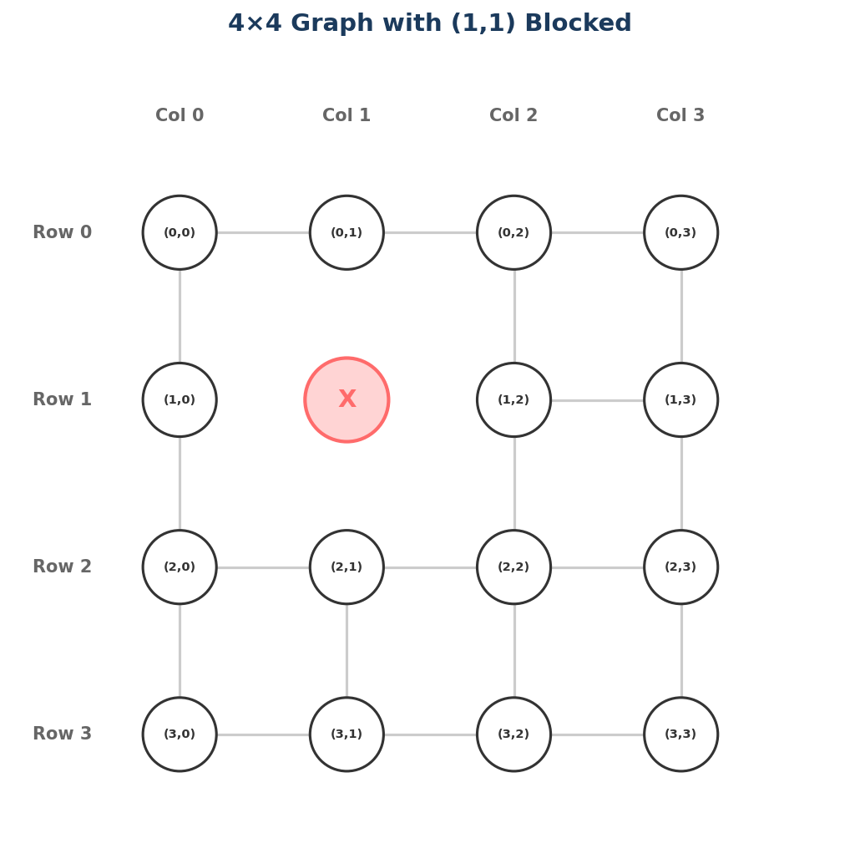
Graph as a Picture
Visualizing the graph with (1,1) blocked on a 4x4 grid:
Count the nodes: 15 (16 minus 1 blocked)
Check your dictionary: len(d.graph) should equal 15.
Check a specific node:
This is a great way to catch bugs early — compare the picture to the dictionary.
(0,0) --- (0,1) --- (0,2) --- (0,3)
| | | |
(1,0) (1,2) --- (1,3)
| | | |
(2,0) --- (2,1) --- (2,2) --- (2,3)
| | | |
(3,0) --- (3,1) --- (3,2) --- (3,3)
print(d.graph[(2,1)])
# Should be: [(1, 1) is blocked!] → [(2, 0), (3, 1), (2, 2)]

Slide 10
Your Turn!
Activity: Implement the Dijkstra Class (Part 1)
Create a new file called dijkstra.py
Implement the Dijkstra class with __init__ and build_graph
Test with no blocked nodes:
d = Dijkstra((0, 0), [])
print(len(d.graph)) # Should be 16
print(d.graph[(0, 0)]) # Should have 2 neighbors
print(d.graph[(1, 1)]) # Should have 4 neighbors
Test with blocked nodes:
d = Dijkstra((0, 0), [(1, 1), (2, 2)])
print(len(d.graph)) # Should be 14
# Verify (1,1) and (2,2) are not keys
# Verify they don't appear in any neighbor lists
Checkpoints:
Does your graph have the right number of nodes?
Do corner nodes have 2 neighbors, edge nodes 3, and interior nodes 4?
Are blocked nodes excluded completely — as keys AND as neighbors?

Slide 11
Connection to Next Lesson
What you did today:
Designed the Dijkstra class with __init__ and build_graph
Used nested loops to build a graph dictionary from the grid
Checked bounds and blocked nodes when finding neighbors
Tested graph construction by printing and inspecting
Next lesson (Lesson 5):
Implement compute_path(destination) — the heart of Dijkstra's algorithm
Use the distances, previous, and visited data structures from Lesson 3
Return a list of tuples — the path from start to destination
Key insight: Today you built the map. Next lesson, you'll navigate it.

