Slide 1

MODULE 4 · LESSON 4-7
Driving the Path
By the end of this lesson you can
Name the four Module 2 functions the driving code is built on, and what each does
Explain why the robot must drive_past_intersection() after every track_to_intersection()
Write turn_to() and drive_path() from their outlines, and test them one at a time
Keep the robot's pose (position and heading) up to date by assigning from what drive_path() returns
Plan, print the path, wait for the button, then drive
Notes:
60 minutes, Python plus robot. The two paper designs from Lesson 4-6 become real code, built on the Module 2 line-tracking functions with no motor code rewritten. Testing goes on screen first, then one leg, then a path.

Slide 2
Time to make the robot move
The two functions you designed on paper join desired_heading() in the NAVIGATOR section
Together they drive any Manhattan path on the grid
They call the line-tracking functions you built in Module 2: no motor code to rewrite
One wrinkle the paper design didn't care about: where the robot actually turns
That's the payoff of building a toolkit

Slide 3
The toolkit you already have
Module 2 ended with four functions in the LINE TRACKING section. Module 3 drove the whole grid with them.
Function | What it does | Ends when
track_to_intersection() | Follows the line forward | both sensors see the cross
turn_clockwise() | Pivots right | the sensors find the next line
turn_counterclockwise() | Pivots left | the sensors find the next line
drive_past_intersection() | Drives straight 8.75 cm | the distance is done
No coordinates, headings or paths: they follow tape and have no idea where the robot is. Today's three functions sit between them and the planner.
Notes:
The split from Lesson 4-0 again: the planner doesn't know how to drive, and the driving functions don't know what a path is. Class-track students with LineTrack write tracker. in front of each.

Slide 4
Check your understanding
Which of these does track_to_intersection() know about?
A. The robot's x and y coordinates
B. Only the reflectance sensors and the motors: it follows tape until both sensors see a cross
C. The heading number
D. The path list
Notes:
Answer: B. Module 2's functions are about tape, not grids. That makes them reusable: the same track_to_intersection() drove the Module 3 square and drives paths here.

Slide 5
Answer
Which of these does track_to_intersection() know about?
A. The robot's x and y coordinates
B. Only the reflectance sensors and the motors: it follows tape until both sensors see a cross
C. The heading number
D. The path list
Module 2's functions are about tape, not grids. That makes them reusable: the same track_to_intersection() drove the Module 3 square and drives paths here.

Slide 6
Arriving: the same pair as Module 3
track_to_intersection() stops the moment both sensors see the cross, but the robot turns about its center of rotation, 8.75 cm behind them. You met this in Lesson 3-1, and the fix is the same here.
track_to_intersection() # sensors reach the cross
drive_past_intersection() # center of rotation on the cross; sensors past it
drive_path() arrives at every intersection with the pair, whichever way it turns next: turns spin on the cross, and the next track starts clean.
Notes:
The two-robot animation in Lesson 3-1 shows what goes wrong if you turn early. The 8.75 cm is the gap between the reflectance sensors and the center of rotation (the pen hole between the drive wheels) on an XRP; if a class has a robot with a different mounting, measure it. Doing the drive-past after every track removes the straight-ahead special case the old lesson had.

Slide 7
Check your understanding
Why does the robot call drive_past_intersection() after every track_to_intersection(), even when it is going straight on?
A. To speed up the run
B. Moves the center of rotation onto the cross: turns pivot there, next track starts clean
C. Only turns need it; going straight it is skipped
D. To recharge the battery
Notes:
Answer: B. The sensors lead the center of rotation. Parking it on the cross makes every turn pivot on the intersection, and moves the sensors off the tape so the next line-follow starts clean. Doing it every time means no special cases.

Slide 8
Answer
Why does the robot call drive_past_intersection() after every track_to_intersection(), even when it is going straight on?
A. To speed up the run
B. Moves the center of rotation onto the cross: turns pivot there, next track starts clean
C. Only turns need it; going straight it is skipped
D. To recharge the battery
The sensors lead the center of rotation. Parking it on the cross makes every turn pivot on the intersection, and moves the sensors off the tape so the next line-follow starts clean. Doing it every time means no special cases.

Slide 9
Add to robot.py: turn_to()
Paste at the end of the NAVIGATOR section, under desired_heading().
# --- Lesson 4-7: turn to a heading, drive a path ---
# turn_to() turns a quarter turn at a time, with the LINE
# TRACKING turns, until the robot faces the heading it
# needs. drive_path() is the loop: for each
# intersection, face it, arrive with the track-then-drive-past
# pair, and record the new position. Both hand back what they
# changed, because the caller keeps the only record.
def turn_to(heading, desired):
"""Turn clockwise a quarter turn at a time until heading
is desired; return the new heading."""
# while heading is not desired:
# one turn_clockwise()
# heading goes up by 1, wrapping 3 back to 0
# return heading
pass
Notes:
The two outlines are the Lesson 4-6 designs. The skeleton continues on the next slide with drive_path(), whose step 3 has grown the wrinkle.

Slide 10
Add to robot.py: drive_path()
Right under turn_to(). Step 3 has grown the wrinkle: arrive with the pair.
def drive_path(path, position, heading):
"""Turn and drive through every intersection in path, from
position facing heading; return the final (position, heading)."""
# for each next_pos in path:
# 1. needed = desired_heading(position, next_pos)
# 2. heading = turn_to(heading, needed)
# 3. arrive: track_to_intersection(), then
# drive_past_intersection()
# 4. position = next_pos -- the robot is there now
# return position, heading
pass
Notes:
Class-track students who built LineTrack in Lesson 2-9 write tracker.turn_clockwise(), tracker.track_to_intersection() and so on: the same names with the object in front.

Slide 11
Read the two assignments carefully
heading = turn_to(heading, needed): the turn function hands back the new heading, and the loop keeps it
position = next_pos: the robot has arrived, so its position is the intersection it just drove to
The function returns both at the end, so whoever called it can keep its own record straight
position, heading = drive_path(path, position, heading)

Slide 12
Why one track per entry is enough
A destination can be many intersections away, but drive_path() never sees it
It gets the planner's list, where every entry is adjacent to the one before
So each pass of the loop is one hop: one turn (maybe none), then track_to_intersection() to the very next intersection
A three-block leg is just three passes of the same loop
The planner breaks the trip into single hops; the driver only ever drives one block
Notes:
This is why the planner returns every intersection instead of only the destination. If the list skipped intersections, track_to_intersection() would stop at the first one and position would be wrong.

Slide 13
One tuple, unpacked
return position, heading looks like returning two things, but it is one: two values with a comma make a tuple
That tuple is the robot's pose, say ((1, 1), 0)
The left-hand side unpacks it, exactly like x, y = position in Lesson 4-2
First variable gets the position, second gets the heading
Forget the left-hand side and the robot drives fine, once. The next path gets planned from where the robot was.

Slide 14
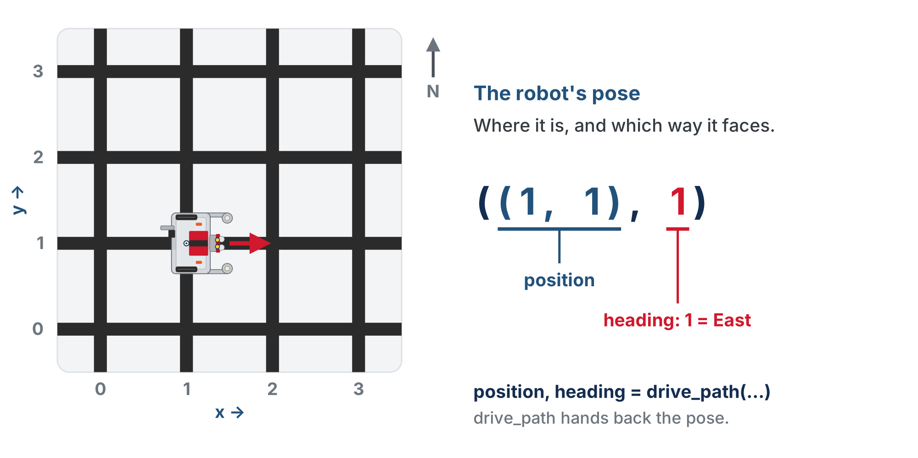
The robot's pose
Where the robot is and which way it faces, as one tuple. drive_path takes the pose and hands back the new one.
Notes:
Position says where the robot is; heading says which way it faces. Together they are its pose. From here on, "pass the pose" and "return the pose" mean the position and heading together.

Slide 15
Check your understanding
A student writes drive_path(path, position, heading) on its own line, then plans the next path with compute_manhattan_path(position, dest). What goes wrong?
A. Nothing: drive_path updates position for them
B. The caller's position and heading never changed: next path planned from the old spot
C. Python raises an error about an unused return value
D. The robot drives the path twice
Notes:
Answer: B. position and heading inside drive_path are the function's own variables. The caller only learns the new values by assigning from the return. This is the single most common Module 4 bug.

Slide 16
Answer
A student writes drive_path(path, position, heading) on its own line, then plans the next path with compute_manhattan_path(position, dest). What goes wrong?
A. Nothing: drive_path updates position for them
B. The caller's position and heading never changed: next path planned from the old spot
C. Python raises an error about an unused return value
D. The robot drives the path twice
position and heading inside drive_path are the function's own variables. The caller only learns the new values by assigning from the return. This is the single most common Module 4 bug.

Slide 17
Plan, print, button, drive
The test that puts the planner and the navigator together: the shape of every driving program from here on. Note the order.
def test_drive_path():
position = (0, 0)
heading = 0 # facing North
destination = (2, 3)
path = compute_manhattan_path(position, destination)
print("Path:", path)
board.wait_for_button() # read the path, THEN press
position, heading = drive_path(path, position, heading)
print("Arrived at:", position, "facing", HEADING_NAMES[heading])
Notes:
The path is planned and printed before the button. This habit costs two lines.

Slide 18
Read the path, then press
Is the printed path what you expect? Then press the button
Path right, robot wrong? The bug is in the driving, not the planner, and you know which half of the file to open
Two button presses per run, both useful:
The one in the RUN block starts the test: the path prints and the robot sits still while you read it
The one in the test is go
A test that drives is the only kind that waits twice
Notes:
The two presses need saying once; after that students like it, because the first press is when they read the path.

Slide 19
Check your understanding
The printed path is correct, but the robot turns left at the second intersection when it should go straight. Where is the bug?
A. In compute_manhattan_path
B. In the driving code: the planner has been shown to be right
C. In the print statement
D. In the destination tuple
Notes:
Answer: B. Printing the path before the button splits the program in two for debugging. A correct printed path clears the planner; whatever went wrong is downstream of it: desired_heading, turn_to, drive_path or the Module 2 functions.

Slide 20
Answer
The printed path is correct, but the robot turns left at the second intersection when it should go straight. Where is the bug?
A. In compute_manhattan_path
B. In the driving code: the planner has been shown to be right
C. In the print statement
D. In the destination tuple
Printing the path before the button splits the program in two for debugging. A correct printed path clears the planner; whatever went wrong is downstream of it: desired_heading, turn_to, drive_path or the Module 2 functions.

Slide 21
Plan, then drive: connect the parts
This test connects the two halves from Lesson 4-0
Each part was built and tested on its own, so connecting them takes three lines: plan, print, drive
It is that short because both parts agreed from the start on what passes between them: a list of intersections
When a run goes wrong, the printed path tells you which part to open

Slide 22
Activity · Trace it, then integrate
Activity
Before running anything, trace [(1,0), (1,1)] from (0,0) heading 0 (N) on paper. For each step write down:
The next intersection, and the heading needed
1
The headings the turning loop steps through
2
What the robot does
3
Then build it in stages, one function per step. Don't go on until each works.
Notes:
The trace and its grid figure are a closed reveal on the lesson page ("paper first"). Point out step 2 when students check: facing East and needing North, the loop goes three quarters of the way round.

Slide 23
Step 1 · The logic, on screen
Activity
Write the body of turn_to() from its outline
1
Write test_turns_paper(): walk [(1, 0), (1, 1)] from (0, 0) heading 0 the way drive_path() will, but print instead of turning
2
Each step: print the intersection and heading needed, then run the same while loop, with a print of the new heading where turn_clockwise() would be. Update position
3
Set the run line to it and compare with your trace: E for the first step, then S, W, N. Nothing moves.
4
Notes:
This paper test is the old "desktop mode" without editing the Module 2 functions: it prints what the robot would do, and it is where most logic bugs get caught. Write and test one function at a time, never the whole section at once.

Slide 24
Step 2 · One leg
Activity
Write the body of drive_path()
1
Write test_one_leg(): drive the one-element path [(1, 0)] from (0, 0) heading 0, and print where it arrived
2
Robot at (0, 0) facing North, run line set to it, both presses
3
One clockwise turn, one track, one drive-past. Does the robot stop with its center of rotation on the intersection?
4
Notes:
The check for turn_to() and drive_path() is a closed reveal on the lesson page. If a leg goes wrong, the first two things to compare are the return heading and the position = next_pos. A student version that differs and drives the path parked on every cross is fine.

Slide 25
Step 3 · A real path
Activity
Add test_drive_path() and run it: (0, 0) to (2, 3)
1
Read the printed path before the second press
2
Watch each arrival: center of rotation on the cross, turns pivoting on it
3
Watch the corner where the path bends from East to North: count the turns
4
Notes:
The clockwise-only loop spins 270 degrees at that corner: correct behavior, and the optional challenge is there for students who want to fix it. Usual bugs, most frequent first: not assigning position, heading from drive_path's return; the start sneaking into the path (desired_heading raises, which is the lesson working); a turn_to that forgets to return heading. Turns end on the sensors, not a timer, so they tolerate battery and friction; if a turn overshoots, shorten the blind first part of Module 2's turn_clockwise().

Slide 26
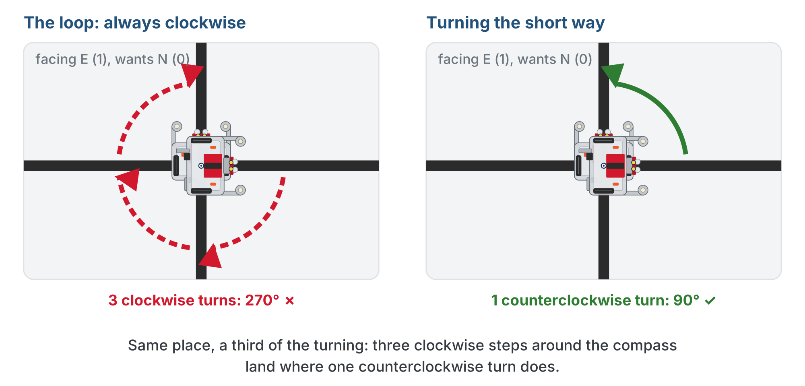
Challenge (optional): the short way round
Optional challenge
At the corner the robot turned right three times to face what was a quarter turn to its left. One counterclockwise turn does the same.

Slide 27
Challenge (optional): fewer turns
Optional challenge
Make turn_to() turn whichever way takes fewer turns
First, on paper: when is counterclockwise actually shorter? Try every pair of headings, or just the four starting from North
Change turn_to() to turn counterclockwise in exactly those cases, clockwise in the rest
Keep heading up to date either way, and still return it
Run test_drive_path() again and count the turns at the corner
Nothing else in the file has to change, because nothing else knows how turn_to() does its job.
Notes:
The answer is in the lesson's teacher copy, not here. Hints if needed: with four headings there is exactly one case where counterclockwise wins; turning around is a tie. Students who compute (desired - heading) % 4 are also right, but it needs % on a negative number (-1 % 4 is 3), worth showing in the REPL if it comes up. Watch for a version that turns left and then also loops because it forgot to update heading.

Slide 28
Check your understanding
The path is [(1,0),(2,0),(2,1)]. How many times does drive_path call track_to_intersection(), and how many times drive_past_intersection()?
A. Three and zero
B. Three and three: one pair per intersection in the path
C. Four and four: including the start
D. It depends on the turns
Notes:
Answer: B. drive_path loops once per element in the path, and every pass ends with the track-then-drive-past pair. Three elements, three pairs. The start is not in the path.

Slide 29
Answer
The path is [(1,0),(2,0),(2,1)]. How many times does drive_path call track_to_intersection(), and how many times drive_past_intersection()?
A. Three and zero
B. Three and three: one pair per intersection in the path
C. Four and four: including the start
D. It depends on the turns
drive_path loops once per element in the path, and every pass ends with the track-then-drive-past pair. Three elements, three pairs. The start is not in the path.

Slide 30
Real-world connections
SOFTWARE
ROBOTICS
CARS
Libraries
Motor controllers
Drive-by-wire
You call a graphics or networking library instead of rewriting it, exactly how drive_path calls track_to_intersection.
High-level planners send "go to X"; a lower-level controller handles the motors, just like this split.
The steering software sets a target; a separate actuator system does the physical turning.
Notes:
Building on a well-tested lower layer is how real systems scale. Hammer the reuse point: the Module 2 functions drove the Module 3 square and now drive grid paths unchanged.

Slide 31
Wrap-up
What four Module 2 functions does the driving code use?
Why drive_past_intersection() after every track?
What does drive_path return, and why?
What do you do before pressing the button?
Next: the final project: a delivery run to several destinations
Notes:
Answers: track_to_intersection, turn_clockwise, turn_counterclockwise, drive_past_intersection. To put the center of rotation on the cross, so turns pivot there and the next track starts clean. The robot's pose, so the caller plans the next path from the right place. Read the printed path. Exit ticket: "At (1,2) heading 1 (E), next is (1,1): heading needed, headings turn_to() steps through, and what the robot does?" (2 (S), since y goes down by 1; E, S: one clockwise turn, then track and drive past.)

Slide 32
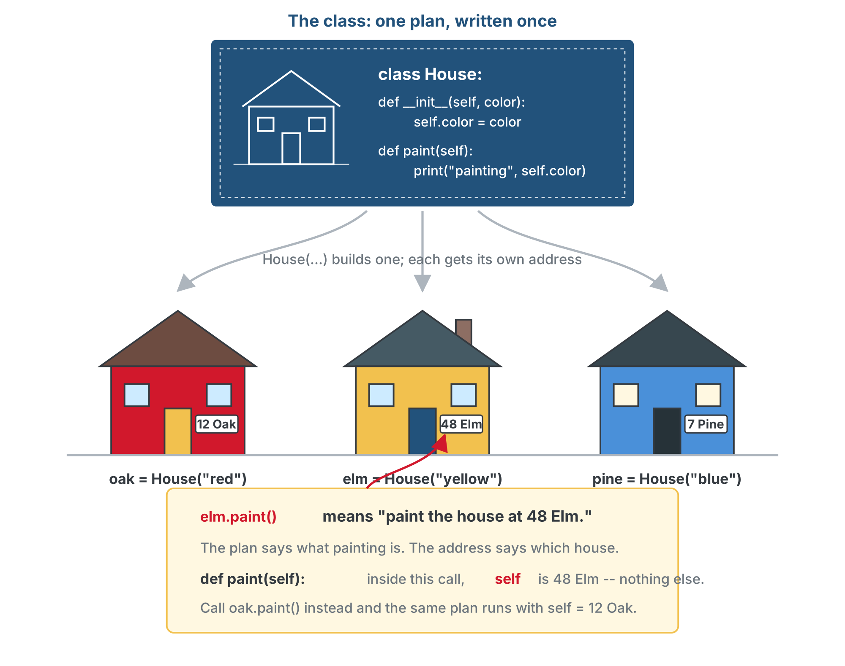
Optional: what self really is
Optional extension
Lesson 2-7: the class is a blueprint, the objects are houses. Now every house has an address
elm.paint() means "paint the house at 48 Elm". Inside paint(), self is that address
A method is a work order written once, with a blank for the address: self is first in the def, and Python fills it in from the object you called it on
Notes:
Optional extension, for students who did the Module 2 class extensions. Navigator is the first class in the course whose constructor takes real parameters. Two errors become easy to read: def paint(): with no self gives "takes 0 positional arguments but 1 was given" (no address blank); color instead of self.color gives a NameError (a color with no address). Navigator((0, 0), 0) and Navigator((3, 3), 2) are two objects from one plan with different numbers on the door.

Slide 33
Optional: the Navigator class
Optional extension
Replaces the three functions (keep HEADING_NAMES and your tests). Move your bodies into the methods. The caller writes navigator.drive_path(path) and reads navigator.position: nothing to pass back, so nothing to forget.
class Navigator:
def __init__(self, start, heading):
self.position = start
self.heading = heading
self.line_track = LineTrack() # has-a LineTrack
def desired_heading(self, next_pos):
pass
def turn_to(self, desired):
pass
def drive_path(self, path):
pass
navigator = Navigator((0, 0), 0)
Notes:
Shortened from the lesson's class-track skeleton: the section header comment and each method's outline comments are left off to fit. Those comments say position becomes self.position, heading becomes self.heading, turns get self.line_track. in front, and turn_to and drive_path store instead of return. __init__ is the new idea, so it is given. The signatures shrank because the object already knows position and heading. From here on class-track students use navigator.drive_path(path) wherever Lesson 4-8 says drive_path(path, position, heading). Full file: lesson-08-navigator-class-addon.py in the Module 4 solutions. The finished methods are behind a reveal on the lesson page and are not shown here.

