Slide 1

MODULE 4 · LESSON 4-6
The Challenge of Turning
By the end of this lesson you can
Break driving a path into two steps, turn then drive, as in Lesson 4-0
Explain why only x or y changes between neighbors
Store heading as 0 = N to 3 = W; position plus heading is the pose
Write desired_heading(position, next_pos), with a paper test
Raise an error when a function cannot answer, and say why
Design a turn: clockwise quarter turns, % 4 to wrap
Describe how drive_path uses both and hands back the new pose
Notes:
55 minutes, design on paper. Only one function is written today, desired_heading(), and it runs on the desk. turn_to() and drive_path() are designed here and written in Lesson 4-7. Resist jumping to the driving code.

Slide 2
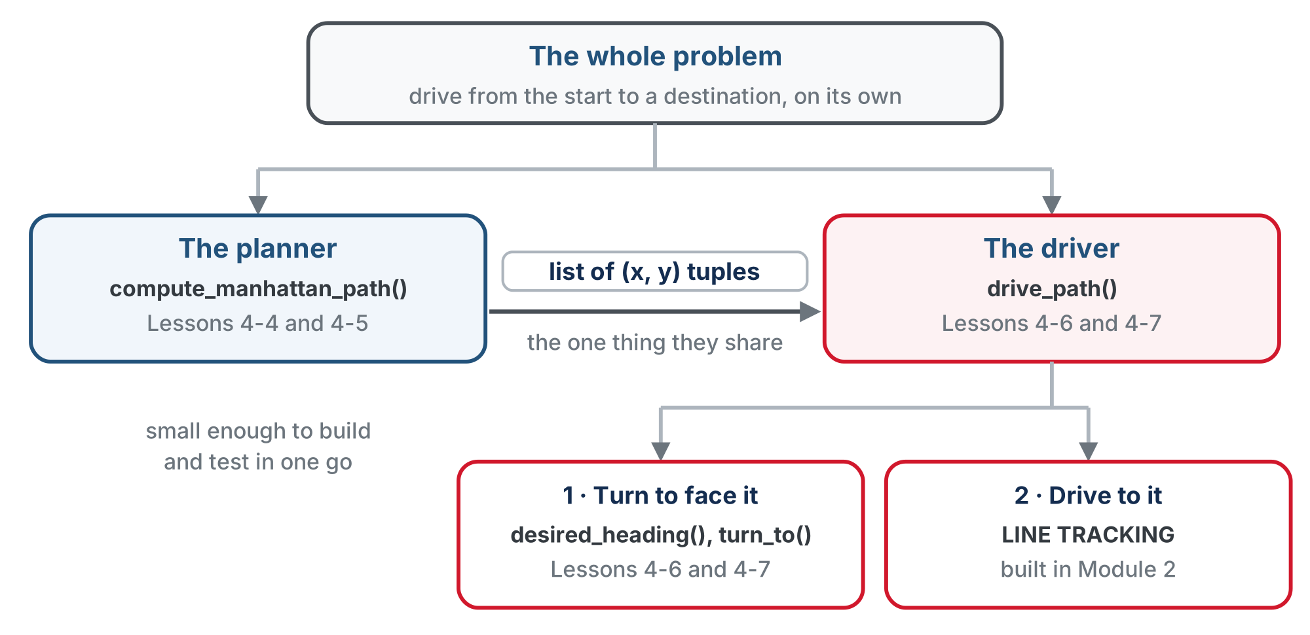
Decompose further, like 4-0
Driving a planned path breaks into two steps at each intersection: turn to face the next one, then drive to it.
Notes:
Tie back to the 4-0 discussion: same move, one level down. The robot has a heading and only drives forward, so it has to turn to face each next intersection before it drives. Today: write desired_heading() and test it on screen; design turn_to() and drive_path() on paper. Lesson 4-7 writes them.

Slide 3
One change at a time: four directions
Between adjacent intersections, either x changes by one or y changes by one. Never both: that would be a diagonal.
Coordinate change | Direction | Heading number
y +1 (up, away from you) | North | 0
x +1 (right) | East | 1
y −1 (down, toward you) | South | 2
x −1 (left) | West | 3
x comes first in the tuple, but North and South change the second number. North is away from you, so moving North makes y bigger.
Notes:
The grid orientation (x first in the tuple, but North is +y, away from you) is the number one confusion of this lesson. Draw it, point at it, quiz it.

Slide 4
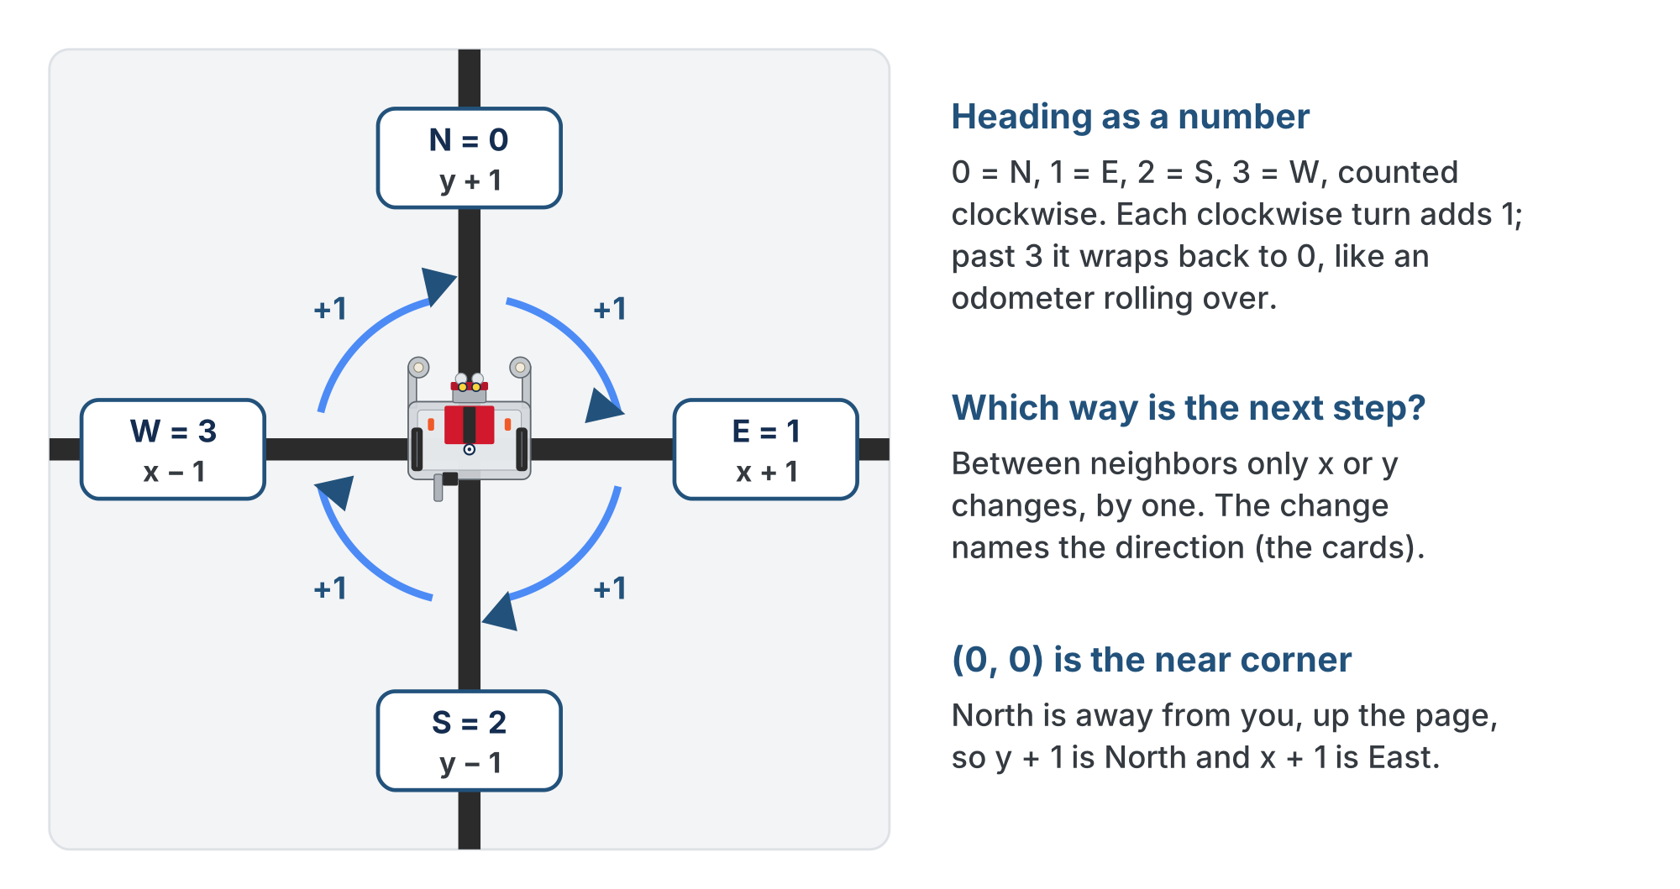
The four neighbors of an intersection
The coordinate change that reaches each neighbor, and its heading number. Clockwise adds 1.
Notes:
The lesson figure, with its card labels redrawn as plain text: the slide renderer overlapped the bold letter and the "= 0" in the original. Get students standing and turning clockwise a quarter at a time, calling out 0, 1, 2, 3, 0. The kinesthetic bit cements the wrap.

Slide 5
Check your understanding
The robot moves from (2,3) to (3,3). Which direction is that, and what heading number?
A. North, heading 0
B. South, heading 2
C. East, heading 1
D. West, heading 3
Notes:
Answer: C. x went 2 → 3 (x +1) and y stayed 3. Increasing x means moving right across the grid, which is East: heading 1.

Slide 6
Answer
The robot moves from (2,3) to (3,3). Which direction is that, and what heading number?
A. North, heading 0
B. South, heading 2
C. East, heading 1
D. West, heading 3
x went 2 → 3 (x +1) and y stayed 3. Increasing x means moving right across the grid, which is East: heading 1.

Slide 7
Heading as a number
Store the robot's facing as a number 0 to 3, clockwise from North: 0 = N, 1 = E, 2 = S, 3 = W
A list, HEADING_NAMES, turns it back into letters for display: HEADING_NAMES[2] is "S"
Why numbers? Each clockwise turn just adds 1
When you would reach 4, you wrap back to 0, like an odometer rolling over
That single rule is the whole turning mechanism
Notes:
Odometer analogy for the wrap: "...3, and one more is 0, not 4." HEADING_NAMES is the one setting in the section students paste next.

Slide 8
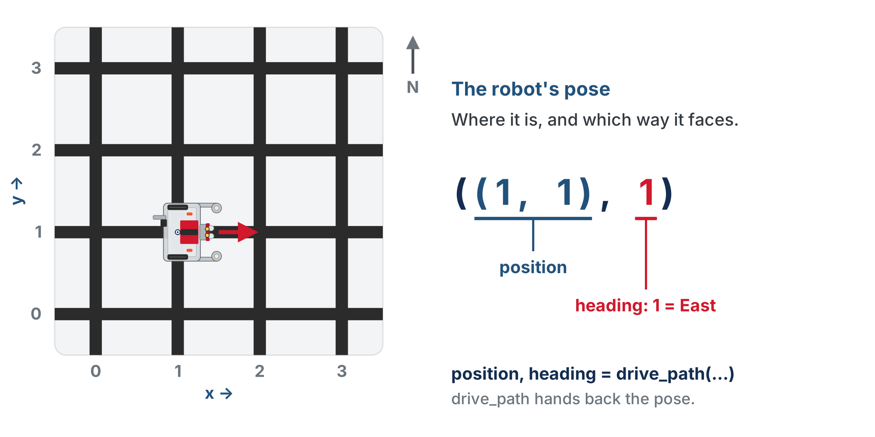
The robot's pose
A pose is a tuple of the two. The functions that drive take the pose and hand back the new one.
Notes:
Position says where the robot is; heading says which way it faces. Together they are its pose. From here on, "pass the pose" and "return the pose" mean the position and heading together.

Slide 9
Add to robot.py: the NAVIGATOR section
The last section of the file. Paste it above RUN, after the MANHATTAN PLANNER section: the heading names, then the one function you write today.
# ===== NAVIGATOR =====
# Drives a planned path. The MANHATTAN PLANNER section says
# WHERE to go (a list of intersections); this section works
# out which way to face at each one and does the driving with
# the LINE TRACKING functions. It is the only code that knows
# the robot's position and heading, and it hands both back.
HEADING_NAMES = ["N", "E", "S", "W"] # HEADING_NAMES[2] -> "S"
Notes:
The section comment sets up the whole module's split: the planner says where, the navigator works out which way to face and drives. The function outline is on the next slide; it goes straight under HEADING_NAMES.

Slide 10
Add to robot.py: desired_heading()
def desired_heading(position, next_pos):
"""Return the heading (0-3) that points from position to
next_pos, which must be one step away; raise if it is not."""
# 1. x_diff and y_diff: next_pos minus position
# 2. one if per direction, from the table above; each
# checks BOTH differences, because the other one is 0
# 3. none matched: raise ValueError, naming both positions
pass
Step 2 is the table as four if lines. North means y went up by one and x didn't move at all: the "one change at a time" rule, written down.
Notes:
Like the planner, desired_heading is told the position rather than remembering it. Why both differences: a version that checks only one (if y_diff == 1: return 0) looks equivalent and is not. From (2,1) to (3,3), x_diff is 1, so it returns East and never reaches the raise. A check with a hole in it is worse than no check. Good thing to show a fast finisher.

Slide 11
Check your understanding
Going from (1,3) to (1,2), what does desired_heading return?
A. 0 (North)
B. 1 (East)
C. 2 (South)
D. 3 (West)
Notes:
Answer: C. x is unchanged; y went 3 → 2 (y −1). Decreasing y is moving toward you, which is South: heading 2.

Slide 12
Answer
Going from (1,3) to (1,2), what does desired_heading return?
A. 0 (North)
B. 1 (East)
C. 2 (South)
D. 3 (West)
x is unchanged; y went 3 → 2 (y −1). Decreasing y is moving toward you, which is South: heading 2.

Slide 13
Say so when you can't answer
None of the four matched? Then the positions aren't one step apart (diagonal, identical, or across the map), and no heading answers that. raise is new: it stops the program on the spot and prints your message.
raise ValueError("what went wrong, in words")
ValueError is Python's name for "the values I was given make no sense". The message is yours: name both positions, with str(position) to turn a tuple into text.
Notes:
This is the debugging lesson, not a Python lesson. raise needs nothing beyond "the program stops and prints your message"; students never write try/except to benefit from it. Don't turn this into a detour on exception handling.

Slide 14
Leave the raise out, and...
Python does not complain. A function that runs off the end hands back None, silently
The next line, turn_to(heading, None), keeps turning until the heading equals None
It never will. The robot spins in place, and nothing is printed
You would look in turn_to, which is perfectly correct. The real problem is whatever handed desired_heading two positions that aren't neighbors
With the raise, the program stops on the line that noticed the problem and names both positions. Ten seconds instead of an afternoon.
Notes:
Worth ten minutes: ask the class to predict what they would see without the raise, then how they would find the cause. "A robot spinning forever, and the first place you would look is the one piece of code that is right" makes the point better than any rule.

Slide 15
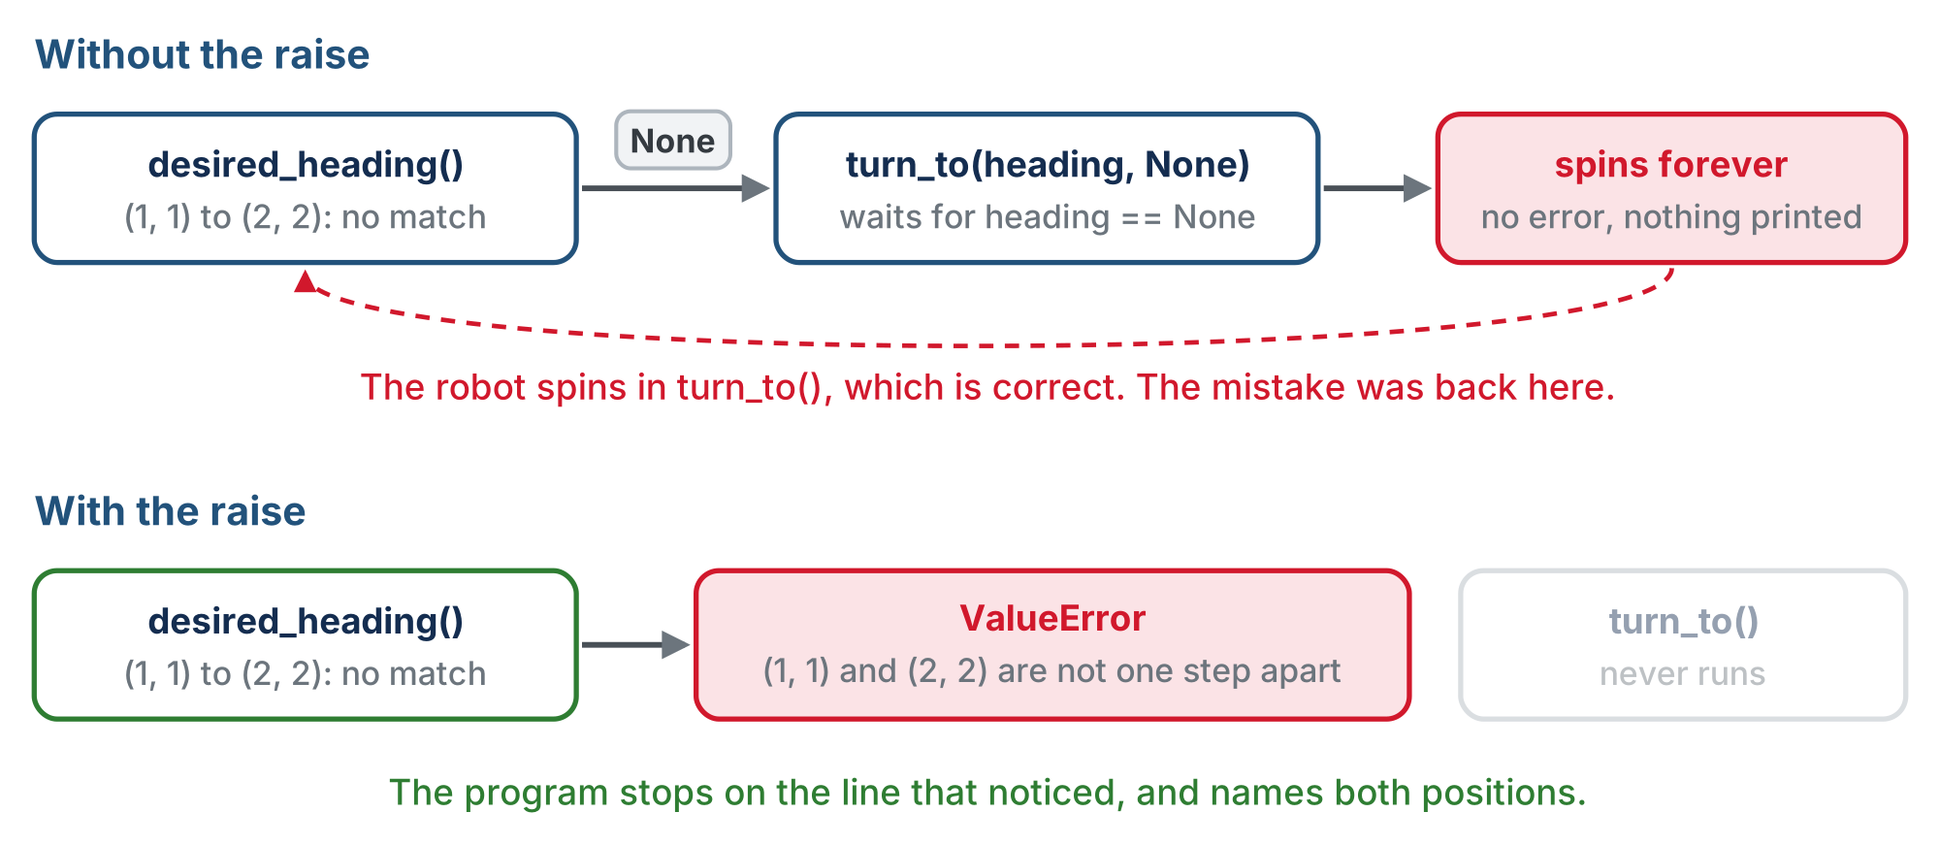
Same bad input, two programs
Without the raise the program never even stops; with it, it stops where the mistake is.
Notes:
Top row: no match, None travels to turn_to, the robot spins forever with no error. Bottom row: ValueError at desired_heading, turn_to never runs.

Slide 16
Stop it at the door
A wrong value that gets returned doesn't stay put
It travels into the next function, and the next
By the time anything visibly breaks, you're a long way from the mistake
Every check like this shortens the distance between where a bug shows up and where it actually is
When a function is asked something it cannot answer, say so immediately and loudly.
Notes:
First time the course asks students to write a line whose only job is to make a future problem easier to find. Can the error actually happen? With compute_manhattan_path feeding it, no: the planner only produces adjacent steps. It becomes reachable when students call desired_heading themselves (the diagonal call in test_headings does, on purpose) or in their own project in Lesson 4-8.

Slide 17
Check your understanding
Why does desired_heading end with raise, instead of just letting Python return None?
A. Because None uses more memory
B. To stop at the line that found the problem, not break later somewhere else
C. Because every Python function has to end with raise
D. To make the robot turn faster
Notes:
Answer: B. Without it, desired_heading hands back None, turn_to waits forever for a heading of None, and the robot spins in correct code with nothing printed. Raising reports the problem where it was found.

Slide 18
Answer
Why does desired_heading end with raise, instead of just letting Python return None?
A. Because None uses more memory
B. To stop at the line that found the problem, not break later somewhere else
C. Because every Python function has to end with raise
D. To make the robot turn faster
Without it, desired_heading hands back None, turn_to waits forever for a heading of None, and the robot spins in correct code with nothing printed. Raising reports the problem where it was found.

Slide 19
Activity · Write it, then ask it the four questions
Activity
Write the body of desired_heading() from the outline
1
Write a paper test, test_headings(), that prints the heading from (1, 1) to each neighbor: (0, 1), (1, 2), (2, 1) and (1, 0)
2
Work out the four answers from the table before you run it
3
Print HEADING_NAMES[...] of each result next to the number. Set the run line to test_headings(): the robot stays on the desk
4
Notes:
The check for desired_heading is a closed reveal on the lesson page; students run test_headings() first. Push them to predict all four on paper before running.

Slide 20
Activity · Then ask it a question it can't answer
Activity
Add one more call at the end of the test: (1, 1) to (2, 2), a diagonal
5
Run it again. The four answers print, then the program stops with your message
6
Read the message: does it name both positions?
7
Why the diagonal goes last: nothing after the raise runs
Notes:
This is the raise doing its job, on purpose, in a test.

Slide 21
Turning until you face it
Like every sensor loop in Module 2: keep doing something until a condition is true. One clockwise quarter turn, until you face the heading you want.
# while heading is not desired:
# one turn_clockwise()
# heading goes up by 1, wrapping 3 back to 0
heading = (heading + 1) % 4
% is the remainder (Lesson 2-5). For 1, 2 and 3 the remainder is the number itself; 4 % 4 is 0, so after West comes North, never a heading 4.
Notes:
The top three lines are the loop design; the last line is the wrap, the odometer in one expression.

Slide 22
Trace it: from South (2) to East (1)
Pass | Heading before | Turn | Heading after, (h + 1) % 4 | Facing East?
1 | 2 (S) | clockwise | 3 (W) | no
2 | 3 (W) | clockwise | 0 (N) | no
3 | 0 (N) | clockwise | 1 (E) | yes, the loop ends
Three passes. The loop never asks which way is shorter: from South it spins three quarters round to face what is a quarter turn to its left.
Notes:
The long way round is on purpose: it is the simplest turn that always works. In Lesson 4-7 students watch the robot spin 270 degrees, and an optional challenge there makes it turn whichever way is fewer turns. If someone spots the problem today, agree and point them at that challenge. An earlier version taught turns = (desired - heading) % 4, which leans on % with a negative number (-1 % 4 is 3) and surprises nearly everyone.

Slide 23
The design of turn_to(heading, desired)
Already facing the right way? The condition is false on the first check, so the loop does nothing: no special case
turn_clockwise() is the Module 2 function that turns until the sensors find the next line
It returns heading at the end, which by then equals desired
So the caller writes heading = turn_to(heading, needed) and keeps its own record up to date
Like the planner, it is handed what it needs as parameters and keeps nothing. You write it next lesson.
Notes:
Three sensor-ended turns take three times as long as one and give the line sensors three chances to miss. That is the reason the optional challenge in 4-7 is worth doing for those who want it.

Slide 24
Check your understanding
The robot faces West (3) and makes one clockwise turn. What does (heading + 1) % 4 give?
A. 4
B. 0, North: 4 % 4 is 0, so the heading wraps around
C. 3, because West is the last heading
D. An error, because there is no heading 4
Notes:
Answer: B. 3 + 1 is 4, and the remainder of 4 divided by 4 is 0. One clockwise turn from West faces North, and the heading never becomes 4.

Slide 25
Answer
The robot faces West (3) and makes one clockwise turn. What does (heading + 1) % 4 give?
A. 4
B. 0, North: 4 % 4 is 0, so the heading wraps around
C. 3, because West is the last heading
D. An error, because there is no heading 4
3 + 1 is 4, and the remainder of 4 divided by 4 is 0. One clockwise turn from West faces North, and the heading never becomes 4.

Slide 26
Check your understanding
Starting at heading 0 (N) and wanting heading 3 (W), how many times does the turning loop turn the robot?
A. Once
B. Three times: N to E, E to S, S to W
C. Twice
D. Not at all, because 0 and 3 are next to each other
Notes:
Answer: B. The loop only ever adds 1: 0, 1, 2, 3. Three clockwise turns, where one turn to the left would have done. Lesson 4-7 has an optional challenge for that.

Slide 27
Answer
Starting at heading 0 (N) and wanting heading 3 (W), how many times does the turning loop turn the robot?
A. Once
B. Three times: N to E, E to S, S to W
C. Twice
D. Not at all, because 0 and 3 are next to each other
The loop only ever adds 1: 0, 1, 2, 3. Three clockwise turns, where one turn to the left would have done. Lesson 4-7 has an optional challenge for that.

Slide 28
Activity · Putting it together: drive_path on paper
For each intersection: figure out the heading, turn to it, drive forward one, update position. The design as you'll meet it in next lesson's skeleton:
def drive_path(path, position, heading):
"""Turn and drive through every intersection in path, from
position facing heading; return the final (position, heading)."""
# for each next_pos in path:
# 1. needed = desired_heading(position, next_pos)
# 2. heading = turn_to(heading, needed)
# 3. drive to the next intersection (LINE TRACKING)
# 4. position = next_pos -- the robot is there now
# return position, heading
pass
Notes:
Step 3 is track_to_intersection(), the Module 2 function that follows the line until both sensors hit a crossing: the robot drives exactly one intersection without measuring distance. It returns the robot's new pose because the caller will plan the next path from wherever the robot ended up. Lesson 4-7 adds one real-world wrinkle to step 3.

Slide 29
Activity · Trace a path, one line per step
Activity
Trace [(1,0), (2,0), (2,1), (2,2)] starting at (0,0) heading 0 (N). For each step write:
The next intersection, and the heading needed
1
The headings the turning loop steps through
2
What the robot does
3
position and heading update every step. Otherwise the next desired_heading compares against the wrong spot.
Notes:
The answer is a closed reveal on the lesson page: all four lines on paper first. Watch for the corner where the path turns from East to North.

Slide 30
Check your understanding
Why must drive_path update position after each step?
A. To make the robot faster
B. So the next desired_heading() compares against the correct current position
C. To reset the heading to North
D. It doesn't matter: position is never used again
Notes:
Answer: B. desired_heading works from the difference between current and next. If position isn't updated, every step after the first computes the wrong direction.

Slide 31
Answer
Why must drive_path update position after each step?
A. To make the robot faster
B. So the next desired_heading() compares against the correct current position
C. To reset the heading to North
D. It doesn't matter: position is never used again
desired_heading works from the difference between current and next. If position isn't updated, every step after the first computes the wrong direction.

Slide 32
Real-world connections
AVIATION
GAMES
ROBOTICS
Compass headings
Facing and rotation
Rovers and drones
Pilots fly numbered headings (0 to 360°). "Turn to heading 090" is exactly this idea at finer resolution.
Game characters store a facing direction and rotate toward targets, often with the same wrap-around math.
Every autonomous vehicle tracks its heading to know which way "forward" actually points.
Notes:
Tracking heading and turning to a target direction is core to real navigation.

Slide 33
Wrap-up
Between adjacent intersections, what can change, and how many cases result?
Why store heading as a number?
How does turn_to know when to stop?
What's the catch with always turning clockwise?
Next: driving the path: turn_to() and drive_path() become real code
Notes:
Answers: x or y, four cases. Each clockwise turn adds 1, and % 4 wraps 4 back to 0. Its loop runs until the heading equals the one it wants; already facing it means zero turns. South to East takes three right turns for a quarter turn left; it still gets there, and a 4-7 challenge makes it quicker. Exit ticket: "Heading 3 (W), desired 1 (E): which headings does the loop step through, and how many turns?" (W, N, E: two clockwise turns, a turn-around.)

