Slide 1

MODULE 1 · LESSON 1-8
Hello, Python
By the end of this lesson you can
Explain why we move from Blockly to Python, and translate a block into the equivalent Python code
Follow the first three of Python's five syntax rules: lowercase, parentheses, quotes
Use the three-step XRPLib pattern (import the class, make an instance, call its methods) to drive the robot from Python
Use print() to show messages and debug
Notes:
50 to 60 minutes. Blockly to text. Nothing here is a new concept: it's the same thinking, typed instead of dragged. Frame it as the next level, not as harder. The one genuinely new thing is syntax, the punctuation rules, so name that and normalize making mistakes with it.

Slide 2
Why switch to Python at all?
Blockly wasn't training wheels: loops, functions and parameters are real programming ideas
You learned them without spending a single minute on typos. That was the point: get the thinking first
But Blockly can only offer you the blocks somebody built for it
Python is a general-purpose programming language: not tied to robots, or to any one job
Notes:
Someone asks every year "why did we waste time on blocks, then?", usually a student who has programmed a little. The honest answer lands better than a defensive one: they learned loops, functions and parameters without losing a single class period to missing colons, and those ideas transfer intact, as they're about to see.

Slide 3
The same Python, far beyond robots
WEB
DATA
AI
SCRIPTS
Web development
Data science
Machine learning
Automation
The servers behind sites and apps.
Analyzing and charting real data sets.
Most of the field's everyday tools are written in or driven by Python.
Scripts that do a tedious job so a person doesn't have to.
Notes:
One of the most widely used languages in the world. And plenty more: scientific research, finance, visual effects.

Slide 4
The best code is code you don't write
As programs get bigger, what saves you isn't writing faster: it's not having to write it at all
Python gives you an enormous body of libraries and frameworks: code other people already wrote, tested, and handed over
Read a sensor, talk to a website, do statistics, draw a graph? Usually a single import line
Next: XRPLib, which makes the robot's motors and sensors a few words of Python instead of a semester of electronics
Notes:
A concrete hook if you want one: Instagram's servers run on Django, a Python web framework; Spotify leans on Python for the data and recommendation pipelines behind its playlists; the first image of a black hole was assembled with Python libraries. The point isn't the trivia: none of those teams wrote their own math, plotting or networking code from scratch.

Slide 5
Check your understanding
What's the main advantage of a general-purpose language like Python over Blockly?
A. Python programs always run faster
B. It isn't limited to the blocks provided, and opens up libraries others wrote and tested
C. Python makes it impossible to write a program with mistakes in it
D. Blockly cannot do loops or functions
Notes:
Answer: B. Blockly gave you the ideas, and it can do loops and functions perfectly well. What it can't do is go beyond the blocks provided, or reach the huge collection of ready-made Python libraries.

Slide 6
Answer
What's the main advantage of a general-purpose language like Python over Blockly?
A. Python programs always run faster
B. It isn't limited to the blocks provided, and opens up libraries others wrote and tested
C. Python makes it impossible to write a program with mistakes in it
D. Blockly cannot do loops or functions
Blockly gave you the ideas, and it can do loops and functions perfectly well. What it can't do is go beyond the blocks provided, or reach the huge collection of ready-made Python libraries.

Slide 7
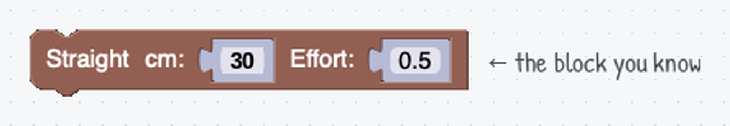
The same program, two ways
Here's the Straight block you've used all module. Next: the Python that does the exact same thing.
Notes:
Put a Blockly program and its Python side by side and let students match them up. (The lesson page draws the generic Straight block; the slide uses the 30 cm version so the block and the Python agree.)

Slide 8
...and the same thing in Python
from XRPLib.differential_drive import DifferentialDrive
drivetrain = DifferentialDrive.get_default_differential_drive()
drivetrain.straight(30)
Three lines. Next slide: what each one does.
Notes:
Ask students to guess which line does the driving before you explain.

Slide 9
Reading it line by line
from XRPLib.differential_drive import DifferentialDrive
Bring in the robot-control library.
1
drivetrain = DifferentialDrive.get_default_differential_drive()
Get the robot's wheels as an object you can command.
2
drivetrain.straight(30)
Drive straight 30 cm. Use a negative number to go backward, just like the block.
3
Notes:
Only the last line moves the robot. The first two are setup, which the next few slides unpack.

Slide 10
What's a library?
XRPLib is a library: code somebody else already wrote, tested, and left on the robot for you to use
Turning a wheel at a steady speed means timing electrical pulses and counting encoder ticks
Reading the reflectance sensor means measuring how much light bounces back and turning that into a number
That work is genuinely hard, it's already done, and it's sitting in the library
Notes:
Lead into the bookshelf picture: one book per piece of hardware.

Slide 11
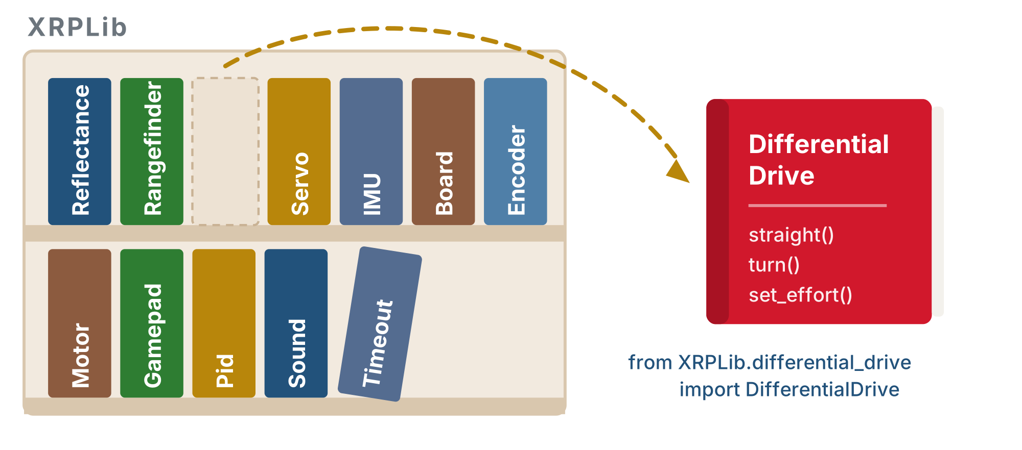
A shelf of books
XRPLib is the shelf; each class is a book. An import takes one book down, and what's written inside it are the commands you can use.
Notes:
One book for the drivetrain, one for the reflectance sensor, one for the rangefinder, one for the servo. You don't read the whole shelf: you take down the one book you need, when you need it.

Slide 12
That's what import does
This line takes the DifferentialDrive book off the shelf and opens it on your desk:
from XRPLib.differential_drive import DifferentialDrive
Inside: straight(), turn(), set_effort(). Leave the book on the shelf and Python has no idea those words mean anything.
Notes:
You import each device as you need it, which is why the import lines at the top of a program are a decent table of contents for what the program touches.

Slide 13
Three steps, and they never change
How you use any piece of hardware in XRPLib:
Import the class. from XRPLib.differential_drive import DifferentialDrive
Tells Python where the code for that hardware lives. Nothing happens to the robot yet.
1
Make an instance. drivetrain = DifferentialDrive.get_default_differential_drive()
An object that stands for the real hardware. The name on the left is yours to pick.
2
Use it. drivetrain.straight(30)
Instance name, a dot, then what you want it to do: instance.method()
3
Notes:
The spine of Modules 2 to 5: import the class, make an instance, call methods on the instance. Students who learn it as a pattern read the reflectance and rangefinder lessons as variations; students who memorise these three lines meet each new device as a fresh mystery. That instance.method() shape is most of the Python they'll write from here on.

Slide 14
Steps 1 and 2 once. Step 3 all day.
from XRPLib.differential_drive import DifferentialDrive # 1 - once, at the top
from XRPLib.board import Board # 1 - once, at the top
drivetrain = DifferentialDrive.get_default_differential_drive() # 2 - once
board = Board.get_default_board() # 2 - once
board.wait_for_button() # 3 - use it
print("Driving forward...")
drivetrain.straight(30) # 3 - use it
drivetrain.turn(90) # 3 - use it
drivetrain.straight(30) # 3 - use it again, and again
print("Done!")
Notes:
Numbering them 1, 2, 3 makes it look like three lines you write together. A real program shows they aren't. Note that turn(90) is a positive turn: counterclockwise, to the left.

Slide 15
Setup, then the program
Steps 1 and 2 are setup: at the top of the file, they run once, and you never repeat them
Importing the same class twice or making a second drivetrain gains you nothing
Step 3 is the actual program: twenty lines later, inside a function you write in Lesson 1-11, as many times as your robot has things to do
When you see the three steps stacked together, read them as a summary of the shape, not a block to copy
Notes:
Head this off: because the examples stack the three lines, some students copy them as a unit and re-import or re-create the drivetrain further down the file or inside a function. Nothing breaks loudly, which is why it survives. Say it plainly once, and point at the Activity, where setup and use are twelve lines apart.

Slide 16
The device changes; the three steps don't
The reflectance sensor from the next module, and the rangefinder, later on:
from XRPLib.reflectance import Reflectance # 1 - import the class
reflectance = Reflectance.get_default_reflectance() # 2 - make an instance
reflectance.get_left() # 3 - use it
from XRPLib.rangefinder import Rangefinder # 1 - import the class
rangefinder = Rangefinder.get_default_rangefinder() # 2 - make an instance
rangefinder.distance() # 3 - use it
Only the names differ. When a new device shows up, you already know two thirds of the code.
Notes:
These are two separate examples, squashed into three lines each so they can be compared. In a real program the first two lines of each go up top with the other setup, and the third goes wherever the robot needs that reading, quite possibly inside a loop. Board exercise: write the three rows with only the device filled in, and have students complete the reflectance row from the drivetrain one before they've seen any sensor code. Most can.

Slide 17
Comments: notes for the human
A # tells Python to ignore the rest of that line
Everything after it is there for the human reading the code, not for the robot
A comment can sit at the end of a line, or on a line of its own
They cost nothing to run, so use them freely
A line explaining why you picked a number is worth far more later than one restating what the code plainly does
Notes:
Point back at the "# 1 - import the class" notes on the previous slide: those are comments.

Slide 18
Let the editor do the spelling
Class names are long, and Python is fussy about capitals: Rangefinder, not rangefinder
Type the first few characters, Diff, and the editor offers DifferentialDrive. Press Tab or Enter to accept it
After a dot too: type drivetrain. and it lists everything the drivetrain can do
A quick way to discover methods nobody told you about
Suggestion never appears? The name you're typing probably isn't imported yet
Notes:
Note the capital/lowercase convention: Rangefinder is the class, rangefinder is their variable. Autocomplete gets the capitals right for them.

Slide 19
Check your understanding
A program starts with "from XRPLib.rangefinder import Rangefinder" and then calls rangefinder.distance(). It fails with a NameError. What was skipped?
A. Step 2: no instance was made, so the name rangefinder means nothing yet
B. Step 1: the import line is wrong
C. The program needs to import Rangefinder twice
D. Nothing: distance() only works in Blockly
Notes:
Answer: A. Importing the class makes Rangefinder available; it does not create rangefinder. The middle step, rangefinder = Rangefinder.get_default_rangefinder(), gives that name an object.

Slide 20
Answer
A program starts with "from XRPLib.rangefinder import Rangefinder" and then calls rangefinder.distance(). It fails with a NameError. What was skipped?
A. Step 2: no instance was made, so the name rangefinder means nothing yet
B. Step 1: the import line is wrong
C. The program needs to import Rangefinder twice
D. Nothing: distance() only works in Blockly
Importing the class makes Rangefinder available; it does not create rangefinder. The middle step, rangefinder = Rangefinder.get_default_rangefinder(), gives that name an object.

Slide 21
Check your understanding
Where do the three steps actually go in a real program?
A. Steps 1 and 2 near the top, once; step 3 wherever the device is needed, as often as you like
B. All three must be written together, in that order, every time
C. Step 2 has to be repeated before each use of the device
D. They can go in any order as long as all three are present
Notes:
Answer: A. Setup happens once: one import, one instance. Using the device is the actual program: it can be twenty lines later, in a loop or a function, as often as you need.

Slide 22
Answer
Where do the three steps actually go in a real program?
A. Steps 1 and 2 near the top, once; step 3 wherever the device is needed, as often as you like
B. All three must be written together, in that order, every time
C. Step 2 has to be repeated before each use of the device
D. They can go in any order as long as all three are present
Setup happens once: one import, one instance. Using the device is the actual program: it can be twenty lines later, in a loop or a function, as often as you need.

Slide 23
The five syntax rules: three for today
Blockly never let you make a spelling mistake. Python will.
Lowercase: print is not Print. Names are case-sensitive
1
Parentheses mark a function call: print names the function, print() runs it. Inside go the arguments: one, several, or none, but the parentheses go in either way
2
Quotes: text goes in quotes, print("hello")
3
The other two are for code that spans several lines. You'll meet them in Lesson 1-10, when you need them.
Notes:
The two held back are colons and indentation: they only make sense once there is a block of code to belong to, and the first arrives with Lesson 1-10's for loop. Don't let it read as something skipped: the lesson promises two more by name, and Lesson 1-10 opens by collecting on that promise.

Slide 24
Check your understanding
Which line is written correctly?
A. Print("Driving...")
B. print "Driving..."
C. print("Driving...")
D. print(Driving...)
Notes:
Answer: C. Lowercase print, parentheses around the call, and quotes around the text. The others break one rule each.

Slide 25
Answer
Which line is written correctly?
A. Print("Driving...")
B. print "Driving..."
C. print("Driving...")
D. print(Driving...)
Lowercase print, parentheses around the call, and quotes around the text. The others break one rule each.

Slide 26
Check your understanding
What do the parentheses in board.wait_for_button() do?
A. They tell Python to call the function, and anything inside them is an argument passed to it
B. They are decoration; Python ignores them
C. They mean the function returns nothing
D. They are only needed when there is something inside them
Notes:
Answer: A. Parentheses are what turns a name into a call. wait_for_button needs no arguments, so they're empty, but leave them off and Python just names the function without running it.

Slide 27
Answer
What do the parentheses in board.wait_for_button() do?
A. They tell Python to call the function, and anything inside them is an argument passed to it
B. They are decoration; Python ignores them
C. They mean the function returns nothing
D. They are only needed when there is something inside them
Parentheses are what turns a name into a call. wait_for_button needs no arguments, so they're empty, but leave them off and Python just names the function without running it.

Slide 28
Activity · Write your first Python program
Activity
Same tool, different file: in XRP Code, File → New File, then choose MICROPYTHON instead of Blockly
1
Your robot's files are down the left, the editor in the middle, and the shell along the bottom: that's where print() output shows up
2
Create a file called lesson_1_8_first_drive.py: the lesson number, then what the program does
3
Type the program in (typing, not pasting: it builds muscle memory), then press RUN
4
Notes:
Let students hit real syntax errors and practice reading the messages: that is the skill, and the errors here are the easy kind, one line, one mistake. Indentation is the number one stumble overall, but it can't happen yet: nothing in this lesson is indented.

Slide 29
Your first program
from XRPLib.differential_drive import DifferentialDrive
from XRPLib.board import Board
drivetrain = DifferentialDrive.get_default_differential_drive()
board = Board.get_default_board()
board.wait_for_button()
print("Driving forward...")
drivetrain.straight(30)
print("Driving backward...")
drivetrain.straight(-30)
print("Done!")
Notes:
Encourage liberal use of print(): a message before and after each action turns an invisible program into a visible one. This is the habit that makes the Python lessons debuggable.

Slide 30
Why board.wait_for_button() matters
It's the Wait for button press block you used all through Blockly, in text
Pressing RUN starts the program immediately
Without that line the robot drives off the moment you upload it: usually off the desk
Put the robot on the floor, press RUN, then press the button on the robot
Watch the shell: your print() messages show exactly where the robot is in the program
Notes:
Demo it once with the robot on the floor so students see the pause.

Slide 31
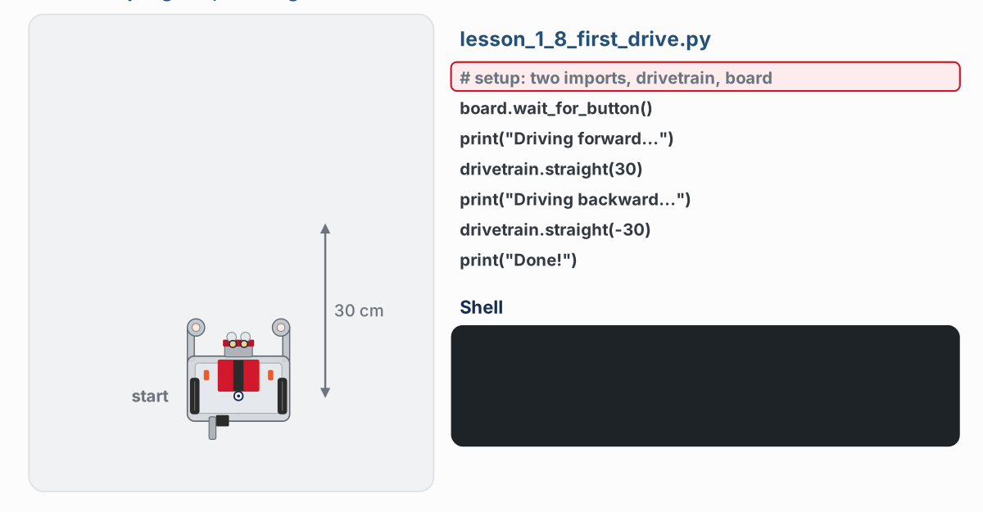
What a correct run looks like
Watch it run. The next slide picks out the key moments.
Notes:
The lesson page animates the whole run: the highlighted line is the one running. First the program waits at board.wait_for_button(); then the shell prints Driving forward..., the robot drives 30 cm, prints Driving backward..., drives back, and prints Done!

Slide 32
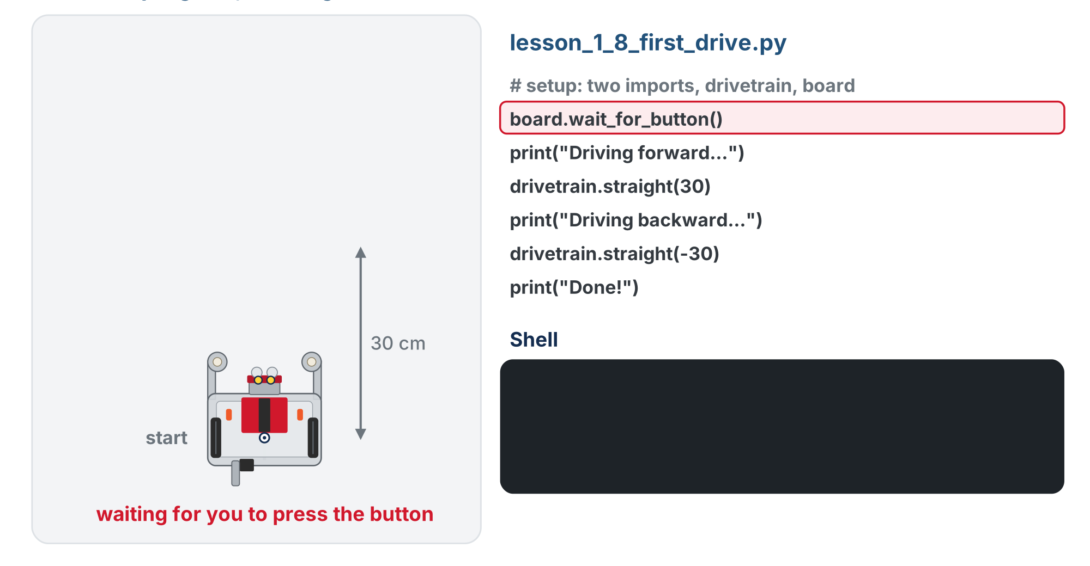
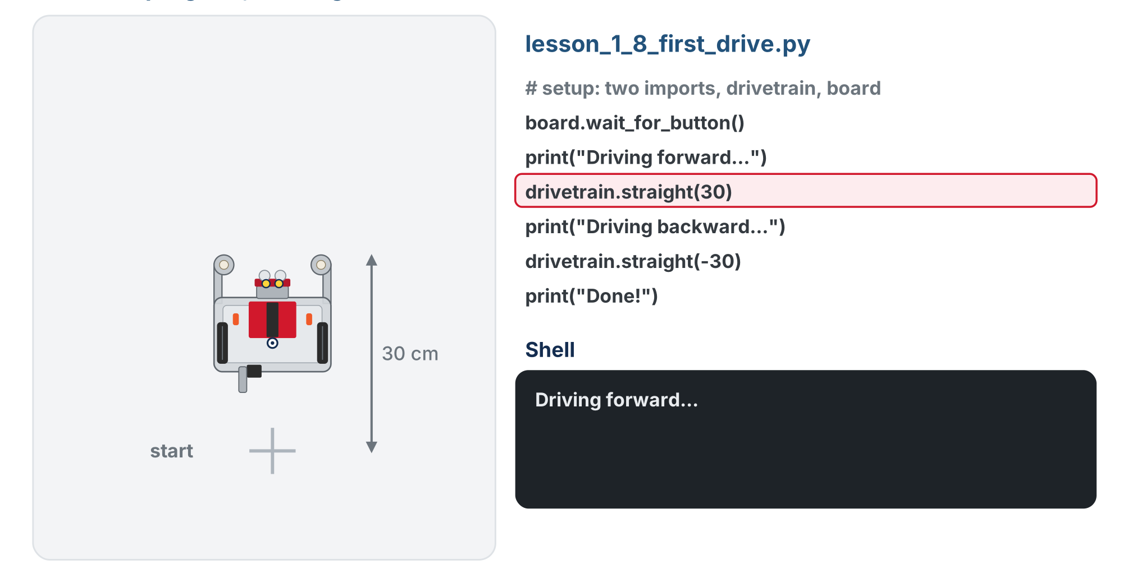
What a correct run looks like
Nothing happens until the button
Each print appears just before its move
Then the robot drives 30 cm back to its start mark, and the shell prints Done!
Notes:
The lesson page animates the whole run: the highlighted line is the one running. First the program waits at board.wait_for_button(); then the shell prints Driving forward..., the robot drives 30 cm, prints Driving backward..., drives back, and prints Done!

Slide 33
Check your understanding
Why does drivetrain.straight(-30) drive the robot backward?
A. Negative numbers reverse the direction, same as a negative cm in the Straight block
B. It drives forward 30 cm, then stops
C. It turns instead of driving
D. It causes an error
Notes:
Answer: A. A negative distance means backward, exactly like typing a negative cm value into the block.

Slide 34
Answer
Why does drivetrain.straight(-30) drive the robot backward?
A. Negative numbers reverse the direction, same as a negative cm in the Straight block
B. It drives forward 30 cm, then stops
C. It turns instead of driving
D. It causes an error
A negative distance means backward, exactly like typing a negative cm value into the block.

Slide 35
Activity · Read it, then fix it
Spotting mistakes is half of programming. What's wrong here?
drivetrain.straight(30)
Print("Backing up")
drivetrain.straight(-30)
Notes:
Give students a moment to find it on their own before the check.

Slide 36
Check your understanding
Find the bug in the code: drivetrain.straight(30), then Print("Backing up"), then drivetrain.straight(-30)
A. straight should be capitalized
B. Print should be lowercase: print
C. The distances should be positive
D. There is no bug
Notes:
Answer: B. Python is case-sensitive. Print with a capital P isn't the same as the built-in print.

Slide 37
Answer
Find the bug in the code: drivetrain.straight(30), then Print("Backing up"), then drivetrain.straight(-30)
A. straight should be capitalized
B. Print should be lowercase: print
C. The distances should be positive
D. There is no bug
Python is case-sensitive. Print with a capital P isn't the same as the built-in print.

Slide 38
Try it: drive an L-shape
Activity
Rewrite your forward/backward program to drive an L-shape
straight, turn(90), straight
Put a print() before each step
Watch the shell: does each message appear just before its move?
Notes:
turn(90) is a positive turn, so the robot turns counterclockwise (left). Assessment: the program runs, the robot moves as intended, and the print messages appear.

Slide 39
Real-world connections
AI
SCIENCE
ROBOTICS
Machine learning
Data & discovery
Real robots
Most AI research and tools, including large language models, are built in Python.
Scientists analyze experiments, genomes, and telescopes' data with Python every day.
From classroom bots to industrial arms, Python is a standard language for robot control.
Notes:
Python is one of the most-used languages in the world, well beyond robots.

Slide 40
Wrap-up
Why learn Python if Blockly works?
Name a job Python does outside robotics.
Name the three syntax rules from this lesson.
What do the parentheses in print() tell Python?
What is print() good for?
Next: Lesson 1-9, variables and expressions
Notes:
Answers: general-purpose rather than limited to the blocks provided, used everywhere, and it lets you build on libraries others wrote and tested. Web development, data science, machine learning, automation. Lowercase, parentheses, quotes (colons and indentation still to come). That the name is a function call: run it; anything inside is an argument. Showing messages and debugging. Formative: can students translate a block to Python and spot a syntax error? Next lesson slows down on drivetrain = ...: what the = does, how to name things, how Python works out the right side. Loops follow in Lesson 1-10.

