Slide 1

MODULE 1 · LESSON 1-11
Python Functions
By the end of this lesson you can
Define a function in Python with def name(parameters):
Call a function with arguments and use its parameters, including ones with a default value
Return a value from a function and use it
Explain why a function's variables are local, and why it can still read drivetrain
Notes:
50 to 60 minutes. Students already built functions in Blockly with the "to do something" block in Lessons 1-3 to 1-5. Today is the same idea in Python, plus parameters and return values.

Slide 2
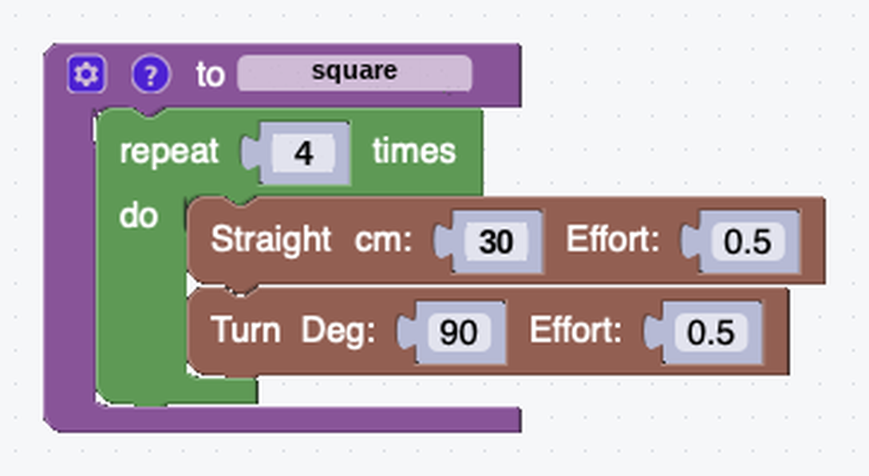
From "to do something" to def
Lessons 1-3 to 1-5: reusable functions with the "to do something" block
Now the same idea in Python, with the def keyword: define once, call many times
Plus: pass in parameters, and hand back a return value
The definition doesn't drive anything on its own. It says what a square is.
Notes:
This is the reusable square from Lesson 1-3. In Blockly the definition sits off to one side of the workspace, apart from the calls.

Slide 3
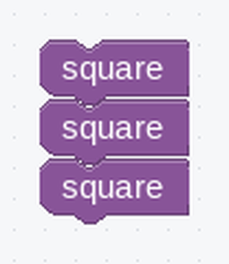
The calls
Three squares, three call blocks
In Blockly the definition and the calls are two separate things in the workspace
In Python both halves live in the same file: the def block first, then the calls underneath it

Slide 4
The same square in Python
def square():
for i in range(4):
drivetrain.straight(30)
drivetrain.turn(90)
square()
square()
square()
Definition at the top, calls underneath

Slide 5
The pieces map to what you know
def: the keyword that defines a function (like the "to do something" block)
square: the name (lowercase, words joined by underscores)
(): the parameter list (empty for now)
: and indentation: everything indented is the function body
square(): calls it. Define it once at the top, call it as often as you like
def square():
for i in range(4):
drivetrain.straight(30)
drivetrain.turn(90)
square()
Notes:
Order matters in Python, a difference from Blockly: Python reads top to bottom, so a function must be defined above the line that calls it. "Called before it's defined" is a common first error, and the fix is to move the def block up. This is the text version of the same define/call idea from Lesson 1-3.

Slide 6
Check your understanding
Which keyword defines a function in Python?
A. function
B. def
C. define
D. func
Notes:
Answer: B. Python uses `def`, followed by the function name, parentheses, and a colon.

Slide 7
Answer
Which keyword defines a function in Python?
A. function
B. def
C. define
D. func
Python uses def, followed by the function name, parentheses, and a colon.

Slide 8
Parameters make it flexible
Like the gear icon added an input in Blockly, a name inside the parentheses adds a parameter.
def square(side_length):
for i in range(4):
drivetrain.straight(side_length)
drivetrain.turn(90)
square(30)
square(50)
square(20)
side_length is the parameter: a local variable
30, 50 and 20 are the arguments, the values you pass in
Same names you used in Blockly
Add more parameters with commas: def square(side_length, effort):

Slide 9
Check your understanding
Given def square(side_length):, what does calling square(45) make the robot do?
A. Draw a square with 45 cm sides
B. Draw a square with 90 cm sides
C. Turn 45 degrees
D. Cause an error: you must pass two numbers
Notes:
Answer: A. The argument 45 fills the `side_length` parameter, so each Straight drives 45 cm. One parameter, one argument.

Slide 10
Answer
Given def square(side_length):, what does calling square(45) make the robot do?
A. Draw a square with 45 cm sides
B. Draw a square with 90 cm sides
C. Turn 45 degrees
D. Cause an error: you must pass two numbers
The argument 45 fills the side_length parameter, so each Straight drives 45 cm. One parameter, one argument.

Slide 11
Returning a value
Some functions do something (draw a square)
Others calculate something and return an answer
The return keyword hands a value back to whoever called it
Store it in a variable, print it, or use it in another calculation
def calculate_angle(sides):
return 360 / sides
angle = calculate_angle(6)
print(f"Hexagon angle: {angle}")
# -> Hexagon angle: 60.0
Notes:
In the lesson the output comment sits at the end of the print line; the slide puts it on its own line to fit. 360 / 6 is 60.0 because / always gives a float.

Slide 12
Bigger functions from smaller ones
A polygon that uses calculate_angle:
def polygon(sides, side_length):
angle = calculate_angle(sides)
for i in range(sides):
drivetrain.straight(side_length)
drivetrain.turn(angle)
polygon(4, 30) # square
polygon(3, 25) # triangle
polygon(8, 15) # octagon
Notes:
Same polygon idea students built in Blockly in Lesson 1-5. Point out that the return value of one function becomes a variable inside another.

Slide 13
Where a variable lives
angle is created inside polygon, so it is local to it: it comes into existence when polygon starts, and is gone when it finishes.
def polygon(sides, side_length):
angle = calculate_angle(sides) # angle is born here
... # and dies when polygon returns
polygon(4, 30)
print(angle) # NameError -- there's no angle out here
Parameters are locals too. They just arrive already holding the values you passed in.
Notes:
Ask for angle from the main program and Python says it doesn't know the name. sides and side_length are locals as well.

Slide 14
A feature, not a restriction
Each call gets its own locals
Two different functions can both use a parameter called sides without interfering
A function's working names are sealed inside it
So you can write one without checking what every other function happens to call things

Slide 15
So why does drivetrain work?
It breaks the pattern. drivetrain isn't a parameter, and it isn't created inside square. It's defined out in the main program.
drivetrain = DifferentialDrive.get_default_differential_drive()
def square(side_length):
for i in range(4):
drivetrain.straight(side_length) # not local -- where's this from?

Slide 16
Local first, then look outward
When Python meets a name inside a function, it looks for a local one first
If there isn't one, it looks outside the function
So a function can read names from the surrounding program
That's why the three-step XRPLib pattern works: make the drivetrain once at the top, and every function you write can reach it

Slide 17
Reading is fine, assigning is different
Reading an outside name from inside a function is fine. This course does it constantly
Assigning to one is a different matter: Python deliberately makes it awkward
drivetrain = something inside a function creates a new local by that name
It does not change the outer one
We won't need that in Module 1
In Module 2, self. is the clean answer to "how does an object remember something between calls"
Notes:
Don't over-promise the sealed box. "Functions can't see outside themselves" is a simplification students will disprove at once, since every robot program calls drivetrain from inside a function. Teach the real rule: local first, then look outward. Keep global out of it; it isn't needed in this course. The read/write asymmetry nudges toward passing values in and returning them out, the habit Module 2's classes formalize. If asked about a local with the same name as an outer one: the local wins inside the function and the outer one is untouched. Two print() calls demonstrate it in thirty seconds.

Slide 18
Check your understanding
A variable created inside a function (like angle above) can be used...
A. Anywhere in the program
B. Only inside that function: it is local
C. Only after the program ends
D. Only in other functions
Notes:
Answer: B. Variables defined in a function are local to it: they're created when the function runs and gone when it returns. Code outside can't see `angle`.

Slide 19
Answer
A variable created inside a function (like angle above) can be used...
A. Anywhere in the program
B. Only inside that function: it is local
C. Only after the program ends
D. Only in other functions
Variables defined in a function are local to it: they're created when the function runs and gone when it returns. Code outside can't see angle.

Slide 20
Check your understanding
If a function's variables are local, how can square() use drivetrain, which was created in the main program?
A. Because drivetrain is special to XRPLib
B. If a name isn't local, Python looks outside: functions can read outer names
C. It does not work; that program has a bug
D. Because drivetrain is passed in automatically
Notes:
Answer: B. Python checks for a local name first, then looks outward. Reading an outer name works, so one drivetrain made at the top serves every function. Assigning to it from inside is what doesn't behave as you'd expect.

Slide 21
Answer
If a function's variables are local, how can square() use drivetrain, which was created in the main program?
A. Because drivetrain is special to XRPLib
B. If a name isn't local, Python looks outside: functions can read outer names
C. It does not work; that program has a bug
D. Because drivetrain is passed in automatically
Python checks for a local name first, then looks outward. Reading an outer name works, so one drivetrain made at the top serves every function. Assigning to it from inside is what doesn't behave as you'd expect.

Slide 22
Check your understanding
What's wrong with this? def multiply(x, y)
A. multiply should be capitalized
B. It is missing the colon: def multiply(x, y):
C. x and y need quotes
D. Nothing is wrong
Notes:
Answer: B. A `def` line, like a `for` line, must end with a colon before its indented body.

Slide 23
Answer
What's wrong with this? def multiply(x, y)
A. multiply should be capitalized
B. It is missing the colon: def multiply(x, y):
C. x and y need quotes
D. Nothing is wrong
A def line, like a for line, must end with a colon before its indented body.

Slide 24
Giving a parameter a default
Some functions have an obvious usual answer
If nine calls out of ten are square(30), typing the 30 every time is noise
Python lets you write that usual value into the definition
def square(side_length=30):
for i in range(4):
drivetrain.straight(side_length)
drivetrain.turn(90)
The =30 doesn't run when the function is defined. It is a fallback for the calls that don't supply one.

Slide 25
The call wins
The same definition, called two ways:
square() # no argument given -> side_length is 30
square(50) # argument given -> side_length is 50
side_length is still a local name that arrives holding a value. The value now has two places it can come from, and the call wins whenever it offers one.

Slide 26
One rule: defaults go last
Some parameters can have defaults and others not, but the ones with defaults go last.
def polygon(sides, side_length=30): # fine
def polygon(sides=4, side_length): # SyntaxError
Python matches arguments to parameters left to right. In polygon(6), an optional one in the middle would leave no way to tell where the 6 goes.
Notes:
Defaults come back in the planner classes: BFS(rows=4, cols=4) in Lesson 5-5's class extension and again in Lesson 6-5. Nearly every grid is 4 by 4, so it is almost always made as plain BFS(), while a different grid is one argument away. Watch for students reading = in a def line as an assignment that runs. Settle it by calling the function both ways and printing the parameter.

Slide 27
Check your understanding
Given def polygon(sides, side_length=30):, what does calling polygon(6) draw?
A. A hexagon with 30 cm sides
B. A hexagon with 6 cm sides
C. A 30-sided shape
D. An error: polygon needs two arguments
Notes:
Answer: A. Arguments fill parameters from the left, so the 6 goes to `sides`. No second argument was given, so `side_length` falls back to its default of 30.

Slide 28
Answer
Given def polygon(sides, side_length=30):, what does calling polygon(6) draw?
A. A hexagon with 30 cm sides
B. A hexagon with 6 cm sides
C. A 30-sided shape
D. An error: polygon needs two arguments
Arguments fill parameters from the left, so the 6 goes to sides. No second argument was given, so side_length falls back to its default of 30.

Slide 29
Activity · Build a shape library
Activity
Write polygon(sides, side_length) and test it on three shapes: the function you built in Blockly in Lesson 1-5, now in Python
1
Add a helper calculate_perimeter(sides, side_length) that returns sides * side_length, and print the perimeter after drawing
2
Challenge: give polygon a default side_length, so polygon(6) draws a hexagon with 30 cm sides. Check that polygon(6, 50) still overrides it
3
Notes:
More support: start with a no-parameter def say_hello() that prints "Hello", and a fill-in-the-blank skeleton before robot code. More challenge: a full shape library (star, spiral), or functions that call functions. Encourage a one-line docstring under each def: "a sentence saying what it does, in quotes, as the first line". Lesson 1-12 explains docstrings properly.

Slide 30
Real-world connections
EVERYWHERE
TEAMS
ROBOTICS
Standard libraries
Shared code
Motion & perception
Languages ship thousands of ready-made functions. You call them without knowing the internals.
Engineers split a big system into functions so many people can work on it at once.
"read distance", "drive to", "plan path": real robot code is functions calling functions.
Notes:
Functions with parameters and return values are the building blocks of every program.

Slide 31
Wrap-up
What keyword defines a function, and what punctuation must end the line?
What's the difference between a parameter and an argument?
What does return do?
What does a default do, and where must defaulted parameters go?
Next: Lesson 1-12, the Python final project
Notes:
Answers: def, and a colon. Parameter = the name in the def; argument = the value in the call. return sends a value back to whoever called the function. A default supplies a value when the call doesn't; defaulted parameters go last. Formative: correct def syntax, using parameters in the body, reading a return. Exit ticket: "Write add(a, b) that returns a + b." Lesson 1-12 is the capstone: students design and build their own complete Python program.

