Slide 1

MODULE 2 · LESSON 2-2
Drive to the Edge and Stop
By the end of this lesson you can
Write a while loop that repeats until a condition changes, and say how it differs from for
Use comparison operators (<, >, ==, !=, <=, >=)
Drive the robot with set_effort() while checking a sensor each pass
Write a drive-until-the-line test from a comment outline, in your robot.py
Explain why the sensor must be re-read inside the loop
Notes:
50 to 60 minutes. The lesson has six objectives; the slide folds "how while differs from for" into the first line. Expect a third of the room to write the infinite loop on the first try: that is the lesson, and the infinite-loop section comes after the activity on purpose.

Slide 2
Drive and watch at the same time
Last lesson the robot read the sensor but sat still
Today it rolls forward until the sensor spots the line, then stops
The tool that makes this possible: the while loop
How do you repeat "drive and check" without knowing how many times?
Notes:
Take a couple of answers to the callout question before the next slide.

Slide 3
for vs. while
In Module 1 for repeated a fixed number of times: for i in range(4) draws four sides
"Drive until you hit the line" has no fixed count: you don't know how many steps it will take
while repeats as long as a condition stays true
A while loop repeats until a condition changes, however long that takes

Slide 4
A while loop
It keeps going while the sensor is on white:
while left < THRESHOLD:
# this runs over and over while the sensor is on white
# the moment left >= THRESHOLD, the loop stops
The condition is checked before every pass. The first time it is False, the loop ends
Notes:
Same shape as a for loop: a colon after the condition, an indented body. The body here is only comments; students write the real body in the activity.

Slide 5
Conditions: comparison operators
A while loop needs a condition: a test that is either True or False.
0.3 < 0.5 # True (less than)
0.8 > 0.5 # True (greater than)
0.5 == 0.5 # True (equal to)
0.9 != 0.5 # True (not equal to)
Two more: <= (less than or equal to) and >= (greater than or equal to)
Notes:
Point out that == is a comparison, not the = that stores a value. The lesson lists <= and >= among the operators in its objectives.

Slide 6
Check your understanding
Which loop fits the task "drive until the robot detects a line"?
A. A for loop: you know it takes exactly 4 steps
B. A while loop: you repeat until a condition changes, however long that takes
C. Neither: you cannot loop with sensors
D. Both work exactly the same here
Notes:
Answer: B. You don't know the number of steps in advance, so you loop while the sensor says "no line": that's a while loop.

Slide 7
Answer
Which loop fits the task "drive until the robot detects a line"?
A. A for loop: you know it takes exactly 4 steps
B. A while loop: you repeat until a condition changes, however long that takes
C. Neither: you cannot loop with sensors
D. Both work exactly the same here
You don't know the number of steps in advance, so you loop while the sensor says "no line": that's a while loop.

Slide 8
Driving inside a loop: set_effort()
straight() and turn() block: they finish their distance before the next line runs, so you can't watch a sensor while they're going
set_effort(left, right) sets the motor power and returns immediately
The robot keeps rolling while your program goes on, so a loop can drive and check a sensor on every pass
The motors stay on until something changes them: drivetrain.stop() turns them off
drivetrain.set_effort(0.3, 0.3): both motors at 30%, and come straight back
Notes:
Worth stating outright: straight() blocks, set_effort() returns instantly, which is exactly what a sensor loop needs. Keep the speed low (0.3 or less): at higher speeds momentum carries the robot past the line before it can stop.

Slide 9
Add to robot.py: THRESHOLD
The threshold you picked last lesson becomes a setting in the LINE SENSOR section: right under the section's comment, above get_left().
THRESHOLD = 0.5 # use YOUR value from Lesson 2-1
Capitals mean this is a setting, not a value that changes while the program runs. Python doesn't enforce that; readers rely on it.

Slide 10
Add to robot.py: test_drive_to_line()
Paste it above RUN. This time the test is the exercise: the outline is inside it, and you write the body.
def test_drive_to_line():
# read the left sensor into a variable
# while that reading says "white":
# drive forward
# read the sensor again
# stop the motors
# print the reading that ended the loop
pass
You know everything it needs: get_left(), THRESHOLD, a while loop, and driving inside one
Notes:
This lesson used to hand students the whole program. Now the setup is the file they already have and the loop is theirs, because they have every piece by this point. Do not show a finished body; the lesson page has a reveal for checking after they run it.

Slide 11
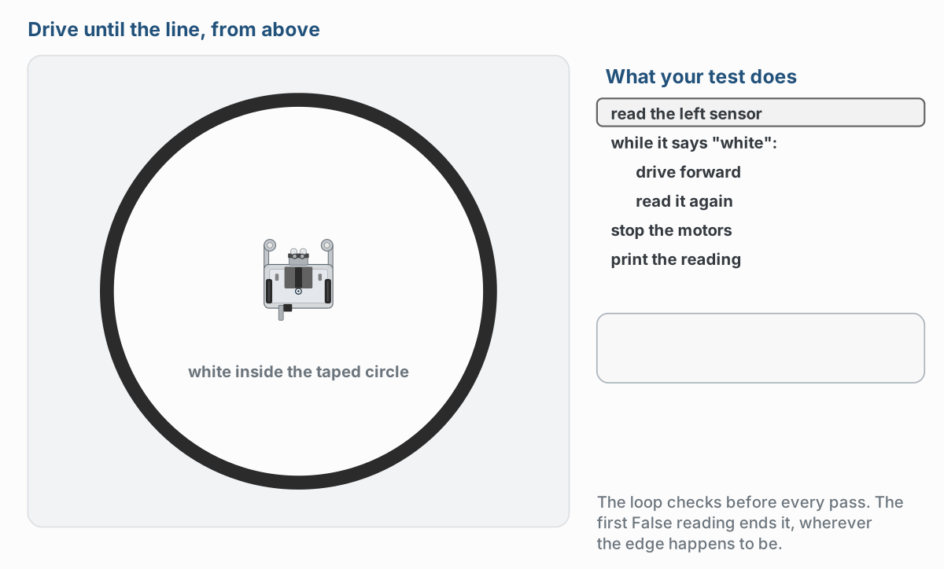
What step 1 should look like
Watch it run. The next slide picks out the key moments.
Notes:
The figure on the lesson page is an animation; these are two moments of the first run. In the animation the robot is then put back in the middle pointing at a different part of the edge, and it stops at the line there too.

Slide 12
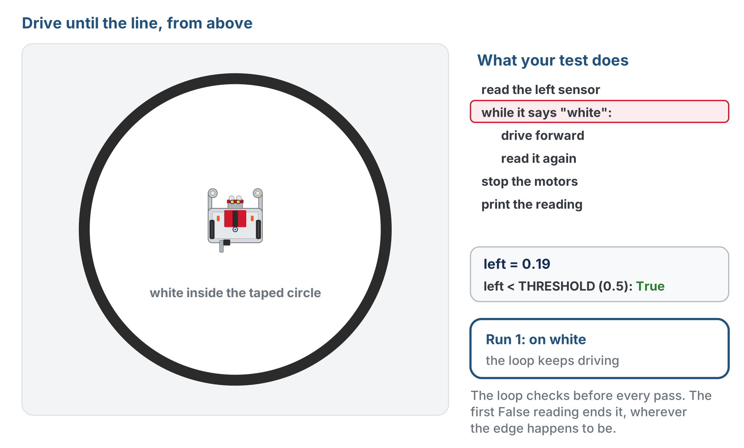
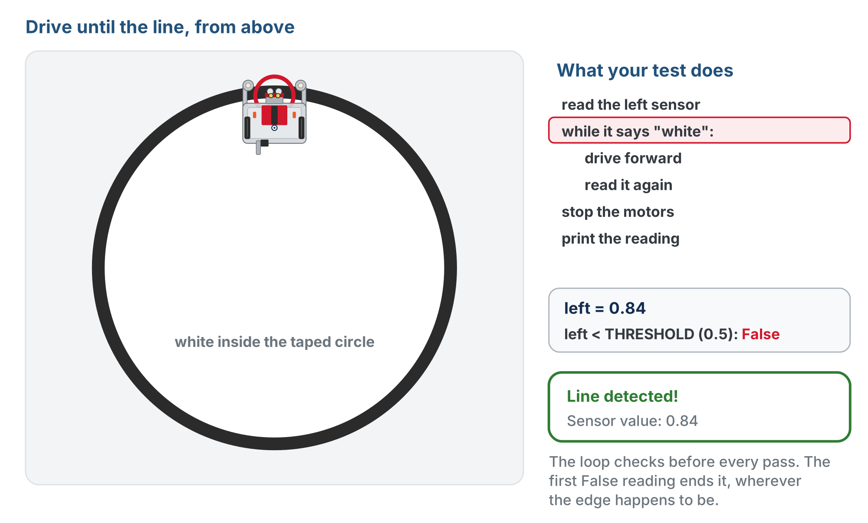
What step 1 should look like
On white: True, the loop goes round again
On the tape (0.84): False, the loop ends
The loop checks the reading before every pass, and the first reading on the tape ends it
Notes:
The figure on the lesson page is an animation; these are two moments of the first run. In the animation the robot is then put back in the middle pointing at a different part of the edge, and it stops at the line there too.

Slide 13
Step 1 · Write it and run it
Activity
Turn the comments into code and set the run line to test_drive_to_line()
1
Start the robot inside the taped circle, pointing at an edge, and press the button
2
Watch it stop at the line
3
Stops as soon as you press the button? The sensor already read "black": check your threshold. Never stops? Read on.
Notes:
More support: start with a non-robot counting loop (count = 0, while count < 5) so the loop mechanics are clear before sensors enter, and give the first line of the body. Use effort 0.2 so there is time to observe. More challenge: count the loop passes before the line is found, or flash the LED on detection.

Slide 14
Step 2 · Either sensor
Activity
Switch to get_right() and make sure it still works
1
Make the loop keep going only while both sensors are still on white, so the robot stops when either one hits the line
2
You'll need and between two conditions, and a second sensor read inside the loop
3
More on and and or next lesson

Slide 15
Step 3 · Tidy it
Activity
Once step 2 works, try reading the sensors in the condition itself:
while get_left() < THRESHOLD and get_right() < THRESHOLD:
No variable to remember to update: the sensors are read fresh every time the condition is checked. The body shrinks to one line, and the two reads before the loop go away.
Notes:
Most sensor loops in this course are written this way. The variable version (step 1) is the one that can fall into the trap, which is why students write it first; the condition-read version is where they end up.

Slide 16
The infinite-loop trap
Did your robot drive forever in step 1? Your loop is missing its most important line
The sensor is read once before the loop and never again
So the variable in the condition never changes, the condition never becomes false, and the robot drives until you catch it
The most common bug in every sensor program you'll ever write
The rule: always update the variable your while loop is checking, inside the loop, or put the sensor call in the condition
Notes:
Read this section after it has happened in the room, not before. Students who hit it remember it.

Slide 17
Check your understanding
A student's robot drives forward and never stops, even over the line. What did they most likely forget?
A. The board.wait_for_button() line
B. To re-read the sensor inside the loop, so the condition never changes
C. To import the drivetrain
D. To charge the battery
Notes:
Answer: B. Without updating left inside the loop, the condition stays true forever: a classic infinite loop.

Slide 18
Answer
A student's robot drives forward and never stops, even over the line. What did they most likely forget?
A. The board.wait_for_button() line
B. To re-read the sensor inside the loop, so the condition never changes
C. To import the drivetrain
D. To charge the battery
Without updating left inside the loop, the condition stays true forever: a classic infinite loop.

Slide 19
Check your understanding
THRESHOLD is 0.5 and the sensor reads 0.3. Is left < THRESHOLD True or False?
A. True: 0.3 is less than 0.5
B. False: 0.3 is greater than 0.5
C. True: they are equal
D. It causes an error
Notes:
Answer: A. 0.3 < 0.5 is True, so the loop keeps running: the robot is still on white and should keep driving.

Slide 20
Answer
THRESHOLD is 0.5 and the sensor reads 0.3. Is left < THRESHOLD True or False?
A. True: 0.3 is less than 0.5
B. False: 0.3 is greater than 0.5
C. True: they are equal
D. It causes an error
0.3 < 0.5 is True, so the loop keeps running: the robot is still on white and should keep driving.

Slide 21
Real-world connections
HOME
SOFTWARE
GAMES
Thermostats
Downloads
Game loops
The furnace runs while the room is below the set temperature, then stops: a while loop in hardware.
A download loops "grab the next chunk" while there's more file left to fetch.
A game repeats "update and draw" while the game is still running.

Slide 22
Wrap-up
When do you reach for while instead of for?
What's the one line you must never forget in a sensor while loop?
What does set_effort() do that straight() can't?
Next: add if/else so the robot turns around at the line: bounce driving
Notes:
Answers: when you repeat until a condition changes, not a fixed count. Re-reading the sensor inside the loop. It runs the motors without blocking, so the loop can keep checking. Formative: correct while syntax, and explaining the infinite-loop trap. Exit ticket: "What happens if you don't update the sensor inside the loop?" (an infinite loop).

