Slide 1

MODULE 2 · LESSON 2-4
Random Turns
By the end of this lesson you can
Explain what a module is and use import to bring one in
Generate random integers with random.randint(a, b)
Say why always turning 180° traps the robot in a pattern
Write a random-angle version of your bounce test, from an outline
Notes:
50 to 60 minutes. A short lesson with one new tool, randint, and one one-line change to last lesson's test. Most of the time goes to the experiment in step 2.

Slide 2
Your bounce robot has a flaw
It turns exactly 180° every time
So it retraces the same path back and forth
It never explores the rest of the circle
The fix is randomness: turn a different amount each bounce
Notes:
Ask who noticed this at the end of Lesson 2-3. To get random numbers we import one of Python's built-in toolboxes.

Slide 3
Modules and import
Python ships with thousands of ready-made tools grouped into modules. Think of each as a toolbox. To use one, you import it at the top of your file. You have done this already for the robot:
from XRPLib.reflectance import Reflectance
For random numbers you import Python's built-in random

Slide 4
random.randint(a, b)
import random
for i in range(5):
number = random.randint(1, 10)
print("Random number:", number)
random.randint(1, 10) hands back one random whole number from 1 to 10, including both ends. Run it again and you will (usually) get a different number.
Notes:
More support: have students run just this, with no robot, so randint is concrete before it drives anything. Computer randomness is really "pseudo-random": deterministic underneath, but plenty random for us.

Slide 5
Check your understanding
What can random.randint(1, 6) return?
A. Any decimal between 1 and 6
B. Any whole number from 1 to 6, including 1 and 6
C. The numbers 1 through 5 only
D. Exactly six random numbers at once
Notes:
Answer: B. randint gives one integer, and the range is inclusive: 1, 2, 3, 4, 5, or 6 (like rolling a die).

Slide 6
Answer
What can random.randint(1, 6) return?
A. Any decimal between 1 and 6
B. Any whole number from 1 to 6, including 1 and 6
C. The numbers 1 through 5 only
D. Exactly six random numbers at once
randint gives one integer, and the range is inclusive: 1, 2, 3, 4, 5, or 6 (like rolling a die).

Slide 7
Check your understanding
Where do import statements belong?
A. At the very top of the file
B. Inside the while loop, so they run every pass
C. Right before the robot moves
D. Anywhere: it makes no difference
Notes:
Answer: A. By convention imports go at the top. You import once; the tools are then available everywhere below.

Slide 8
Answer
Where do import statements belong?
A. At the very top of the file
B. Inside the while loop, so they run every pass
C. Right before the robot moves
D. Anywhere: it makes no difference
By convention imports go at the top. You import once; the tools are then available everywhere below.

Slide 9
Random bounce driving
The only change from Lesson 2-3 is in the if branch
Instead of a fixed turn(180), pick a random angle first
Then turn by that
Nothing else in the program moves
Same loop, same is_either_on_line(): only the turn changes

Slide 10
Add to robot.py: test_random_bounce()
import random goes at the top, with the other imports. Paste the test above RUN.
import random # at the top of robot.py, with the other imports
def test_random_bounce():
# a copy of test_bounce(), with the if branch becoming:
# stop
# pick a random whole number of degrees, 90 to 270
# print it, so you can see each choice
# turn by that many degrees
pass
Keep test_bounce() as it is: by the end of the module your file is a record of everything the robot has learned to do
Notes:
Students should copy test_bounce(), not edit it. The fixed-angle bounce is part of the record the file keeps.

Slide 11
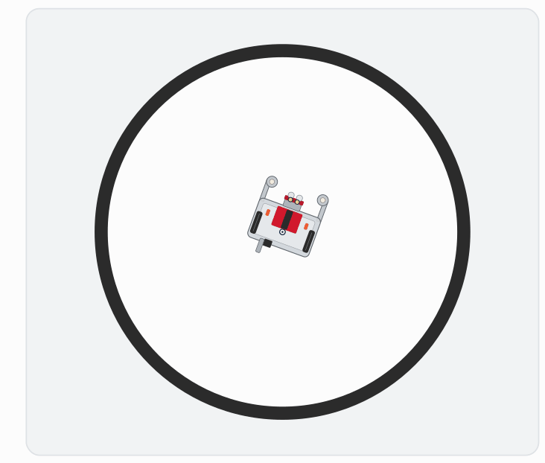
Why 90 to 270, and not 0 to 360?
Each bounce picks a fresh angle, so the robot fans out and covers the whole circle. But it has to meaningfully change direction:
Near 0: it barely turns, and drifts out of the circle
Near 180: it goes straight back the way it came
The band in the middle is where exploring happens
Notes:
randint(90, 270) guarantees a real change of direction. A range that includes very small angles can send the robot back across the line it just hit, or barely turn it, so it drifts out of the circle. The figure is the end of the lesson's animated run: the paths fan out across the circle. The lesson worksheet has a range table for step 2.

Slide 12
Check your understanding
Why does always turning exactly 180° cause a problem?
A. It drains the battery faster
B. The robot retraces the same path back and forth and never explores the rest
C. 180° turns are inaccurate on hardware
D. It makes the robot leave the circle
Notes:
Answer: B. A 180° turn sends the robot straight back the way it came, so it bounces between the same two points forever. Random angles break that.

Slide 13
Answer
Why does always turning exactly 180° cause a problem?
A. It drains the battery faster
B. The robot retraces the same path back and forth and never explores the rest
C. 180° turns are inaccurate on hardware
D. It makes the robot leave the circle
A 180° turn sends the robot straight back the way it came, so it bounces between the same two points forever. Random angles break that.

Slide 14
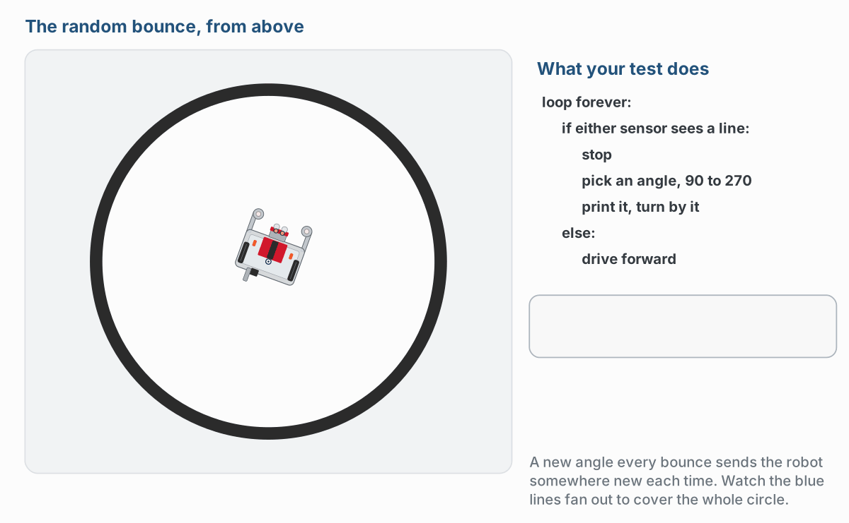
What step 1 should look like
With randint(90, 270). Your angles will be different every run, which is the point.
Notes:
One moment from the lesson's animation: bounce 4, where randint picked 221. The outline on the right highlights the line of the test that is running, and the box below shows the angle each bounce picked.

Slide 15
Step 1 · The random turn
Activity
Add import random at the top of robot.py
1
Copy the body of test_bounce() into test_random_bounce(), and change the if branch as outlined
2
Set the run line to test_random_bounce() and run it
3
The printed angle should differ on (almost) every bounce, and the robot should wander the whole circle instead of pacing one line

Slide 16
Step 2 · Try three ranges
Activity
Run each one and write down how the robot's coverage of the circle changes.
Range | How much of the circle does it cover?
randint(170, 190)
randint(90, 270)
randint(45, 315)
Which one explores best, and why?
Notes:
Let students see for themselves why a mid-range band explores best: 170 to 190 is nearly the old 180 pattern, and a wide range lets in small turns. The lesson worksheet has the same range table.

Slide 17
Step 3 · Challenge: random speed too
Activity
randint() only gives whole numbers, and set_effort() wants a value between 0 and 1
1
Pick a whole number in a range you choose, and divide it to get an effort between 0.2 and 0.5
2
Drive at that speed until the next bounce
3
Notes:
Step 3 is hand-in work. The division is the part students have to find: most try randint with decimals first and get an error. More challenge: a "dance mode" victory spin every 10th bounce, or random.choice() from a few set angles, a nice preview of lists.

Slide 18
Real-world connections
GAMES
CLEANING
SCIENCE
Procedural worlds
Robot vacuums
Simulations
Games generate endless different levels, loot, and maps from random numbers.
Simpler vacuums use semi-random turns to eventually cover a whole room, just like your bounce bot.
Weather, traffic, and epidemic models run millions of random trials to predict outcomes.
Notes:
Randomness is a real engineering tool, not just chaos.

Slide 19
Wrap-up
What does import do?
What does random.randint(1, 6) return?
Why is a random turn better than a fixed 180° here?
Next: stop bouncing off the line and start following it
Notes:
Answers: brings in a module's tools so you can use them. One whole number, 1 to 6 inclusive. It stops the robot retracing the same path. Formative: correct use of import random and the inclusive range of randint. Exit ticket: "What values could random.randint(90, 270) give?" (any integer from 90 to 270). Next lesson is the big one: proportional control.

