Slide 1

MODULE 3 · LESSON 3-1
Introduction to the Grid
By the end of this lesson you can
Describe how a grid is built from lines and intersections
Explain how a grid intersection is just the "cross" from Module 2
Use track_to_intersection() and drive_past_intersection() to arrive at the next intersection
Start the GRID DRIVING section of robot.py, and write its first two tests from a description
Place the robot on the grid and reach the first intersection
Notes:
40 to 50 minutes. The big idea of Module 3 is not a new Python concept, it is reuse: the exact same functions running on a new course. Say it out loud early, because students expect a new problem to need new code.

Slide 2
From the circle to the grid
In Module 2 the robot learned to follow a line and detect a cross
Now a whole grid of lines goes on the floor
The LINE TRACKING section of robot.py already knows how to drive it
No new driving code: this lesson opens a new section and fills it with tests
Same tape, same surface, same functions, new course

Slide 3
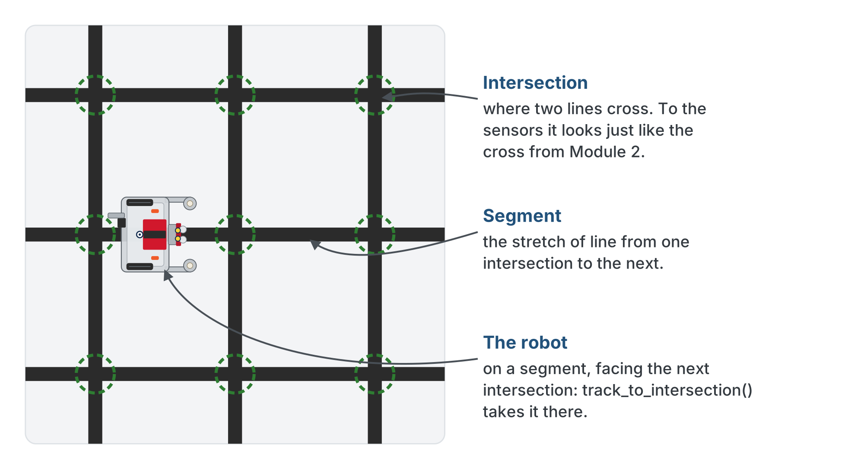
A grid is just a lot of intersections
Rows and columns of tape. Every place they cross is an intersection: a spot the robot can stop and turn.
Notes:
To the robot's two sensors, an intersection looks exactly like the taped cross from Module 2: both sensors go high at once. A segment is the stretch of line from one intersection to the next.

Slide 4
You already built the whole toolkit
The LINE TRACKING section you finished in Lesson 2-9 has the four functions that drive a grid:
track_to_intersection(): follow the line to the next intersection and stop
drive_past_intersection(): put the wheels on the intersection, sensors past it
turn_clockwise(): turn onto the perpendicular line to the right
turn_counterclockwise(): turn onto the perpendicular line to the left
A grid intersection is the Module 2 cross, so the toolkit works unchanged
Notes:
The grid is the same color surface with the same tape the circle was made from, so there is nothing to re-measure and nothing to re-tune: both sections of robot.py come across untouched.

Slide 5
Built the LineTrack class? Use it
Your LINE TRACKING section is the class, with tracker = LineTrack() right under it
The skeletons in this module use the function names; yours is the same name on your object
Where an outline says "arrive at the intersection", your body calls the tracker
No threshold constant, no sensor to hand in, nothing shared through global
tracker.track_to_intersection()
tracker.drive_past_intersection()
The tracker brought its sensor and its settings with it. That is what the class bought you.
Notes:
Only for students who built the LineTrack class in Module 2. The helper they write in Lesson 3-2 calls the tracker the same way.

Slide 6
Check your understanding
Do you need to change your driving toolkit to drive on the grid?
A. Yes: grids need a whole new set of functions
B. No: a grid intersection looks just like the Module 2 cross, so the toolkit works unchanged
C. Yes: you must rewrite track_to_intersection()
D. Only the sensor functions change
Notes:
Sell the reuse: it is the point of the module. That is how professionals work: a well-designed toolkit outlives the problem it was written for.

Slide 7
Answer
Do you need to change your driving toolkit to drive on the grid?
A. Yes: grids need a whole new set of functions
B. No: a grid intersection looks just like the Module 2 cross, so the toolkit works unchanged
C. Yes: you must rewrite track_to_intersection()
D. Only the sensor functions change
An intersection reads the same to the sensors as the circle's cross did, so the same functions navigate the grid with no changes. That's code reuse.
Notes:
Sell the reuse: it is the point of the module. That is how professionals work: a well-designed toolkit outlives the problem it was written for.

Slide 8
Add to robot.py: a new GRID DRIVING section
Paste it above RUN, after the whole LINE TRACKING section. No functions yet, only tests.
# ===== GRID DRIVING =====
# Drives the taped grid one intersection at a time, using only
# the LINE TRACKING functions: a grid intersection is the
# cross from Module 2. To ARRIVE at an intersection is
# track_to_intersection() then drive_past_intersection(); a
# turn happens parked on one. Nothing here touches a sensor.
def test_first_intersection():
# from a line, arrive at the next intersection and say so
pass
def test_arrive_and_turn():
# arrive at the intersection, then turn right onto the
# crossing line
pass
Notes:
A new kind of driving gets a new section. It starts with no functions of its own because there is nothing new to write yet.

Slide 9
Two things are different this module
The tests have no bodies: the comment says what the test should do, and you write it
From here on, that is how every test arrives
pass holds the place, as it did in Lesson 2-1, so the file runs before you've written anything
Read the comment, write the body, run the test
Notes:
The hint level drops this module. Module 2 gave the test functions in full; from here the skeleton gives the def line and a comment, and the body is the student's: test-driven development, lightly. The bodies in this lesson are two to five calls they have made before, so it is the right place to start that habit.

Slide 10
Drive to the first intersection
Place the robot centered on a line, facing toward the next intersection. The first test is two calls:
track_to_intersection() follows the line right up to the cross
drive_past_intersection() rolls forward so the wheels are over the intersection
Exactly as test_park() did in Lesson 2-9
Those two calls together are the arrival pair: what "arrive at an intersection" means for the rest of the course

Slide 11
Where the robot turns
When track_to_intersection() stops, the sensors are on the cross
But the sensors sit at the very front of the robot
The robot turns about its center of rotation: the pen hole between the drive wheels, 8.75 cm further back
Turn from where the track stopped, and the robot swings around a point short of the intersection
On the grid, the second call of the pair matters more than it did on the circle

Slide 12
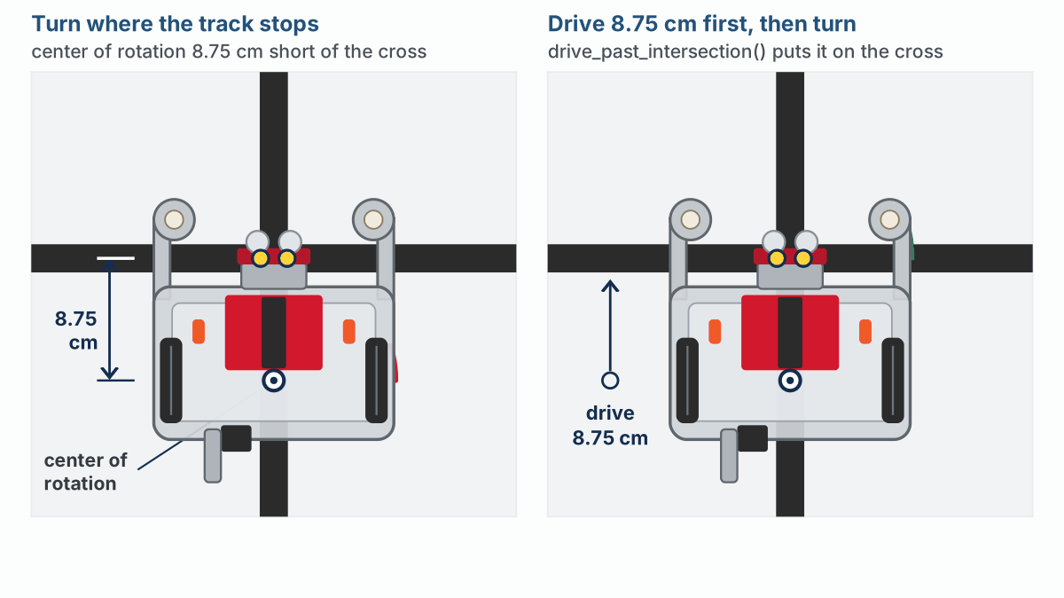
Turn now, or drive past first?
Left: turns right away, and its sensors miss the cross street. Right: drives past first, spins on the intersection, and lands on the new line.
Notes:
Both robots start where track_to_intersection() left them. On the lesson page this is an animation; the slide shows the end state.

Slide 13
Why every arrival is the pair
drive_past_intersection() drives forward exactly that 8.75 cm
The center of rotation ends up where the sensors were: right on the intersection
Any turn from there spins the robot in place on the cross
The sensors come down on the crossing line
Every arrival is the pair, never the track alone, even when the robot is about to go straight on

Slide 14
Check your understanding
Which function drives the robot from where it is to the next intersection?
A. turn_clockwise()
B. track_to_intersection()
C. drive_past_intersection()
D. get_error()
Notes:
Answer: B. `track_to_intersection()` follows the line and stops when both sensors hit the intersection: one grid segment per call. `drive_past_intersection()` then parks the wheels on it.

Slide 15
Answer
Which function drives the robot from where it is to the next intersection?
A. turn_clockwise()
B. track_to_intersection()
C. drive_past_intersection()
D. get_error()
track_to_intersection() follows the line and stops when both sensors hit the intersection: one grid segment per call. drive_past_intersection() then parks the wheels on it.

Slide 16
Check your understanding
Why drive past the intersection before turning, instead of turning where track_to_intersection() stops?
A. To save battery
B. The robot turns about its center of rotation, 8.75 cm behind the sensors, so turning early pivots short of the intersection and the sensors miss the new line
C. Because turn_clockwise() only works while the robot is moving
D. It does not matter; both land on the new line
Notes:
Answer: B. The sensors arrive first. Driving the 8.75 cm puts the center of rotation on the cross, so the turn spins on the intersection and the sensors come down on the crossing line.

Slide 17
Answer
Why drive past the intersection before turning, instead of turning where track_to_intersection() stops?
A. To save battery
B. The robot turns about its center of rotation, 8.75 cm behind the sensors, so turning early pivots short of the intersection and the sensors miss the new line
C. Because turn_clockwise() only works while the robot is moving
D. It does not matter; both land on the new line
The sensors arrive first. Driving the 8.75 cm puts the center of rotation on the cross, so the turn spins on the intersection and the sensors come down on the crossing line.

Slide 18
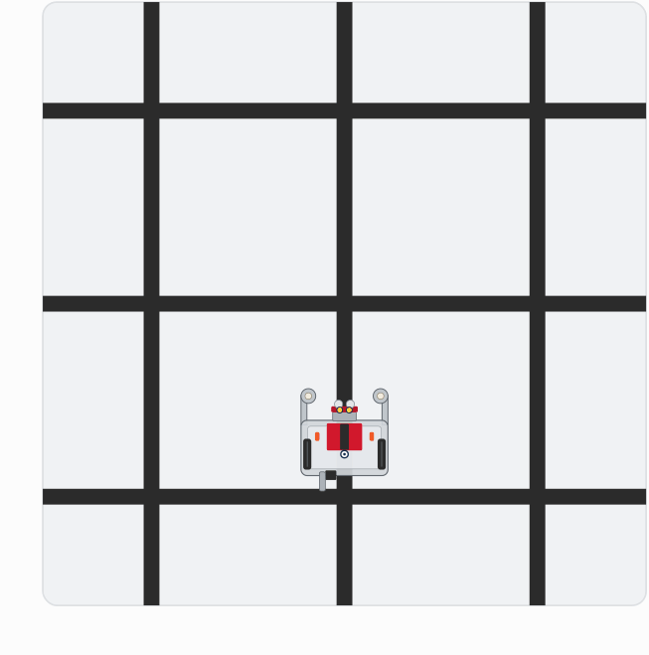
Activity · Reach it, then turn
Activity
Watch it run. The next slide picks out the key moments.
Notes:
On the lesson page this is one animation of both tests, with the step running highlighted beside the grid. These are the end of each step.

Slide 19
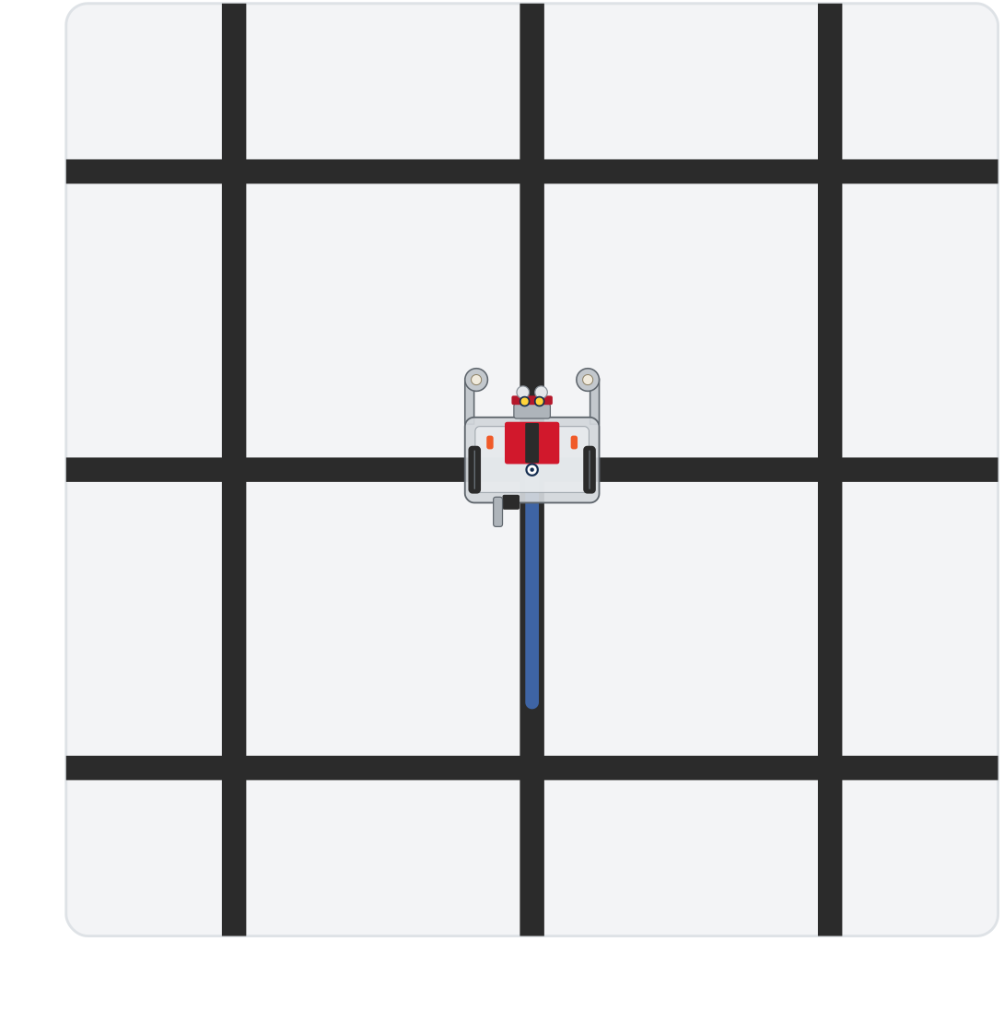
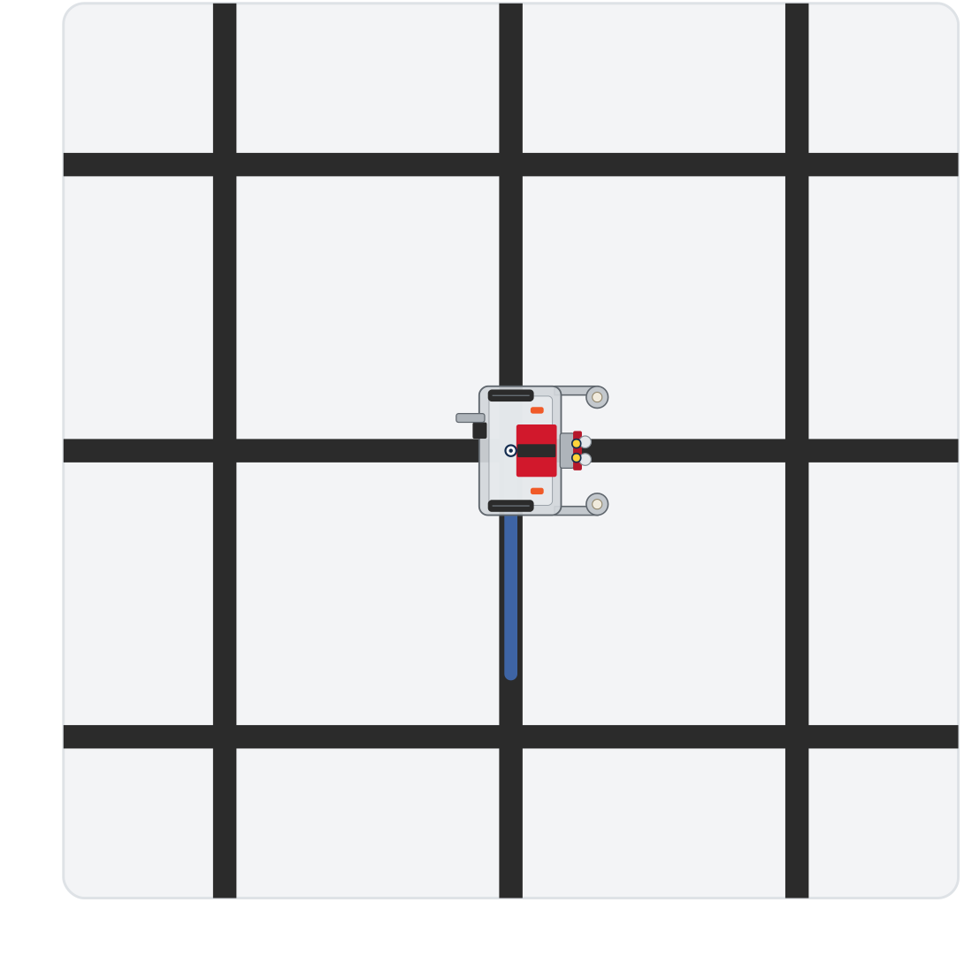
Activity · Reach it, then turn
Activity
Step 1: parked on the intersection
Step 2: turned onto the crossing line
The arrival pair parks the wheels on the intersection, and from there one turn lands on the crossing line
Notes:
On the lesson page this is one animation of both tests, with the step running highlighted beside the grid. These are the end of each step.

Slide 20
Step 1 · test_first_intersection()
Activity
Write the body: a print saying what it's about to do, the arrival pair, and a print saying it got there
1
Set the run line to test_first_intersection(). Put the robot on a line segment facing the next intersection, and run
2
It should stop with its wheels on the intersection. Try a few starting spots. Don't go on until it does
3
Notes:
More support: have students get test_first_intersection() reliable before writing the turn test.

Slide 21
Step 2 · test_arrive_and_turn()
Activity
Write the body: the arrival pair, then turn_clockwise(), with a print before the turn and one after
1
Set the run line to test_arrive_and_turn() and run
2
It should arrive, pivot on the intersection, and stop facing along the crossing line with a sensor on the tape
3
Detects an intersection immediately? It started on one: nudge it back onto the line.
Notes:
The lesson has a closed reveal with both tests; students write and run theirs first. Prints can say anything; the calls and their order are what matter. Common snags: starting on an intersection (detects instantly), a threshold that needs re-calibrating for the grid surface, or the robot not centered before a turn. More challenge: a test_two_segments() that arrives, turns, and arrives again, previewing Lesson 3-2.

Slide 22
Check your understanding
You run the program and the robot reports "Intersection reached!" instantly without moving. Why?
A. The battery is dead
B. It started sitting on an intersection, so both sensors were already high
C. track_to_intersection() is broken
D. The threshold is too low
Notes:
Answer: B. If it starts on a cross, `is_at_cross()` is already true and the follow loop exits at once. Back it onto a plain line segment to start.

Slide 23
Answer
You run the program and the robot reports "Intersection reached!" instantly without moving. Why?
A. The battery is dead
B. It started sitting on an intersection, so both sensors were already high
C. track_to_intersection() is broken
D. The threshold is too low
If it starts on a cross, is_at_cross() is already true and the follow loop exits at once. Back it onto a plain line segment to start.

Slide 24
Real-world connections
WAREHOUSES
CITIES
GAMES
Fulfillment robots
Street navigation
Grid worlds
Warehouse robots roll along floor grids, stopping at labeled intersections to pick shelves.
Self-driving cars think in intersections and blocks: drive to the next junction, then decide.
Countless games move characters on a grid, one tile at a time, exactly like this.

Slide 25
Wrap-up
What is a grid intersection, to the robot?
Which function drives one segment to the next intersection?
Why didn't you have to write any new driving code?
Next: drive through intersections, with a loop and counting
Notes:
Answers: the same both-sensors-high cross from Module 2. track_to_intersection(), then drive_past_intersection() to park on it. LINE TRACKING already handles lines and crosses: reuse, and only the tests are new. Formative: explain why LINE TRACKING works unchanged, and drive to the first intersection reliably. Exit ticket: "Which function turns the robot onto the crossing line?" (turn_clockwise() or turn_counterclockwise()). Next lesson the GRID DRIVING section gets its first function.

