Slide 1

MODULE 5 · LESSON 5-1
The Grid as a Graph
By the end of this lesson you can
Define node, edge and neighbor
Explain why a grid of intersections is a graph
Remove a blocked node (and its edges) from a graph
Find a shortest path by hand that detours around obstacles
Explain why the Manhattan algorithm can't handle blocked intersections
Notes:
45 to 50 minutes, no coding: a mental model first, on paper and the physical grid. This lesson is the why for the whole module, so spend real time on the hook. Save the worksheets: they become test cases in Lessons 5-3 to 5-5.

Slide 2
What if the road is closed?
Your usual route to school is closed for construction
You don't give up: you find a detour, and your GPS reroutes you automatically
The robot needs to do the same
Manhattan only knows one strategy: across first, then up or down
It has no idea of an obstacle, so it drives right into a blocked intersection
To route around things, we need a smarter way to think about the grid
Notes:
Show a blocked intersection sitting on Manhattan's route and let students feel that the old algorithm is stuck before you offer anything new.

Slide 3
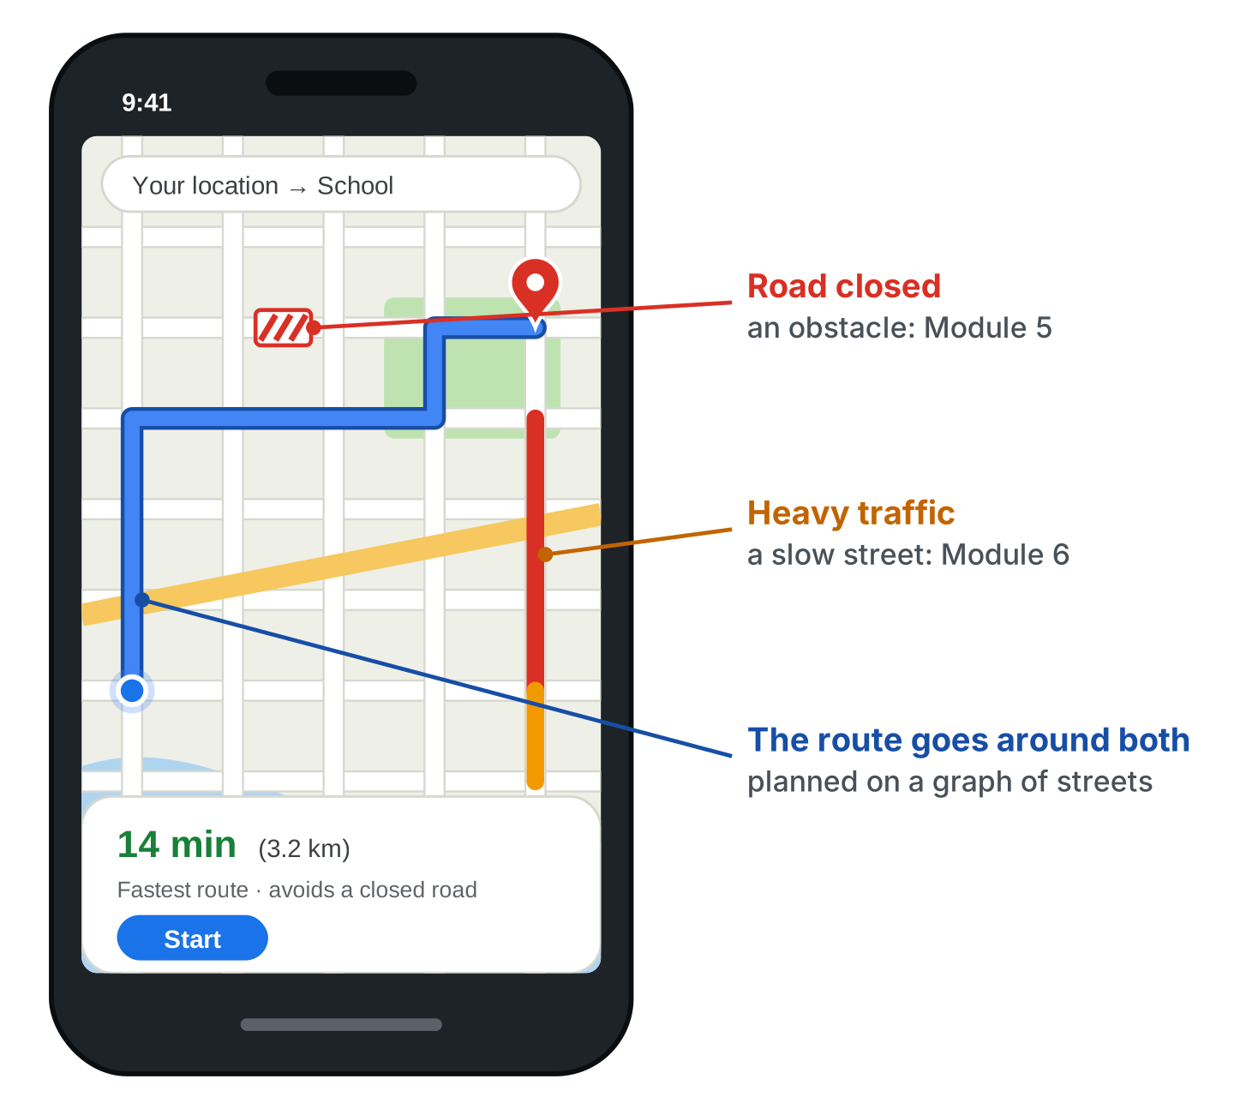
The same puzzle your phone solves
A city's streets form a graph. A closed road is blocked, heavy traffic makes some streets slower.
This module, breadth-first search: a route around blocked intersections
Module 6, Dijkstra's algorithm: the fastest route when some streets are slow
Real apps use faster descendants of Dijkstra (A* is the best known), but the core idea is the one you'll write
Notes:
The figure: a maps app going around a closed road (this module's problem) and avoiding a slow street (the next module's).

Slide 4
Check your understanding
Why can't the Manhattan algorithm route around a blocked intersection?
A. It runs too slowly
B. It only knows one fixed strategy (across, then up or down) and has no concept of obstacles
C. It can, if you turn it off and on again
D. The robot has no wheels
Notes:
Answer: B. Manhattan always follows the same L-shaped route. It never checks whether an intersection is blocked, so it can't detour.

Slide 5
Answer
Why can't the Manhattan algorithm route around a blocked intersection?
A. It runs too slowly
B. It only knows one fixed strategy (across, then up or down) and has no concept of obstacles
C. It can, if you turn it off and on again
D. The robot has no wheels
Manhattan always follows the same L-shaped route. It never checks whether an intersection is blocked, so it can't detour.

Slide 6
Nodes, edges, neighbors
A graph is a collection of nodes (points) connected by edges (links)
You already know graphs:
a road map: intersections and streets
a social network: people and friendships
airline routes: airports and flights
A graph captures what connects to what
In computer science a graph is a network of nodes and edges, not a bar chart
Notes:
Clear up the word "graph" immediately: in CS it is a network of nodes and edges, not a bar chart.

Slide 7
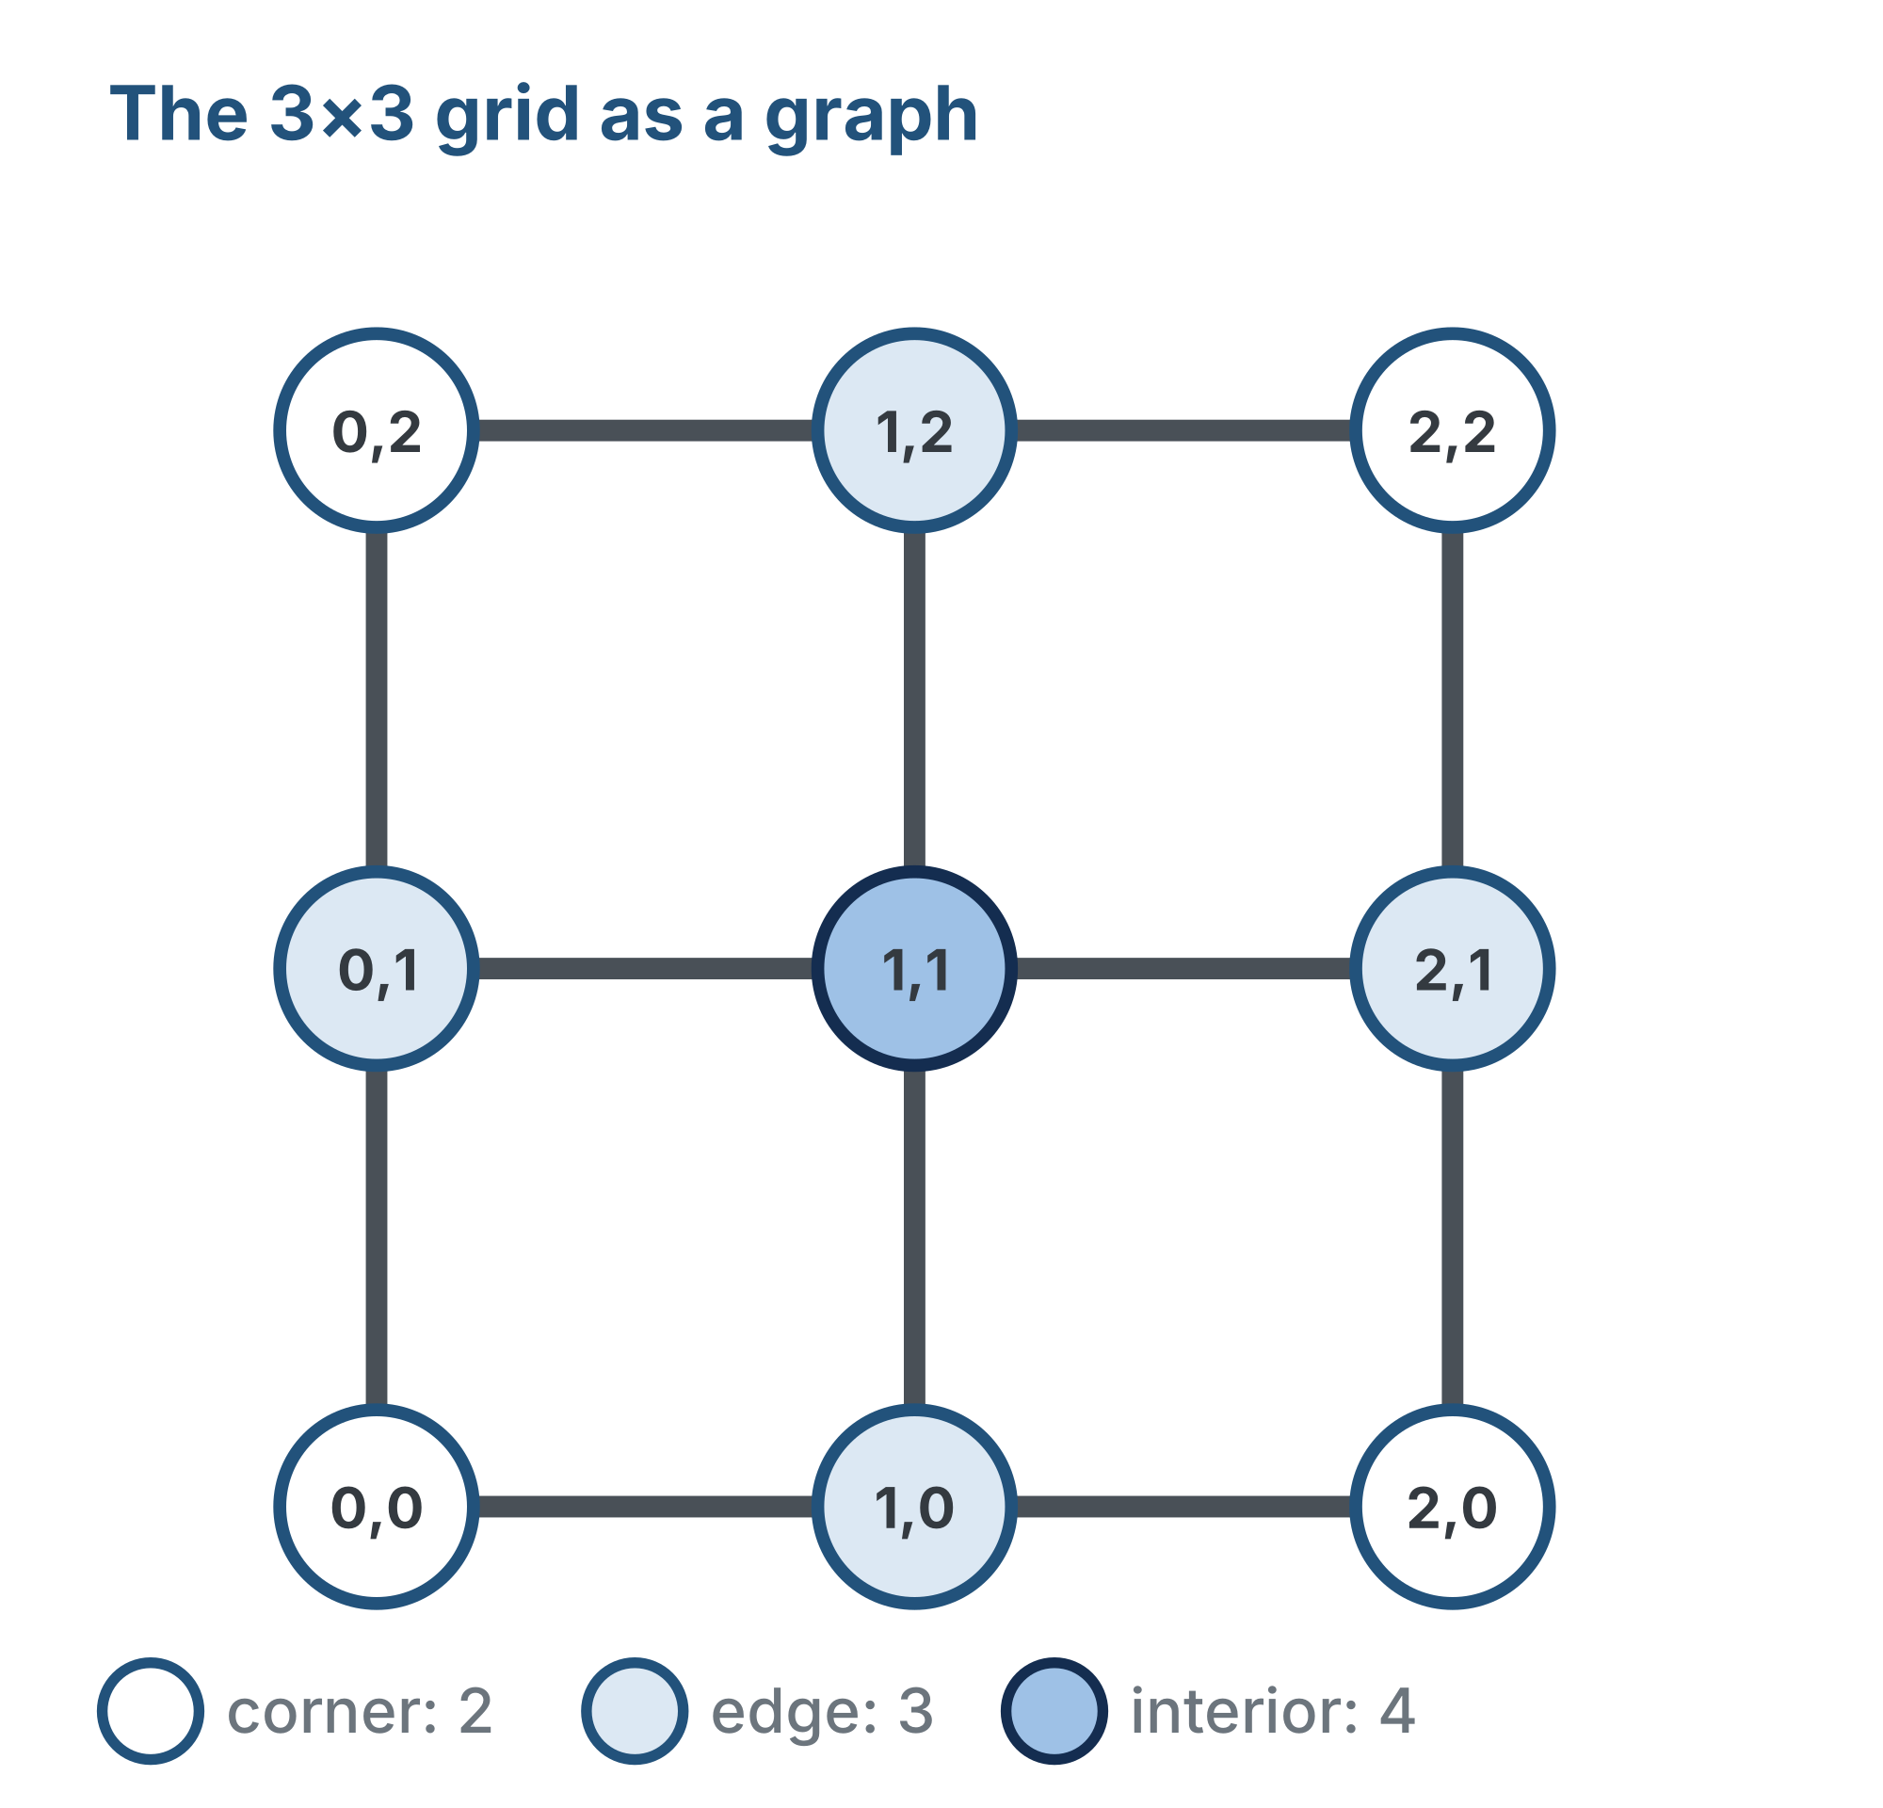
Our grid is a graph
Every intersection is a node, named by its coordinate, like (1, 2)
Every line between two adjacent intersections is an edge
The nodes an edge connects you to are that node's neighbors
How many depends on where it sits:
a corner has 2
an edge node has 3
an interior node has 4
Notes:
(0, 0) is the bottom-left, as in Module 4. Draw a big 3x3 graph on the board and have students count the neighbors of a corner, an edge node and the center. No diagonals.

Slide 8
Check your understanding
On a 3×3 grid, how many neighbors does the interior node (1,1) have?
A. 2
B. 3
C. 4
D. 8
Notes:
Answer: C. (1,1) connects left, right, down, and up: (0,1), (2,1), (1,0), (1,2). No diagonals, so four neighbors.

Slide 9
Answer
On a 3×3 grid, how many neighbors does the interior node (1,1) have?
A. 2
B. 3
C. 4
D. 8
(1,1) connects left, right, down, and up: (0,1), (2,1), (1,0), (1,2). No diagonals, so four neighbors.

Slide 10
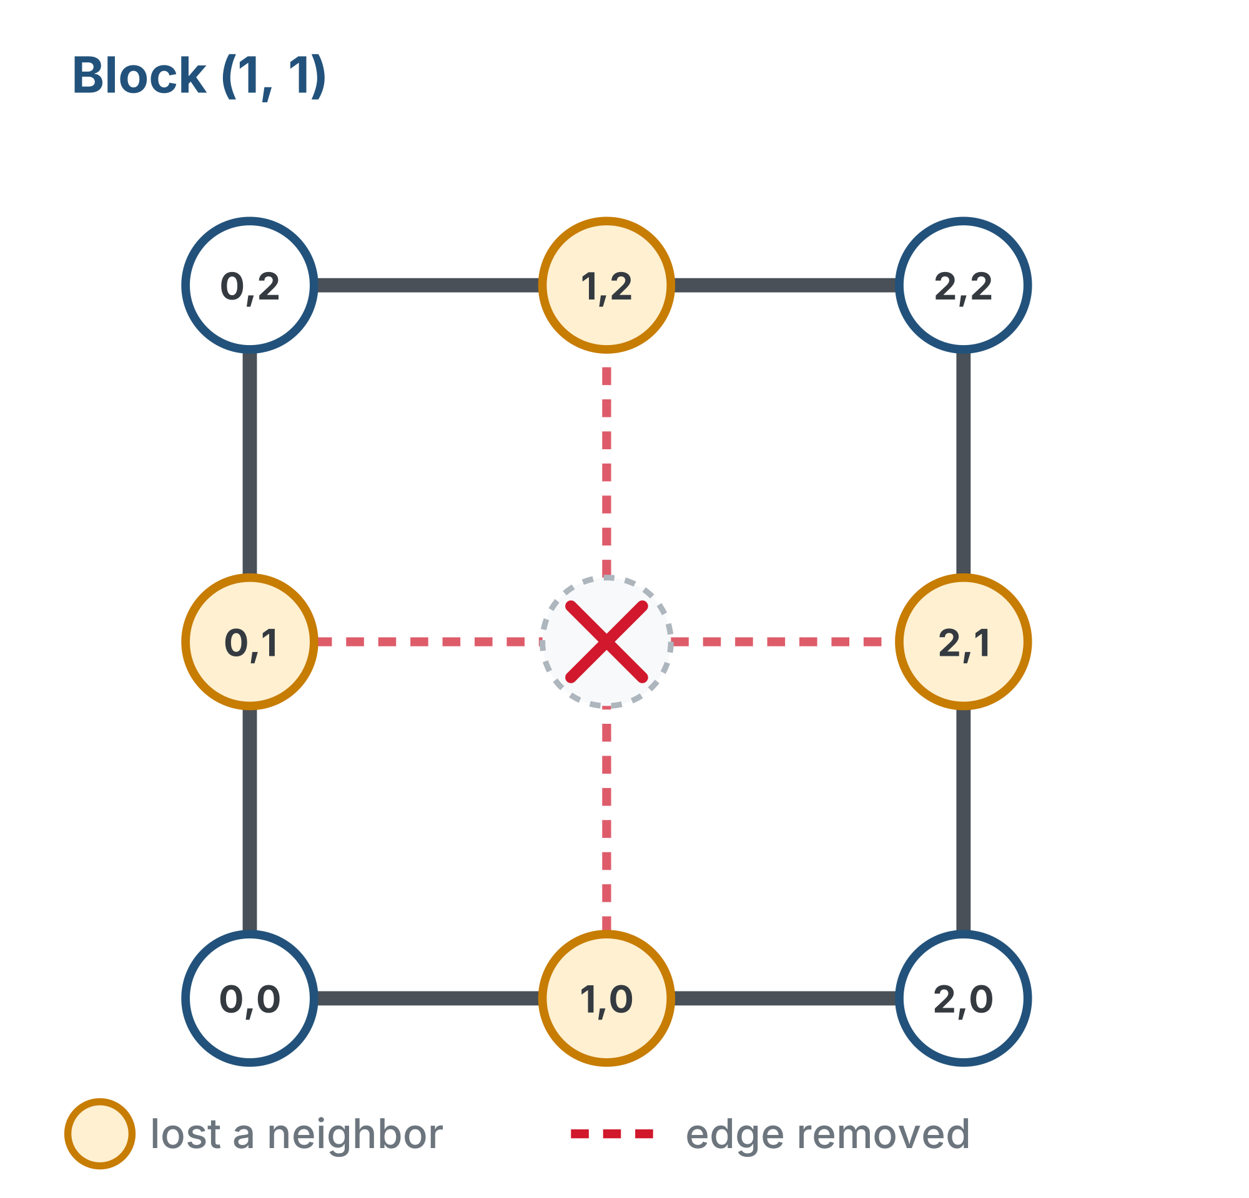
Blocking a node
When an intersection is blocked, we remove it from the graph entirely
The node and all its edges
Block (1,1): every node that used to touch it, (0,1), (1,0), (1,2) and (2,1), has lost a neighbor
Blocking one node changes its neighbors too
Notes:
Have students come up to the board, cross out a blocked node and erase its edges with their own hands.

Slide 11
Check your understanding
After (1,1) is blocked, how many neighbors does (0,1) have?
A. 3: nothing changed
B. 2: it lost its connection to the right, to (1,1)
C. 4
D. 0
Notes:
Answer: B. (0,1) used to connect to (0,0), (0,2), and (1,1). With (1,1) removed, only two neighbors remain.

Slide 12
Answer
After (1,1) is blocked, how many neighbors does (0,1) have?
A. 3: nothing changed
B. 2: it lost its connection to the right, to (1,1)
C. 4
D. 0
(0,1) used to connect to (0,0), (0,2), and (1,1). With (1,1) removed, only two neighbors remain.

Slide 13
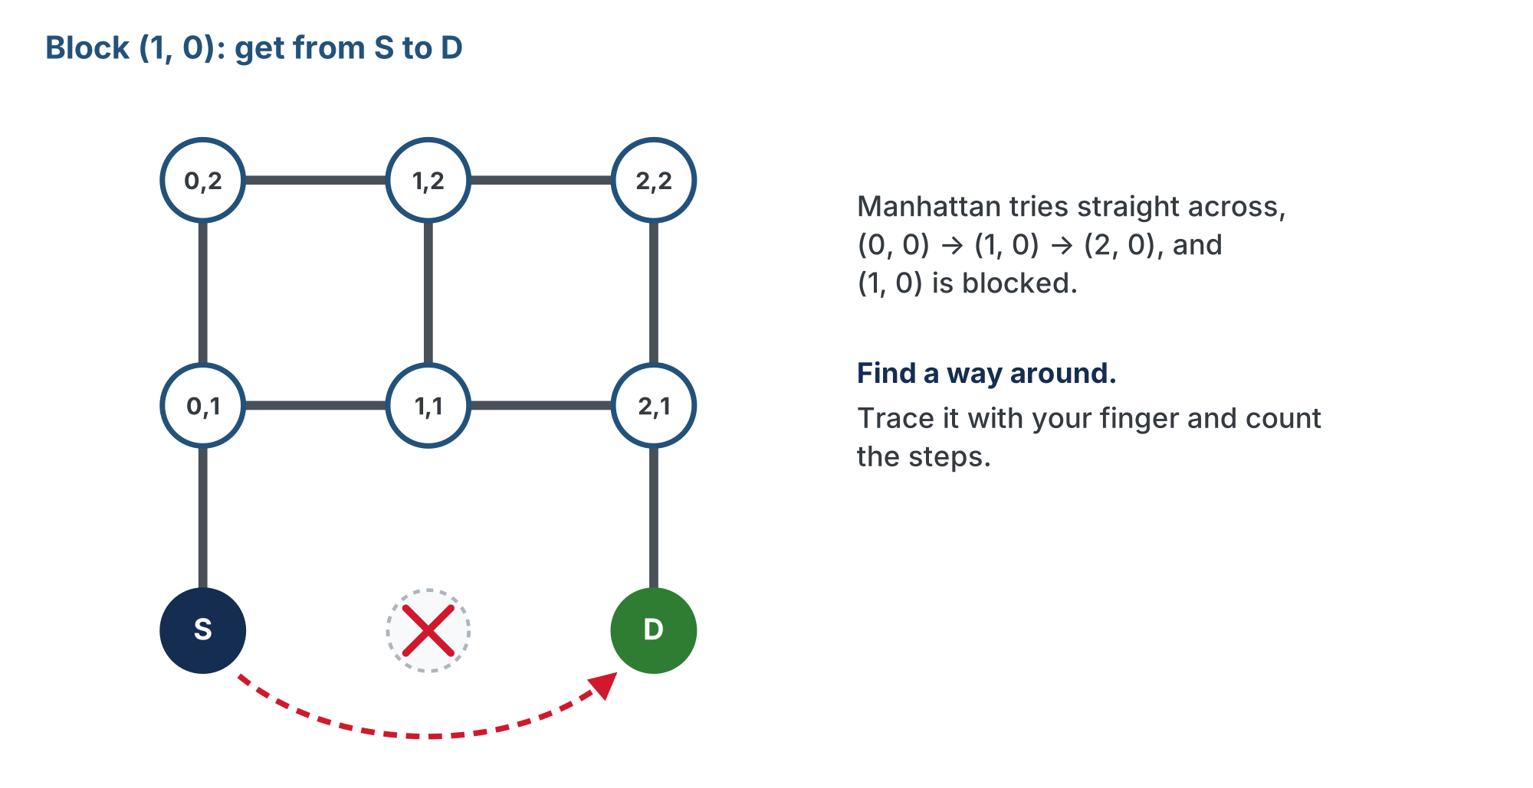
Activity · Finding a path around
Activity
Block (1,0) instead. Find the shortest path from (0,0) to (2,0): trace a way around with your finger and count the steps.
Notes:
Manhattan would try (0,0) to (1,0) to (2,0), but (1,0) is blocked, so it fails. Let students struggle to find the path by hand; that struggle is what motivates a systematic method in Lesson 5-3. The answer is behind a reveal on the lesson page: take answers from the room before opening it.

Slide 14
Obstacles make paths longer
Without the obstacle, the Manhattan distance from (0,0) to (2,0) is only 2
With obstacles, Manhattan distance is just a lower bound, not the real answer
There's usually more than one shortest path
Our grid is unweighted: every edge costs 1 step
In a weighted graph, a highway edge might cost less than a side street
This module: the unweighted case. The optional Module 6: edges with different costs
Notes:
Ask for the length of the detour students found before this slide. If two students found different routes of the same length, both are right.

Slide 15
Check your understanding
With (1,0) blocked, the shortest path from (0,0) to (2,0) is 4 steps, but the Manhattan distance is 2. What does that tell you?
A. The Manhattan distance is wrong
B. With obstacles, the real shortest path can be longer than the Manhattan distance
C. Obstacles always add exactly 2 steps
D. The destination is unreachable
Notes:
Answer: B. Manhattan distance is the shortest path with NO obstacles. Blocked nodes can force a longer detour, so it becomes a lower bound.

Slide 16
Answer
With (1,0) blocked, the shortest path from (0,0) to (2,0) is 4 steps, but the Manhattan distance is 2. What does that tell you?
A. The Manhattan distance is wrong
B. With obstacles, the real shortest path can be longer than the Manhattan distance
C. Obstacles always add exactly 2 steps
D. The destination is unreachable
Manhattan distance is the shortest path with NO obstacles. Blocked nodes can force a longer detour, so it becomes a lower bound.

Slide 17
Real-world connections
NAVIGATION
SOCIAL
INTERNET
GPS & Waze
Friend networks
Network routing
Roads are edges, intersections are nodes. Rerouting around a closure is exactly this graph problem.
People are nodes, friendships are edges. "Friends of friends" is a graph search.
Data hops between routers (nodes) over links (edges), picking a shortest path each time.

Slide 18
Wrap-up
What are a node, an edge, and a neighbor?
What happens to the graph when a node is blocked?
Why can obstacles make a path longer than the Manhattan distance?
Next: store the graph in Python with a dictionary
Notes:
Answers: a point, a link between adjacent points, and the points a node links to. It is removed entirely, node and all its edges. You have to detour around blocked nodes. Formative: identify nodes, edges and neighbors, remove a blocked node cleanly, trace a detour, explain why Manhattan fails. Exit ticket: "On a 3x3 grid with (1,0) blocked, draw the shortest path from (0,0) to (2,0) and count the steps." (4). Preview: next lesson stores the graph as a dictionary, {(0,0): [(0,1),(1,0)], ...}.

Slide 19
Check your understanding
Wrap-up quiz
In computer science, what does the word 'graph' mean?
A. A bar chart or scatter plot
B. A network of nodes connected by edges
C. A grid of pixels
D. A line showing data over time
Notes:
Answer: B. Same word, different field. In CS a graph is nodes and edges: the structure behind maps, networks, and our grid.

Slide 20
Answer
Wrap-up quiz
In computer science, what does the word 'graph' mean?
A. A bar chart or scatter plot
B. A network of nodes connected by edges
C. A grid of pixels
D. A line showing data over time
Same word, different field. In CS a graph is nodes and edges: the structure behind maps, networks, and our grid.

