Slide 1

MODULE 4 · LESSON 4-4
The Manhattan Algorithm
By the end of this lesson you can
Explain Manhattan distance, and why it is named after Manhattan, NYC
Describe the "across first, then up or down" strategy and hand-trace a path on paper
Write compute_path(start, end) in the MANHATTAN PLANNER section, with while loops that build a list
Extend it from 2 loops (east/north) to 4 loops (all directions), with no if/else
Test it on screen against your paper traces, edge cases included
Notes:
60 minutes. Coordinates (4-1), tuples (4-2) and lists (4-3) come together: a function that computes a whole path from a start and a destination. Paper first for 8 to 10 minutes, then the bulk of the lesson is writing and testing compute_path().

Slide 2
Coordinates, tuples, lists: together
Today you write the function that computes a whole path automatically
Give it a start and a destination; it hands back the list of intersections to drive
Trace it on paper first, then build it in two stages
It goes in a new section of robot.py, the first one that never touches the robot
Tuples in, a list out. The robot can stay on the desk all lesson.

Slide 3
Why "Manhattan"?
Picture the streets of Manhattan in New York
You can't cut diagonally through the buildings: you walk along the streets and avenues
The distance is the blocks across plus the blocks up or down
Taxi drivers know it too: it is also called taxicab distance
Our robot is in the same spot: it drives along grid lines, never diagonally
Manhattan distance = steps across + steps up or down, the idea you computed by hand in Lesson 4-1
Notes:
If you can, show an actual map of Manhattan for the hook: the name sticks when it is tied to real streets.

Slide 4
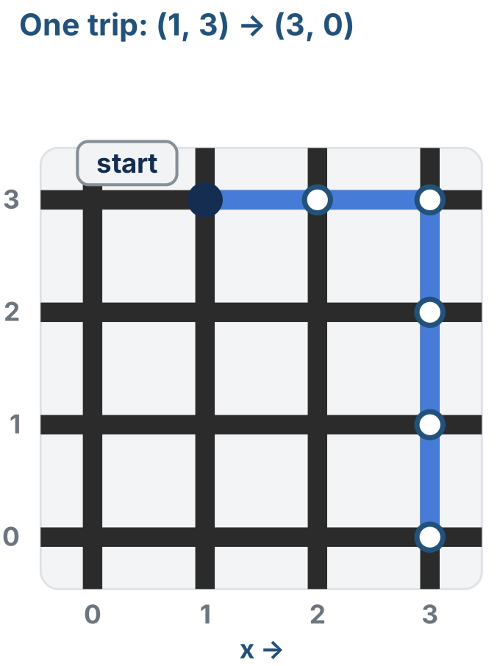
The strategy: across first, then up or down
The simplest strategy that always works:
Move across until x is right
Then move up or down until y is right
That always traces an L-shaped path
Or a straight line, if x or y is already correct
Notes:
The figure is the right half of the lesson's four-loops figure: the trip from (1, 3) to (3, 0), across two, then down three. The whole figure comes back in Step 2.

Slide 5
Check your understanding
Why can't the robot use a straight diagonal to shorten the trip?
A. Diagonals are slower than straight lines
B. The robot follows grid lines, so it can only move along rows and columns
C. The grid is too small
D. It can: the Manhattan algorithm just chooses not to
Notes:
Answer: B. Like walking Manhattan's streets, the robot can't cut through the middle of a block, only along the lines. That is why the distance is steps across + steps up or down.

Slide 6
Answer
Why can't the robot use a straight diagonal to shorten the trip?
A. Diagonals are slower than straight lines
B. The robot follows grid lines, so it can only move along rows and columns
C. The grid is too small
D. It can: the Manhattan algorithm just chooses not to
Like walking Manhattan's streets, the robot can't cut through the middle of a block, only along the lines. That is why the distance is steps across + steps up or down.

Slide 7
Activity · Trace it on paper first
Activity
Take (0, 0) → (2, 3): right first, then up. The robot is already at the start, so the path lists only the spots it moves to. Fill in a row per move.
Step | Action | New position | Path so far
1 | x +1 | (1, 0) | [(1,0)]
2
3
4
5
Notes:
Hand out a big grid and markers: one color for moves across, another for moves up and down. Keep it short and targeted; the goal is intuition, not mastery. Then ask how many steps it took, and check that against the Manhattan distance, |2−0| + |3−0|. The finished table is behind a reveal on the lesson page.

Slide 8
Now try the same spot
Trace (1, 1) → (1, 1)
No moves across, no moves up or down
The path is []: an empty list, zero steps
That's not a bug: the robot is already there

Slide 9
Check your understanding
Hand-tracing (2,0) → (2,3), what path do you get?
A. [(2,0), (2,1), (2,2), (2,3)]
B. [(2,1), (2,2), (2,3)]
C. [(2,3)]
D. []
Notes:
Answer: B. Same x, so no moves across, only three moves up. The start (2,0) is not included, so the path is [(2,1), (2,2), (2,3)]: three steps.

Slide 10
Answer
Hand-tracing (2,0) → (2,3), what path do you get?
A. [(2,0), (2,1), (2,2), (2,3)]
B. [(2,1), (2,2), (2,3)]
C. [(2,3)]
D. []
Same x, so no moves across, only three moves up. The start (2,0) is not included, so the path is [(2,1), (2,2), (2,3)]: three steps.

Slide 11
Add to robot.py: MANHATTAN PLANNER
# ===== MANHATTAN PLANNER =====
# Plans a route across the grid: given where the robot is and
# where it should go, returns the list of (x, y) tuples to
# drive to, across first and then up or down. Pure arithmetic --
# nothing in here touches a sensor or a motor, so every test
# in this section runs on screen with the robot sitting still.
def compute_path(start, end):
"""Return the (x, y) steps from start to end, across
first, then up or down. The start itself is not in the list."""
# 1. path = [] ; unpack start and end into x and y numbers
# 2. east loop: while x is short of the end x,
# step x by one and append the new position
# 3. north loop: the same for y
# 4. return path
pass
Notes:
Paste it into robot.py above RUN, after the GRID DRIVING section. It is the first section in the file with no driving in it at all: a function that takes two tuples and returns a list.

Slide 12
Two things are new about this skeleton
The outline is shorter than Module 2's
You just traced the algorithm by hand, so the comments name the pieces instead of spelling them out
There is no test function in it
From this module on, the lesson says what a test should show, and you write it, name and all
These are paper tests: they print a path, you compare it with your trace, nothing moves
Notes:
The hint level drops again here. The outline names the pieces (unpack, two loops, return) because the trace table just did the algorithm by hand. Expect two or three print lines per test; the habit is what matters, because every planner test from here to Module 6 is written this way. Students who want the Module 2 scaffolding back can be pointed at their own trace table: it is the outline.

Slide 13
Step 1 · East and north only
Activity
Start with just the two "positive" directions, right and up: steps 1 to 4 of the outline. Step 1 uses tuple unpacking from Lesson 4-2: one line pulls both numbers out of a tuple into two variables.
x, y = start # start is (0, 0): x is 0, y is 0
Do the same for end, and the loops compare plain numbers
Notes:
Build it in two stages: get the easy half working and run it before you generalize. A half-finished algorithm you have tested beats a whole one you haven't. Check that tuple unpacking from 4-2 stuck.

Slide 14
Step 1 · The two loops
Activity
Each loop is the build-in-a-loop pattern from Lesson 4-3, with a while instead of a for
As long as x is still short of the destination x, step it by one and append the new (x, y)
The north loop does the same for y
The double parentheses in append((...)): the outer pair is the function call, the inner pair is the tuple
Notes:
Take real time on the double parentheses in append((x, y)): the outer pair is the function call, the inner pair is the tuple.

Slide 15
Step 1 · Test it against your trace
Activity
Write a test, say test_paper_paths(), that prints compute_path((0, 0), (2, 3)) and compute_path((0, 1), (3, 3))
1
Set the run line to it and run it
2
Compare with your paper traces: both should give exactly the hand-traced lists, 5 steps each
3
Don't go on until they match

Slide 16
Now find the limit
Add compute_path((3, 3), (1, 0)) to the test and run it again
An empty list!
3 < 1 is False and 3 < 0 is False, so neither loop runs
Going left or down, this version does nothing
We need west and south too

Slide 17
Check your understanding
Why does the stage-1 function return [] for (3,3) → (1,0)?
A. append() is broken
B. Both while conditions start False (3 is not < 1, 3 is not < 0), so neither loop runs
C. The start and end are the same
D. It runs forever
Notes:
Answer: B. Stage 1 only handles increasing x and y. Moving left or down needs the two decreasing loops we add next.

Slide 18
Answer
Why does the stage-1 function return [] for (3,3) → (1,0)?
A. append() is broken
B. Both while conditions start False (3 is not < 1, 3 is not < 0), so neither loop runs
C. The start and end are the same
D. It runs forever
Stage 1 only handles increasing x and y. Moving left or down needs the two decreasing loops we add next.

Slide 19
Step 2 · All four directions
Activity
The fix: add two more while loops, west (x decreases) and south (y decreases)
Each is the mirror of the loop it sits next to: the comparison flips and the step goes the other way
No if/else needed: for any trip, at most one x loop and one y loop run
Keep the two x loops together, before the two y loops, so the path always goes across first
Notes:
This is the lesson's big idea: a while loop whose condition starts False simply does nothing. Students who have seen conditionals will try to wrap this in if x < dest_x ... elif x > dest_x. Steer them back: the four loops are simpler and handle every case, including the same position (all four skipped, so []).

Slide 20
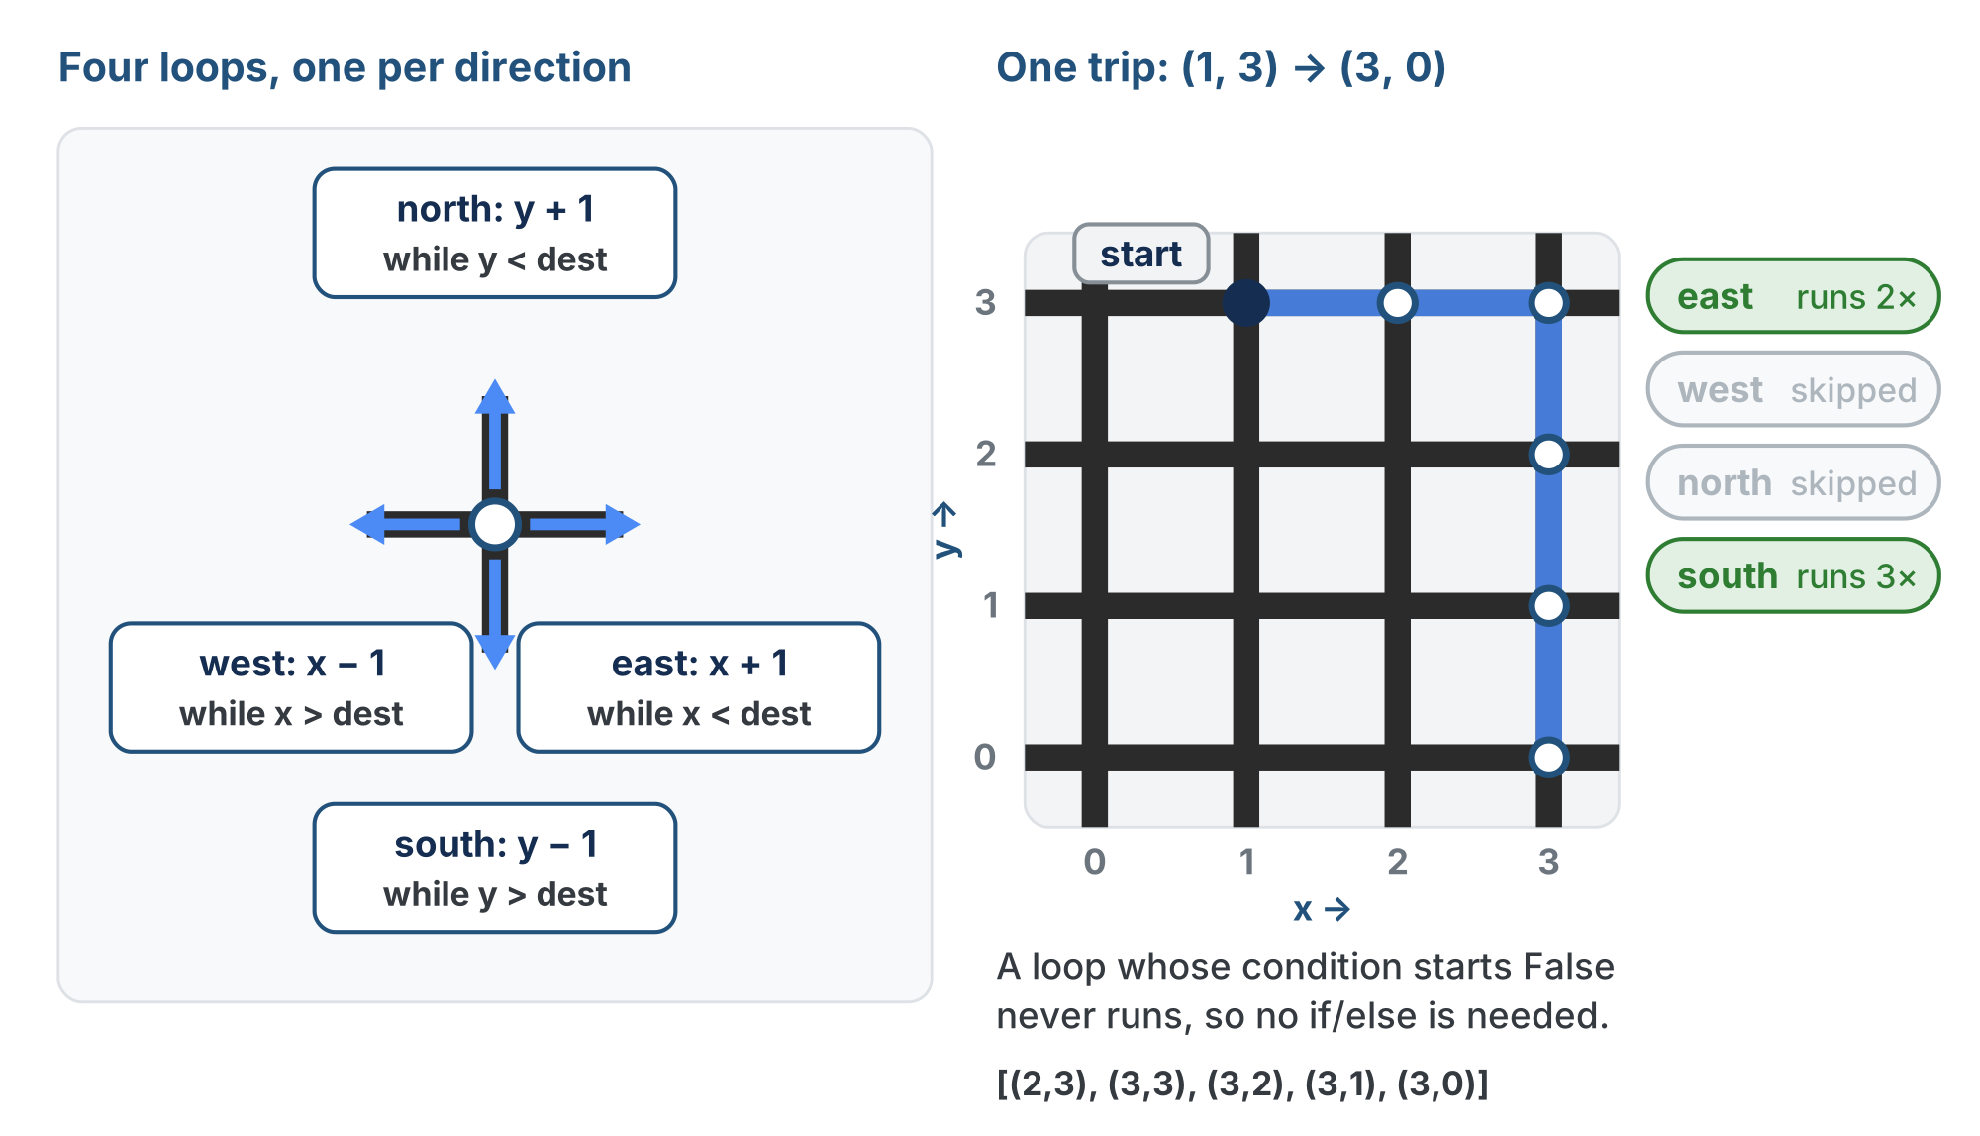
Four loops, one per direction
Every trip runs at most one x loop and one y loop. The other two find their condition False on the first check and never run.
Notes:
Walk the right half: (1, 3) to (3, 0). East runs twice, west and north are skipped, south runs three times. Five steps, matching |3−1| + |0−3|.

Slide 21
Step 2 · Trace it, then run it
Activity
Trace (3, 3) → (1, 0) on paper
1
Say which of the four loops run: the robot has to go left and down, so two of them stay idle
2
Run test_paper_paths() again and compare with your trace
3
Notes:
The finished trace is behind a reveal on the lesson page. The page also has an animation of the four loops running three trips, in a reveal for students whose tests already match; it is not on these slides because it shows the traced answers.

Slide 22
Check your understanding
For a trip that goes up and to the right, how many of the four while loops actually run?
A. All four
B. Two: the north loop and the east loop
C. Just one
D. None: it needs if/else
Notes:
Answer: B. At most one x loop (east OR west) and one y loop (north OR south) run for any trip. Up-and-right means north + east; the other two are skipped.

Slide 23
Answer
For a trip that goes up and to the right, how many of the four while loops actually run?
A. All four
B. Two: the north loop and the east loop
C. Just one
D. None: it needs if/else
At most one x loop (east OR west) and one y loop (north OR south) run for any trip. Up-and-right means north + east; the other two are skipped.

Slide 24
Activity · The edge cases
Activity
Good algorithms handle the awkward inputs without special code. Write a second test, test_edge_cases(), with three calls:
Same column: (2, 0) to (2, 3)
1
Same row: (0, 2) to (3, 2)
2
Same spot: (1, 1) to (1, 1)
3
Trace all three on paper and write your prediction as a comment next to each call before you set the run line to it
Notes:
The predicted outputs, and a finished compute_path(), are in reveals on the lesson page. Nothing special is written for these cases: the loops just don't run when there is no distance to cover.

Slide 25
Check your understanding
What does compute_path((2, 2), (2, 2)) return, and why?
A. [(2, 2)]: the current position
B. []: all four loop conditions are False, so nothing is appended
C. An error
D. 0
Notes:
Answer: B. Start equals destination, so every while condition is False from the start. No loop runs, the path stays empty, and len(path) is 0: the robot is already there.

Slide 26
Answer
What does compute_path((2, 2), (2, 2)) return, and why?
A. [(2, 2)]: the current position
B. []: all four loop conditions are False, so nothing is appended
C. An error
D. 0
Start equals destination, so every while condition is False from the start. No loop runs, the path stays empty, and len(path) is 0: the robot is already there.

Slide 27
Real-world connections
GAMES
AI
DATA
Grid movement
Pathfinding heuristics
Clustering
Turn-based and tile games measure moves in Manhattan steps: no diagonal shortcuts.
Manhattan distance is a classic "how far, roughly?" estimate that guides search algorithms like A*.
Some machine-learning methods group points by Manhattan (taxicab) distance instead of straight-line distance.
Notes:
"Move one axis, then the other" and Manhattan distance show up all over computing.

Slide 28
Wrap-up
What does "across first, then up or down" produce?
Why four while loops instead of if/else?
Why isn't the starting position in the path?
Next: the same function gets its real name, and a written promise
Notes:
Answers: an L-shaped path, predictable and always valid. Only the relevant loops run; a False condition just skips. The robot is already there, so len(path) is the number of steps. Exit ticket: "What does compute_path((0,0),(2,3)) return, and how many steps is that?" ([(1,0),(2,0),(2,1),(2,2),(2,3)], 5). Next lesson the function becomes compute_manhattan_path(position, destination), with a docstring; the algorithm does not change at all.

