Slide 1

MODULE 1 · LESSON 1-0
What Is a Robot?
By the end of this lesson you can
Argue whether a given device is or isn't a robot, and say why
Work out, from the examples, what every robot has to be able to do, and state it as a short definition
Explain why the classic "mechanical arm" definition isn't enough anymore
Describe how the XRP, and this course, fits that definition
Notes:
30 to 40 minutes, a kickoff discussion with no coding. The lesson page holds the talking points and the "answers" in teacher boxes; these notes carry the short version. Rough budget: 15 minutes for the gallery, 10 for the definition, 5 to 10 for the wrap-up.

Slide 2
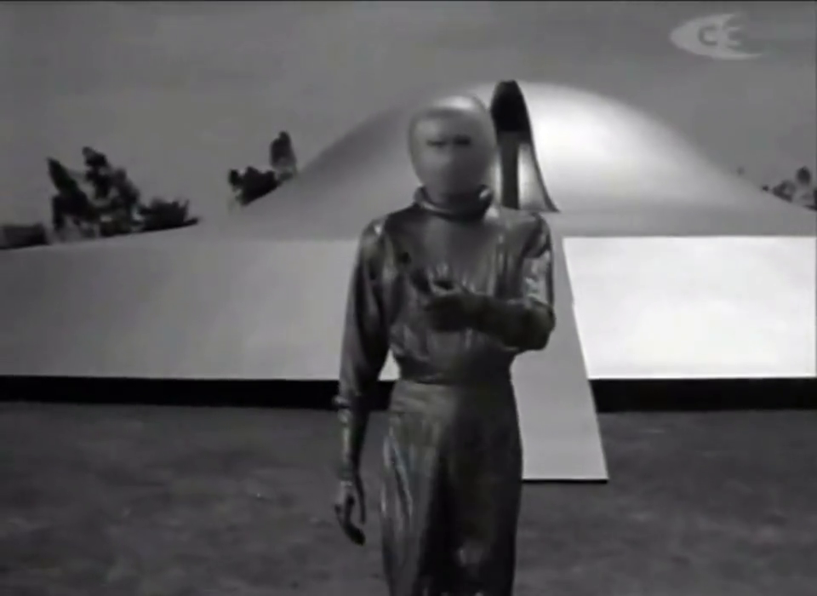
It used to be easy to tell
Gort, from The Day the Earth Stood Still (1951): the robot everyone recognizes. Today the line is a lot blurrier.
Notes:
For most of the last century a robot was easy to spot: a metal figure with a visor, walking stiffly out of a flying saucer. Nobody argued about whether that was a robot. The clip plays from the slide.

Slide 3
Where do you draw the line?
The machines around us are smarter now, and much less obvious.
Is the thing in your pocket a robot?
The car in the driveway?
The washing machine?
You'll look at eight machines and argue it out until a definition emerges
Notes:
This is a discussion, not a lecture: do not reveal answers as you go, the value is in the disagreement. A format that works: show one device at a time, have students vote with their feet (robot on one side, not a robot on the other, not sure in the middle), then ask someone from each side to defend it. Keep a running list of their reasons on the board. Listen for, and amplify, sensors and acting on what was sensed, but do not name those traits for them. Keep asking "what's your reason?"

Slide 4
Activity · Is this a robot?
Activity
You're about to see eight devices. For each one, before the class discusses it:
Decide: robot or not a robot. You have to pick: no "not sure."
1
Say why. One sentence: what is it about this device that makes it a robot, or keeps it from being one?
2
Record your answer in the box under the picture, or on paper. You'll look back over all eight at the end.
3
Most prompts ask the same thing: what happens if the person walks away?
Notes:
The Yes/No buttons and the Why? line under each picture on the lesson page are live: type the class consensus there on the projector so nobody has to scroll back.

Slide 5
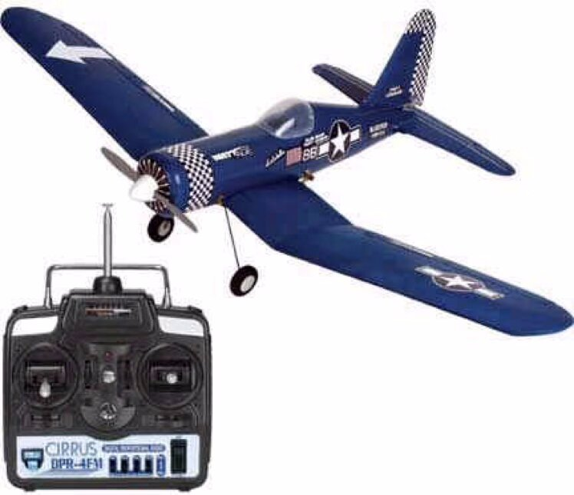
A radio-controlled airplane
Device 1 of 8
It flies. It has motors. Somebody's holding a controller. Robot? Think about it: If the pilot sets the controller down, what does the plane do next?
Notes:
Most say not a robot, and the reason is the key one: a person does all the deciding. The plane senses nothing and decides nothing; the pilot's eyes and hands do. Push back gently: "It has motors and it moves. Isn't that enough?" You want them to say that moving isn't the test.

Slide 6
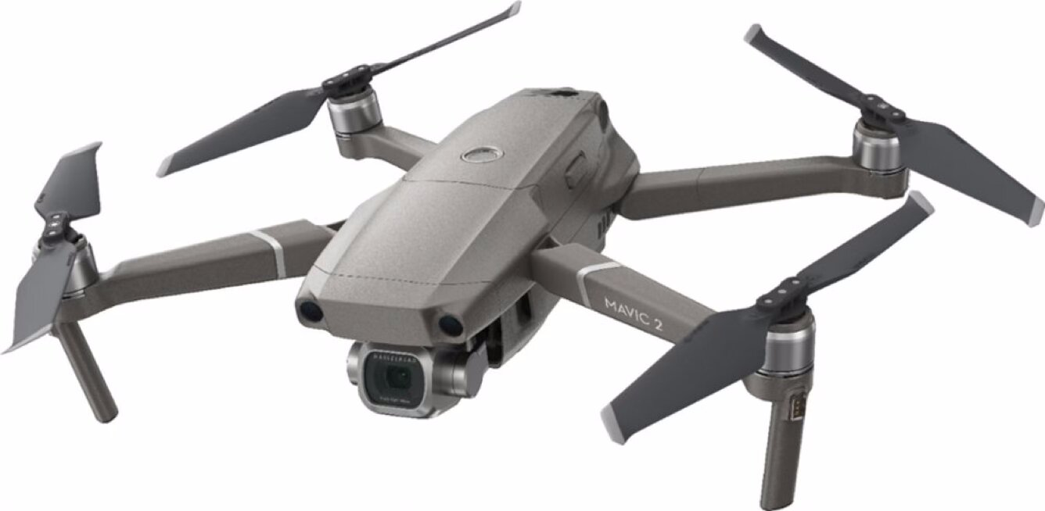
A camera drone
Device 2 of 8
Also flies, also has a controller in the box. Same answer as the airplane? Think about it: If the pilot lets go of the sticks, what happens? If your answer is different from the airplane's, what makes the difference?
Notes:
The pair to the airplane, and where the room starts to split. A camera drone has GPS, obstacle sensors and a computer that holds it level, stops it hitting a wall and flies it home on low battery, even with a human nominally in control. Ask: "What can the drone do that the airplane can't?" It senses and makes some decisions itself.

Slide 7
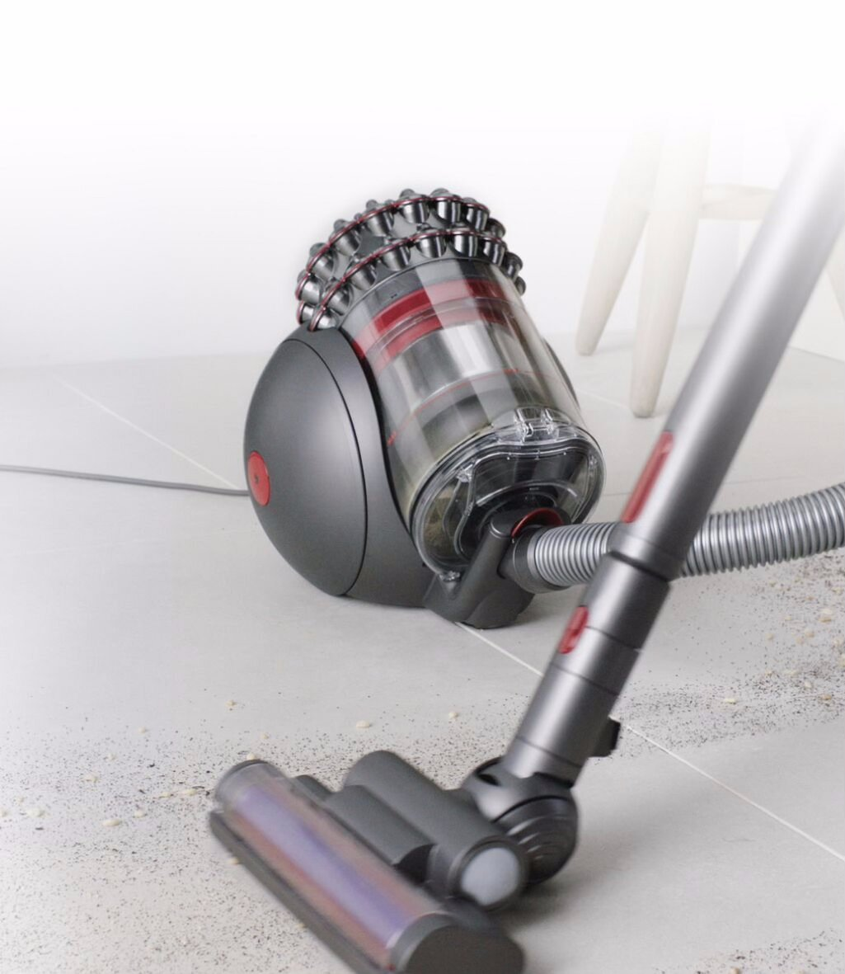
A vacuum cleaner
Device 3 of 8
Powerful motor, does a useful job. Robot? Think about it: Who steers it? If you walk away in the middle of cleaning, what happens?
Notes:
An easy no, for the same reason as the airplane: a person pushes it everywhere. A motor and a job, but no sensing and no deciding. Keep it quick; it sets up the next one.

Slide 8
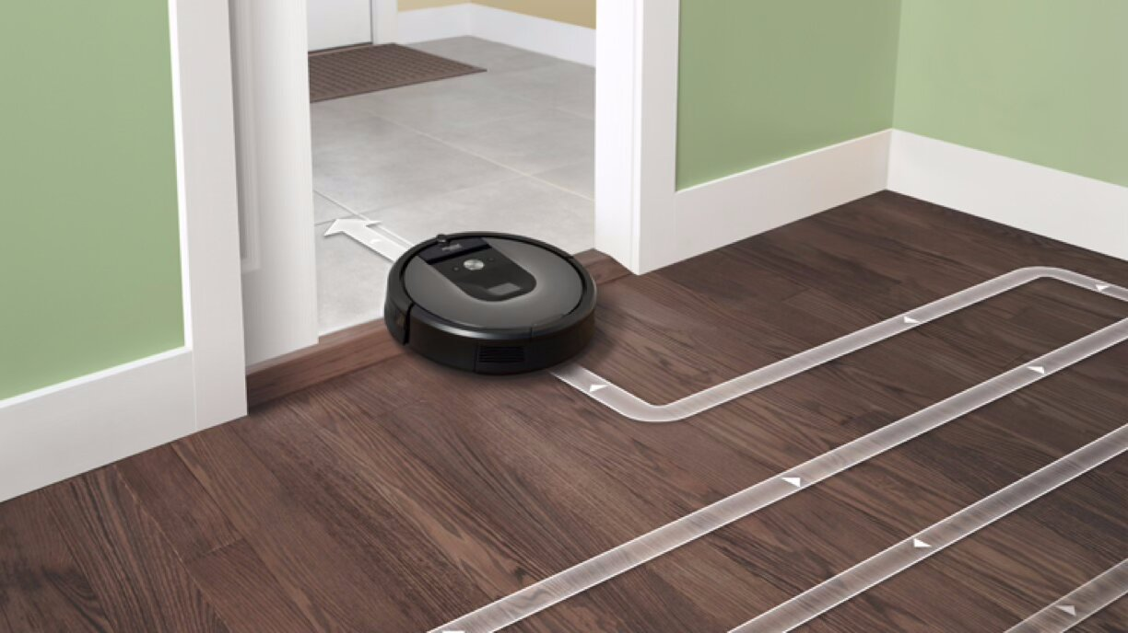
A vacuum that drives itself
Device 4 of 8
Same job as the vacuum before. Different answer? Think about it: What's different about how it does the job? What happens if you walk away?
Notes:
Nearly everyone says yes; it is even called a robot vacuum. Make them prove it. What does it sense (bumper, cliff sensors, dirt detection)? What does it decide (turn when it hits something, go back to the dock)? What does it do (drive, vacuum)? Put sense, decide and do on the board: they are about to become the definition.

Slide 9
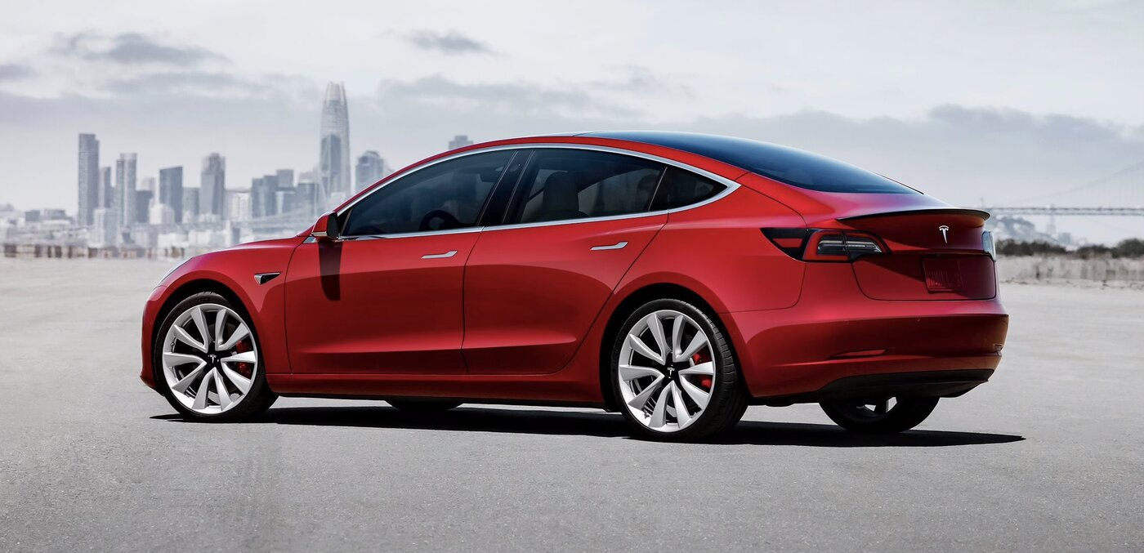
A car
Device 5 of 8
A car. Is a car a robot? Think about it: Answer once with a person driving, then again with the car in self-driving mode. Did your answer change? If so, what changed about the car?
Notes:
Expect a real split, and let it run. With a person driving, most say no. On driver assist or self-driving, cameras sense the road, a computer decides to brake or steer, and it steers: most say yes. The same machine can be a robot or not depending on what is doing the thinking. Celebrate a student who gets there alone.

Slide 10
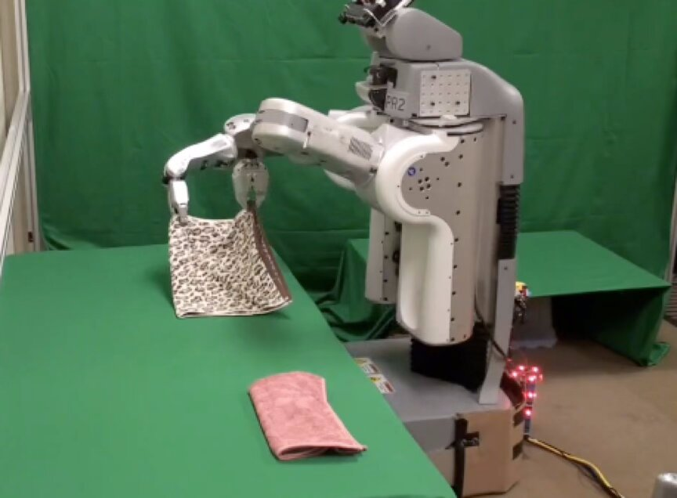
A laundry-folding machine
Device 6 of 8
A research robot folding laundry. Think about it: Most people say yes right away, so say precisely what makes it one. What would it have to know about the towel in order to fold it?
Notes:
An easy yes, and a chance to name why it is hard: it has to sense where the cloth is, work out how to grab it, and move its arms precisely. A task trivial for a person is a research problem for a robot, which students will feel in Module 2 when line following turns out harder than it looks.

Slide 11
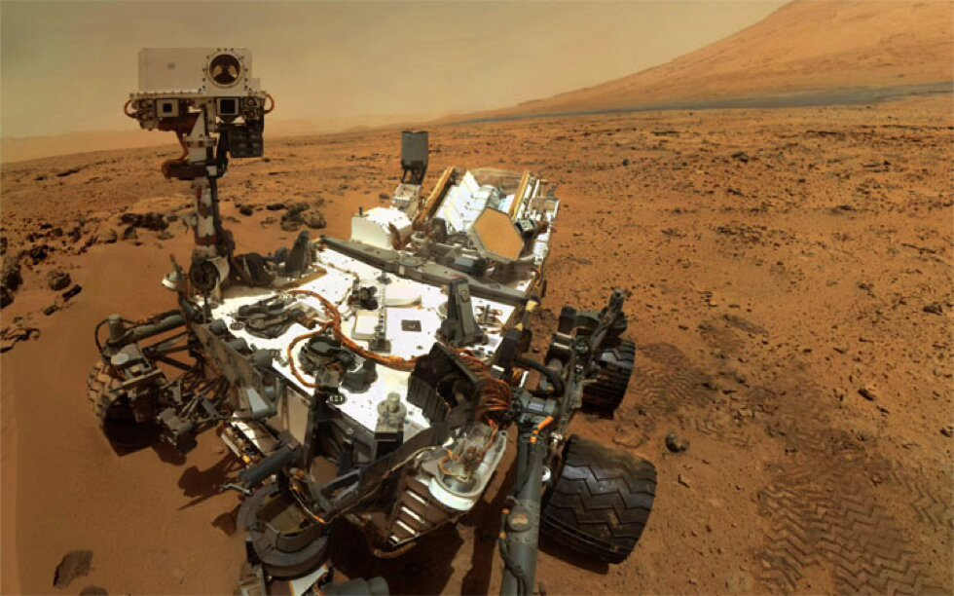
A Mars rover
Device 7 of 8
A rover on Mars, hundreds of millions of km away. Think about it: A radio signal takes minutes each way. How does that change how it's driven? Compare the RC airplane.
Notes:
Yes, and the twist is worth stating: with minutes of delay each way, nobody can drive it with a joystick. It has to look at the ground, decide whether a rock is safe, and drive around it by itself. Ask: "Why couldn't NASA just remote-control it like the airplane?" Distance forces autonomy.

Slide 12
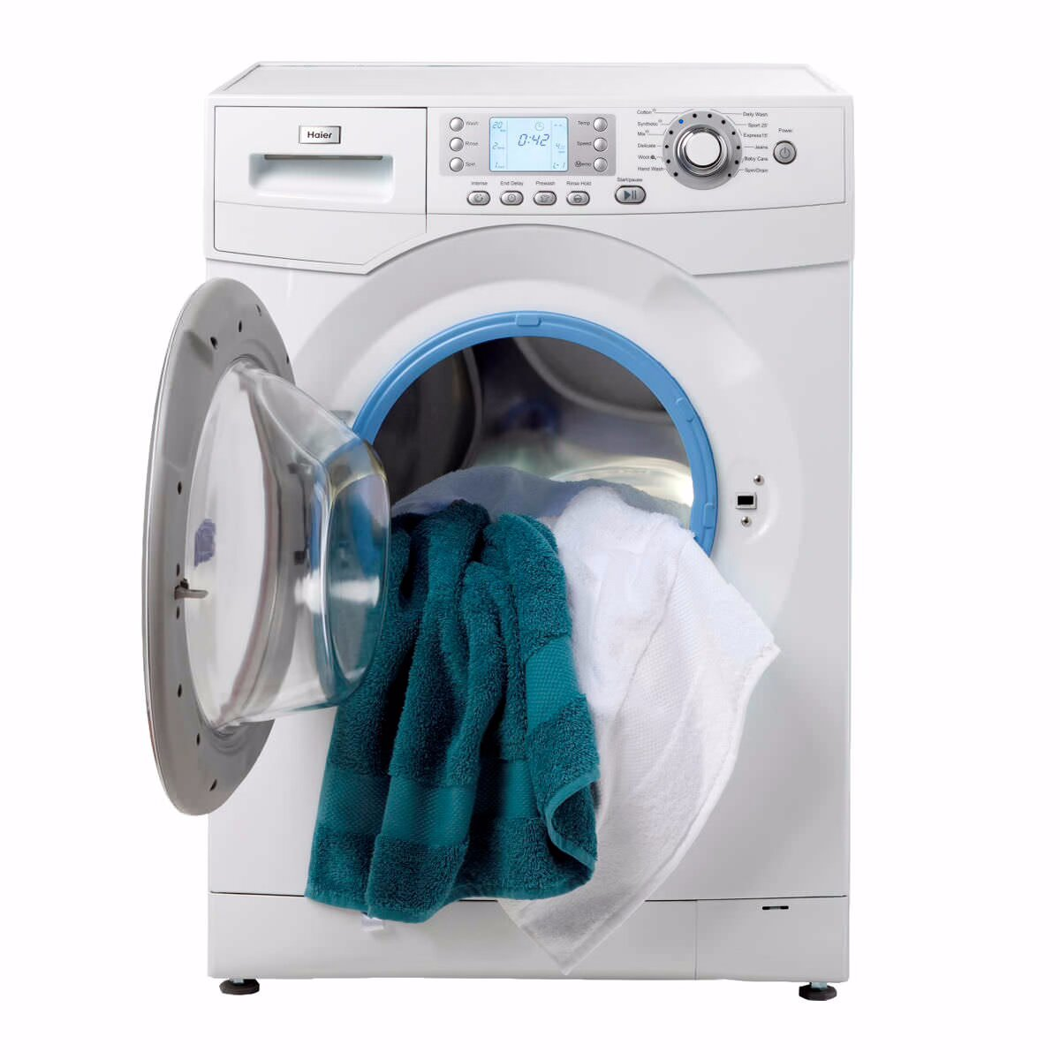
A washing machine
Device 8 of 8
A washing machine. Think carefully before you answer. Think about it: Press start and walk away. What does it do on its own? Look at what you wrote for the vacuum that drives itself. Are you being consistent?
Notes:
Save this one for last: it breaks the room. Students say "obviously not" until someone points out it senses the load and water level, decides when to spin and how long to rinse, and acts, all without a person after the button press. Don't resolve it. "Robot" is a spectrum, not a switch: simple and fixed here, rich and adaptable in a rover.

Slide 13
Look back over your eight answers
What do your yes reasons have in common?
What do your no reasons have in common?
Try to write the rule in one sentence
A device is a robot if it ______.
Notes:
Harvest the board into the definition. Group the class's words into sense, think and act: you are naming the definition they built, not handing one over. The punchline: every device on the list moves or acts, so acting can't be the test; the robots sense something and act on what they sensed. If a student says "it's not about moving, it's about sensing and deciding," write it on the board in their words.

Slide 14
So what is a robot? The 1979 answer
The Robot Institute of America, 1979: "a reprogrammable, multifunctional manipulator designed to move material, parts, tools, or specialized devices through various programmed motions for the performance of a variety of tasks."
In plain English: a programmable mechanical arm that does factory work: assembly, welding, painting
The classic jobs are the three Ds: work that is dirty, dull, or dangerous for people
Check it against the eight: a Mars rover isn't a "manipulator," and neither is a drone or a robot vacuum. Too narrow.

Slide 15
Check your understanding
Which device from the lineup does the 1979 "reprogrammable manipulator" definition clearly leave out, even though almost everyone agrees it's a robot?
A. The towel-folding robot: it has arms
B. The Mars rover: it drives and explores, but it isn't a manipulator arm
C. The RC airplane
D. The canister vacuum
Notes:
Answer: B. The 1979 definition describes a factory arm. A rover, a drone, or a robot vacuum has no manipulator at all, yet they're clearly robots. That's why we need a better definition.

Slide 16
Answer
Which device from the lineup does the 1979 "reprogrammable manipulator" definition clearly leave out, even though almost everyone agrees it's a robot?
A. The towel-folding robot: it has arms
B. The Mars rover: it drives and explores, but it isn't a manipulator arm
C. The RC airplane
D. The canister vacuum
The 1979 definition describes a factory arm. A rover, a drone, or a robot vacuum has no manipulator at all, yet they're clearly robots. That's why we need a better definition.

Slide 17
Try again: sense, think, act
1 · SENSE
2 · THINK
3 · ACT
Take in the world
Decide
Change the world
Cameras, bump sensors, distance sensors, GPS, light sensors: some way of finding out what's out there.
A program that turns sensor readings into a choice: turn left, stop, go home, grab here.
Motors, wheels, arms, propellers: something that carries the decision out physically.
Notes:
These three traits come from the robotics engineering program at WPI. A robot must sense (take in information with some kind of sensor), think (process what it sensed and decide), and act (do something in the world based on that decision). Point back at the class's own words on the board.

Slide 18
Miss one, and it's something else
A machine that only acts is a tool: the vacuum cleaner
A machine where a person does the sensing and thinking is remote-controlled: the airplane
A robot must sense, think, and act

Slide 19
Check your understanding
Using sense, think, act, why isn't the RC airplane a robot?
A. It can't fly high enough
B. The human does the sensing and thinking; the plane only acts
C. It has no motor
D. It isn't reprogrammable
Notes:
Answer: B. The plane acts (motor, control surfaces), but all the sensing (the pilot's eyes) and deciding (the pilot's hands) happen in a person. Two of the three traits are missing from the machine itself.

Slide 20
Answer
Using sense, think, act, why isn't the RC airplane a robot?
A. It can't fly high enough
B. The human does the sensing and thinking; the plane only acts
C. It has no motor
D. It isn't reprogrammable
The plane acts (motor, control surfaces), but all the sensing (the pilot's eyes) and deciding (the pilot's hands) happen in a person. Two of the three traits are missing from the machine itself.

Slide 21
Check your understanding
Why can't NASA fly a Mars rover the way you'd fly the RC airplane?
A. Mars has no radio
B. The radio delay is minutes each way, so the rover must sense and decide for itself
C. Rovers have no motors
D. It could; they just prefer not to
Notes:
Answer: B. A command takes minutes to arrive and the reply takes minutes to come back. By then the rover could have driven off a ledge. Distance forces it to do its own sensing and thinking.

Slide 22
Answer
Why can't NASA fly a Mars rover the way you'd fly the RC airplane?
A. Mars has no radio
B. The radio delay is minutes each way, so the rover must sense and decide for itself
C. Rovers have no motors
D. It could; they just prefer not to
A command takes minutes to arrive and the reply takes minutes to come back. By then the rover could have driven off a ledge. Distance forces it to do its own sensing and thinking.

Slide 23
Check your understanding
A washing machine senses the load, follows cycle logic, and spins on its own. Under sense, think, act, what's the honest answer?
A. Definitely not a robot: it doesn't move around
B. All three, in a simple, fixed way: the low end of a robot spectrum, and arguing is the point
C. Definitely a robot, exactly like a Mars rover
D. It fails because it has no sensors
Notes:
Answer: B. The spectrum idea (washing machine at one end, rover at the other) is the most important nuance here. It heads off the "is it or isn't it" dead end, and it sets up the idea that this course moves the XRP along that spectrum.

Slide 24
Answer
A washing machine senses the load, follows cycle logic, and spins on its own. Under sense, think, act, what's the honest answer?
A. Definitely not a robot: it doesn't move around
B. All three, in a simple, fixed way: the low end of a robot spectrum, and arguing is the point
C. Definitely a robot, exactly like a Mars rover
D. It fails because it has no sensors
By the letter of the definition it qualifies, just barely: simple sensing, fixed logic, one kind of action. A good definition makes the disagreement precise; it doesn't always make it go away.
Notes:
Answer: B. The spectrum idea (washing machine at one end, rover at the other) is the most important nuance here. It heads off the "is it or isn't it" dead end, and it sets up the idea that this course moves the XRP along that spectrum.

Slide 25
Why robots?
Robots combine many ideas at once
A competition robot built by high-school students senses where the balls and the goal are with a camera, thinks with trigonometry to aim, and acts: it drives into position and shoots
A climbing robot needs torque, gear ratios and speed calculations just to get off the ground
Robotics is where math, physics, and programming stop being separate subjects

Slide 26
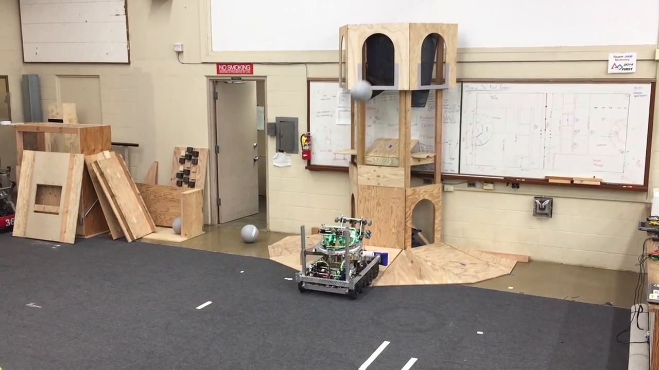
Sense, think, act in competition
A FIRST competition robot built by high-school students: it senses the balls and goal with a camera, aims with trigonometry, and shoots.
Notes:
While it plays, ask the class to call out each part as they see it: what is it sensing, what is it deciding, what is it doing?

Slide 27
The robot on your desk
SENSE
THINK
ACT
The XRP's senses
The XRP's brain
The XRP's muscles
Reflectance sensors that see light vs. dark, an ultrasonic rangefinder that measures distance, and encoders that count how far each wheel has turned.
The controller board runs your program. Every decision it makes is one you wrote: in Blockly first, then in Python.
Two motors, one per wheel. That's enough to drive straight, turn, curve, and spin.
Notes:
Hold up an XRP and point at each part as you read the card.

Slide 28
The shape of this course
Module 1: mostly act: driving, turning, drawing shapes
Module 2: add sensing, so it can follow a line and react to what it sees
Modules 4 and 5: the thinking gets serious: your robot plans its own route across a grid and re-plans around obstacles it discovers
By the end, the XRP does all three: a robot by anyone's definition
Not a toy: the same robot is used in a college sophomore programming course. The tools you learn here are the real ones.

Slide 29
Check your understanding
Which of the three traits will you spend most of Module 1 on?
A. Sense: reading sensors
B. Act: making the robot drive, turn, and draw shapes
C. Think: pathfinding algorithms
D. None: Module 1 is all theory
Notes:
Answer: B. Module 1 is about controlling the motors: driving, turning, shapes. Sensing arrives in Module 2, and the heavy thinking (pathfinding) in Modules 4 and 5.

Slide 30
Answer
Which of the three traits will you spend most of Module 1 on?
A. Sense: reading sensors
B. Act: making the robot drive, turn, and draw shapes
C. Think: pathfinding algorithms
D. None: Module 1 is all theory
Module 1 is about controlling the motors: driving, turning, shapes. Sensing arrives in Module 2, and the heavy thinking (pathfinding) in Modules 4 and 5.

Slide 31
Real-world connections: the three Ds
DIRTY
DULL
DANGEROUS
Sewers & disaster sites
Warehouses & factories
Bombs, reactors, deep space
Inspection robots crawl pipes and rubble where people can't or shouldn't go.
Robots move shelves, weld seams, and paint car bodies, thousands of identical times a day.
Bomb-disposal robots, nuclear-plant inspectors, and rovers do the jobs where a mistake costs a life.
Notes:
Robots earn their keep on work that is dirty, dull, or dangerous for people.

Slide 32
Wrap-up
What three things must a robot do?
Why isn't a remote-controlled plane a robot?
Name a device at home and argue whether it's a robot, using all three traits.
Next: meet the XRP: its parts, XRP Code, and your first program
Notes:
Answers: sense, think, act. The person does the sensing and thinking. Formative check: can students give a reason, not just a vote, for each device, and map it onto sense, think, act? Exit ticket: "Pick any device in your house. Is it a robot? Defend your answer using all three traits." Look for the spectrum idea: "it senses and acts but doesn't really decide anything."

