Slide 1

MODULE 1 · LESSON 1-3
Introduction to Functions
By the end of this lesson you can
Explain what a function is: a named, reusable block of code
Define a function with the to do something block, and say why the return version is not the one you want here
Call your function from the main program
Recognize when a function will make your code shorter and easier to change
Notes:
50 to 60 minutes, still in Blockly. The big idea is reuse: write the square code once, give it a name, use it as many times as you like. The whole lesson hangs on keeping define and call apart.

Slide 2
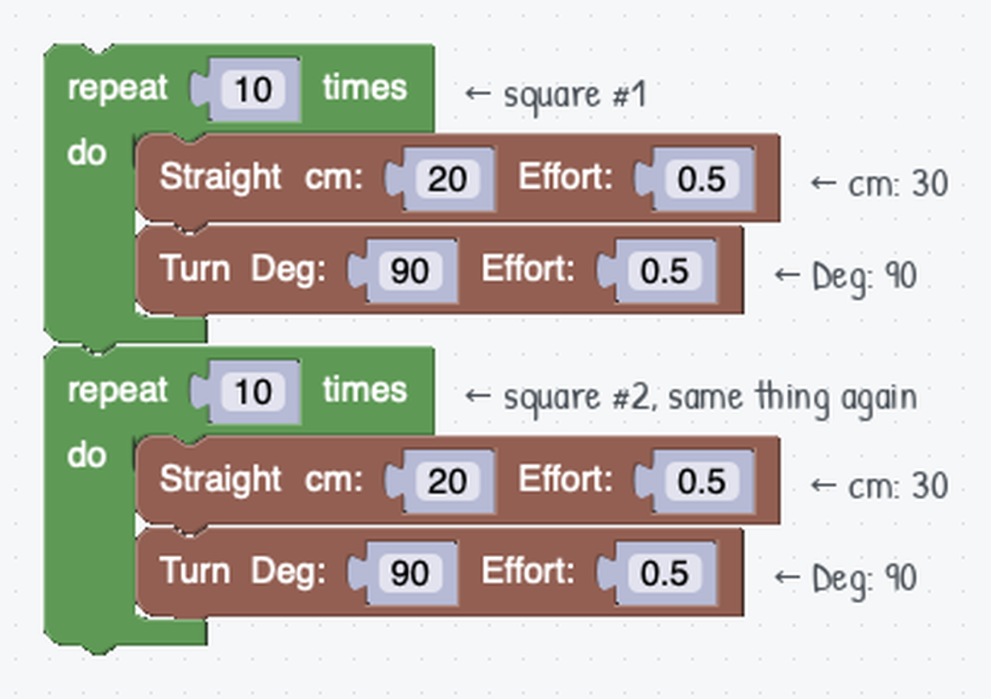
The copy-paste problem
Your square program works. But what if you want three squares?
Copying the whole loop again and again gets long and messy fast
Want bigger squares? Change the number in every copy, and hope you don't miss one
Repetition like this is a signal you want a function
Notes:
Hook: put the copy-pasted version on the board and ask "what's annoying about this?" Students land on "it's long" and "it's hard to change" on their own, and that felt need is why functions exist. Recipe-card analogy: write the recipe once, cook from it as many times as you want.

Slide 3
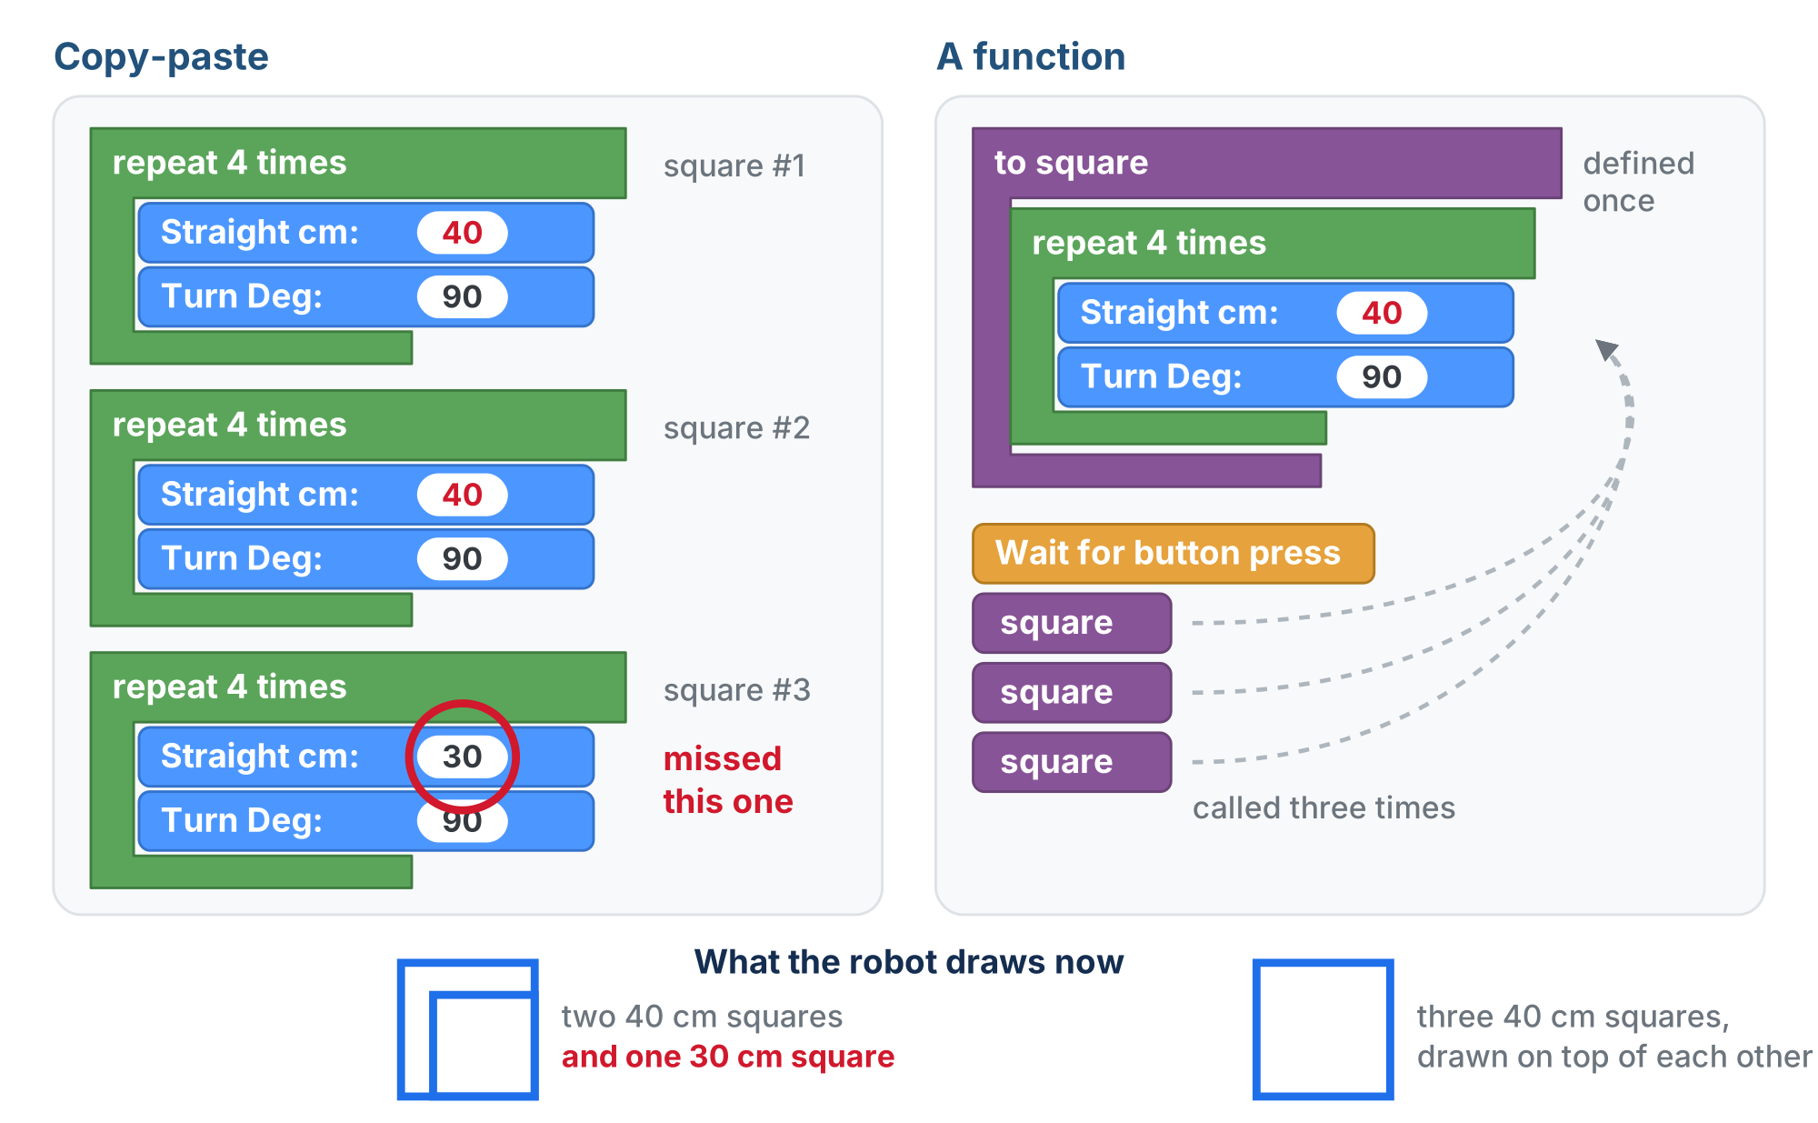
One change of plan, two programs
Make the squares 40 cm. In the copy-paste version every copy has to be found and fixed. In the function version there is only one place to look.
Notes:
On the lesson page this is an animation. It opens with both programs drawing three 30 cm squares. Then the plan changes to 40 cm: on the left the 30 is changed in the first and second loops and the third is missed; on the right it is changed once, in the definition, and all three calls pick it up. The slide shows the end. Ask what each robot draws now before pointing at the bottom row.

Slide 4
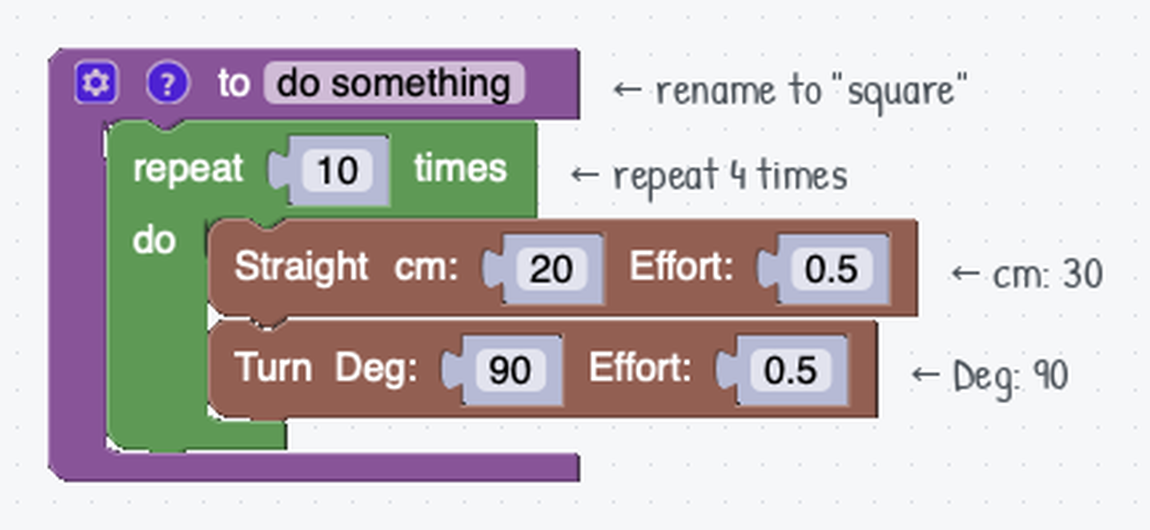
Define once, call many times
A function has two parts. Keeping them straight is the whole lesson.
Define: where you write what the function does
The to do something block: rename it to square, drop your Repeat loop inside
Call: where you use it
A new square block appears in the Functions palette. Drag it into your main program wherever you want a square
The definition: the square loop now lives inside a function named square
Notes:
Recipe card again: the definition is writing the recipe card, the call is cooking from it. Writing the card does not make dinner.

Slide 5
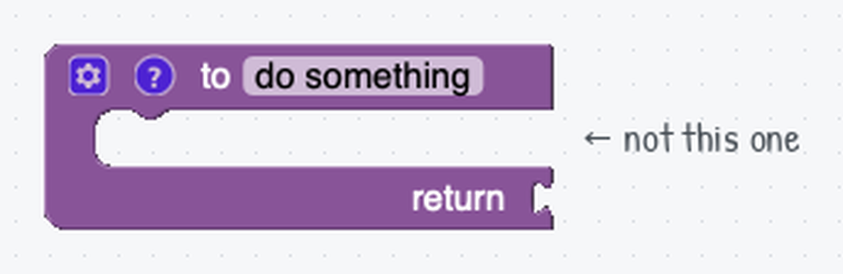
Two function blocks: take the first one
The Functions category has two definition blocks that look almost the same
Take the one that says to do something and nothing else
The other has a return socket on its bottom row. Leave it alone for this whole module
Its call block is rounded: it stands for a value, not an action
It only fits a slot where a number or a word belongs, like the cm box on Straight
Call block rounded and won't click into place? Delete it and rebuild with the plain block
You'll use return in Lesson 1-11. square drives the robot: there's nothing to hand back, so no return.
Notes:
Name the two blocks out loud when you demo. A handful of students grab the return version every year. Everything looks fine until the call block comes out rounded and won't connect, and they assume they broke something. The blocks inside can be dragged out and reused, so rebuilding is quick.

Slide 6
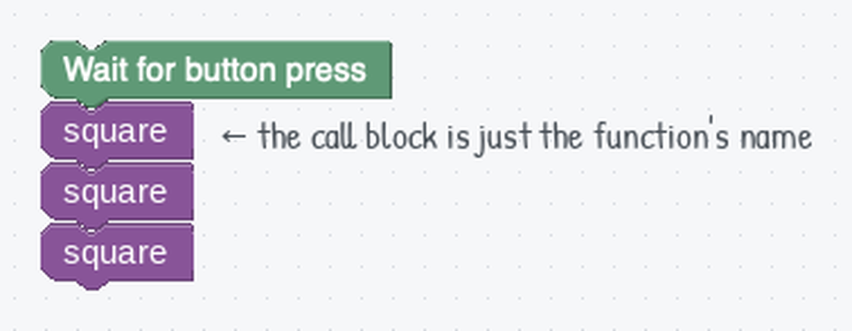
The main program gets short
Wait for the button, then call square as many times as you want
The call block carries no extra wording: it's labeled square, the name you gave it
Your own functions sit in the palette alongside the built-in ones
Everything about how a square gets drawn lives in the definition. The main program only says when.
Notes:
Point out that the call block is labeled square because that is the name students gave the function. If a student's call block says do something, they never renamed the definition.

Slide 7
Check your understanding
What's the difference between defining a function and calling it?
A. Defining runs the code; calling just names it
B. Defining writes what it does; calling runs it in your program
C. They are two words for the same thing
D. You can only call a function once
Notes:
Answer: B. Defining is setup: it doesn't move the robot. The function only runs when you call it.

Slide 8
Answer
What's the difference between defining a function and calling it?
A. Defining runs the code; calling just names it
B. Defining writes what it does; calling runs it in your program
C. They are two words for the same thing
D. You can only call a function once
Defining is setup: it doesn't move the robot. The function only runs when you call it.

Slide 9
Check your understanding
Your program calls square (a 4-sided loop) four times. How many sides does the robot drive in total?
A. 4
B. 8
C. 16
D. 1
Notes:
Answer: C. Each call draws 4 sides, and you called it 4 times: 4 × 4 = 16.

Slide 10
Answer
Your program calls square (a 4-sided loop) four times. How many sides does the robot drive in total?
A. 4
B. 8
C. 16
D. 1
Each call draws 4 sides, and you called it 4 times: 4 × 4 = 16.

Slide 11
Check your understanding
You built your square function, but the call block that appeared is rounded and won't snap into your main program. What went wrong?
A. You used the definition block with a return value instead of the plain one
B. The function is empty, so there is nothing to call
C. You have to press Run before the block will connect
D. Function calls always go inside a Repeat block
Notes:
Answer: A. A function with a return value stands for a value, so its call block is rounded and only fits where a number belongs. Rebuild the definition with the plain "to do something" block.

Slide 12
Answer
You built your square function, but the call block that appeared is rounded and won't snap into your main program. What went wrong?
A. You used the definition block with a return value instead of the plain one
B. The function is empty, so there is nothing to call
C. You have to press Run before the block will connect
D. Function calls always go inside a Repeat block
A function with a return value stands for a value, so its call block is rounded and only fits where a number belongs. Rebuild the definition with the plain "to do something" block.

Slide 13
Say it in English first
Before you build anything, write one or two plain sentences on paper about what your function should do
If you can't describe it in words, you're not ready to build it in blocks
Do the same for triangle before step 3
"square: repeat 4 times, drive 30 cm, then turn 90°"
Notes:
Hold the line on this: no blocks until the sentence is on paper. It is the habit that makes the Python lessons later much easier.

Slide 14
Activity · Build reusable shapes
Activity
Take your square loop from Lesson 1-2 and move it inside a new function named square
1
In the main program, call square a few times and watch the robot retrace the same square each time
2
Make a second function, triangle: Repeat 3, and work the turn angle out with the rule from Lesson 1-2 rather than looking it up. Call both in a sequence.
3
Notes:
More support: give a program with the function already made and ask students just to add call blocks. More challenge: a pattern of square, triangle, square, triangle from four calls. Watch for students who re-define the function instead of calling it; point them to the ready-made square block in the Functions palette. A rounded call block that won't snap means the return version: that is the first thing to check.

Slide 15
Check your understanding
You want bigger squares everywhere in your program. With a square function, how many places do you change the size?
A. One: just inside the function
B. One for every time you called it
C. You have to rewrite the function
D. Two
Notes:
Answer: A. That's the payoff of a function: fix or change it in one place, and every call updates automatically.

Slide 16
Answer
You want bigger squares everywhere in your program. With a square function, how many places do you change the size?
A. One: just inside the function
B. One for every time you called it
C. You have to rewrite the function
D. Two
That's the payoff of a function: fix or change it in one place, and every call updates automatically.

Slide 17
Real-world connections
APPS
GAMES
ROBOTICS
Buttons & menus
Spawning enemies
Skill libraries
An app defines a "button" once, then reuses it thousands of times across every screen.
One "make an enemy" function, called over and over, fills a whole level.
Big robots are built from reusable skills, like "pick up" and "drive to", called in different orders.
Notes:
"Write it once, use it everywhere" is how all real software is built.

Slide 18
Wrap-up
Why put repeated code in a function?
What are the two parts of using a function?
Does defining a function make the robot move?
Next: one function, any size square, with a parameter
Notes:
Answers: write once, reuse, and change it in one place. Define it, then call it. No, only calling it does. Formative: can students point at which code belongs in the function and which in the main program? Exit ticket: "If square draws 4 sides and you call it 3 times, how many sides total?" (12).

