Slide 1

MODULE 1 · LESSON 1-5
The Polygon Function
By the end of this lesson you can
Combine a loop, a function and parameters to solve one bigger problem
Compute the turn angle inside the function with 360 ÷ sides
Test one function against many shapes (triangle, square, hexagon, octagon...)
Explain how one general function replaces a whole pile of specific ones
Notes:
50 to 60 minutes, still in Blockly. A synthesis lesson: everything from Lessons 1-2 to 1-4 (loops, functions, parameters, the angle formula) goes into one function.

Slide 2
This is the big one
Loops, functions, parameters and the angle formula, all in one function
It draws any regular polygon
Tell it how many sides and how long, and it figures out the rest
Every polygon is: repeat N times, drive a side, turn 360 ÷ N
Notes:
A synthesis lesson. Ask students to say the pattern out loud for a square and a triangle before showing the function: repeat 4, turn 90; repeat 3, turn 120.

Slide 3
One function to draw them all
So far each shape needed its own function
Only two things change from shape to shape:
the number of sides
the side length
Things that change are perfect for parameters
And the angle? The function can calculate it itself
Look for the pattern: what changes becomes a parameter, what can be worked out gets computed
Notes:
Lead students to name the two things that change themselves. The angle is the twist: it changes too, but it can be worked out from sides, so it does not need to be a parameter.

Slide 4
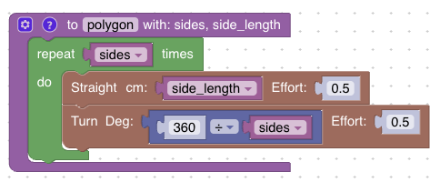
The polygon function
One function draws every regular polygon. The two parameters are sides and side_length; the turn angle is computed from sides.
Notes:
Walk the block from the top: the definition with two parameters, the repeat count, the Straight cm and the Turn angle. Ask where sides shows up (twice) before the next slide says it.

Slide 5
The new trick: division in the Turn slot
Put a math division block, 360 ÷ sides, right into the Turn block's angle slot
sides now does double duty:
it sets how many times the loop repeats
and it sets the angle
Not a parameter: Effort stays at 0.5 in both blocks
A parameter earns its place when callers actually need to vary it. sides and side_length change with every shape, speed doesn't
Notes:
The one unfamiliar step is Math, then the division block. Have students drag 360 ÷ [ ] into the Turn angle slot, then drop the sides variable into the blank. Point out that sides is used in two places, which is why this single function generalizes. Build the square test case first and confirm it works before turning students loose on other shapes.

Slide 6
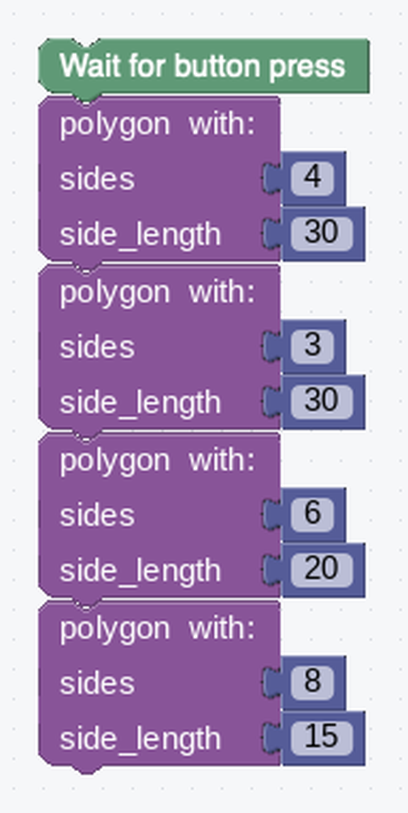
Activity · Test it like an engineer
Activity
Real programmers test one function against many inputs
In your main program, call polygon with different values
Write down what you expect each call to draw before you click RUN
Then run it and see whether the robot agrees with you
The arguments fill the sockets in order: sides first, then side_length
Notes:
Insist on written predictions first. The lesson page has a "Check your predictions" reveal with an animation of all four calls: open it only after everyone has committed and run their robot. The side lengths shrink as the shapes gain sides, because a shape with more sides needs more floor for the same side length.

Slide 7
Check your understanding
What turn angle will polygon compute for a 12-sided shape (a dodecagon)?
A. 12°
B. 30°
C. 36°
D. 90°
Notes:
Answer: B. The function calculates 360 ÷ 12 = 30° on its own: no need to work it out by hand.

Slide 8
Answer
What turn angle will polygon compute for a 12-sided shape (a dodecagon)?
A. 12°
B. 30°
C. 36°
D. 90°
The function calculates 360 ÷ 12 = 30° on its own: no need to work it out by hand.

Slide 9
Check your understanding
polygon (8, 25) traces an octagon about 2 m around. What does polygon (8, 50) do?
A. A different shape
B. The same octagon shape, but about twice as big (~4 m around)
C. An octagon at double speed
D. Nothing changes
Notes:
Answer: B. Doubling side_length doubles each side, so the perimeter doubles. But the angles, and therefore the shape, stay the same.

Slide 10
Answer
polygon (8, 25) traces an octagon about 2 m around. What does polygon (8, 50) do?
A. A different shape
B. The same octagon shape, but about twice as big (~4 m around)
C. An octagon at double speed
D. Nothing changes
Doubling side_length doubles each side, so the perimeter doubles. But the angles, and therefore the shape, stay the same.

Slide 11
Activity · Explore
Activity
Run the four test shapes and check each one roughly closes back to its start
1
Notice what happens as sides go up (10, 12, 20): the shape gets closer and closer to a circle
2
Challenge: draw a pentagon, Turn 72°, then draw the pentagon again. The two overlapping pentagons make a star or mandala.
3
Notes:
More support: give a skeleton with the Repeat block already placed and ask only for Straight and the 360 ÷ sides Turn. More challenge: a "spiral polygon" that grows each side, or a star helper built on top of polygon. When a shape looks off: first confirm the math (360 ÷ 6 = 60), then rule out wheel slip by testing at effort 0.5. Many "bugs" here are physics, not code.

Slide 12
Check your understanding
Without polygon, you'd write one function each for square, triangle, pentagon, hexagon, and octagon. With polygon, how many functions do you need?
A. Five
B. One
C. One per shape you draw
D. Three
Notes:
Answer: B. That's the power of generalizing: a single well-designed function replaces all the special-case ones.

Slide 13
Answer
Without polygon, you'd write one function each for square, triangle, pentagon, hexagon, and octagon. With polygon, how many functions do you need?
A. Five
B. One
C. One per shape you draw
D. Three
That's the power of generalizing: a single well-designed function replaces all the special-case ones.

Slide 14
Real-world connections
SOFTWARE
DESIGN
MANUFACTURING
Libraries
Parametric CAD
Configurable machines
A charting library draws any chart from parameters: you don't write new code for every graph.
Engineers define a part once with parameters, then generate every size from the same model.
One programmable machine makes many products by changing inputs, not by rebuilding the machine.
Notes:
Writing one flexible tool instead of many rigid ones is the heart of good engineering.

Slide 15
Wrap-up
What two parameters does polygon take, and what does each control?
How does the function get the turn angle?
Why is one general function better than many specific ones?
Next: under straight and turn, to control the left and right motors directly
Notes:
Answers: sides (how many times to repeat, and the angle) and side_length (how long each side is). 360 ÷ sides, computed inside. Less code, fewer bugs, easier to change. Formative: can students explain why sides appears in two places, and predict a shape from a call? Exit ticket: "Turn angle for a 9-sided polygon?" (360 ÷ 9 = 40°).

