Slide 1

MODULE 1 · LESSON 1-6
Differential Drive & Motor Control
By the end of this lesson you can
Explain differential drive: steering by running the two wheels at different speeds
Predict the robot's motion from what each side's motor is doing
Use Set effort to control the motors directly (-1 to 1), and explain how effort differs from speed
Steer with Arcade, and say what changing its Turn number does to the size of the circle
Decide when to use direct motor control vs. the high-level Straight/Turn
Notes:
60 to 75 minutes. Under the hood: every Straight and Turn so far was really two motors. Today students drive the motors directly, meet the word effort, and finish with two hands-on activities (circles, then Earth – Moon – Earth). Have dry-erase markers, whiteboard panels and the printable Earth and Moon ready.

Slide 2
How the robot really steers
Every Straight and Turn you've used is really controlling two motors
The XRP is a differential drive robot: it has no steering wheel
All it can control is how fast each side turns, and in which direction
That turns out to be enough for every motion it can make
Today you take the wheel: curves, spins and smooth steering the high-level blocks can't do on their own
Notes:
Quick hook. Ask: a car steers by turning its front wheels. The XRP's wheels can't turn. So how does it steer? Take a few answers, then predict.

Slide 3
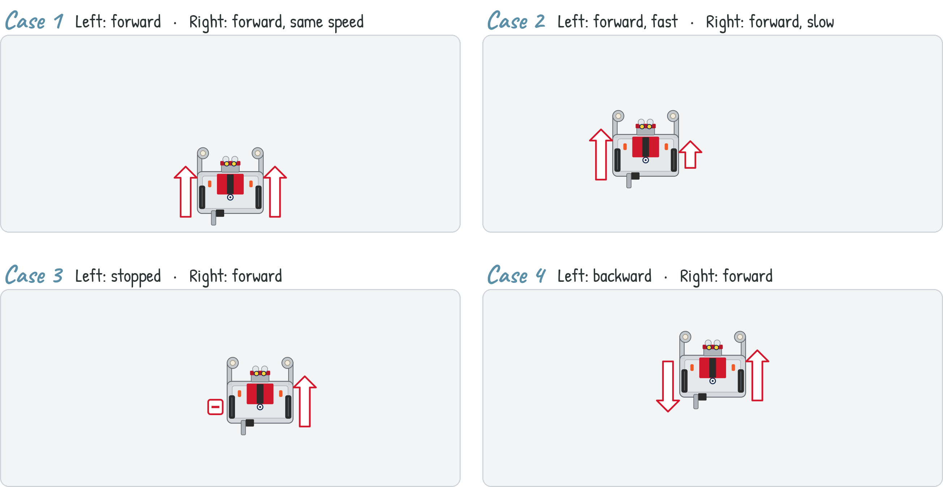
Predict first: which way will the robot drive?
Seen from above. Arrows show which way each side turns, and how fast (longer = faster). Straight, curve, swing around, or spin? Decide for each case.
Notes:
Have every student commit to a prediction for all four cases before you advance (write them down, or a show of fingers 1 to 4). On the lesson page each case is an animation with a Drive it button; you can play them there instead of the next slide.

Slide 4
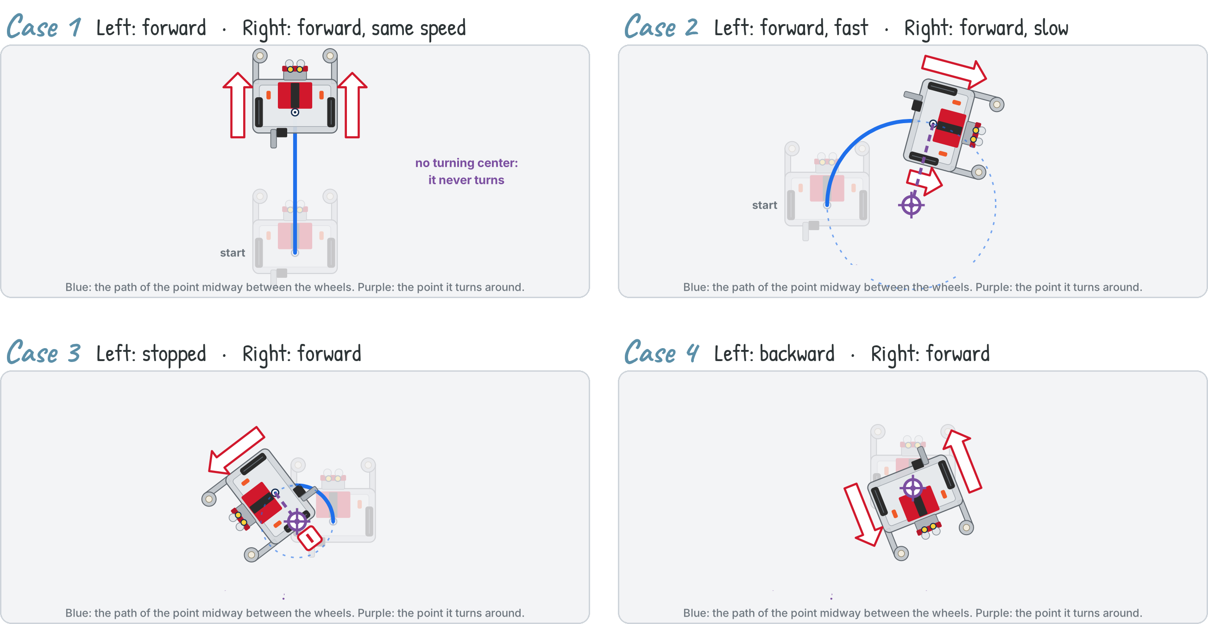
Drive it: what each case does
Notes:
Blue: the path of the point midway between the wheels. Purple: the point it turns around. Case 1 drives straight. Case 2 arcs toward the slower side (here, right): the faster side travels farther in the same time. Case 3 swings around the stopped left wheel. Case 4 spins on the spot, around the pen hole midway between the wheels. Ask who predicted each one right before explaining.

Slide 5
One idea: drive each side on its own
SAME
DIFFERENT
OPPOSITE
Both sides, same speed
One side faster
Each side opposite
Drives straight. Match the two sides and there's nothing to turn the robot.
Turns. The bigger the difference, the tighter the curve, until one side stops and it swings about that wheel.
Turns in place. The robot rotates about its own center without going anywhere.
Notes:
Every one of the four cases comes from this: the left and right sides of the driveline are operated independently.

Slide 6
Check your understanding
Your robot is supposed to drive straight but keeps drifting to the left. What does that tell you about the two sides?
A. Both sides are running at exactly the same speed
B. The right side is running slightly faster than the left
C. The motors are running in opposite directions
D. One side is completely stopped
Notes:
Answer: B. Drifting is Case 2 in miniature: the faster side travels farther, so the robot curves toward the slower one. Drifting left means the right side is winning.

Slide 7
Answer
Your robot is supposed to drive straight but keeps drifting to the left. What does that tell you about the two sides?
A. Both sides are running at exactly the same speed
B. The right side is running slightly faster than the left
C. The motors are running in opposite directions
D. One side is completely stopped
Drifting is Case 2 in miniature: the faster side travels farther, so the robot curves toward the slower one. Drifting left means the right side is winning.

Slide 8
Commanding the motors: Set effort
Effort runs from -1 (full reverse) through 0 (stopped) to 1 (full forward)
You set each wheel separately, so each of the four cases is just a pair of effort numbers
Straight finishes: it drives its 20 cm, stops the motors, and hands the program to the next block
Set effort doesn't finish: it switches the motors on and moves straight to the next block, leaving them running
They keep running until something stops them
Notes:
This is the big idea of the lesson: blocks that finish vs. blocks that don't. Say it plainly now and come back to it in every section.

Slide 9
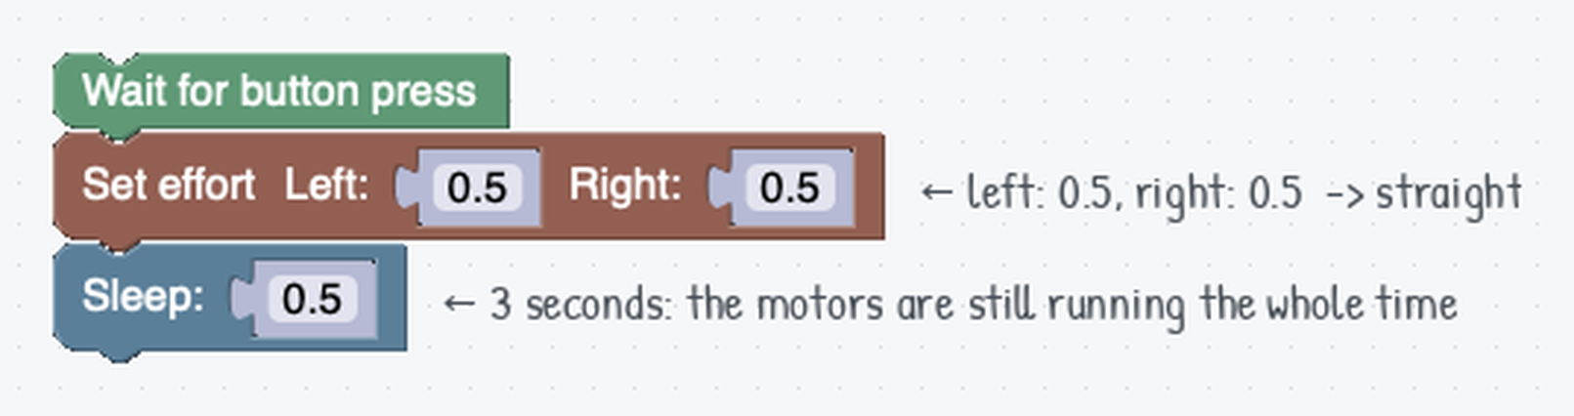
When should the motors stop?
A question Straight never asks you. For a first look we answer it with a Sleep, but keep an eye on how well that works.
Notes:
Set effort starts both wheels, and they stay on while the program sleeps. The Sleep is a placeholder because we have no sensors yet; don't let timed driving take root as a habit. The block pictures are the generic ones from the site, so the numbers drawn inside a block can differ from the note beside it: the note is what this program uses.

Slide 10
Check your understanding
You run Set effort with left 0.5 and right 0.5. What does the robot do?
A. Curves to the left
B. Drives straight forward
C. Spins in place
D. Stays still
Notes:
Answer: B. Equal effort on both wheels means both sides move at the same speed, so the robot goes straight.

Slide 11
Answer
You run Set effort with left 0.5 and right 0.5. What does the robot do?
A. Curves to the left
B. Drives straight forward
C. Spins in place
D. Stays still
Equal effort on both wheels means both sides move at the same speed, so the robot goes straight.

Slide 12
Check your understanding
What happens with left 0.5 and right -0.5 (one wheel forward, one backward)?
A. Drives straight
B. Spins in place
C. Drives backward
D. Curves gently
Notes:
Answer: B. Opposite efforts push the two sides in opposite directions, so the robot rotates on the spot.

Slide 13
Answer
What happens with left 0.5 and right -0.5 (one wheel forward, one backward)?
A. Drives straight
B. Spins in place
C. Drives backward
D. Curves gently
Opposite efforts push the two sides in opposite directions, so the robot rotates on the spot.

Slide 14
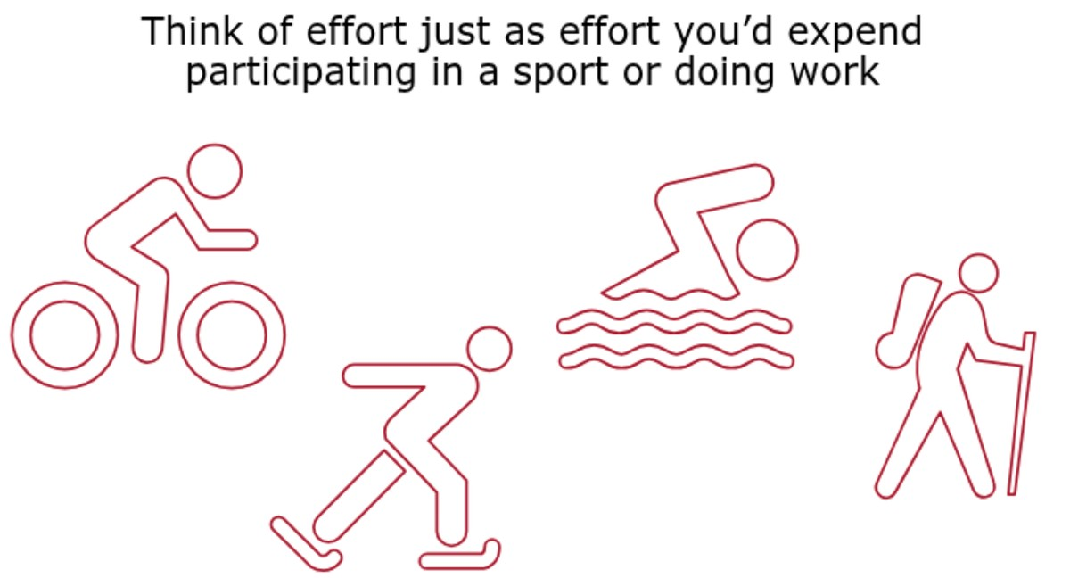
Effort is not the same as speed
Effort is how hard the motors try: electrically, how much voltage they get
Like your own effort in a sport: how hard you're working, not how fast you go
Pedal uphill at a constant effort and you slow down; the same effort on the flat carries you much faster
Effort is your input. Speed is the result
Speed depends on the hill, the carpet, the battery, and how much the robot is carrying
Notes:
Name this explicitly, or students read "effort 0.5" as "half speed" and are puzzled when the same program behaves differently on carpet, a ramp or a tired battery. The bike-uphill analogy lands fastest.

Slide 15
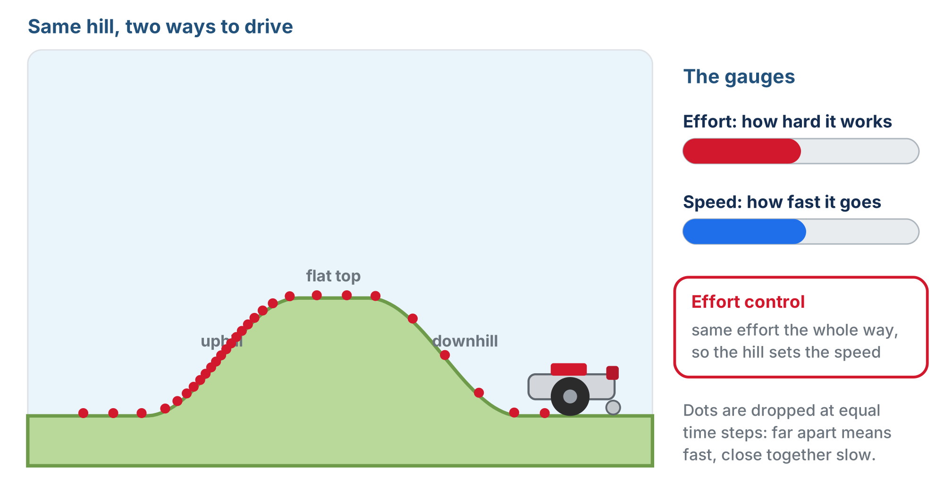
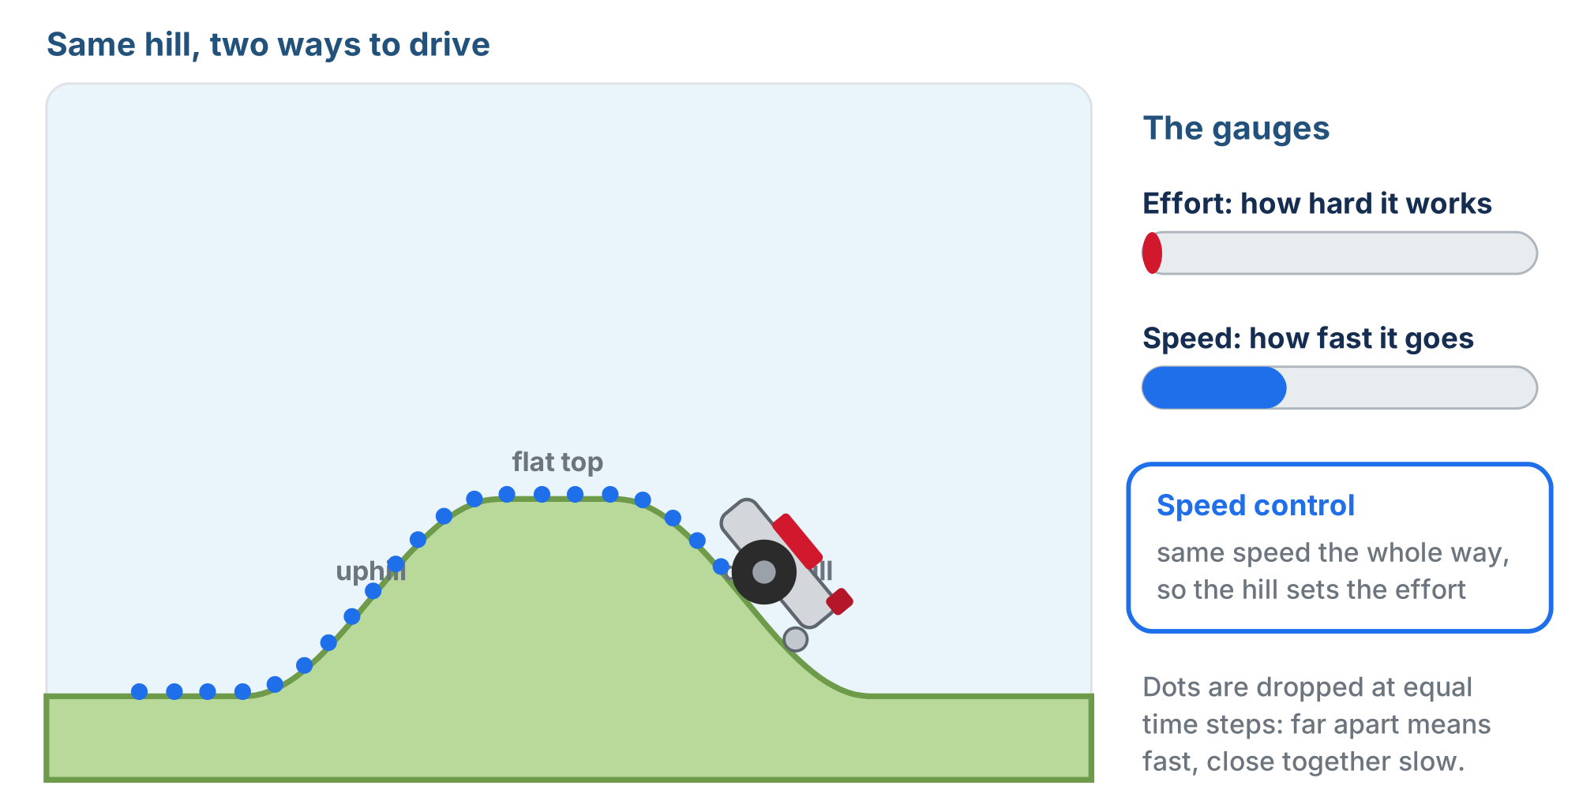
Same hill, two ways to drive
Effort control: same effort, so the hill sets the speed
Speed control: same speed, so the hill sets the effort
Name the speed you want, and the robot adjusts its own effort: harder uphill, easing off on the way down
Notes:
Dots are dropped at equal time steps: bunched means slow, spread out means fast. Left: effort held, the robot crawls uphill and races down. Right: speed held, the effort gauge drops low on the downhill. The lesson page animates both runs with buttons; worth playing live.

Slide 16
Why the same numbers move differently
Effort 0.5 on a smooth floor is quicker than effort 0.5 on thick carpet
And quicker again with a fresh battery
Straight and Turn are more repeatable than raw effort
They watch the robot's sensors and adjust, instead of blindly holding one voltage
Notes:
If you have a ramp or a carpet square handy, run one Set effort program on both surfaces back to back: thirty seconds of demo and the distinction sticks. This is also the honest answer to "why do we even have Straight and Turn?": they close the loop with sensors; Set effort is open-loop. Module 2's line following builds on adjusting effort from what the robot senses.

Slide 17
Check your understanding
You set both motors to effort 0.5 and drive across a smooth floor, then across a thick carpet. What happens?
A. The robot travels at the same speed on both: effort sets the speed
B. Slower on the carpet: effort is how hard the motors try, and the carpet fights back
C. It goes faster on the carpet
D. The robot refuses to move on carpet
Notes:
Answer: B. Effort is the input (roughly, motor voltage), not the outcome. The same effort against more resistance gives less speed, exactly like pedalling a bike uphill.

Slide 18
Answer
You set both motors to effort 0.5 and drive across a smooth floor, then across a thick carpet. What happens?
A. The robot travels at the same speed on both: effort sets the speed
B. Slower on the carpet: effort is how hard the motors try, and the carpet fights back
C. It goes faster on the carpet
D. The robot refuses to move on carpet
Effort is the input (roughly, motor voltage), not the outcome. The same effort against more resistance gives less speed, exactly like pedalling a bike uphill.

Slide 19
Check your understanding
A robot is asked to hold a steady speed as it drives up and over a hill. What does its effort do?
A. Stays at one fixed value the whole way
B. Rises going uphill and drops going downhill, to keep the speed the same
C. Drops going uphill
D. Goes to zero at the top
Notes:
Answer: B. That's the trade: commanding speed means the robot changes effort by itself to maintain what you asked for. Commanding effort means you fix the effort and let the speed vary.

Slide 20
Answer
A robot is asked to hold a steady speed as it drives up and over a hill. What does its effort do?
A. Stays at one fixed value the whole way
B. Rises going uphill and drops going downhill, to keep the speed the same
C. Drops going uphill
D. Goes to zero at the top
That's the trade: commanding speed means the robot changes effort by itself to maintain what you asked for. Commanding effort means you fix the effort and let the speed vary.

Slide 21
Blocks that finish vs. blocks that don't
Try it
Run the Set effort program (effort 0.5, Sleep 3 seconds) three times, and measure how far the robot goes each time:
With a fresh battery
1
On carpet
2
On a smooth floor
3
Three seconds at effort 0.5 is not a distance. It's three seconds.
Notes:
The distance changes with the battery, the surface, the weight on the robot, even whether the floor slopes. That's effort-isn't-speed showing up as a practical problem. Having students measure it themselves is what stops timed driving from taking root.

Slide 22
Two kinds of block
FINISHES
DOESN'T FINISH
Straight / Turn
Set effort / Arcade
Runs until the job is done (the distance driven, the angle turned), then stops the motors by itself. The next block doesn't start until it's finished.
Switches the motors on and moves to the next block immediately. The motors stay on until something stops them.
Notes:
The distinction to drill: finishing vs. not finishing. It's also abstraction vs. control: Straight and Turn are precise and repeatable but limited to straight lines and pivots; Set effort is raw but can make smooth curves. Neither is better; it's the right tool for the task.

Slide 23
What stops the motors?
Three things:
A Stop motors block
Another Set effort (including effort 0)
The program ending
No stop block needed at the end of a program: the robot stops the motors when the program is over
Any time the motors should quit while the program keeps going, that's what Stop motors is for
Notes:
Head off the habit of a stop block at the end of every program: it does nothing there. Stop motors is for stopping mid-program.

Slide 24
What should the robot wait for?
A Sleep is the crudest possible answer, and you just measured why
The answer for the rest of this course: stop on something the robot senses
until the rangefinder says the wall is 10 cm away
until the reflectance sensor sees the line
until the encoder has counted far enough
Same Set effort, but the robot decides when it's done instead of the clock
That's where Module 2 goes next
Notes:
Real programs stop on what the robot senses (Module 2), or use Straight/Turn when a measured distance is what they want.

Slide 25
Check your understanding
What's the difference between what Straight does and what Set effort does?
A. Straight drives its distance and stops; Set effort starts the motors and leaves them running
B. They do the same thing: Set effort is just the Python version
C. Straight leaves the motors running; Set effort stops them when it finishes
D. Set effort can only drive backward
Notes:
Answer: A. Straight and Turn finish a job and stop. Set effort just sets the motors going: deciding when they stop is now your problem.

Slide 26
Answer
What's the difference between what Straight does and what Set effort does?
A. Straight drives its distance and stops; Set effort starts the motors and leaves them running
B. They do the same thing: Set effort is just the Python version
C. Straight leaves the motors running; Set effort stops them when it finishes
D. Set effort can only drive backward
Straight and Turn finish a job and stop. Set effort just sets the motors going: deciding when they stop is now your problem.

Slide 27
Check your understanding
Why is "Set effort 0.5, Sleep 3 seconds" a poor way to travel a set distance?
A. Sleep blocks are slower than Straight blocks
B. Effort is not speed: 3 seconds covers different distances with battery, surface, and load
C. Sleep stops the motors, so the robot never gets anywhere
D. The robot cannot run Set effort and Sleep in the same program
Notes:
Answer: B. Timed driving is guesswork: a fresh battery on a smooth floor goes much farther in 3 seconds than a tired one on carpet. Use Straight for a distance, and a sensor to stop at something.

Slide 28
Answer
Why is "Set effort 0.5, Sleep 3 seconds" a poor way to travel a set distance?
A. Sleep blocks are slower than Straight blocks
B. Effort is not speed: 3 seconds covers different distances with battery, surface, and load
C. Sleep stops the motors, so the robot never gets anywhere
D. The robot cannot run Set effort and Sleep in the same program
Timed driving is guesswork: a fresh battery on a smooth floor goes much farther in 3 seconds than a tired one on carpet. Use Straight for a distance, and a sensor to stop at something.

Slide 29
Smooth steering with Arcade
Setting two efforts by hand is fiddly. Arcade takes two numbers, like a game controller, and works out the two motor efforts for you:
Straight: how fast it drives forward (the one people call speed)
Turn: how hard it bends, and which way
0 is dead straight
positive and negative bend opposite ways
Notes:
For more support, let students use Arcade before Set effort: it is more intuitive. Start with symmetric efforts (0.3 on both wheels) before curves, and give a table of effort pairs and their outcomes. For more challenge: build a spiral by gradually increasing one side's effort across several Set effort blocks.

Slide 30
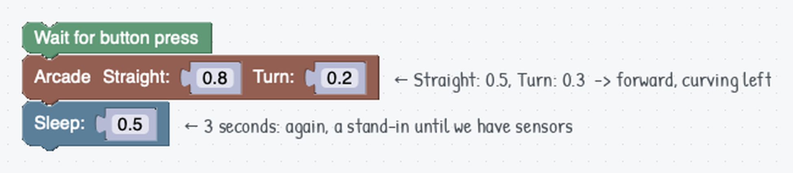
Arcade in a program
Arcade combines forward motion and steering into one block. Like Set effort, it doesn't finish: the Sleep says when to stop.
Notes:
A positive Turn bends left (counterclockwise). The Arcade block picture is the generic one from the site and shows its own default numbers; the note beside it gives the values this program uses (Straight 0.5, Turn 0.3).

Slide 31
Check your understanding
When is the Arcade block a better choice than Set effort?
A. When you need smooth, intuitive steering like a game controller
B. When you need to control each wheel to an exact effort
C. When you want precise, measured distances
D. Arcade and Set effort are exactly the same
Notes:
Answer: A. Arcade is easiest for smooth curves and navigation; Set effort gives finer, per-wheel control when you need it.

Slide 32
Answer
When is the Arcade block a better choice than Set effort?
A. When you need smooth, intuitive steering like a game controller
B. When you need to control each wheel to an exact effort
C. When you want precise, measured distances
D. Arcade and Set effort are exactly the same
Arcade is easiest for smooth curves and navigation; Set effort gives finer, per-wheel control when you need it.

Slide 33
Activity · Get a feel for circles
Step 1
Marker in the holder, on a whiteboard panel. Wait for button, Arcade, Sleep: Straight 0.5, a Sleep long enough to come round once. Change only Turn.
Straight | Turn | How big was the circle?
0.5 | 0.15
0.5 | 0.3
0.5 | 0.5
0.5 | 0.8
No exact measurements needed. Write one sentence: what happens to the circle when the turn number goes up?
Notes:
Circles first, so students aren't fighting what the numbers do and a four-part mission at the same time. No marker? Chalk a starting mark and eyeball it. Step 1 is genuinely open: resist handing over the relationship; it takes about four runs to see, and a student who says it owns it.

Slide 34
Check your understanding
You run Arcade with Straight 0.5 and Turn 0.3, then change Turn to 0.6. What happens to the circle?
A. It gets bigger
B. It gets smaller: more turn means a tighter circle
C. It stays the same size but the robot goes faster
D. The robot drives straight
Notes:
Answer: B. Turn is how hard the robot is bending. More bend for the same forward speed means a tighter circle. Turn 0 is no bend at all: a straight line.

Slide 35
Answer
You run Arcade with Straight 0.5 and Turn 0.3, then change Turn to 0.6. What happens to the circle?
A. It gets bigger
B. It gets smaller: more turn means a tighter circle
C. It stays the same size but the robot goes faster
D. The robot drives straight
Turn is how hard the robot is bending. More bend for the same forward speed means a tighter circle. Turn 0 is no bend at all: a straight line.

Slide 36
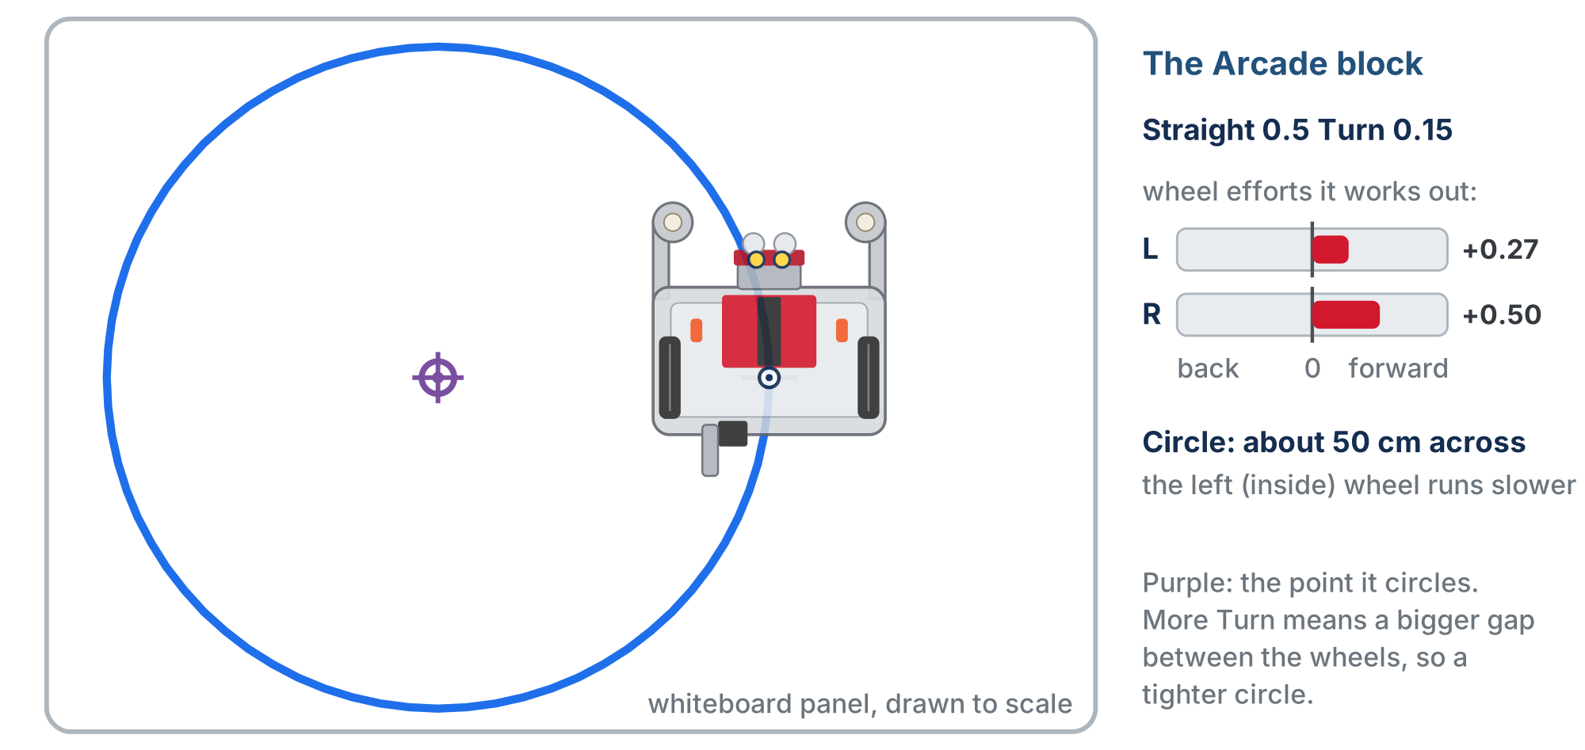
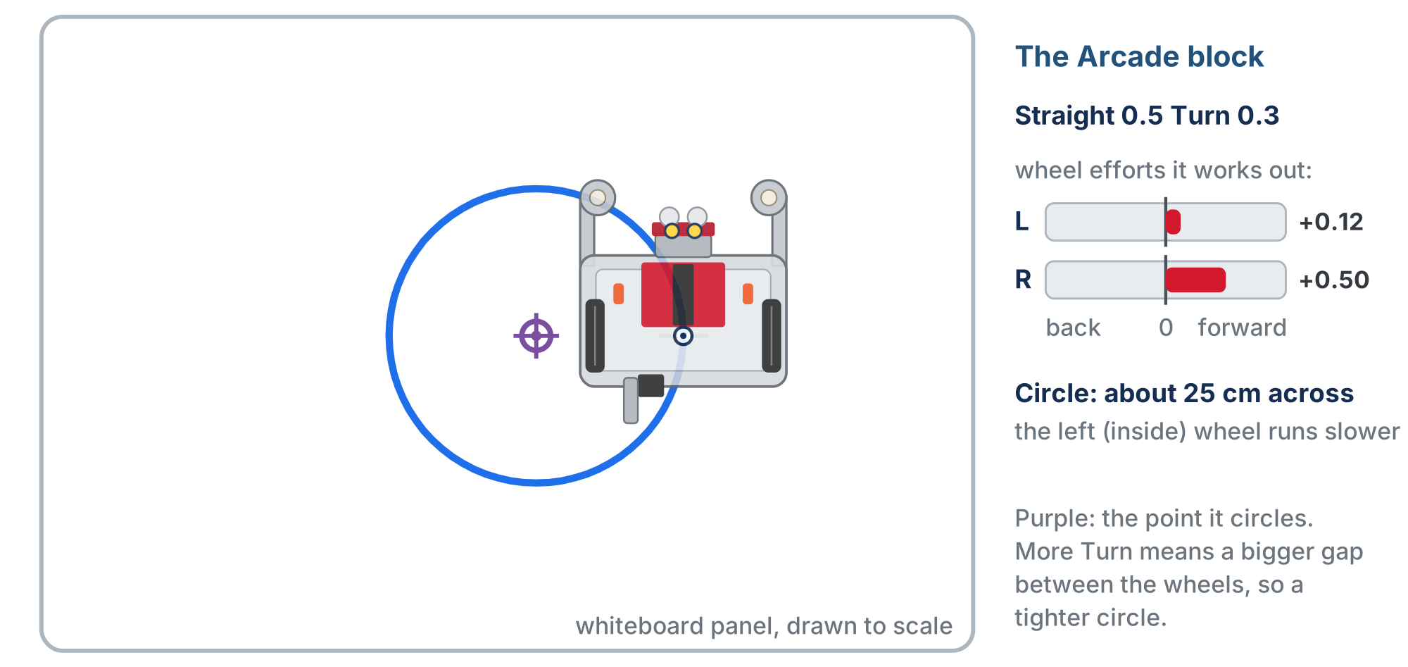
Compare with a simulated robot
After your own runs
Turn 0.15: about 50 cm across
Turn 0.3: about 25 cm across
Watch the two wheel efforts as well as the circle
Notes:
Show only after students have done their own runs. The simulated robot is drawn to scale on a whiteboard panel. Their robots' circles won't match these numbers exactly, and that's expected.

Slide 37
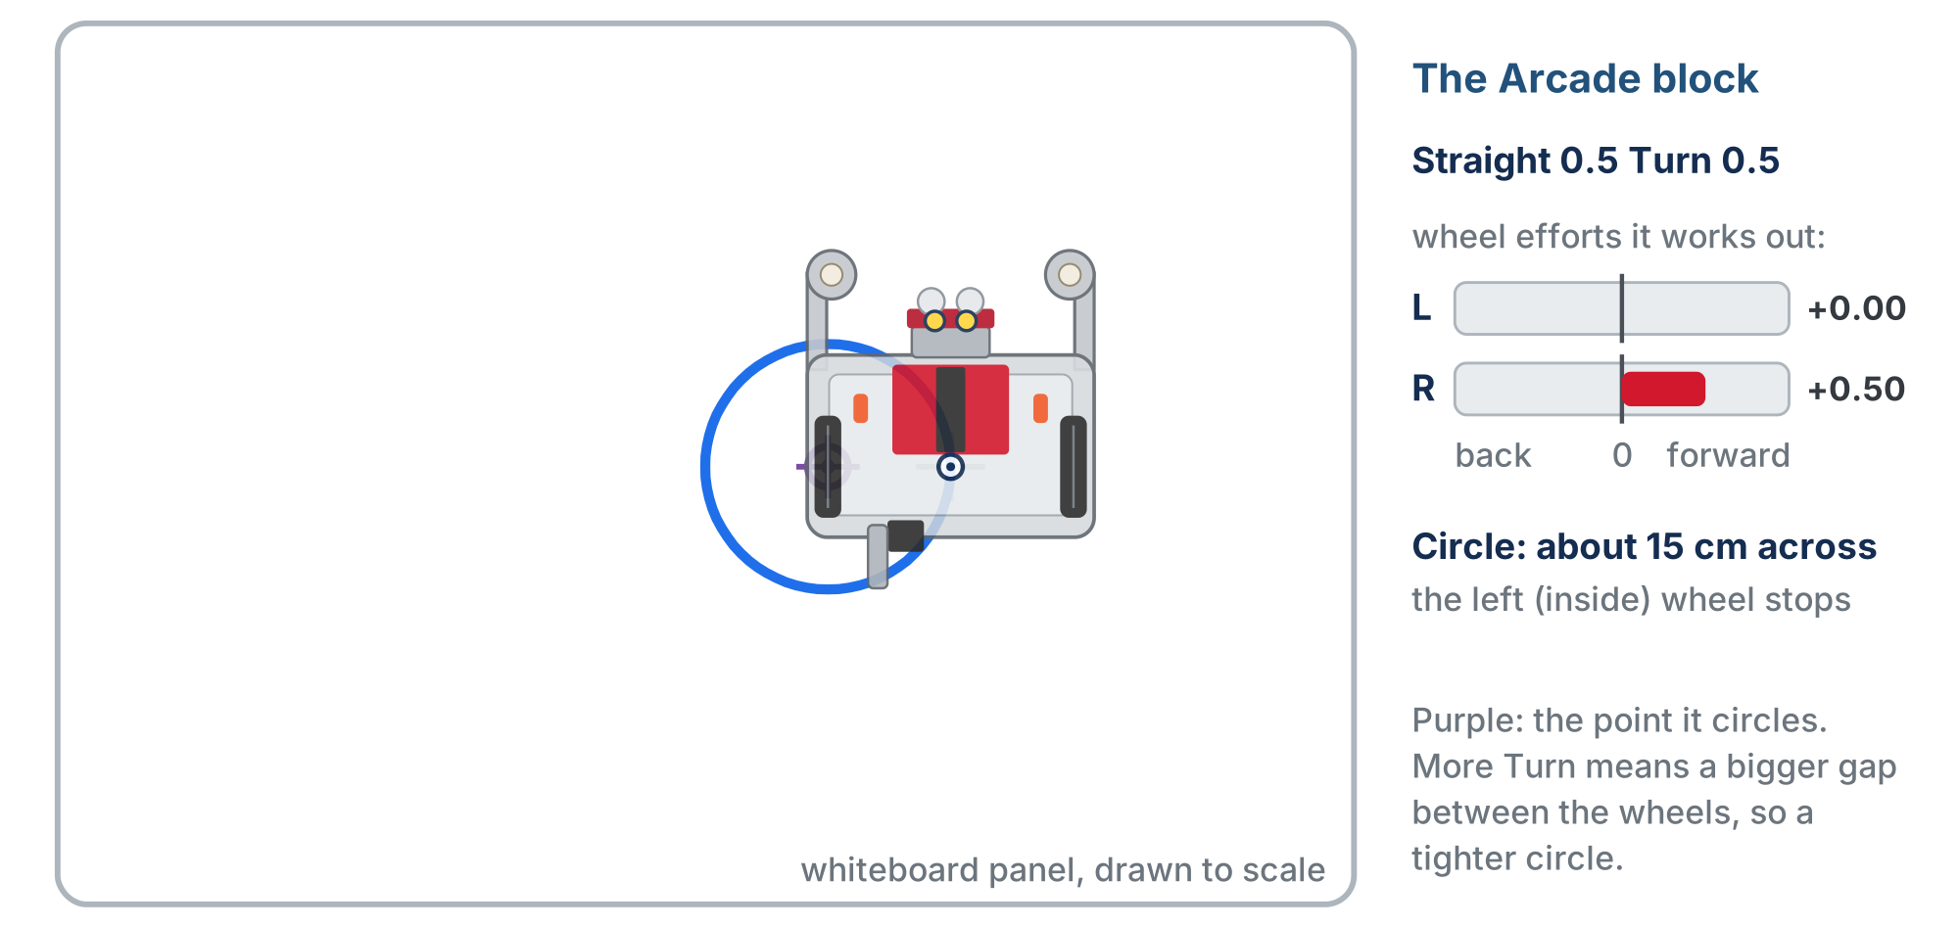
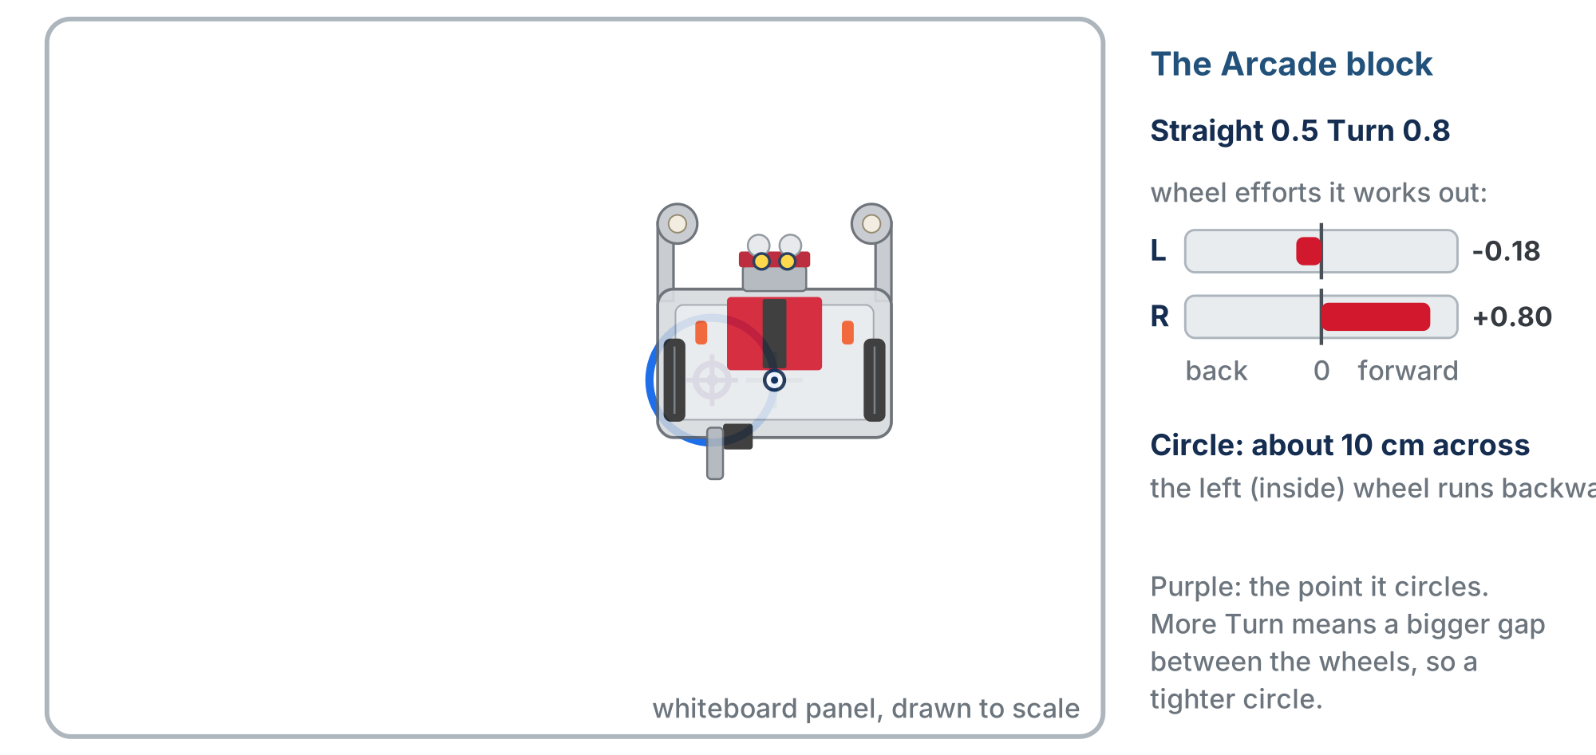
Compare with a simulated robot
After your own runs
Turn 0.5: the left wheel stops, about 15 cm
Turn 0.8: the left wheel runs backward, about 10 cm
The bigger the difference between the wheels, the tighter the circle
Notes:
At Turn 0.5 the inside wheel stops and the robot swings around it (Case 3). At 0.8 the inside wheel runs backward and the circle is smaller than the robot (heading toward Case 4).

Slide 38
Step 2 · Find a circle that fits
Activity
Aim for a circle roughly 12 to 18 inches (30–45 cm) across: it fits on a whiteboard panel and on your desk space later
1
Don't calculate it. Change Turn, run it, look, change it again. Three or four tries is normal
2
Write both numbers down and don't lose them: My circle: Straight ____ Turn ____
3
Every robot lands on slightly different numbers. The rest of this lesson uses yours.
Notes:
For your eyes only: at Straight 0.5, a Turn around 0.4 to 0.6 usually lands in the 12 to 18 inch range, but don't publish it; it varies with battery, floor and tyre wear, and the hunt is the point. If a group is stuck, ask which direction to move the number, not which number to use.

Slide 39
Step 3 · Time a half circle
Activity
Keep Straight and Turn exactly as they are. Change only the Sleep
1
Stop when the robot faces the opposite direction from where it started: a half circle
2
Start from a wall or a tape line, so you have something to judge against
3
Write it down: My half circle takes ____ seconds. A full circle takes twice that
4
"Is it pointing backwards?" you can answer by looking. "Is it back where it started?" is a guess.
Notes:
Insist on the point-the-opposite-way test. Students who judge a full circle are out by a quarter turn without knowing it, and in the next activity that error is what makes them miss the Earth. The drawn circles are worth the mess: identical numbers on two robots give different circles, which is the timed-driving problem arriving on its own.

Slide 40
Check your understanding
Your half circle takes 1.4 seconds. Roughly how long is a full circle at the same Straight and Turn?
A. Still 1.4 seconds
B. About 2.8 seconds: twice as far around
C. About 0.7 seconds
D. There is no way to tell
Notes:
Answer: B. Nothing about the robot's motion changed (same Straight, same Turn), so going twice as far around the circle takes twice as long.

Slide 41
Answer
Your half circle takes 1.4 seconds. Roughly how long is a full circle at the same Straight and Turn?
A. Still 1.4 seconds
B. About 2.8 seconds: twice as far around
C. About 0.7 seconds
D. There is no way to tell
Nothing about the robot's motion changed (same Straight, same Turn), so going twice as far around the circle takes twice as long.

Slide 42
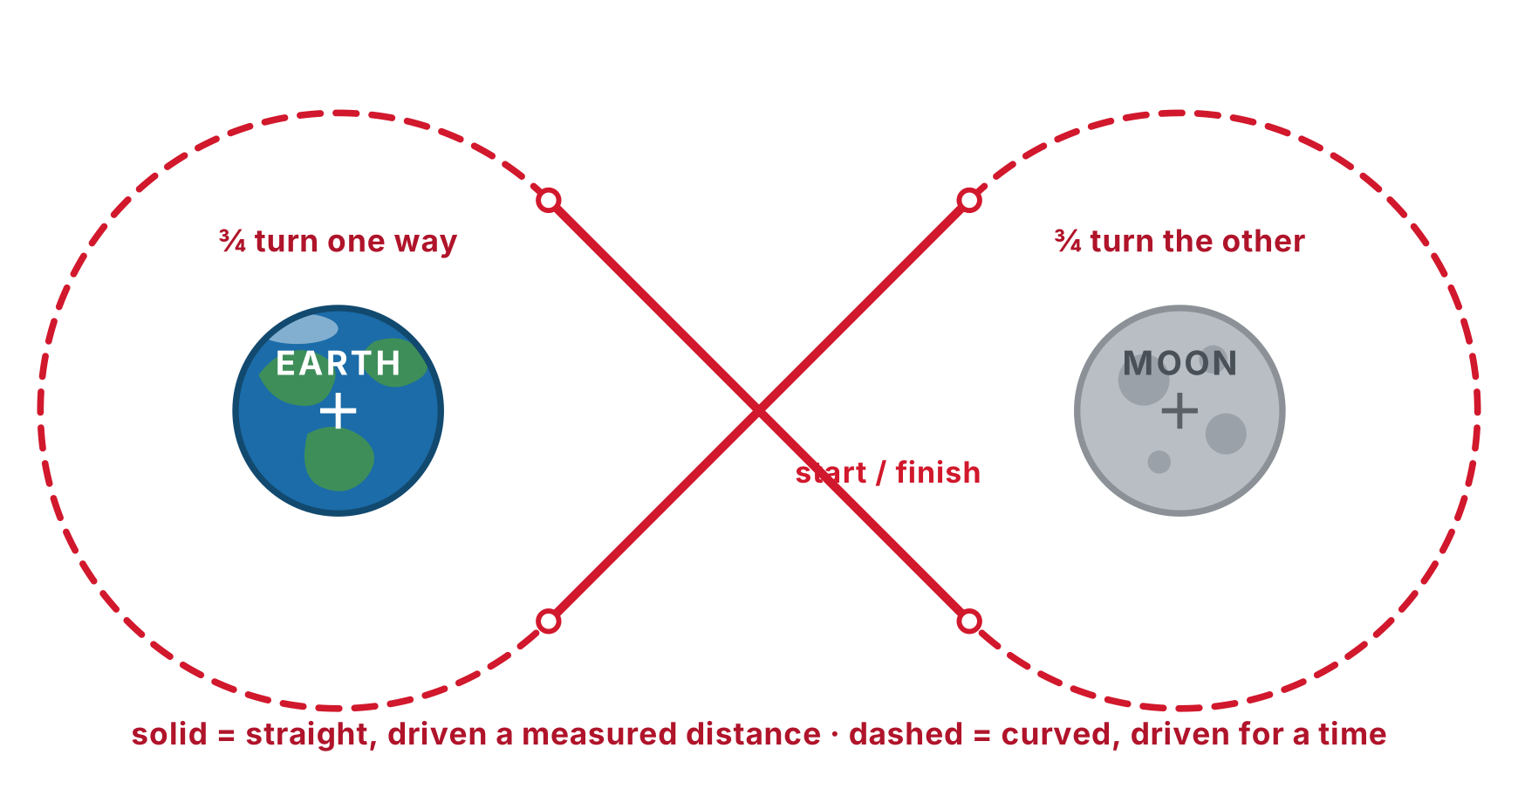
Activity · Earth – Moon – Earth
Tape an Earth and a Moon to your whiteboard panel, about 18–24 inches (45–60 cm) apart
Your robot is a spacecraft. Its mission:
swing around the Moon
cross to the Earth
swing around the Earth the other way
come back to rejoin its own lunar orbit
Printable Earth and Moon: in this lesson's Resources. Print, cut out, tape down.
Notes:
Both bodies are drawn the same size, which is not remotely true and very convenient: both orbits are the same size, so the circle numbers from the last activity work for each. (The real Moon is about a quarter of Earth's width, and thirty Earths would fit in the gap.) The mission framing gives students a reason to care whether the robot arrives pointing the right way, which is what actually teaches heading. The whole path fits in roughly 1 m by 0.5 m.

Slide 43
Step 1 · Plan the mission on paper
Before you touch a block, draw the path
Mark where the robot starts and which way it goes round the Moon
Mark where it crosses to the Earth, and which way it goes round that one
You should end up with a shape you recognize
The robot bends one way around the Moon and the other way around the Earth. That's why Straight and Turn blocks can't draw this shape at all.
Notes:
Step 1 is not optional. Students who skip the drawing tune four numbers at once with no idea which one is wrong. The drawing tells them what should happen, so a wrong run becomes information.

Slide 44
How far apart should the bodies go?
About one and a half times your circle's diameter
Any closer: the crossings are too shallow to see
Any further: they get steep and the path stops looking like an infinity symbol
At one and a half, the crossings meet at a tidy 45°, and each swing is three-quarters of a turn
A 14-inch circle wants the Earth and Moon about 21 inches apart
Notes:
If a group picked a big circle in the last activity, they spread the bodies out to match, or go back and find a smaller circle. That is a fair consequence, not a failure.

Slide 45
Step 2 · Build the mission
Four moves, and you already have the numbers for two of them:
# | Move | Block | The number
1 | Orbit the Moon | Arcade + Sleep | your Straight and Turn
2 | Cross to the Earth | Straight | the gap, in cm
3 | Orbit the Earth, the other way | Arcade + Sleep | same, with Turn negated
4 | Cross back to the Moon | Straight | the same gap
Orbit Sleep: about three-quarters of a full circle, 1.5 times your half-circle time. Tune from there.
Notes:
Three-quarters is not a guess: with the bodies spaced at one and a half diameters, three-quarters of a turn is exactly what brings the robot out of a swing pointing at the other body.

Slide 46
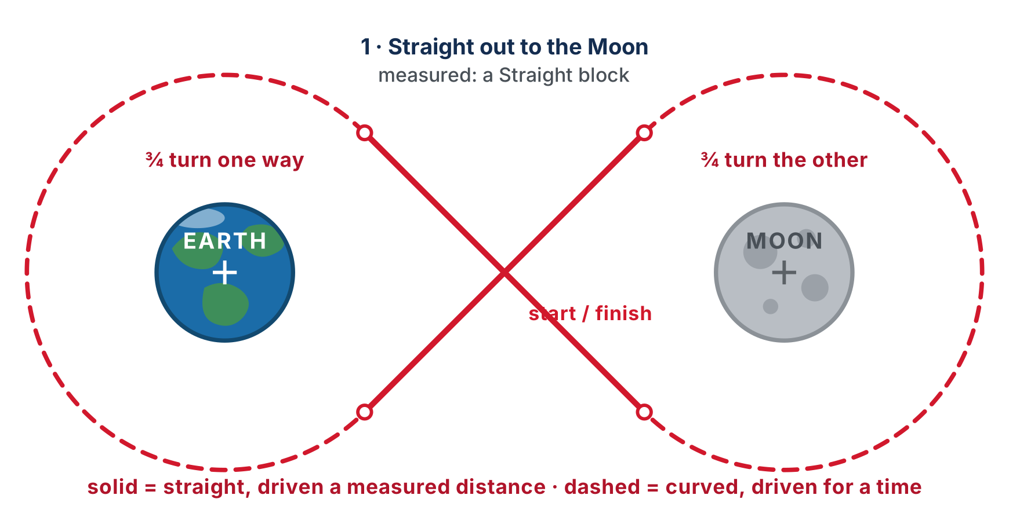
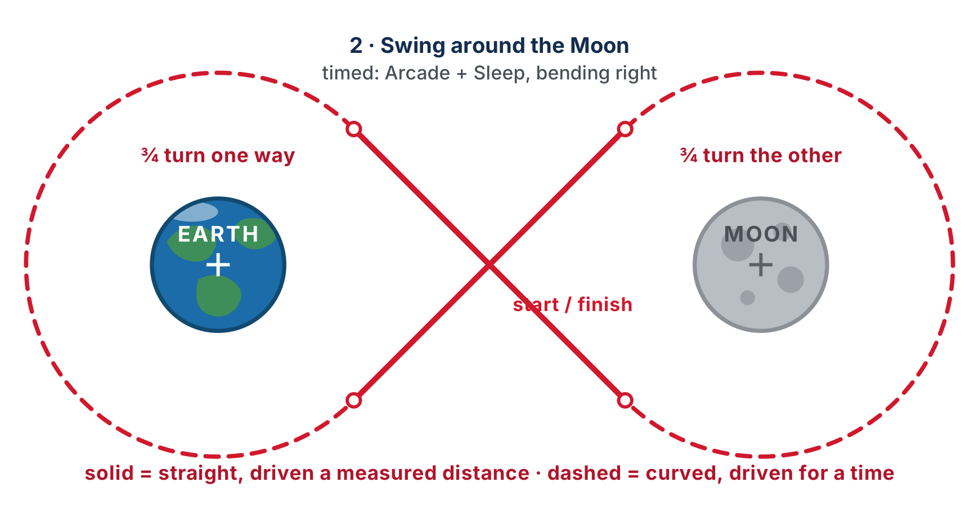
Measured vs. timed, in one program
Crossings: Straight finishes, so it's drawn solid
Swings: Arcade needs a Sleep, so it's drawn dashed
A distance lands the same way every run. A time is a much shakier thing to rely on.
Notes:
This is the finishes / doesn't-finish distinction from earlier, doing real work in one program. The animated figure on the lesson page flies the whole mission; the robot itself does not appear in these still frames.

Slide 47
Step 3 · Fly it, then fix it
It will not work first time. That's the job:
Overshooting the turn round the Moon: it leaves pointing the wrong way. Shorten that Sleep
Missing the Earth entirely: the crossing distance is wrong, or the orbit before it left the robot off-heading. Fix the heading first
A lopsided path: the two Turn values aren't true mirror images. Check the sign is the only thing that changed
You've succeeded when the marker loops the Moon, crosses to the Earth, loops it the other way, and comes back to meet where it started
Notes:
The first flight rarely closes, and that is the useful part. Two robots with identical numbers fly visibly different missions; the same robot differs on a fresh battery. Name it: the only reason we're timing this is that the robot can't yet sense where it is. Module 2 picks that thread up.

Slide 48
Challenge, and no whiteboard?
Challenge: move the two bodies further apart without changing the size of your orbits. Which of the four numbers has to change, and which don't?
No whiteboard panel or cutouts? Two sticky notes on the floor work, or two chalk marks
You lose the drawn path, so judge by eye: does the robot pass close to each marker, and finish where it began?
Notes:
If you want the science: the Apollo missions really did fly a figure-eight. The free-return trajectory loops behind the Moon and lets its gravity throw the spacecraft back toward Earth, so if the engines fail the crew comes home anyway. It's what saved Apollo 13. Worth ninety seconds, not a lesson.

Slide 49
Real-world connections
MOBILITY
GAMING
HEAVY EQUIPMENT
SPACEFLIGHT
Wheelchairs & rovers
Twin-stick control
Skid-steer loaders
Free-return trajectory
Powered wheelchairs and Mars rovers steer by differential drive: this left/right speed trick.
Tank-style games map two sticks to two "tracks", the same idea as setting two efforts.
Construction skid steers turn by driving their left and right wheels at different speeds.
Apollo flew a real figure-eight: loop behind the Moon, let its gravity throw you back at Earth. It brought Apollo 13 home.
Notes:
Direct motor control is how machines that don't drive in straight lines work.

Slide 50
Wrap-up
How does a differential-drive robot turn?
What happens to the motors when Straight finishes? And after Set effort?
Why is timed driving unreliable, and what should a robot stop on instead?
When would you pick Straight/Turn over Set effort?
In Arcade, which number changes the size of the circle, and which way?
Next: Lesson 1-7, Blockly challenges: the capstone of the Blockly phase
Notes:
Answers: by running its wheels at different speeds. Straight stops them; Set effort leaves them running. Effort isn't speed (battery and surface change the distance); stop on a sensor reading. When you need precise, repeatable distances and angles. Turn: bigger Turn, tighter circle. Exit ticket: "Fill in efforts to spin the robot in place" (equal and opposite, e.g. 0.5 / -0.5).

