Slide 1

MODULE 1 · LESSON 1-7
Blockly Challenges & Synthesis
By the end of this lesson you can
Combine loops, functions, parameters, and motor control in one program
Plan a program's structure before you start dragging blocks
Debug with a repeatable process: predict → test → observe → adjust
Judge trade-offs (precision vs. speed, simple vs. flexible)
Notes:
60+ minutes. The Blockly capstone: nothing new to learn, two open-ended challenges. Have a taped course ready on the floor for Challenge 1 (the map gives the distances), tape measures, and a marked parking box and LED-capable robots for Challenge 2 options.

Slide 2
Your Blockly capstone
There's nothing new to learn today
You put everything together: loops, functions, parameters, motor control
Two open-ended challenges: precision navigation, then a creative design
Like real engineering problems, these have many right answers
Plan first, then build. Predict → test → observe → adjust.
Notes:
Set expectations: value the process (planning, iterating, documenting) over a flawless result.

Slide 3
Challenge 1 · Precision navigation
Your robot is a delivery vehicle
It has to follow a marked course
Stop on a target within ±30 cm
Then signal that it arrived
Everything you need you already have: Straight, Turn, a function to wrap the route, and the debugging loop
Notes:
Target: finish within ±30 cm; ±15 cm as a stretch goal.

Slide 4
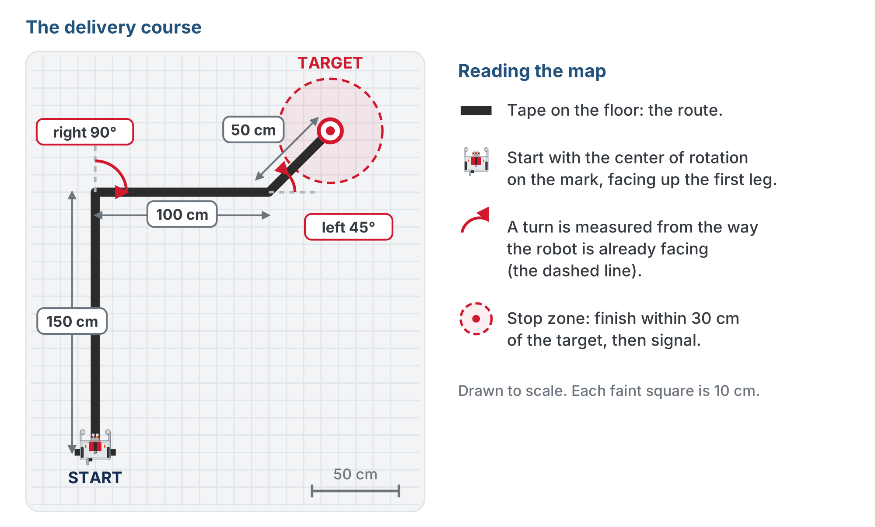
The delivery course
Measure it, then translate it into blocks.
Notes:
Seen from above, drawn to scale (each faint square is 10 cm). The robot starts facing up the page with its center of rotation on the start mark. Each turn is measured from the way the robot is already facing (the dashed line). The dashed red circle is the 30 cm stop zone. Make sure students read turn directions off the map rather than guessing: in XRPLib a positive turn is counterclockwise (left).

Slide 5
Plan it, build it, test it in pieces
Activity
Measure the course
1
Plan the moves on paper: sketch the segments, label the distances and angles
2
Build it: Straight and Turn blocks, wrapped in a function
3
Test it in pieces: get the first straight-and-turn landing correctly before you add the next
4
Far easier than running all five moves and guessing which one is off
Notes:
Have teams measure and plan on paper first, before any coding. Push the test-in-pieces habit hard: students who build all five moves at once and then debug struggle the most. A consistent over- or undershoot is a distance to trim; erratic results point to wheel slip or the surface, not the code.

Slide 6
Stuck on how to organize it?
Only if stuck
One clean structure: a single function that sequences the whole route
first leg, first corner, second leg, second corner, final leg
Call it from a short main program
The main program reads as one instruction, and the route lives in one place you can tune
The distances and angles are yours to measure
Notes:
The lesson keeps this hint behind a reveal: show it only to teams that are stuck on structure after planning on paper. The lesson page draws it as a block program; the slide gives it in words, because the generic Straight and Turn block pictures show placeholder numbers (20 cm, 90 degrees) that would read as course values, and the first corner on this course is a right turn.

Slide 7
Check your understanding
Your robot overshoots the target by about 15 cm every run. What's the most sensible fix?
A. Give up and start over
B. Shorten the final Straight distance by roughly 15 cm and re-test
C. Increase the effort to 1.0
D. Add more turns
Notes:
Answer: B. Consistent overshoot is a measurement to adjust, not a mystery. Trim the distance a bit and re-test: predict, test, observe, adjust.

Slide 8
Answer
Your robot overshoots the target by about 15 cm every run. What's the most sensible fix?
A. Give up and start over
B. Shorten the final Straight distance by roughly 15 cm and re-test
C. Increase the effort to 1.0
D. Add more turns
Consistent overshoot is a measurement to adjust, not a mystery. Trim the distance a bit and re-test: predict, test, observe, adjust.

Slide 9
Challenge 2 · Creative design
OPTION A
OPTION B
OPTION C
Multi-shape artist
Precision parking
Robot choreography
Use your polygon function to lay out a design: pentagon, hexagon, octagon arranged into a pattern.
Drive in, then use Set effort for a slow, careful final nudge to park centered in a marked box.
Combine curves, spins, and the LED into a 30-second performance that tells a little story.
Notes:
Design your own robotic performance: pick one, or invent your own, and bring the whole toolkit. Encourage descriptive function names and a one-line "story" describing what the robot does.

Slide 10
The workflow professionals use
Activity
Brainstorm, then break it into functions
1
Write pseudocode
2
Build the core functions and test each one
3
Assemble, then refine
4
Brainstorm → functions → pseudocode → build → test each → assemble → refine
Notes:
Give a hard "stop coding" time five minutes early so there's room for a showcase. Have two or three teams present (what was your goal, which functions did you use, what was hardest?) and run quick peer feedback.

Slide 11
Check your understanding
Your creative program is one giant stack of 40 blocks and it's hard to debug. What's the best move?
A. Delete it and pick an easier project
B. Break it into small named functions and test each one on its own
C. Add more blocks until it works
D. Run it faster
Notes:
Answer: B. Splitting a big program into small, testable functions is exactly what functions are for: it makes bugs easy to isolate.

Slide 12
Answer
Your creative program is one giant stack of 40 blocks and it's hard to debug. What's the best move?
A. Delete it and pick an easier project
B. Break it into small named functions and test each one on its own
C. Add more blocks until it works
D. Run it faster
Splitting a big program into small, testable functions is exactly what functions are for: it makes bugs easy to isolate.

Slide 13
Real-world connections
SPACE
WAREHOUSES
NAVIGATION
Driving a Mars rover
Shelf-carrying robots
Dead reckoning
Rover drivers plan each day's moves on Earth, send the whole sequence at once, then check where the rover actually stopped before planning the next drive.
Warehouse robots drive set routes across the floor and have to stop on exactly the right spot to pick up a shelf.
Before GPS, navigators worked out where they were from heading, speed and time, then corrected at a landmark. Your robot drives the same way.
Notes:
Planning a route, running it, and trimming it until it lands is how real machines get where they're going.

Slide 14
Looking ahead: why Python next?
You may have hit Blockly's limits today: big programs get unwieldy
Some ideas are just faster to type than to drag
That's why the next phase moves to Python
The good news: the same concepts you already know (loops, functions, parameters), written as text
Same ideas, new way to write them
Notes:
Ask who felt the stack getting unwieldy today; that frustration is the motivation for Python.

Slide 15
Check your understanding
Moving from Blockly to Python next lesson mostly means…
A. Learning brand-new concepts from scratch
B. Writing the same ideas (loops, functions, parameters) as typed text
C. Giving up on the robot
D. Only drawing shapes
Notes:
Answer: B. The logic carries straight over. Python is a new way to write the ideas you already understand, not a new set of ideas.

Slide 16
Answer
Moving from Blockly to Python next lesson mostly means…
A. Learning brand-new concepts from scratch
B. Writing the same ideas (loops, functions, parameters) as typed text
C. Giving up on the robot
D. Only drawing shapes
The logic carries straight over. Python is a new way to write the ideas you already understand, not a new set of ideas.

Slide 17
Wrap-up
What's the debugging loop?
Why break a big program into functions?
Which Module 1 concept will you lean on most in Python?
Next: Lesson 1-8, Hello, Python
Notes:
Answers: predict → test → observe → adjust. Easier to build, test, and fix. Their call: loops, functions, and parameters all carry over. Assessment is two-part: Challenge 1 within ±30 cm, and a working, creative Challenge 2 with a short written reflection (what did you build, which concepts did you use and why, what was hardest, what would you improve?). Rubric: planning, implementation, debugging evidence, reflection.

