Slide 1

MODULE 1 · LESSON 1-10
Python Loops
By the end of this lesson you can
Write a Python for loop and use it to repeat robot commands
Explain what range(n) produces and why counting starts at 0
Apply the last two of Python's five syntax rules, colons and indentation, to say exactly what's inside the loop
Nest one loop inside another, using the outer counter to change what the inner loop draws
Notes:
50 to 60 minutes. The logic is identical to the Repeat block; only the syntax changed. This lesson also delivers the two syntax rules Lesson 1-8 promised, because a loop is the first thing students have written that has an inside.

Slide 2
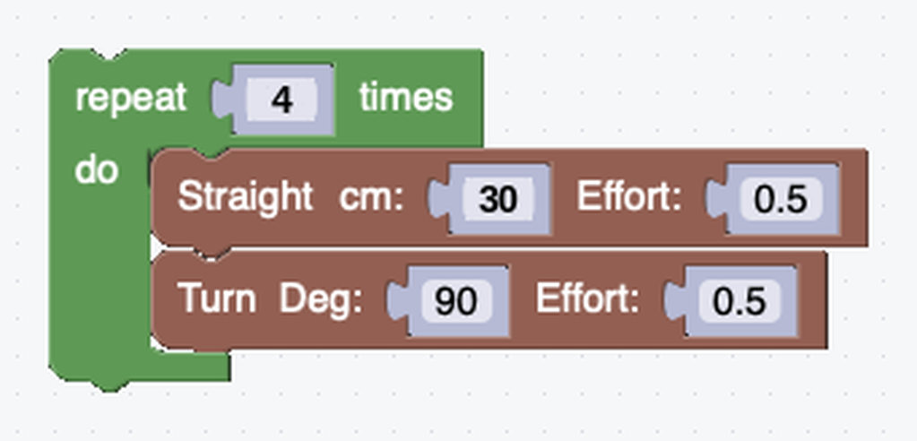
The Repeat block, in text
Here's the square you drew in Lesson 1-2 as a Blockly Repeat.
Remember how much shorter the Repeat block made shapes?
Python has the same tool: the for loop
Same logic, only the syntax changed
Later today: put a loop inside another loop, something Blockly made awkward
Notes:
Put the blocks next to the Python on the projector and let students match each block to its line before showing the next slide.

Slide 3
The same square in Python
Breaking down that first line:
for i in range(4):
drivetrain.straight(30)
drivetrain.turn(90)
for: the keyword that starts a loop
i: a counter variable (you can use it or ignore it)
range(4): produces the numbers 0, 1, 2, 3, four of them
: the colon, required. More on that in a moment.
Notes:
The same square as the Lesson 1-2 Repeat block: Repeat N times becomes for i in range(N):, and the blocks inside become the indented lines.

Slide 4
The two syntax rules you were promised
Lesson 1-8 said there were five syntax rules, then showed three
The other two answer a question a flat list of one-line instructions never raised: which lines belong to which?
The for loop is the first thing in this course that has an inside
Rule 4 is the colon. Rule 5 is indentation.

Slide 5
Rules 4 and 5: colons and indentation
4. Colons: a : ends any line that opens a block
for i in range(4): promises that lines belonging to the loop follow
if and def do the same, as you'll see soon enough
5. Indentation: the spaces at the start of a line say what's inside
Indented means in; back at the margin means out
for i in range(4):
drivetrain.straight(30)
drivetrain.turn(90)
Python took away the braces { } and made indentation the rule, so a stray space is a genuine error, not a style nitpick
Notes:
Most languages use curly braces for this and treat indentation as a courtesy. In Python the shape of the code on the page and what the code does can never disagree. Demonstrate the broken (un-indented) version and the correct one so students see the error message.

Slide 6
Check your understanding
What's wrong with this line? for i in range(4)
A. range should be capitalized
B. It is missing the colon at the end: for i in range(4):
C. It needs quotes around the 4
D. Nothing is wrong
Notes:
Answer: B. Rule 4: a line that opens a block must end with a colon. for, if and def all follow it.

Slide 7
Answer
What's wrong with this line? for i in range(4)
A. range should be capitalized
B. It is missing the colon at the end: for i in range(4):
C. It needs quotes around the 4
D. Nothing is wrong
Rule 4: a line that opens a block must end with a colon. for, if and def all follow it.

Slide 8
Check your understanding
What numbers does range(4) produce?
A. 1, 2, 3, 4
B. 0, 1, 2, 3
C. 0, 1, 2, 3, 4
D. 4, 3, 2, 1
Notes:
Answer: B. Two things trip nearly everyone: counting from 0 (range(4) is 0, 1, 2, 3, not 1, 2, 3, 4), and indentation as syntax.

Slide 9
Answer
What numbers does range(4) produce?
A. 1, 2, 3, 4
B. 0, 1, 2, 3
C. 0, 1, 2, 3, 4
D. 4, 3, 2, 1
range(n) counts from 0 and stops BEFORE n, so range(4) is 0, 1, 2, 3: four numbers, which is why the loop runs 4 times.
Notes:
Answer: B. Two things trip nearly everyone: counting from 0 (range(4) is 0, 1, 2, 3, not 1, 2, 3, 4), and indentation as syntax.

Slide 10
Indentation decides what repeats
Rule 5 in action. The only difference is where one line starts:
for i in range(4):
drivetrain.straight(30)
drivetrain.turn(90)
print("Square complete!") # NOT indented -> runs once, after the loop
The two indented lines repeat four times. The print runs once at the end, because it's not indented.

Slide 11
Check your understanding
In the code above, how many times does print("Square complete!") run?
A. Four times: once per loop
B. Once, after the loop finishes
C. Never
D. It causes an error
Notes:
Answer: B. Because it isn't indented, print is outside the loop body: it runs a single time once the loop is done.

Slide 12
Answer
In the code above, how many times does print("Square complete!") run?
A. Four times: once per loop
B. Once, after the loop finishes
C. Never
D. It causes an error
Because it isn't indented, print is outside the loop body: it runs a single time once the loop is done.

Slide 13
Use the counter
The loop variable isn't just for counting: you can use it. print() takes several things at once, separated by commas:
for i in range(5):
print("Drawing side", i + 1, "of 5")
drivetrain.straight(20)
drivetrain.turn(72)
Prints Drawing side 1 of 5, Drawing side 2 of 5 ... with a space between items. i + 1 because range(5) counts from 0, but people count from 1.

Slide 14
The same message, as an f-string
for i in range(5):
print(f"Drawing side {i + 1} of 5")
drivetrain.straight(20)
drivetrain.turn(72)
The output is identical. An f-string (f for formatted) is one piece of text with a slot in it, where Python drops in the value of i + 1.

Slide 15
The rules for f-strings
Put an f right before the opening quote: f"…", with no space between them
Curly braces { } mark a slot. Python works out what's inside and puts the answer in the text: {i}, {i + 1}, {360 / 5}
Everything outside the braces is printed exactly as you typed it. Python adds nothing.
Use as many slots as you like: f"Side {i + 1}: drive {length} cm, turn {angle} degrees"
Forget the f and the braces stop working: Python prints them literally. Curly braces in your output? Look for a missing f.

Slide 16
Check your understanding
i is 2. What does print("Side {i + 1}") show?
A. Side 3
B. Side 2
C. Side {i + 1}
D. An error
Notes:
Answer: C. There is no f before the quote, so it is ordinary text and the braces are just characters. Add the f, as in f"Side {i + 1}", and it shows Side 3.

Slide 17
Answer
i is 2. What does print("Side {i + 1}") show?
A. Side 3
B. Side 2
C. Side {i + 1}
D. An error
There is no f before the quote, so it is ordinary text and the braces are just characters. Add the f, as in f"Side {i + 1}", and it shows Side 3.

Slide 18
Why bother? 1 · You can read it
For a short message the two are interchangeable. As the message grows, an f-string looks like the line it will print; the comma version is chopped into pieces.
print("Side", i + 1, "- drive", length, "cm, turn", angle, "degrees")
print(f"Side {i + 1} - drive {length} cm, turn {angle} degrees")
With commas, you have to assemble the message in your head

Slide 19
Why bother? 2 · You control the spacing
Commas always put a space between items, whether you want one or not. Try printing a fraction like 1/5:
print("Side", i + 1, "/", 5) # Side 1 / 5
print(f"Side {i + 1}/5") # Side 1/5
No way to make the comma version print 1/5. In an f-string, the only spaces are the ones you typed.

Slide 20
Why bother? 3 · It's a value, not just a printout
Commas only mean "several things" inside print(). An f-string is a complete piece of text you can store in a variable and use later:
message = f"Drawing side {i + 1} of 5"
print(message)
Later in the course: more f-string tricks, like rounding a long sensor reading to two decimal places as you print it

Slide 21
Check your understanding
You want a loop to run 6 times to draw a hexagon. What goes in the range?
A. range(5)
B. range(6)
C. range(7)
D. range(60)
Notes:
Answer: B. range(6) gives 0 to 5, which is six passes: one per side of the hexagon (turning 360 ÷ 6 = 60° each time).

Slide 22
Answer
You want a loop to run 6 times to draw a hexagon. What goes in the range?
A. range(5)
B. range(6)
C. range(7)
D. range(60)
range(6) gives 0 to 5, which is six passes: one per side of the hexagon (turning 360 ÷ 6 = 60° each time).

Slide 23
Try these
Activity
Write a loop to draw a triangle: range(3), turn 120
1
Write a loop to draw a pentagon: range(5), turn 72
2
Add a print() inside each loop so you can watch the progress
3
Notes:
More support: practice loops that only print numbers before touching the robot (for i in range(3): print(i)), and predict output before running. More challenge: a loop with an if that changes the side length on alternating passes, a preview of Lessons 1-11 and 1-12.

Slide 24
A loop inside a loop
New problem: draw four squares, each bigger than the last: 20 cm, then 25, then 30, then 35.
You already know how to draw one square with a loop
You could write that loop four times, changing one number in each copy...
In Lesson 1-2, the answer to "the same thing, over and over" was a loop. It still is.
The difference this time: the thing being repeated is itself a loop

Slide 25
Four squares, one program
from XRPLib.defaults import *
board.wait_for_button()
for square in range(4): # outer loop -- one pass per square
size = 20 + square * 5 # 20, 25, 30, 35
for side in range(4): # inner loop -- one pass per side
drivetrain.straight(size)
drivetrain.turn(90)
Before you run it, predict: how many sides will the robot drive in total?
Notes:
size = 20 + square * 5 is straight out of Lesson 1-9's precedence section.

Slide 26
Read it from the inside out
The inner loop is the square you already wrote: four sides, four corners
The outer loop runs that entire square four times
square counts 0, 1, 2, 3, so 20 + square * 5 gives a different size on every pass
size is indented once: outer loop, recalculated once per square
The drivetrain lines are indented twice: inner loop, four times per square, sixteen sides in all
A square finishes where it started, so each new square sets off from the same corner and the four nest inside each other

Slide 27
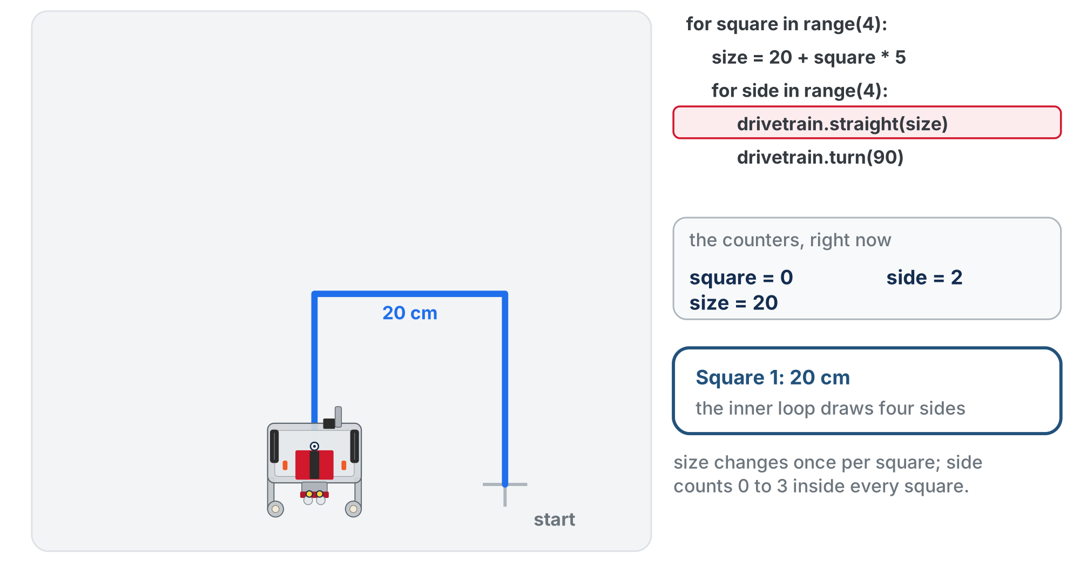
Pass 1 of the outer loop: square = 0
size is 20, and side counts 0 to 3 as the inner loop draws the first square.
Notes:
On the lesson page this is an animation of the first two passes, with the running line highlighted and the counters shown. This slide and the next are two moments from it. Trace it out loud together: square = 0, size 20, four sides; square = 1, size 25, four sides.

Slide 28
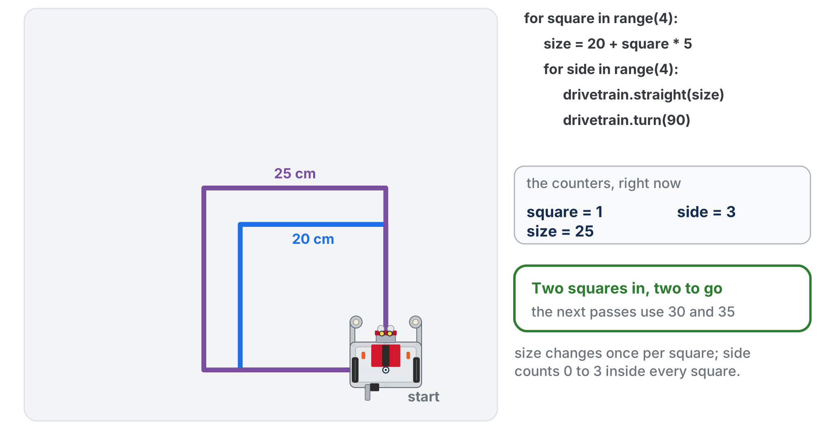
Pass 2 of the outer loop: square = 1
Watch which counter changes when: size once per square, side four times inside every square.
Notes:
size was worked out again at the top of the pass: 25. The 25 cm square starts from the same corner, around the first. The animation stops after two squares; the program goes on to 30 and 35.

Slide 29
Check your understanding
In the nested program, how many times does drivetrain.straight() run in total?
A. Four times: once per square
B. Sixteen times: four sides in each of four squares
C. Eight times
D. Once, because it is inside two loops
Notes:
Answer: B. Have students predict the total before running; 16 surprises people who expect 8. The slippery idea is not the syntax, it is that the outer loop's body is a whole loop.

Slide 30
Answer
In the nested program, how many times does drivetrain.straight() run in total?
A. Four times: once per square
B. Sixteen times: four sides in each of four squares
C. Eight times
D. Once, because it is inside two loops
The inner loop runs four times per pass of the outer loop, and the outer loop runs four times: 4 × 4 = 16 sides.
Notes:
Answer: B. Have students predict the total before running; 16 surprises people who expect 8. The slippery idea is not the syntax, it is that the outer loop's body is a whole loop.

Slide 31
Check your understanding
What happens if you indent the size line twice, so it lines up with the drivetrain lines?
A. Nothing changes
B. The program will not run at all
C. Every square comes out the same size
D. The robot draws only one square
Notes:
This is deliberately a near-miss. Say out loud that moving size deeper does not break anything, because students often believe any indentation change breaks a program. The change that does matter is moving it above the outer loop.

Slide 32
Answer
What happens if you indent the size line twice, so it lines up with the drivetrain lines?
A. Nothing changes
B. The program will not run at all
C. Every square comes out the same size
D. The robot draws only one square
It still computes the same value, just four times per square instead of once: wasteful, but harmless. Indentation changes WHEN a line runs. (Move it ABOVE the outer loop, though, and every square would be the same size.)
Notes:
This is deliberately a near-miss. Say out loud that moving size deeper does not break anything, because students often believe any indentation change breaks a program. The change that does matter is moving it above the outer loop.

Slide 33
Activity · Draw a nest of squares
Activity
Type the nested-loop program and run it. Before you press the button, write down two predictions: the total distance the robot will drive, and how many turns it will make. Check them against what you see.
1
Change it to draw six squares. What did you have to change, and what stayed the same?
2
Challenge: make the squares shrink instead of grow, so the largest is drawn first. There are two ways: change the arithmetic, or count down.
3
Notes:
Step 1 predictions, for the teacher: 4 × (20 + 25 + 30 + 35) = 440 cm and 16 turns. Less than 440 cm on the floor is wheel slip and corner error, and the biggest square rarely closes perfectly: that is the encoder and wheel-slip reality, not a bug. Step 2 is the real check: only the outer range changes; the inner loop and the size formula are untouched, which is the payoff of nesting. The two range(4)s mean different things: one counts squares, the other counts sides. Step 3 is for groups that finish early; both the arithmetic answer and counting down are right.

Slide 34
Real-world connections
WEB
DATA
ROBOTICS
Feeds & lists
Processing records
Sensor polling
A social feed loops over posts, drawing each one with the same code.
Analyzing a million rows is one loop that runs a million times, with no extra code.
Robots loop constantly: read sensors, decide, act, repeat, thousands of times a second.
Notes:
Loops are how software handles "do this for every..." without endless copy-paste.

Slide 35
Wrap-up
What does range(4) produce, and how many times does the loop run?
What decides which lines are inside the loop?
In a nested loop, which loop runs more often: the inner one or the outer one?
How did the outer loop change the size of each square?
Next: Python functions with parameters, the text version of Lessons 1-3 to 1-5
Notes:
Answers: 0, 1, 2, 3, so four times. Indentation. The inner one, once per side, per square. Its counter was used in the arithmetic that set size. Formative: correct for syntax, the right range for a shape, correct reading of indentation, and whether a student can say which loop a line belongs to and why. Exit ticket: "Write a loop to draw a hexagon" (look for range(6) and a 60 degree turn); stretch: three hexagons of different sizes. Next lesson, the nested squares program is crying out to become square(side_length) called from a loop.

