Slide 1

MODULE 2 · LESSON 2-1
The Reflectance Sensor
By the end of this lesson you can
Explain how a reflectance sensor tells light surfaces from dark ones
Read the left and right sensors with get_left() and get_right()
Start robot.py, your one file for the course, and write its first two functions
Interpret sensor values (roughly 0.0 on white to 1.0 on black)
Pick a threshold and record calibration data for your own robot and tape
Notes:
50 to 60 minutes. First look at sensing, and the day robot.py is born. The lesson has six objectives; the slide folds "pick a threshold" and "record calibration data" into one line.

Slide 2
From doing to sensing
In Module 1 the robot only did what you told it, step by step
Now it gets to sense the world
Its "eyes": two reflectance sensors that tell a white surface from a black line
Today you record the readings you will rely on for the rest of the module
Question for the room: you can see the line. How could a robot tell?
Notes:
Quick hook. Take a few answers before moving on; most students guess a camera or a color sensor, which sets up the next slide nicely.

Slide 3
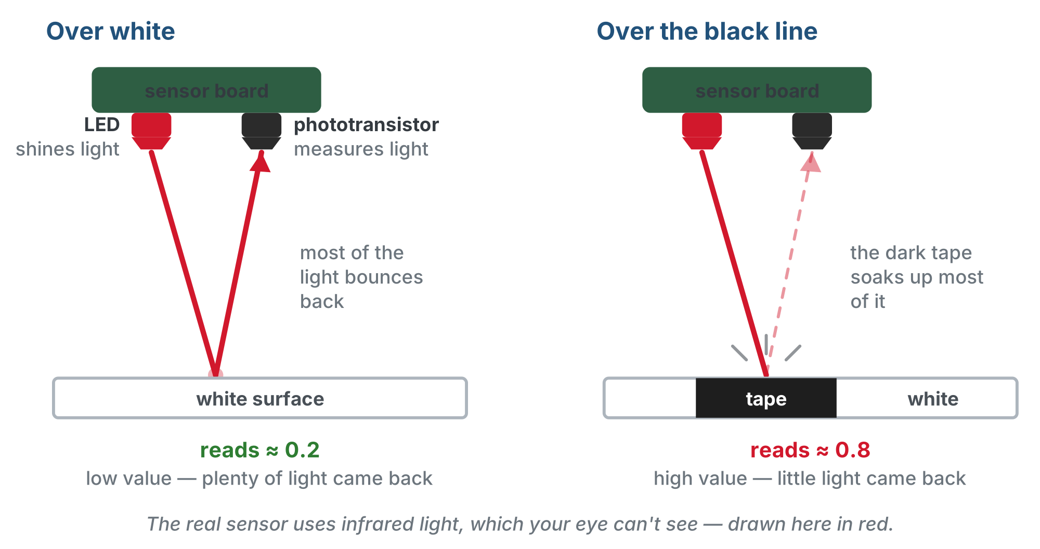
How the robot "sees" a line
The LED shines, the phototransistor listens. White bounces most of the light back: a low reading. Black tape soaks it up: a high reading.
Notes:
Flip a robot over and show the two sensors underneath. Each is a pair of parts side by side: an LED shining down, and a phototransistor right next to it measuring how much light comes back. The real sensor uses infrared, which is invisible; the figure draws it in red.

Slide 4
It measures light, not color
The sensor only knows how much light came back
White surface: most light bounces back, a low value (around 0.1–0.3)
Black line: light is absorbed, a high value (around 0.7–0.9)
Anything dark reads like a line, anything light reads like the floor
A left and a right sensor, each with its own reading
Two readings let the robot tell which side of a line it is on

Slide 5
Check your understanding
Your sensor reads 0.8. What is it most likely over?
A. A white surface
B. A black line
C. The edge of the line
D. Nothing: that value is impossible
Notes:
Answer: B. High values (near 1.0) mean little light came back: a dark surface absorbs it. White gives low values near 0.0.

Slide 6
Answer
Your sensor reads 0.8. What is it most likely over?
A. A white surface
B. A black line
C. The edge of the line
D. Nothing: that value is impossible
High values (near 1.0) mean little light came back: a dark surface absorbs it. White gives low values near 0.0.

Slide 7
Read the sensors in Python
Reading a sensor is just importing its class and calling a method:
from XRPLib.reflectance import Reflectance
from XRPLib.board import Board
reflectance = Reflectance.get_default_reflectance()
board = Board.get_default_board()
board.wait_for_button()
left = reflectance.get_left()
right = reflectance.get_right()
print("Left sensor:", left)
print("Right sensor:", right)
Notes:
Have students run this as a scratch program before robot.py exists. They get two numbers, then the program ends. Let them notice that sliding the robot afterwards changes nothing: that frustration is the point of the next slide.

Slide 8
A snapshot, not a live feed
Run it: you get two numbers, then the program ends
get_left() and get_right() run once, the instant you press the button
Python reaches the bottom of the file and the program is over
Sliding the robot across the tape afterwards changes nothing on screen
To watch the readings change, the reading has to happen over and over: it goes in a loop

Slide 9
Pausing a program: time.sleep()
A loop with nothing slowing it down runs fast: fifty readings print before you could move the robot
Python comes with a built-in module called time. It isn't part of XRPLib; it ships with Python itself (and MicroPython on the XRP)
Bring it in with import time at the top of the file
time.sleep() means "the sleep function that lives in the time module", the same way reflectance.get_left() belongs to the sensor
Notes:
The dot notation is the new idea here: module dot function, just like object dot method. MicroPython is the version of Python running on the XRP.

Slide 10
time.sleep() takes seconds
One number: how many seconds to pause. Whole numbers and decimals both work.
import time
time.sleep(1) # wait one second
time.sleep(0.5) # wait half a second
time.sleep(0.1) # wait a tenth of a second
The program stops at that line, then carries on. Anything already in motion keeps going: motors that were running are still running.
Notes:
The lesson lists the three sleeps as examples rather than one program. The point about motors matters next lesson: sleeping does not stop the robot.

Slide 11
One file, for the rest of the course
Until now, every lesson started a new program
From here on you have one file, robot.py, and each lesson adds to it
Sensor functions this module, then driving, grid driving in Module 3, and on to the end
Lost the file or joined partway? The robot.py templates page has it as it stands after every lesson
The loop you are about to write is the first piece of code you keep

Slide 12
Create robot.py with this start
from XRPLib.reflectance import Reflectance
from XRPLib.differential_drive import DifferentialDrive
from XRPLib.board import Board
import time
reflectance = Reflectance.get_default_reflectance()
drivetrain = DifferentialDrive.get_default_differential_drive()
board = Board.get_default_board()
# ===== RUN =====
board.wait_for_button()
# call ONE test function here
Notes:
Everyone creates robot.py now and pastes this in. The templates page on the site has the file as it stands after every lesson, skeletons pasted and nothing written, for anyone who loses it or joins late.

Slide 13
Two rules that keep it working all year
New code goes above RUN, never below it. Python runs top to bottom, so everything the run block calls has to be defined above it
One test at a time. The one line under RUN calls the test you are working on: change the call, don't stack them
Each lesson gives a skeleton to paste: a banner comment, what the section does, its settings, function outlines and a test function
Notes:
Make the two file rules a ritual today: new code above RUN, one test call. They are what keeps the Module 5 file readable.

Slide 14
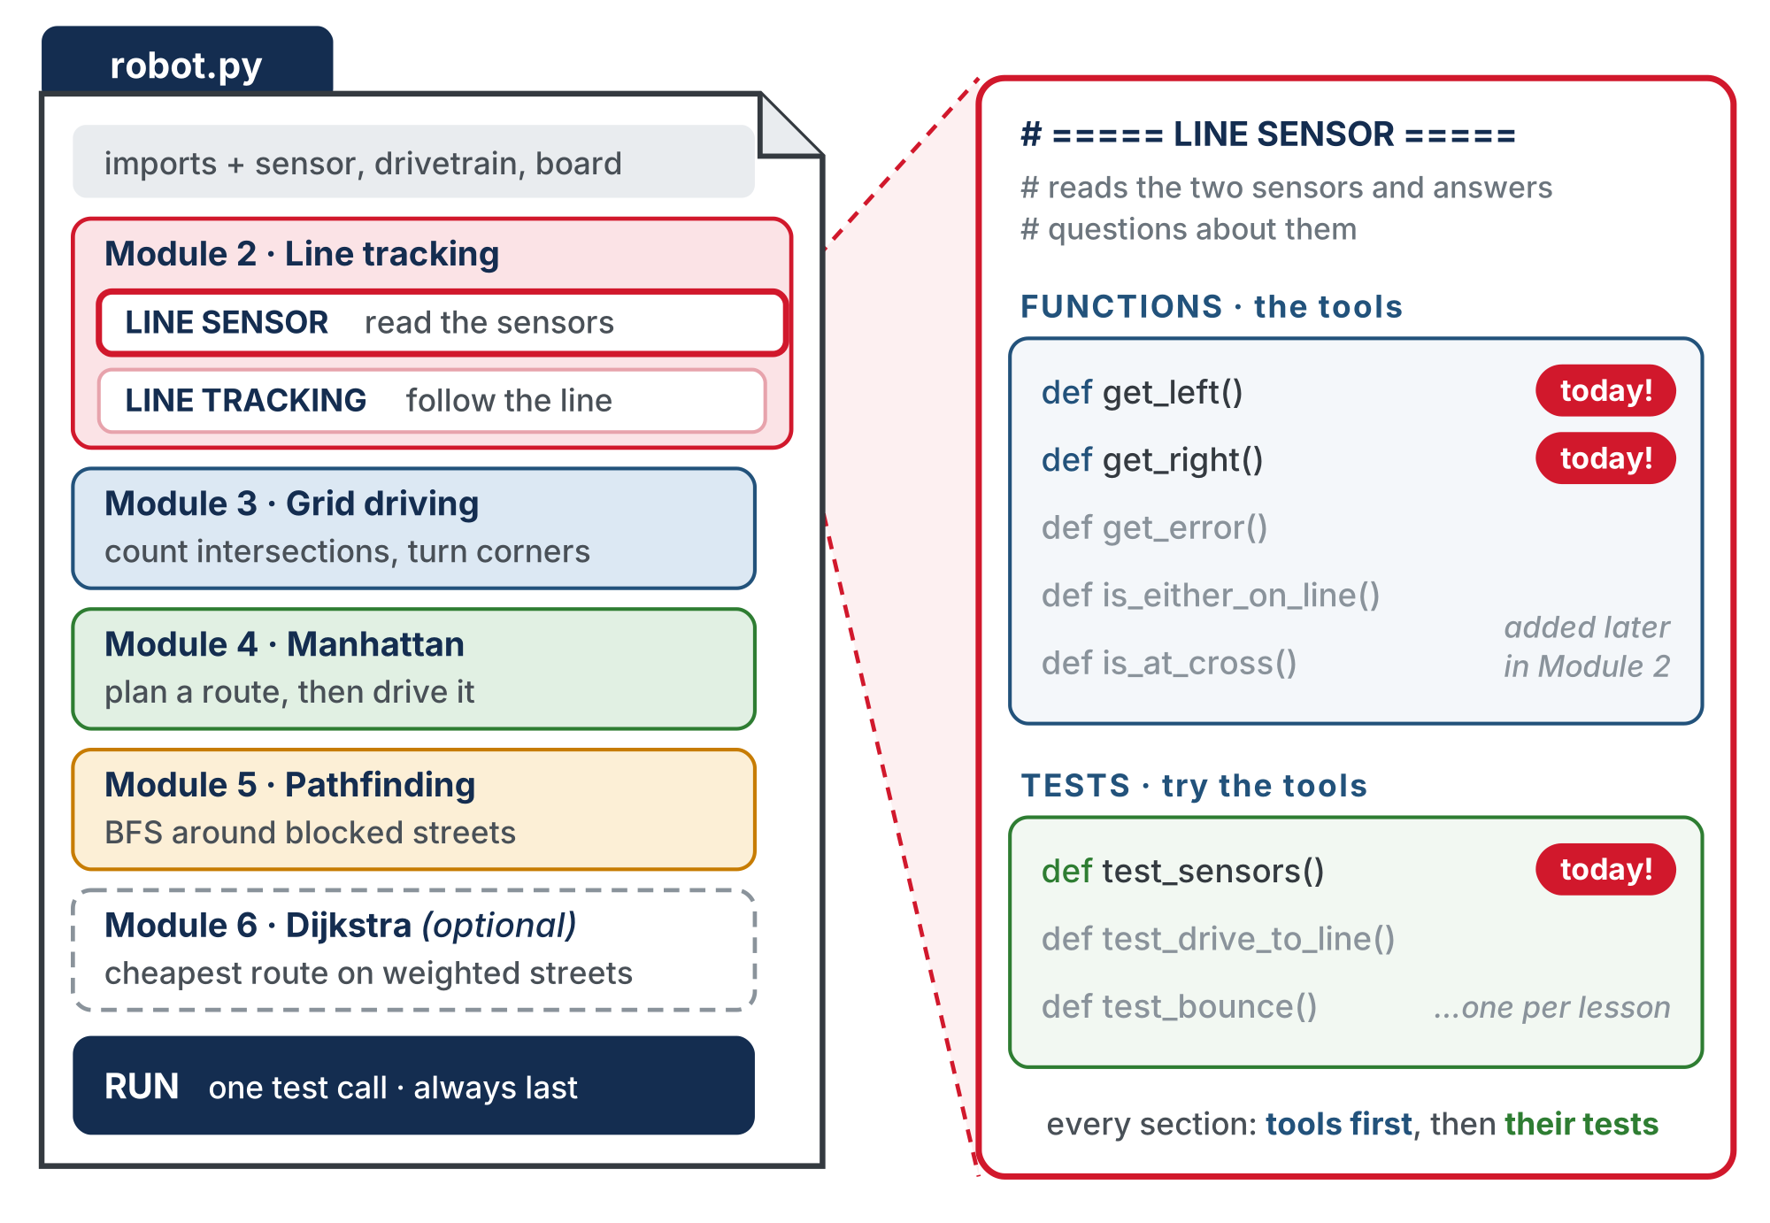
One file, one section per job
Each module adds its sections above RUN. In every section the functions come first, then the tests. Today you start LINE SENSOR with three of them.
Notes:
Point at the three marked "today": get_left, get_right and test_sensors. The greyed-out ones arrive later in the module. The figure is a copy of the lesson's robot-py-one-file.svg with its footer line re-anchored so the slide renderer draws it cleanly.

Slide 15
Paste above RUN: the LINE SENSOR section
# ===== LINE SENSOR =====
# Reads the two reflectance sensors and answers questions
# about them. Starts here with the two raw readings; over this
# module it grows to answer "how far off the line am I?" and
# "am I on a line? on a cross?" Nothing in here drives.
# Everything that drives asks these functions instead of the
# hardware.
def get_left():
# return the left reflectance reading
pass
def get_right():
# return the right reflectance reading
pass
Notes:
This and the next slide are one skeleton on the lesson page, pasted in one go. It is split here so it stays readable from the back of the room.

Slide 16
... and its test, still in the same paste
The test is already written. It calls your two functions.
def test_sensors():
# prints both readings 50 times, a tenth of a second apart
for i in range(50):
print("Left:", get_left(), " Right:", get_right())
time.sleep(0.1)
pass means "nothing here yet": it holds the place of the body so the file runs. Delete it when the real line goes in.

Slide 17
Your first two functions
get_left() and get_right() are one line each: they return the reading from reflectance
You wrote functions with return in Lesson 1-11
New: they use reflectance without being handed it
It was created at the top of the file, outside any function, so every function below can see it
The same way polygon() used drivetrain in Module 1
Notes:
Do not write the two bodies on the board; students write them. The lesson page has a reveal to check against after they run test_sensors().

Slide 18
Where the returned value goes
A function call is a question, and return is its answer
At the print line in test_sensors(), Python stops at get_left() and runs your function
The value after its return takes the place of the call
By the time print runs, it is as if you had typed the number itself, say 0.23
You ask get_left(), you get a number back to print, compare or do arithmetic with

Slide 19
Two things to watch for
Two things with the same name. Inside yours, reflectance.get_left() is the sensor's own method, not your function calling itself
The reflectance. in front makes the difference. Yours is a plain function that asks the sensor and passes its answer on
If it prints None, the return is missing
A function that ends without a return hands back None, Python's word for "nothing"
The sensor is fine; the number just never left the function

Slide 20
Check your understanding
test_sensors() prints Left: None Right: None every time, even while you slide the robot across the tape. What is the most likely cause?
A. The reflectance sensor is unplugged
B. get_left() and get_right() read the sensor but never return the reading
C. The robot is not over the tape
D. print() cannot show sensor readings
Notes:
Answer: B. A function that ends without a return statement gives back None. The sensor was read inside the function, but the value never came out of it. Put return in front of the read.

Slide 21
Answer
test_sensors() prints Left: None Right: None every time, even while you slide the robot across the tape. What is the most likely cause?
A. The reflectance sensor is unplugged
B. get_left() and get_right() read the sensor but never return the reading
C. The robot is not over the tape
D. print() cannot show sensor readings
A function that ends without a return statement gives back None. The sensor was read inside the function, but the value never came out of it. Put return in front of the read.

Slide 22
Why wrap one line in a function?
From now on every program asks for a sensor reading by this name
Only this one place knows how the hardware is read
In six lessons these two will be the bottom of a toolkit of functions, and they will not have changed
Read it once → keep reading: the idea behind next lesson's while loop
Notes:
The two wrappers are trivial on purpose. Students call get_left() from here to the end of the course, and by the time the sensor toolkit is finished in Lesson 2-7 these two have been in use for six lessons.

Slide 23
Write them and run test_sensors()
Try it
Write the two bodies in place of pass
1
Set the run line to test_sensors() and run
2
You have about five seconds: slide the robot across the tape and watch the numbers follow it
3
Seeing None? Check the return.
Notes:
Same two readings as the first program; they just happen fifty times now, a tenth of a second apart. Setup that makes or breaks the readings: tape pressed flat with no bubbles, sensors a few millimeters off the surface, no direct sunlight or bright overhead lights. Emphasize print() as the number-one debugging tool all module.

Slide 24
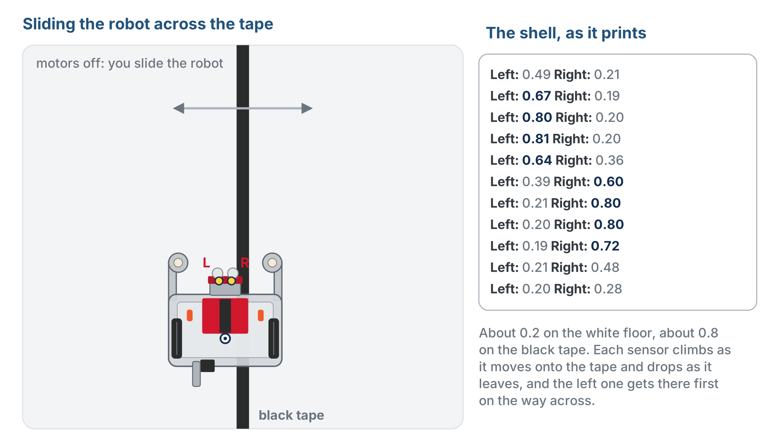
What you should see
About 0.2 on white, about 0.8 on the tape. The left sensor climbs first, then the right one as the left leaves.
Notes:
The figure on the lesson page is an animation of the robot slid by hand across the tape and back while the shell scrolls; this is the moment just after the first crossing, with the whole sweep in the shell (newest line at the bottom). With the tape between the two sensors, both read about 0.5.

Slide 25
Activity · Calibrate and pick a threshold
Activity
Surfaces and tape differ, so measure your own. Run test_sensors() and record:
Both sensors on white
1
Both sensors on the black line
2
One sensor on the edge
3
threshold = (highest white value + lowest black value) ÷ 2
Notes:
Have students save their calibration data: they reuse it in Lessons 2-2 through 2-8. 0.5 is a fine starting guess, but a glossy surface, a faded line or bright lighting can push the real edge value well off it. Students who calibrate get line following that works in 2-5 and 2-6; students who guess spend those lessons fighting a bad threshold. Real robots calibrate on startup.

Slide 26
The threshold
Halfway between your highest white reading and your lowest black reading
Your programs use it to decide "on the line" vs. "off"
Above it: the line. Below it: white
0.5 is a fine first guess, but your surface, tape and lighting can move it
Calibrate instead of trusting a textbook number. Write your values down!

Slide 27
Check your understanding
Your "off line" (white) values average 0.2 and your "on line" (black) values average 0.8. What threshold should you choose?
A. 0.2
B. 0.5
C. 0.8
D. 1.0
Notes:
Answer: B. Halfway between 0.2 and 0.8 is 0.5. A reading above it means the line; below it means white.

Slide 28
Answer
Your "off line" (white) values average 0.2 and your "on line" (black) values average 0.8. What threshold should you choose?
A. 0.2
B. 0.5
C. 0.8
D. 1.0
Halfway between 0.2 and 0.8 is 0.5. A reading above it means the line; below it means white.

Slide 29
Check your understanding
Why does the XRP have two reflectance sensors instead of one?
A. As a spare in case one breaks
B. So it can tell which side of the line it is on
C. To read the line twice as fast
D. One reads white, the other reads black
Notes:
Answer: B. Two independent readings let the robot tell whether it is drifting left or right of the line: essential for following it later.

Slide 30
Answer
Why does the XRP have two reflectance sensors instead of one?
A. As a spare in case one breaks
B. So it can tell which side of the line it is on
C. To read the line twice as fast
D. One reads white, the other reads black
Two independent readings let the robot tell whether it is drifting left or right of the line: essential for following it later.

Slide 31
Real-world connections
RETAIL
WAREHOUSES
PHONES
Barcode scanners
Line-following AGVs
Ambient light
Scanners read the pattern of light and dark bars exactly the way your sensor reads tape.
Automated guided vehicles follow lines taped or painted on warehouse floors.
Your phone's ambient light sensor dims its screen using the same idea: measuring reflected or available light.

Slide 32
Wrap-up
Does a higher reading mean lighter or darker?
What is a threshold, and how do you pick one?
Why two sensors?
Next: a while loop drives the robot until it finds the line
Notes:
Answers: darker, less light bounced back. The cutoff between line and white, halfway between your calibrated values. To tell which side of the line the robot is on. Formative: can students read and interpret values and explain how the sensor works? Exit ticket: white average 0.2, black average 0.8, choose a threshold (0.5). Next lesson THRESHOLD goes into the LINE SENSOR section.

