Slide 1

MODULE 2 · LESSON 2-5
Proportional Control
By the end of this lesson you can
Explain a setpoint, and why the edge of the line (about 0.5) is ours
Compute error as setpoint − reading, and read its sign
Turn error into a steering correction with a gain, Kp
Write get_error() and the control loop in robot.py
Tune Kp by watching the robot
Notes:
60+ minutes. This is the first control loop, and the hardest shift in the module: from "do this, then that" to "constantly read and adjust". Lean on the car-steering analogy.

Slide 2
Bouncing is not following
Bounce driving kept the robot inside the circle, but it reacted after hitting the line
Following means constantly adjusting so you never leave it
Like nudging the steering wheel around a gentle curve, instead of stopping to turn
Today: your first control loop, one of the most important ideas in the course

Slide 3
Steer while you drive: arcade()
arcade(speed, turn) sets a forward speed and a steering amount in one call, and it does not stop the program.
drivetrain.arcade(speed, turn)
# works like:
drivetrain.set_effort(speed - turn,
speed + turn)
# then XRPLib scales both so the
# faster wheel gets the larger of
# speed and turn
A positive turn steers left (counterclockwise)
A negative turn steers right
Zero drives straight
Same rule as Lesson 1-6's Arcade block
arcade(0.3, 0.15) slows the left wheel, speeds up the right: it curves left

Slide 4
Check your understanding
What does arcade(0.3, -0.15) do?
A. Drives forward, curving right
B. Drives forward, curving left
C. Drives backward
D. Spins in place
Notes:
Answer: A. The speed is positive, so it drives forward. The turn is negative, so the left wheel speeds up, the right slows down, and the robot curves right.

Slide 5
Answer
What does arcade(0.3, -0.15) do?
A. Drives forward, curving right
B. Drives forward, curving left
C. Drives backward
D. Spins in place
The speed is positive, so it drives forward. The turn is negative, so the left wheel speeds up, the right slows down, and the robot curves right.

Slide 6
Setpoint and error
The setpoint is the reading we want the sensor to hold
Following the edge of the line, that is about 0.5: halfway between white and black
Error is how far off we are
error = setpoint − sensor_reading
Notes:
Hammer this: the setpoint is the edge (about 0.5), not white (0.0). The robot rides the boundary. Encourage students to use their own edge value from Lesson 2-1 rather than assuming exactly 0.5.

Slide 7
The sign says which way, the size says how far
Where the robot is | Reading | error = 0.5 − reading | Meaning
On the edge (perfect) | 0.5 | 0.0 | no correction
Drifted onto white | 0.2 | +0.3 | steer toward the line
Drifted onto black | 0.8 | −0.3 | steer back off the line
Far onto white | 0.1 | +0.4 | steer hard toward the line

Slide 8
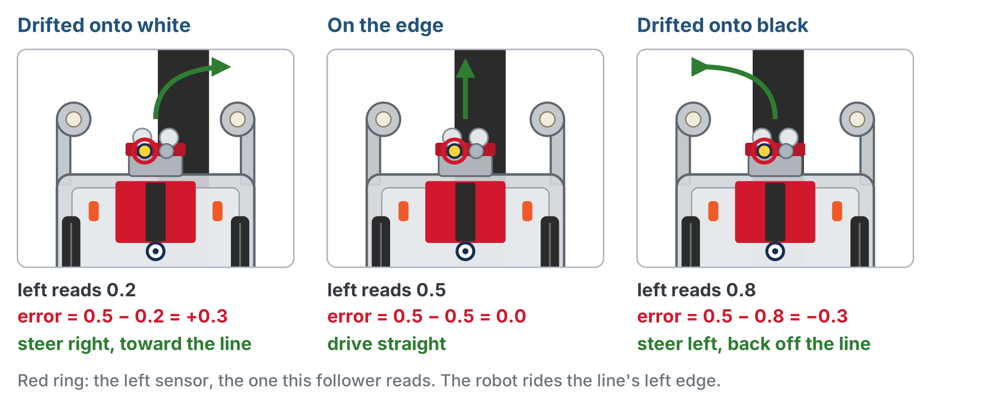
Reading the error
Positive error steers toward the line, negative steers back off it. The sign picks the direction, so the loop needs no if/else.

Slide 9
Check your understanding
The setpoint is 0.5 and the sensor reads 0.2. What is the error?
A. −0.3
B. +0.3
C. 0.7
D. 0.2
Notes:
Answer: B. error = 0.5 − 0.2 = +0.3. The positive sign says the robot drifted onto white and should steer toward the line.

Slide 10
Answer
The setpoint is 0.5 and the sensor reads 0.2. What is the error?
A. −0.3
B. +0.3
C. 0.7
D. 0.2
error = 0.5 − 0.2 = +0.3. The positive sign says the robot drifted onto white and should steer toward the line.

Slide 11
From error to steering: the gain Kp
We scale the error by a proportional gain, Kp, to set how strongly the robot reacts
With Kp = 0.5, an error of +0.3 gives a correction of +0.15
Bigger error → bigger correction → sharper steer
Error 0 → correction 0 → drive straight
correction = error × Kp
Notes:
Kp breaks the lowercase naming rule on purpose: every control-systems text writes the proportional gain as Kp. In robot.py it is a file-level setting, so it is written in capitals, KP, like THRESHOLD.

Slide 12
Why the minus sign?
We steer with the correction, with a minus sign in front of it:
drivetrain.arcade(BASE_EFFORT, -correction)
Positive error = drifted onto white, so steer right. In arcade() a positive turn steers left. The minus lines the math up with the robot.
Notes:
No if/else anywhere: the sign of the error does the deciding. Next lesson the error is measured differently, and the minus sign comes out again.

Slide 13
Check your understanding
If Kp = 0.6 and the error is 0.3, what is the correction?
A. 0.9
B. 0.18
C. 0.3
D. 0.5
Notes:
Answer: B. correction = error × Kp = 0.3 × 0.6 = 0.18.

Slide 14
Answer
If Kp = 0.6 and the error is 0.3, what is the correction?
A. 0.9
B. 0.18
C. 0.3
D. 0.5
correction = error × Kp = 0.3 × 0.6 = 0.18.

Slide 15
Add to robot.py: the LINE SENSOR section
SETPOINT goes under THRESHOLD. get_error() goes under get_right().
SETPOINT = 0.5 # the reading at the edge of the line
def get_error():
# return SETPOINT minus the left reading
pass
The error is a sensor question: how far off the edge am I?

Slide 16
Add to robot.py: a new LINE TRACKING section
Paste it above RUN. The loop's outline is inside the test.
# ===== LINE TRACKING =====
BASE_EFFORT = 0.3 # forward speed while following
KP = 0.5 # proportional gain -- tune this!
def test_follow():
# loop forever:
# error = get_error()
# correction = error times KP
# steer: arcade() with BASE_EFFORT and minus the correction
# time.sleep(0.01), so the loop doesn't flood the processor
pass
Notes:
The section comment in the lesson is longer (it says the section grows over the module); the slide shortens it. The time.sleep(0.01) only keeps the loop from flooding the processor.

Slide 17
Step 1 · Write the loop and run it
Activity
Write get_error(), and turn the comments in test_follow() into code
1
Set the run line to test_follow(). Put the left sensor on the edge of the line, press the button
2
It should hold the edge, nudging left and right as the line curves
3
Drives straight off? Check the sign of your error and the minus in front of the correction. Spins in place? Check the order of the two arguments to arcade().

Slide 18
Step 2 · Tune Kp
Activity
Run the test with KP = 0.2 and write down what the robot does on a curve
1
Run it again with KP = 0.5, then with KP = 1.0
2
Decide: which is too high, which too low, and what does each one look like?
3
Notes:
There is no single right Kp: it depends on the surface, the tape and the base speed. The goal is the relationship, not a magic number. Start everyone at BASE_EFFORT = 0.3 or lower so the robot is observable.

Slide 19
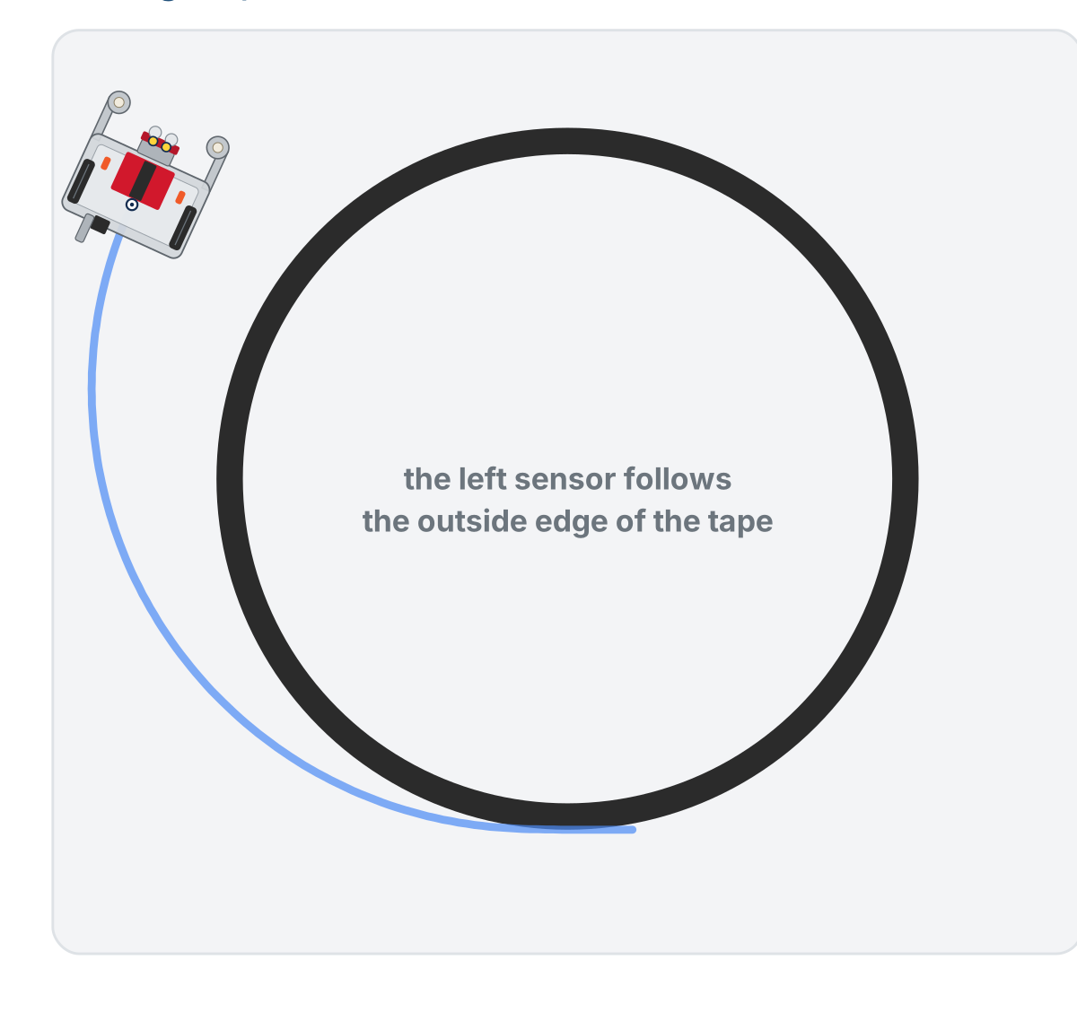
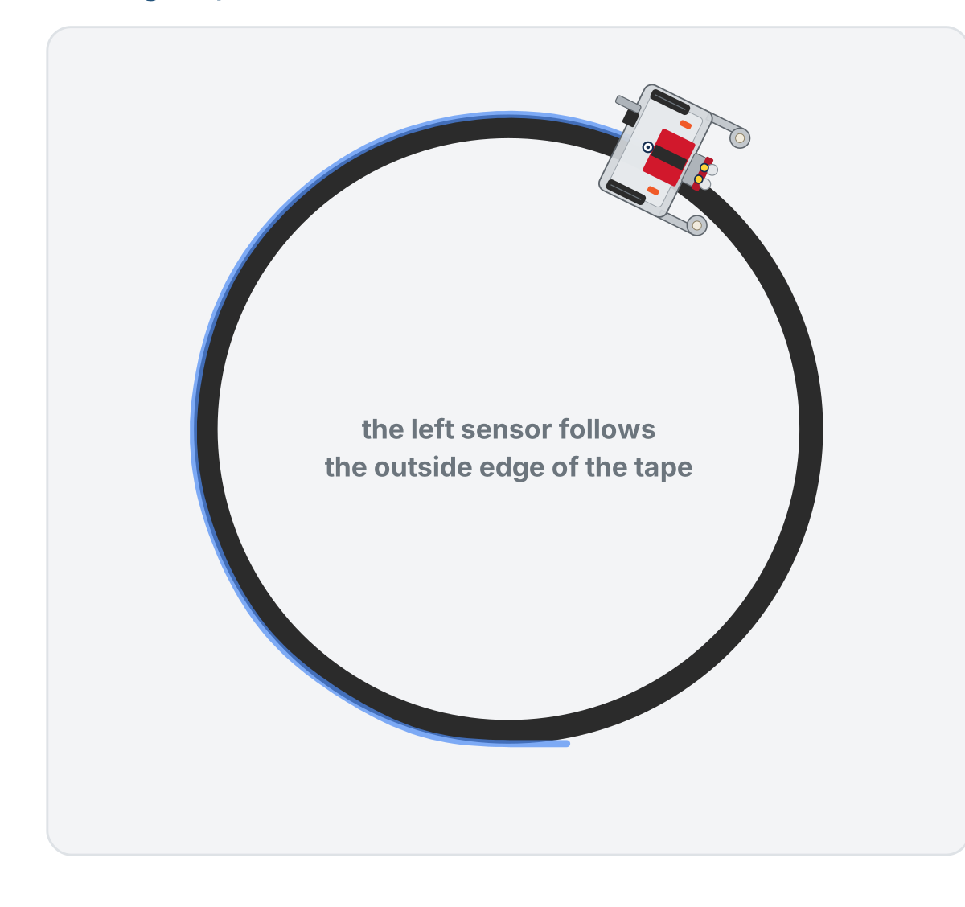
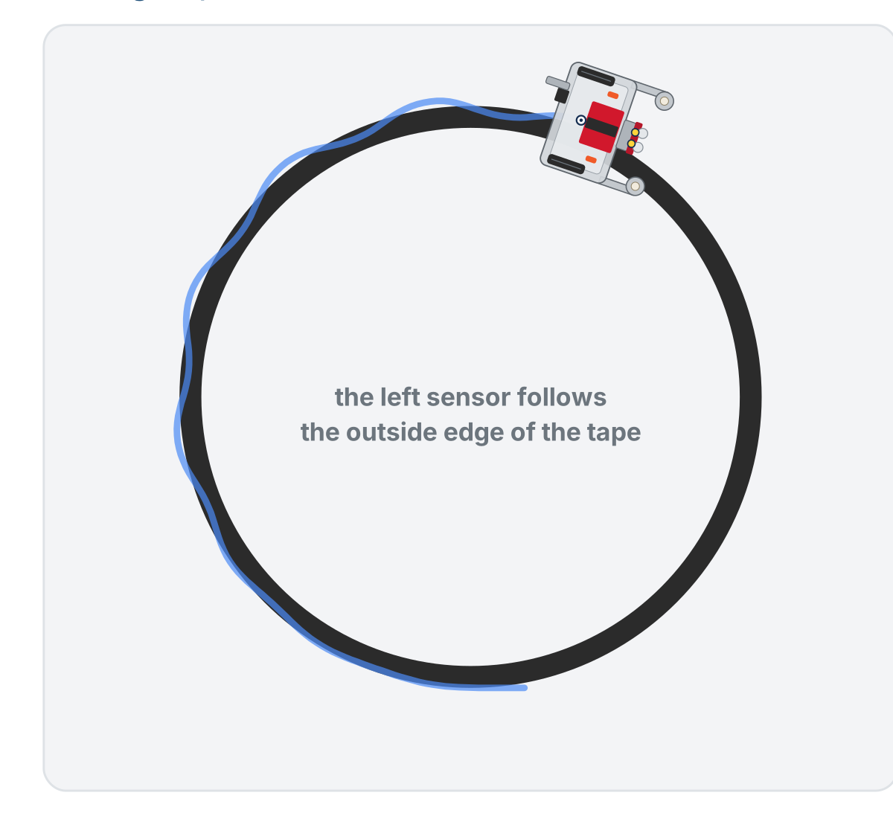
What too low, about right and too high look like
Too low (KP = 0.2): drifts off the curve
About right (KP = 0.5): holds the edge
Too high (KP = 1.0): weaves and over-corrects
No single correct number: it depends on your surface, tape and speed
Notes:
Show this after the class has tried all three values. The figure on the lesson page is an animation of the three runs; these are its three end states. Too low: the robot cannot steer hard enough for the curve. Too high: every small error turns into a big swerve.

Slide 20
Check your understanding
Your robot follows the line but weaves back and forth rapidly, never settling. What should you do to Kp?
A. Increase it: it needs to react harder
B. Decrease it: it is over-correcting
C. Set it to 0
D. Leave KP and increase BASE_EFFORT instead
Notes:
Answer: B. Rapid weaving is over-correction: Kp is too high. Lower it for gentler, smoother steering.

Slide 21
Answer
Your robot follows the line but weaves back and forth rapidly, never settling. What should you do to Kp?
A. Increase it: it needs to react harder
B. Decrease it: it is over-correcting
C. Set it to 0
D. Leave KP and increase BASE_EFFORT instead
Rapid weaving is over-correction: Kp is too high. Lower it for gentler, smoother steering.

Slide 22
Print every 50th pass: %
The loop runs hundreds of times a second. a % b is the remainder after dividing a by b (nothing to do with percent).
7 % 3 # 1 (3 goes into 7 twice, remainder 1)
10 % 5 # 0 (5 goes into 10 exactly)
50 % 50 # 0
51 % 50 # 1
100 % 50 # 0
149 % 50 # 49
150 % 50 # 0
i % 50 == 0 is true on pass 0, 50, 100 ... and false in between

Slide 23
Check your understanding
What is 120 % 50, and would a print inside if i % 50 == 0: happen on pass 120?
A. 2.4, and yes
B. 20, and no: 120 is not a multiple of 50
C. 0, and yes
D. 70, and no
Notes:
Answer: B. 50 goes into 120 twice (100) with 20 left over, so 120 % 50 is 20. Only passes whose remainder is 0 (multiples of 50) print.

Slide 24
Answer
What is 120 % 50, and would a print inside if i % 50 == 0: happen on pass 120?
A. 2.4, and yes
B. 20, and no: 120 is not a multiple of 50
C. 0, and yes
D. 70, and no
50 goes into 120 twice (100) with 20 left over, so 120 % 50 is 20. Only passes whose remainder is 0 (multiples of 50) print.

Slide 25
Watch the sign flip: test_sweep()
No motors. Slide the robot by hand so the left sensor goes from white, across the edge, onto black.
def test_sweep():
# no motors: sweep the robot across the line BY HAND
for i in range(500):
error = get_error()
correction = error * KP
if i % 50 == 0:
print(f"i={i} error={error:.2f} correction={correction:.2f}")
time.sleep(0.02)
At the edge the error falls to zero and goes negative: the steering changes direction with no if/else
Notes:
This is the moment to make the sign flip physical: motors off, robot in hand, the printed error crossing zero as the sensor crosses the edge. If the error never changes sign, the sensor did not cross the edge, or SETPOINT is not their edge value from Lesson 2-1.

Slide 26
Step 3 · Put it in your own loop
Activity
Your loop is a while True:, so there is no i. Make your own counter:
Set a counter to zero before the loop
1
At the end of the loop body, add one to it (count = count + 1, from Lesson 1-9)
2
Print the error and correction only when the counter is a multiple of 50
3
Tune KP again, reading the numbers: too high shows up as a correction that flips sign on nearly every printed line

Slide 27
Real-world connections
CARS
FLIGHT
DRIVING
Cruise control
Drone stabilization
Lane-keeping
The further you are below the set speed, the harder it presses the throttle: error × gain.
Drones hold level by constantly correcting in proportion to how far they have tilted.
Lane assist steers in proportion to how far the car has drifted from center.

Slide 28
Wrap-up
What is the setpoint for edge-following, and why?
What do the sign and the size of the error each tell you?
The robot oscillates. Is Kp too high or too low?
Next: two sensors, a simpler error, smoother tracking
Notes:
Answers: about 0.5, the boundary between white and black. Sign = which way to steer, size = how hard. Too high: decrease it. Exit ticket: "setpoint 0.5, sensor 0.2: error and steer direction?" (+0.3, toward the line).

