Slide 1

MODULE 2 · LESSON 2-10
Final Project
By the end of this lesson you can
Combine both sections of robot.py into one complete, working program
Write a short, readable project function that is mostly calls to your own functions
Test and debug a real robot behavior systematically
Explain and demonstrate your design
Notes:
Multi-day capstone. Treat it as an arc: plan, build, test, present. The final project is the summative assessment for Module 2.

Slide 2
Put it all together
robot.py has two finished sections
LINE SENSOR reads the tape
LINE TRACKING drives on it
This project is the first program built entirely out of them
Follow the taped circle, detect the cross, reverse direction, repeat four times, then stop
The capstone of Module 2: sensors, control loops, decisions, and functions built on functions

Slide 3
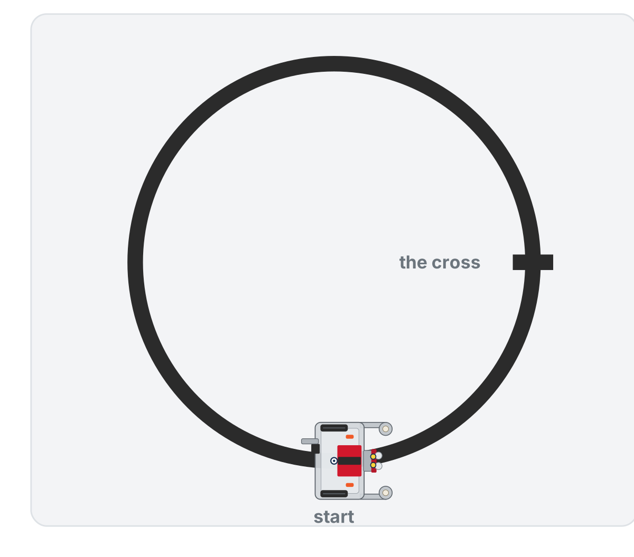
The mission
Your robot must:
Follow the taped circle with track_to_intersection()
Detect the cross intersection
Reverse direction
Keep following, and repeat for 4 total reversals
Stop and print a completion message
Built the classes? Use tracker.track_to_intersection() wherever the list says track_to_intersection()

Slide 4
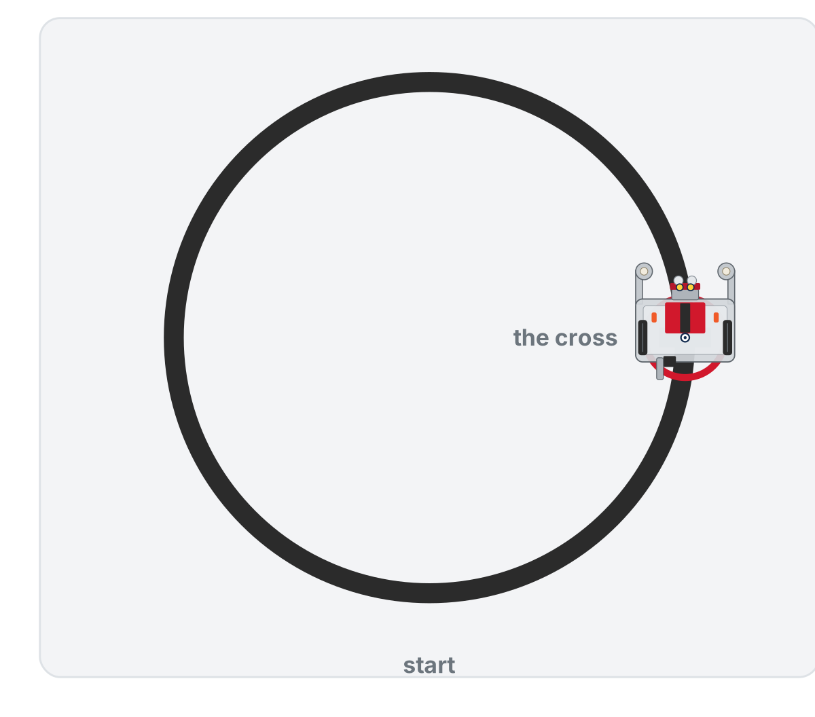
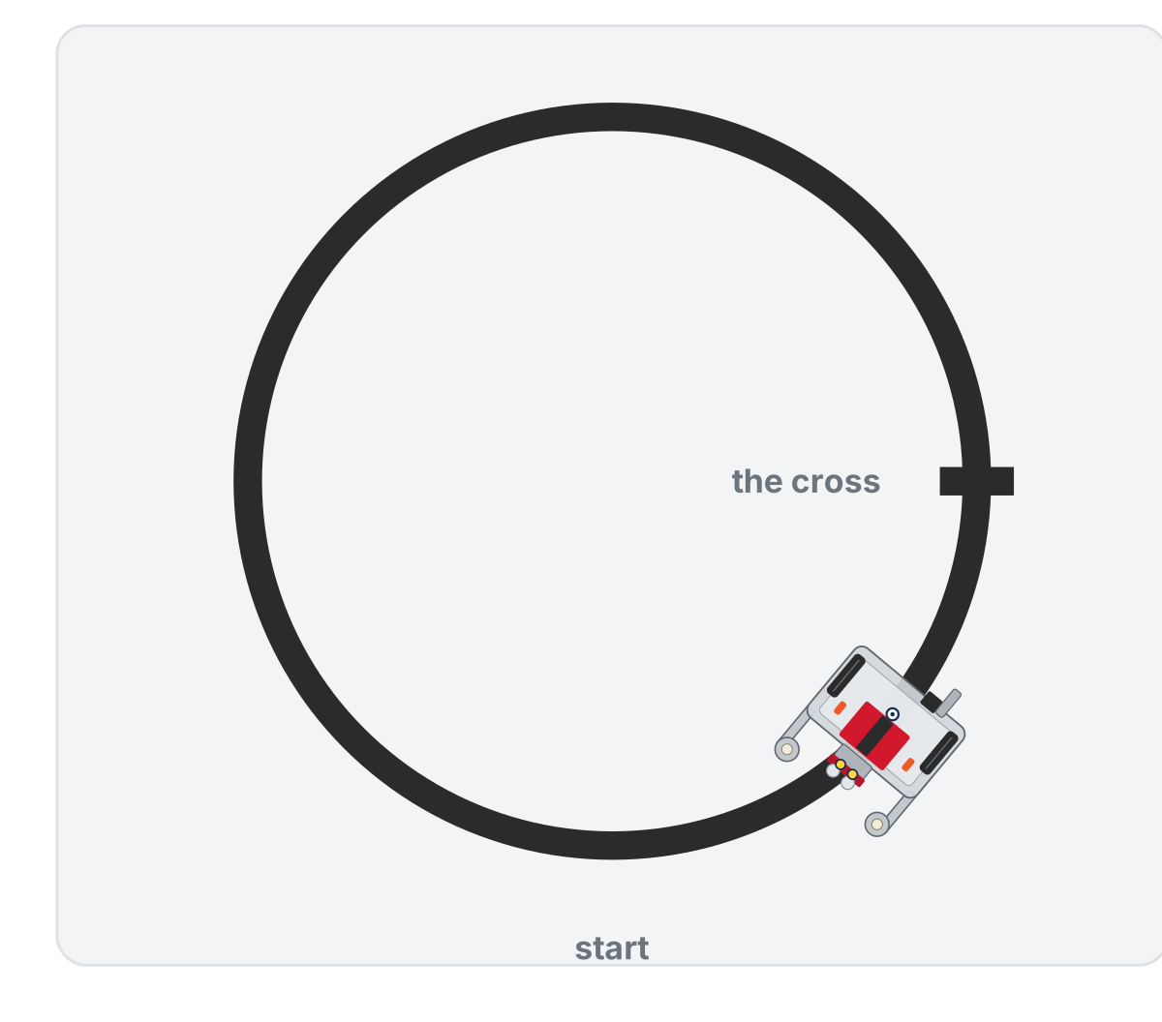
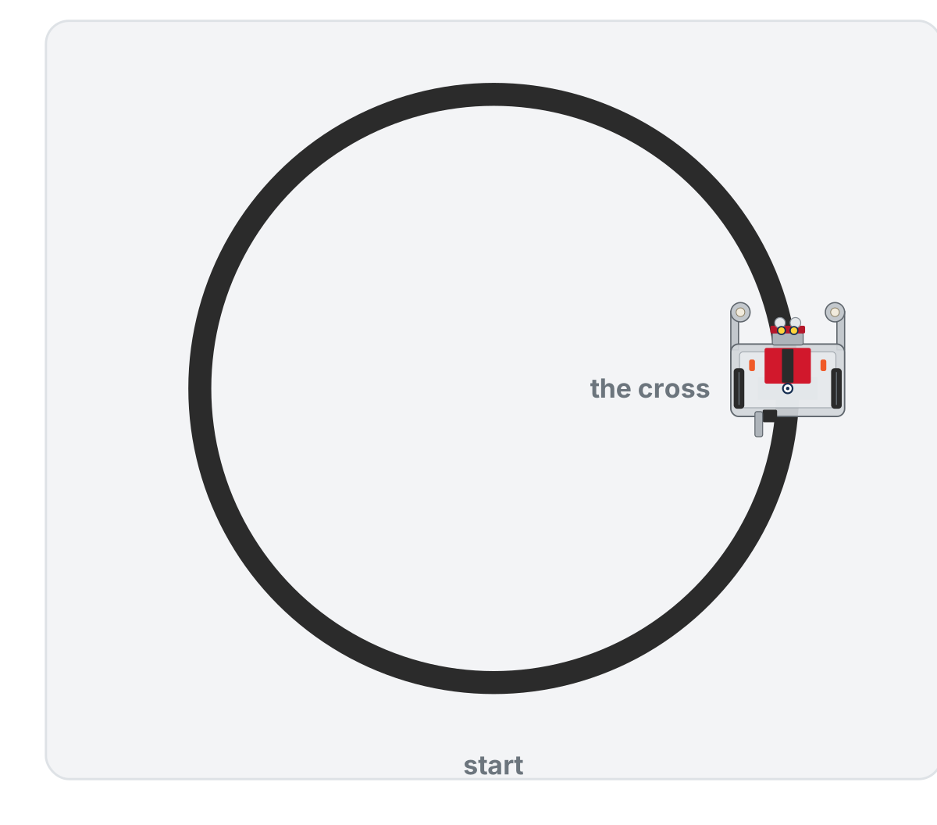
What the finished project looks like
At the cross: park, one clockwise turn
Next leg: following the other way
Done: four reversals, it stops
The cross is too short to stop a turn, so one clockwise turn reverses the robot, and it meets the cross once a lap
Notes:
On the lesson page this is an animation of the whole run, with a panel naming each stage. The cross is one short strip, about half as long as the robot is wide: long enough for both sensors to see it, too short to stop the turn.

Slide 5
Pick your option
OPTION A
OPTION B
OPTION C
Standard
Enhanced
Advanced
The mission, using your two sections unchanged. Focus on a clean project function and solid debugging.
Use a turn_around() function (the Lesson 2-9 challenge; write it now if not), count each leg, and flash the LED or beep at every reversal.
Add line-loss recovery, or speed up on later laps. Invent your own twist (teacher-approved).

Slide 6
Add to robot.py: this lesson's skeleton
Paste it above RUN, at the end of LINE TRACKING. Two tests, and the second one is the project.
def test_reversal():
# park on the cross, turn around (one clockwise turn
# does it here), then follow back to the cross
pass
def test_final_project():
# the mission: follow to the cross, park on it, reverse,
# four times in all; then stop and print "Done!"
# write your plan here as comments first, then the code
pass
Both bodies are yours. The outline is short on purpose: the plan is the first part of the project.
Notes:
There are no new driving functions in this lesson. The skeleton on the lesson page opens with a section comment: the module project laps the circle, reversing at the cross, four times, then stops; nothing new is defined for it; it is a list of calls to the four driving functions, because the sections did the work and the project assembles them. The slide leaves that comment out to fit.

Slide 7
Activity · Plan before you build
Activity
Pseudocode test_final_project() first, in plain English, before you type any Python
1
Write your plan as # comments inside the function, one step per line
2
It will be shorter than you expect: the two sections do the heavy lifting, so each line of the plan is close to one line of code
3
When you're done, each comment will have its line of code under it
Notes:
The lesson page has a closed reveal with one possible plan; students write theirs first. If a plan has many more steps, ask: what work are you doing by hand that a function in LINE TRACKING already does? The button wait is not part of the plan: the RUN block does that before every test.

Slide 8
Check your understanding
For the final project, do you need to rewrite the sensor and driving logic from scratch?
A. Yes: copy it all into the project function
B. No: reuse the tested LINE SENSOR and LINE TRACKING sections of robot.py
C. Yes: functions cannot be reused in a new program
D. Only the sensor part
Notes:
Answer: B. That's the whole point of building the file one tested function at a time: the project is a handful of calls to functions you already trust.

Slide 9
Answer
For the final project, do you need to rewrite the sensor and driving logic from scratch?
A. Yes: copy it all into the project function
B. No: reuse the tested LINE SENSOR and LINE TRACKING sections of robot.py
C. Yes: functions cannot be reused in a new program
D. Only the sensor part
That's the whole point of building the file one tested function at a time: the project is a handful of calls to functions you already trust.

Slide 10
Build it in pieces
Activity
You have every part already. Build in this order, and don't go on until each step works:
Park on the cross. Run test_park() from Lesson 2-9 once more. Wheels on the cross?
1
One turn. Run test_turn(). Does the turn find the line again?
2
One full reversal. Write the body of test_reversal() and run it: park, one clockwise turn, follow back to the same cross
3
The loop. Write test_final_project() under your plan comments and set the run line to it
4
Notes:
Insist on incremental testing. If a student did the Lesson 2-9 challenge, test_turn_around() is test_reversal() already. The teacher copy of the solution is for unsticking a team, not a handout: the assembly and tuning is the graded work, and there is no student reveal for it.

Slide 11
Activity · Test, tune, present
Activity
Work up in stages, and keep a note of what you tuned:
Does test_park() follow and stop at the cross, with the wheels left on it?
1
Does one turn in test_turn() find the line again?
2
Does test_reversal() work end to end?
3
Do all four reversals in test_final_project() run and stop?
4
Notes:
The common fixes are all tuning: THRESHOLD (cross not detected), the blind part of the turn or TURN_EFFORT (the loop ends on the old line, or spins past the new one), and BASE_EFFORT (overshoots the cross). Frame that tuning as the real engineering, not failure. Two successful reversals already show mastery; four is the goal.

Slide 12
Check your understanding
Your robot follows the line but blows past the cross without stopping. What's the best first thing to try?
A. Rewrite both toolkits
B. Lower BASE_EFFORT (and/or check THRESHOLD) so it detects the cross in time
C. Delete the turn methods
D. Increase Kp to 5
Notes:
Answer: B. Overshooting is usually too much speed or a threshold that's too high. Slow down and re-check calibration before touching anything else.

Slide 13
Answer
Your robot follows the line but blows past the cross without stopping. What's the best first thing to try?
A. Rewrite both toolkits
B. Lower BASE_EFFORT (and/or check THRESHOLD) so it detects the cross in time
C. Delete the turn methods
D. Increase Kp to 5
Overshooting is usually too much speed or a threshold that's too high. Slow down and re-check calibration before touching anything else.

Slide 14
You built a robot that thinks
You started Module 2 reading a single sensor value
You finish it with two cooperating sections of one file that follow a line, detect intersections, and navigate a course
Sensing and driving cleanly separated, each built on the layer below, each function tested the lesson it was written
That is exactly how professional robot code is structured, and the next module adds a section on top of it
Notes:
Students who did the class extensions have the same thing as LineSensor and LineTrack objects, and that is the version they should have used for the project.

Slide 15
Demo and reflect
What was hardest?
How did building the file one tested function at a time make the project easier?
What would you add with more time?
Next: Module 3 · Grid Driving
Notes:
The final project is the summative assessment: a 50-point rubric across code organization, functionality, testing and debugging, and presentation works well. Reward process and tuning, not just a flawless demo. Module 3 adds a GRID DRIVING section to robot.py: track_to_intersection() and drive_past_intersection() become the way the robot drives from one intersection to the next.

