Slide 1

MODULE 3 · LESSON 3-2
Driving Multiple Intersections
By the end of this lesson you can
Explain why track_to_intersection() called twice in a row would not move the robot without drive_past_intersection() between them
Drive past one intersection to reach the next
Use a for loop to drive a chosen number of intersections
Write drive_intersections(count) from its docstring, test it, and use it
Notes:
40 to 50 minutes. The thought experiment at the top is the heart of the lesson; the loop itself is short.

Slide 2
From the first intersection to the third
Reaching the first intersection is easy
Reaching the third is the same two calls, three times
That is what a for loop is for
Today "arrive at an intersection" becomes a building block you can repeat
The first real function in the GRID DRIVING section

Slide 3
Add to robot.py: this lesson's skeleton (1 of 2)
Paste it above RUN, at the end of the GRID DRIVING section. First, one function outline:
# --- Lesson 3-2: a run of intersections ---
# drive_intersections(count) is the arrival pair in a loop.
# It ends parked on the count-th intersection, so Lessons 3-3
# and 3-4 build every path out of it and the two turns.
def drive_intersections(count):
"""Arrive at count intersections in a row, printing
which one it is each time. Ends parked on the last one
with the sensors past it, ready to turn or to go on."""
pass
Notes:
The skeleton on the lesson page is one block: this slide and the next split it in two to fit.

Slide 4
Add to robot.py: this lesson's skeleton (2 of 2)
Then two tests, right under the function:
def test_two_by_hand():
# the arrival pair written out twice, no loop: the robot
# should end parked on the SECOND intersection
pass
def test_drive_run():
# drive_intersections(3), then print that it is done
pass
One function outline and two tests

Slide 5
A docstring, not step comments
The function has a docstring (Lesson 1-12) instead of step comments
The string under the def line says what the function does and what ends it
That's all the help you get: the steps are yours to work out
Keep the docstring when you write the body: it belongs to the function
This lesson tells you enough to write it

Slide 6
Why the second call works: a thought experiment
Call track_to_intersection() twice in a row, with nothing in between. Where does the robot end up?
track_to_intersection()
track_to_intersection()
Predict before the next slide: does the second call drive anywhere?
Notes:
Trace the two calls on the board and have students say why the second one returns at once before you show the figure. This is the lesson.

Slide 7
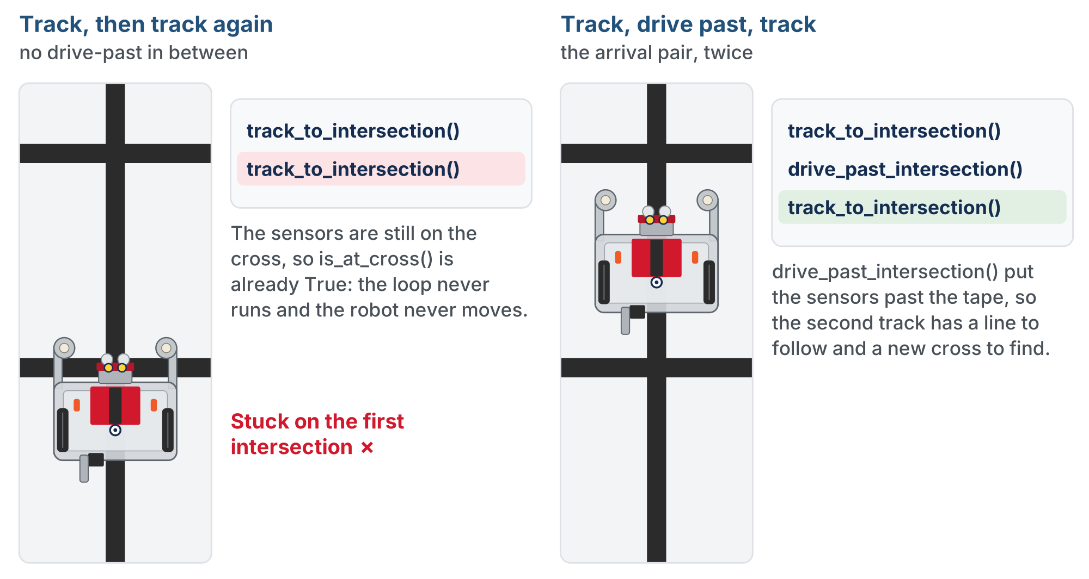
Track twice, or track, drive past, track
Without the drive-past, the second track starts with its sensors on the cross and is finished before it begins. With it, there is a new cross ahead.
Notes:
On the lesson page both runs animate side by side. This is the end: the left robot is stuck on the first intersection, the right one is parked on the next.

Slide 8
The drive-past's second job
The first call stops with both sensors on the cross
The second call's loop condition, not is_at_cross(), is already False
So the robot "arrives" without moving
The drive-past parks the center of rotation on the intersection, and carries the sensors past the tape
Then the next track has a line to follow and a new cross to find
Driving the grid is the arrival pair, repeated: track, drive past, track, drive past, ...
Notes:
Lesson 2-9 mentioned this second job in passing. Because the drive-past parks the robot on the intersection, it always ends up sitting on the last one, ready to turn.

Slide 9
Check your understanding
Why would a second track_to_intersection() call right after the first do nothing, without drive_past_intersection() between them?
A. The function can only be called once
B. Sensors still on the cross: is_at_cross() is already True, so the loop exits
C. The battery needs a rest
D. You must call turn_clockwise() in between
Notes:
Answer: B. After stopping, both sensors are still on the cross. The follow loop only runs while NOT at a cross, so it exits at once. `drive_past_intersection()` moves the sensors onto plain line first.

Slide 10
Answer
Why would a second track_to_intersection() call right after the first do nothing, without drive_past_intersection() between them?
A. The function can only be called once
B. Sensors still on the cross: is_at_cross() is already True, so the loop exits
C. The battery needs a rest
D. You must call turn_clockwise() in between
After stopping, both sensors are still on the cross. The follow loop only runs while NOT at a cross, so it exits at once. drive_past_intersection() moves the sensors onto plain line first.

Slide 11
Check your understanding
After track, drive past, track, drive past, where is the robot?
A. Halfway between the second and third intersections
B. Parked with its wheels on the second intersection, sensors just past it
C. On the first intersection
D. It depends on the battery
Notes:
Answer: B. Each drive-past ends with the wheels over the cross the sensors just found. Two pairs, two intersections, and the robot is sitting on the second one, which is why there is no special case for the last intersection.

Slide 12
Answer
After track, drive past, track, drive past, where is the robot?
A. Halfway between the second and third intersections
B. Parked with its wheels on the second intersection, sensors just past it
C. On the first intersection
D. It depends on the battery
Each drive-past ends with the wheels over the cross the sensors just found. Two pairs, two intersections, and the robot is sitting on the second one, which is why there is no special case for the last intersection.

Slide 13
Drive a set number with a for loop
Writing the pair out by hand is repetitive, and wrong the moment you want a different number
A for loop over range(count) repeats the pair a chosen number of times
Same shape as polygon() in Module 1: a loop and a count, packaged into a function with the count as its parameter
Nothing in the loop body changes from pass to pass
The loop variable is only good for the print ("Intersection 1 of 3"), and it starts at 0
No special case for the last intersection: the drive-past parks the robot on it

Slide 14
Check your understanding
A student worries that drive_past_intersection() on the last loop pass will carry the robot off the final intersection. Are they right?
A. Yes: the last pass should skip it
B. No: it puts the wheels ONTO the last cross, so the robot ends parked there
C. Yes: it should be called twice on the last pass
D. It depends on the grid spacing
Notes:
Answer: B. Older versions of this lesson taught a timed nudge after each intersection, with an if i < count - 1 guard to skip it on the last one. drive_past_intersection() replaces both: a fixed distance that parks the wheels on the cross, so there is nothing to skip. Spend the saved time on the thought experiment, and walk the loop with i = 0, 1, 2, asking where the robot is after each pass.

Slide 15
Answer
A student worries that drive_past_intersection() on the last loop pass will carry the robot off the final intersection. Are they right?
A. Yes: the last pass should skip it
B. No: it puts the wheels ONTO the last cross, so the robot ends parked there
C. Yes: it should be called twice on the last pass
D. It depends on the grid spacing
The name says what the sensors do, not the wheels. The sensors end up past the cross; the wheels end up on it. Every arrival ends the same way, last one included.
Notes:
Answer: B. Older versions of this lesson taught a timed nudge after each intersection, with an if i < count - 1 guard to skip it on the last one. drive_past_intersection() replaces both: a fixed distance that parks the wheels on the cross, so there is nothing to skip. Spend the saved time on the thought experiment, and walk the loop with i = 0, 1, 2, asking where the robot is after each pass.

Slide 16
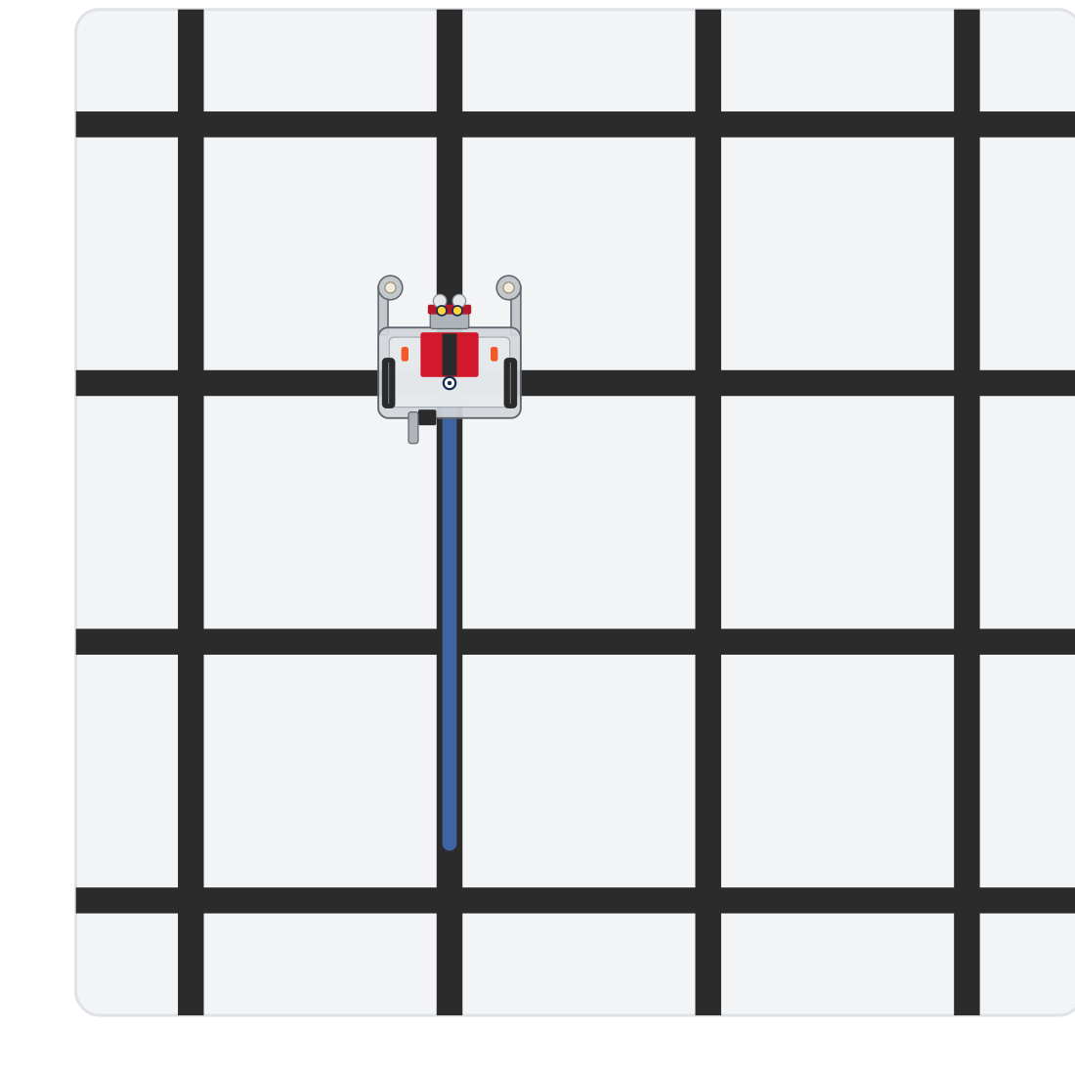
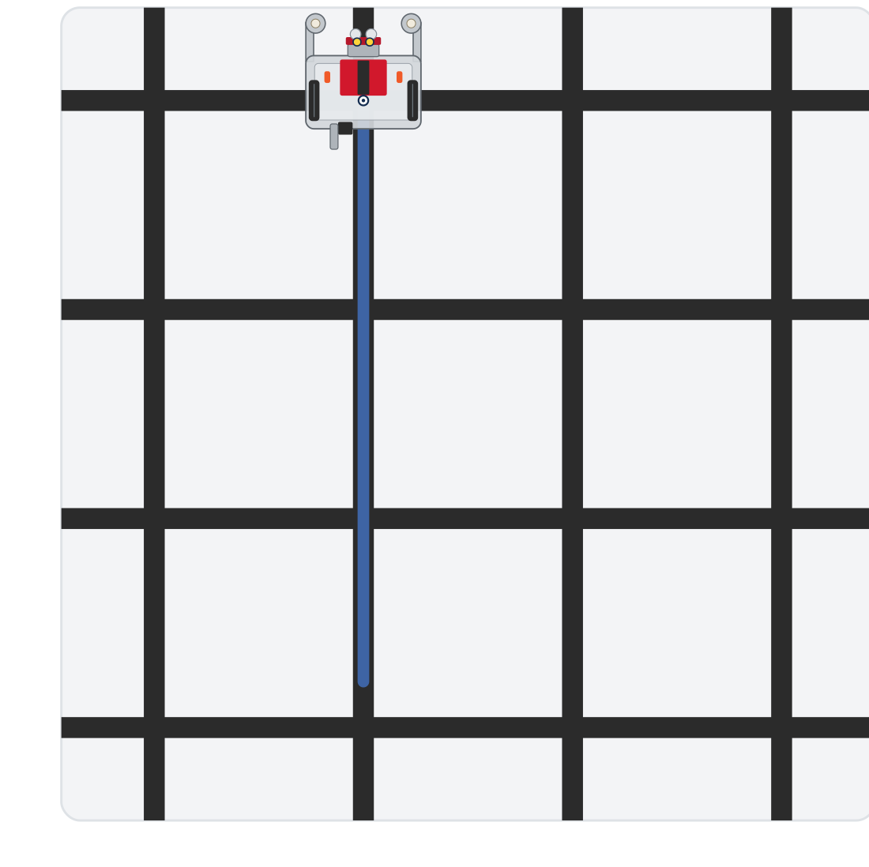
Activity · Two by hand, then the helper
Activity
Step 1: four calls reach the second intersection
Step 2: drive_intersections(3) reaches the third
Every step starts on a line segment, facing the next intersection, with at least three intersections ahead
Notes:
On the lesson page this is one animation of both tests, with the step running highlighted beside the grid. These are the end of each step.

Slide 17
Step 1 · test_two_by_hand()
Activity
Write the body: the arrival pair, then the arrival pair again (four calls, no loop) and a print at the end
1
Set the run line to test_two_by_hand() and run. It should end parked on the second intersection
2
Now take out the first drive_past_intersection() and run again. Where does it stop? What does the second track do?
3
Put the call back. Don't go on until the four-call version reaches the second intersection
4
Notes:
This step proves the thought experiment on the floor. More support: some students need to trace the pair, twice, on the board before they write the loop.

Slide 18
Step 2 · drive_intersections(count)
Activity
Write the function from its docstring: one parameter, a for loop over it, the arrival pair inside, and a print so you can follow along
1
Write the body of test_drive_run(): one call, drive_intersections(3), and a print
2
Set the run line to test_drive_run() and run. It should arrive three times, printing each one, and end parked on the third intersection
3
Then drive_intersections(4) drives four segments in one clean line: the building block of the next two lessons
Notes:
The lesson has a closed reveal with the function; students write and test theirs first. If a student's version has an if in it, ask what it is guarding against, and whether drive_past_intersection() actually drives the robot past anything. Class-track students call the tracker inside the helper; the helper itself stays a plain function in this section. More challenge: a speed parameter that changes BASE_EFFORT before the loop and restores it after (needs global, Lesson 2-7), or a running count checked against the grid.

Slide 19
Check your understanding
A student's drive_intersections(count) calls track_to_intersection() on every pass but drive_past_intersection() only on the first. What happens with count = 3?
A. It works: only the first intersection needs clearing
B. Reaches the second, then the third track returns at once: it never gets to the third
C. The robot drives past all three
D. It turns instead of driving
Notes:
Answer: B. Pass 2 ends with the sensors on the second cross and no drive-past. Pass 3's loop condition is already False, so the robot reports arriving at intersection 3 while parked short of the second.

Slide 20
Answer
A student's drive_intersections(count) calls track_to_intersection() on every pass but drive_past_intersection() only on the first. What happens with count = 3?
A. It works: only the first intersection needs clearing
B. Reaches the second, then the third track returns at once: it never gets to the third
C. The robot drives past all three
D. It turns instead of driving
Pass 2 ends with the sensors on the second cross and no drive-past. Pass 3's loop condition is already False, so the robot reports arriving at intersection 3 while parked short of the second.

Slide 21
Real-world connections
ELEVATORS
MANUFACTURING
TRANSIT
Floor counting
Indexing lines
Counting stops
An elevator counts floor sensors as it rises and stops on the Nth: same detect-and-count idea.
Assembly lines advance a fixed number of steps between stations, clearing each position.
Automated shuttles track how many stops they've passed to know when to pull over.

Slide 22
Wrap-up
Why does drive_past_intersection() have to come between two tracks?
What loop drives a set number of segments?
Where is the robot after the last pass?
Next: turns, and L-shaped paths across the grid
Notes:
Answers: the sensors are still on the cross, so the second track would return at once. A for loop over range(count), with the arrival pair inside. Parked on the last intersection: the drive-past puts the wheels on it. Formative: explain the thought experiment, and drive exactly N intersections with a loop. Exit ticket: "Why is there no special case for the last intersection?" (the drive-past parks on it, not past it).

