Slide 1

MODULE 3 · LESSON 3-3
Turning on the Grid
By the end of this lesson you can
Sequence drive and turn operations into a path
Turn at intersections with turn_clockwise() and turn_counterclockwise(), and say why the turn pivots on the intersection
Navigate an L-shaped path, as a test function written from a description
Plan a path on paper before you write the code
Notes:
40 to 50 minutes. Sequencing and planning. There is no new function this lesson: a path is calls to what students already have.

Slide 2
Turning corners
You can drive straight along the grid
Now you'll turn corners, sequencing drives and turns to trace an L-shaped path
Any route across a grid is really just a sequence of "drive some segments, turn, drive some more"
A path is a list of drives and turns

Slide 3
Add to robot.py: this lesson's skeleton
Paste it above RUN, at the end of GRID DRIVING. No new function this time: two tests.
# --- Lesson 3-3: turning on the grid ---
# No new function: a path is drive_intersections(), a turn,
# drive_intersections() again. The turn works because the
# helper leaves the wheels parked on the intersection.
def test_l_shape():
# drive 2 intersections, turn right, drive 2 more, then
# print that the L is complete
pass
def test_my_path():
# the path you planned on paper, one leg per line
pass

Slide 4
Drive, turn, drive
Turning a corner on the grid is just like walking city streets
Go to the intersection, then turn
In code: drive_intersections(), then a turn, then drive_intersections() again
Three lines for an L: one per leg or corner

Slide 5
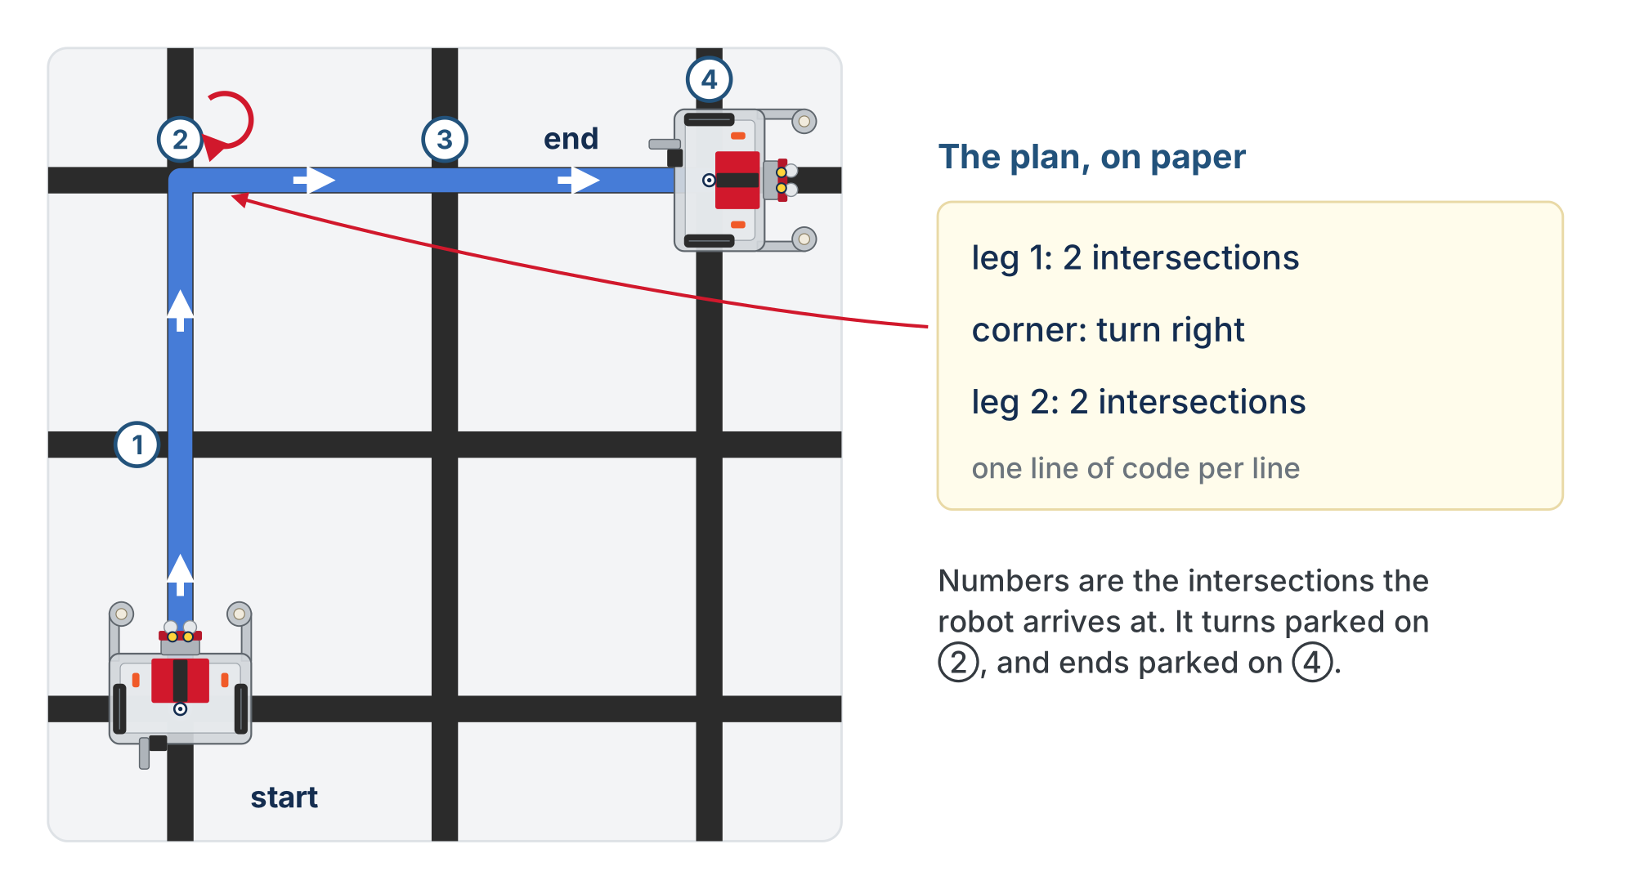
An L-shape
Two intersections, a right turn, two more. The plan beside it is the paper sketch from Step 2.
Notes:
The robot starts parked on the bottom-left intersection, the corner nearest you, facing away from you. The numbers are the intersections it arrives at: it turns parked on 2 and ends parked on 4.

Slide 6
Check your understanding
Which sequence drives an L-shape: two segments, a right turn, then two more segments?
A. First turn_clockwise(), then drive_intersections(2), then drive_intersections(2)
B. First drive_intersections(2), then turn_clockwise(), then drive_intersections(2)
C. drive_intersections(4)
D. turn_clockwise(); turn_clockwise()
Notes:
Answer: B. The lesson writes the first two options as one line of calls separated by semicolons; the slide spells them out with "then" so they fit.

Slide 7
Answer
Which sequence drives an L-shape: two segments, a right turn, then two more segments?
A. First turn_clockwise(), then drive_intersections(2), then drive_intersections(2)
B. First drive_intersections(2), then turn_clockwise(), then drive_intersections(2)
C. drive_intersections(4)
D. turn_clockwise(); turn_clockwise()
Drive to the corner, turn, then continue: the drive/turn/drive order is what makes the L.
Notes:
Answer: B. The lesson writes the first two options as one line of calls separated by semicolons; the slide spells them out with "then" so they fit.

Slide 8
Why the turn lands on the new line
drive_intersections() leaves the robot parked with its wheels over the last intersection, sensors just past it
That is exactly the position a turn needs
The robot pivots about its center of rotation (Lesson 3-1), so it spins on the intersection
The blind 60° plus the sensor-ended finish from Lesson 2-9 bring the sensors down on the crossing line
After the turn, the next drive_intersections() starts with a line to follow: no extra step in between

Slide 9
Check your understanding
After turn_clockwise(), what has to happen before the next drive_intersections()?
A. A drive_past_intersection() to clear the cross
B. Nothing: the turn ends with a sensor on the new line, and the next track follows it
C. A short time.sleep()
D. A second turn to straighten up
Notes:
Answer: B. The turn finishes when `is_either_on_line()` sees the crossing line. The robot is on the intersection, facing the new direction, with a sensor on tape: ready to track.

Slide 10
Answer
After turn_clockwise(), what has to happen before the next drive_intersections()?
A. A drive_past_intersection() to clear the cross
B. Nothing: the turn ends with a sensor on the new line, and the next track follows it
C. A short time.sleep()
D. A second turn to straighten up
The turn finishes when is_either_on_line() sees the crossing line. The robot is on the intersection, facing the new direction, with a sensor on tape: ready to track.

Slide 11
Check your understanding
A student calls turn_clockwise() right after track_to_intersection(), skipping drive_past_intersection(). What goes wrong?
A. Nothing: the turn works the same
B. The wheels are short of the intersection, so it pivots in front of it and the sensors miss the new line
C. The robot turns the wrong way
D. The turn takes twice as long
Notes:
Answer: B. Two rules trip students up. The robot must be parked on an intersection to turn: you cannot turn mid-segment, and drive_intersections() always leaves it parked. And the arrival pair is track then drive past, every time. Students who hand-write the pair sometimes drop the second half; drive_intersections() exists partly so they can't.

Slide 12
Answer
A student calls turn_clockwise() right after track_to_intersection(), skipping drive_past_intersection(). What goes wrong?
A. Nothing: the turn works the same
B. The wheels are short of the intersection, so it pivots in front of it and the sensors miss the new line
C. The robot turns the wrong way
D. The turn takes twice as long
The sensors reach the cross before the wheels do. Turning before the drive-past spins the robot around a point short of the intersection; the sensor-ended turn then hunts for a line that is not where it expects.
Notes:
Answer: B. Two rules trip students up. The robot must be parked on an intersection to turn: you cannot turn mid-segment, and drive_intersections() always leaves it parked. And the arrival pair is track then drive past, every time. Students who hand-write the pair sometimes drop the second half; drive_intersections() exists partly so they can't.

Slide 13
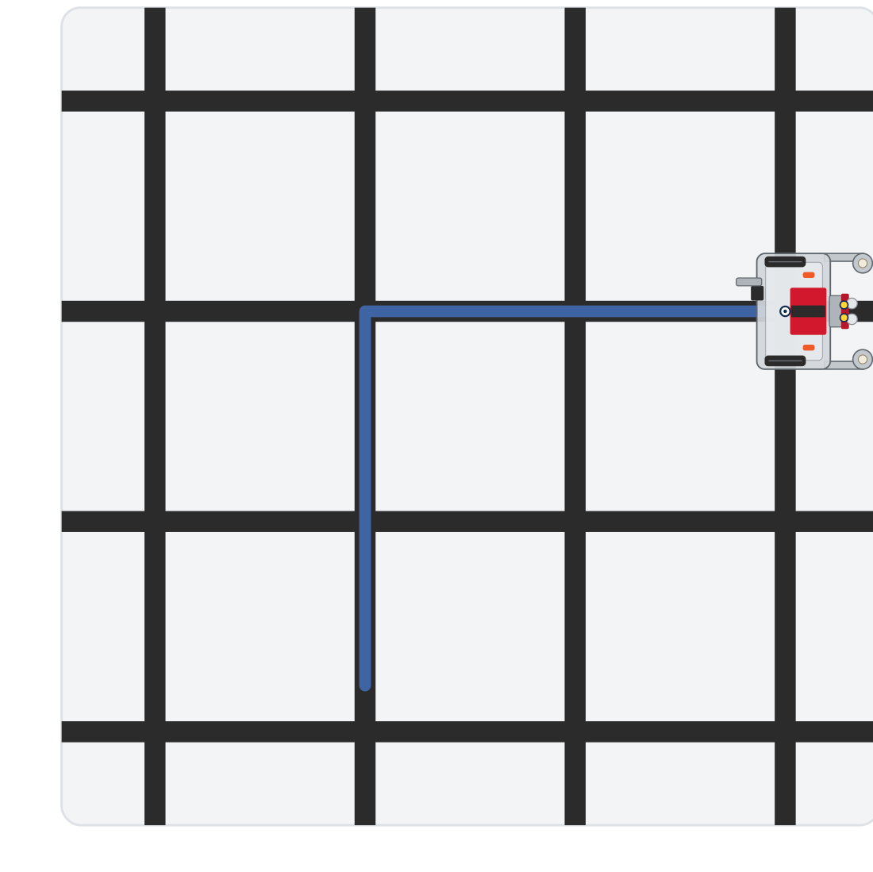
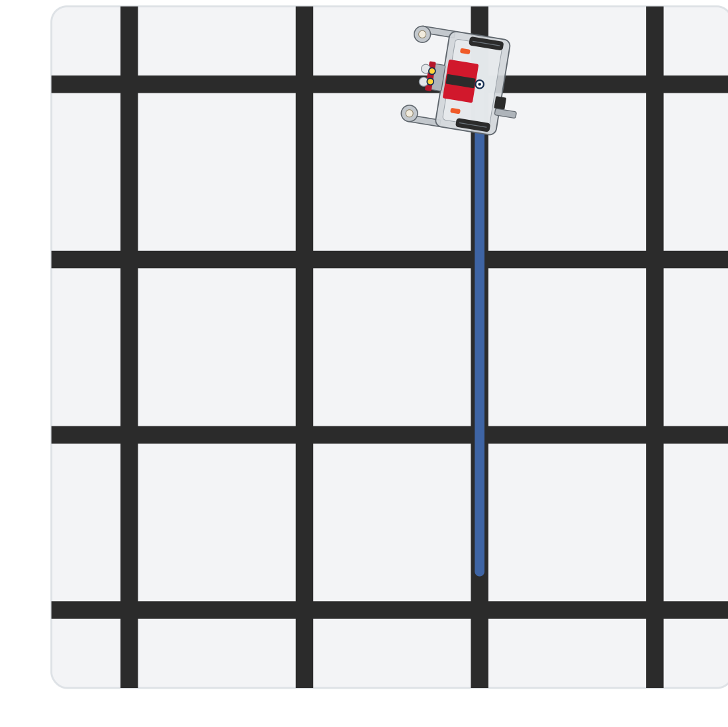
Activity · The L, then a path of your own
Activity
Step 1: the L, parked on the fourth intersection
Step 2 example: three, a left turn, one more
Your own plan in Step 2 will draw something else
Notes:
On the lesson page this is one animation: the L from step 1, then the example plan from step 2 from a different start. These are the end of each run.

Slide 14
Step 1 · test_l_shape()
Activity
Write the body from its comment: three calls and a print
1
Start the robot on a line segment with at least two intersections ahead and room to the right. Set the run line to test_l_shape() and run
2
It should drive two segments, pivot on the second intersection, drive two more, and stop parked on the fourth. Don't go on until it does
3
Notes:
The lesson has a closed reveal with the L; students run theirs first. Class-track students call the turns on the tracker; the helper call is the same for everyone.

Slide 15
Step 2 · Plan on paper, then test_my_path()
Activity
A plan reads like directions: leg 1: three segments; corner: left; leg 2: one segment.
Sketch the path: mark the start, the direction the robot faces, how many segments each leg is, and where the turns go
1
Translate it into test_my_path(), one leg or corner per line, with a comment saying which is which
2
Set the run line to test_my_path() and run. Did the robot end where your sketch says?
3
If not, the sketch and the code disagree somewhere: find the line
Notes:
test_my_path() is the student's own, so there is nothing to check it against but their sketch. Planning on paper first prevents most sequencing mistakes. More support: give students a drawn path and have them write the matching sequence. More challenge: a test_u_turn() (drive, turn right, drive one, turn right, drive), a good reminder that two right turns only reverse direction if you drive a segment between them.

Slide 16
Check your understanding
Starting at the bottom-left corner facing away from you, the robot runs: drive_intersections(3), turn_clockwise(), drive_intersections(2). Where does it end up?
A. Back at the start
B. 3 intersections up from the start, then 2 intersections to the right from there
C. 2 up, then 3 to the right
D. It never turns
Notes:
Answer: B. It drives 3 up, away from you, turns right (now facing right), and drives 2 to the right: an L ending 3 up and 2 across.

Slide 17
Answer
Starting at the bottom-left corner facing away from you, the robot runs: drive_intersections(3), turn_clockwise(), drive_intersections(2). Where does it end up?
A. Back at the start
B. 3 intersections up from the start, then 2 intersections to the right from there
C. 2 up, then 3 to the right
D. It never turns
It drives 3 up, away from you, turns right (now facing right), and drives 2 to the right: an L ending 3 up and 2 across.

Slide 18
Real-world connections
MAPS
WAREHOUSES
MANUFACTURING
Turn-by-turn directions
Pick routes
Toolpaths
"Go 3 blocks, turn right, go 2 blocks" is the same drive/turn sequence you just wrote.
A warehouse robot's route is a list of segment-drives and turns between shelf intersections.
CNC and pick-and-place machines follow planned sequences of moves and direction changes.

Slide 19
Wrap-up
What's the basic shape of any grid path?
What has to come before a turn?
What comes after a turn?
Next: the final project: four drive-and-turn legs in a loop, a complete square
Notes:
Answers: a sequence of drives and turns. The arrival pair: the robot parked on the intersection. The next drive: a sensor is already on the new line. Formative: sequence drives and turns for a described path, and explain why the turn must wait for the drive-past. Exit ticket: "Write the calls for drive 2, turn left, drive 1."

