Slide 1

MODULE 4 · LESSON 4-3
Lists
By the end of this lesson you can
Create a list with [] and see how it differs from a tuple
Add items with append() and count them with len()
Loop through a list with a for loop
Build a list step by step inside a loop, and store a path as a list of tuples
Explain what a variable holds when the value is a list, and what happens when two names refer to the same one
Notes:
50 minutes. Scratch work again, like Lesson 4-2: a scratch file or the Python prompt, not robot.py. The build-in-a-loop pattern practiced here is what next lesson's planner function is made of; that function is what goes in the file.

Slide 2
A path is many positions
A tuple stores one position
A path is many positions in order, and for that you need a list
By the end you'll represent a route as a list of coordinate tuples, like [(1,0), (2,0), (2,1), (2,2), (2,3)]
And build one up step by step: exactly what the Manhattan algorithm does next lesson
Scratch work again: a scratch file or the Python prompt, not robot.py

Slide 3
The start is not in the path
That example is the route from (0,0) to (2,3)
The robot's own starting intersection isn't in it
A path lists the places the robot drives to
It's already standing on the start: putting it in the list would mean "drive to where you already are"
Every path in this module and the next works that way

Slide 4
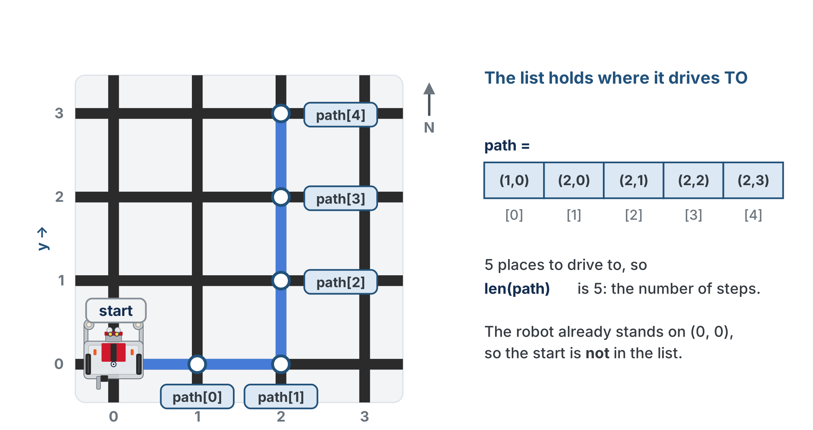
One tuple per intersection it drives to
In order. The start is where it already is, so it is not in the list, and len(path) is the number of steps.

Slide 5
List vs. tuple
A list is an ordered collection written with square brackets, and unlike a tuple it's mutable: it can grow and change.
numbers = [1, 2, 3, 4, 5]
print(numbers[0]) # 1 -- indexing works like tuples
print(len(numbers)) # 5 -- how many items

Slide 6
Which one, when?
 | Tuple | List
Brackets | ( ) | [ ]
Can change? | No (immutable) | Yes (mutable)
Best for | a fixed position | a growing path
So a coordinate is a tuple; a path is a list of tuples

Slide 7
Check your understanding
Which is true about lists compared to tuples?
A. Lists use () and cannot change
B. Lists use [] and CAN change (they are mutable)
C. Lists and tuples are identical
D. Lists can only hold numbers
Notes:
Answer: B. Lists use square brackets and are mutable, so they can grow: perfect for a path that's built up step by step.

Slide 8
Answer
Which is true about lists compared to tuples?
A. Lists use () and cannot change
B. Lists use [] and CAN change (they are mutable)
C. Lists and tuples are identical
D. Lists can only hold numbers
Lists use square brackets and are mutable, so they can grow: perfect for a path that's built up step by step.

Slide 9
Growing a list with append()
append() adds an item to the end of a list. Start empty and build up:
path = []
path.append((1, 0))
path.append((2, 0))
path.append((3, 0))
print(path) # [(1, 0), (2, 0), (3, 0)]
print(len(path)) # 3
A robot at (0,0) driving three intersections to the right: three places to drive to, so len(path) is 3, the number of steps

Slide 10
Loop through it with for
for step in path:
print("Visit:", step, " x:", step[0], " y:", step[1])
Each pass, step is one tuple from the list, in order

Slide 11
Check your understanding
Given path = [(1, 0), (2, 0), (3, 0)], what does path[2] return?
A. (2, 0)
B. (3, 0)
C. 2
D. An IndexError
Notes:
Answer: B. Indexing starts at 0, so path[2] is the third item: the tuple (3, 0).

Slide 12
Answer
Given path = [(1, 0), (2, 0), (3, 0)], what does path[2] return?
A. (2, 0)
B. (3, 0)
C. 2
D. An IndexError
Indexing starts at 0, so path[2] is the third item: the tuple (3, 0).

Slide 13
Check your understanding
For that same path, what does path[2][1] return?
A. 3
B. 0
C. (3, 0)
D. An error
Notes:
Answer: B. path[2] is (3, 0); then [1] takes its y, 0. Two indexes: which step, then which part of that step.

Slide 14
Answer
For that same path, what does path[2][1] return?
A. 3
B. 0
C. (3, 0)
D. An error
path[2] is (3, 0); then [1] takes its y, 0. Two indexes: which step, then which part of that step.

Slide 15
Activity · Build a path in a loop
Activity
The pattern the whole module depends on: start empty, append inside a loop.
path = []
for x in range(1, 5): # start at 1, not 0 -- the robot is already at x = 0
path.append((x, 0))
print(path) # [(1, 0), (2, 0), (3, 0), (4, 0)]
range(1, 5) counts 1, 2, 3, 4: it starts where you tell it to, so the first intersection you append is the first one the robot drives to

Slide 16
Trace it, then change it
Activity
Trace the loop: the list grows by one each pass
1
Change the loop to vary y instead, and you build a vertical path
2
Combine a "go right" loop and a "go up" loop, and you've basically written the Manhattan algorithm
3
Notes:
This is make-or-break: Lesson 4-4's algorithm relies entirely on "empty list, append inside a loop." Spend real time here with a trace table. Demo the classic bug live: put append() outside the loop (wrong indentation) so only the last item lands, then fix the indentation. Keep scope tight: [], append(), len(), indexing and for. No insert, pop, slicing or comprehensions yet.

Slide 17
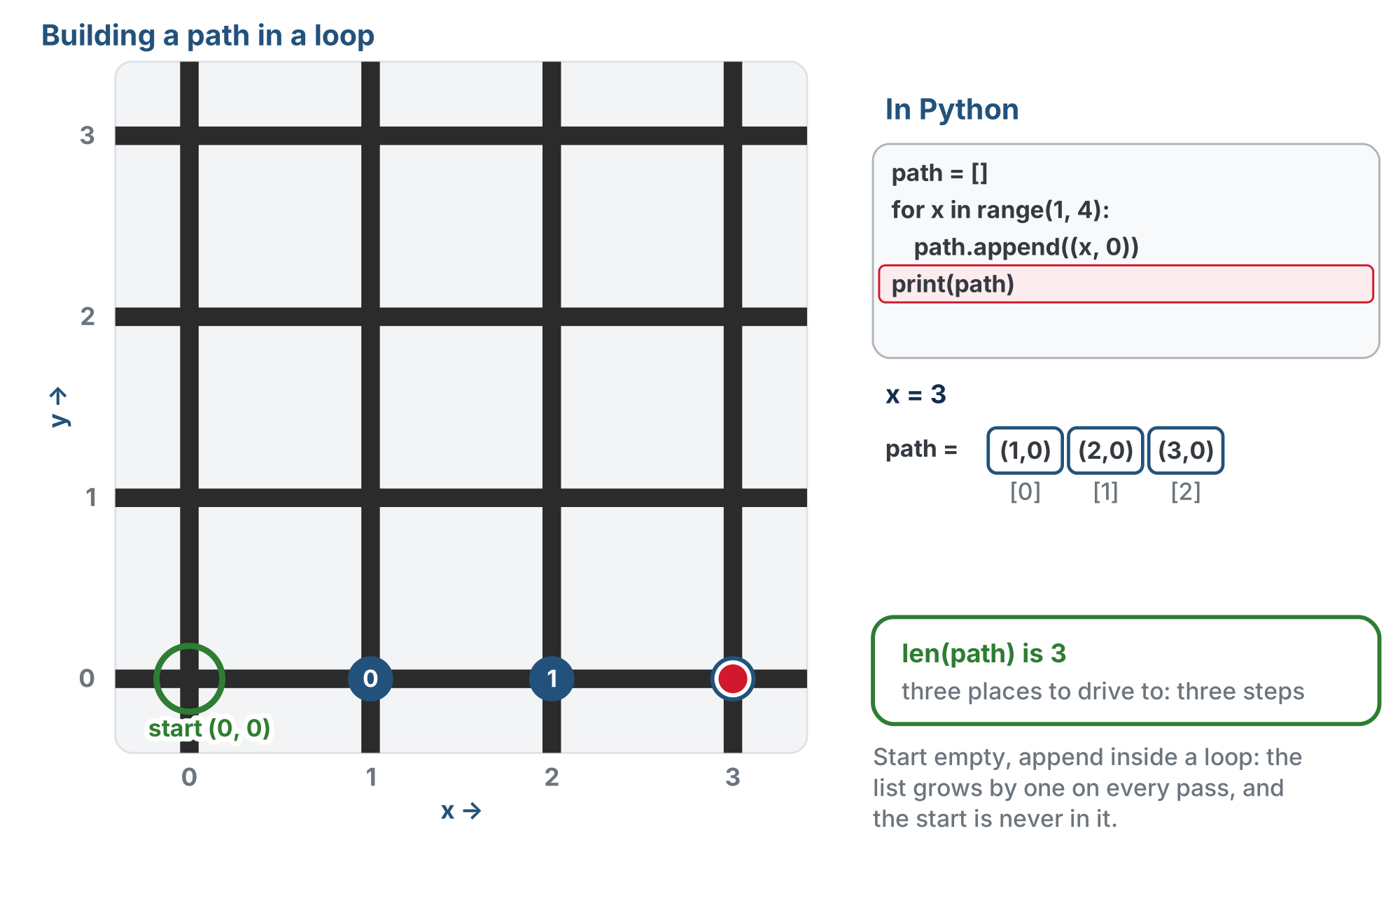
The pattern, traced
One append per pass, so the list grows by one each time. Drawn on a 4 by 4 grid, so the loop stops at x = 3.
Notes:
The lesson figure is an animation: the loop appends (1, 0), (2, 0), (3, 0) one pass at a time, and the start (0, 0) is never added. This is the end of that part. (The slides use a copy of the figure with its text halos redrawn for the slide renderer.)

Slide 18
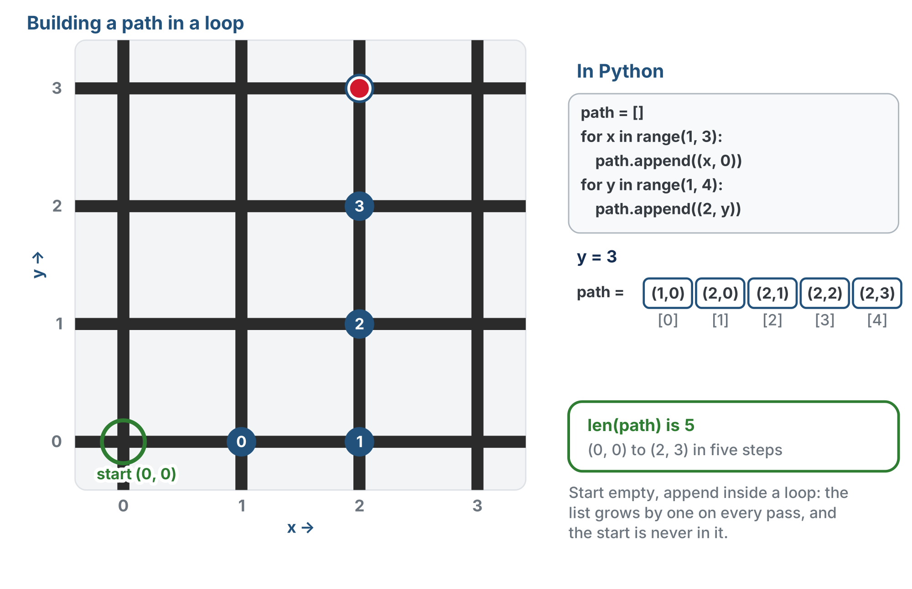
Then a go-right loop and a go-up loop
Two loops, one after the other: the path from (0, 0) to (2, 3), five steps.
Notes:
The second half of the same animation. Students do not write the general version yet: that is next lesson.

Slide 19
What the variable actually holds
Back in Lesson 1-9, a variable was a named location in memory, and = stored a value there
That's still true, and for a number it's the whole story: side_length = 30 puts a 30 in that location
Remember the numbers on those locations, the addresses? Here is what they're for.

Slide 20
A list can't fit in a location
A list grows: append() makes it longer
A memory location is a fixed size, so none is guaranteed big enough
So the list lives somewhere else in memory, in as much room as it needs
What goes in path's location is that area's address: the number that says where to find it
An address stored in a variable is called a reference

Slide 21
Two names, one address
That sounds like a technicality until two names hold the same address:
path = []
path.append((1, 0))
same_path = path # copies the ADDRESS, not the list
same_path.append((2, 0))
print(path) # [(1, 0), (2, 0)] <- path changed too
same_path = path works out the right side, an address, and stores it. Nothing copied the list.

Slide 22
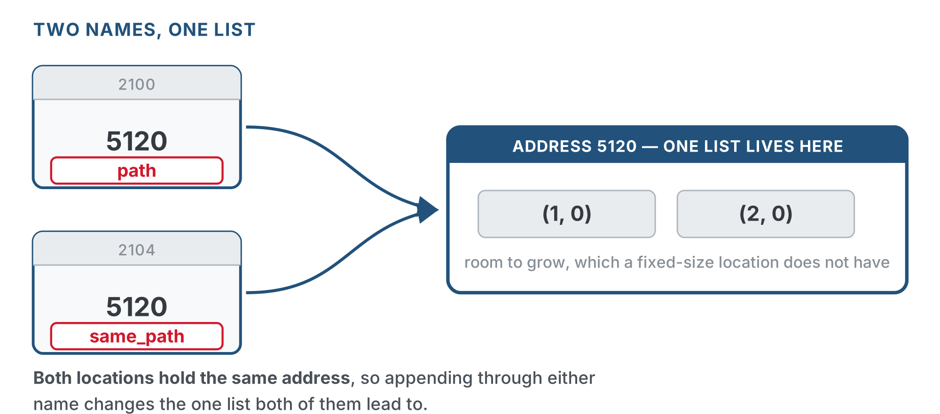
Two names, one list
Two locations, the same address in each, one list at the end of both arrows.

Slide 23
Compare: a number is copied
There is only one list above: appending through either name changes it. A number is small and fixed in size, so it really is stored in the location:
a = 5
b = a # copies the VALUE
b = b + 1
print(a) # 5 <- unchanged
If a list were copied on assignment, path would still be one item long. It isn't.

Slide 24
Check your understanding
After scores = [10, 20], then backup = scores, then backup.append(30), what does scores hold?
A. [10, 20]: backup is a separate copy
B. [10, 20, 30]: both names refer to the same list
C. [30]
D. An error: you cannot assign a list to another name
Notes:
Answer: B. backup = scores stores the address that was in scores, not a copy of the list, so both names lead to one list. Appending through either name changes what both see. To get an independent copy you would have to make a new list.

Slide 25
Answer
After scores = [10, 20], then backup = scores, then backup.append(30), what does scores hold?
A. [10, 20]: backup is a separate copy
B. [10, 20, 30]: both names refer to the same list
C. [30]
D. An error: you cannot assign a list to another name
backup = scores stores the address that was in scores, not a copy of the list, so both names lead to one list. Appending through either name changes what both see. To get an independent copy you would have to make a new list.

Slide 26
Not a trap: a mechanism
This is the mechanism the rest of the course relies on
In Module 5 you'll build a list of blocked intersections and hand it to a planner object
You keep adding to it as the robot discovers obstacles
The planner sees every new obstacle precisely because it holds the address of your list, not a frozen copy of it
Notes:
Be explicit: this section adds to Lesson 1-9, it does not correct it. A variable is still a named memory location, and = still works out the right side and stores the result. The only new fact is what the stored value is for a list: the address that was printed on the location all along. If asked why the address exists, the physical reason is the honest one: a location is a fixed size, a list can grow. A demo that lands: two students each hold a slip with the same post office box number. One puts something in the box. The other one's slip has not changed, but what they find in the box has. Then ask what would have to be different for them to have separate boxes. Don't teach copy() or slicing: nothing in the course needs an independent copy, and the aliasing is load-bearing in Module 5.

Slide 27
The most common list bug
Indentation decides what's inside the loop. Get it wrong and only the last item is added:
# WRONG -- append is outside the loop
path = []
for x in range(1, 4):
position = (x, 0)
path.append(position) # only runs once -> [(3, 0)]
# CORRECT -- append is inside the loop
path = []
for x in range(1, 4):
position = (x, 0)
path.append(position) # runs each pass -> [(1, 0), (2, 0), (3, 0)]

Slide 28
Check your understanding
A student's loop ends with a list holding only the LAST coordinate instead of all of them. What's wrong?
A. append() is broken
B. append() is outside the loop (wrong indentation), so it runs only once
C. They used a tuple instead of a list
D. range() is the wrong size
Notes:
Answer: B. If append() isn't indented inside the loop, it runs a single time after the loop ends, capturing just the final value.

Slide 29
Answer
A student's loop ends with a list holding only the LAST coordinate instead of all of them. What's wrong?
A. append() is broken
B. append() is outside the loop (wrong indentation), so it runs only once
C. They used a tuple instead of a list
D. range() is the wrong size
If append() isn't indented inside the loop, it runs a single time after the loop ends, capturing just the final value.

Slide 30
Real-world connections
APPS
NAVIGATION
DATA
Feeds & playlists
Route waypoints
Records & logs
A playlist or a feed is a list you add to and iterate through, item by item.
A GPS route is a list of waypoints the app walks through in order.
Programs collect results into a list, then loop over them to summarize or display.

Slide 31
Wrap-up
Tuple vs list: which is for a position, which for a path?
What does append() do?
What's the pattern for building a path?
Two names refer to the same list and you append through one. What does the other see?
Next: computing a path automatically: the Manhattan algorithm
Notes:
Answers: tuple = position, list = path. Adds an item to the end. Start with [], append() inside a loop. The change: there's only one list, and both names hold its address. Formative: create a list, append() in a loop, index into a list of tuples (path[3][1]), and spot the indentation bug. Exit ticket: "Given path = [(1,0),(2,0),(3,0)], what is path[2][1]?" (0). Next lesson starts on paper.

