Slide 1

MODULE 4 · LESSON 4-5
A Reusable Planner Function
By the end of this lesson you can
Rename compute_path() to compute_manhattan_path(position, destination), update every call, and say why each part of the name matters
State the function's three promises
Write a docstring that records those promises
Explain why the planner takes the robot's position as a parameter instead of storing it
Write a paper test that calls the planner from several positions, and check each result by hand
Notes:
50 minutes. A small lesson on purpose: students own the algorithm from 4-4, so keep the load on the contract. Not a line inside the function changes.

Slide 2
Same function, its real name
Last lesson you wrote compute_path() and it worked
Today not a single line inside it changes
You give it its real name and write down exactly what it promises
And you settle one design rule the rest of the course depends on
The planner is told where the robot is. It never remembers.
Notes:
Small lesson, big consequences: Module 5 swaps in a completely different planner behind this same function shape, and nothing else has to change.

Slide 3
A rename with a reason
The whole change to the function's first line, in the MANHATTAN PLANNER section:
# Lesson 4-4
def compute_path(start, end):
# Lesson 4-5
def compute_manhattan_path(position, destination):
Nothing is pasted in this lesson: it's an edit to a function you already have, the same way Lesson 2-6 rewrote get_error()

Slide 4
Three words changed, each on purpose
Word | Why
manhattan | Says which algorithm. In Module 5 you write a second planner, compute_bfs_path(), and the two must not collide.
position, not start | Where the robot is right now. After it drives to (2, 3), the next path is planned from (2, 3).
destination, not end | end is a vague word, and a worse one next to start. The path ends at the destination; so does the robot.
A path isn't always planned from the robot's starting corner
Notes:
Right now it is the only planner, so "manhattan" feels redundant. A path is not always planned from the robot's starting corner, which is why "start" is the wrong word for the first parameter.

Slide 5
Check your understanding
Why does the function's name include 'manhattan' when it is the only planner in the course so far?
A. Python requires function names to have three parts
B. Module 5 adds compute_bfs_path(), and both must exist in one program without colliding
C. Because it is faster to type
D. It is a convention for while loops
Notes:
Answer: B. A name that says which algorithm it is costs nothing now and saves a rename later. compute_manhattan_path() and compute_bfs_path() will sit side by side in Module 5.

Slide 6
Answer
Why does the function's name include 'manhattan' when it is the only planner in the course so far?
A. Python requires function names to have three parts
B. Module 5 adds compute_bfs_path(), and both must exist in one program without colliding
C. Because it is faster to type
D. It is a convention for while loops
A name that says which algorithm it is costs nothing now and saves a rename later. compute_manhattan_path() and compute_bfs_path() will sit side by side in Module 5.

Slide 7
What the function promises: a docstring
A function is a contract: give me these inputs, and I guarantee this output. Write the guarantee in a docstring: a string in triple quotes, right under the def line, that Python keeps attached to the function.
def compute_manhattan_path(position, destination):
"""Compute a Manhattan path from position to destination.
position: an (x, y) tuple -- where the robot is now
destination: an (x, y) tuple -- where it needs to go
Returns a list of (x, y) tuples the robot should move to,
not including position itself.
"""
path = []
...
Notes:
Docstrings are new. Show that help(compute_manhattan_path) prints it, and that the first line is a one-sentence summary by convention. Don't go further than that. The last sentence is the one people get wrong: check it against the code. The first thing appended to path is the position after the first step, never position itself.

Slide 8
The three promises
The path... | Example
1. never includes the start | compute_manhattan_path((0, 0), (2, 0)) is [(1, 0), (2, 0)]
2. ends at the destination | the last element is always destination
3. is empty if you're already there | compute_manhattan_path((1, 1), (1, 1)) is []: every loop is skipped
Every planner in this course, Manhattan now, BFS and Dijkstra later, makes the same three promises
Notes:
Promise 1: the path for (0, 0) to (2, 0) is not [(0, 0), (1, 0), (2, 0)]. Have students write the promises in the docstring and say them out loud.

Slide 9
Why promise 1 matters
The robot is going to drive this list
Each element is an intersection to drive to
The robot is already standing on position
Telling it to drive there means driving zero distance, and getting confused about which way to turn
A path is a list of places to go, never the place you are
Notes:
This is the promise that bites later. In Lesson 4-8 the driving loop is for next_pos in path, and a path that includes the start makes the first desired_heading() call see a zero move and return None.

Slide 10
Check your understanding
What does compute_manhattan_path((2, 1), (2, 1)) return, and why?
A. [(2, 1)]: the destination is always included
B. []: the robot is already there, so every while condition is false
C. An error, because position equals destination
D. [(2, 1), (2, 1)]
Notes:
Answer: B. Promise 3. With x == dest_x and y == dest_y, none of the four loops run, and path stays empty. That is the right answer: there is nowhere to go.

Slide 11
Answer
What does compute_manhattan_path((2, 1), (2, 1)) return, and why?
A. [(2, 1)]: the destination is always included
B. []: the robot is already there, so every while condition is false
C. An error, because position equals destination
D. [(2, 1), (2, 1)]
Promise 3. With x == dest_x and y == dest_y, none of the four loops run, and path stays empty. That is the right answer: there is nowhere to go.

Slide 12
Check your understanding
A classmate's version returns [(0, 0), (1, 0), (2, 0)] for position (0, 0), destination (2, 0). Which promise did it break, and why does it matter?
A. Promise 2: the path does not end at the destination
B. Promise 1: it includes the start, so the robot is told to drive where it already is
C. Promise 3: the path should be empty
D. No promise was broken; this is also correct
Notes:
Answer: B. The path is a list of places to drive TO. The robot is already at (0, 0); listing it as a step gives the driving code a zero-length move and a turn it cannot work out.

Slide 13
Answer
A classmate's version returns [(0, 0), (1, 0), (2, 0)] for position (0, 0), destination (2, 0). Which promise did it break, and why does it matter?
A. Promise 2: the path does not end at the destination
B. Promise 1: it includes the start, so the robot is told to drive where it already is
C. Promise 3: the path should be empty
D. No promise was broken; this is also correct
The path is a list of places to drive TO. The robot is already at (0, 0); listing it as a step gives the driving code a zero-length move and a turn it cannot work out.

Slide 14
The planner is told, it doesn't remember
Look at how the same function is used three times in a row:
path1 = compute_manhattan_path((0, 0), (2, 3)) # plan from the corner
path2 = compute_manhattan_path((2, 3), (0, 3)) # robot drove there; plan from there
path3 = compute_manhattan_path((0, 3), (0, 0)) # and again
Every call is handed the robot's position. The planner never stores it.
Notes:
The "told, not remembered" rule is Module 5's foundation, so give it the full ten minutes.

Slide 15
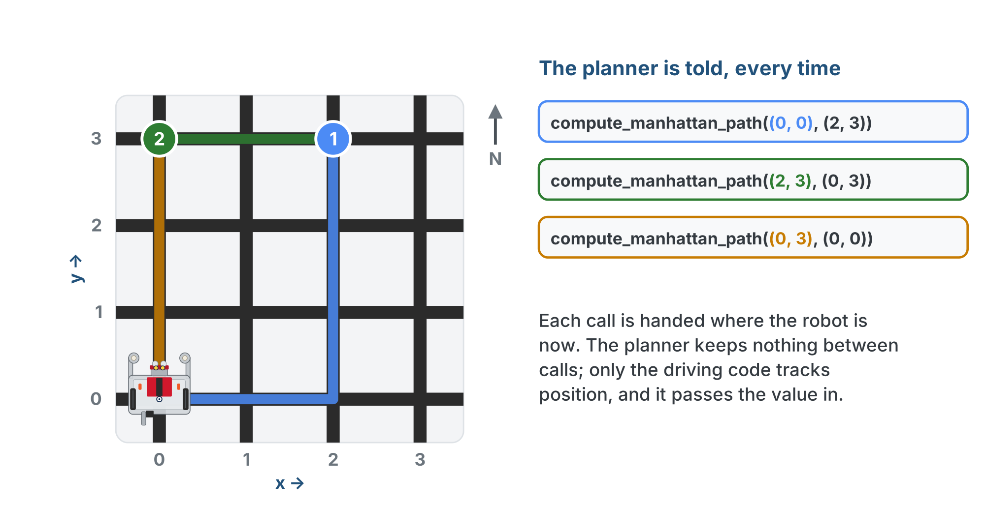
Three legs, three positions
The first argument changes every time, because the robot has moved. The planner never has to know that; it is told.

Slide 16
One owner for the robot's position
Only one piece of code is in charge of knowing where the robot is: the driving code, in Lesson 4-8
It updates its position variable after every intersection, and hands the current value to the planner
If the planner also kept a copy, you'd have two variables that are supposed to agree
The first time one is updated and the other isn't, the robot plans from a place it isn't
A planner has no memory: tuples in, list out. That's also why you can test it with no robot attached, next lesson.
Notes:
The bug it prevents is concrete: in the old class version of this lesson, the planner stored self.position and the driving code stored its own, and every student program needed a line to keep them in sync. Nobody misses that line. The easiest way to never have the bug is to never have the second copy.

Slide 17
Check your understanding
Why does compute_manhattan_path() take position as a parameter every call, instead of remembering where the robot started?
A. Functions cannot store values between calls
B. So only the driving code tracks the robot; a copy in the planner would drift from it
C. Because the start is always (0, 0)
D. To make the function slower and more careful
Notes:
Answer: B. One owner for the robot's position. The driving code updates it after every intersection; the planner is handed the current value and does arithmetic with it. No second copy, no disagreement.

Slide 18
Answer
Why does compute_manhattan_path() take position as a parameter every call, instead of remembering where the robot started?
A. Functions cannot store values between calls
B. So only the driving code tracks the robot; a copy in the planner would drift from it
C. Because the start is always (0, 0)
D. To make the function slower and more careful
One owner for the robot's position. The driving code updates it after every intersection; the planner is handed the current value and does arithmetic with it. No second copy, no disagreement.

Slide 19
Step 1 · The rename
Activity
In MANHATTAN PLANNER, change the def line and replace the one-line docstring with the full one
1
Set the run line to test_paper_paths(), run it, and read the error: your Lesson 4-4 tests still call compute_path(), which no longer exists
2
Update both tests and run them again: same output as yesterday
3
A rename changes every call as well as the definition. That's why names in this file are chosen carefully and changed almost never.

Slide 20
Step 2 · A test from everywhere
Activity
Write test_from_everywhere() with these four calls. Before you run it, trace each answer by hand on the grid and write what you expect as a comment.
print(compute_manhattan_path((0, 0), (2, 3))) # east, then north
print(compute_manhattan_path((0, 0), (3, 1)))
print(compute_manhattan_path((3, 3), (1, 0))) # west, then south
print(compute_manhattan_path((2, 0), (2, 4))) # same column: north only
Set the run line to it. Check each result against the promises, then add a fifth call where position equals destination.
Notes:
The traced answers are behind a reveal on the lesson page. Reading their own output against the three promises is the habit Lesson 4-6 builds on.

Slide 21
Check your understanding
A classmate runs compute_manhattan_path((3, 3), (1, 0)) and gets [(3, 3), (2, 3), (1, 2), (1, 1), (1, 0)]. What went wrong?
A. Nothing: that is a valid Manhattan path
B. The west loop appends before it subtracts 1, so the start is in and (1, 3) is skipped
C. The destination tuple is backwards
D. The south loop ran before the west loop
Notes:
Answer: B. The append-before-update bug is the one students actually make. Promise 1 is broken, and the corner (1, 3) is missing.

Slide 22
Answer
A classmate runs compute_manhattan_path((3, 3), (1, 0)) and gets [(3, 3), (2, 3), (1, 2), (1, 1), (1, 0)]. What went wrong?
A. Nothing: that is a valid Manhattan path
B. The west loop appends before it subtracts 1, so the start is in and (1, 3) is skipped
C. The destination tuple is backwards
D. The south loop ran before the west loop
Swapping the two lines inside a loop (append first, then change x) shifts that leg by one: the start appears and the corner is missed. Promise 1 spots it fastest: the first element should never equal position.
Notes:
Answer: B. The append-before-update bug is the one students actually make. Promise 1 is broken, and the corner (1, 3) is missing.

Slide 23
Real-world connections
MAPS
SOFTWARE
TEAMS
Routing engines
Pure functions
Interfaces
A map app's router is handed your location every time you ask. Swap in a bike router and the app does not change.
Inputs in, output out, nothing stored: the easiest code to test and the hardest to get subtly wrong.
Write down what a function promises and two people can work on either side of it without talking every hour.
Notes:
A function with a written promise, no memory, and the same shape as its alternatives is how big systems stay swappable.

Slide 24
Wrap-up
Why compute_manhattan_path and not compute_path?
What are the three promises?
Who knows where the robot is?
Next: testing the planner systematically, on screen
Notes:
Answers: Module 5 adds compute_bfs_path, and the name says which. No start in the path; ends at the destination; [] when already there. The driving code, and only it: the planner is told. Exit ticket: "Your partner's planner stores the start position inside it. Describe one bug that could cause." Next lesson adds a run_test() helper, possible only because the planner is pure arithmetic.

Slide 25
Optional: the Manhattan class
Optional extension
Did the class extensions in Module 2? Here is the same planner as a class. It holds no state: compute_path() is told the robot's position every call.
path = compute_manhattan_path((0, 0), (2, 3))
planner = Manhattan()
path = planner.compute_path((0, 0), (2, 3))
Why bother? So it has the same shape as the Module 5 and 6 planners (BFS, Dijkstra): one main program and one test harness work with any of them by changing one name.
Notes:
Optional extension, for students who built classes in Module 2. The code is the lesson's side-by-side: the function call, then the same call on the class. From here on, class-track students use their class: when Lesson 4-6 says compute_manhattan_path(position, destination), they write planner.compute_path(position, destination), in the test harness, in the final project, everywhere.

Slide 26
Optional: the class skeleton
Optional extension
Paste it in place of compute_manhattan_path() (keep your tests), and move the four loops into the method. In your tests, compute_manhattan_path( becomes planner.compute_path(.
class Manhattan:
def __init__(self):
pass # nothing to set up
def compute_path(self, position, destination):
# your compute_manhattan_path(), unchanged: nothing in
# it needs self., because the planner holds nothing
pass
planner = Manhattan()
No start position in __init__, no self.position: the planner is still told where the robot is
Notes:
On the lesson page the skeleton also has a section comment and a docstring (the "why bother" from the previous slide); the slide leaves them out to fit. Run test_from_everywhere() again: same five lists. The __init__ is empty because Manhattan has nothing to set up; BFS in Module 5 uses its __init__ to hold the list of blocked intersections, and that is when the class earns its keep. The finished method is behind a reveal on the lesson page and is not shown here. Solution file: lesson-05-manhattan-class-addon.py.

