Slide 1

MODULE 4 · LESSON 4-6
Testing Without a Robot
By the end of this lesson you can
Explain why testing on screen is faster than debugging on the robot
Describe separation of concerns: planning (math) vs. driving (hardware)
Hand-calculate an expected path, then compare it to the actual output
Add a reusable run_test() helper to the MANHATTAN PLANNER section, and a test that runs six cases through it
Debug a failing test with print statements
Notes:
50 minutes. The planner is pure math, so it can be proven correct before the robot ever moves. Two non-negotiables today: expected paths are calculated by hand before anything runs, and the suite covers every direction and edge case.

Slide 2
Pure math is a gift
Your compute_manhattan_path() is pure math: no motors, no sensors
You can prove it's correct on any computer before the robot ever moves
Today: the habit real software engineers live by
Test on screen before you test on the floor.
Notes:
Repeat the motto until it sticks. Five minutes of testing saves thirty minutes chasing a robot.

Slide 3
Why test without the robot?
Would a pilot fly a brand-new plane without testing the engines on the ground?
A robot driving into a wall tells you something is wrong, but not what or where
A failing test on screen tells you the exact input that produced the wrong output
Because the planner is just math, you can run it hundreds of times in seconds: no grid, no batteries, no chasing a robot across the room

Slide 4
Separation of concerns
compute_manhattan_path() only computes a path; the driving functions (Lesson 4-8) drive it. Each can be checked on its own.
Problem | Where it runs | What you test
Computing the path | Any computer | Does the path make sense?
Driving the path | On the robot | Does the robot follow it?
The planner is handed the robot's position and never stores it (Lesson 4-5), so there is nothing to set up before a test: tuples in, list out

Slide 5
Check your understanding
What does 'separation of concerns' let you do here?
A. Run the robot faster
B. Test the path-planning math on its own, separately from the driving
C. Skip testing entirely
D. Combine planning and driving into one function
Notes:
Answer: B. Because the planner only computes paths and the driving functions only drive them, you can verify the algorithm on any computer before hardware is ever involved.

Slide 6
Answer
What does 'separation of concerns' let you do here?
A. Run the robot faster
B. Test the path-planning math on its own, separately from the driving
C. Skip testing entirely
D. Combine planning and driving into one function
Because the planner only computes paths and the driving functions only drive them, you can verify the algorithm on any computer before hardware is ever involved.

Slide 7
Expected vs. actual
Decide what the answer should be by hand, then check whether the code agrees. Hand-trace (0,0) → (2,3): right 2, then up 3.
expected = [(1, 0), (2, 0), (2, 1), (2, 2), (2, 3)]
actual = compute_manhattan_path((0, 0), (2, 3))
if actual == expected:
print("Test 1: PASS")
else:
print("Test 1: FAIL")
print(" Expected:", expected)
print(" Actual: ", actual)
Notes:
This is the heart of testing. The block is on the lesson page as written; the next slide is its picture.

Slide 8
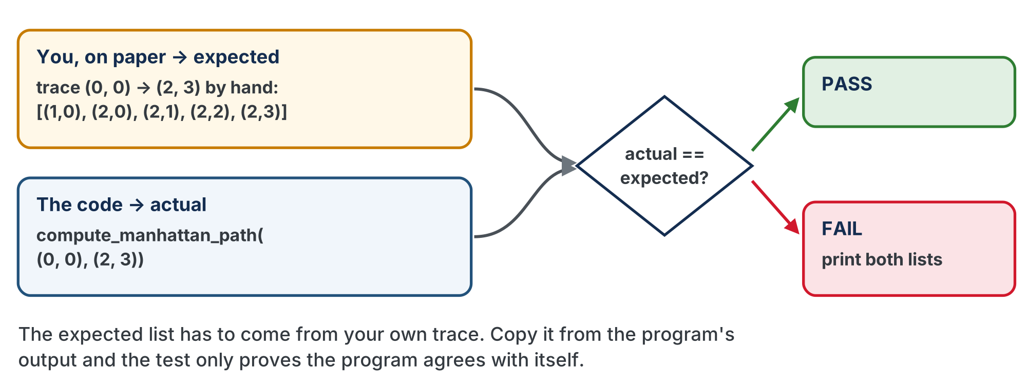
Two sources, one comparison
The test is only worth something because the two sides were worked out independently.

Slide 9
Expected comes from you
The expected list has to come from your own tracing
Copy whatever the code prints and call it "expected"?
You haven't tested anything
You've assumed the code is right
A test needs an independent source of truth: your trace
Notes:
Watch for the student who runs the code first and pastes the output into expected: that student's suite will pass on day one and hide a real bug on day three.

Slide 10
Check your understanding
Where should the 'expected' path come from?
A. Whatever the code prints when you run it
B. Hand-calculated by you, before running the code
C. A random guess
D. The robot's actual movement
Notes:
Answer: B. Testing needs an independent source of truth. You trace the path by hand first; the whole point is to catch the case where the code disagrees with the correct answer.

Slide 11
Answer
Where should the 'expected' path come from?
A. Whatever the code prints when you run it
B. Hand-calculated by you, before running the code
C. A random guess
D. The robot's actual movement
Testing needs an independent source of truth. You trace the path by hand first; the whole point is to catch the case where the code disagrees with the correct answer.

Slide 12
Add to robot.py: the test harness
That compare-and-report pattern repeats for every case, so it becomes a function. Paste this at the end of the MANHATTAN PLANNER section.
# --- Lesson 4-6: the test harness ---
# run_test() asks the planner for a path and compares it
# with one you traced by hand, printing PASS or FAIL. A
# planner test from here on is a list of run_test() calls.
def run_test(test_name, position, destination, expected):
"""Plan position -> destination and compare the result
with expected; print test_name with PASS or FAIL."""
pass
The body is the expected-vs-actual block with the four values coming in as parameters. On a FAIL, print both lists.
Notes:
A harness is a function whose only job is to test another one. Class-track students ask planner.compute_path(position, destination) for the path; the rest is the same. The finished run_test() is behind a reveal on the lesson page.

Slide 13
Activity · A suite of cases
Activity
Write test_planner(): six run_test() calls, each case one line. One is worked out; trace the other five, then fill them in.
run_test("Forward right", (0, 0), (2, 3), [(1,0), (2,0), (2,1), (2,2), (2,3)])
run_test("Backward left", (2, 3), (0, 0), [ ... ]) # trace it, then fill it in
run_test("Same column", (1, 0), (1, 3), [ ... ])
run_test("Same row", (0, 2), (3, 2), [ ... ])
run_test("Same spot", (1, 1), (1, 1), [ ... ])
run_test("One step", (0, 0), (0, 1), [ ... ])
Work each expected out by hand before you run anything.
Notes:
Don't hand the expected values out: the hand-tracing is the lesson. Trace on the Lesson 4-1 grid worksheet.

Slide 14
Six PASS lines, and why six
A test whose expected came from the program's own output proves nothing except that the program agrees with itself
If a test fails, one of two things is wrong: your trace or your code. Finding out which is the skill
Set the run line to test_planner(). Six PASS lines is the goal; the robot does not move
Only ever test (0,0) → (2,3), and a bug that only shows up going backward slips right past you
A good suite covers every direction and every edge case
Notes:
Celebrate the FAILs: reframe a failing test as the test doing its job. "The test found a bug for you."

Slide 15
Check your understanding
Your test shows actual = [(1,0),(2,0),(2,1)] but expected = [(1,0),(2,0),(2,1),(2,2),(2,3)]. What's the likely problem?
A. The robot battery is low
B. The north (y) loop stops early or doesn't run fully: the moves up are missing
C. The test is wrong
D. Nothing: that output is fine
Notes:
Answer: B. The moves across are all there but the moves up are cut short. That points straight at the north while loop: exactly the kind of pinpointing screen-testing gives you.

Slide 16
Answer
Your test shows actual = [(1,0),(2,0),(2,1)] but expected = [(1,0),(2,0),(2,1),(2,2),(2,3)]. What's the likely problem?
A. The robot battery is low
B. The north (y) loop stops early or doesn't run fully: the moves up are missing
C. The test is wrong
D. Nothing: that output is fine
The moves across are all there but the moves up are cut short. That points straight at the north while loop: exactly the kind of pinpointing screen-testing gives you.

Slide 17
Activity · Debug a failing test
Activity
When a test fails, don't guess: add print statements inside compute_manhattan_path to watch the logic run. One at the top, and one inside each loop right after the append:
print("Computing from", position, "to", destination) # first line
...
print(" added:", (x, y)) # in each loop
The trace shows exactly which loop ran and what it appended

Slide 18
Try it: catch a bug on purpose
Activity
Change one + 1 to - 1 in compute_manhattan_path
1
Run test_planner() and watch a test catch the bug
2
Change it back
3
Once you've found and fixed a bug, remove the debug prints so the output stays clean

Slide 19
Check your understanding
After using print statements to fix a bug, what should you do with them?
A. Leave them in: more output is always better
B. Remove or comment them out so the test output stays clean
C. Move them outside the function
D. Turn them into knowledge checks
Notes:
Answer: B. Debug prints are scaffolding. Once the bug is fixed, clear them so future test runs are easy to read.

Slide 20
Answer
After using print statements to fix a bug, what should you do with them?
A. Leave them in: more output is always better
B. Remove or comment them out so the test output stays clean
C. Move them outside the function
D. Turn them into knowledge checks
Debug prints are scaffolding. Once the bug is fixed, clear them so future test runs are easy to read.

Slide 21
Real-world connections
SOFTWARE
AEROSPACE
CARS
Unit tests
Simulation
Digital twins
Professional code ships with automated tests that check each function against known answers: a formal version of run_test().
Rockets and planes fly thousands of simulated missions before a real one, catching problems on screen.
Self-driving systems test on virtual roads first: far cheaper and safer than a real crash.
Notes:
"Verify before you deploy" is everywhere in engineering.

Slide 22
Wrap-up
Why test on screen before the robot?
Where does the expected path come from?
What makes a good test suite?
Next: turning, so the robot faces the right way at each step
Notes:
Answers: faster, and it points to the exact broken input. Hand-calculation, before you run the code. Every direction and edge case, not just one happy path. Exit ticket: "Write a test for position (1,1), destination (3,2): what's the expected path?" ([(2,1),(3,1),(3,2)]). The algorithm is proven correct; next lesson tackles turning.

