Slide 1

MODULE 5 · LESSON 5-2
Dictionaries
By the end of this lesson you can
Explain what a dictionary is: a collection of key-value pairs
Create a dictionary, add pairs, and look up a value by key
Check whether a key exists with the in keyword
Represent a grid graph as {node: [neighbors]}
Open the GRID GRAPH section of robot.py with build_grid_graph() and remove_blocked(), each with a paper test
Notes:
50 minutes. You drew the grid graph on paper in Lesson 5-1; today it goes into Python. The last objective on the lesson page names the full signatures, build_grid_graph(rows, cols) and remove_blocked(graph, blocked_nodes); the slide shortens them. Show a plain dictionary like {"name": "Alice"} before the tuple-keyed graph.

Slide 2
What is a dictionary?
A dictionary stores key-value pairs in curly braces
A real dictionary maps words to definitions
A phone book maps names to numbers
A Python dictionary maps any key to any value
Today: store the Lesson 5-1 graph in a dictionary, ready for the search in Lesson 5-3

Slide 3
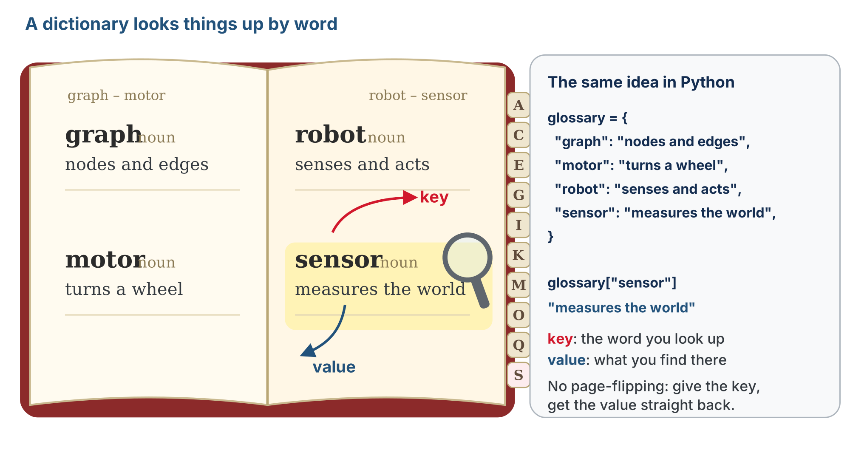
The key and the value
The word you look up is the key; what's printed beside it is the value. Python's dictionary works the same way.

Slide 4
Why a dictionary is fast: hashing
A printed dictionary is in alphabetical order, so you flip straight to the right page
A Python dictionary is organized for speed too, though not alphabetically
Storing: Python turns the key into a number that says where to keep it
Looking up: it does the same arithmetic and goes straight there
That trick is hashing: a lookup is just as fast with four thousand entries as with four
So a key must be something that can't change, like a number or a tuple
Notes:
If the key could change, Python would be looking in the wrong place. Tuples can be dictionary keys, lists cannot: keys must be immutable.

Slide 5
Dictionaries in code
Snippets like these are for trying out in a scratch file or at the Python prompt, not for keeping in robot.py:
scores = {"Alice": 95, "Bob": 87}
graph = {} # empty, ready to fill
graph[(0, 0)] = [(0, 1), (1, 0)] # node (0,0) -> its neighbor list
For our graph, the keys are node tuples and the values are lists of neighbor tuples
Notes:
Why not just a list? Because we look things up by content ("what are the neighbors of (1,1)?"), not by position. A dictionary jumps straight to the answer.

Slide 6
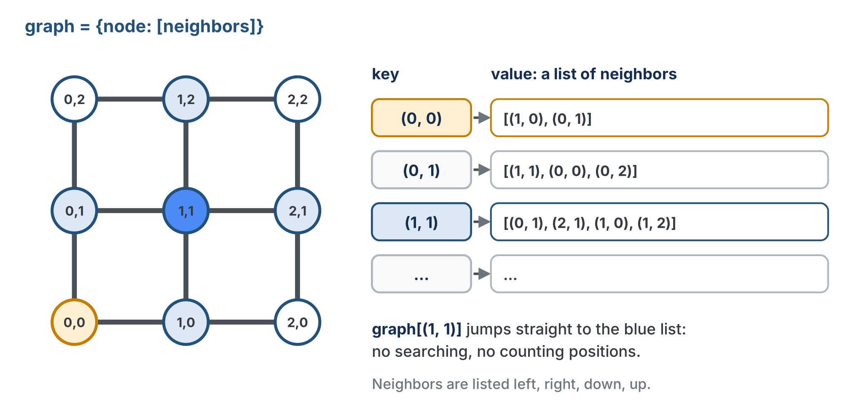
The graph as a dictionary
One entry per node: the node is the key, its neighbor list is the value.
Notes:
Have students open their Lesson 5-1 drawings and translate each node into a key-value pair: it makes the paper-to-code jump concrete. The snippets in this part of the lesson are for trying out in a scratch file or at the Python prompt, as with tuples in Lesson 4-2. Only the two functions in the skeleton go into robot.py.

Slide 7
Check your understanding
In our graph dictionary, what are the keys and what are the values?
A. Keys are numbers; values are strings
B. Keys are (x, y) node tuples; values are lists of neighbor tuples
C. Keys are lists; values are tuples
D. Both are single integers
Notes:
Answer: B. Each node is a tuple key, and its value is the list of nodes it connects to: the Python version of the paper graph.

Slide 8
Answer
In our graph dictionary, what are the keys and what are the values?
A. Keys are numbers; values are strings
B. Keys are (x, y) node tuples; values are lists of neighbor tuples
C. Keys are lists; values are tuples
D. Both are single integers
Each node is a tuple key, and its value is the list of nodes it connects to: the Python version of the paper graph.

Slide 9
Access and the in keyword
Look up a value with square brackets, and check whether a key exists with in:
graph = {(0, 0): [(0, 1), (1, 0)], (0, 1): [(0, 0), (0, 2), (1, 1)]}
print(graph[(0, 0)]) # [(0, 1), (1, 0)]
print(len(graph[(0, 0)])) # 2 -- number of neighbors
print((0, 0) in graph) # True
print((2, 2) in graph) # False -- not added
A blocked node simply isn't in the graph, so (1, 1) in graph tells you whether that intersection is reachable

Slide 10
Missing keys, and deleting one
Accessing a missing key, like graph[(9, 9)], raises a KeyError
So check with in first
del graph[(1, 1)] removes the pair whose key is (1, 1)
Afterwards, (1, 1) in graph is False
You'll need del for blocking a node later in this lesson

Slide 11
Check your understanding
Given graph = {(0,0): [(0,1)]}, what does (0,0) in graph return?
A. True
B. False
C. [(0,1)]
D. A KeyError
Notes:
Answer: A. `in` checks whether a key exists. (0,0) is a key, so it returns True. (Accessing a missing key with [] would raise KeyError, which is why we use `in`.)

Slide 12
Answer
Given graph = {(0,0): [(0,1)]}, what does (0,0) in graph return?
A. True
B. False
C. [(0,1)]
D. A KeyError
in checks whether a key exists. (0,0) is a key, so it returns True. (Accessing a missing key with [] would raise KeyError, which is why we use in.)

Slide 13
Add to robot.py: GRID GRAPH (1 of 3)
A new kind of data gets a new section. Paste it above RUN, after the NAVIGATOR section. Nothing in it drives.
# ===== GRID GRAPH =====
# The grid as a graph, in a dictionary: every intersection is
# a key, and its value is the list of neighbors it is joined
# to. The BFS PLANNER searches this graph. Starts with the
# open grid; Lesson 5-4 adds the blocked list, so a blocked
# intersection is neither a key nor anyone's neighbor.
ROWS = 4 # the grid is ROWS x COLS intersections
COLS = 4
ROWS and COLS are the size of your taped grid
Notes:
Like the MANHATTAN PLANNER, nothing here drives: two functions that take numbers and lists and return a dictionary. The functions take the size as parameters rather than reading the settings, so a test can build a 3x3 while the settings say 4x4.

Slide 14
Add to robot.py: GRID GRAPH (2 of 3)
def build_grid_graph(rows, cols):
"""Return the open grid as a dictionary: every (x, y)
maps to the list of its on-grid neighbors."""
# 1. graph = {}
# 2. for every x, for every y:
# neighbors = []
# left, right, down, up: append each one that is
# still on the grid (a bounds check for each)
# graph[(x, y)] = neighbors
# 3. return graph
pass
The build-in-a-loop pattern from Lesson 4-3, with two loops, one inside the other, and a value that is itself a list you build
Notes:
It goes under the ROWS and COLS settings. The outline is longer than Module 4's because this is the first time students build a dictionary inside a function: start empty, add one entry per pass. In Lesson 5-4 this function is rewritten with the blocked list folded in; the tests students write today will tell them whether that rewrite broke anything. Every student needs a working copy.

Slide 15
Add to robot.py: GRID GRAPH (3 of 3)
Right under build_grid_graph():
def remove_blocked(graph, blocked_nodes):
"""Take every node in blocked_nodes out of graph: delete
its key AND drop it from every other node's neighbors."""
# 1. for each blocked node that is in graph: del its key
# 2. for each node still in graph: replace its neighbor
# list with one that leaves the blocked nodes out
# 3. return graph
pass
Two numbered steps: delete the key, then clean every neighbor list
Notes:
remove_blocked() is deleted in Lesson 5-4, the way SETPOINT went in Lesson 2-6, when the blocked list is folded into the graph builder.

Slide 16
Activity · Build the graph automatically
Activity
Typing all 9 nodes of a 3×3 grid by hand is tedious; a 10×10 grid has 100
So build_grid_graph() generates the graph for any size
For each node, check left, right, down and up, and add only the ones that are on the grid
That means a bounds check before each append:
left only if you're not on the left edge: x > 0
right only if you're not on the right edge: x < cols - 1
the same two checks for y, against the bottom and top rows
The four checks are what give corners 2 neighbors and interior nodes 4

Slide 17
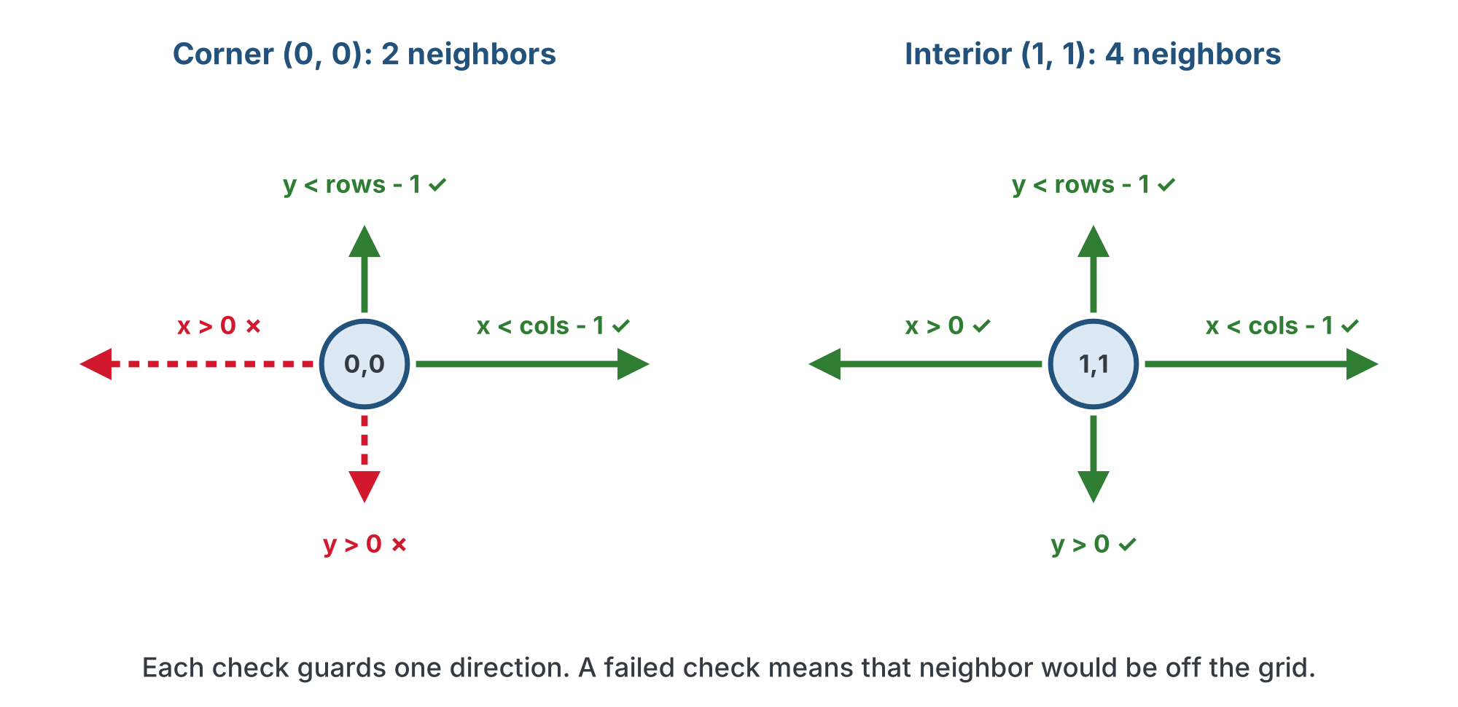
Four bounds checks
Activity
A failed check is a neighbor that would be off the grid, so it is never appended.

Slide 18
Step 1 · Test build_grid_graph()
Activity
Write the body of build_grid_graph() from its outline
1
Write a test, say test_grid_graph(), that builds the 4×4 graph and prints len(graph), the neighbors of (1, 1) and the neighbors of (0, 0)
2
Before you run it, write down what each should be from your Lesson 5-1 drawing
3
Set the run line to it. The robot stays on the desk
4
Notes:
The expected output is behind a reveal on the lesson page; let students predict and run first. The order inside a neighbor list depends on the order the four directions are checked; left, right, down, up is the order the search in Lesson 5-5 will use.

Slide 19
Check your understanding
In build_grid_graph, why is each neighbor guarded by an if (like if x > 0)?
A. To make the code shorter
B. To keep neighbors inside the grid: a corner or edge node has no neighbor off the grid
C. To skip blocked nodes
D. It has no effect
Notes:
Answer: B. The bounds checks prevent adding neighbors that fall off the edge of the grid, so corners get 2 neighbors and interior nodes get 4.

Slide 20
Answer
In build_grid_graph, why is each neighbor guarded by an if (like if x > 0)?
A. To make the code shorter
B. To keep neighbors inside the grid: a corner or edge node has no neighbor off the grid
C. To skip blocked nodes
D. It has no effect
The bounds checks prevent adding neighbors that fall off the edge of the grid, so corners get 2 neighbors and interior nodes get 4.

Slide 21
Activity · Removing blocked nodes
Activity
Blocking a node is a two-step job:
delete its key
and remove it from every other node's neighbor list
Forget step 2 and other nodes still think they can reach a blocked intersection
Step 2, one way: start a new empty list, loop over the old neighbors, append each one that is not in blocked_nodes
Then assign the new list back to graph[node]
Those are the outline's two numbered steps
Notes:
Spend extra time here: forgetting to clean the neighbor lists is the number one bug in later lessons. A plain loop-and-append is the version to expect from most students, and it is fine.

Slide 22
Step 2 · Test remove_blocked()
Activity
Write the body of remove_blocked() from its outline
1
Write a test, test_remove_blocked(), that builds a 3×3 graph and removes (1, 1)
2
Print how many intersections are left, (1, 1) in graph, and the neighbors of (0, 1). Predict all three first
3
Don't go on until both tests print what you predicted
4
Notes:
The finished bodies and the expected output are behind a reveal on the lesson page, and the full section is in the teacher solution file lesson-02-dictionaries.py in the Module 5 solutions. The reveal uses a list comprehension, which is new; students who wrote the loop keep the loop.

Slide 23
Check your understanding
To block node (1,1), what two things must happen to the graph dictionary?
A. Just delete the key (1,1)
B. Delete the key (1,1) AND remove (1,1) from every other node's neighbor list
C. Set graph[(1,1)] to an empty list
D. Nothing: blocked nodes are ignored automatically
Notes:
Answer: B. Deleting only the key leaves dangling references: neighbors still list (1,1). You must also clean it out of every neighbor list.

Slide 24
Answer
To block node (1,1), what two things must happen to the graph dictionary?
A. Just delete the key (1,1)
B. Delete the key (1,1) AND remove (1,1) from every other node's neighbor list
C. Set graph[(1,1)] to an empty list
D. Nothing: blocked nodes are ignored automatically
Deleting only the key leaves dangling references: neighbors still list (1,1). You must also clean it out of every neighbor list.

Slide 25
Real-world connections
WEB
GAMES
DATA
User profiles
Inventories
Caches & indexes
A username maps to a profile object: look up any user instantly by their key.
Item name maps to quantity; the game jumps straight to "how many potions?" without searching.
Databases and caches use key lookups so huge datasets stay fast to search.

Slide 26
Wrap-up
How is a dictionary different from a list?
Why are tuples the keys and lists the values in our graph?
What are the two steps to block a node?
Next: breadth-first search, on paper
Notes:
Answers: looked up by key, not by position. A node is a fixed pair; its neighbors are a changing collection. Delete its key; remove it from all neighbor lists.

