Slide 1

MODULE 5 · LESSON 5-4
The Pathfinding Functions
By the end of this lesson you can
Write add_blocked(intersection) so an intersection is recorded once, even if told twice
Rewrite build_grid_graph() as build_graph(rows, cols, blocked): blocked intersections are neither keys nor anyone's neighbor
State the two rules every planner follows: the position is passed in; the path leaves the start out
Explain why the blocked list is shared at the top of the section, and why the graph is rebuilt on every call
Notes:
45 minutes. The concept from Lesson 5-3 turns into code, in stages. Today the GRID GRAPH section becomes a toolkit like Module 2's sensor code: a shared blocked list, a function that adds to it, and build_graph() built around it. A new BFS PLANNER section opens with a placeholder that Lesson 5-5 fills in.

Slide 2
Where does the robot keep what it has learned?
Three lessons from now the robot is driving, sees a box with its rangefinder, and has to plan around it
So where does it write down that the box is there?
"Pass the blocked list to the function" is half right
The robot learns about obstacles one at a time, in the middle of driving
Something has to keep the list between one path and the next
Notes:
Ask the question before showing the bullets. Most students say "pass it in". Agree that it is half right, then ask when the robot finds out about each obstacle.

Slide 3
One list at the top of the section
Like reflectance and THRESHOLD at the top of LINE SENSOR, and ROWS and COLS already at the top of GRID GRAPH:
BLOCKED = [] # intersections the robot must not drive through
Capital letters, like THRESHOLD: it is a setting, not something that changes in the middle of a calculation. BLOCKED does grow, but only through one function.
Notes:
A variable at the top of the section that every function can see is the same idea students used for the sensor toolkit in Module 2.

Slide 4
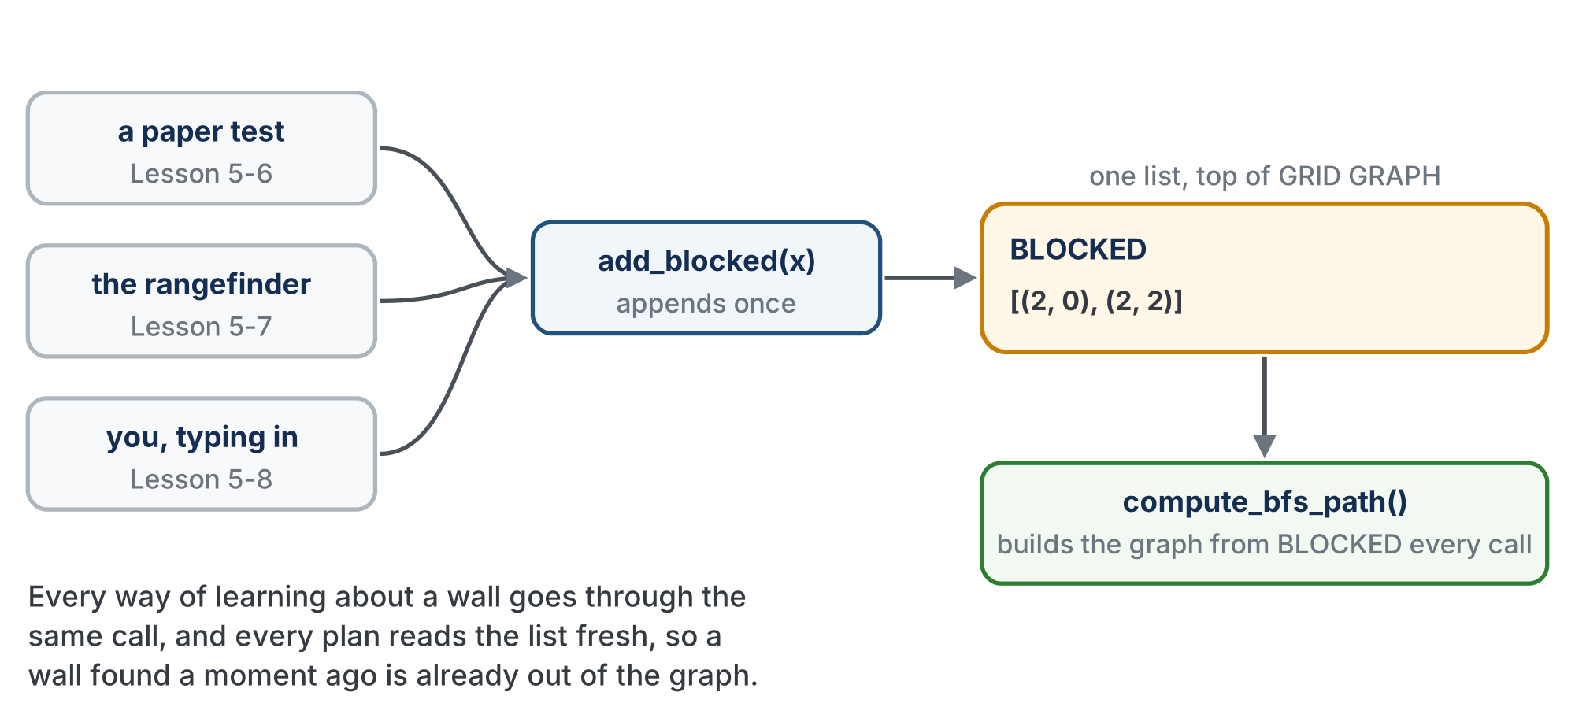
One list, three ways in, one way out
Every plan builds its graph from BLOCKED as it stands right now.
Notes:
Point at the three sources: a paper test in Lesson 5-6, the rangefinder in Lesson 5-7, and the student typing in a list in Lesson 5-8. All three call add_blocked(), and compute_bfs_path() reads the list fresh on every call.

Slide 5
Two rules we will never break
Rule 1: the planner is told where the robot is. Every planner looks like compute_something_path(position, destination)
It never remembers the position between calls
The driving code already knows. Two copies could disagree, and the planner would plan from the wrong place. One owner.
Rule 2: the path is the list of intersections to drive to. The start is not in it
So len(path) is the number of steps, and "already there" is []
Module 4's planner already follows both:
compute_manhattan_path((0, 0), (0, 2)) returns [(0, 1), (0, 2)]
Notes:
Keep these two rules on the board all module. Nothing later breaks them, including the class versions and Module 6.

Slide 6
Check your understanding
Why must a planner be TOLD the robot's position instead of remembering it?
A. So the planner and the driving code can never disagree about where the robot is
B. Because functions cannot store values between calls
C. To make the path shorter
D. Because the position changes while the path is being computed
Notes:
Answer: A. The driving code owns the position. Two copies of the same fact is how a planner ends up planning from an intersection the robot left three steps ago.

Slide 7
Answer
Why must a planner be TOLD the robot's position instead of remembering it?
A. So the planner and the driving code can never disagree about where the robot is
B. Because functions cannot store values between calls
C. To make the path shorter
D. Because the position changes while the path is being computed
The driving code owns the position. Two copies of the same fact is how a planner ends up planning from an intersection the robot left three steps ago.

Slide 8
Add to robot.py: the blocked list
At the end of the GRID GRAPH section, under your Lesson 5-2 tests:
# --- Lesson 5-4: the blocked list ---
# BLOCKED is the one record of where the robot must not go.
# add_blocked() is the one way in: tests, the rangefinder and
# you all use it. build_graph() builds AROUND the list, so a
# blocked intersection is never a key and never a neighbor.
BLOCKED = [] # intersections the robot must not drive through
def add_blocked(intersection):
"""Record intersection in BLOCKED, once, even if told twice."""
pass
def clear_blocked():
"""Empty BLOCKED in place, so a test can start fresh."""
pass
Notes:
Two pastes today and one rewrite. This is the first paste. Both bodies are written in Step 1.

Slide 9
Add to robot.py: a new BFS PLANNER section
Paste it after GRID GRAPH, above RUN. The placeholder body is given: Lesson 5-5 replaces it.
# ===== BFS PLANNER =====
# The second planner. compute_bfs_path(position, destination)
# has the same shape as the MANHATTAN PLANNER's function and
# keeps the same two promises (told the position; the path
# leaves the start out), but it searches the GRID GRAPH ring
# by ring, so it routes AROUND whatever is in BLOCKED. Pure
# dictionary work: every test here runs with the robot still.
def compute_bfs_path(position, destination):
"""Shortest path from position to destination around
BLOCKED, as the list of intersections to drive to."""
graph = build_graph(ROWS, COLS, BLOCKED) # rebuilt every call
print("compute_bfs_path is not written yet!")
return []
Notes:
A planner is a different kind of work from a graph, so it gets its own section. The placeholder is given because it is not the function yet.

Slide 10
Activity · Build the toolkit
Step 1: write add_blocked() and clear_blocked()
Step 2: rewrite build_grid_graph() as build_graph(rows, cols, blocked)
Like the rename in Lesson 4-5, it changes every call as well as the definition
Step 3: read the placeholder, and write a test with a wall in it
Every test today is a paper test: the robot stays on the desk
Notes:
The rewrite is the step most likely to go wrong. Budget the most time for Step 2.

Slide 11
Step 1 · add_blocked()
Activity
The one way anyone tells the planner about an obstacle.
The body is an if and an append: add the intersection to BLOCKED only if it isn't already there
1
Why the if? The robot may see the same wall twice. (2, 0) in the list twice is harmless but untidy, and it makes the printed grid confusing
2
clear_blocked() empties the list in place: pop() until len(BLOCKED) is zero, so tests can start fresh
3
Write both bodies. There's nothing to run yet: Step 2 gives you the test.
Notes:
Students write both bodies now and test them in Step 2. If anyone asks why there is no global, hold it for the next slide.

Slide 12
Does add_blocked() need global BLOCKED?
In Lesson 2-7, set_threshold() needed global THRESHOLD. The difference is what each function does to the name:
THRESHOLD = new_value # Lesson 2-7: REASSIGNS the name -- needs global
BLOCKED.append(intersection) # today: CHANGES the list -- no global needed
global is for reassigning a module-level name. append reassigns nothing: BLOCKED still names the same list, which just has one more thing in it.
Notes:
clear_blocked() is the same idea the other way. Writing BLOCKED = [] inside it would reassign the name and need global; popping does not. This is the exit ticket question, so give it time.

Slide 13
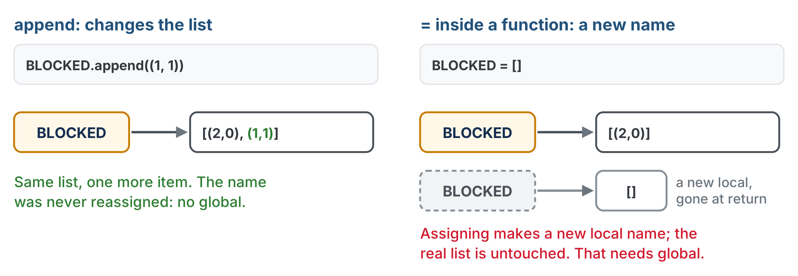
Changing the list vs. reassigning the name
append changes the list the name points at. = points a name at something else, and inside a function that name is a new local.
Notes:
Right side: BLOCKED = [] inside a function makes a new local name pointing at a new empty list, gone when the function returns. The real BLOCKED is untouched. That is the case that needs global.

Slide 14
Check your understanding
Why does add_blocked() not need global BLOCKED, when set_threshold() in Lesson 2-7 needed global THRESHOLD?
A. append changes the list in place; set_threshold reassigns the name
B. Lists are always global
C. BLOCKED is in capital letters
D. It does need it: the code above is wrong
Notes:
Answer: A. `global` is needed only to reassign a module-level name. Appending to a list changes the list that BLOCKED already names; the name itself is untouched.

Slide 15
Answer
Why does add_blocked() not need global BLOCKED, when set_threshold() in Lesson 2-7 needed global THRESHOLD?
A. append changes the list in place; set_threshold reassigns the name
B. Lists are always global
C. BLOCKED is in capital letters
D. It does need it: the code above is wrong
global is needed only to reassign a module-level name. Appending to a list changes the list that BLOCKED already names; the name itself is untouched.

Slide 16
Step 2 · build_graph(): two functions become one
In Lesson 5-2: build_grid_graph(), then remove_blocked(). Today one function does both: while building, skip anything blocked. Change the def line to:
def build_graph(rows, cols, blocked):
"""Return the grid as a dictionary, leaving out every
intersection in blocked: not a key, not anyone's neighbor."""
Then two changes to the body you already have
Notes:
This rewrite is in place, in the GRID GRAPH section, where build_grid_graph() was.

Slide 17
Step 2 · Two in blocked checks
First: if (x, y) itself is in blocked, skip it entirely. It never becomes a key
Second: each of the four neighbor checks gets one more condition: the neighbor must not be in blocked either
Both are needed. The second keeps a blocked intersection out of every other intersection's neighbor list
Keep the four directions in the order left, right, down, up: the order Lesson 5-3's trace checked neighbors
Miss the second check and the graph still has edges leading into the wall
Notes:
The order matters because it is why the Lesson 5-3 trace's printed path matched the table. A build_graph that drops blocked keys but still lists them as neighbors is the single most common bug in the module, and it only shows up in Lesson 5-5 as a search that walks into a wall. Catch it today.

Slide 18
Step 2 · Tidy up, then test
Activity
Delete remove_blocked() and its test: the new function has absorbed them, the way SETPOINT disappeared in Lesson 2-6
1
Fix test_grid_graph(), which still calls a function that no longer exists: build with build_graph(ROWS, COLS, BLOCKED)
2
Set the run line to it. With nothing blocked the output is exactly Lesson 5-2's: 16, four neighbors, two neighbors
3
Don't go on until it is
Notes:
Like the rename in Lesson 4-5, every call to build_grid_graph() has to change, not only the definition. A NameError at this point usually means a call was missed.

Slide 19
Check your understanding
(1,1) is blocked. Someone wrote build_graph with the first in blocked check but forgot the second. What is wrong with the result?
A. (1,1) is not a key, but it is still in its neighbors' lists: edges into the wall
B. (1,1) is a key with an empty neighbor list
C. Nothing: the first check is enough
D. The graph has 16 keys instead of 15
Notes:
Answer: A. The first check removes (1,1) as a key. Only the second check removes it from the lists of (0,1), (1,0), (1,2) and (2,1). Without it, a search could step into the wall.

Slide 20
Answer
(1,1) is blocked. Someone wrote build_graph with the first in blocked check but forgot the second. What is wrong with the result?
A. (1,1) is not a key, but it is still in its neighbors' lists: edges into the wall
B. (1,1) is a key with an empty neighbor list
C. Nothing: the first check is enough
D. The graph has 16 keys instead of 15
The first check removes (1,1) as a key. Only the second check removes it from the lists of (0,1), (1,0), (1,2) and (2,1). Without it, a search could step into the wall.

Slide 21
Step 3 · Why rebuild the graph on every call?
The placeholder compute_bfs_path() builds the graph itself, from BLOCKED, every time it is called. Why not build it once at the top of the file?
A wall the robot finds at step 3 has to be gone from the graph it plans step 4 on
Rebuilding on every call makes that automatic: there is no "forgot to rebuild" bug to have
On a 4×4 grid the rebuild visits sixteen intersections and takes no time worth measuring
Every plan uses the blocked list as it stands right now
Notes:
This is the third wrap-up question. Point back at the blocked-list figure: one way in, and every plan reads the list fresh.

Slide 22
Step 3 · test_blocked_graph()
Activity
A test that exercises all three functions. Set the run line to it.
Block (1, 1) with add_blocked(), and build the graph
1
Print the blocked list, the number of intersections, whether (1, 1) is in the graph, and the neighbors of (0, 1)
2
Call add_blocked((1, 1)) a second time, and print the list again
3
Print what compute_bfs_path((0, 0), (3, 3)) returns
4
Notes:
The lesson page describes the test in words; students write it. The expected output is on the next slide.

Slide 23
What test_blocked_graph() should show
Blocked: [(1, 1)]
Number of intersections: 15
(1,1) in graph? False
Neighbors of (0,1): [(0, 0), (0, 2)]
Blocked after adding (1,1) again: [(1, 1)]
compute_bfs_path is not written yet!
Path: []
Check: fifteen keys, (1, 1) not one of them, (1, 1) gone from (0, 1)'s neighbors, and the list still one entry long
Notes:
The neighbors-of-(0,1) line is the one that catches the missing second in-blocked check. The empty path is the placeholder: for now, the right answer to nothing.

Slide 24
Before you leave: write down, don't run
What should these return once Lesson 5-5 is finished, with nothing blocked?
compute_bfs_path((0, 0), (0, 2))
compute_bfs_path((2, 2), (2, 2))
Use the two rules: what is in the path, and what is left out?
Notes:
Answers: [(0, 1), (0, 2)] and [], Rule 2 both times. Challenge for early finishers: block (1, 0) and (1, 1), rebuild, and print the whole graph. Which intersections in the left column (x = 0) can still reach the column at x = 2, and through what? Then: using only build_graph and the ripples idea, write is_reachable(a, b). They will write most of Lesson 5-5 a day early, which is fine.

Slide 25
Real-world connections
MAPS
SOFTWARE
ROBOTICS
Road closures
One owner per fact
Maps that grow
A navigation app keeps one shared list of closed roads and rebuilds its routing graph from it: this toolkit, at city scale.
Rule 1 is a general principle: keep one copy of each piece of state, and tell everything else. Copies drift apart.
A robot vacuum's map starts empty and fills in as bumps and sensors report walls: its BLOCKED list, with thousands of entries.
Notes:
Rule 1 and the shared list are the same idea at any scale: one owner for each fact.

Slide 26
Wrap-up
What are the two planner rules?
Who calls add_blocked()?
Why is the graph rebuilt on every call?
Why no global in add_blocked()?
Next: the placeholder becomes real: compute_bfs_path()
Notes:
Answers: told the position, and the path excludes the start. A paper test in 5-6, the rangefinder in 5-7, and you in 5-8, typing in what the last run found. So a just-found obstacle is already missing from it. Appending changes the list; it does not reassign the name. Formative: the two rules from memory, the second in-blocked bug caught, the global explanation. Exit ticket: "Why doesn't add_blocked() need global?" Next lesson: previous, to_visit and the walk-back from Lesson 5-3, in about twenty lines.

