Slide 1

MODULE 5 · LESSON 5-6
Testing and Swapping
By the end of this lesson you can
Explain why an exact-match test is wrong for BFS and right for Manhattan
Name the five properties every correct path has, and write each as one if
Explain why the walled-off case needs its own test
Hand a function to another function, and explain what planner(position, destination) does in the harness
Run one harness against Manhattan and BFS and explain every FAIL line
Write a main program that works with either planner by changing one name
Notes:
50 to 60 minutes. The planner passes five tests; now test it properly. The property-versus-exact idea outlasts this course, so say so. Then one small trick points the same tests at Module 4's Manhattan planner, which fails on paper for exactly the reason this module exists.

Slide 2
Two right answers
Compare your Lesson 5-5 Test 1 path with a classmate's. Different? Good. If not, here's another correct one:
[(1, 0), (2, 0), (3, 0), (3, 1), (3, 2), (3, 3)] # yours, maybe
[(0, 1), (0, 2), (0, 3), (1, 3), (2, 3), (3, 3)] # also six steps, also right
Both go from (0, 0) to (3, 3) in six steps, and both are shortest
Notes:
Have pairs actually compare paths on screen before showing the slide.

Slide 3
...and one test
Module 4's test from Lesson 4-6, still in your file as run_test():
if actual == expected:
print(test_name, "- PASS")
One of those two correct paths gets marked FAIL. Fine for Manhattan, which has exactly one answer. BFS doesn't.
Notes:
A different kind of test gets a different name. run_test() stays in the MANHATTAN PLANNER section, doing the job it was written for. Reusing the name with a different parameter list would silently replace it and break test_planner().

Slide 4
Test what must be true
Forget the exact list. What has to be true of any correct path from (0, 0) to (3, 3)?
1. The first step is next to the start
2. The last step is the destination
3. Every step is next to the one before it
4. No step is a blocked intersection
5. With nothing blocked, the number of steps is the Manhattan distance
A property test: check what must be true, not what you happened to expect
Notes:
Five one-line checks. Together they are stricter than an exact match: an exact match cannot tell you a path is valid, only that it is the one you expected. And they allow every correct answer.

Slide 5
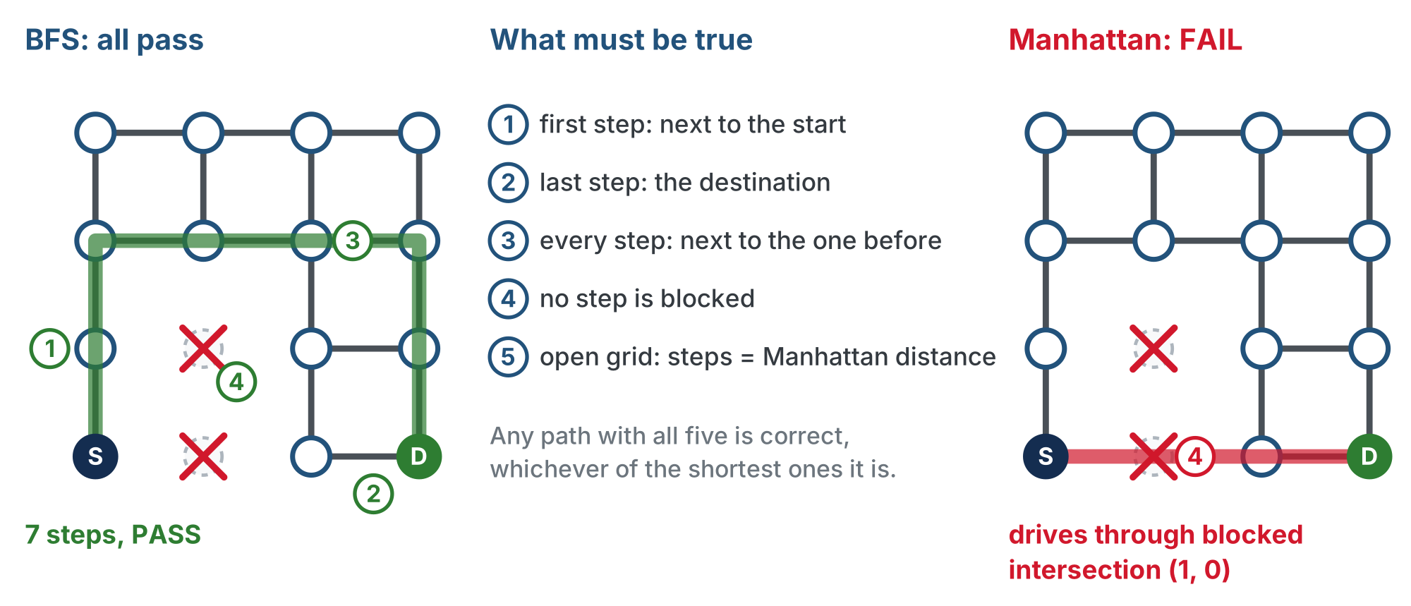
The five properties on the wall test
The checks never ask which shortest path you found, only whether it is a legal one of the right length.
Notes:
Left: the BFS path around the wall, 7 steps, properties 1 to 4 holding. Right: Manhattan goes straight through blocked (1, 0) and fails property 4. The fifth property is only checked on an open grid.

Slide 6
Check your understanding
Why are the five property checks stronger than comparing with one expected path?
A. They check that a path is valid, and accept every correct answer instead of just one
B. They run faster
C. They do not need to know the destination
D. They are not stronger: an exact match is always better
Notes:
Answer: A. An exact match passes only the path you wrote down, even if your expectation was wrong. The properties check validity directly, and any shortest path passes.

Slide 7
Answer
Why are the five property checks stronger than comparing with one expected path?
A. They check that a path is valid, and accept every correct answer instead of just one
B. They run faster
C. They do not need to know the destination
D. They are not stronger: an exact match is always better
An exact match passes only the path you wrote down, even if your expectation was wrong. The properties check validity directly, and any shortest path passes.

Slide 8
Add to robot.py: the property harness
At the end of the BFS PLANNER section. First the header and two helpers:
# --- Lesson 5-6: the property harness ---
# Tests any planner by what must be true of its path, not by
# one expected list, because BFS has many right answers.
# run_all_tests() is handed a planner FUNCTION and runs the
# six cases through it: one program tests Manhattan and BFS.
# Module 4's run_test() stays; exact match is right there.
def manhattan_distance(a, b):
"""Steps between a and b with nothing in the way."""
pass
def is_neighbor(a, b):
"""True when a and b are one step apart."""
pass
Notes:
The skeleton is one paste on the lesson page; the slides show it in four parts. The two helpers and the checker are the students' to write; run_all_tests() and navigate() are given, because they are the "same program" in "same program, swap the planner".

Slide 9
The skeleton: the checker
def check_path(path, position, destination):
"""Return a list of everything wrong with path as a route
from position to destination; [] means it is good."""
# problems = []
# an empty path is fine only if already there; return
# 1. first step next to the start?
# 2. last step the destination?
# 3. every step next to the one before it?
# 4. no step in BLOCKED?
# return problems
pass
Properties 1 to 4. The fifth, the step count, is checked by the test that calls it.
Notes:
Students write this in Step 2. The outline's first line after problems = [] is the empty-path special case.

Slide 10
The skeleton: the two tests
def run_path_test(test_name, planner, position, destination, expected_steps):
"""Ask planner for a path, check the five properties, print
PASS or FAIL with the path; return True on a pass."""
# path = planner(position, destination)
# problems from check_path(), plus 5. the step count
# no problems: print " PASS ", test_name, "", path
# otherwise: print " FAIL " the same way, then each
# problem on its own line, " - " in front
pass
def run_no_path_test(test_name, planner, position, destination):
"""For a walled-off destination the only right answer is
[]; print PASS or FAIL and return True on a pass."""
pass
Notes:
Students write both in Step 3, after the idea of handing over a function. Each returns True on a pass so run_all_tests() can count.

Slide 11
The skeleton: run_all_tests() is given
The suite. Each case is one if, and a pass adds one to passed. It starts like this:
def run_all_tests(name, planner):
"""The six cases, through whichever planner is handed in:
four on the open grid, the wall, and walled off."""
print("==========", name, "==========")
passed = 0
clear_blocked()
if run_path_test("open (0, 0) to (3, 3)", planner, (0, 0), (3, 3), 6):
passed = passed + 1
It ends by printing how many of the 6 passed
Notes:
The rest of run_all_tests() is five more cases in the same pattern (next slide), with add_blocked() calls before the wall cases, then clear_blocked() and the count. navigate() is the last given function; it comes up in the swap activity.

Slide 12
The six cases in run_all_tests()
Case | Trip | Blocked | Expect
open | (0, 0) to (3, 3) | nothing | 6 steps
open | (0, 0) to (0, 3) | nothing | 3 steps
open | (2, 1) to (0, 3) | nothing | 4 steps
open | (1, 1) to (1, 1) | nothing | 0 steps
wall | (0, 0) to (3, 0) | (1, 0), (1, 1) | 7 steps
walled off | (0, 0) to (3, 0) | the whole column at x = 1 | []
Notes:
The first five go through run_path_test(); the walled-off case goes through run_no_path_test(). The harness blocks the wall itself with add_blocked() and clears the list before and after.

Slide 13
Step 1 · Two helpers
Activity
manhattan_distance() is the Lesson 4-2 formula: the x difference plus the y difference, each made positive with abs()
1
is_neighbor() asks whether that distance is exactly 1
2
Notes:
Both are one line. is_neighbor() calls manhattan_distance(), the same one function calling another idea as the sensor toolkit.

Slide 14
Step 2 · check_path() returns a list of problems
Activity
One if per property, each appending a sentence to problems when it fails. An empty list means the path is good
1
First the special case: an empty path is correct when position == destination and a problem otherwise. Either way there are no steps to check, so return at once
2
Property 3 is a loop from the second step to the last, comparing each with the one before. Property 4 is a loop over every step
3
Notes:
Returning problems rather than True or False is deliberate: see the next slide.

Slide 15
Make the sentences specific
Build each sentence with + and str(). Property 1's:
"first step " + str(path[0]) + " is not next to the start " + str(position)
A test that says only FAIL is a test you'll ignore. "drives through blocked intersection (1, 0)" tells you what to fix.
Notes:
The others follow the same pattern: name the step, say what is wrong with it.

Slide 16
One case check_path() can't judge
An empty path when the destination is walled off is correct
But check_path can't tell "walled off" from "forgot to look"
So the walled-off case gets its own small test, run_no_path_test(), where the only right answer is []
Lesson 5-5's Tests 3 and 5 both returned []. Now the harness tells them apart.
Notes:
This is the third wrap-up question.

Slide 17
Check your understanding
A planner returns [(0,1), (0,3)] for (0,0) to (0,3). Which property fails, and what does the FAIL line say?
A. Property 3: "step (0, 3) is not next to (0, 1)"
B. Property 1: the first step is not next to the start
C. Property 2: the last step is not the destination
D. Nothing fails: it reaches the destination
Notes:
Answer: A. This is the exit ticket.

Slide 18
Answer
A planner returns [(0,1), (0,3)] for (0,0) to (0,3). Which property fails, and what does the FAIL line say?
A. Property 3: "step (0, 3) is not next to (0, 1)"
B. Property 1: the first step is not next to the start
C. Property 2: the last step is not the destination
D. Nothing fails: it reaches the destination
(0,1) and (0,3) are two apart. The first step is fine, the last step is the destination, but the middle is a gap, and the step count (2 instead of 3) fails too.
Notes:
Answer: A. This is the exit ticket.

Slide 19
Step 3 · Hand the harness its planner
The one new Python idea in the lesson. Look at the last two lines:
def run_path_test(test_name, planner, position, destination, expected_steps):
path = planner(position, destination)
...
run_all_tests("Manhattan", compute_manhattan_path)
run_all_tests("BFS", compute_bfs_path)
compute_bfs_path with no parentheses is the function itself, handed over the way you'd hand over a number or a list
Notes:
Read the last two lines aloud: the name of the function, with no parentheses, goes in like any other value.

Slide 20
A function in a parameter
run_all_tests passes the function straight on to run_path_test
There, planner holds that function, and planner(position, destination) calls whichever one was handed in
Both planners have the same shape, so the harness never needs to know which one it has
Try it at the prompt first: f = compute_bfs_path, then f((0, 0), (3, 3))
Notes:
The prompt demo prevents most of the parentheses slips. Do it on the projector.

Slide 21
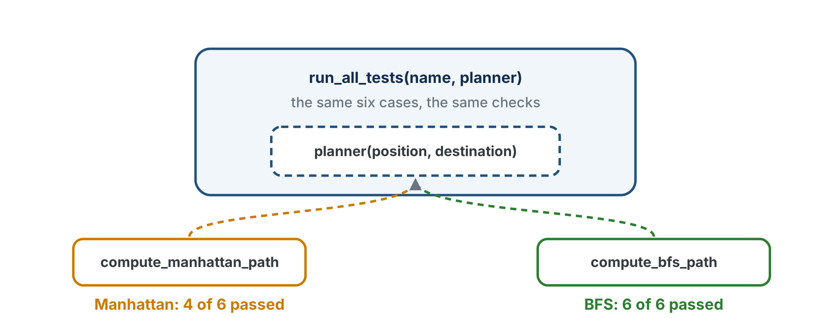
A slot shaped like a planner call
The harness has a slot shaped like a planner call. Any function that fits can be handed in.
Notes:
The figure on the lesson page has one more line at the bottom, "hand the harness a function, no parentheses", which the slide renderer cuts off; the next slide says it.

Slide 22
No parentheses when you hand it over
run_all_tests("BFS", compute_bfs_path) passes the function
run_all_tests("BFS", compute_bfs_path()) calls it first, with no arguments, and passes the result: an error
The parentheses are the difference between "here is the planner" and "here is what the planner said"
Notes:
The parentheses slip in the run_all_tests call is the first of the two things to listen for during the activity.

Slide 23
Write run_path_test() and run_no_path_test()
Each returns True on a pass, so run_all_tests() can count. A PASS line and a FAIL line should look like this:
PASS open (0, 0) to (0, 3) [(0, 1), (0, 2), (0, 3)]
FAIL wall at (1,0),(1,1): (0,0) to (3,0) [(1, 0), (2, 0), (3, 0)]
- drives through blocked intersection (1, 0)
- expected 7 steps, got 3
The print format is in the outline
Notes:
The second line is a FAIL with two problems, each on its own line with the dash in front. The wording of the problems can differ; what matters is that each names the step that broke the property.

Slide 24
Check your understanding
Inside run_path_test, what does path = planner(position, destination) do when the harness was handed compute_bfs_path?
A. Calls compute_bfs_path(position, destination): whichever planner was handed in
B. Calls every planner in the file
C. Looks up a planner named "BFS"
D. Causes an error, because planner is a parameter
Notes:
Answer: A. The lesson's question says the harness was called with run_all_tests("BFS", compute_bfs_path); the slide shortens that to fit. planner is a parameter holding a function, and calling it calls the function that was passed in.

Slide 25
Answer
Inside run_path_test, what does path = planner(position, destination) do when the harness was handed compute_bfs_path?
A. Calls compute_bfs_path(position, destination): whichever planner was handed in
B. Calls every planner in the file
C. Looks up a planner named "BFS"
D. Causes an error, because planner is a parameter
planner is a parameter holding a function. Calling it calls the function that was passed in. Hand it compute_manhattan_path instead and the same line tests Manhattan.
Notes:
Answer: A. The lesson's question says the harness was called with run_all_tests("BFS", compute_bfs_path); the slide shortens that to fit. planner is a parameter holding a function, and calling it calls the function that was passed in.

Slide 26
Activity · Run it against both
Activity
Write test_harness(): the two run_all_tests() lines. Set the run line to it
1
BFS should pass 6 of 6
2
Then read Manhattan's lines carefully
3
Notes:
Let students discover Manhattan's FAIL lines by running it, rather than telling them in advance. "Run it against Manhattan and read what it says" lands harder than any explanation.

Slide 27
Manhattan through the harness
========== Manhattan ==========
PASS open (0, 0) to (3, 3) [(1, 0), (2, 0), (3, 0), (3, 1), (3, 2), (3, 3)]
PASS open (0, 0) to (0, 3) [(0, 1), (0, 2), (0, 3)]
PASS open (2, 1) to (0, 3) [(1, 1), (0, 1), (0, 2), (0, 3)]
PASS open (1, 1) to (1, 1) []
FAIL wall at (1,0),(1,1): (0,0) to (3,0) [(1, 0), (2, 0), (3, 0)]
- drives through blocked intersection (1, 0)
- expected 7 steps, got 3
FAIL walled off: (0,0) to (3,0) [(1, 0), (2, 0), (3, 0)]
- there is no way through, so the path should be empty
Manhattan: 4 of 6 passed
Manhattan isn't broken: across, then up or down, with no idea what a wall is. The harness just showed why this module exists.
Notes:
Manhattan is doing exactly what it was built to do in Module 4. The harness shows it on paper, with the path printed.

Slide 28
The same swap in a main program
navigate() is the skeleton's last function, given: it plans with whatever planner it's handed, prints the path, and returns where the robot would be.
def navigate(planner, position, destination):
"""Plan with planner and print the path; return
destination, where the robot would be after driving it."""
path = planner(position, destination)
print(" Path from", position, "to", destination, ":", path, " Steps:", len(path))
return destination
Notes:
Returning the destination is all a paper test needs: it is where the robot would be after driving the path.

Slide 29
test_swap(): change one name
Block (2, 0), then run two trips, (0, 0) to (3, 3) and back, with each planner. Only the planner's name changes:
position = navigate(compute_manhattan_path, (0, 0), (3, 3)) # through the wall
position = navigate(compute_bfs_path, (0, 0), (3, 3)) # around it
Same program, swap the planner
Notes:
test_swap() runs each planner there and back: (0, 0) to (3, 3), then from position back to (0, 0). Manhattan drives through the wall at (2, 0); BFS goes around it.

Slide 30
Break a property on purpose
Activity
Watch the harness catch it. Put each back before the next.
Make compute_bfs_path return path[1:]: it drops the first step
1
Then make it return path + [destination]
2
Which property catches each?
3
Notes:
Answers: dropping the first step fails property 1, "first step (2, 0) is not next to the start (0, 0)". Appending the destination again fails property 3, "step (3, 3) is not next to (3, 3)": an intersection is not its own neighbor. Both fail the step count too. Challenge for early finishers: add a sixth property, "no intersection appears twice". Can BFS ever fail it? Could a buggy planner?

Slide 31
Optional: the harness with planner objects
Optional extension
With Lesson 5-5's classes, the harness is handed an object and calls its methods
Both classes have add_blocked(), clear_blocked() and compute_path(), so the harness never needs to know which it holds
Manhattan.add_blocked() does nothing, so Manhattan() fails the same two tests for the same reason: the correct result
run_all_tests("Manhattan", Manhattan())
run_all_tests("BFS", BFS())
# inside the harness:
path = planner.compute_path(position, destination)
block(planner, (1, 0))
clear(planner)
Notes:
Optional extension for the class track. The four edits: run_path_test() and run_no_path_test() call planner.compute_path(position, destination); run_all_tests() calls block(planner, ...) and clear(planner); check_path()'s property 4 reads HARNESS_BLOCKED; test_harness() hands in Manhattan() and BFS(). test_swap() gets the same treatment. Solution file: lesson-06-testing-class-addon.py.

Slide 32
Optional: the harness keeps its own record
Optional extension
Property 4 needs to know what's blocked, but the list now lives inside the planner. Paste above manhattan_distance():
# class track: the harness's own record of what it blocked
HARNESS_BLOCKED = []
def block(planner, intersection):
"""Tell planner about intersection AND note it in
HARNESS_BLOCKED, so check_path() can see it."""
pass
def clear(planner):
"""Tell planner to forget its blocks, and forget ours."""
pass
Notes:
Why not read planner.blocked directly? Manhattan has no such attribute, and the harness is not supposed to know what is inside a planner: it only uses the three shared methods. That is the lesson's optional check question. The finished helpers are in a reveal on the lesson page and are not shown here.

Slide 33
Real-world connections
SOFTWARE
DESIGN
ROBOTICS
Property-based testing
Plug-in parts
Test before you drive
Professional test tools generate thousands of random inputs and check properties, because most real programs have no single expected answer.
Handing a function or object to code that doesn't know which one it got is how programs are built from swappable parts.
Teams test the planner on a laptop: it's faster, and it separates "the algorithm is wrong" from "the robot drove wrong".
Notes:
Sort orders, file formats and planners are all examples of swappable parts.

Slide 34
Wrap-up
Why not compare with one expected path?
What are the five properties?
Why does walled-off get its own test?
What's passed in run_all_tests("BFS", compute_bfs_path)?
Why does Module 4's run_test() keep its name and its job?
Next: the planner goes on the robot
Notes:
Answers: BFS has many correct answers; the properties allow all of them and check validity. Starts next to the start, ends at the destination, every step a neighbor, no blocked step, Manhattan-distance length on an open grid. check_path can't tell it from a broken planner's []. The function itself. Exact match is right for a planner with one answer. Formative: the five properties from memory, the no-parentheses explanation, Manhattan's FAIL lines read and explained. Next lesson the rangefinder loop calls add_blocked() exactly as this harness did, so passing these tests means the robot will re-plan correctly. Module 6, if you do it, adds a third planner to this same harness.

