Slide 1

MODULE 5 · LESSON 5-7
Obstacle Detection
By the end of this lesson you can
Add the XRP rangefinder to the start of robot.py and read a distance
Explain how an ultrasonic rangefinder measures distance
Use a threshold to decide whether the intersection ahead is blocked
Say which intersection a reading refers to, and why the path already tells you
Write a driving test: Module 4's drive_path() loop plus one rangefinder check
Notes:
60 minutes, robot required. The planner was tested on paper in Lesson 5-6 and nothing about it changes today. The only new thing is detection: look before you drive, and if something is there, call add_blocked() and ask for a new path. The last objective on the page also says: re-plan when it fires, first with a simulated sensor, then the real one.

Slide 2
The robot fills in the blocked list
Until now the blocked list was filled in by hand: by you, in a test
Today the robot fills it in itself, with the ultrasonic rangefinder
The planner does not change. The only new thing is detection: look before you drive
If something is there, call add_blocked() (the exact call your tests made) and ask for a new path
This opens the last section of robot.py: OBSTACLES

Slide 3
The robot gets eyes
The rangefinder sends out a sound pulse, too high for us to hear
It times the echo bouncing back
The round-trip time tells it how far away an object is
It returns that distance in centimeters
The sensor does the physics internally. You just read a number.

Slide 4
Reading it takes three lines
from XRPLib.rangefinder import Rangefinder
rangefinder = Rangefinder.get_default_rangefinder()
distance = rangefinder.distance() # float, in cm
The first two lines go in the start block: the import under the other XRPLib imports, the object under board = ...
Notes:
Putting rangefinder in the start block means every function below can use it the way they use drivetrain. It is the first new object in the start block since Lesson 2-1 (the only other change was import random in 2-4).

Slide 5
Check your understanding
How does an ultrasonic rangefinder measure distance?
A. It uses a camera to estimate size
B. It sends a sound pulse and times how long the echo takes to return
C. It counts wheel rotations
D. It reads a GPS signal
Notes:
Answer: B. Sound pulse out, echo back, time it: that round-trip time converts to a distance. The XRP returns it in centimeters.

Slide 6
Answer
How does an ultrasonic rangefinder measure distance?
A. It uses a camera to estimate size
B. It sends a sound pulse and times how long the echo takes to return
C. It counts wheel rotations
D. It reads a GPS signal
Sound pulse out, echo back, time it: that round-trip time converts to a distance. The XRP returns it in centimeters.

Slide 7
Choosing a threshold
Readings have noise: they vary a little each time
So don't check for an exact distance: use a threshold
Measure with the next intersection blocked (say ~12 cm) and clear (say ~50 cm)
Pick a cutoff between them
if distance < OBSTACLE_CM:
print("OBSTACLE DETECTED")
else:
print("Path is clear")
Why OBSTACLE_CM and not THRESHOLD? The file already has a THRESHOLD (the reflectance one from Lesson 2-2). Two settings with one name is a bug waiting to happen.
Notes:
Calibrate the threshold ahead of class and have a value ready: it depends on grid spacing, obstacle material and the sensor. Soft or angled surfaces read inconsistently, which is a good real-world-sensor talking point.

Slide 8
Check your understanding
Why use a threshold instead of checking for an exact distance?
A. Exact distances are illegal
B. Sensor readings vary slightly (noise), so a cutoff is more reliable than an exact match
C. To make the robot slower
D. Thresholds use less memory
Notes:
Answer: B. Ultrasonic readings fluctuate with angle, surface, and noise. A threshold ("closer than 15 cm = blocked") absorbs that variation; an exact-match check would fail constantly.

Slide 9
Answer
Why use a threshold instead of checking for an exact distance?
A. Exact distances are illegal
B. Sensor readings vary slightly (noise), so a cutoff is more reliable than an exact match
C. To make the robot slower
D. Thresholds use less memory
Ultrasonic readings fluctuate with angle, surface, and noise. A threshold ("closer than 15 cm = blocked") absorbs that variation; an exact-match check would fail constantly.

Slide 10
Add to robot.py: the OBSTACLES section
Paste it above RUN, after the BFS PLANNER section. Like the NAVIGATOR, it drives, so its tests wait for the button twice.
# ===== OBSTACLES =====
# The robot fills BLOCKED itself. Before each step of a path
# the rangefinder looks at the intersection ahead; if there is
# something, add_blocked() tells the BFS PLANNER (the call the
# 5-6 harness made) and a new path is planned from where the
# robot stands. Facing and driving are the NAVIGATOR's job.
OBSTACLE_CM = 15 # closer than this = blocked
SIMULATED_OBSTACLES = [(2, 0), (2, 2)] # pretend boxes, for a dry run
def simulate_rangefinder(next_pos):
"""Stand-in for rangefinder.distance(): 8.0 if next_pos is
in SIMULATED_OBSTACLES, otherwise 50.0."""
pass
Notes:
It is the file's last section. Two tests go under it, both the students' to write: test_rangefinder() in Step 1, and test_detect_once(), whose outline is two slides on.

Slide 11
Which intersection is blocked?
The one directly in front of the robot, and you already know which one that is. Look at Module 4's drive_path() loop:
for next_pos in path:
needed = desired_heading(position, next_pos)
heading = turn_to(heading, needed)
track_to_intersection()
drive_past_intersection()
position = next_pos
After turn_to(), the robot is facing next_pos. A short reading right then means next_pos is blocked: the path already told you.
Notes:
Facing next_pos is what turning to the needed heading means, so no new code is needed to know which intersection is blocked. "Which intersection is blocked" used to confuse students when it was computed from the heading. Demonstrate the new reasoning physically: stand on an intersection, turn to face the next one on the path, point at it.

Slide 12
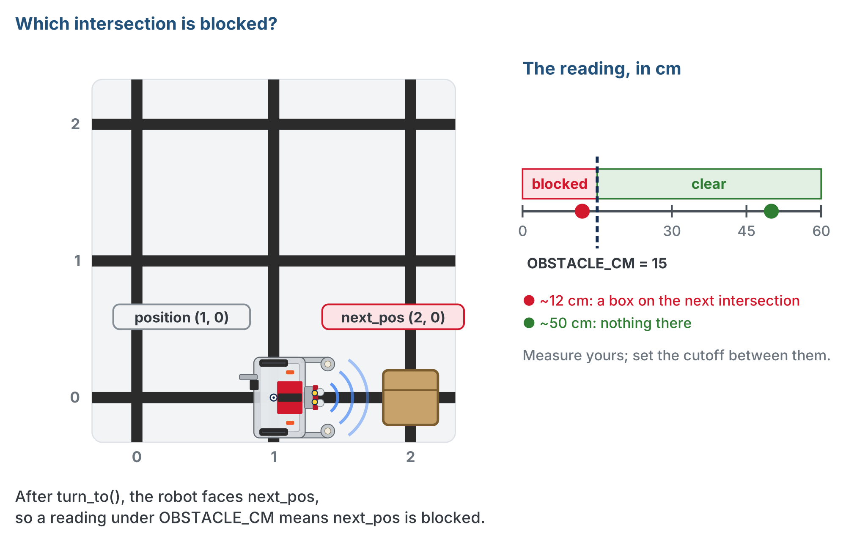
Parked, and facing next_pos
The robot is parked and facing next_pos, so a short reading can only mean next_pos.
Notes:
Left: the robot on (1, 0), turned east toward next_pos (2, 0), where a box sits. Right: the reading scale with the cutoff at OBSTACLE_CM = 15. A box on the next intersection reads about 12 cm, nothing there about 50 cm.

Slide 13
Check your understanding
The robot is at (2,1), has just turned to face the next step on its path, (1,1), and the rangefinder reads 8 cm. Which intersection is blocked?
A. (2,1): where the robot is
B. (1,1): the next step on the path, which the robot is now facing
C. (3,1)
D. It depends on the heading number
Notes:
Answer: B. `turn_to(heading, needed)` pointed the robot at `next_pos`. Whatever the sensor sees now is at `next_pos`. The robot sits on a clear intersection; the obstacle is the one it faces.

Slide 14
Answer
The robot is at (2,1), has just turned to face the next step on its path, (1,1), and the rangefinder reads 8 cm. Which intersection is blocked?
A. (2,1): where the robot is
B. (1,1): the next step on the path, which the robot is now facing
C. (3,1)
D. It depends on the heading number
turn_to(heading, needed) pointed the robot at next_pos. Whatever the sensor sees now is at next_pos. The robot sits on a clear intersection; the obstacle is the one it faces.

Slide 15
The loop: Module 4's, plus one check
def test_detect_once():
# robot at (0, 0) facing North; destination (3, 3)
# plan the path, print it, wait for the button
# for each next_pos in path:
# face it: desired_heading(), then turn_to()
# NEW: look ahead -- distance = simulate_rangefinder(
# next_pos) for now; rangefinder.distance() later
# print position, HEADING_NAMES[heading], the distance
# if distance < OBSTACLE_CM:
# tell the planner: add_blocked(next_pos); say so
# new path from HERE: compute_bfs_path(position,
# destination); print it; then break
# else:
# arrive: track_to_intersection(), then
# drive_past_intersection(); position = next_pos
# print the blocked list
pass
Notes:
Students write it as test_detect_once() under the skeleton. Today's driving test is drive_path()'s loop with exactly one step added, between turning and driving: look ahead. Everything else is Lesson 4-8.

Slide 16
The new branch
The one piece that isn't Lesson 4-8:
if distance < OBSTACLE_CM:
add_blocked(next_pos)
print("Obstacle at", next_pos, "! Rerouting...")
path = compute_bfs_path(position, destination)
print("New path:", path)
break # Lesson 5-8 keeps going instead
The break ends the for loop as soon as a new path is planned: today the robot re-plans once and stops
Notes:
Lesson 5-8 replaces that break with "follow the new path, and keep going until you arrive."

Slide 17
Three things to notice
add_blocked(next_pos) is the same call your Lesson 5-6 harness made
The planner can't tell a test script from a sensor: passing the paper tests means it will re-plan correctly
Re-planning is one line, from where the robot is: compute_bfs_path(position, destination)
Rule 1 from Lesson 5-4. The planner rebuilds its graph from BLOCKED every call, so there is no "rebuild the graph" step to forget
The robot is parked when it re-plans
drive_past_intersection() runs after every track, so the wheels are still over the intersection it re-planned from
Notes:
Nothing moves the robot during a re-plan. Class track: if students built the LineTrack or Navigator class, the driving calls are tracker. or navigator.line_track. calls, as in Lesson 4-8, and the planner calls are planner.add_blocked() and planner.compute_path().

Slide 18
Check your understanding
When the robot detects a new obstacle, what does it do to reroute?
A. Stops permanently
B. Calls add_blocked(next_pos), then compute_bfs_path(position, destination) from where it is
C. Reverses back to the start
D. Ignores it and drives through
Notes:
Answer: B. Detecting an obstacle means reroute, not stop. `add_blocked` tells the planner; `compute_bfs_path` from the current position returns a path around it, because the planner rebuilds its graph from `BLOCKED` on every call.

Slide 19
Answer
When the robot detects a new obstacle, what does it do to reroute?
A. Stops permanently
B. Calls add_blocked(next_pos), then compute_bfs_path(position, destination) from where it is
C. Reverses back to the start
D. Ignores it and drives through
Detecting an obstacle means reroute, not stop. add_blocked tells the planner; compute_bfs_path from the current position returns a path around it, because the planner rebuilds its graph from BLOCKED on every call.

Slide 20
Check your understanding
Why does the robot not need a separate "rebuild the graph" step after add_blocked()?
A. Because compute_bfs_path builds the graph from BLOCKED every time it is called
B. Because the graph is never rebuilt: obstacles are checked while driving
C. Because add_blocked rebuilds the graph itself
D. It does need one: the code above is missing it
Notes:
Answer: A. Lesson 5-4 put `build_graph()` inside the planner precisely so that a wall found at step 3 is already missing from the graph used at step 4.

Slide 21
Answer
Why does the robot not need a separate "rebuild the graph" step after add_blocked()?
A. Because compute_bfs_path builds the graph from BLOCKED every time it is called
B. Because the graph is never rebuilt: obstacles are checked while driving
C. Because add_blocked rebuilds the graph itself
D. It does need one: the code above is missing it
Lesson 5-4 put build_graph() inside the planner precisely so that a wall found at step 3 is already missing from the graph used at step 4.

Slide 22
Print the plan before the button
The first two lines of the outline are the Lesson 4-8 habit: plan and print the path before the robot moves.
path = compute_bfs_path(position, destination)
print("Planned path:", path)
board.wait_for_button()
Printed path right, but the robot still goes wrong? The bug is in the driving, not the planner.
Notes:
Read it before pressing the button: is it what you expected? This is the Lesson 5-6 paper test built into every run, and the first diagnostic. As in Module 4, that makes two presses per driving test: the one in RUN starts the test and prints the plan; the one in the test is go.

Slide 23
Step 1 · The sensor
Activity
Add the import and the object to the start block
1
Write test_rangefinder(): print rangefinder.distance() fifty times, a tenth of a second apart, the way test_sensors() did in Lesson 2-1
2
Set the run line to it. Hold a box in front of the robot at the distance of the next intersection, then take it away
3
Write both readings down. Check that OBSTACLE_CM sits between them; change it if not
4
Notes:
Have your own calibrated value ready to compare against.

Slide 24
Step 2 · Simulate the sensor
Activity
Write simulate_rangefinder(): one line, 8.0 if next_pos is in SIMULATED_OBSTACLES, otherwise 50.0
1
Write test_detect_once() from the outline, with the simulated sensor in the look-ahead line
2
Robot at (0, 0) facing North on an empty grid, run line set to it. Read the planned path before the second press: (2, 0) is on it
3
It should face East, drive to (1, 0), face (2, 0), "see" the pretend box, print the new path, and stop
4
Confirm on screen: the blocked list has grown, and the new path goes around
Notes:
Only the sensor is simulated. The planner needs no simulation: it was tested in Lesson 5-6. Have everyone run this before touching a box: the robot still drives, but the obstacle is pretend, so a wrong reroute is a logic bug and nothing else. Separating software bugs from hardware bugs saves enormous frustration.

Slide 25
Step 3 · The real sensor
Activity
Change the look-ahead line to rangefinder.distance()
1
Put a box on one intersection of the printed path: (2, 0) again is a good choice
2
Press the button. Watch the robot stop, print "Rerouting...", print the new path, and stop
3
Taking the new path is next lesson
Notes:
Place real obstacles on the printed path so the reroute is visible and dramatic. Hardware note: the driving functions are Module 4's, unchanged. If the robot overshoots or misses a turn here, it did in Module 4 too; tune there. The lesson page has a closed reveal with a finished test_detect_once() for students to check against after they run it; it is not on the slides.

Slide 26
Check your understanding
Why test with a simulated rangefinder before using the real one?
A. The real sensor never works
B. To verify the reroute logic in software first, separating code bugs from hardware bugs
C. Simulation is required by Python
D. To avoid writing the loop
Notes:
Answer: B. A simulated sensor lets you confirm the detection logic on screen. Once that's solid, real-sensor problems are clearly hardware, not logic, and the planner itself was already proven in Lesson 5-6.

Slide 27
Answer
Why test with a simulated rangefinder before using the real one?
A. The real sensor never works
B. To verify the reroute logic in software first, separating code bugs from hardware bugs
C. Simulation is required by Python
D. To avoid writing the loop
A simulated sensor lets you confirm the detection logic on screen. Once that's solid, real-sensor problems are clearly hardware, not logic, and the planner itself was already proven in Lesson 5-6.

Slide 28
Real-world connections
CARS
WAREHOUSES
SPACE
Self-driving
Fulfillment robots
Mars rovers
Radar and LIDAR detect obstacles; the planner reroutes in real time, just like this loop.
Robots sense blocked aisles and replan paths on the fly to keep goods moving.
Rovers scan the terrain ahead and reroute around rocks they can't cross.
Notes:
Sense, decide, act is the loop behind every autonomous machine.

Slide 29
Wrap-up
What three lines read the rangefinder?
Which intersection does an obstacle reading refer to?
What is the one line that tells the planner?
Why is there no "rebuild the graph" step?
Next: keep going until you arrive, and remember what you found
Notes:
Answers: the import, get_default_rangefinder(), .distance(). next_pos: the robot just turned to face it. add_blocked(next_pos), the same call the tests used. The planner rebuilds from BLOCKED on every call. Exit ticket: "Why can the planner not tell a sensor from a test script?" (Both call add_blocked().) Preview: the break becomes a while loop that keeps re-planning until the robot arrives, and the robot prints what it found so the next run starts out knowing it.

