Slide 1

MODULE 6 · LESSON 6-1
When Fewest Steps Isn't Fastest
By the end of this lesson you can
Explain why the shortest path in steps is not always the fastest in time
Time a normal block and the slow segment, and turn the ratio into a weight
Add up the cost of a route by hand, with and without the slow segment
Predict which of two routes BFS will choose, and whether it is the faster one
Say why a slow segment that costs exactly three blocks is not slow enough to matter
Notes:
45 minutes. Stopwatch and paper. Set the grid up before class: re-tape one segment between two adjacent intersections as a winding detour that takes at least four normal blocks' time to drive (five is better). Same tape width, gentle curves, and test it with track_to_intersection() before students arrive. Both intersections must still read as crosses. Between (0, 1) and (0, 2) on a 4 by 4 grid, with trips up the left edge (x = 0), works well.

Slide 2
Today one block is different
Module 5's planner finds the path with the fewest steps
So far that has always been the fastest path too: every block took the same time
Your teacher has changed one segment so the tape takes a long detour between two neighboring intersections
The map still says one step. The robot will take a lot longer than one step to drive it.
Today: measure that, and turn it into a number the planner can use

Slide 3
The grid has a slow road
One segment winds back and forth before it arrives
Line following still works on it: the sensors don't care that the tape wiggles
But the robot has to drive the whole length of the wiggle
To the Module 5 graph it is still one edge: (0, 1) is a neighbor of (0, 2), full stop
build_graph() has no way to say "this neighbor is far"
compute_bfs_path() counts edges, so from (0, 0) to (0, 3) it picks the straight run up the left edge, three steps, along the slow road, every time

Slide 4
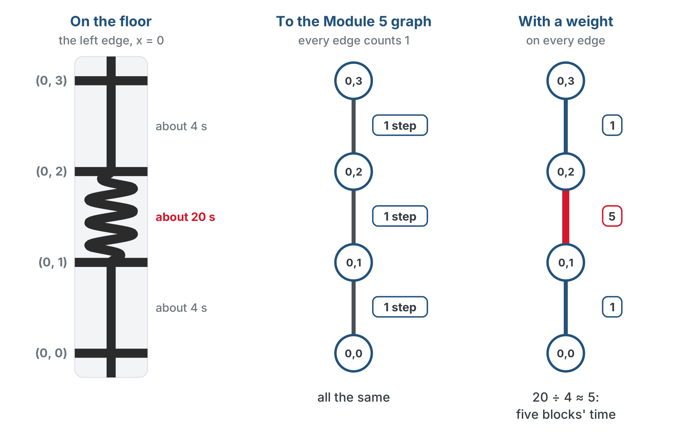
The floor and the graph disagree
The graph needs a number on each edge that says how long it takes, and the stopwatch is where that number comes from.
Notes:
Left: the left edge of the floor, x = 0, with two straight blocks of about 4 seconds and the winding one of about 20. Middle: the Module 5 graph calls every edge 1 step. Right: with weights, the edges are 1, 5 and 1.

Slide 5
Check your understanding
Why does compute_bfs_path() choose the slow road without hesitation?
A. It has a bug
B. It counts steps, and the slow road is one step like any other: the graph has no way to say an edge is long
C. It prefers rows to columns
D. It always chooses the first neighbor in the list
Notes:
Answer: B. BFS finds the path with the fewest edges. Nothing in the graph or the planner knows one edge takes longer to drive than another. That information does not exist yet: this module adds it.

Slide 6
Answer
Why does compute_bfs_path() choose the slow road without hesitation?
A. It has a bug
B. It counts steps, and the slow road is one step like any other: the graph has no way to say an edge is long
C. It prefers rows to columns
D. It always chooses the first neighbor in the list
BFS finds the path with the fewest edges. Nothing in the graph or the planner knows one edge takes longer to drive than another. That information does not exist yet: this module adds it.

Slide 7
Activity · Measure it
Activity
A planner needs a number, not "it's slow." Get one with a stopwatch:
Time the robot driving one normal block, intersection to intersection, with track_to_intersection(). Do it three times and average.
1
Time the robot driving the slow segment the same way, three times, and average.
2
Divide: slow time ÷ normal time. That ratio is the segment's weight: how many normal blocks' worth of time it costs.
3
Notes:
The stopwatch activity is the heart of the lesson. The weight has to come from a measurement students made, or the module is just arithmetic. Three timings each and an average also quietly revisits why we measure more than once.

Slide 8
From two averages to a weight
Normal block: 4.1 s 4.0 s 4.2 s average 4.1 s
Slow segment: 19.8 s 20.5 s 20.1 s average 20.1 s
weight = 20.1 / 4.1 = 4.9 -> call it 5
Round to a whole number: the planner needs to know this edge is about five times worse. Write your weight down. Lesson 6-2 types it into the program.
Notes:
The planner does not need two decimal places. Make sure every group leaves with its own weight written down.

Slide 9
Check your understanding
A normal block takes 4 seconds and the slow segment takes 16. What is its weight?
A. 16
B. 4: it costs four normal blocks' worth of time
C. 12
D. 0.25
Notes:
Answer: B. weight = slow time / normal time = 16 / 4 = 4. A weight is measured in blocks, not seconds, so the same number works whatever speed the robot drives at.

Slide 10
Answer
A normal block takes 4 seconds and the slow segment takes 16. What is its weight?
A. 16
B. 4: it costs four normal blocks' worth of time
C. 12
D. 0.25
weight = slow time / normal time = 16 / 4 = 4. A weight is measured in blocks, not seconds, so the same number works whatever speed the robot drives at.

Slide 11
Cost on paper
From (0, 0) to (0, 3) on a 4×4 grid, slow segment between (0, 1) and (0, 2) at weight 5. A route's cost is the sum of its edge weights.
Route A, straight up the left edge (x = 0):
(0,0) -> (0,1) -> (0,2) -> (0,3)
cost = 1 + 5 + 1 = 7 (3 steps)
Route B, right, up through x = 1, and back:
(0,0) -> (1,0) -> (1,1) -> (1,2) -> (1,3) -> (0,3)
cost = 1 + 1 + 1 + 1 + 1 = 5 (5 steps)
Route A has fewer steps. Route B is faster. BFS picks A.

Slide 12
Check your understanding
With the slow segment at weight 5, which route does BFS choose from (0,0) to (0,3), and what does it cost?
A. Route B, cost 5: BFS finds the cheapest path
B. Route A, cost 7: BFS finds the fewest steps, and A has 3 steps to B's 5
C. Route A, cost 3
D. Neither; it reports no path
Notes:
Answer: B. BFS compares 3 steps against 5 steps and takes 3. It never sees the 7, because cost is not something it computes. The robot pays the extra time on the floor.

Slide 13
Answer
With the slow segment at weight 5, which route does BFS choose from (0,0) to (0,3), and what does it cost?
A. Route B, cost 5: BFS finds the cheapest path
B. Route A, cost 7: BFS finds the fewest steps, and A has 3 steps to B's 5
C. Route A, cost 3
D. Neither; it reports no path
BFS compares 3 steps against 5 steps and takes 3. It never sees the 7, because cost is not something it computes. The robot pays the extra time on the floor.

Slide 14
Why three isn't enough
Try the same comparison with the slow segment at weight 3
Route A costs 1 + 3 + 1 = 5. Route B still costs 5. They tie.
Going round one segment on an open grid always takes exactly three normal blocks
So weight 3 is the break-even point
For the two planners to disagree, the slow segment needs a weight of 4 or more. If your stopwatch gave you 3, ask your teacher to make the detour longer.
Notes:
If your detour comes out at exactly weight 3, the module falls flat. Lengthen it.

Slide 15
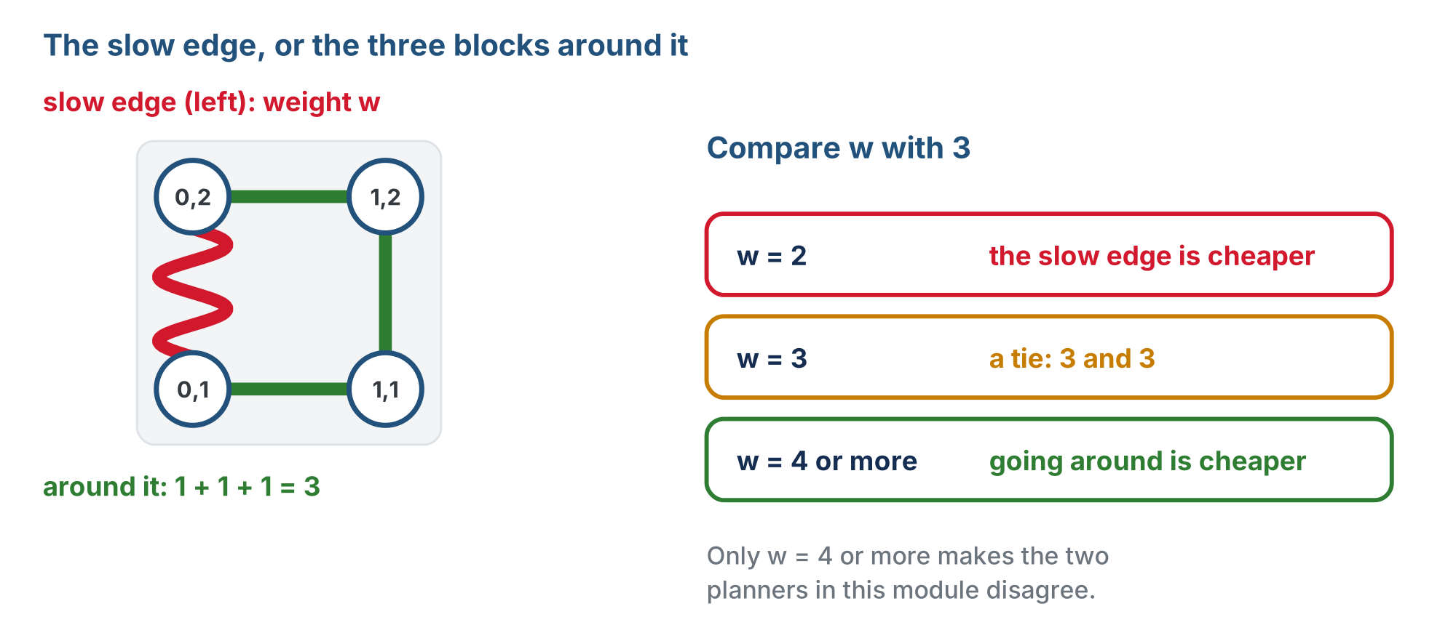
The slow edge, or the three blocks around it
Going around one segment always costs 3. The slow segment has to cost more than that before going around wins.

Slide 16
Check your understanding
The slow segment measures weight 3. From (0,0) to (0,3), what happens?
A. The detour is faster by 2
B. Straight costs 1+3+1 = 5 and the detour costs 5: a tie, so the slow road is not slow enough to change the answer
C. The straight route is faster by 2
D. BFS reports no path
Notes:
Answer: B. Going round one segment costs three normal blocks on an open grid, so weight 3 exactly breaks even. The module needs the slow segment to be worse than that.

Slide 17
Answer
The slow segment measures weight 3. From (0,0) to (0,3), what happens?
A. The detour is faster by 2
B. Straight costs 1+3+1 = 5 and the detour costs 5: a tie, so the slow road is not slow enough to change the answer
C. The straight route is faster by 2
D. BFS reports no path
Going round one segment costs three normal blocks on an open grid, so weight 3 exactly breaks even. The module needs the slow segment to be worse than that.

Slide 18
Real-world connections
MAPS
NETWORKS
LOGISTICS
Fastest, not shortest
Link costs
Toll roads and traffic
A map app's route is rarely the fewest turns or the fewest miles; it is the least time, with each road weighted by its speed.
Internet routers weight links by bandwidth and delay; more hops over fast links beat a short path over a slow one.
Delivery routing adds tolls, traffic and loading time to distance. The cheapest route has the smallest total.
Notes:
Every real router works in time or cost, not hops.

Slide 19
Wrap-up
What does a weight mean?
How do you get one?
What is a route's cost?
Why isn't weight 3 enough?
Next: the weight goes into the program, and BFS fails a new test
Notes:
Answers: how many normal blocks' worth of time a segment costs. Time the slow segment, divide by a normal block, round. The sum of its edge weights. The detour around one segment is 3 blocks, so it ties. Formative: compute a weight from two timings; add up two routes by hand; say which BFS picks. Exit ticket: "Weight 4, from (0,0) to (0,3): cost of each route, and which is faster?" (A: 6, B: 5; B.) Next lesson the weight goes into the program, the harness learns to add up cost, and BFS fails the new test on paper.

