Slide 1

MODULE 6 · LESSON 6-2
Weights in the Graph
By the end of this lesson you can
Store slow segments as (a, b, cost) entries and add one with add_slow_edge()
Write weight(a, b) so it returns the slow cost in either direction and 1 otherwise
Write path_cost(position, path) by walking the path and summing weights
Write check_cost(), the cost check, and explain what its FAIL line means
State BFS's limitation precisely: it minimizes steps, and cost is not steps
Notes:
50 minutes. No robot needed: every test today is a paper test. Students need the weight they measured in Lesson 6-1.

Slide 2
You have a weight. Now the program needs it.
A new section of robot.py: a list of slow segments next to the blocked list
weight() answers "what does this edge cost?"
path_cost() adds a route up
Then cost becomes one more thing the Module 5 harness checks
BFS, unchanged, fails that check: on paper, with the path printed, before any robot is involved
That failure is the reason the next lesson exists

Slide 3
Skeleton, paste above RUN (1 of 2)
# ===== WEIGHTED GRAPH =====
# The grid with a cost on every edge. A normal block costs 1;
# a slow segment costs what you measured in Lesson 6-1. The
# slow list is kept the way GRID GRAPH keeps BLOCKED, and
# weight() is the one question every planner asks of it.
# path_cost() adds a route up; check_cost() is a sixth
# property for the BFS PLANNER's harness, and BFS fails it.
SLOW_EDGES = [] # (a, b, cost), one per slow segment
def add_slow_edge(a, b, cost):
"""Record the segment between a and b as costing cost."""
pass
def clear_slow_edges():
"""Empty SLOW_EDGES in place, as clear_blocked() does."""
pass
Notes:
It starts the WEIGHTED GRAPH section: one list, five function outlines, no tests yet. One paste: the skeleton is split over two slides to fit. Students write the tests as they go, as in Module 5.

Slide 4
Skeleton, paste above RUN (2 of 2)
def weight(a, b):
"""Cost of driving from a to b: the slow cost if that
segment is in SLOW_EDGES, in either order; otherwise 1."""
pass
def path_cost(position, path):
"""Total cost of driving path from position: the weight
of every segment, starting with position to path[0]."""
pass
def check_cost(test_name, position, destination, path, expected_cost):
"""Print PASS if path costs expected_cost, else FAIL with
the cost and the path; return True on a pass."""
pass

Slide 5
A second list, next to BLOCKED
Module 5 kept what the planner knows about the grid in BLOCKED, fed through add_blocked() and emptied by clear_blocked()
Slow segments get the same treatment: SLOW_EDGES, fed through add_slow_edge(), emptied by clear_slow_edges()
Both are one-liners shaped like their Module 5 twins
A slow segment belongs to the edge between two intersections, not to either one, so each entry holds both ends and the weight you measured
add_slow_edge((0, 1), (0, 2), 5) appends the tuple ((0, 1), (0, 2), 5)

Slide 6
weight(a, b): in either order
The one question every planner will ask
It loops over SLOW_EDGES looking for the pair, and returns 1 if it never finds it
The robot might drive the segment from (0, 1) to (0, 2) or from (0, 2) to (0, 1), and it is slow both ways
So the test inside the loop matches the pair either way round: an or of two comparisons
Anything not in the list costs 1: a normal block
Notes:
The or in weight() is easy to drop, and then the check passes or fails depending on which way the robot happens to drive the segment. A good bug to plant.

Slide 7
Check your understanding
SLOW_EDGES holds ((0, 1), (0, 2), 5). What do weight((0, 2), (0, 1)) and weight((1, 1), (1, 2)) return?
A. 5 and 5
B. 5 and 1: the slow segment matches in either order; a segment not in the list is a normal block
C. 1 and 1
D. An error, because the first pair is backwards
Notes:
Answer: B. The or in the if makes the match direction-free; the final return 1 is the default for every ordinary segment.

Slide 8
Answer
SLOW_EDGES holds ((0, 1), (0, 2), 5). What do weight((0, 2), (0, 1)) and weight((1, 1), (1, 2)) return?
A. 5 and 5
B. 5 and 1: the slow segment matches in either order; a segment not in the list is a normal block
C. 1 and 1
D. An error, because the first pair is backwards
The or in the if makes the match direction-free; the final return 1 is the default for every ordinary segment.

Slide 9
Adding up a route
A path from the planner is the intersections to drive to, not including the start
Its cost is the weight of every segment driven: start to the first step, that step to the next, and so on
path_cost() keeps a running total and a here that starts at the robot's position and moves forward one step each pass
Same shape as drive_path()'s position = next_pos
For [(0, 1), (0, 2), (0, 3)] from (0, 0), with the slow edge at 5: 1 + 5 + 1 = 7

Slide 10
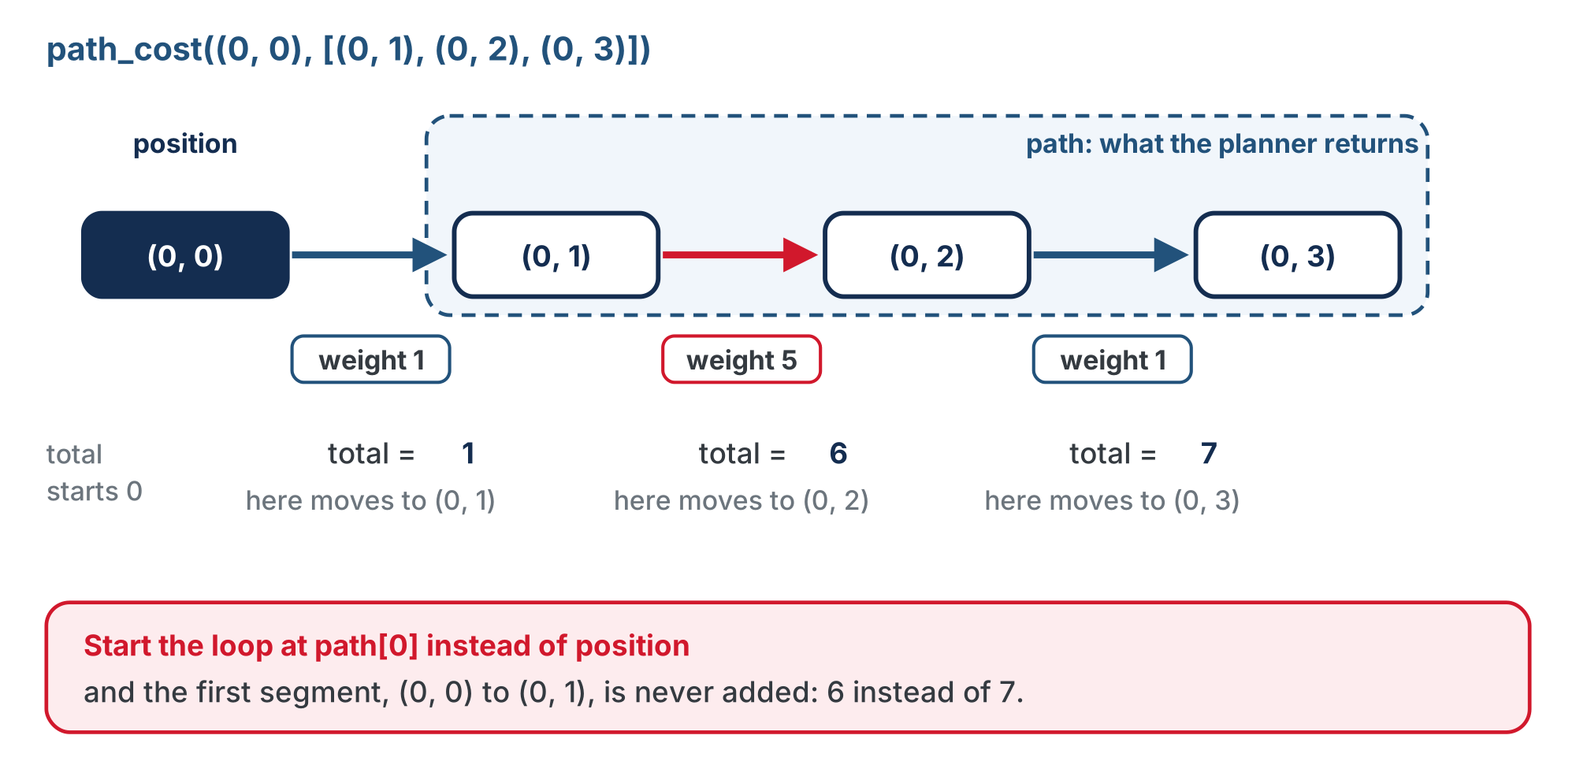
Why path_cost() is handed position
The path leaves out the start, but the first segment begins there.
Notes:
path_cost() must start from position, not from path[0]. Students who start at path[0] miss the first segment and get costs one too small; step 2 of the activity is written to catch exactly that.

Slide 11
Check your understanding
Why does path_cost() need the position parameter, when the path is right there?
A. It does not; position is unused
B. The path excludes the start (Lesson 4-5's promise 1), so the first segment runs from position to path[0], and only the caller knows position
C. To check the path is not empty
D. Because weight() requires three arguments
Notes:
Answer: B. Every planner in the course returns the intersections to drive TO. The segment from where the robot is to the first of those is part of the trip, and its weight counts.

Slide 12
Answer
Why does path_cost() need the position parameter, when the path is right there?
A. It does not; position is unused
B. The path excludes the start (Lesson 4-5's promise 1), so the first segment runs from position to path[0], and only the caller knows position
C. To check the path is not empty
D. Because weight() requires three arguments
Every planner in the course returns the intersections to drive TO. The segment from where the robot is to the first of those is part of the trip, and its weight counts.

Slide 13
The sixth property
The Module 5 harness checks five properties of a path. Add a sixth: the path's cost equals the cheapest possible
For now you work out the cheapest by hand, trace the routes and add them up, and type the number in. The next lesson writes the planner that finds it.
check_cost() is shaped like Lesson 5-6's run_no_path_test(): a PASS or FAIL line in the same format, and True on a pass, so the harness can count it
One difference: it is handed the path, not the planner, so you can point it at any planner's answer
Notes:
check_cost() prints in the 5-6 format and returns True for a reason: next lesson it becomes the seventh case inside run_all_tests(), and the count line becomes "of 7". clear_slow_edges() exists for the same reason: the harness has to run its open-grid cases with no slow edges.

Slide 14
A PASS line and a FAIL line
As they should look:
PASS open grid [(0, 1), (0, 2), (0, 3)] cost: 3
FAIL slow grid [(0, 1), (0, 2), (0, 3)] cost: 7
- the cheapest route costs 5
The FAIL line prints the path and its cost, then the cost it should have had

Slide 15
Activity · Build it, then watch BFS fail
Activity
Every test today is a paper test: the robot stays on the desk.
The list and weight(). Write add_slow_edge(), clear_slow_edges() and weight(). Then write test_weights(): clear the slow list, add your segment from Lesson 6-1, and print weight() for the slow pair in both orders and for one ordinary pair. Run it: your weight, your weight, 1.
1
path_cost(). Write the body, and add two lines to test_weights(): the cost of Route A and Route B from Lesson 6-1, from (0, 0), typed in as lists. Expect 7 and 5 with a weight of 5. Route A one too small? Your loop started at path[0] instead of position.
2
Notes:
Make students write the expected cost by hand before they run the check; if they let the program tell them what to expect, the test tests nothing (Lesson 4-6's point).

Slide 16
Step 3 · check_cost(), against BFS
Activity
Write check_cost()
Then a second test, test_cost_check(), that runs it against BFS twice:
Open grid: clear the blocked list and the slow list, plan (0, 0) to (0, 3) with compute_bfs_path(), and check it against a cost of 3
Slow grid: add the slow segment at weight 5, plan the same trip, and check it against 5, the cost of the detour you added up in Lesson 6-1
Built the BFS class? Plan with planner.compute_path() and clear with planner.clear_blocked(). The slow list is this section's own.
Notes:
Class track: add_slow_edge() and clear_slow_edges() are called as written, because the slow list belongs to the WEIGHTED GRAPH section, not to the planner.

Slide 17
Step 3 · There it is
Set the run line to test_cost_check():
PASS open grid [(0, 1), (0, 2), (0, 3)] cost: 3
FAIL slow grid [(0, 1), (0, 2), (0, 3)] cost: 7
- the cheapest route costs 5
Not a crash, not a wrong turn on the floor: a FAIL line with the path printed. BFS drove the slow road, because it counts steps and 3 is less than 5.
Notes:
This is Lesson 5-6's idea doing its job: the failure is found at a desk, not a robot taking the long way while everyone wonders.

Slide 18
Check your understanding
BFS passes every Module 5 property on the slow grid and fails only the cost check. What does that tell you?
A. BFS is broken and must be rewritten from scratch
B. BFS does exactly what it promises, fewest steps, and cost is a different thing it was never asked to minimize
C. The harness is wrong
D. The slow segment should be blocked instead
Notes:
Name the limitation exactly: BFS minimizes steps; it never looks at a weight. Don't say BFS is wrong. Next lesson keeps 90% of it.

Slide 19
Answer
BFS passes every Module 5 property on the slow grid and fails only the cost check. What does that tell you?
A. BFS is broken and must be rewritten from scratch
B. BFS does exactly what it promises, fewest steps, and cost is a different thing it was never asked to minimize
C. The harness is wrong
D. The slow segment should be blocked instead
A property test tells you precisely which promise failed. The path is valid, connected, unblocked and shortest in steps. It is not cheapest, and nothing in BFS ever looks at a weight.
Notes:
Name the limitation exactly: BFS minimizes steps; it never looks at a weight. Don't say BFS is wrong. Next lesson keeps 90% of it.

Slide 20
Real-world connections
MAPS
TESTING
NETWORKS
Edge attributes
A new requirement, a new test
Symmetric links
Road networks store a speed, a length and a toll on every edge: exactly a weight table, far larger than yours.
When "fewest steps" became "least time", the first move was a test, not a rewrite. Working code failing a new test is how software grows.
Most links cost the same both ways, which is what the or in weight() encodes. One-way streets are the exception.
Notes:
One-way streets are a good extension question: how would weight() change?

Slide 21
Wrap-up
Where does a slow segment live, and how does it get there?
What does weight(a, b) return for an ordinary segment?
Why does path_cost() take position?
What exactly did BFS fail?
Next: copy your BFS, change two places, and the FAIL becomes a PASS
Notes:
Answers: in SLOW_EDGES, via add_slow_edge(a, b, cost). 1. The path excludes the start. The cost check: it minimized steps, as promised. Formative: write weight() with the or; trace path_cost() on a three-step path; read a FAIL line and say what BFS did. Exit ticket: "Why does BFS pass the open-grid cost check and fail the slow one?" Next: the cost check goes into run_all_tests() as case seven; then copy compute_bfs_path, rename it, change two places.

