Slide 1

MODULE 4 · LESSON 4-5
A Reusable Planner Function
By the end of this lesson you can
Rename compute_path() to compute_manhattan_path(position, destination), update every call, and say why each part of the name matters
State the function's three promises
Write a docstring that records those promises
Explain why the planner takes the robot's position as a parameter instead of storing it
Write a test that calls the planner from several positions, and check each result against a figure
Notes:
50 minutes. A small lesson on purpose: students own the algorithm from 4-4, so keep the load on the contract. Not a line inside the function changes.

Slide 2
Same function, its real name
Last lesson you wrote compute_path() and it worked
Today it gets its real name, its promises written down, and one rule
The planner is told where the robot is; it never remembers.

Slide 3
A rename with a reason
The whole change to the function's first line, in the MANHATTAN PLANNER section:
# Lesson 4-4
def compute_path(start, end):
# Lesson 4-5
def compute_manhattan_path(position, destination):

Slide 4
Three words changed, each on purpose
Old | New | Why
compute_path | compute_manhattan_path | Says which planner. Module 5 adds compute_bfs_path() beside it.
start | position | Where the robot is now. After it drives to (2, 3), the next path starts at (2, 3).
end | destination | Where it's going.
Notes:
Right now it is the only planner, so "manhattan" feels redundant until Module 5.

Slide 5
Check your understanding
Why does the function's name include 'manhattan' when it is the only planner in the course so far?
A. Python requires function names to have three parts
B. Module 5 adds compute_bfs_path(), and both must exist in one program without colliding
C. Because it is faster to type
D. It is a convention for while loops
Notes:
Answer: B. A name that says which algorithm it is costs nothing now and saves a rename later. compute_manhattan_path() and compute_bfs_path() will sit side by side in Module 5.

Slide 6
Answer
Why does the function's name include 'manhattan' when it is the only planner in the course so far?
A. Python requires function names to have three parts
B. Module 5 adds compute_bfs_path(), and both must exist in one program without colliding
C. Because it is faster to type
D. It is a convention for while loops
A name that says which algorithm it is costs nothing now and saves a rename later. compute_manhattan_path() and compute_bfs_path() will sit side by side in Module 5.

Slide 7
What the function promises: a docstring
A function is a contract: give me these inputs, and I guarantee this output. Write the guarantee in a docstring: a string in triple quotes, right under the def line, that Python keeps attached to the function.
def compute_manhattan_path(position, destination):
"""Compute a Manhattan path from position to destination.
position: an (x, y) tuple -- where the robot is now
destination: an (x, y) tuple -- where it needs to go
Returns a list of (x, y) tuples the robot should move to,
not including position itself.
"""
path = []
...
Notes:
Docstrings are new. Show that help(compute_manhattan_path) prints it, and that the first line is a one-sentence summary by convention. Don't go further than that. The last sentence is the one people get wrong: check it against the code. The first thing appended to path is the position after the first step, never position itself.

Slide 8
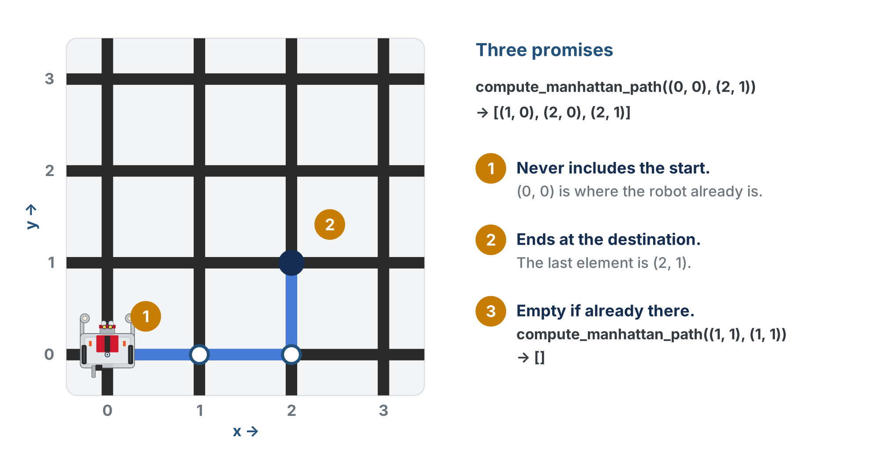
The three promises
Promise 1 matters because each element is a place to drive to, and the robot already stands on position. Every planner in this course makes the same three promises.
Notes:
Promise 1 bites in Lesson 4-8: a path that includes the start makes the first desired_heading() call see a zero move and return None. Promise 3: every while loop is skipped, so path stays empty.

Slide 9
Check your understanding
A classmate's version returns [(0, 0), (1, 0), (2, 0)] for position (0, 0), destination (2, 0). Which promise did it break, and why does it matter?
A. Promise 2: the path does not end at the destination
B. Promise 1: it includes the start, so the robot is told to drive where it already is
C. Promise 3: the path should be empty
D. No promise was broken; this is also correct
Notes:
Answer: B. The path is a list of places to drive TO. The robot is already at (0, 0); listing it as a step gives the driving code a zero-length move and a turn it cannot work out.

Slide 10
Answer
A classmate's version returns [(0, 0), (1, 0), (2, 0)] for position (0, 0), destination (2, 0). Which promise did it break, and why does it matter?
A. Promise 2: the path does not end at the destination
B. Promise 1: it includes the start, so the robot is told to drive where it already is
C. Promise 3: the path should be empty
D. No promise was broken; this is also correct
The path is a list of places to drive TO. The robot is already at (0, 0); listing it as a step gives the driving code a zero-length move and a turn it cannot work out.

Slide 11
The planner is told, it doesn't remember
Look at how the same function is used three times in a row:
path1 = compute_manhattan_path((0, 0), (2, 3)) # plan from the corner
path2 = compute_manhattan_path((2, 3), (0, 3)) # robot drove there; plan from there
path3 = compute_manhattan_path((0, 3), (0, 0)) # and again
Every call is handed the robot's position. The planner never stores it.
Notes:
The "told, not remembered" rule is Module 5's foundation, so give it the full ten minutes.

Slide 12
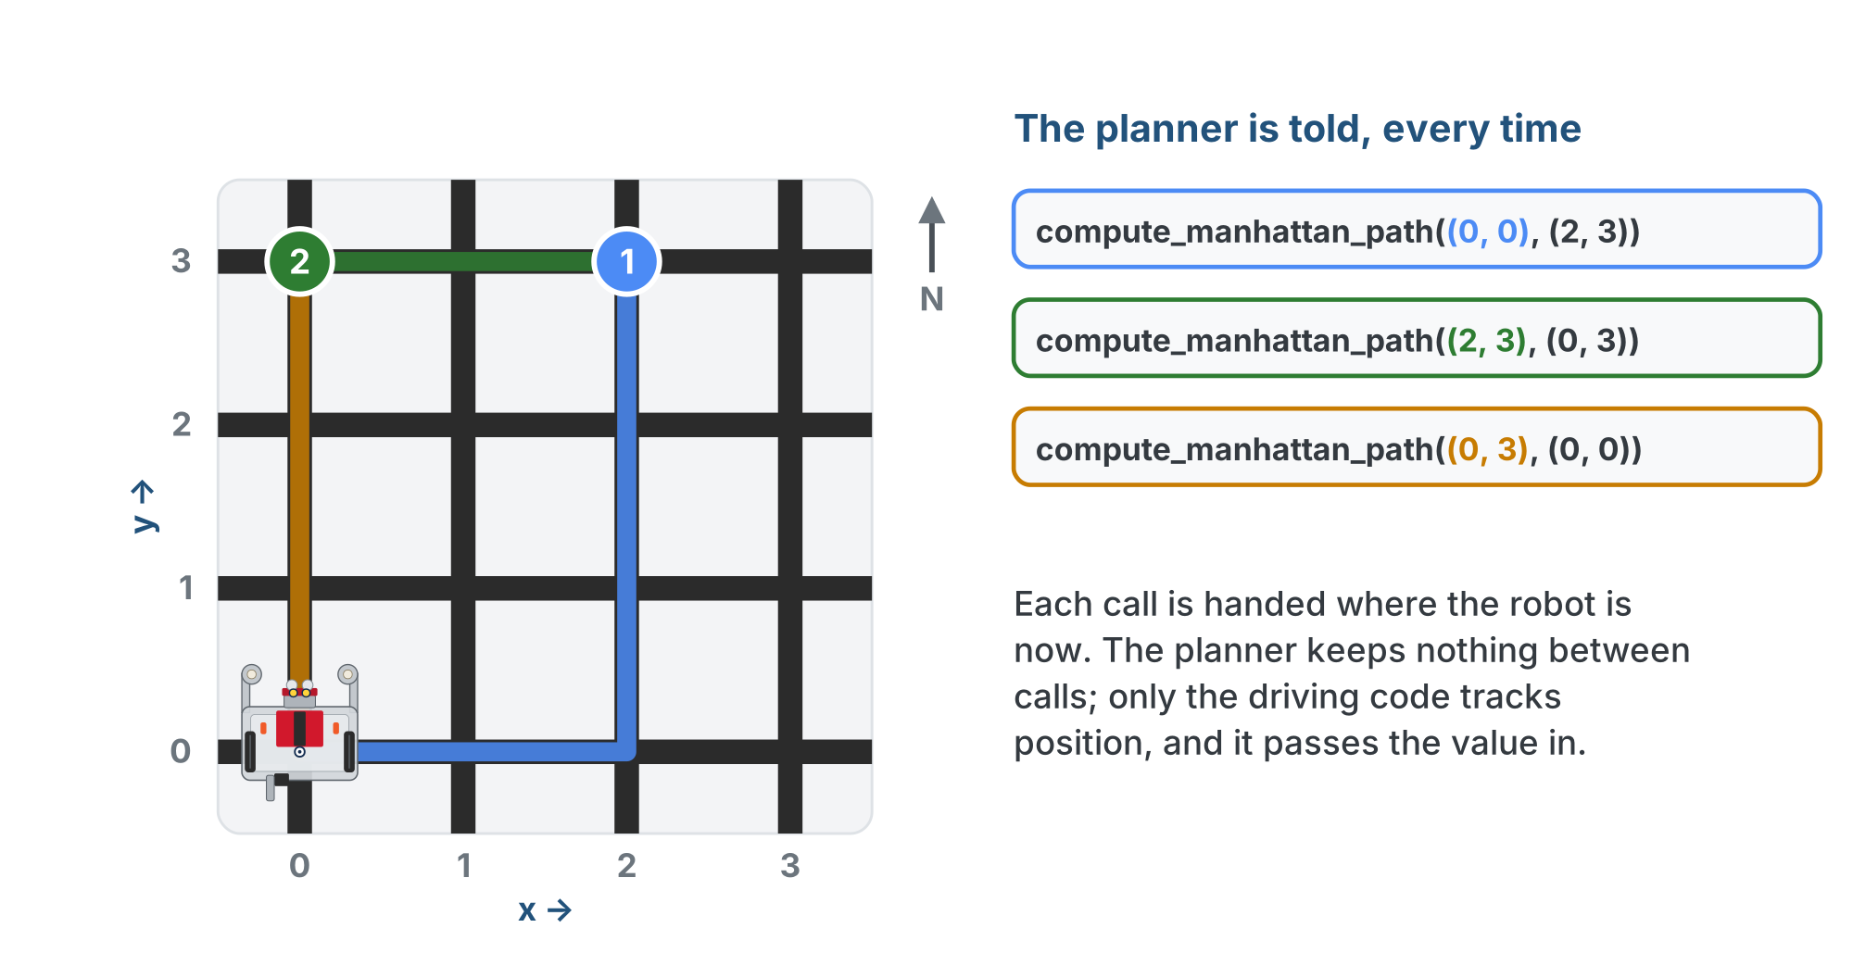
Three legs, three positions
The first argument changes every time, because the robot has moved. The planner never has to know that; it is told.

Slide 13
One owner for the robot's position
Only the driving code (Lesson 4-8) tracks where the robot is, and hands it to the planner every call
A second copy inside the planner would sooner or later disagree, and the robot would plan from a place it isn't
Notes:
The bug it prevents is concrete: in the old class version of this lesson, the planner stored self.position and the driving code stored its own, and every student program needed a line to keep them in sync. Nobody misses that line. The easiest way to never have the bug is to never have the second copy.

Slide 14
Check your understanding
Why does compute_manhattan_path() take position as a parameter every call, instead of remembering where the robot started?
A. Functions cannot store values between calls
B. So only the driving code tracks the robot; a copy in the planner would drift from it
C. Because the start is always (0, 0)
D. To make the function slower and more careful
Notes:
Answer: B. One owner for the robot's position. The driving code updates it after every intersection; the planner is handed the current value and does arithmetic with it. No second copy, no disagreement.

Slide 15
Answer
Why does compute_manhattan_path() take position as a parameter every call, instead of remembering where the robot started?
A. Functions cannot store values between calls
B. So only the driving code tracks the robot; a copy in the planner would drift from it
C. Because the start is always (0, 0)
D. To make the function slower and more careful
One owner for the robot's position. The driving code updates it after every intersection; the planner is handed the current value and does arithmetic with it. No second copy, no disagreement.

Slide 16
Step 1 · The rename
Activity
Nothing is pasted: you edit the function you have, as Lesson 2-6 did with get_error()
1
In MANHATTAN PLANNER, change the def line and replace the one-line docstring with the full one
2
Set the run line to test_paper_paths(), run it, and read the error: your Lesson 4-4 tests still call compute_path(), which no longer exists
3
Update both tests and run them again: same output as yesterday
4
A rename changes every call as well as the definition. That's why names in this file are chosen carefully and changed almost never.

Slide 17
Step 2 · A test from everywhere
Activity
Write your own test_from_everywhere() that prints the three legs from the figure, plus a fourth call where position equals destination.
print(compute_manhattan_path((0, 0), (2, 3))) # leg 1
print(compute_manhattan_path((2, 3), (0, 3))) # leg 2
print(compute_manhattan_path((0, 3), (0, 0))) # leg 3
Set the run line to it. Check each list against its leg in the figure: no start, ends at the destination, [] for the fourth call.
Notes:
Output: [(1, 0), (2, 0), (2, 1), (2, 2), (2, 3)], [(1, 3), (0, 3)], [(0, 2), (0, 1), (0, 0)], []. First test students write themselves: the hint level drops here.

Slide 18
Check your understanding
A classmate runs compute_manhattan_path((3, 3), (1, 0)) and gets [(3, 3), (2, 3), (1, 2), (1, 1), (1, 0)]. What went wrong?
A. Nothing: that is a valid Manhattan path
B. The west loop appends before it subtracts 1, so the start is in and (1, 3) is skipped
C. The destination tuple is backwards
D. The south loop ran before the west loop
Notes:
Answer: B. The append-before-update bug is the one students actually make. Promise 1 is broken, and the corner (1, 3) is missing.

Slide 19
Answer
A classmate runs compute_manhattan_path((3, 3), (1, 0)) and gets [(3, 3), (2, 3), (1, 2), (1, 1), (1, 0)]. What went wrong?
A. Nothing: that is a valid Manhattan path
B. The west loop appends before it subtracts 1, so the start is in and (1, 3) is skipped
C. The destination tuple is backwards
D. The south loop ran before the west loop
Swapping the two lines inside a loop (append first, then change x) shifts that leg by one: the start appears and the corner is missed. Promise 1 spots it fastest: the first element should never equal position.
Notes:
Answer: B. The append-before-update bug is the one students actually make. Promise 1 is broken, and the corner (1, 3) is missing.

Slide 20
Real-world connections
MAPS
SOFTWARE
TEAMS
Routing engines
Pure functions
Interfaces
A map app's router is handed your location every time you ask. Swap in a bike router and the app does not change.
Inputs in, output out, nothing stored: the easiest code to test and the hardest to get subtly wrong.
Write down what a function promises and two people can work on either side of it without talking every hour.
Notes:
A function with a written promise, no memory, and the same shape as its alternatives is how big systems stay swappable.

Slide 21
Wrap-up
Why compute_manhattan_path and not compute_path?
What are the three promises?
Who knows where the robot is?
Next: testing the planner systematically, on screen
Notes:
Answers: Module 5 adds compute_bfs_path, and the name says which. No start in the path; ends at the destination; [] when already there. The driving code, and only it: the planner is told. Exit ticket: "Your partner's planner stores the start position inside it. Describe one bug that could cause." Next lesson adds a run_test() helper, possible only because the planner is pure arithmetic.

Slide 22
Optional: the Manhattan class
Optional extension
Did the class extensions in Module 2? Here is the same planner as a class. It holds no state: compute_path() is told the robot's position every call.
path = compute_manhattan_path((0, 0), (2, 3))
planner = Manhattan()
path = planner.compute_path((0, 0), (2, 3))
Why bother? So it has the same shape as the Module 5 and 6 planners (BFS, Dijkstra): one main program and one test harness work with any of them by changing one name.
Notes:
Optional extension, for students who built classes in Module 2. The code is the lesson's side-by-side: the function call, then the same call on the class. From here on, class-track students use their class: when Lesson 4-6 says compute_manhattan_path(position, destination), they write planner.compute_path(position, destination), in the test harness, in the final project, everywhere.

Slide 23
Optional: the class skeleton
Optional extension
Paste it in place of compute_manhattan_path() (keep your tests), and move the four loops into the method. In your tests, compute_manhattan_path( becomes planner.compute_path(.
class Manhattan:
def __init__(self):
pass # nothing to set up
def compute_path(self, position, destination):
# your compute_manhattan_path(), unchanged: nothing in
# it needs self., because the planner holds nothing
pass
planner = Manhattan()
No start position in __init__, no self.position: the planner is still told where the robot is
Notes:
On the lesson page the skeleton also has a section comment and a docstring (the "why bother" from the previous slide); the slide leaves them out to fit. Run test_from_everywhere() again: same four lists. The __init__ is empty because Manhattan has nothing to set up; BFS in Module 5 uses its __init__ to hold the list of blocked intersections, and that is when the class earns its keep. The finished method is behind a reveal on the lesson page and is not shown here. Solution file: lesson-05-manhattan-class-addon.py.

