Slide 1

MODULE 5 · LESSON 5-0
When the Road Is Blocked
By the end of this lesson you can
Describe what the robot will do by the end of Module 5
Explain why the Module 4 planner can't get around a blocked intersection
Name the module's three new pieces, a map of the grid, a planner that searches it, and obstacle detection, and say what each one does
Explain what it means to swap one planner for another without changing the rest of the program
Notes:
15 to 20 minutes, no coding yet. Keep it to the destination and the three pieces. Do not say how the planner searches: students invent that in Lesson 5-3. The figure uses a different grid from Lesson 5-1's detour activity, so it does not give that answer away. If students ask how the robot finds the way around: "Lessons 5-1 and 5-3, with a pencil, before any code."

Slide 2
Module 4's one blind spot
Module 4 ended with a robot that plans its own routes and drives them
It plans every route the same way: across, then up
And it assumes nothing is ever in the way
Put a box on one intersection of its route and it drives straight at it
This module teaches it to go around

Slide 3
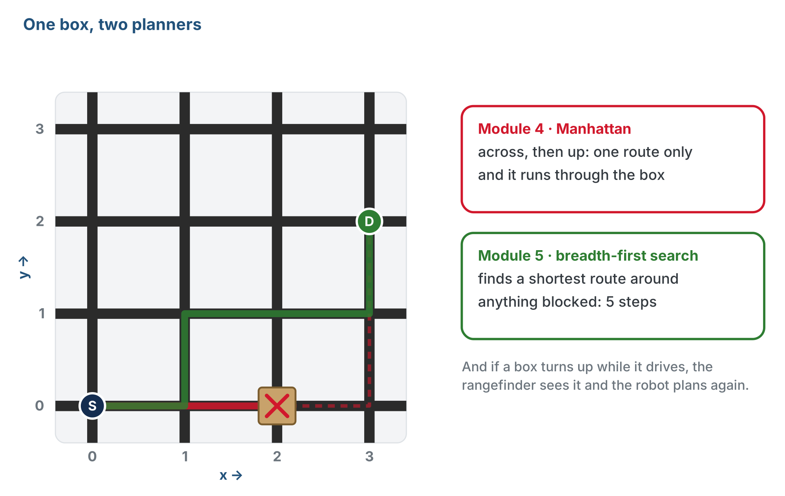
One box, two planners
Module 4's planner has one route and it's blocked; this module's planner finds a way around.
Notes:
The box is at (2, 0). Manhattan goes across first and runs into it. The way around is still 5 steps, the same as if the box were not there.

Slide 4
Where this module ends up
Visit several destinations on a grid with obstacles on it
Plan around the obstacles it knows about
Spot new ones with the rangefinder while it drives, and re-plan on the spot
Do better on its second run, because it remembers what the first run found
The last required module: everything you've built works together

Slide 5
Three new pieces
MAP
PLANNER
SENSES
The grid as a graph
Breadth-first search
Obstacle detection
Every intersection, which ones it connects to, and which are blocked.
A shortest route from here to there, around every blocked intersection.
The rangefinder looks ahead; if something is there, it goes on the map and the robot plans again.
Notes:
Each piece gets its own section of robot.py: GRID GRAPH, BFS PLANNER and OBSTACLES. The driving does not change: the NAVIGATOR section from Module 4 comes across untouched. Like Manhattan, the new planner is tested on screen before it drives anything.

Slide 6
The swap
Manhattan and the new planner answer the same request
Where the robot is and where it should go in; a list of intersections out
The navigator doesn't care which planner made the list
So once the new planner passes its tests, you swap it in by changing one name
The route that ran into the box now goes around it
Notes:
This is the payoff of four modules of reusable code, and of the decomposition in Lesson 4-0: what passes between planner and driver was decided before either was written, so either side can be replaced without touching the other. Come back to the figure in Lesson 5-6, when the swap happens on screen; from Lesson 5-7 the robot drives it.

Slide 7
Check your understanding
Both planners take a position and a destination and return a list of intersections. Why does that matter?
A. It means they always return the same route
B. The code that drives the route works with either one, so swapping planners changes one name, not the whole program
C. It means the new planner is just as fast as Manhattan
D. It means you can delete the Manhattan planner
Notes:
Answer: B. Everything that uses the list, the navigator, the tests and the main program, works with either planner. Only the name changes.

Slide 8
Answer
Both planners take a position and a destination and return a list of intersections. Why does that matter?
A. It means they always return the same route
B. The code that drives the route works with either one, so swapping planners changes one name, not the whole program
C. It means the new planner is just as fast as Manhattan
D. It means you can delete the Manhattan planner
Everything that uses the list, the navigator, the tests and the main program, works with either planner. Only the name changes.

Slide 9
Your roadmap (1 of 2)
Lesson | What happens
5-1 Grid as a Graph | Block an intersection and find a way around by hand. No code.
5-2 Dictionaries | Store the graph in Python. GRID GRAPH opens.
5-3 BFS Concept | Turn "I just looked" into a method, traced with a pencil. No code.
5-4 Pathfinding Functions | A shared blocked list; BFS PLANNER opens
5-5 compute_bfs_path() | The pencil method, line for line, in Python

Slide 10
Your roadmap (2 of 2)
Lesson | What happens
5-6 Testing and Swapping | Test any planner on screen; swap by changing one name
5-7 Obstacle Detection | Look before each block, and plan again. OBSTACLES opens.
5-8 Building Experience | Re-plan until arrival; start Run 2 knowing what Run 1 found
5-9 Capstone Project | Several destinations, obstacles avoided, a better second run
Notes:
Materials: the 4 x 4 grid, and from Lesson 5-7 a few flat, firm boxes the rangefinder can see. Lessons 5-1 to 5-6 never put a robot on the floor. Pacing: about four weeks; the course is complete at the end of this module.

Slide 11
Wrap-up
What will the robot do by the end of the module?
Why can't the Module 4 planner handle a box on its route?
What are the three new pieces?
Next: see the grid as a graph, and find a way around by hand
Notes:
Answers: visit several destinations, plan around known obstacles, find new ones while driving, and improve on its second run. It always plans across then up, and has no idea anything is blocked. A map of the grid, a planner that searches it, and detection with the rangefinder.

