Slide 1

MODULE 4 · LESSON 4-2
Lists
By the end of this lesson you can
Create a list with [] and see how it differs from a tuple
Add items with append() and count them with len()
Loop through a list with a for loop
Build a list step by step inside a loop, and store a path as a list of tuples
Explain what a variable holds when the value is a list, and what happens when two variables refer to the same one
Notes:
50 minutes. Practice code goes in a new file, not robot.py. The build-in-a-loop pattern practiced here is what next lesson's planner function is made of.

Slide 2
A path is many positions
A tuple stores one position
A path is many positions in order, and for that you need a list
By the end you'll represent a route as a list of coordinate tuples, like [(1,0), (2,0), (2,1), (2,2), (2,3)]
And build one up step by step: exactly what the Manhattan algorithm does next lesson
Try this lesson's code in a new file, not robot.py

Slide 3
The start is not in the path
That example is the route from (0,0) to (2,3)
The robot's own starting intersection isn't in it
A path lists the places the robot drives to
It's already standing on the start: putting it in the list would mean "drive to where you already are"
Every path in this module and the next works that way

Slide 4
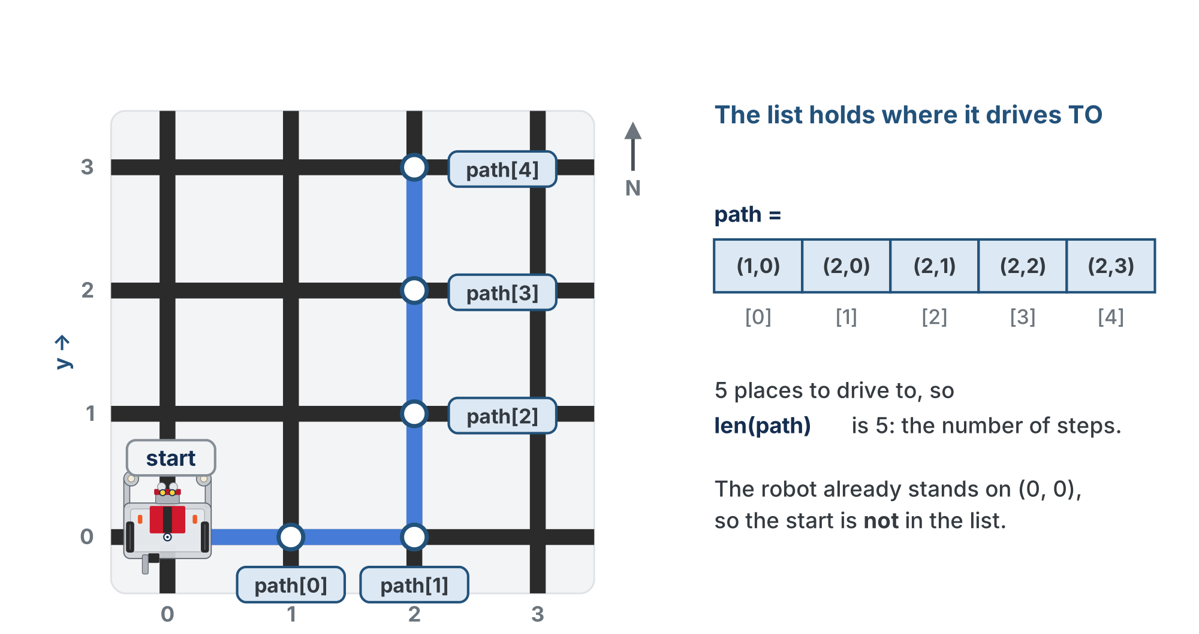
One tuple per intersection it drives to
In order. The start is where it already is, so it is not in the list, and len(path) is the number of steps.

Slide 5
List vs. tuple
A list is an ordered collection written with square brackets, and unlike a tuple it's mutable: it can grow and change.
numbers = [1, 2, 3, 4, 5]
print(numbers[0]) # 1 -- indexing works like tuples
print(len(numbers)) # 5 -- how many items

Slide 6
Which one, when?
 | Tuple | List
Brackets | ( ) | [ ]
Can change? | No (immutable) | Yes (mutable)
Best for | a fixed position | a growing path
So a coordinate is a tuple; a path is a list of tuples

Slide 7
Check your understanding
Which is true about lists compared to tuples?
A. Lists use () and cannot change
B. Lists use [] and CAN change (they are mutable)
C. Lists and tuples are identical
D. Lists can only hold numbers
Notes:
Answer: B. Lists use square brackets and are mutable, so they can grow: perfect for a path that's built up step by step.

Slide 8
Answer
Which is true about lists compared to tuples?
A. Lists use () and cannot change
B. Lists use [] and CAN change (they are mutable)
C. Lists and tuples are identical
D. Lists can only hold numbers
Lists use square brackets and are mutable, so they can grow: perfect for a path that's built up step by step.

Slide 9
Growing a list with append()
append() adds an item to the end of a list. Start empty and build up:
path = []
path.append((1, 0))
path.append((2, 0))
path.append((3, 0))
print(path) # [(1, 0), (2, 0), (3, 0)]
print(len(path)) # 3
A robot at (0,0) driving three intersections to the right: three places to drive to, so len(path) is 3, the number of steps

Slide 10
Loop through it by index
To visit every step, you could count through the indexes with range() and look each one up:
for i in range(len(path)):
step = path[i]
print("Visit:", step, " x:", step[0], " y:", step[1])

Slide 11
The shortcut: for step in path
That's so common that Python has a shortcut. In for step in path:, each element of the list is assigned in turn, first to last, to the variable on the left of in. No index needed:
for step in path:
print("Visit:", step, " x:", step[0], " y:", step[1])
Both loops print the same three lines

Slide 12
Check your understanding
Given path = [(1, 0), (2, 0), (3, 0)], what does path[2] return?
A. (2, 0)
B. (3, 0)
C. 2
D. An IndexError
Notes:
Answer: B. Indexing starts at 0, so path[2] is the third item: the tuple (3, 0).

Slide 13
Answer
Given path = [(1, 0), (2, 0), (3, 0)], what does path[2] return?
A. (2, 0)
B. (3, 0)
C. 2
D. An IndexError
Indexing starts at 0, so path[2] is the third item: the tuple (3, 0).

Slide 14
Check your understanding
For that same path, what does path[2][1] return?
A. 3
B. 0
C. (3, 0)
D. An error
Notes:
Answer: B. path[2] is (3, 0); then [1] takes its y, 0. Two indexes: which step, then which part of that step.

Slide 15
Answer
For that same path, what does path[2][1] return?
A. 3
B. 0
C. (3, 0)
D. An error
path[2] is (3, 0); then [1] takes its y, 0. Two indexes: which step, then which part of that step.

Slide 16
Activity · Build a path in a loop
Activity
The pattern the whole module depends on: start empty, append inside a loop.
path = []
for x in range(1, 4): # start at 1, not 0 -- the robot is already at x = 0
path.append((x, 0))
print(path) # [(1, 0), (2, 0), (3, 0)]
range(1, 4) counts 1, 2, 3: it starts where you tell it to, so the first intersection you append is the first one the robot drives to

Slide 17
Trace it, then change it
Activity
Trace the loop: the list grows by one each pass
1
Change the loop to vary y instead, and you build a vertical path
2
Combine a "go right" loop and a "go up" loop, and you've basically written the Manhattan algorithm
3
Notes:
This is make-or-break: Lesson 4-3's algorithm relies entirely on "empty list, append inside a loop." Spend real time here with a trace table. Demo the classic bug live: put append() outside the loop (wrong indentation) so only the last item lands, then fix the indentation. Keep scope tight: [], append(), len(), indexing and for. No insert, pop, slicing or comprehensions yet.

Slide 18
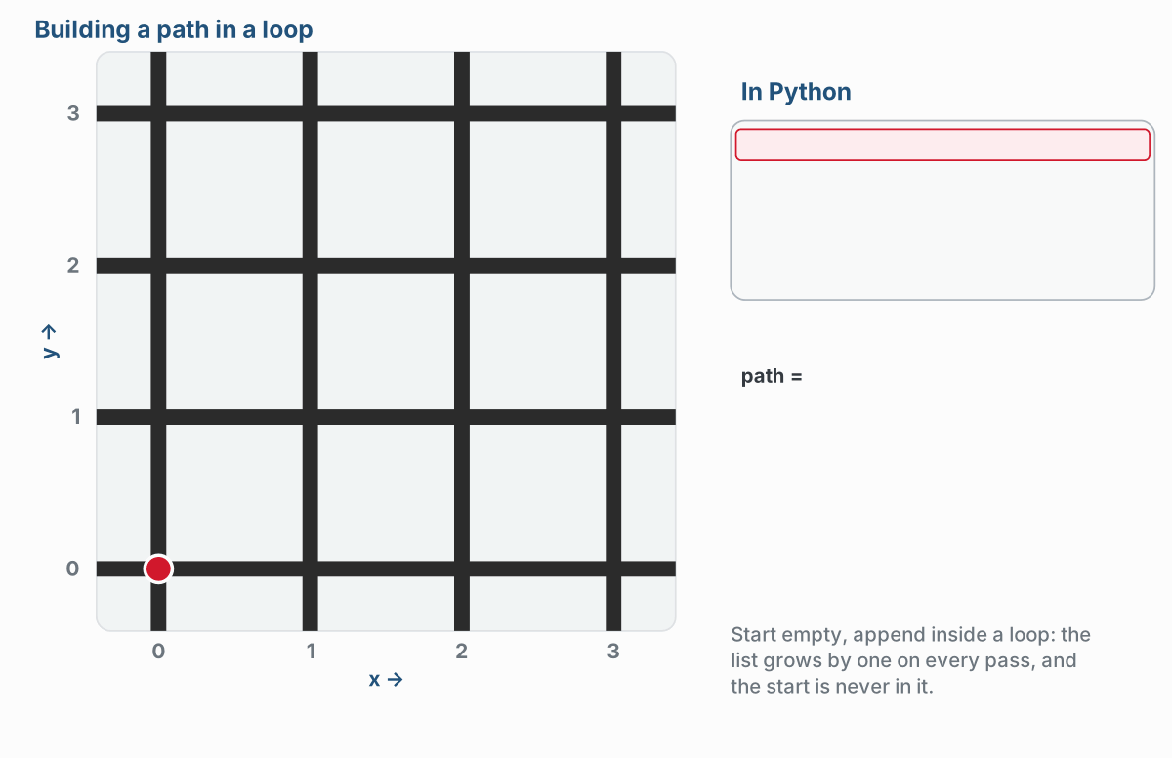
The pattern, traced
One append per pass, so the list grows by one each time. Drawn on a 4 by 4 grid, so the loop stops at x = 3.
Notes:
The lesson figure is an animation: the loop appends (1, 0), (2, 0), (3, 0) one pass at a time, and the start (0, 0) is never added. This is the end of that part. (The slides use a copy of the figure with its text halos redrawn for the slide renderer.)

Slide 19
Then a go-right loop and a go-up loop
Two loops, one after the other: the path from (0, 0) to (2, 3), five steps.
Notes:
The second half of the same animation. Students do not write the general version yet: that is next lesson.

Slide 20
What the variable actually holds
Lesson 1-9: a variable is a named location in memory. For a number, that's the whole story
A list grows, but a location is a fixed size, so the list lives somewhere else
The variable holds the list's address
An address stored in a variable is called a reference

Slide 21
Two variables, one address
a = 5
b = a # copies the VALUE: two 5s
path = [(1, 0)]
same_path = path # copies the ADDRESS: still one list
same_path.append((2, 0))
print(path) # [(1, 0), (2, 0)] <- path changed too

Slide 22
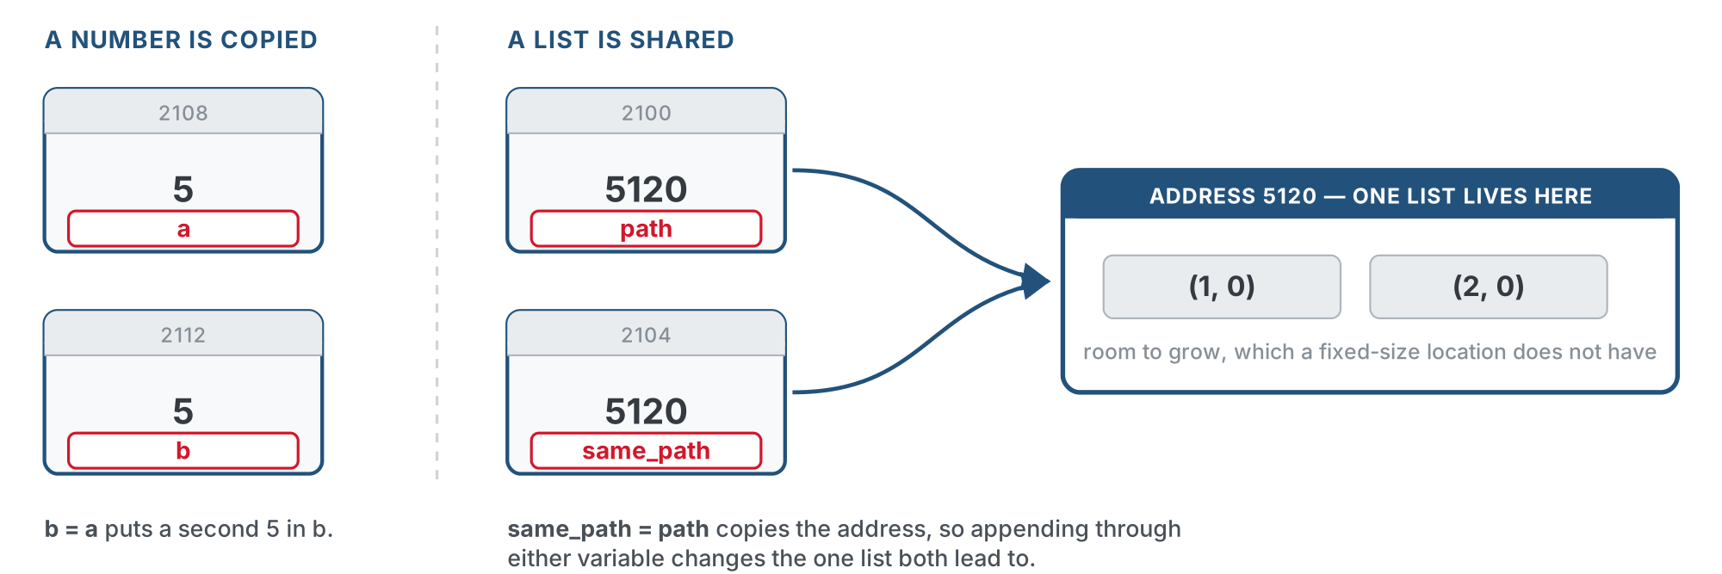
A number is copied, a list is shared
b = a makes a second 5. same_path = path makes a second arrow to the same list.

Slide 23
Check your understanding
After scores = [10, 20], then backup = scores, then backup.append(30), what does scores hold?
A. [10, 20]: backup is a separate copy
B. [10, 20, 30]: both variables refer to the same list
C. [30]
D. An error: you cannot assign a list to another name
Notes:
Answer: B. backup = scores stores the address that was in scores, not a copy of the list, so both variables lead to one list. Appending through either variable changes what both see. To get an independent copy you would have to make a new list.

Slide 24
Answer
After scores = [10, 20], then backup = scores, then backup.append(30), what does scores hold?
A. [10, 20]: backup is a separate copy
B. [10, 20, 30]: both variables refer to the same list
C. [30]
D. An error: you cannot assign a list to another name
backup = scores stores the address that was in scores, not a copy of the list, so both variables lead to one list. Appending through either variable changes what both see. To get an independent copy you would have to make a new list.

Slide 25
Not a trap: a mechanism
The course relies on this
In Module 5 a planner sees each obstacle you add to your list because it holds the list's address, not a copy
Notes:
Be explicit: this section adds to Lesson 1-9, it does not correct it. A variable is still a named memory location, and = still works out the right side and stores the result. The only new fact is what the stored value is for a list: the address that was printed on the location all along. If asked why the address exists, the physical reason is the honest one: a location is a fixed size, a list can grow. A demo that lands: two students each hold a slip with the same post office box number. One puts something in the box. The other one's slip has not changed, but what they find in the box has. Then ask what would have to be different for them to have separate boxes. Don't teach copy() or slicing: nothing in the course needs an independent copy, and the aliasing is load-bearing in Module 5.

Slide 26
The most common list bug
Indentation decides what's inside the loop. Get it wrong and only the last item is added:
# WRONG -- append is outside the loop
path = []
for x in range(1, 4):
position = (x, 0)
path.append(position) # only runs once -> [(3, 0)]
# CORRECT -- append is inside the loop
path = []
for x in range(1, 4):
position = (x, 0)
path.append(position) # runs each pass -> [(1, 0), (2, 0), (3, 0)]

Slide 27
Check your understanding
A student's loop ends with a list holding only the LAST coordinate instead of all of them. What's wrong?
A. append() is broken
B. append() is outside the loop (wrong indentation), so it runs only once
C. They used a tuple instead of a list
D. range() is the wrong size
Notes:
Answer: B. If append() isn't indented inside the loop, it runs a single time after the loop ends, capturing just the final value.

Slide 28
Answer
A student's loop ends with a list holding only the LAST coordinate instead of all of them. What's wrong?
A. append() is broken
B. append() is outside the loop (wrong indentation), so it runs only once
C. They used a tuple instead of a list
D. range() is the wrong size
If append() isn't indented inside the loop, it runs a single time after the loop ends, capturing just the final value.

Slide 29
Real-world connections
APPS
NAVIGATION
DATA
Feeds & playlists
Route waypoints
Records & logs
A playlist or a feed is a list you add to and iterate through, item by item.
A GPS route is a list of waypoints the app walks through in order.
Programs collect results into a list, then loop over them to summarize or display.

Slide 30
Wrap-up
Tuple vs list: which is for a position, which for a path?
What does append() do?
What's the pattern for building a path?
Two variables refer to the same list and you append through one. What does the other see?
Next: computing a path automatically: the Manhattan algorithm
Notes:
Answers: tuple = position, list = path. Adds an item to the end. Start with [], append() inside a loop. The change: there's only one list, and both variables hold its address. Formative: create a list, append() in a loop, index into a list of tuples (path[3][1]), and spot the indentation bug. Exit ticket: "Given path = [(1,0),(2,0),(3,0)], what is path[2][1]?" (0). Next lesson starts on paper.

