Slide 1

MODULE 4 · LESSON 4-3
The Manhattan Algorithm
By the end of this lesson you can
Count steps across plus steps up or down to check a path's length
Describe the "across first, then up or down" strategy and hand-trace a path on paper
Read each row of your trace table as one trip around a while loop, and match the given east loop in compute_manhattan_path(start, destination) to it
Write the north loop by copying the east loop, then west and south by copying and flipping — four loops, no if/else
Test it on screen against your paper traces, including the edge cases: same row, same column, and same position
Notes:
60 minutes. Coordinates and tuples (4-1) and lists (4-2) come together: a function that computes a whole path from a start and a destination. Paper first for 8 to 10 minutes, then the bulk of the lesson is writing and testing compute_manhattan_path().

Slide 2
Coordinates, tuples, lists: together
Today you write the function that computes a whole path automatically
Give it a start and a destination; it hands back the list of intersections to drive
Trace it on paper first, then build it one loop at a time
It goes in a new section of robot.py, the first one that never touches the robot
Tuples in, a list out. The robot can stay on the desk all lesson.

Slide 3
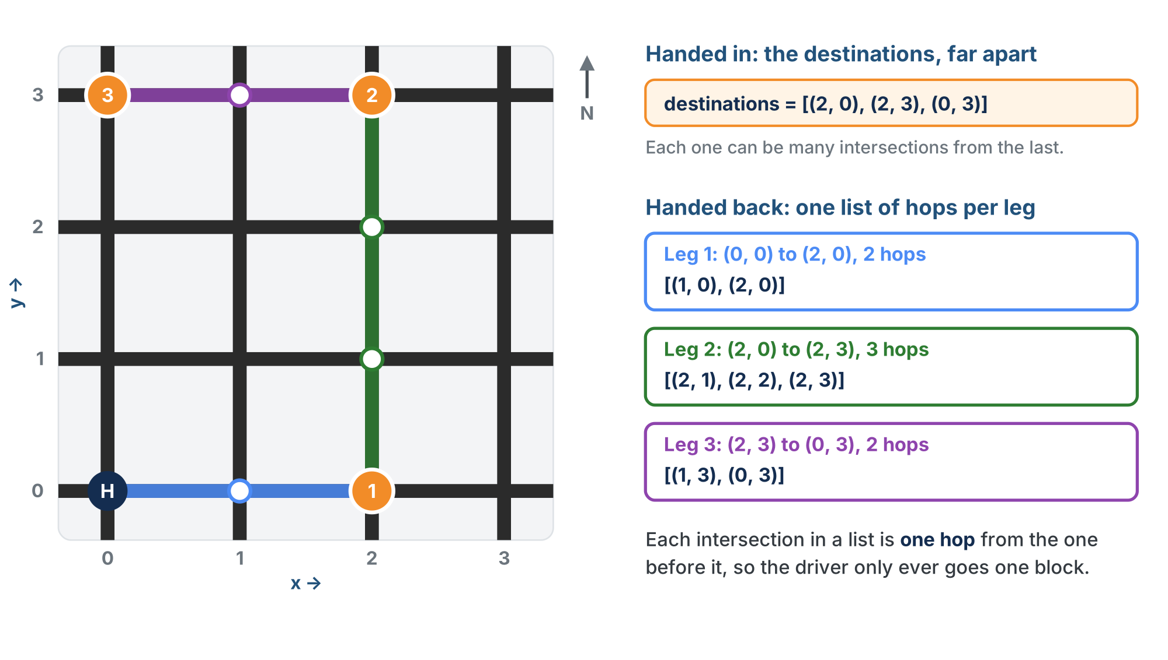
What goes in, what comes back
Handed one destination, possibly many intersections away. Hands back a list of adjacent intersections, one hop each, ending at the destination.
Notes:
The main program supplies the destinations, like the three deliveries in Lesson 4-0. The function you write today handles one destination at a time: the main loop calls it once per destination. Every entry in the list it returns is one block from the entry before it, and the first is one block from the start.

Slide 4
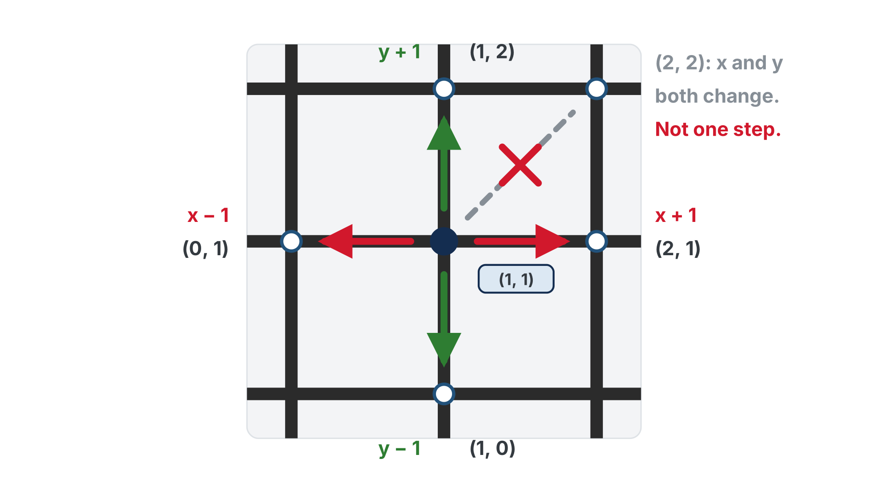
One step: x or y, never both
One step changes x or y by 1, never both. Both would be a diagonal, and the robot can't drive one.
Notes:
Make this solid before the trace: every row of the trace table changes exactly one coordinate by 1. Ask for the four neighbors of (2, 2), then ask why (3, 3) is not one of them.

Slide 5
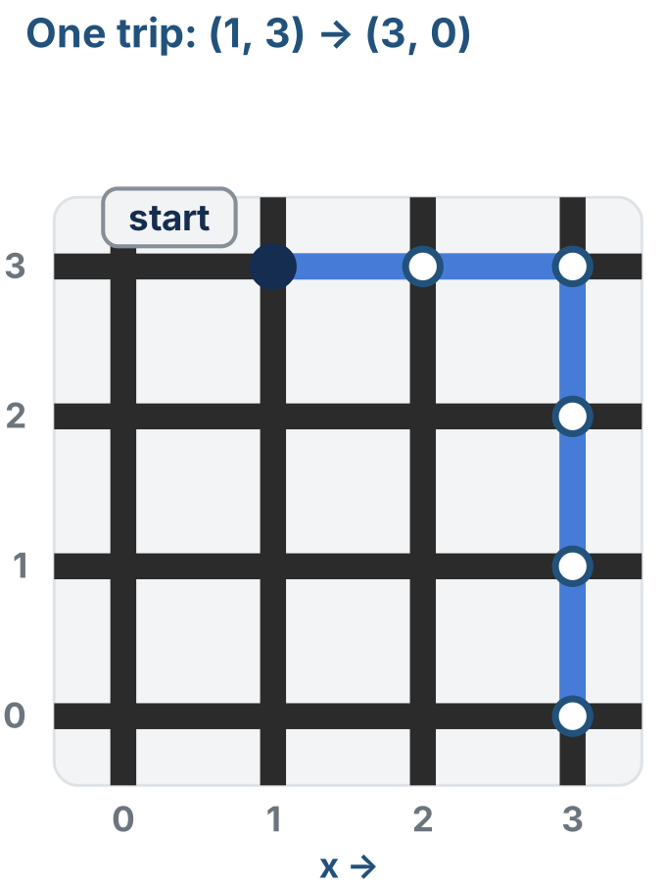
The strategy: across first, then up or down
The simplest strategy that always works:
Move across until x is right
Then move up or down until y is right
That always traces an L-shaped path
Or a straight line, if x or y is already correct
Notes:
The figure is the right half of the lesson's four-loops figure: the trip from (1, 3) to (3, 0), across two, then down three. The whole figure comes back in Step 3.

Slide 6
Activity · Trace it on paper
Activity
Path 1, move by move: trace (0, 0) → (2, 3), one row per move. The start is never in the path.
Step | Action | New position
1 | x + 1 | (1, 0)
2
3
4
5
Printable worksheet: learningpython.bradhouse.com/printables/lesson-4-3-trace-worksheet.pdf
Notes:
One paper activity, about 15 minutes: this table, then all six paths, then the path 3 question. Big grid and markers: one color for moves across, another for moves up and down. The sheet becomes their answer key for the coding steps. Check the sheets before students go on: a wrong key sends them hunting for a bug that is not there. The filled-in key is behind a reveal on the lesson page.

Slide 7
Activity · All six paths
Activity
Write each expected path and its steps. Path 1 is the one you just traced. Steps should equal steps across plus steps up or down.
# | From → to | Expected path | Steps
1 | (0, 0) → (2, 3)
2 | (0, 1) → (3, 3)
3 | (3, 3) → (1, 0)
4 | (2, 0) → (2, 3)
5 | (0, 2) → (3, 2)
6 | (1, 1) → (1, 1)
Then: what is different about path 3 compared with paths 1 and 2?
Notes:
Paths 1 to 3 are test_paper_paths(), paths 4 to 6 are test_edge_cases(). Answer to the question: paths 1 and 2 go right and up, so x and y get bigger; path 3 goes left and down, so they get smaller. It sets up Step 2: the first version only handles x and y getting bigger, so path 3 comes back empty. Path 6 is [] because the robot is already there.

Slide 8
From the trace table to a loop
Write the code the way you worked out each new position
x and y are the robot's current position: x, y = start
dest_x and dest_y are the destination: dest_x, dest_y = destination
Loop 1: keep adding 1 to x while x is less than dest_x
Loop 2: do the same for y
Inside each loop, append the new current position (x, y) to the path
The function doesn't know where the robot is: whoever calls it supplies the position as start

Slide 9
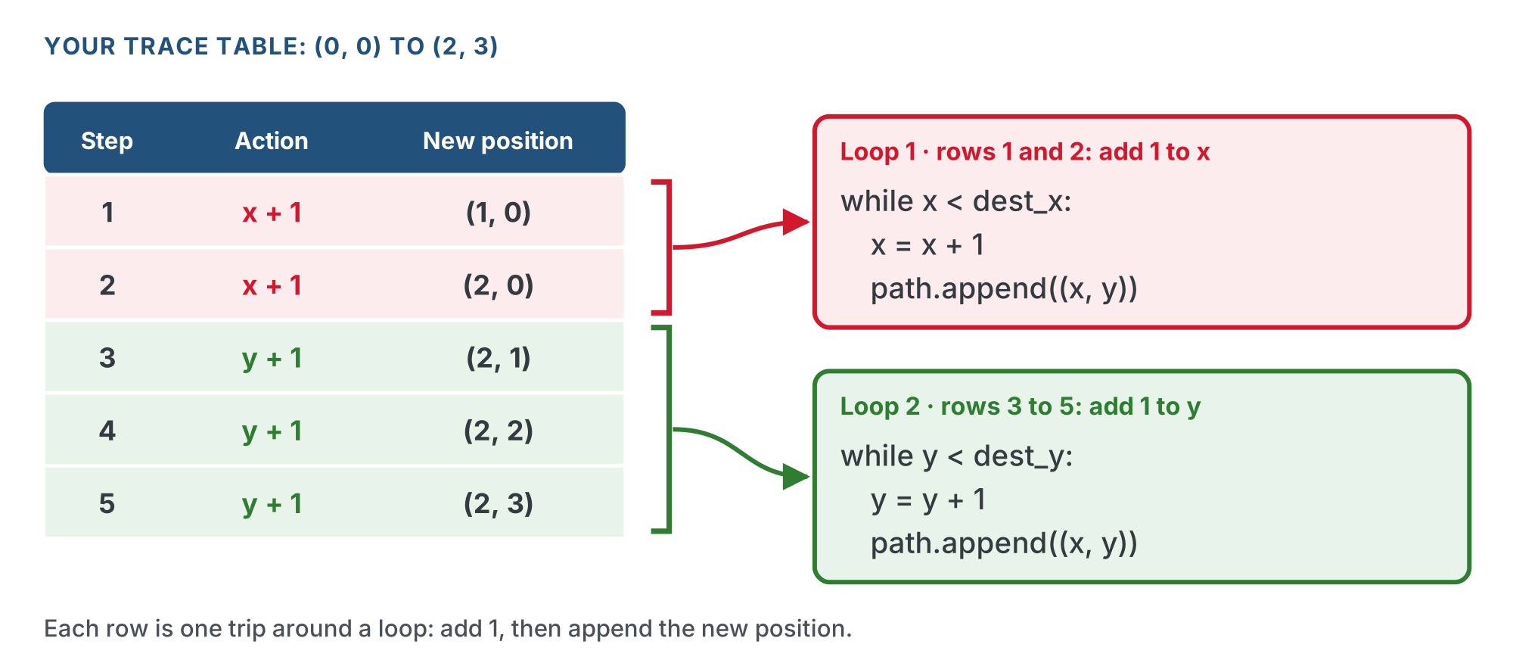
Each row is one trip around a loop
Going left or down, the same loops subtract 1 instead: that's Step 3.
Notes:
x and y are the robot's current position; they change by 1 each trip. When x reaches dest_x the condition is False and the loop stops, just as students stopped writing x + 1 rows once they reached x = 2. The inner parentheses in path.append((x, y)) make the tuple; the outer pair is the call to append().

Slide 10
A name that says the algorithm
This planner uses the Manhattan algorithm
Later you'll write other kinds of planners, so this one is called compute_manhattan_path()
The name says which algorithm it uses

Slide 11
Add to robot.py: MANHATTAN PLANNER
# ===== MANHATTAN PLANNER =====
def compute_manhattan_path(start, destination):
"""Return the (x, y) steps from start to destination, across
first, then up or down. The start itself is not in the list."""
path = []
x, y = start # where the robot is now
dest_x, dest_y = destination # where it is going
# East: keep stepping right until x matches dest_x
while x < dest_x:
x = x + 1 # one step right
path.append((x, y)) # record the new spot
# West: copy east, flip < to > and + to -
# North: copy east, but step y until it matches dest_y
# South: copy north, flip < to > and + to -
return path
Notes:
Paste it into robot.py above RUN, after the GRID DRIVING section. The lesson page has the whole block, with the section comment, blank lines between the three comments for the loops to come, and the two tests: copy it from there. The east loop is given finished; the other three loops are the students' work, and each one is a copy of the east loop with a small change.

Slide 12
The two tests come with it
def test_paper_paths():
print(compute_manhattan_path((0, 0), (2, 3))) # your trace table
print(compute_manhattan_path((0, 1), (3, 3)))
print(compute_manhattan_path((3, 3), (1, 0))) # left and down
def test_edge_cases():
print(compute_manhattan_path((2, 0), (2, 3))) # same column
print(compute_manhattan_path((0, 2), (3, 2))) # same row
print(compute_manhattan_path((1, 1), (1, 1))) # same spot
The tests are paper tests
Notes:
More hints than usual, on purpose: this is the first while loop that builds a list and the first section with no robot in it. The step down to writing tests themselves comes in Lesson 4-4, once the algorithm is theirs. Students who stall on a loop can be pointed at their own trace table: each row is one trip around a loop.

Slide 13
What a paper test is
A paper test is a test function that only prints
Set the run line to it and run it with the robot on the desk: nothing moves
Then check every printed line against the answer you worked out by hand, on paper
Every line matches: the code is right

Slide 14
Plan first: the planner on its own
Lesson 4-0 split the problem into planning and driving
The planner is the first part; this lesson and the next two build and test it alone
What it takes in and hands back is already decided: two tuples in, a list of intersections out
Nothing else in the file has to work for it to work

Slide 15
Step 1 · Paste in the skeleton
Activity
Copy the MANHATTAN PLANNER skeleton shown earlier: the function and both tests
1
Paste it into robot.py in the editor, above `RUN`, after the GRID DRIVING section
2
Save the file
3
Notes:
The skeleton is on the "Add to robot.py: MANHATTAN PLANNER" and "The two tests come with it" slides, and on the lesson page under This lesson's skeleton.

Slide 16
Step 2 · Run the east loop
Activity
Set the run line to test_paper_paths() and run it before you write anything
1
The first line prints [(1, 0), (2, 0)]: the first two spots of path 1 in your answer key
2
Then it stops short: nothing moves it up yet
3
Build it one loop at a time, and run it after each one
Notes:
A half-finished algorithm you have tested beats a whole one you haven't. Check that tuple unpacking from 4-1 (x, y = start) stuck.

Slide 17
Step 2 · Write north by copying east
Activity
Under the north comment, copy the east loop
Compare y with dest_y, and step y instead of x
Leave path.append((x, y)) as it is: it always records the whole position
Run it again and check the first two lines against paths 1 and 2 of your answer key
Don't go on until both match
Notes:
The north loop is in a reveal on the lesson page. Students with a wrong line should check their key first, then their code: one of the two is wrong.

Slide 18
Now find the limit
Look at the third line: (3, 3) to (1, 0) gives an empty list!
Your answer key says path 3 has five steps: it goes left and down
3 < 1 is False and 3 < 0 is False, so neither loop runs
Going left or down, this version does nothing
That is what the west and south comments are for

Slide 19
Check your understanding
Why does the Step 2 version (east and north only) return [] for (3,3) → (1,0)?
A. append() is broken
B. Both while conditions start False (3 is not < 1, 3 is not < 0), so neither loop runs
C. The start and destination are the same
D. It runs forever
Notes:
Answer: B. East and north only handle increasing x and y. Moving left or down needs the two flipped loops you add next.

Slide 20
Answer
Why does the Step 2 version (east and north only) return [] for (3,3) → (1,0)?
A. append() is broken
B. Both while conditions start False (3 is not < 1, 3 is not < 0), so neither loop runs
C. The start and destination are the same
D. It runs forever
East and north only handle increasing x and y. Moving left or down needs the two flipped loops you add next.

Slide 21
Step 3 · West and south: copy and flip
Activity
The fix: two more while loops, and you already have both, backwards
West is the east loop flipped: < becomes >, + 1 becomes - 1
South is the north loop, flipped the same way
Notes:
This is the lesson's big idea: a while loop whose condition starts False simply does nothing. Students who have seen conditionals will try to wrap this in if x < dest_x ... elif x > dest_x. Steer them back: the four loops are simpler and handle every case, including the same position (all four skipped, so []).

Slide 22
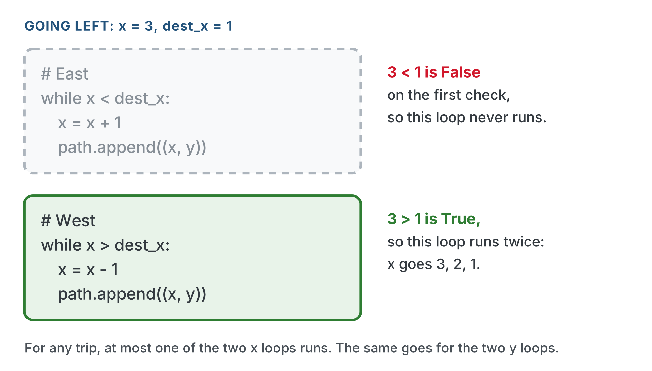
Only one x loop runs
A while loop checks its condition first. Going left, east's first check is False, so it never runs. Same for the two y loops: no if/else needed.
Notes:
Ask: going right, which x loop never runs? (West: x > dest_x is False from the start.) Then: going up, which y loop never runs? (South.)

Slide 23
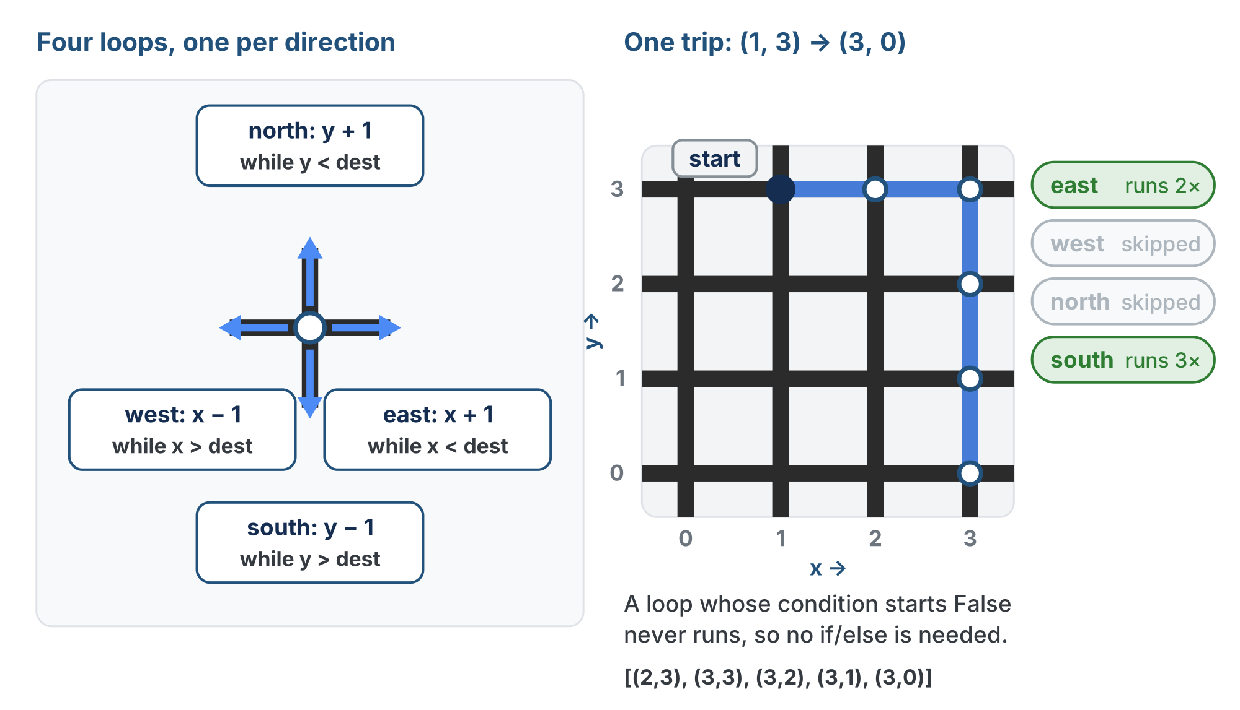
Four loops, one per direction
Every trip runs at most one x loop and one y loop. The other two find their condition False on the first check and never run.
Notes:
Walk the right half: (1, 3) to (3, 0). East runs twice, west and north are skipped, south runs three times. Five steps, matching |3−1| + |0−3|.

Slide 24
Step 3 · Check it against your key
Activity
Look at path 3 in your answer key, (3, 3) → (1, 0)
1
Say which of the four loops run: the robot has to go left and down, so two of them stay idle
2
Run test_paper_paths() again: all three lines should match your key
3
Notes:
Which loops run is behind a reveal on the lesson page. The page also has an animation of the four loops running three trips, in a reveal for students whose tests already match; it is not on these slides because it shows the traced answers.

Slide 25
Check your understanding
For a trip that goes up and to the right, how many of the four while loops actually run?
A. All four
B. Two: the north loop and the east loop
C. Just one
D. None: it needs if/else
Notes:
Answer: B. At most one x loop (east OR west) and one y loop (north OR south) run for any trip. Up-and-right means north + east; the other two are skipped.

Slide 26
Answer
For a trip that goes up and to the right, how many of the four while loops actually run?
A. All four
B. Two: the north loop and the east loop
C. Just one
D. None: it needs if/else
At most one x loop (east OR west) and one y loop (north OR south) run for any trip. Up-and-right means north + east; the other two are skipped.

Slide 27
Activity · The edge cases
Activity
Good algorithms handle the awkward inputs without special code. The second test in your skeleton, test_edge_cases(), has three:
Same column: (2, 0) to (2, 3)
1
Same row: (0, 2) to (3, 2)
2
Same spot: (1, 1) to (1, 1)
3
They are paths 4 to 6 in your answer key. Set the run line to test_edge_cases() and check all three lines against it
Notes:
A finished compute_manhattan_path() is in a reveal on the lesson page. Nothing special is written for these cases: the loops just don't run when there is no distance to cover.

Slide 28
Check your understanding
What does compute_manhattan_path((2, 2), (2, 2)) return, and why?
A. [(2, 2)]: the current position
B. []: all four loop conditions are False, so nothing is appended
C. An error
D. 0
Notes:
Answer: B. Start equals destination, so every while condition is False from the start. No loop runs, the path stays empty, and len(path) is 0: the robot is already there.

Slide 29
Answer
What does compute_manhattan_path((2, 2), (2, 2)) return, and why?
A. [(2, 2)]: the current position
B. []: all four loop conditions are False, so nothing is appended
C. An error
D. 0
Start equals destination, so every while condition is False from the start. No loop runs, the path stays empty, and len(path) is 0: the robot is already there.

Slide 30
Real-world connections
GAMES
AI
DATA
Grid movement
Pathfinding heuristics
Clustering
Turn-based and tile games count moves across plus up or down: no diagonal shortcuts.
Steps across plus steps up or down is a classic "how far, roughly?" estimate that guides search algorithms like A*.
Some machine-learning methods measure how far apart points are the same way, instead of in a straight line.
Notes:
"Move one axis, then the other" shows up all over computing.

Slide 31
Wrap-up
What does "across first, then up or down" produce?
Why four while loops instead of if/else?
Why isn't the starting position in the path?
Why is it called compute_manhattan_path?
Next: the same function gets a written promise and unit tests
Notes:
Answers: an L-shaped path, predictable and always valid. Only the relevant loops run; a False condition just skips. The robot is already there, so len(path) is the number of steps. It uses the Manhattan algorithm; the planners students write later get their own names. Exit ticket: "What does compute_manhattan_path((0,0),(2,3)) return, and how many steps is that?" ([(1,0),(2,0),(2,1),(2,2),(2,3)], 5). Next lesson this exact function gets a docstring that writes down what it promises, and is checked with unit tests; the algorithm does not change at all.

