Slide 1

MODULE 4 · LESSON 4-2
Tuples
By the end of this lesson you can
Create a tuple to hold an (x, y) coordinate
Read its parts with position[0] (x) and position[1] (y), or unpack both at once
Explain immutability and why it suits coordinates
Compare positions with == and compute a Manhattan distance in code
Notes:
50 minutes. This is where Module 4 turns into code, but scratch code: students try the snippets in a scratch file or at the Python prompt and throw them away. Nothing goes into robot.py until Lesson 4-4.

Slide 2
From the grid to Python
You can name any grid spot with (x, y)
Now you'll store one in Python, using a tuple: a single value that packages two numbers
Scratch code, this lesson and the next: a scratch file or the Python prompt
The file gets its next section in Lesson 4-4, once there is a function worth keeping
Nothing here goes into robot.py

Slide 3
One value, two numbers
You could use two variables, x = 2 and y = 3, but ten positions would need twenty variables. A tuple packs both into one value, written with parentheses:
position = (2, 3)
start = (0, 0)
destination = (3, 2)

Slide 4
Pull the pieces out by index
Python counts from zero, just like our grid: index 0 is x and index 1 is y.
position = (2, 3)
print(position[0]) # 2 -> x, across
print(position[1]) # 3 -> y, away from you
[0] = x, [1] = y

Slide 5
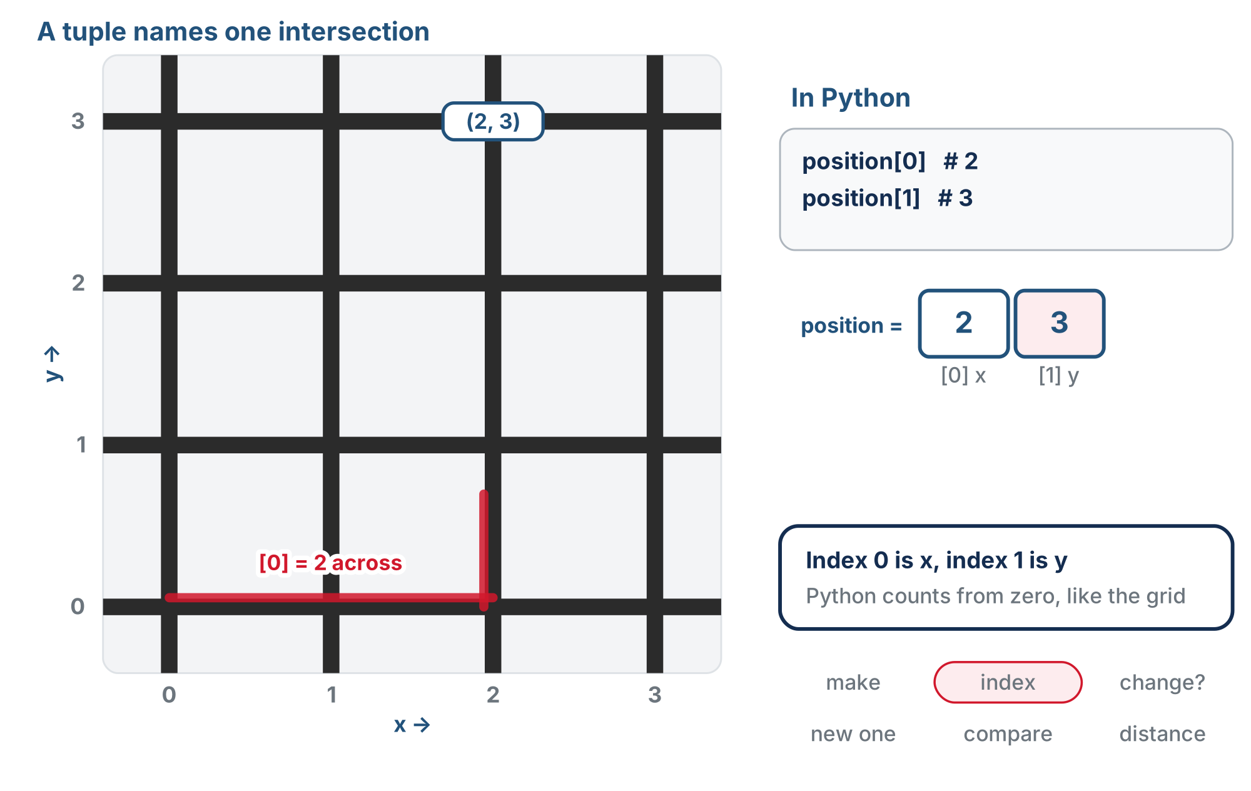
A tuple names one intersection
position[0] is 2, drawn as 2 across; position[1] is 3, drawn as 3 away.
Notes:
The lesson figure is one animation that runs through the whole lesson: make a tuple, index it, fail to change it, make a new one, compare two, and count the steps between them. This deck shows its moments section by section. (The slides use a copy of the figure with its text halos redrawn for the slide renderer.)

Slide 6
Check your understanding
Given position = (3, 1), what does position[0] return?
A. 1
B. 3
C. (3, 1)
D. An error
Notes:
Answer: B. Index 0 is the first element, x, so position[0] is 3. position[1] would be y, 1.

Slide 7
Answer
Given position = (3, 1), what does position[0] return?
A. 1
B. 3
C. (3, 1)
D. An error
Index 0 is the first element, x, so position[0] is 3. position[1] would be y, 1.

Slide 8
Unpacking: both numbers at once
Indexing pulls out one part at a time. Often you want both, as ordinary variables, in one line:
position = (2, 3)
x, y = position # x is 2, y is 3
That's tuple unpacking: the first name gets index 0, the second gets index 1

Slide 9
It does exactly what two lines do
The names are yours to choose: dest_x, dest_y = destination works the same way
There must be exactly as many names as parts
Two names and a three-part tuple, or three names and a two-part tuple: Python stops with a ValueError
x = position[0]
y = position[1]
Lesson 4-4's planner starts by unpacking where the robot is and where it's going

Slide 10
Check your understanding
After start = (3, 2) and then a, b = start, what is b?
A. 3
B. 2
C. (3, 2)
D. An error
Notes:
Answer: B. The names take the parts in order: a gets index 0, which is 3, and b gets index 1, which is 2. The names don't have to be x and y.

Slide 11
Answer
After start = (3, 2) and then a, b = start, what is b?
A. 3
B. 2
C. (3, 2)
D. An error
The names take the parts in order: a gets index 0, which is 3, and b gets index 1, which is 2. The names don't have to be x and y.

Slide 12
Tuples don't change (and that's good)
Try to modify a tuple and Python stops you:
position = (2, 3)
position[0] = 5 # TypeError: 'tuple' object does not support item assignment
Tuples are immutable: once made, they can't be altered

Slide 13
A new spot is a new tuple
That's right for a coordinate: (2, 3) should always mean x = 2, y = 3. To represent a new spot, you make a new tuple:
old_position = (2, 3)
new_position = (3, 3) # one step east -- a brand-new tuple
Like a street address: move, and you get a new address. You don't edit the old one.
Notes:
Expect [0] versus [1] confusion for a few exercises: post "[0] = x, [1] = y" on the wall. Flag the bracket rule early: tuples are made with parentheses; square brackets are only for indexing (and, next lesson, for lists). The immutability payoff is not obvious yet; the street-address analogy is enough for now. It really pays off once tuples live inside lists and the algorithm.

Slide 14
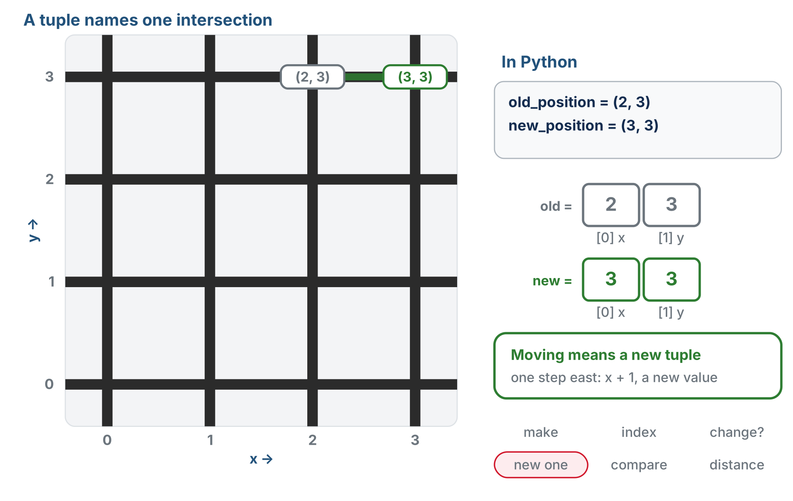
Can't change it, so make a new one
A tuple can't be changed, so one step east makes a new tuple, (3, 3), beside the old one.

Slide 15
Check your understanding
What happens when you run position[0] = 5 on a tuple?
A. x changes to 5
B. You get a TypeError: tuples cannot be modified
C. It creates a new tuple automatically
D. Nothing happens
Notes:
Answer: B. Tuples are immutable, so item assignment raises a TypeError. To "change" a position, create a new tuple.

Slide 16
Answer
What happens when you run position[0] = 5 on a tuple?
A. x changes to 5
B. You get a TypeError: tuples cannot be modified
C. It creates a new tuple automatically
D. Nothing happens
Tuples are immutable, so item assignment raises a TypeError. To "change" a position, create a new tuple.

Slide 17
Comparing positions
== checks whether two tuples are the same position: both parts must match, in order.
current = (1, 2)
target = (1, 2)
print(current == target) # True
other = (2, 1)
print(current == other) # False -- order matters!
Later the algorithm asks "have we reached the destination yet?" by comparing tuples

Slide 18
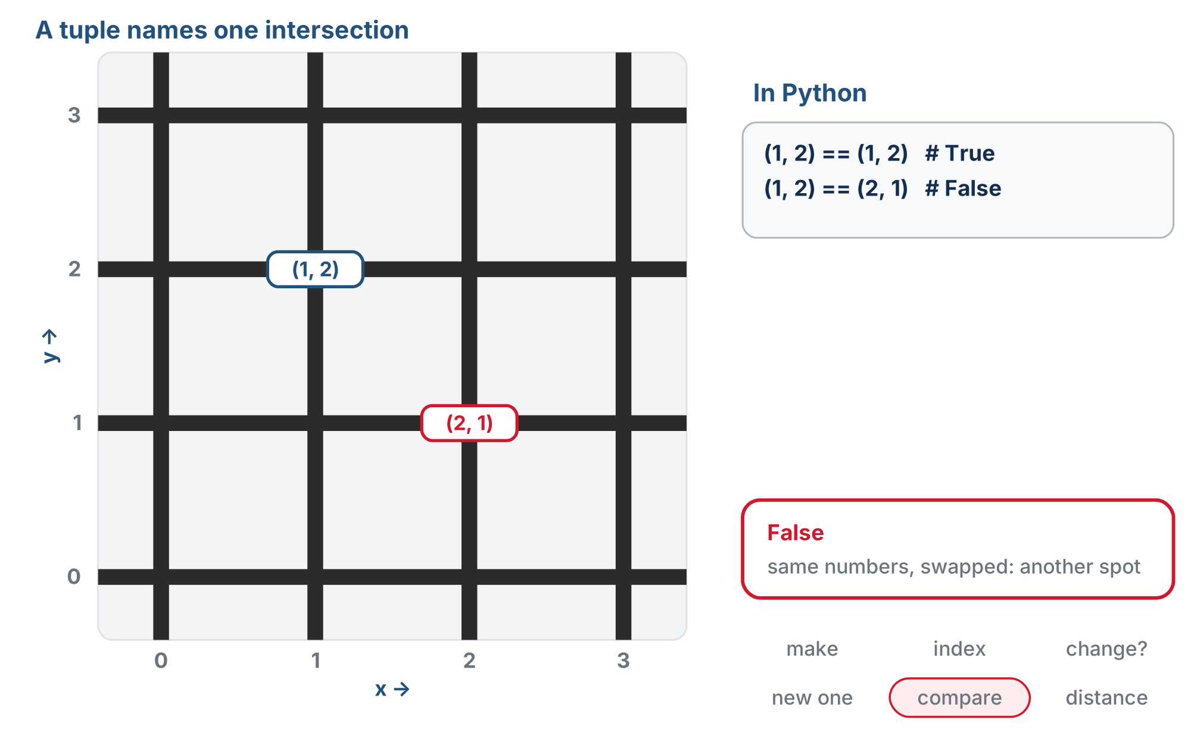
Same spot, or a different one?
(1, 2) == (1, 2) is True, the same spot. (1, 2) == (2, 1) is False, a different spot.

Slide 19
Check your understanding
Does (1, 3) == (3, 1) evaluate to True?
A. Yes: they contain the same numbers
B. No: the parts must match in order, and these are swapped
C. Yes: tuples ignore order
D. It causes an error
Notes:
Answer: B. Two tuples are equal only if every element matches in order. (1, 3) is 1 for x and 3 for y; (3, 1) is 3 for x and 1 for y: different, so False.

Slide 20
Answer
Does (1, 3) == (3, 1) evaluate to True?
A. Yes: they contain the same numbers
B. No: the parts must match in order, and these are swapped
C. Yes: tuples ignore order
D. It causes an error
Two tuples are equal only if every element matches in order. (1, 3) is 1 for x and 3 for y; (3, 1) is 3 for x and 1 for y: different, so False.

Slide 21
Activity · Manhattan distance in code
Activity
The paper counting from Lesson 4-1 becomes simple arithmetic on tuple parts:
start = (0, 0)
destination = (2, 3)
x_distance = destination[0] - start[0] # 2
y_distance = destination[1] - start[1] # 3
total_steps = x_distance + y_distance # 5
print("Total steps:", total_steps)

Slide 22
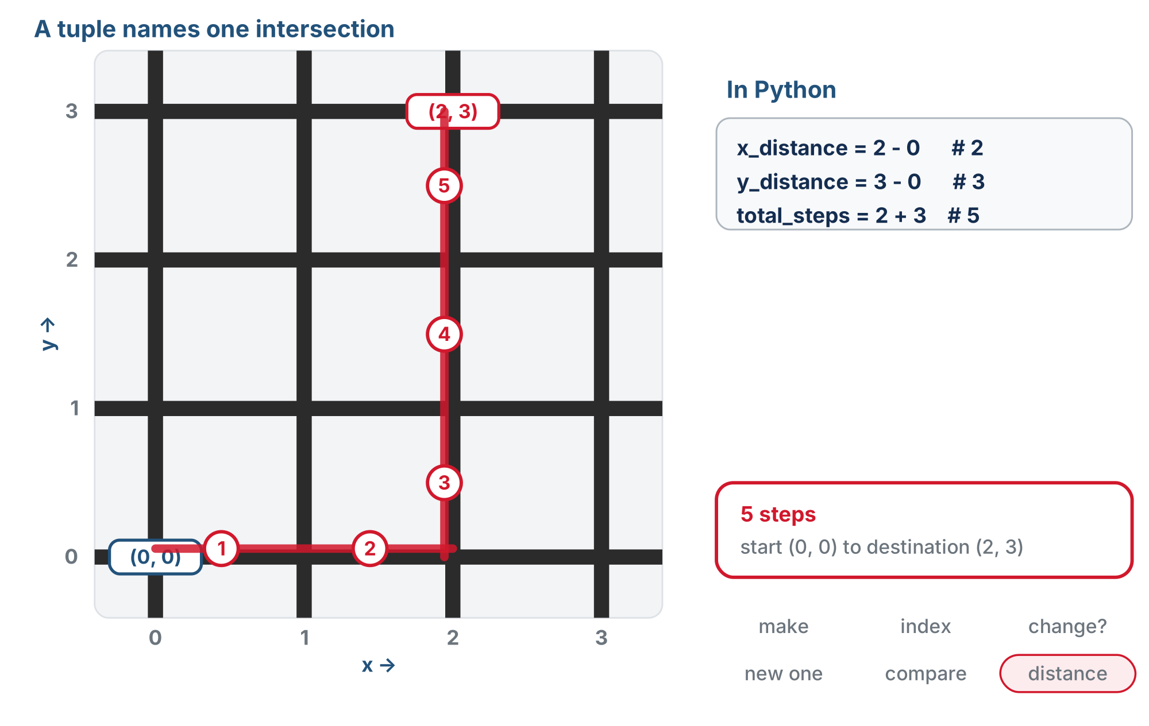
Counting the steps
From (0, 0) to (2, 3): 2 across plus 3 away, 5 steps.

Slide 23
Check your understanding
Using this method, what's the Manhattan distance from (0, 1) to (3, 3)?
A. 7
B. 5
C. 3
D. 2
Notes:
Answer: B. (3 − 0) across + (3 − 1) up = 3 + 2 = 5 steps.

Slide 24
Answer
Using this method, what's the Manhattan distance from (0, 1) to (3, 3)?
A. 7
B. 5
C. 3
D. 2
(3 − 0) across + (3 − 1) up = 3 + 2 = 5 steps.

Slide 25
Try it
Activity
Store five of your grid positions as tuples
1
Print each one's x and y
2
Compute a couple of distances
3
Notes:
More support: a reference card ("[0] = x, [1] = y"), the interactive shell for instant feedback, and starting with just creating and printing tuples. More challenge: an (x, y, heading) three-tuple (what does [2] give?), or tuples built from input. Watch for: subtracting a bigger start from a smaller destination gives a negative distance. Acknowledge it is real and say Lesson 4-4 deals with it; for now keep destinations up and to the right of the start.

Slide 26
Real-world connections
GRAPHICS
DATA
MAPS
Points & colors
Records
Lat/long pairs
Screen points (x, y) and colors (r, g, b) are stored exactly like coordinate tuples.
A row of a dataset, (name, age, score), is a fixed bundle, just like a coordinate.
Every mapped location is a two-value pair passed around as one unit.

Slide 27
Wrap-up
How do you get x and y out of a tuple?
What does immutable mean, and why is it good for coordinates?
Why is (2, 3) == (3, 2) False?
Next: a whole path, many tuples, in a list
Notes:
Answers: [0] and [1]. It can't change; a position should stay fixed. The elements must match in order. Formative: correct tuple syntax, the right index for x versus y, and reading ==. Exit ticket: "Manhattan distance from (1,0) to (3,3), show your work" (5).

