Slide 1

MODULE 1 · LESSON 1-1
Meet the XRP
By the end of this lesson you can
Identify the key hardware parts of the XRP robot and say what each one does
Find your way around the XRP Code (Blockly) programming environment
Write, upload, and run a block program that drives the robot forward and backward
Debug the most common first-day problems
Notes:
50 to 60 minutes, Blockly, no experience needed. Students meet the robot, learn what each part does, and get their first program running on real hardware.

Slide 2
Today: your first program on a real robot
Meet your robot and learn what each part does
Write your very first program to make it drive
By the end, you'll have code running on real hardware
No experience required
What makes a robot move? How does it know what to do?
Notes:
Opening hook, 5 to 10 minutes. The lesson's hook clip of an XRP driving around is still to come, so demo a live robot instead. Ask the two questions in the callout and let students guess before you explain: it surfaces their mental models. Then set the goal: learn the hardware and write a first program to make it move.

Slide 3
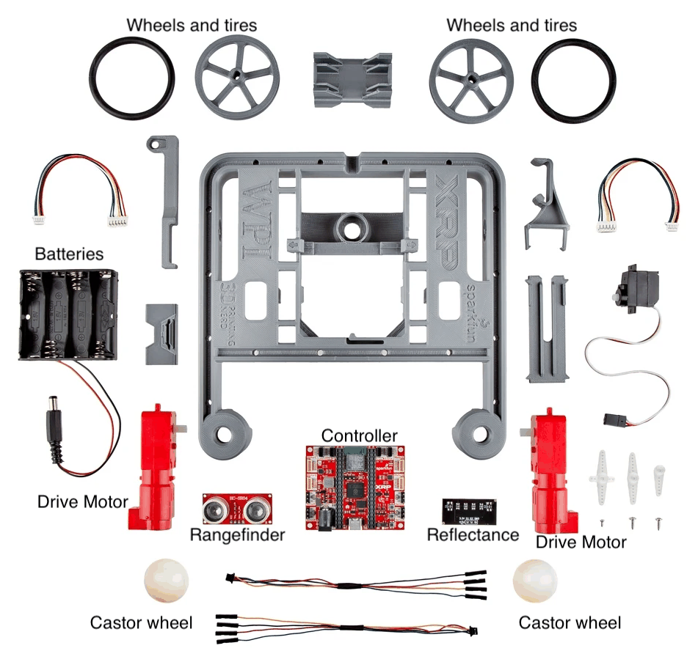
The parts of the robot
Everything in the XRP kit. Find each labeled part in front of you as it comes up.
Notes:
Hardware tour, 15 to 20 minutes. Hold up a real robot and point to each part as you go. Every part has one job, and knowing them makes debugging much easier later.

Slide 4
Every part has one job
Wheels & motors: two motors, one per side, each spinning one wheel. The sides move independently, so the robot can steer
Controller board: the robot's "brain." It receives your program over USB and tells the motors what to do
Battery: powers everything. A low battery makes the robot sluggish
Sensors: the Reflectance sensor sees light vs. dark; the Rangefinder measures distance. You'll use these in later modules
Caster wheel: the little rear wheel that keeps the robot balanced
Notes:
Quick checks while you tour: point out the left and right motors and ask which one spins to turn the robot left. Show where the USB plugs in: that is how programs get onto the robot. Only name the sensors for now; they come into play in Modules 2 to 5.

Slide 5
Check your understanding
Why does the XRP have two motors instead of just one?
A. So it can carry heavier loads
B. So each side can move at a different speed, which lets the robot steer
C. So there is a spare motor in case one fails
D. One motor drives, the other only brakes
Notes:
Answer: B. Two independently driven wheels are what let a differential-drive robot turn: speed up one side to curve toward the other.

Slide 6
Answer
Why does the XRP have two motors instead of just one?
A. So it can carry heavier loads
B. So each side can move at a different speed, which lets the robot steer
C. So there is a spare motor in case one fails
D. One motor drives, the other only brakes
Two independently driven wheels are what let a differential-drive robot turn: speed up one side to curve toward the other.

Slide 7
Check your understanding
Which part is the "brain" that runs your program and tells the motors what to do?
A. The battery
B. The reflectance sensor
C. The controller board
D. The caster wheel
Notes:
Answer: C. The controller board receives your uploaded program and drives everything else.

Slide 8
Answer
Which part is the "brain" that runs your program and tells the motors what to do?
A. The battery
B. The reflectance sensor
C. The controller board
D. The caster wheel
The controller board receives your uploaded program and drives everything else.

Slide 9
How the robot gets instructions
Always the same
A robot only does what you tell it. The workflow is always the same:
1
Write a program (we'll use Blockly)
2
Connect your computer to the robot, by USB cable or over Bluetooth
3
Upload the program to the robot
4
The robot runs the program, each command in order
Writing isn't enough: it has to be uploaded. In XRP Code, the green RUN button uploads the program and starts it.

Slide 10
Two ways to connect
USB cable: how you connect today
Every robot needs it the first time: XRP Code uses it to install and update the software that lives on the robot
Bluetooth: once a robot has been set up over USB
Unplug, turn the robot on, click CONNECT, choose Bluetooth, pick your robot from the list
Works exactly like USB, but you're not tethered to the table
Every XRP has its own ID, shown under the RUN button. Write yours on the robot, and don't pair with somebody else's.
Notes:
Bluetooth in a classroom: do the USB pass first, let XRP Code finish its update, and label every robot with its ID, or the pairing list is chaos. Low batteries kill Bluetooth before anything else. A running program can block the connection: press reset so it restarts without running. Chrome or Edge only. On Windows, give it up to about 20 seconds after a dropped connection. Keep known-good USB cables at the demo station as the fallback.

Slide 11
Check your understanding
Your robot is brand new. Why can't you just connect to it over Bluetooth right away?
A. Bluetooth only works with Python, not Blockly
B. It needs one USB connection first, so XRP Code can set up the software on the robot
C. Bluetooth is slower, so uploads would fail
D. You can: Bluetooth always works out of the box
Notes:
Answer: B. The first USB connection is what lets XRP Code install and update the robot's MicroPython software. After that, the same robot can connect wirelessly.

Slide 12
Answer
Your robot is brand new. Why can't you just connect to it over Bluetooth right away?
A. Bluetooth only works with Python, not Blockly
B. It needs one USB connection first, so XRP Code can set up the software on the robot
C. Bluetooth is slower, so uploads would fail
D. You can: Bluetooth always works out of the box
The first USB connection is what lets XRP Code install and update the robot's MicroPython software. After that, the same robot can connect wirelessly.

Slide 13
Your first program in XRP Code
XRP Code runs in a web browser: nothing to install, nothing to log into
Open xrpcode.wpi.edu and build programs by dragging blocks
Use Google Chrome or Microsoft Edge. Talking to the robot needs serial and Bluetooth features only those browsers have
Safari and Firefox let you build a program, then your robot never appears in the CONNECT list
Robot not in the list? Switch browsers before you troubleshoot anything else
Notes:
The XRP User Guide has a whole chapter on XRP Code: a tour of the three panels, connecting over USB step by step, and troubleshooting for a robot that won't show up. Have students keep it open in a tab. The lesson's screen recording of creating a project and the three key blocks is still to come; do a live tour on the projector instead.

Slide 14
Check your understanding
A classmate built a program in XRP Code on Safari, but when they click CONNECT their robot never appears in the list. What is the most likely reason?
A. The robot is broken
B. Safari cannot connect to the robot: XRP Code needs Chrome or Edge for that
C. The program has too many blocks
D. They need to create an account first
Notes:
Answer: B. Building a program works in any browser; connecting to the robot does not. The serial and Bluetooth features XRP Code uses exist only in Chrome and Edge.

Slide 15
Answer
A classmate built a program in XRP Code on Safari, but when they click CONNECT their robot never appears in the list. What is the most likely reason?
A. The robot is broken
B. Safari cannot connect to the robot: XRP Code needs Chrome or Edge for that
C. The program has too many blocks
D. They need to create an account first
Building a program works in any browser; connecting to the robot does not. The serial and Bluetooth features XRP Code uses exist only in Chrome and Edge.

Slide 16
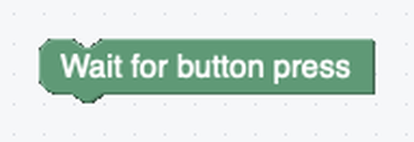
Block 1: Wait for button press
Goes at the very top of the program
A program starts running the moment you click RUN
This block makes the robot sit still until you press its button
So it doesn't drive off the table while you're still holding it
Notes:
A few blocks do everything students need today. Have them drag each one out of the block palette as you introduce it.

Slide 17
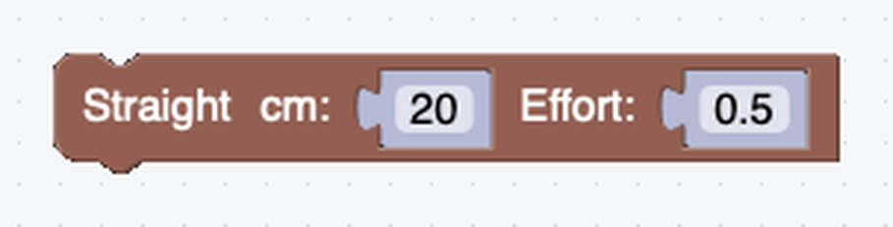
Block 2: Straight
Drives in a straight line
cm is how far to go
A negative number drives backward
Effort is how hard the motors push, from 0 to 1
0.5 is a good starting speed

Slide 18
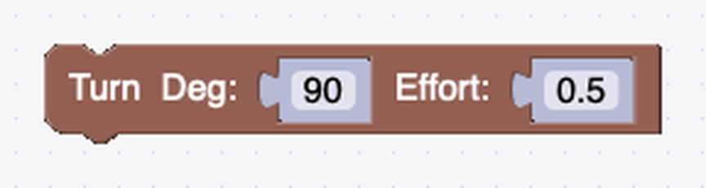
Block 3: Turn
Turns the robot in place
Deg is the angle: 90 is a quarter turn
Effort works the same way as in Straight
No block needed to stop at the end: when the program finishes, the robot stops the motors for you

Slide 19
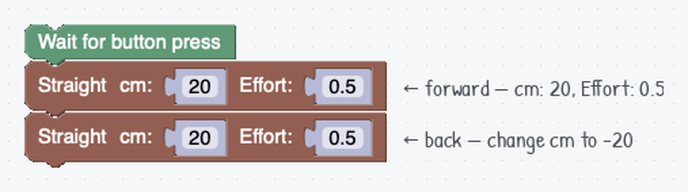
The program we'll build together
Wait for the button, drive out 20 cm, then back 20 cm (a negative cm reverses). Predict: what will the robot do? Will it end up where it started?
Notes:
This is the worked example on the lesson page. Take a few predictions before anyone runs it.

Slide 20
Check your understanding
You place two Straight blocks one above the other. When you run the program, what happens?
A. Both blocks run at the same time
B. The blocks run in order: the first finishes, then the second starts
C. Only the top block runs
D. The robot picks one block at random
Notes:
Answer: B. Blocks execute in sequence, top to bottom: one command finishes before the next begins.

Slide 21
Answer
You place two Straight blocks one above the other. When you run the program, what happens?
A. Both blocks run at the same time
B. The blocks run in order: the first finishes, then the second starts
C. Only the top block runs
D. The robot picks one block at random
Blocks execute in sequence, top to bottom: one command finishes before the next begins.

Slide 22
Put the robot down before you switch it on
At power-on, or after reset, the XRP spends a few seconds calibrating its IMU: the sensor that measures how far it has turned
That calibration assumes the robot is perfectly still, and it can't tell if it isn't
Held in your hand while it starts up, it calibrates from a moving robot
No error message: it just turns the wrong amount, differently each time
Give the robot a few seconds of stillness

Slide 23
Every run, in this order
The habit
Put the robot down on the floor or table, where it will actually drive
1
Power it on, or press reset if it's already on
2
Wait a few seconds, hands off, while it calibrates
3
Then press the User button to release your Wait for button press block
4
That gap between "calibrated" and "driving" is why the Wait for button press block is so useful
Notes:
Establish this habit now, before turns matter. A robot held in the air calibrates wrong, which shows up later as turns that are off by a different amount each run: a bug students will blame on their code. When a turn misbehaves in any lesson, "put it down and press reset" is the first thing to try.

Slide 24
Check your understanding
Your program tells the robot to turn 90°, but every run it turns a different, unpredictable amount. What is the most likely cause?
A. The robot was moving or held when it powered on, so its IMU calibration is bad
B. The Turn block only works in Python programs
C. The battery is fully charged
D. A program can only contain one Turn block
Notes:
Answer: A. The IMU calibrates in the first seconds after power-on or reset, and assumes the robot is still. Put the robot down, power on or reset, wait a few seconds, then press the button.

Slide 25
Answer
Your program tells the robot to turn 90°, but every run it turns a different, unpredictable amount. What is the most likely cause?
A. The robot was moving or held when it powered on, so its IMU calibration is bad
B. The Turn block only works in Python programs
C. The battery is fully charged
D. A program can only contain one Turn block
The IMU calibrates in the first seconds after power-on or reset, and assumes the robot is still. Put the robot down, power on or reset, wait a few seconds, then press the button.

Slide 26
Activity · Upload and run it
Activity
1
Create a new project called Lesson_1_First_Drive
2
Build the forward/backward program from before
3
Plug in the USB cable: your robot needs one USB connection before it can go wireless
4
Click CONNECT, choose USB, and pick your robot from the list
5
Set the robot down where it will drive (held it while it started? press reset and wait)
6
Click the green RUN button: it uploads and starts. Wait for button press holds the robot still
7
Press the User button on the robot: the program is released and it drives
Notes:
Guided practice, 10 to 15 minutes. Expect it to drive about 20 cm out and back to roughly where it started. Keep everyone on the cable for this first upload: it is also the USB pass that makes Bluetooth possible later.

Slide 27
You've succeeded when
The program runs without errors
The robot drives forward about 20 cm
The robot drives back about 20 cm
It stops near where it started
Not exactly 20 cm? Floor friction and battery level affect distance. Close is fine for now.

Slide 28
If something goes wrong
Robot won't move: check the battery is charged and the USB is seated, then click RUN again
Turns wildly off, or different every run: it was moving while it powered on. Set it down, press reset, wait a few seconds hands off, try again
Drives the wrong way: motor directions can be reversed; that's normal and fixable later
Not in the CONNECT list: try another USB port or cable (some cables are charge-only), then reload the page
Not there over Bluetooth: charge the battery, press reset, use Chrome or Edge. Still stuck? Plug in the cable and keep going
Notes:
USB not detected is almost always a charge-only cable or a flaky port: keep a couple of known-good data cables at the demo station. If RUN fails, have students wait ten seconds and try once more before troubleshooting further.

Slide 29
Activity · Make it your own
Activity
Now experiment. Try these in order:
Go farther: change the cm on both Straight blocks to 30 and re-run
1
Change the effort: try 0.3, then 0.8. What changes: how far it goes, how fast it gets there, or both? Measure before you decide
2
Add a turn: drop a Turn block between the two Straight blocks. What shape does the path make now?
3
Challenge: make the robot drive a square and end up back where it started. No hints: try, run, watch, adjust
4
Notes:
Lesson 1-2 picks up right where the challenge leaves off, so whatever they figure out now is a head start. More challenge: measure the distance at Effort 0.3, 0.5, 0.7 and 1.0 and report what changes. More support: a starter project with the blocks already placed, changing only the cm number, and pair programming with Driver and Navigator roles.

Slide 30
Real-world connections
WAREHOUSES
HOMES
SPACE
Delivery robots
Robot vacuums
Planetary rovers
Differential-drive robots shuttle shelves around fulfillment centers: the same two-motor steering as your XRP.
They drive, turn, and sense obstacles using exactly the sequence-of-commands idea from this lesson.
Rovers upload a program, then run it on their own, because they're too far away to control live.
Notes:
The same ideas students just used run much bigger machines.

Slide 31
Check your understanding
True or false: you can run a program on the robot without uploading it.
A. True
B. False: it has to be sent to the robot first (clicking RUN does that, over USB or Bluetooth)
Notes:
Answer: B. Blockly is just the editor. Clicking RUN is what uploads the program to the robot and starts it.

Slide 32
Answer
True or false: you can run a program on the robot without uploading it.
A. True
B. False: it has to be sent to the robot first (clicking RUN does that, over USB or Bluetooth)
Blockly is just the editor. Clicking RUN is what uploads the program to the robot and starts it.

Slide 33
Check your understanding
True or false: the reflectance sensors detect color.
A. True
B. False: they detect light vs. dark (white floor vs. black line), not color
Notes:
Answer: B. Reflectance sensors measure how much light bounces back, so they read light and dark, not specific colors.

Slide 34
Answer
True or false: the reflectance sensors detect color.
A. True
B. False: they detect light vs. dark (white floor vs. black line), not color
Reflectance sensors measure how much light bounces back, so they read light and dark, not specific colors.

Slide 35
Wrap-up
What are the main parts of the robot, and what does each do?
What does a block program actually do?
How does a program get from your screen onto the robot?
Next: the Turn block and some geometry to draw shapes
Notes:
Answer in your head or with a partner. The two true-or-false checks before this slide are the lesson's wrap-up checks. Formative: can students navigate XRP Code, drag blocks, and explain what each block does? Summative: a successful first upload plus a plain-language explanation of the hardware and of command sequencing. Next lesson: squares and triangles.

