Slide 1

MODULE 1 · LESSON 1-2
Drawing Shapes
By the end of this lesson you can
Build a program up one step at a time, running it after each change
Make the robot trace a square, and explain why the program needs what it needs
Find a shorter way to write a program that does the same thing many times
Work out the turn angle for any regular shape (360° ÷ number of sides)
Notes:
50 to 60 minutes, Blockly. This lesson is a discovery sequence: students figure out the square, and the shortcut, before either is explained. Resist showing a finished program at any point. Rough budget: 10 minutes for straight and turn, 15 for the square, 10 for the shortcut, 15 for other shapes.

Slide 2
Today: a square, one block at a time
In Lesson 1-1 you drove the robot forward and back
Today you get it to draw a square
You'll work out how, one block at a time. No recipe up front
Along the way you'll invent a shortcut that programmers use constantly
Notes:
The whole point is who does the discovering. Students who arrive at "repeat the straight-and-turn four times" on their own own the idea of a loop; students who are handed the Repeat block have merely seen one. Your job is to ask questions, not answer them: "What did the robot do? What do you want it to do next? What's one block that would get you closer?"

Slide 3
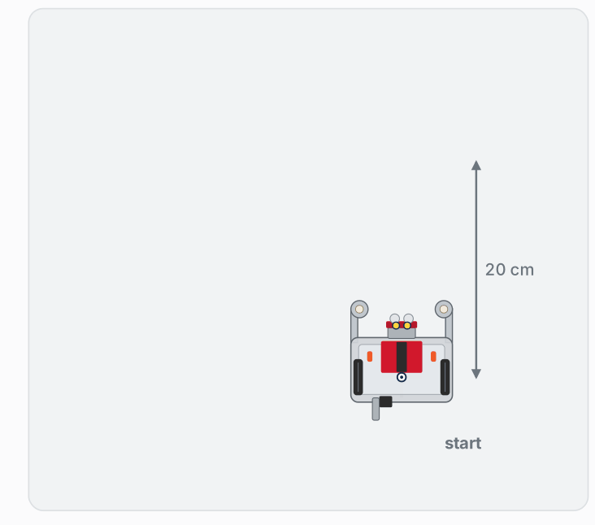
Where you're headed
Four equal sides, four equal corners, back to the start facing the same way. You'll get there one block at a time.
Notes:
On the lesson page this is an animation: the robot carries a marker in the hole between its wheels and draws the square as it drives. The slide shows the finished drawing. It shows the goal, not the program.

Slide 4
Activity · Build up to a square
Activity
Three steps, each one a small change to the program you already have.
Drive straight: 20 centimeters
1
Add a turn: 90 degrees, after the drive
2
Make a square: and end up back where you started
3
Run the robot after every step: watching what it actually does is the point

Slide 5
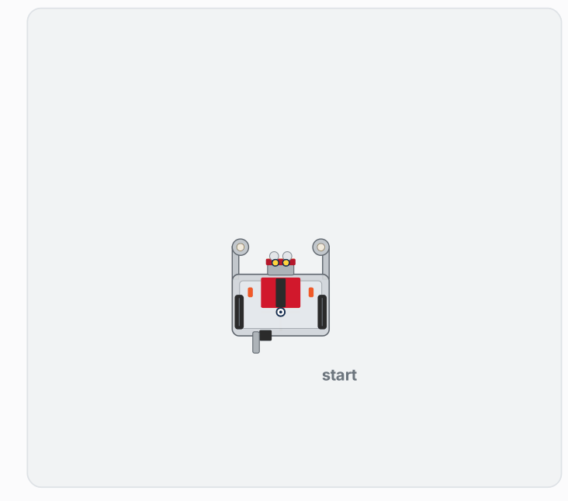
Step 1 · Drive straight
Start a new project in XRP Code
Find a block that makes the robot drive straight for 20 centimeters. Look through the palette, drag it out, set it up
Put a Wait for button press block above it
Robot on the floor, click RUN, press the button on the robot
Did it go 20 cm? Where did it end up, and which way is it facing?
Notes:
Let students find the Straight block themselves: say "find a block that drives straight" rather than naming it. They are practicing searching the palette, which they need again when they hunt for the shortcut. A few will forget the button-press block and the robot drives off the table: a memorable lesson in why it exists. Keep this part short; it's a warm-up.

Slide 6
Step 2 · Add a turn
Change your program so that after driving straight, the robot turns 90 degrees
Find the block that turns, add it under the Straight block, set the angle
Predict before you press the button: where will the robot end up, and which way will it be facing?
Then run it and check
Predict first, then run

Slide 7
Check your understanding
Your program is Straight 20, then Turn 90. After it runs, how has the robot changed from where it started?
A. It is in the same spot, facing the same way
B. It moved 20 cm forward and now faces a quarter-turn from where it started
C. It has turned but not moved
D. It has driven in a full circle
Notes:
Answer: B. Blocks run in order: first the drive, then the turn. So the robot is 20 cm away AND rotated 90°. A side and a corner: the building block of every shape.

Slide 8
Answer
Your program is Straight 20, then Turn 90. After it runs, how has the robot changed from where it started?
A. It is in the same spot, facing the same way
B. It moved 20 cm forward and now faces a quarter-turn from where it started
C. It has turned but not moved
D. It has driven in a full circle
Blocks run in order: first the drive, then the turn. So the robot is 20 cm away AND rotated 90°. A side and a corner: the building block of every shape.

Slide 9

Step 2: one side and one corner
Watch it run. The next slide picks out the key moments.
Notes:
Show this after students have predicted and run their own. Ask "what shape has the robot drawn so far?" (a single side and a corner, an L). Then ask the question that sets up the square: "What would you have to add to draw a second side?" Don't answer it.

Slide 10
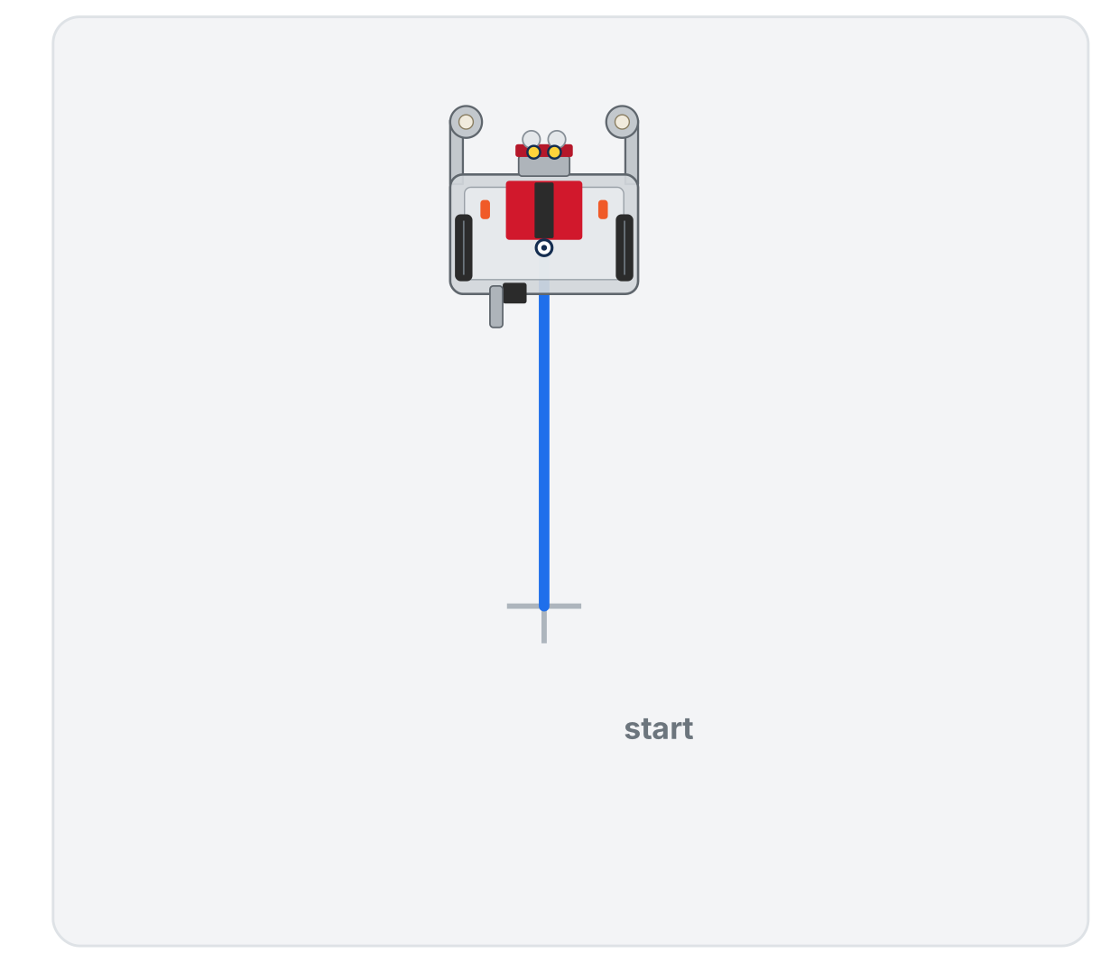
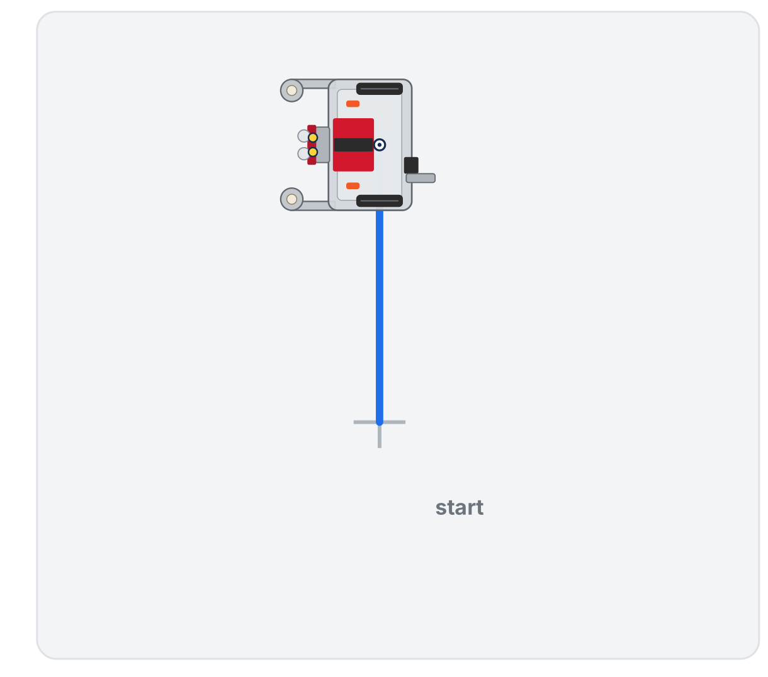
Step 2: one side and one corner
Straight: driving 20 cm forward
Turn: a quarter turn, in place
Drive, then turn in place: one side and one corner
Notes:
Show this after students have predicted and run their own. Ask "what shape has the robot drawn so far?" (a single side and a corner, an L). Then ask the question that sets up the square: "What would you have to add to draw a second side?" Don't answer it.

Slide 11
Step 3 · Make a square
The real challenge: change your program so the robot drives a complete square and ends up back where it started, facing the same way.
You already know everything you need. Use the blocks you have
Try something, run it, watch what happens, adjust, run it again
A first try that's a triangle or an open box is fine: that's information
You've succeeded when the robot drives four roughly equal sides, turns four corners, and finishes near its starting spot
Notes:
Nearly every student will stack Straight, Turn, Straight, Turn, Straight, Turn, Straight, Turn: eight blocks. That is the correct answer for this part. Do not suggest a shorter way. If a student finds it in the palette on their own, ask them to hold on to it and demonstrate later. Common stumbles: only three sides, or a turn of 45° or 180°; they will see the wrong shape and fix it.

Slide 12

A wrong shape tells you what to change
Watch it run. The next slide picks out the key moments.
Notes:
The lesson page animates both tries. Here: the first try ends one side short, so count again; with one more side and one more corner, the square closes and the robot is back on its start mark, facing the way it began.

Slide 13
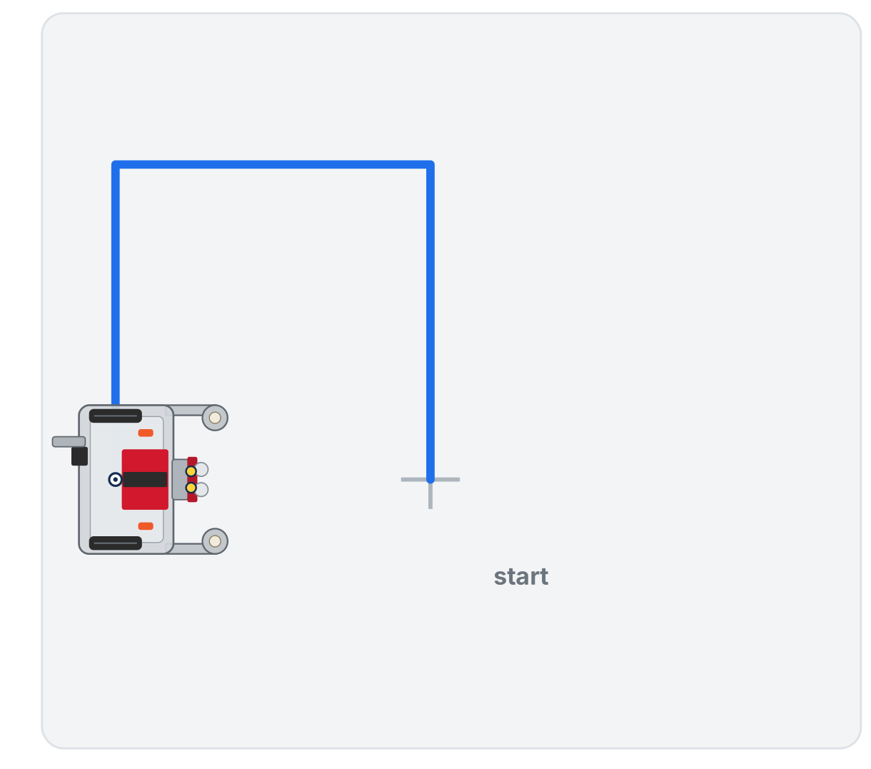
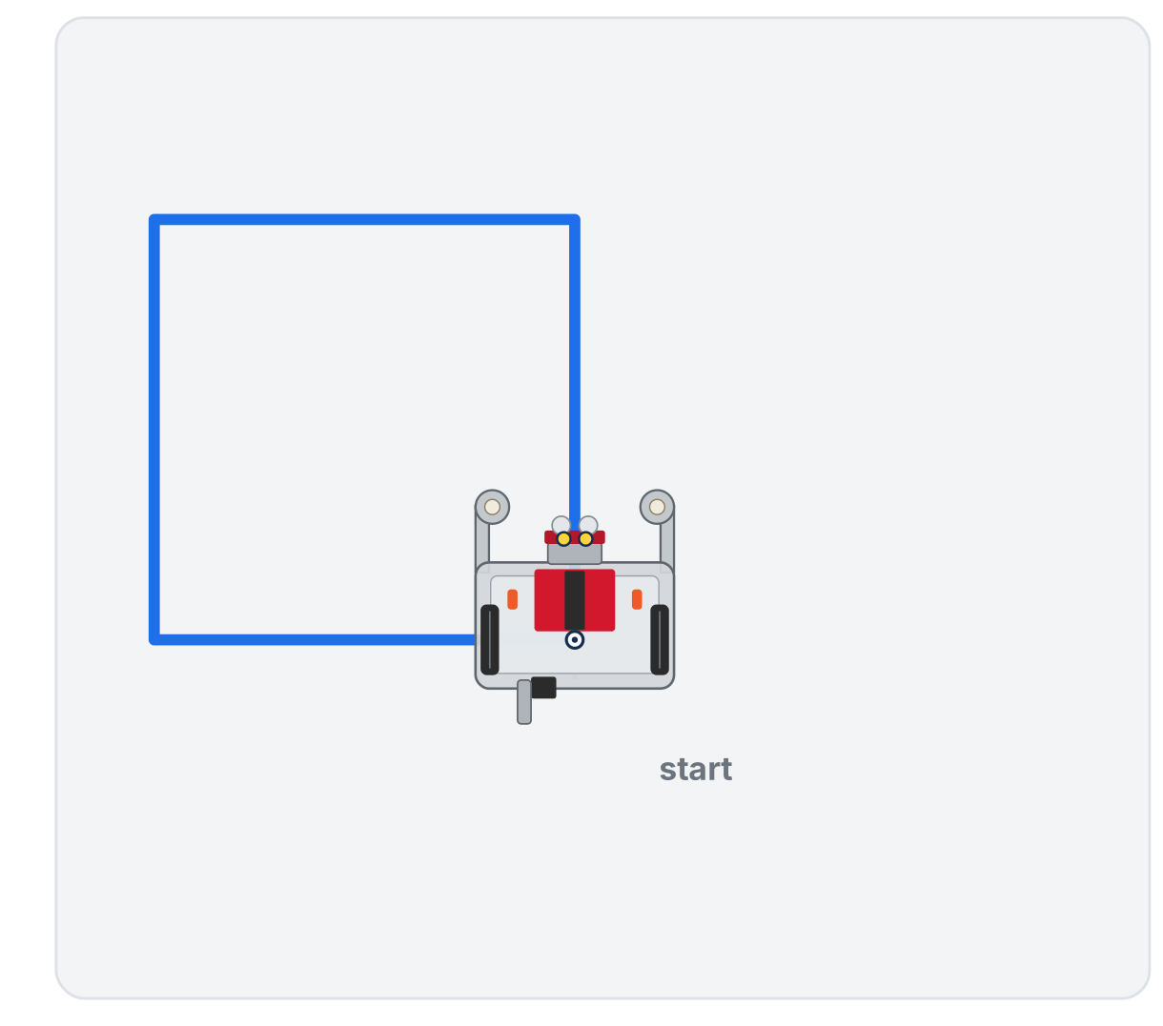
A wrong shape tells you what to change
A first try: three sides, not closed
The fix: four sides, closed
Notes:
The lesson page animates both tries. Here: the first try ends one side short, so count again; with one more side and one more corner, the square closes and the robot is back on its start mark, facing the way it began.

Slide 14
Once your square works, look at your program
How many blocks did it take?
Is there anything in it that's the same thing, over and over?
Count, then point at anything that repeats
Notes:
Once a student's square works, ask them to count their blocks and to point at anything that's repeated. That question is the bridge to the shortcut. The lesson page has a working eight-block square behind a reveal for students to compare with after theirs runs; it stays off the slides.

Slide 15
Check your understanding
In the eight-block square, what is being repeated, and how many times?
A. The Straight block, eight times
B. The pair Straight-then-Turn, four times
C. The Turn block, eight times
D. Nothing is repeated
Notes:
Answer: B. Look at the pattern: drive a side, turn a corner. That pair appears four times, once per side of the square.

Slide 16
Answer
In the eight-block square, what is being repeated, and how many times?
A. The Straight block, eight times
B. The pair Straight-then-Turn, four times
C. The Turn block, eight times
D. Nothing is repeated
Look at the pattern: drive a side, turn a corner. That pair appears four times, once per side of the square.

Slide 17
Activity · A shorter way to say "four times"
You just wrote the same two blocks four times
A shape with 12 sides would take 24 blocks. There has to be a better way
The palette has a block that repeats whatever you put inside it. Go find it.
Drag it out, set it to run 4 times, move one Straight and one Turn inside it, and delete the other six
Run it. Does the robot still draw a square?
Notes:
Give students a minute or two to find the block themselves (it's Repeat, in the Loops category). If someone found it while building the square, this is their moment to demonstrate. Only after most have tried it, show a finished version and name it: a loop, one copy of the instructions run as many times as you say. Stress dropping the blocks inside the Repeat's mouth: beside it instead of inside is the classic error, and the robot drives one side and stops. A new Repeat block starts at 10.

Slide 18
You just used a loop
You write the instructions once
The Repeat block runs them as many times as you tell it to
One of the most important ideas in all of programming
And you got to it by noticing your own program repeating itself
A loop: one copy of the instructions, run as many times as you say

Slide 19
Check your understanding
A student's Repeat-4 program makes the robot drive one side and then stop. What's the most likely problem?
A. The robot is out of battery
B. The Straight and Turn blocks are next to the Repeat instead of inside it
C. Repeat only works with Turn blocks
D. The number 4 is too small
Notes:
Answer: B. Only blocks tucked inside the Repeat's mouth get repeated. Blocks stacked beside it run once, so the robot drives a single side, and the empty loop repeats nothing.

Slide 20
Answer
A student's Repeat-4 program makes the robot drive one side and then stop. What's the most likely problem?
A. The robot is out of battery
B. The Straight and Turn blocks are next to the Repeat instead of inside it
C. Repeat only works with Turn blocks
D. The number 4 is too small
Only blocks tucked inside the Repeat's mouth get repeated. Blocks stacked beside it run once, so the robot drives a single side, and the empty loop repeats nothing.

Slide 21
Activity · Now try a triangle
Change your Repeat from 4 to 3
What angle should the turn be?
Make your best guess, run it, and look at the result
Did it close? Which way is it facing compared to the start?
Notes:
Let the wrong angle happen. Most students leave the turn at 90° (three sides of a square) or guess 60° because they remember a triangle's corners are 60° (a wide, open zig-zag). Both failures are the whole point. Ask: "Did it close? Which way is it facing compared to the start? How far did it turn in total?"

Slide 22
Didn't close? Walk the triangle yourself
Pace out a side
Pivot at the corner the way the robot does
Keep going until you're back where you began, facing the way you started
How far did you turn in total, adding up all three corners?
That total is the whole answer
Notes:
Have a student walk the triangle at the front of the room, pivoting at each corner, so everyone sees they have turned all the way around by the end. Let the class work out what each corner must be before you go on; the lesson keeps that step behind a reveal.

Slide 23
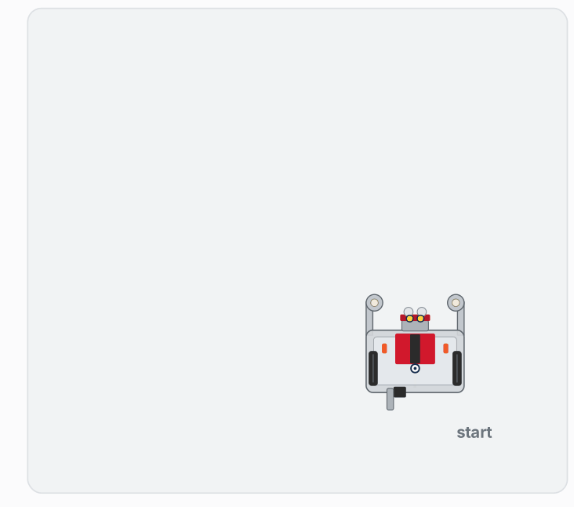
Two tries that don't close
Watch it run. The next slide picks out the key moments.
Notes:
Use this for students who are stuck after their first try. On the lesson page it is an animation with a running total of the degrees turned at each corner.

Slide 24
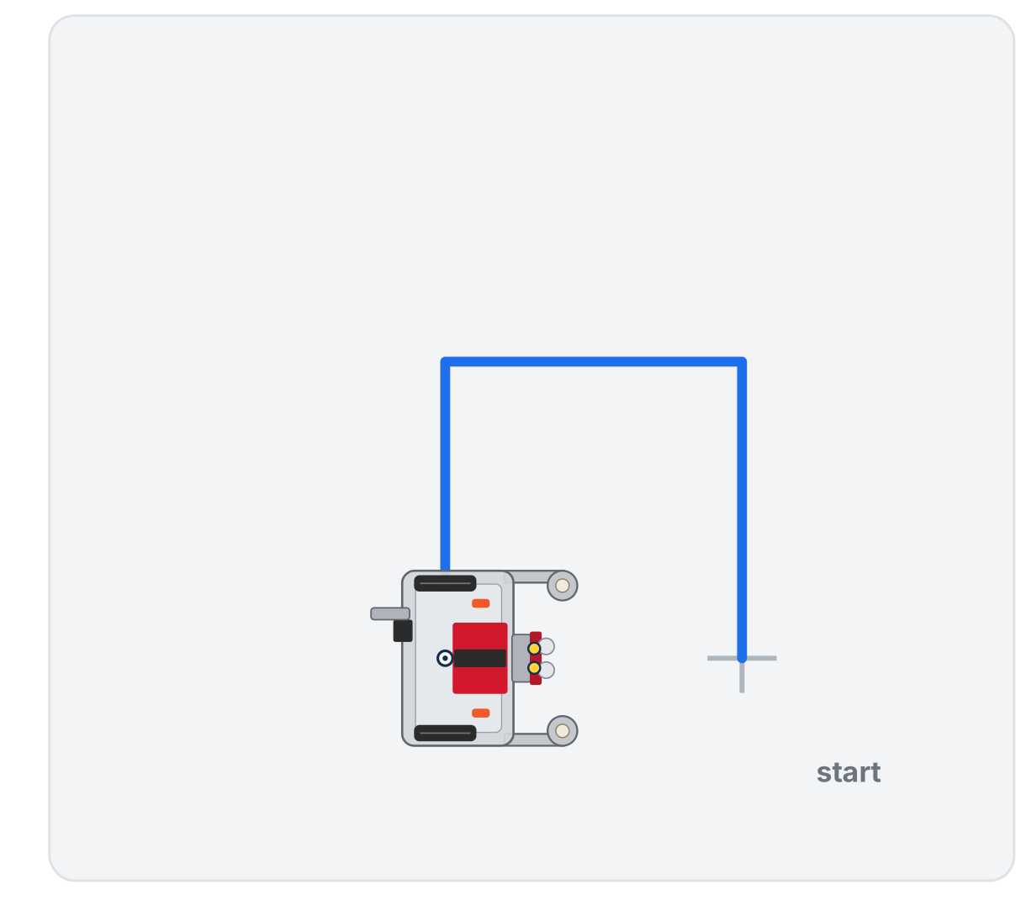
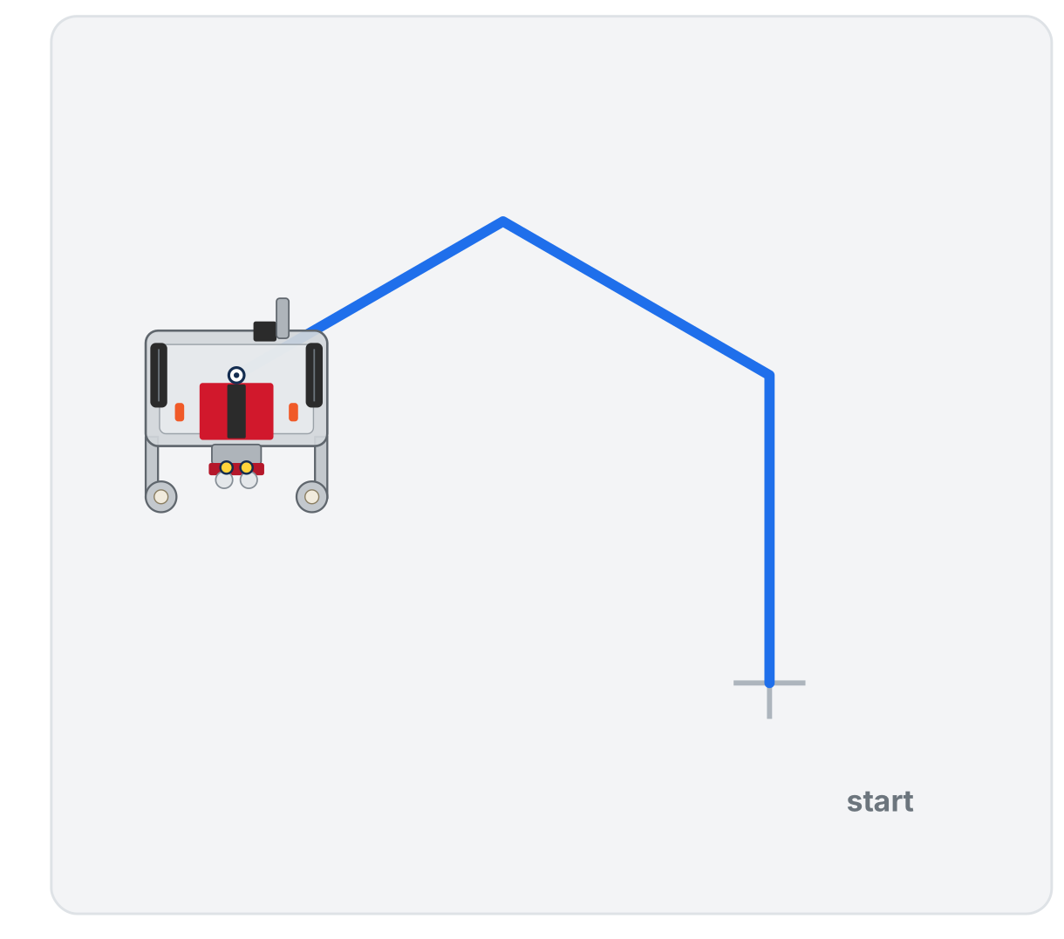
Two tries that don't close
Turn 90: three sides of a square, 270° in total
Turn 60: an open zig-zag, only 180° in total
Keep an eye on the running total: a closed shape has to add up to one full turn
Notes:
Use this for students who are stuck after their first try. On the lesson page it is an animation with a running total of the degrees turned at each corner.

Slide 25
Check your understanding
A classmate's triangle isn't closing up: the robot ends facing the wrong way. They used Turn 60°. What should it be?
A. 90°
B. 120°
C. 30°
D. 45°
Notes:
Answer: B, 120°. Ask this once students have set their own turn to the angle they worked out and seen the triangle close.

Slide 26
Answer
A classmate's triangle isn't closing up: the robot ends facing the wrong way. They used Turn 60°. What should it be?
A. 90°
B. 120°
C. 30°
D. 45°
A triangle has 3 sides: 360 ÷ 3 = 120°. The turn is the OUTSIDE angle, not the 60° inside angle: a common mix-up.
Notes:
Answer: B, 120°. Ask this once students have set their own turn to the angle they worked out and seen the triangle close.

Slide 27
Do the reasoning on paper first
Sketch a square and walk your pencil around it, writing the turn at each corner: four 90s that add up to 360. Then fill in the table.
Shape | Sides | Repeat | Turn angle
Triangle | 3 | 3 | ____
Square | 4 | 4 | ____
Pentagon | 5 | 5 | ____
Hexagon | 6 | 6 | ____
Octagon | 8 | 8 | ____
Notes:
The completed table is in the teacher copy on the lesson page. Students who fill it in without the rule usually get the triangle row wrong, so that one row is the quickest check of whether the idea landed. Collect the table if you want a paper artifact: it's the only written work in this lesson.

Slide 28
Activity · Make other shapes
Activity
Change just two numbers: the repeat count and the turn angle. Predict, then run.
Pentagon: Repeat 5, and the turn angle from your table. Shorten the sides to 15 cm so it fits
1
Hexagon: Repeat 6, and its angle from your table
2
Your choice: pick a number of sides, work out 360 ÷ sides, predict, run. What happens as the number of sides gets big?
3
Doesn't close? The angle and the repeat count disagree
Notes:
Give each robot a clear patch of floor, about 1 m square at 20 cm sides. Lopsided shapes are usually wheel slip: lower Effort to 0.3 on carpet, or nudge it to 0.7 if the robot is sluggish. Within about 10% is a success. More support: a reference card of angles and a fill-in template "Repeat (__) · Straight (__) · Turn (__)." More challenge: a five-point star (Repeat 5, Turn 144°: ask them to work out why 144 before running it), or two shapes back-to-back from the same start.

Slide 29
Check your understanding
What turn angle do you need to draw a regular hexagon (6 sides)?
A. 90°
B. 60°
C. 120°
D. 45°
Notes:
Answer: B. 360 ÷ 6 = 60°. Split one full turn evenly across all six corners.

Slide 30
Answer
What turn angle do you need to draw a regular hexagon (6 sides)?
A. 90°
B. 60°
C. 120°
D. 45°
360 ÷ 6 = 60°. Split one full turn evenly across all six corners.

Slide 31
Check your understanding
You change a working square program from Repeat 4 to Repeat 6, and set the turn to 60°. What does the robot draw?
A. A bigger square
B. A hexagon (6 sides)
C. The same square, slower
D. An incomplete shape
Notes:
Answer: B. Six sides with 60° turns (360 ÷ 6) closes into a hexagon. The side length sets the size, not the number of sides.

Slide 32
Answer
You change a working square program from Repeat 4 to Repeat 6, and set the turn to 60°. What does the robot draw?
A. A bigger square
B. A hexagon (6 sides)
C. The same square, slower
D. An incomplete shape
Six sides with 60° turns (360 ÷ 6) closes into a hexagon. The side length sets the size, not the number of sides.

Slide 33
Real-world connections
MANUFACTURING
MAKING
ART
CNC machines
3D printers
Pen plotters
Cutting tools trace shapes by repeating precise move-and-turn steps, just at much finer scale.
Each layer is a looped path the print head repeats hundreds of times to build up an object.
Drawing robots turn loops of coordinates into logos, maps, and signatures on paper.
Notes:
Repeating a move-and-turn is exactly how machines make precise, repeatable paths.

Slide 34
Wrap-up
Why did the eight-block square work, and why is the Repeat version better?
What's the rule for the turn angle?
If a shape doesn't close, what's the first thing to check?
Next: tuck the square inside a function, so you can reuse it by name
Notes:
Answers: same result, but one copy of the instructions instead of four, and easy to change. 360 ÷ number of sides. The turn angle: did the turns add up to 360? Formative: did each student get a square working before seeing Repeat, and can they say what Repeat does in their own words? Exit ticket: "Octagon: what goes in the Repeat, and what's the turn?" (8, and 360 ÷ 8 = 45°). Next lesson, true to form, students feel the need for a function before they meet one.

