Slide 1

MODULE 1 · LESSON 1-4
Parameters & Customization
By the end of this lesson you can
Explain what a parameter is: an input that changes what a function does
Add a parameter to a Blockly function with the gear icon and the mutator bubble
Find that parameter in the Variables palette and use its value inside the function
Call one function with different arguments to get different results
Notes:
50 to 60 minutes, still in Blockly. The gear-icon step is the one piece of Blockly UI nobody discovers on their own, so plan to demo it live and slowly.

Slide 2
Same size every time
Your square function always draws the same size square
Want a big one, then a small one? You could write square_big and square_small...
... but that's the copy-paste problem all over again
The fix is a parameter: a slot you fill in each time you call the function
Notes:
Quick hook. Ask how they would draw a big square and then a small one with what they have. Someone will suggest a second function; that is the copy-paste problem from Lesson 1-3 coming back.

Slide 3
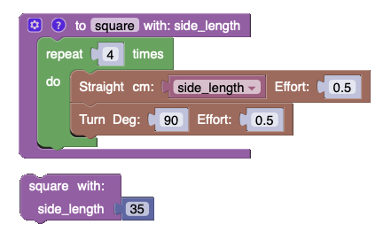
One function, any size
A parameter is like a blank in a recipe: not "add 1 cup of sugar" but "add this much sugar"
For square, the blank is the side length. We name the parameter side_length
The Straight block's cm slot holds the parameter instead of a fixed number
The call at the bottom fills it in with 35
Notes:
You decide how much sugar each time you cook. Point at the two places the name appears: on the definition (with: side_length) and in the Straight block's cm slot.

Slide 4
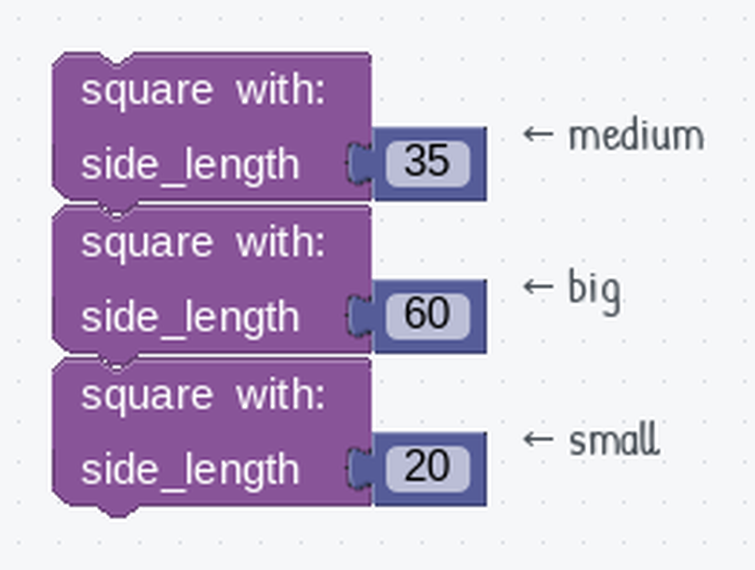
One function, three sizes
Pass a different value each time you call it
Getting there takes two moves:
Add the parameter to the function
Use its value inside the body
They happen in two different places, so it's easy to do one and forget the other
One function, three sizes. Only the number in the socket changes.
Notes:
The two moves are the heart of the lesson: add the parameter with the gear, then use it from the Variables palette. Students who do only the first get three identical squares. The next slides walk through both.

Slide 5
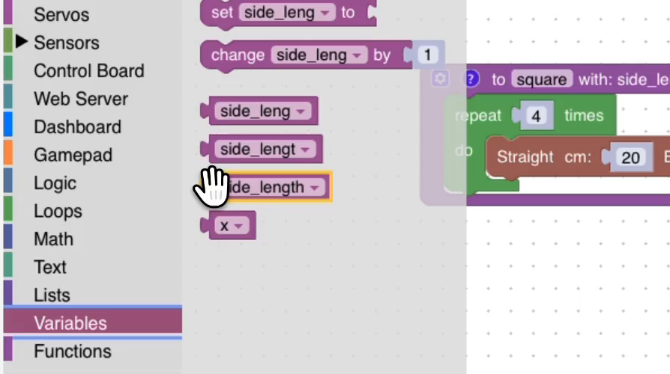
The whole build, start to finish
Name the function, add the parameter with the gear, build the body in a Repeat 4, feed the parameter to Straight, then call it twice: 20 cm and 30 cm.
Notes:
About a minute and a half, no sound, silent by design. Watch it once for the shape of it, then work through the steps on the next slides. Project it, pause it wherever you want to talk, and run it again. It is also the fastest way to get a student who fell behind back to the same place as everyone else.

Slide 6
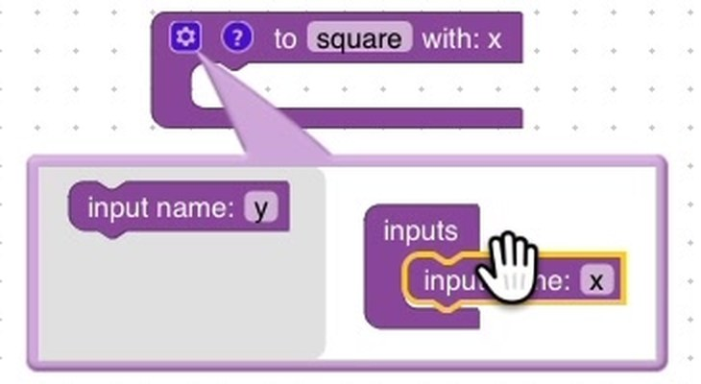
Adding the parameter: the gear icon
Top-left corner of your square definition: a small blue gear. It means "this block can change shape".
1 · Click the gear. A bubble opens with its own tiny workspace
In the gray strip: input name: x. To its right: inputs, with an empty notch
2 · Drag input name: x into the inputs block
The definition behind the bubble grows a row: with: x
That's your parameter. It already exists, it just has a terrible name.
Notes:
Demo this live and slowly, narrating each move. Students expect a menu or an "Add Input" button; instead they drag a block inside another block in a floating mini-workspace. Several will drop the input next to the inputs block rather than inside it and see nothing happen. The tell: a definition block with no with: row.

Slide 7
Rename it, then close the bubble
3 · Rename it. Click the x, type side_length, press Enter
Underscores, not spaces: the name you'd want in Python later (Lesson 1-11)
Keep it short: it rides along on the definition, every call and every variable block
4 · Close the bubble by clicking the gear again
Your definition now reads to square with: side_length
A second parameter? Stack another input name underneath. Top to bottom in the bubble is left to right in the call, so order matters.
Notes:
In the next lesson, polygon (sides, side_length) is not the same function as polygon (side_length, sides). In Lesson 1-11 students write this same function in text, which is why the name should already be Python-friendly.

Slide 8
Check your understanding
You click the gear on a function block and drag an 'input name' block into the 'inputs' block. What happens to the function definition?
A. Nothing until you press Run
B. It grows a "with:" row naming the new parameter
C. The blocks inside the function are deleted
D. A new function is created
Notes:
Answer: B. The definition block changes shape as soon as the input connects: that "with:" row is the parameter list. Renaming the input renames what appears there.

Slide 9
Answer
You click the gear on a function block and drag an 'input name' block into the 'inputs' block. What happens to the function definition?
A. Nothing until you press Run
B. It grows a "with:" row naming the new parameter
C. The blocks inside the function are deleted
D. A new function is created
The definition block changes shape as soon as the input connects: that "with:" row is the parameter list. Renaming the input renames what appears there.

Slide 10
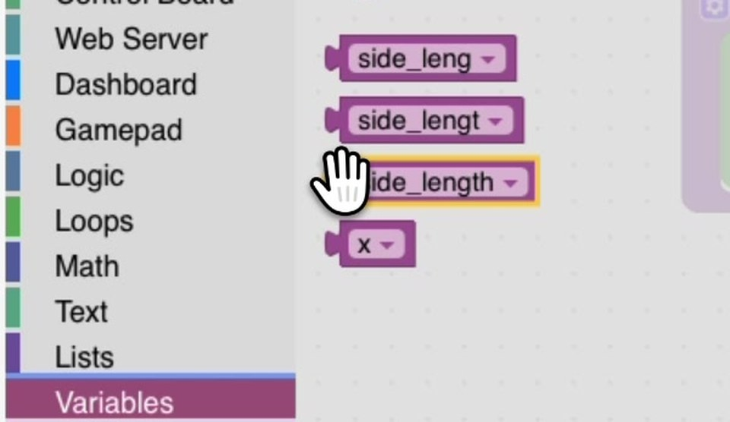
Using the parameter: the Variables palette
The Straight block inside is still set to a hard number, so nothing has changed yet
Open Variables. Past Create variable and the set and change blocks, there's a rounded side_length block
Adding the parameter created it. You don't have to make it
Grabbed the wrong one? Switch it from its dropdown instead of starting over
This workspace has a few half-typed leftovers too: read the name before you drag
Notes:
Predictable snag: students rename the input but never visit Variables, so the body still uses a fixed number. The function ignores its argument, and every call draws the same square.

Slide 11
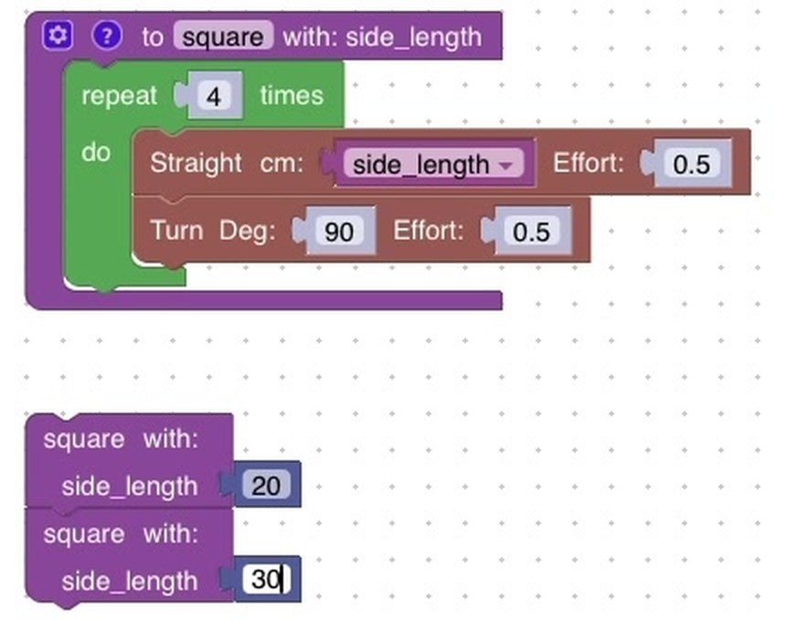
Drop it in, then call it
Drag side_length into Straight's cm slot, right on top of the number
The number isn't deleted: it's tucked underneath, and comes back if you pull the variable out
Use the same parameter as many times as you like inside the function
In Functions, the call block now reads square with: side_length, with a socket
Drag one out and type 20, a second and type 30, and snap them into a stack
Two sizes, one function. This is the payoff.
Notes:
Second predictable snag: a student drags the side_length block out of the function and into the main program, where it has no value. It only means something inside the function that declares it. If a student deletes a parameter later, any side_length block left in the body becomes a plain variable that is never set: clean those out with them.

Slide 12
Check your understanding
Inside the function body, where do you get a block that holds the parameter's value?
A. The Variables category: the parameter appears there as a rounded block
B. The Functions category, next to the call block
C. You type its name into the number slot
D. You have to make a new variable with the same name
Notes:
Answer: A. Adding a parameter creates a variable of the same name, and Blockly lists it under Variables. Drag that block into any slot inside the function where you want the value.

Slide 13
Answer
Inside the function body, where do you get a block that holds the parameter's value?
A. The Variables category: the parameter appears there as a rounded block
B. The Functions category, next to the call block
C. You type its name into the number slot
D. You have to make a new variable with the same name
Adding a parameter creates a variable of the same name, and Blockly lists it under Variables. Drag that block into any slot inside the function where you want the value.

Slide 14
Parameter vs. argument
Two words that sound similar and trip everyone up:
Parameter: the name in the definition
The side_length in square (side_length). It's the empty slot
Argument: the value you pass in when you call it
The 50 in square (side_length: 50). It's what fills the slot
Parameter = the slot. Argument = what you put in it.
Notes:
Keep pointing at the blocks: the parameter lives on the definition, the argument sits in the socket of a call. Exit-ticket style question: in square (side_length: 50), which word is the parameter and which number is the argument?

Slide 15
Check your understanding
In the call square (side_length: 50), what is the 50?
A. The parameter
B. The argument: the value passed in
C. The function name
D. The turn angle
Notes:
Answer: B. The parameter is the name (side_length) in the definition; the argument is the value (50) you pass when calling.

Slide 16
Answer
In the call square (side_length: 50), what is the 50?
A. The parameter
B. The argument: the value passed in
C. The function name
D. The turn angle
The parameter is the name (side_length) in the definition; the argument is the value (50) you pass when calling.

Slide 17
Check your understanding
With square (side_length), calling square (side_length: 35) makes the robot drive each side how long?
A. 90 cm
B. 35 cm
C. 4 cm
D. It depends on the effort
Notes:
Answer: B. The argument 35 flows into the side_length parameter, so every Straight drives 35 cm.

Slide 18
Answer
With square (side_length), calling square (side_length: 35) makes the robot drive each side how long?
A. 90 cm
B. 35 cm
C. 4 cm
D. It depends on the effort
The argument 35 flows into the side_length parameter, so every Straight drives 35 cm.

Slide 19
Activity · Make your functions flexible
Activity
Add a side_length parameter to square (gear icon, then the Variables palette) and call it at three sizes. All three identical? Check what's in the Straight block's cm slot.
1
Do the same for triangle: one function, any size triangle
2
Challenge: add a second parameter, effort, for the Effort on Straight and Turn: square (side_length, effort). Does it earn its keep? Next lesson's polygon leaves Effort at 0.5.
3
Notes:
If all three squares come out identical, the student did the first half (add) and not the second (use). More support: pair students and have one talk the other through the gear sequence without touching the mouse; saying it out loud is what makes it stick. More challenge: preview Lesson 1-5 by adding a sides parameter and computing the turn as 360 ÷ sides, or add effort and compare the robot at 0.3 and 0.8.

Slide 20
Check your understanding
A function is defined as draw rectangle (length, width). Are draw rectangle (50, 30) and draw rectangle (30, 50) the same?
A. Yes: the numbers are the same
B. No: order matters, so length and width are swapped
C. Yes: Blockly sorts them
D. Only if the robot is turned off
Notes:
Answer: B. Arguments fill parameters in order. (50, 30) means length 50 and width 30; (30, 50) swaps them into a different rectangle.

Slide 21
Answer
A function is defined as draw rectangle (length, width). Are draw rectangle (50, 30) and draw rectangle (30, 50) the same?
A. Yes: the numbers are the same
B. No: order matters, so length and width are swapped
C. Yes: Blockly sorts them
D. Only if the robot is turned off
Arguments fill parameters in order. (50, 30) means length 50 and width 30; (30, 50) swaps them into a different rectangle.

Slide 22
Real-world connections
PRINT
GAMES
ROBOTICS
Print dialog
Difficulty settings
Motion commands
"Copies," "paper size," and "color" are parameters: one print function, many outcomes.
Easy or hard is a parameter fed into the same game code to change enemy speed and health.
"Drive to (x, y) at speed s": real robot commands are functions with parameters just like yours.
Notes:
Parameters are everywhere you customize something without rebuilding it.

Slide 23
Wrap-up
What does a parameter let one function do?
Parameter vs. argument: which is which?
Why does parameter order matter?
Next: one polygon function that draws any regular shape
Notes:
Answers: behave differently each time, based on the value you pass. Parameter = the name or slot; argument = the value you pass in. Arguments fill the slots in order. Formative: can students add a parameter with the gear, use it in the body, and call with different arguments? Exit ticket: "Given triangle (side_length), what does triangle (40) drive per side?" (40 cm). Next lesson combines a parameter with the 360 ÷ sides math.

