Slide 1

MODULE 2 · LESSON 2-7
Finishing the Sensor Toolkit
By the end of this lesson you can
Write is_at_cross(), completing the five-function sensor toolkit
Explain how the functions share reflectance and THRESHOLD through global variables
Say why one function calls another instead of repeating its logic
Say when a function needs the global keyword, and when it doesn't
Test the whole toolkit by sliding the robot over the line and reading the printout
Notes:
60 minutes. Four of the five functions already exist, written one at a time in Lessons 2-1, 2-3, 2-5 and 2-6. This lesson adds the fifth and mostly names what has been going on: two shared globals, and the global keyword for the one case where a function assigns. Keep the focus on the sharing.

Slide 2
You've already built a toolkit
get_left() and get_right() since Lesson 2-1
is_either_on_line() since the bounce
A get_error() you've already rewritten once
Each written when a program needed it, and tested before that program ran
Today: add the last function, name how they share, and test all five
Notes:
Open robot.py on the projector and scroll the LINE SENSOR section. From next lesson on the robot drives on this toolkit, so this is the lesson to be sure of it.

Slide 3
The goal: code that reads like English
Next lesson the robot follows the line until it reaches a crossing line. With the sensor logic in functions, that loop reads as a sentence:
while not is_at_cross():
correction = get_error() * KP
drivetrain.arcade(BASE_EFFORT, correction)
is_at_cross() is far clearer than left > 0.5 and right > 0.5 in the middle of a loop, and get_error() says what the subtraction means
Notes:
Every driving function in Lessons 2-8 and 2-9 is built on these five functions.

Slide 4
Shared, not passed: global variables
The functions need the same two things: the reflectance sensor, and the threshold
You could have passed both into every function as parameters
Instead they were created once, at the top of the file, outside any function
reflectance in the start block
THRESHOLD at the top of the section
Every function just used them
A variable created outside every function is a global variable: every function below it can read it without being handed it

Slide 5
Nothing new: globals since Module 1
drivetrain is a global that polygon() used without a parameter
Lesson 2-1 said so in passing; now it has a name
THRESHOLD is in capitals by convention
That spelling says: a setting, not a value that changes as the program runs
Python doesn't enforce the capitals. Readers rely on them.

Slide 6
Check your understanding
Why can get_left() use reflectance when it was never passed in as a parameter?
A. Python passes the first variable in the file automatically
B. reflectance is a global variable: created outside every function, so every function below it can read it
C. get_left() creates its own reflectance each call
D. It cannot; this is a bug
Notes:
Answer: B. A name created at the top level of the file is visible inside every function. `drivetrain` has worked this way since Module 1; `reflectance` and `THRESHOLD` work the same way here.

Slide 7
Answer
Why can get_left() use reflectance when it was never passed in as a parameter?
A. Python passes the first variable in the file automatically
B. reflectance is a global variable: created outside every function, so every function below it can read it
C. get_left() creates its own reflectance each call
D. It cannot; this is a bug
A name created at the top level of the file is visible inside every function. drivetrain has worked this way since Module 1; reflectance and THRESHOLD work the same way here.

Slide 8
The last function: is_at_cross()
Your LINE SENSOR section has four functions. Add the fifth under is_either_on_line():
def is_at_cross():
# return True when BOTH readings are above THRESHOLD
pass
Where a second taped line crosses the one you're following, both sensors sit on black at once

Slide 9
The two is_ functions are a pair
is_either_on_line(): at least one sensor dark, so or
is_at_cross(): both sensors dark, so and
The first ends a turn in Lesson 2-9
The second ends a follow in Lesson 2-8
With or, a cross check would fire every time one sensor touched the line
Notes:
Insist on the is_ prefix for functions that return True or False. is_at_cross() and is_either_on_line() are used unchanged through the end of the course.

Slide 10
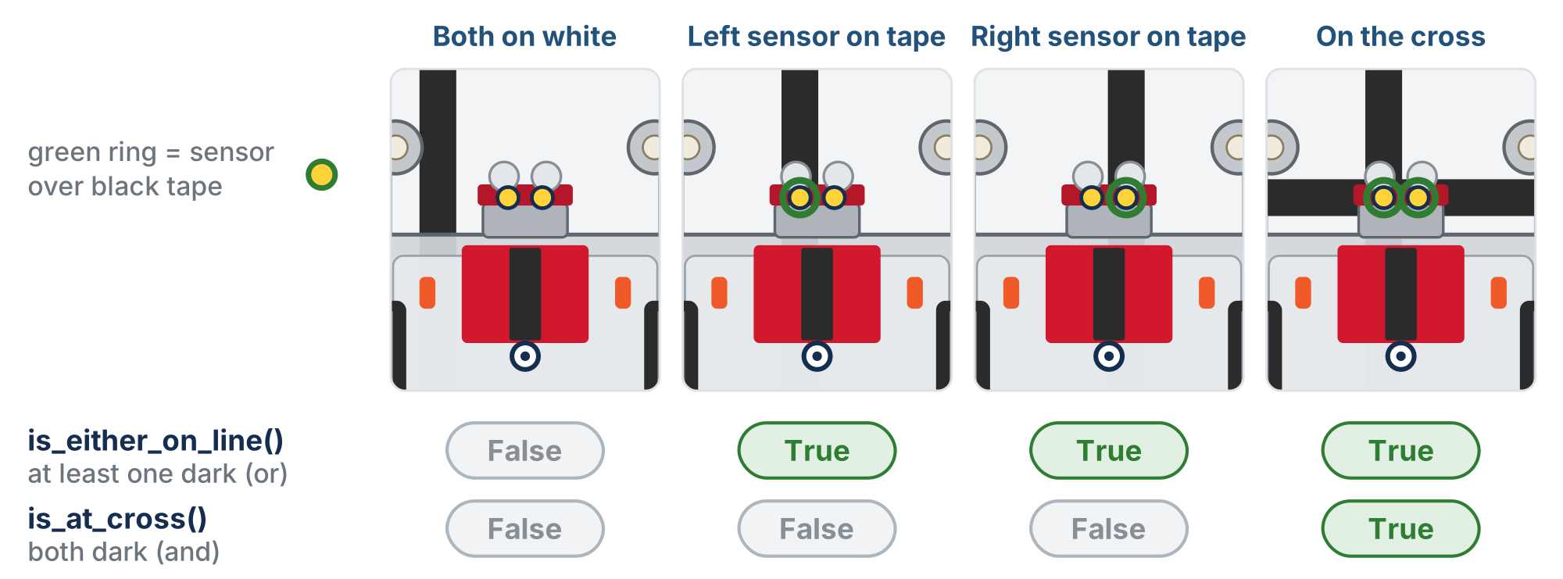
Four positions, two answers
Only the cross makes both True. That's why is_at_cross() needs and.
Notes:
Have students predict the two Booleans for each position before you reveal the bottom rows.

Slide 11
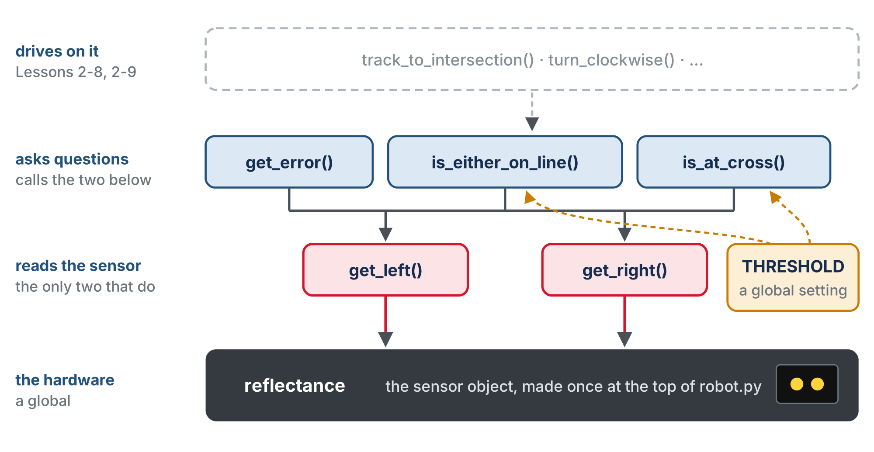
The whole toolkit
One place knows how to read the hardware; everything else goes through it.
Notes:
Only get_left() and get_right() touch reflectance. The other three call those two. These five names are the vocabulary of the rest of the course, used unchanged through Module 5.

Slide 12
Check your understanding
Which condition detects an intersection (both sensors on the line)?
A. left > 0.5 or right > 0.5
B. left > 0.5 and right > 0.5
C. left > 0.5
D. not (left > 0.5)
Notes:
Answer: B. A cross means BOTH sensors are on black at once, so both comparisons must be true: that's `and`. `or` would fire during normal following too.

Slide 13
Answer
Which condition detects an intersection (both sensors on the line)?
A. left > 0.5 or right > 0.5
B. left > 0.5 and right > 0.5
C. left > 0.5
D. not (left > 0.5)
A cross means BOTH sensors are on black at once, so both comparisons must be true: that's and. or would fire during normal following too.

Slide 14
Check your understanding
Both sensors read 0.2 with THRESHOLD = 0.5. What do is_at_cross() and is_either_on_line() return?
A. True and True
B. False and False: neither reading is above the threshold, so neither the and nor the or is satisfied
C. False and True
D. True and False
Notes:
Answer: B. `0.2 > 0.5` is False for both sensors. `and` needs both True; `or` needs at least one. Both come out False: the robot is off the line entirely.

Slide 15
Answer
Both sensors read 0.2 with THRESHOLD = 0.5. What do is_at_cross() and is_either_on_line() return?
A. True and True
B. False and False: neither reading is above the threshold, so neither the and nor the or is satisfied
C. False and True
D. True and False
0.2 > 0.5 is False for both sensors. and needs both True; or needs at least one. Both come out False: the robot is off the line entirely.

Slide 16
Check your understanding
Why does get_error() call get_left() instead of reflectance.get_left()?
A. reflectance.get_left() is slower
B. So only one function knows how the hardware is read: if the sensor changes, you fix get_left() and everything else keeps working
C. Functions cannot use global variables twice
D. It makes no difference either way
Notes:
Answer: B. Functions calling functions keeps each job in one place. `get_error()` means left minus right; how a reading is taken is `get_left()`'s business.

Slide 17
Answer
Why does get_error() call get_left() instead of reflectance.get_left()?
A. reflectance.get_left() is slower
B. So only one function knows how the hardware is read: if the sensor changes, you fix get_left() and everything else keeps working
C. Functions cannot use global variables twice
D. It makes no difference either way
Functions calling functions keeps each job in one place. get_error() means left minus right; how a reading is taken is get_left()'s business.

Slide 18
When global is needed
Every function so far reads THRESHOLD. Reading a global is free. Assigning to one is different:
def set_threshold(new_value):
THRESHOLD = new_value # looks right; does nothing useful
Call set_threshold(0.3), then print THRESHOLD: still 0.5
Notes:
Inside a function, assigning to a name creates a new local variable with that name, which vanishes when the function returns. The global was never touched, and Python gives no error.

Slide 19
Declare it global first
Inside a function, assigning creates a new local variable that vanishes when the function returns. To mean the one at the top of the file:
def set_threshold(new_value):
global THRESHOLD
THRESHOLD = new_value
Read a global freely; to assign to it, declare global first
Notes:
You will need this rarely, since settings in capitals are not supposed to change. But the silent failure without it is the kind of bug that costs an afternoon. Ask the class why the course avoids needing global at all. Name the limit out loud: one THRESHOLD for the whole program means one sensor setting. The optional class extension solves that.

Slide 20
Check your understanding
Why does set_threshold() need the global keyword when is_at_cross() does not?
A. Because set_threshold takes a parameter
B. is_at_cross() only reads THRESHOLD; set_threshold() assigns to it, and without global the assignment makes a throwaway local
C. Every function that mentions THRESHOLD needs global
D. Because THRESHOLD is in capitals
Notes:
Answer: B. Reading a global needs nothing. Assigning inside a function creates a local unless you declare `global` first, and the real `THRESHOLD` stays 0.5, with no error to tell you.

Slide 21
Answer
Why does set_threshold() need the global keyword when is_at_cross() does not?
A. Because set_threshold takes a parameter
B. is_at_cross() only reads THRESHOLD; set_threshold() assigns to it, and without global the assignment makes a throwaway local
C. Every function that mentions THRESHOLD needs global
D. Because THRESHOLD is in capitals
Reading a global needs nothing. Assigning inside a function creates a local unless you declare global first, and the real THRESHOLD stays 0.5, with no error to tell you.

Slide 22
Before you start: tape the cross
Activity
Add one short, straight strip of tape across your circle's line at a single spot
About 10 cm (4 inches): long enough that both sensors sit on it at once
Short enough to swing clear when the robot spins in place there (Lesson 2-9)
The robot meets it once per lap
The cross stays on the floor for the rest of the module
Notes:
The cross is introduced now, with the function that detects it, so the function can be tested on real tape the moment it is written.

Slide 23
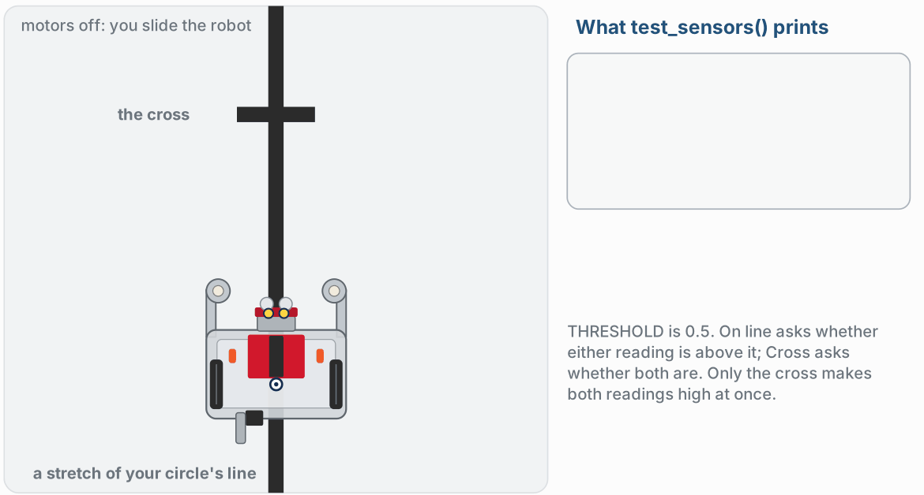
Testing by hand · on the line, off to one side
Activity
Watch it run. The next slide picks out the key moments.
Notes:
The figure on the lesson page is one animation of steps 1 and 2; this slide and the next show its four stops. Ask for a prediction of both Booleans before each one.

Slide 24
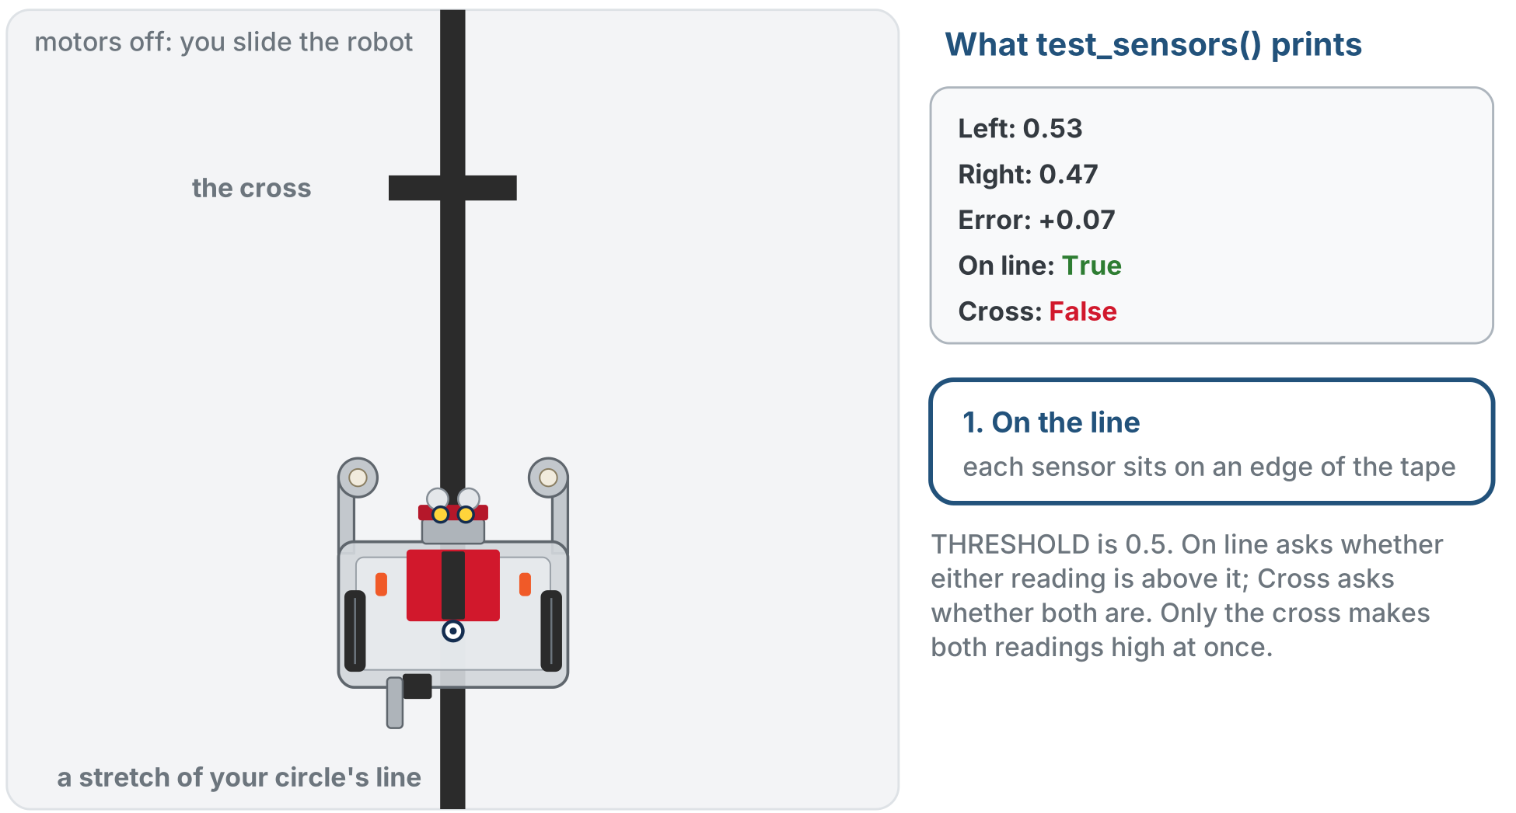
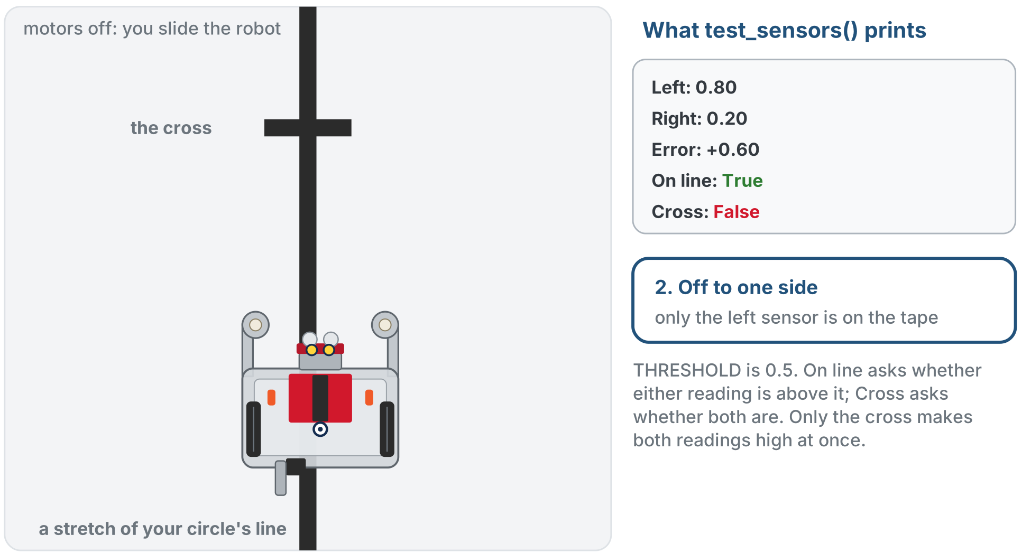
Testing by hand · on the line, off to one side
Activity
On the line: each sensor on an edge of the tape
Off to one side: only the left sensor on the tape
Motors off: slide the robot by hand and read what test_sensors() prints
Notes:
The figure on the lesson page is one animation of steps 1 and 2; this slide and the next show its four stops. Ask for a prediction of both Booleans before each one.

Slide 25
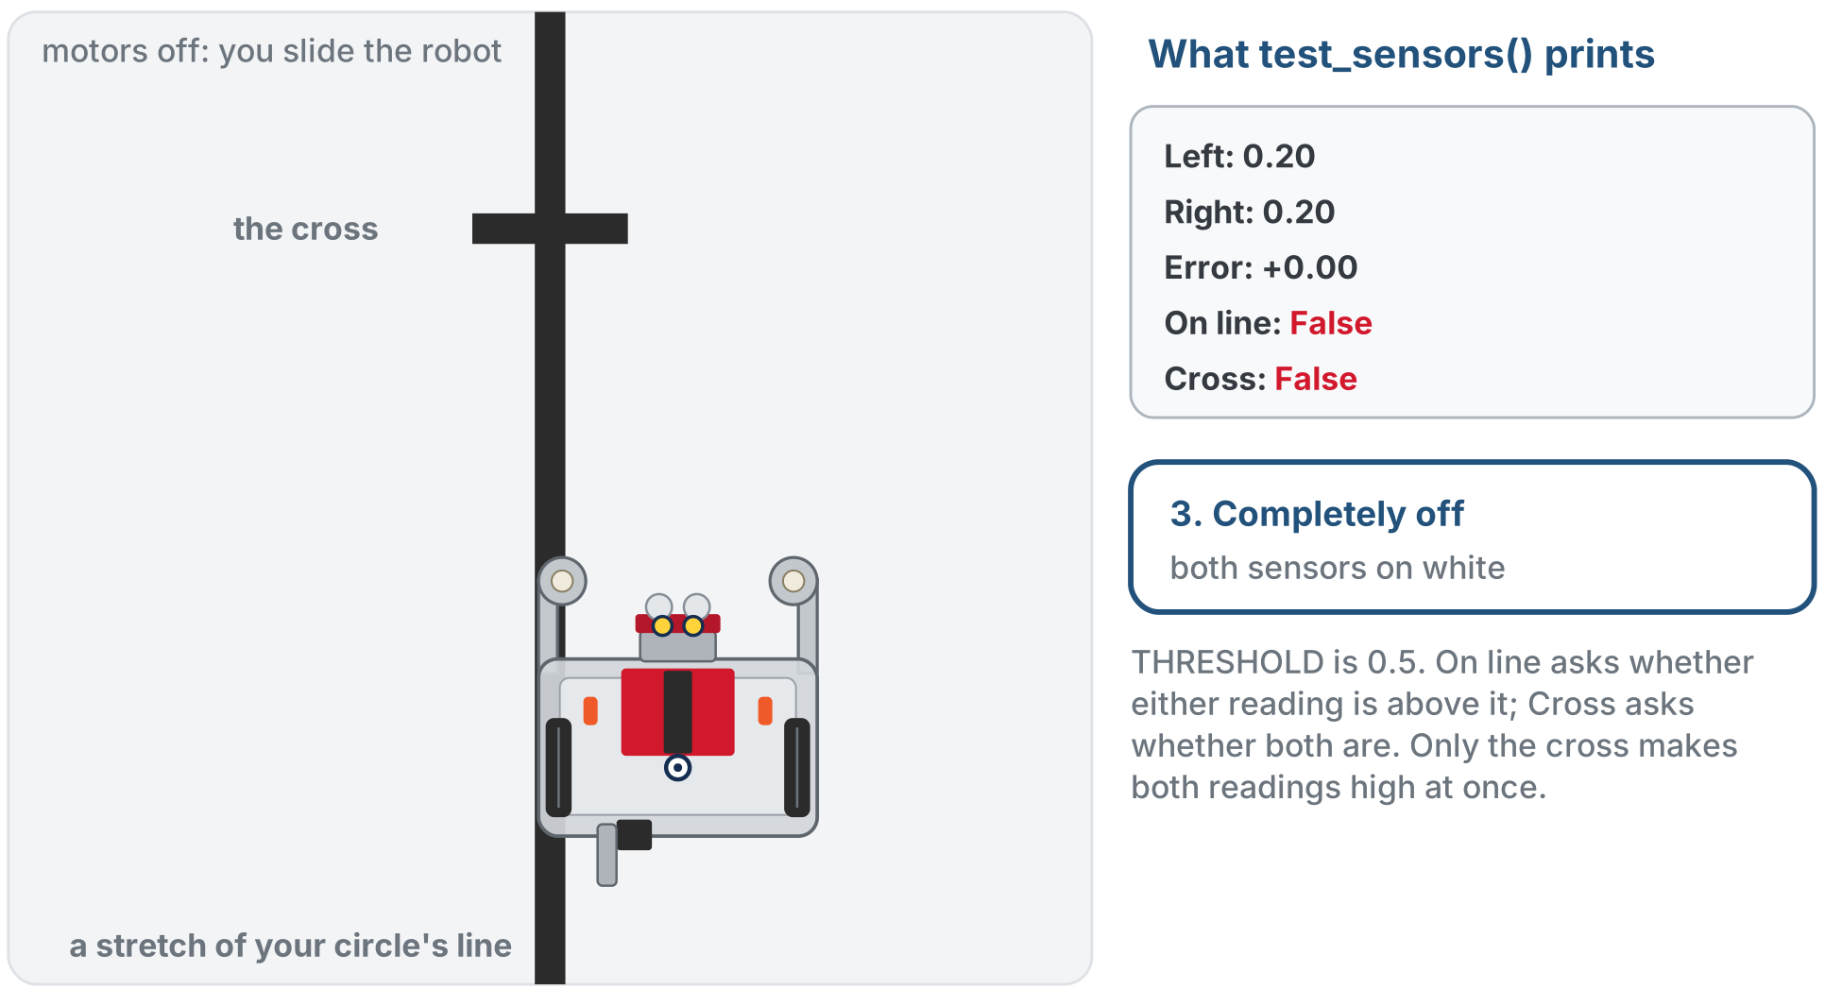
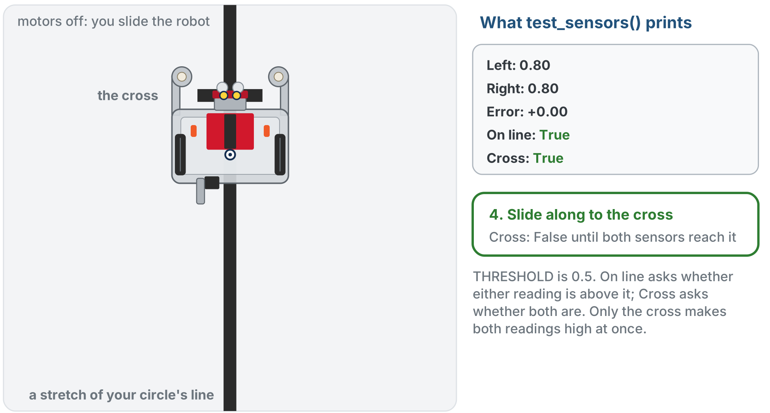
Testing by hand · completely off, on the cross
Activity
Completely off: both sensors on white
On the cross: both sensors on the strip
Only the cross puts both sensors on tape at once
Notes:
Sliding along the line toward the cross, Cross stays False until both sensors are on the strip.

Slide 26
Step 1 · is_at_cross()
Activity
Write the body of is_at_cross()
1
Add " Cross:", is_at_cross() to the print in test_sensors(), and set the run line to test_sensors()
2
Slide the robot along the circle: False all the way around, True only when both sensors sit on the crossing strip
3
True on the plain circle? The threshold is too low. Never True on the cross? Too high.

Slide 27
Step 2 · The whole toolkit
Activity
test_sensors() should now print all five: left, right, error, on-line, cross. Check four positions and write down what you see.
Position | error | is_at_cross() | is_either_on_line()
Centered on the line |  | False | True
Off to one side | positive or negative | False | True
Completely off the line |  | False | False
On the cross |  | True | True
Predict the two Booleans before each slide of the robot
Notes:
Have students predict both Booleans before each slide of the robot. The figure on the previous slide shows the same four positions with sample numbers.

Slide 28
Step 3 · set_threshold()
Activity
Add set_threshold() to the section without global, and call set_threshold(0.9) as the first line of test_sensors()
1
Slide over the cross: is_at_cross() still fires, because the real THRESHOLD never changed
2
Add the global line and run again: now nothing reads as tape
3
Take the call out again when you're done; the function can stay
4
Notes:
Do this one live if you can: the silent no-op is more convincing than any rule.

Slide 29
Step 4 · Nothing broke
Activity
Set the run line to test_follow() and run it once
1
The toolkit changed under it this lesson, and the follower should not care
2
From here on this section is finished: the next lessons use it and don't touch it

Slide 30
Real-world connections
HARDWARE
LIBRARIES
TEAMS
Device drivers
What you import
One place to fix
A sensor library is a handful of functions around one shared device handle: exactly this shape.
XRPLib's own reflectance module is functions and settings bundled the same way.
When the hardware changes, one function changes. Everyone who called it is unaffected.

Slide 31
Wrap-up
Where do reflectance and THRESHOLD live, and why can every function see them?
Why does get_error() call get_left() rather than the hardware?
When do you need global?
Next: the robot drives on these five, until is_at_cross() says stop
Notes:
Answers: at the top of the file, outside any function, so they are globals. One place knows how to read the sensor. Only to assign to a global inside a function. Formative: write is_at_cross() from its description; explain why get_error() needs no parameters; predict the two Booleans for a robot position. Exit ticket: "Why does set_threshold() need global and is_at_cross() not?" Lesson 2-9 then adds the functions that park on the cross and turn until a sensor finds the next line.

Slide 32
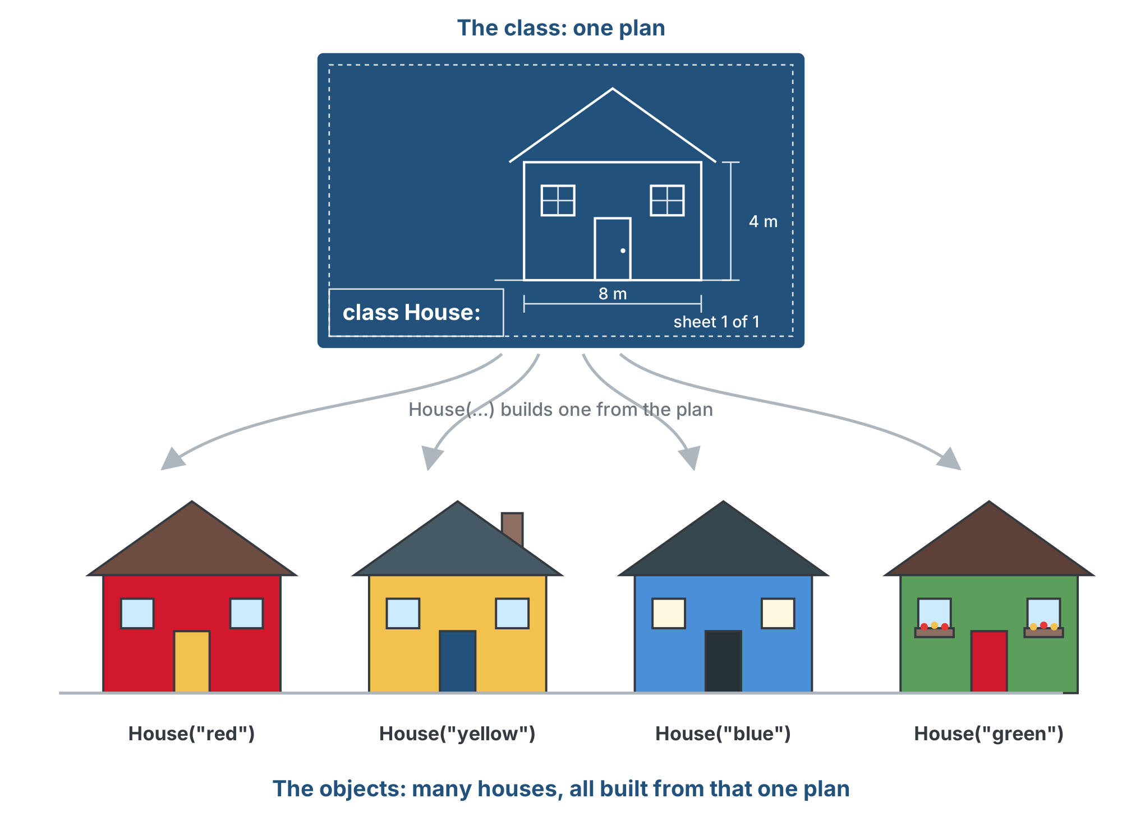
Optional extension · The LineSensor class
Optional
A class is a blueprint grouping data and actions. Each object built from it, an instance, can be a little different.
Notes:
Only for students who finish early. The five functions work, but their parts are spread out: two globals at the top and five functions below that depend on both. A class keeps the data and the functions that use it together. The class is just a definition: you cannot call get_error() on the LineSensor class itself. LineSensor() builds one object, an instance; the parentheses build it. Each can differ depending on what you pass the constructor. Students have used classes all along: DifferentialDrive, Reflectance, Board.

Slide 33
Optional extension · __init__ and self
Optional
__init__ is the constructor: Python runs it when you write LineSensor(). self is the object itself.
class LineSensor:
def __init__(self):
self.reflectance = Reflectance.get_default_reflectance()
self.threshold = 0.5
sensor = LineSensor() # __init__ runs now
print(sensor.threshold) # 0.5
Each function becomes a method with self first, the globals become self. data, and calls go through the object: sensor.get_error()
Notes:
The four changes from function to method: functions move inside the class with self as the first parameter; reflectance and THRESHOLD become self.reflectance and self.threshold, set in __init__; inside methods, those values and sibling calls get self. in front; outside calls go through the object, and Python supplies self. The payoff: copy the class and nothing is forgotten, two objects can have two thresholds, and no global keyword. Students paste the lesson's class skeleton in place of the LINE SENSOR functions, translate the five bodies, and add sensor. to calls in their tests. Classic slips: missing self in a parameter list, missing self. in front of an attribute or method, a method indented out of the class. The file is lesson-07-linesensor-class-addon.py in the Module 2 solutions.

