Slide 1

MODULE 4 · LESSON 4-0
The Big Picture
By the end of this lesson you can
Describe the goal of Module 4: autonomous multi-destination navigation
Name the two halves, the planner (compute_manhattan_path) and the driver (drive_path), and each one's job
Read the short main program and explain it in plain English
Explain top-down design: start with the big picture, then build each piece
Notes:
15 to 20 minutes, top-down design, no coding yet. This is an advance organizer: the point is the shape, not the detail. Resist explaining how anything works. If students ask how compute_manhattan_path works, the answer is "that is exactly Lessons 4-4 and 4-5". Tell them plainly they are not meant to understand every line yet: by Lesson 4-9 they will, because they will have built each piece.

Slide 2
Where we are headed
By the end of this module your robot starts at one corner of the grid
It visits several destinations in order, all by itself
No remote control, no manual steering
It figures out each route and drives it, intersection by intersection
Before we learn a single new piece, we look at the whole thing

Slide 3
How we compute the route
The robot plans every route the same simple way:
Go across until x is right. Then go up or down until y is right.
That's the whole algorithm
It always gives an L-shaped route, or a straight line if the robot is already in the right column or row
It never takes a step it doesn't need
It's called the Manhattan algorithm, after a real place

Slide 4
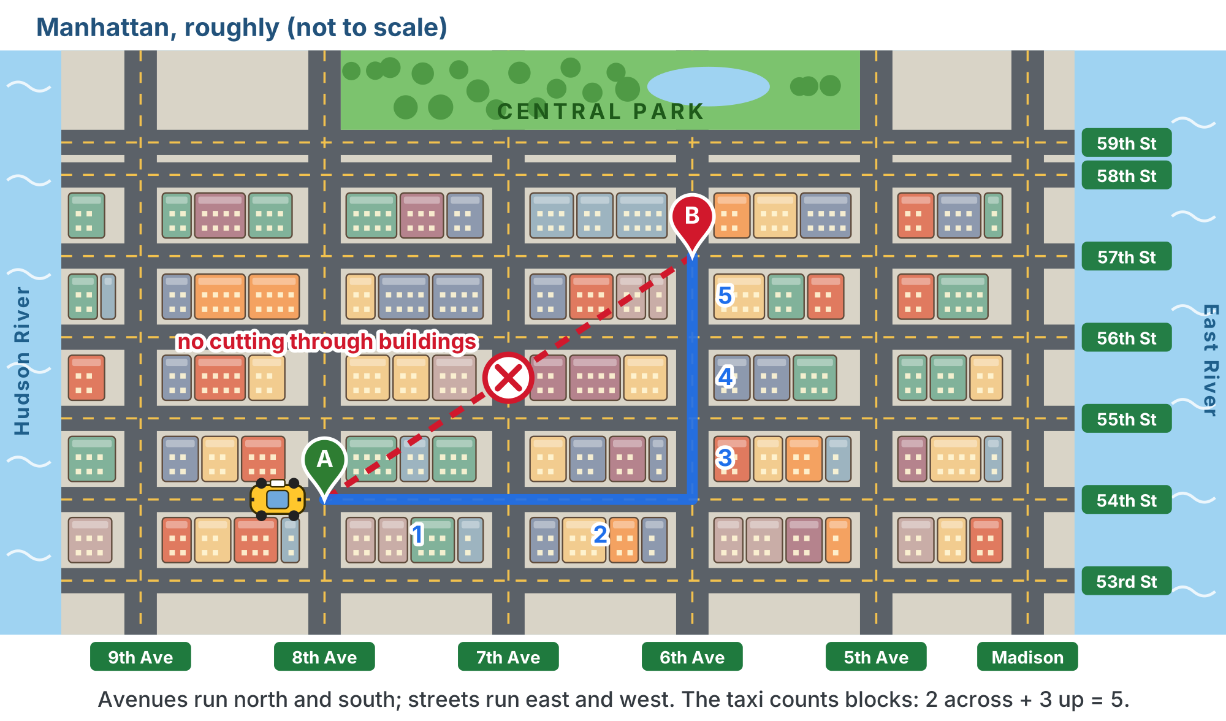
Why "Manhattan"?
A taxi can't cut through the buildings, so every trip is blocks across plus blocks up or down.
Notes:
Most of Manhattan is a rectangular grid: long avenues run north and south, shorter numbered streets cross them east and west, and every block is packed with buildings. New Yorkers give directions this way: "two blocks east, then three up." The robot is in exactly the same situation, because it can only drive along the tape. Lesson 4-4 builds the algorithm properly. For the curious: the grid comes from the Commissioners' Plan of 1811; it is turned roughly 29 degrees from true north, so "Manhattan north" is a local convention; and the same distance is called taxicab distance in mathematics. The map is a hook, not a lesson. Lesson 4-4 opens with "Why Manhattan?" and assumes students have seen this. (This slide uses a copy of the lesson figure with its text halos redrawn for the slide renderer.)

Slide 5
The big assumption: every street is clear
The Manhattan algorithm assumes nothing is in the way: every line of tape and every intersection can be driven
That's why it can be so simple: it never has to look for a detour
Real streets aren't always clear
Module 5 puts obstacles on the grid: the robot plans around them, and even notices a new one while it's driving
Module 6 (optional) handles streets that are open but slow, where the shortest route in steps isn't the fastest

Slide 6
The whole program, really
Here's the entire main program you're building toward. Seven lines:
position = (0, 0)
heading = 0 # facing North
destinations = [(2, 0), (2, 3), (0, 3)]
for dest in destinations:
path = compute_manhattan_path(position, dest)
print("Path:", path)
position, heading = drive_path(path, position, heading)
It is short because the functions do all the work
Notes:
In plain English: start at corner (0, 0) facing North; for each destination, compute the path from where we are, print it, drive it, and remember where we ended up. Students do not need to understand compute_manhattan_path or drive_path yet. Consider printing these seven lines on a card students keep and revisit at the start of each lesson, highlighting the piece they build that day.

Slide 7
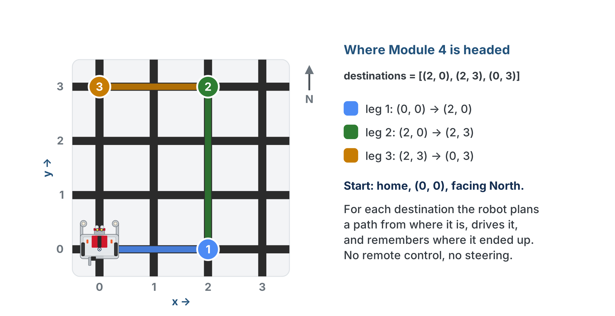
The seven lines, on the floor
Three destinations, three legs, each planned from where the last one ended.

Slide 8
Where the seven lines will live
In your robot.py they are the body of the module's last test function
The two functions they call live in two new sections above it: MANHATTAN PLANNER and NAVIGATOR
Those sit on top of the LINE TRACKING and GRID DRIVING sections you already have
The RUN block waits for the button, as always
All of that is left out of the seven lines so the shape stands out

Slide 9
Two halves, two jobs
PLANNER
DRIVER
compute_manhattan_path
drive_path
Told where the robot is and where it wants to go, it computes a list of intersections to follow. It never touches the robot.
Given that list, it drives the robot through each intersection, turning and line-following, and reports where it ended up. It never decides the route.

Slide 10
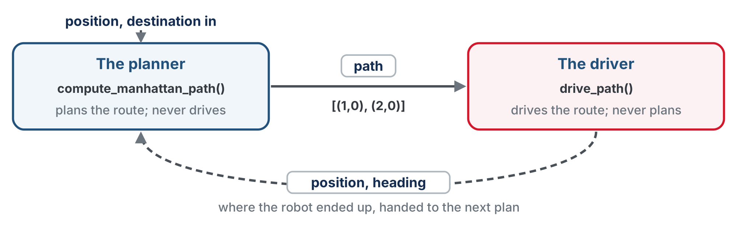
A path goes one way
A path goes from planner to driver; where the robot ended up comes back for the next plan.

Slide 11
Separation of concerns
The planner produces a path; the driver consumes it
Each half has exactly one responsibility: that's called separation of concerns
It makes bugs easy to find
A wrong route is a planner problem
A wrong turn is a driver problem
The planner is told where the robot is rather than remembering, so the printed path is always checkable before the robot moves

Slide 12
Check your understanding
Which half decides the route, and which one drives the robot?
A. drive_path plans; compute_manhattan_path drives
B. compute_manhattan_path plans the path; drive_path drives it
C. They both do both jobs
D. track_to_intersection does everything
Notes:
Answer: B. compute_manhattan_path computes the list of intersections (planning); drive_path drives through them (execution). One job each.

Slide 13
Answer
Which half decides the route, and which one drives the robot?
A. drive_path plans; compute_manhattan_path drives
B. compute_manhattan_path plans the path; drive_path drives it
C. They both do both jobs
D. track_to_intersection does everything
compute_manhattan_path computes the list of intersections (planning); drive_path drives through them (execution). One job each.

Slide 14
Your roadmap
Every lesson in this module builds one piece of that program:
4-1 coordinates: the (x, y) system
4-2 tuples: storing a position like (2, 3) (scratch work)
4-3 lists: storing a path like [(1,0), (2,0), (3,0)] (scratch work too)
4-4 the Manhattan algorithm, on paper then in code: the MANHATTAN PLANNER section opens
4-5 the planner function: its name, its promises, and why it is told where the robot is
4-6 testing without a robot: a test harness joins the planner section
4-7 turning logic, headings as numbers: the NAVIGATOR section opens
4-8 driving the path, built on your Module 2 line-tracking functions
4-9 the final project: it all comes together in one test function
Notes:
drive_path reuses the Module 2 functions for the actual driving, so students are not starting from scratch: that is the payoff of building a toolkit. If the class did the Module 2 class extensions, Lessons 4-5 and 4-8 each have an optional class version too.

Slide 15
Wrap-up
What will the robot do by the end of the module?
What are the two halves, and what is each one's job?
What does top-down design mean?
Next: coordinates: a name for every spot on the grid
Notes:
Answers: visit multiple destinations on its own. compute_manhattan_path plans; drive_path drives. Start with the big goal, break it into buildable pieces. Reference this overview at the start of every lesson: "remember the big picture? today we build this piece." That thread turns nine separate topics into one system. Return to the seven-line program in Lesson 4-9.

