Slide 1

MODULE 6 · LESSON 6-5
Three Planners, One Harness
By the end of this lesson you can
Write the Dijkstra class by copying BFS and making the same two changes as Lesson 6-3
Give it add_slow_edge(), clear_slow_edges() and weight() as methods, with the slow list inside the object
Run Manhattan(), BFS() and Dijkstra() through one harness and read the results
Explain why the harness can treat three different classes the same way
Notes:
45 minutes. Optional extension, class track only: for students who built the Manhattan and BFS classes in Lessons 4-5 and 5-5. Everything is Lesson 6-3 with self. in front; students who did 6-3 carefully finish this in half an hour.

Slide 2
The third class
You built the Manhattan and BFS classes in Lessons 4-5 and 5-5
Today: the third one, Dijkstra, and all three as objects through the Module 5 class harness
The harness never finds out which one it is holding
That property has a name: polymorphism
Did 6-3 as a function? This replaces that function with the class. Skipped ahead from 6-3? This is where you write it.

Slide 3
Where the skeleton goes
Paste it in place of the DIJKSTRA PLANNER banner and compute_dijkstra_path()
closest() sits under the new banner
dijkstra_distances(), compare(), the Lesson 6-4 part and your tests stay where they are
Move your Lesson 6-3 body into compute_path()
WEIGHTED GRAPH stays too. From today it is the harness's record of the slow edges, the way HARNESS_BLOCKED is its record of the blocks.

Slide 4
Skeleton (1 of 3): the banner and __init__
# ===== DIJKSTRA PLANNER (class version) =====
# One Dijkstra object holds the grid size, ITS OWN blocked
# list and ITS OWN slow list, and plans by cost around both:
# the BFS class with the slow-list methods added and the two
# Lesson 6-3 changes inside compute_path(). Same names as the
# function version, with planner. in front; the 5-6 class
# harness tests all three planners without naming one.
class Dijkstra:
def __init__(self, rows=4, cols=4):
self.rows = rows
self.cols = cols
self.blocked = []
self.slow_edges = [] # NEW: lives inside the planner

Slide 5
Skeleton (2 of 3): blocked and slow methods
def add_blocked(self, intersection):
# as in BFS
pass
def clear_blocked(self):
pass
def add_slow_edge(self, a, b, cost):
# your function, with self.slow_edges for SLOW_EDGES
pass
def clear_slow_edges(self):
pass

Slide 6
Skeleton (3 of 3): the last two methods
def weight(self, a, b):
# your function, reading self.slow_edges
pass
def compute_path(self, position, destination):
# your compute_dijkstra_path(), with
# build_graph(self.rows, self.cols, self.blocked)
# and self.weight(); closest() stays a function
pass
planner = Dijkstra()

Slide 7
A copy of BFS, with one more list
BFS holds its blocked list in self.blocked and has add_blocked(), clear_blocked() and compute_path(position, destination)
Dijkstra is a copy of it with one more list and the two changes
Same shape as the other two: told the position every call, returning a path that excludes the start
The slow list is the planner's own data, as the blocked list already was: nothing outside the object reaches in to change it

Slide 8
One object called planner
The Lesson 5-5 rule: one object called planner, and it is your newest planner
Delete planner = BFS()
Everything in Module 5 that said planner. now plans by cost
On a grid with no slow edges it gives the same answers as before: prove it by running any Module 5 test
The one trap: planner = BFS() left in the file below the Dijkstra one silently puts the old planner back

Slide 9
Check your understanding
Where does the slow-edge list live in the class version, and why?
A. In a global SLOW_EDGES, as in Lesson 6-2
B. Inside the Dijkstra object as self.slow_edges, like self.blocked: the planner's own knowledge, reached only through add_slow_edge()
C. Inside the harness
D. In the Navigator
Notes:
Answer: B. A class keeps its data with the methods that use it. The blocked list moved inside BFS in Lesson 5-5 for the same reason; the slow list follows it.

Slide 10
Answer
Where does the slow-edge list live in the class version, and why?
A. In a global SLOW_EDGES, as in Lesson 6-2
B. Inside the Dijkstra object as self.slow_edges, like self.blocked: the planner's own knowledge, reached only through add_slow_edge()
C. Inside the harness
D. In the Navigator
A class keeps its data with the methods that use it. The blocked list moved inside BFS in Lesson 5-5 for the same reason; the slow list follows it.

Slide 11
One harness, three objects
The Lesson 5-6 class harness is handed an object and calls its methods:
run_all_tests("Manhattan", Manhattan())
run_all_tests("BFS", BFS())
run_all_tests("Dijkstra", Dijkstra())
Inside, every line is planner.compute_path(...), block(planner, ...) or clear(planner). Nothing in the harness names a class.

Slide 12
One more helper: slow()
The seventh case needs a helper of the block() kind. slow(planner, a, b, cost) tells the planner about a slow edge and records it in SLOW_EDGES, so path_cost() adds up the true weights, whichever planner is being tested.
def slow(planner, a, b, cost):
"""Tell planner about the slow edge AND note it in
SLOW_EDGES, so path_cost() can see it."""
pass
Paste it under clear() in the 5-6 part of the file. clear() has to forget the slow edges as well as the blocks, on both sides.

Slide 13
Three edits to the harness
Harness
clear(planner) also calls planner.clear_slow_edges() and clear_slow_edges().
1
In run_all_tests(), the seventh case: slow(planner, (0, 1), (0, 2), 5) where it said add_slow_edge(...), planner.compute_path(...) for the plan, and clear(planner) for both clears.
2
compare() makes a fresh BFS() and a fresh Dijkstra(), and a fresh object knows nothing: before it plans, tell each one every entry in SLOW_EDGES with p.add_slow_edge(a, b, cost). Two lines, and BFS ignores them.
3
Notes:
compare()'s two new lines make the polymorphism point from the other side: a planner that cannot use the slow list is still told it, and nothing checks which one it is.

Slide 14
Manhattan and BFS accept the call too
slow() and clear() call these on any planner, so Manhattan and BFS need them, even though they ignore them, exactly as Manhattan.add_blocked() did nothing in Module 5:
class BFS:
# ...
def add_slow_edge(self, a, b, cost):
pass # BFS does not plan by cost; it accepts the call and ignores it
def clear_slow_edges(self):
pass
Notes:
The add_slow_edge() that does nothing is the teaching moment. Ask why it has to exist, and let students find the "if planner is BFS" they would otherwise need in the harness.

Slide 15
Functions (6-3), then objects (6-5)
# Functions (6-3)
run_all_tests("Dijkstra", compute_dijkstra_path)
path = planner(position, destination)
add_slow_edge((0, 1), (0, 2), 5)
# Objects (6-5)
run_all_tests("Dijkstra", Dijkstra())
path = planner.compute_path(position, destination)
slow(planner, (0, 1), (0, 2), 5)
Notes:
On the lesson page these are two blocks side by side; the slide stacks them.

Slide 16
That is polymorphism
Three classes, one set of method names, one harness that works on any of them
Code written against a shape, the names a planner answers to, rather than against one particular class
You have used it since Lesson 5-6, where the harness was handed a function
Objects make the shape explicit: it is the list of methods
Notes:
The word is introduced here because students have now done the thing three times: the Lesson 5-6 function swap, the Lesson 5-6 class extension, and this. Name it, point at the harness, and move on; a lecture on OOP terminology would undo the lightness that made the class track work.

Slide 17
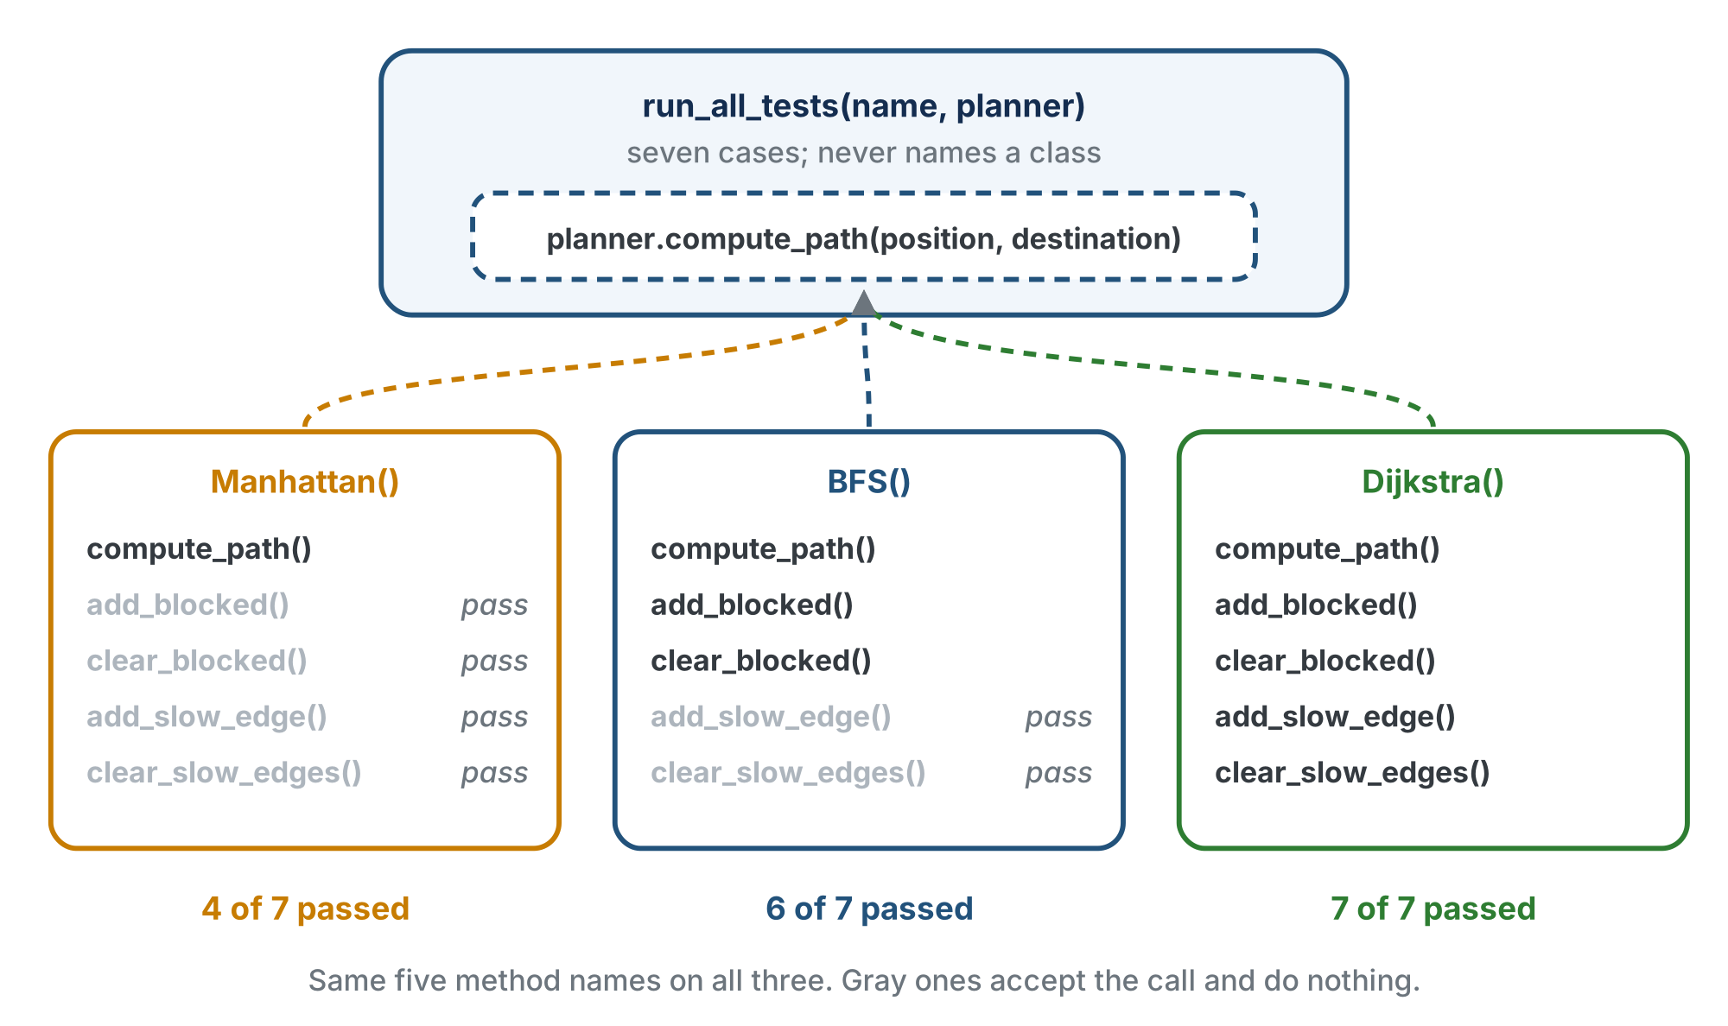
One shape, three classes
The methods a planner cannot use are still there, doing nothing, so the harness can call them on any of the three.

Slide 18
Check your understanding
Why must BFS have an add_slow_edge() method that does nothing?
A. Python requires every class to have the same methods
B. So the harness can call it on whichever planner it holds without checking which: the reason Manhattan has an add_blocked() that does nothing
C. Because BFS secretly uses weights
D. It does not; the harness skips BFS
Notes:
Answer: B. The harness is written against the shape. A planner that cannot use a piece of information still has to accept it, or the harness would need an if for every class, which is exactly what polymorphism avoids.

Slide 19
Answer
Why must BFS have an add_slow_edge() method that does nothing?
A. Python requires every class to have the same methods
B. So the harness can call it on whichever planner it holds without checking which: the reason Manhattan has an add_blocked() that does nothing
C. Because BFS secretly uses weights
D. It does not; the harness skips BFS
The harness is written against the shape. A planner that cannot use a piece of information still has to accept it, or the harness would need an if for every class, which is exactly what polymorphism avoids.

Slide 20
Activity · Build it, test it, read the results
Activity
Fill in the Dijkstra methods: the two blocked ones as in BFS, the three slow ones from WEIGHTED GRAPH with self.slow_edges for SLOW_EDGES, and compute_path() from your 6-3 body. Delete planner = BFS().
1
Give Manhattan and BFS the two methods that do nothing.
2
Write slow() and make the three harness edits. test_three_planners() hands in Manhattan(), BFS() and Dijkstra(); test_cost_grid() says slow(planner, ...) and draws planner.blocked. Run test_three_planners().
3
Notes:
In step 3, dijkstra_distances() also changes: it reads planner.blocked and planner.weight().

Slide 21
Expected, on the slow grid
Activity
=== Manhattan === blocked cases FAIL, cost FAIL 4 of 7
=== BFS === blocked cases PASS, cost FAIL 6 of 7
=== Dijkstra === everything PASS 7 of 7
Each planner fails exactly the tests that describe what it cannot do, in the harness you wrote in Lesson 5-6, with one case added

Slide 22
Step 4 · The swap on the floor
Activity
In test_drive_slow_grid(), PLANNER_NAME now chooses an object: planner = Dijkstra() or planner = BFS()
It is told the slow segment with slow(planner, ...), and asked for the path with planner.compute_path()
With the Navigator class, the drive is navigator.drive_path(path)
Run both planners as in Lesson 6-4
Same test program. The only line that changes is the class name.

Slide 23
Wrap-up
What does Dijkstra add to BFS?
Why can one harness test three classes?
What is that called?
Next: the end of the course: one robot.py, three planners, swapped by one name
Notes:
Answers: a slow list with three methods, and the two changes. They answer to the same method names. Polymorphism. Formative: the three-planner harness output; an explanation of the empty add_slow_edge(). Exit ticket: "What would the harness need if BFS lacked add_slow_edge()?" (An if per class, the thing polymorphism removes.) This is the last lesson in the course: a robot that follows lines, drives a grid, plans around obstacles and now plans by time, with three planners swappable by one name, in one robot.py that has grown since Lesson 2-1.

