Slide 1

MODULE 4 · LESSON 4-9
Final Project
By the end of this lesson you can
Integrate the planner and the driving functions in one program: the last test function in robot.py
Write a main loop that computes and drives a path to each destination in a list
Carry the robot's pose (position and heading) from one leg into the next by assigning from drive_path()
Print the first leg's path before the button, and say why only the first
Test incrementally, then demonstrate a working multi-destination run on the XRP
Notes:
Multi-day project. Keep the intro brief: this is a build-and-test day. For 50-minute periods plan two days: planning and desktop testing, then robot day.

Slide 2
The mission: a delivery drone on a city grid
Start at home base, (0,0), and visit four destinations in order
Compute a fresh path for each leg, and drive it autonomously
compute_manhattan_path(position, dest) returns the list of intersections
drive_path(path, position, heading) turns and drives it
Your job: the main program that connects them. About ten lines, and like every program in this course it is a test function at the bottom of robot.py.
Notes:
Everything comes together: students already built every piece. Optionally the run ends back at home base.

Slide 3
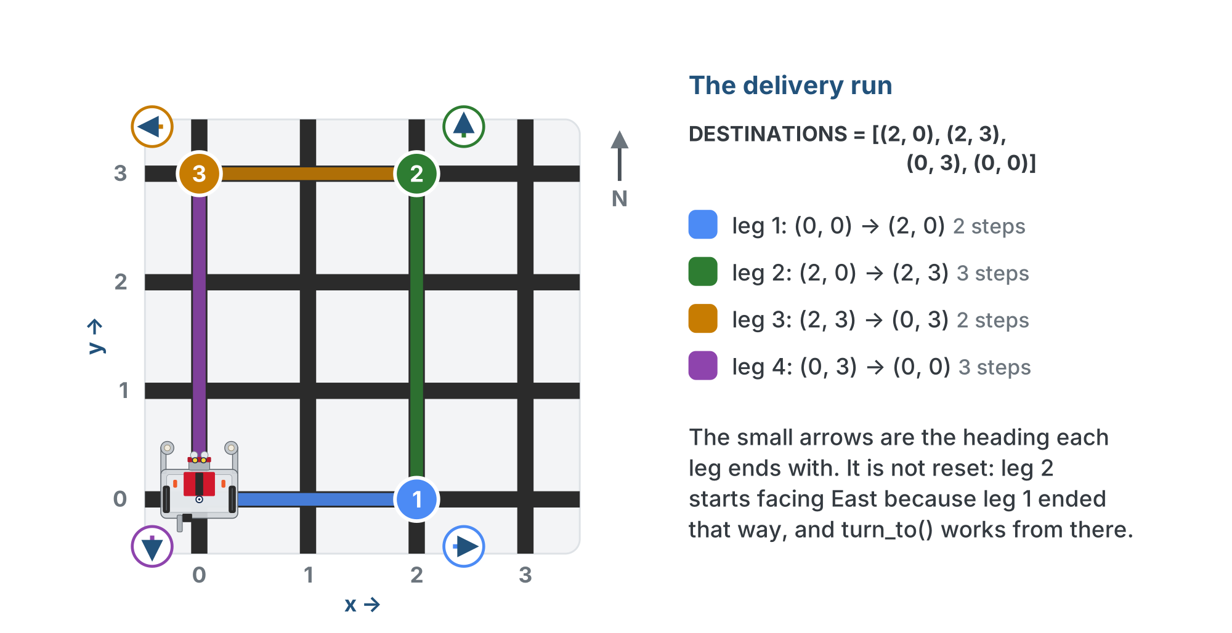
The delivery run
DESTINATIONS on the floor: 2, 3, 2 and 3 steps. Each small arrow is the heading a leg ends with, and the next leg starts from it.
Notes:
Leg 1 goes right 2 steps to (2, 0), ending facing East. Leg 2 goes up 3 to (2, 3), facing North. Leg 3 left 2 to (0, 3), facing West. Leg 4 down 3 back home, facing South.

Slide 4
Four destinations, four lists of single hops
DESTINATIONS is the supplied list: four stops, each several intersections from the last
The main program sends one destination at a time to compute_manhattan_path()
Each call returns a list of adjacent intersections: 2, 3, 2 and 3 hops here
drive_path() drives that list one hop at a time, then the next destination is planned from where it stopped
Destinations say where to go; each path says every intersection on the way
Notes:
Ask students to say the first path out loud before running: from (0, 0) to (2, 0) it is [(1, 0), (2, 0)].

Slide 5
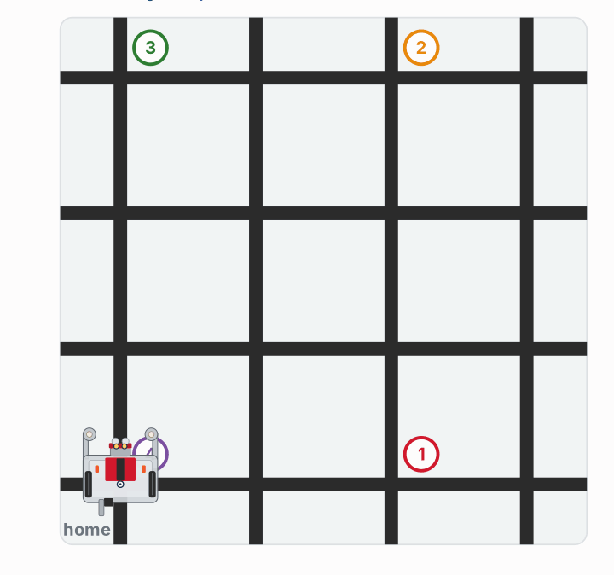
The whole run, driven
Watch it run. The next slide picks out the key moments.
Notes:
On the lesson page this is an animation of the whole run, with the main loop in plain words beside it and the running line highlighted; these are three moments from it, with the side panel cropped off. Leg 1 is one right turn and two steps east; legs 2, 3 and 4 each start with three right turns.

Slide 6
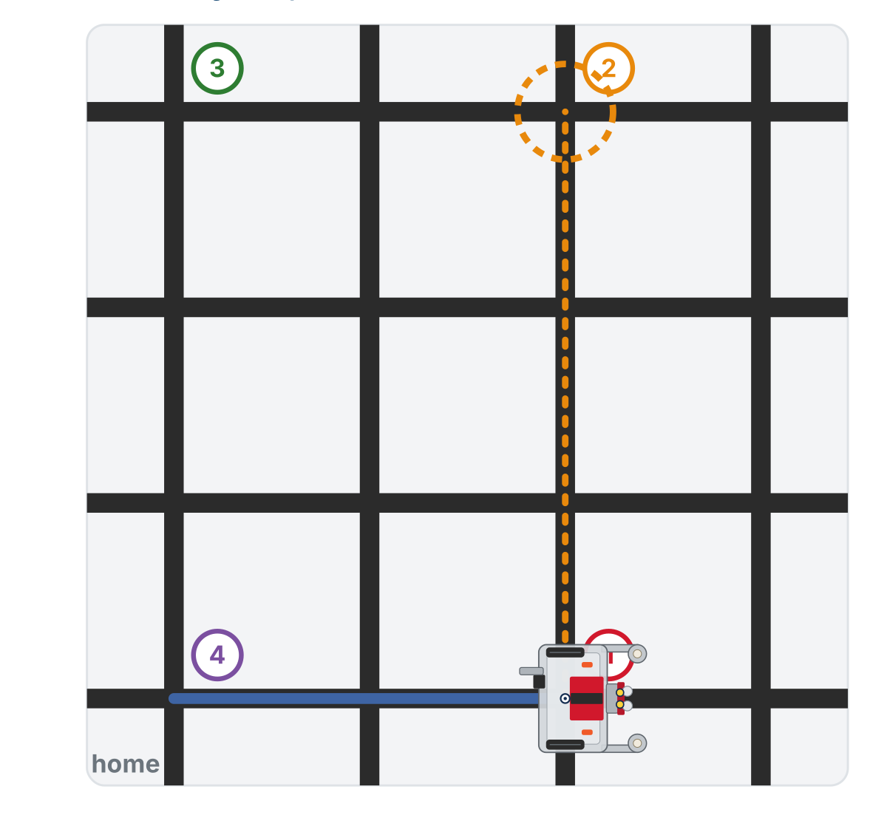
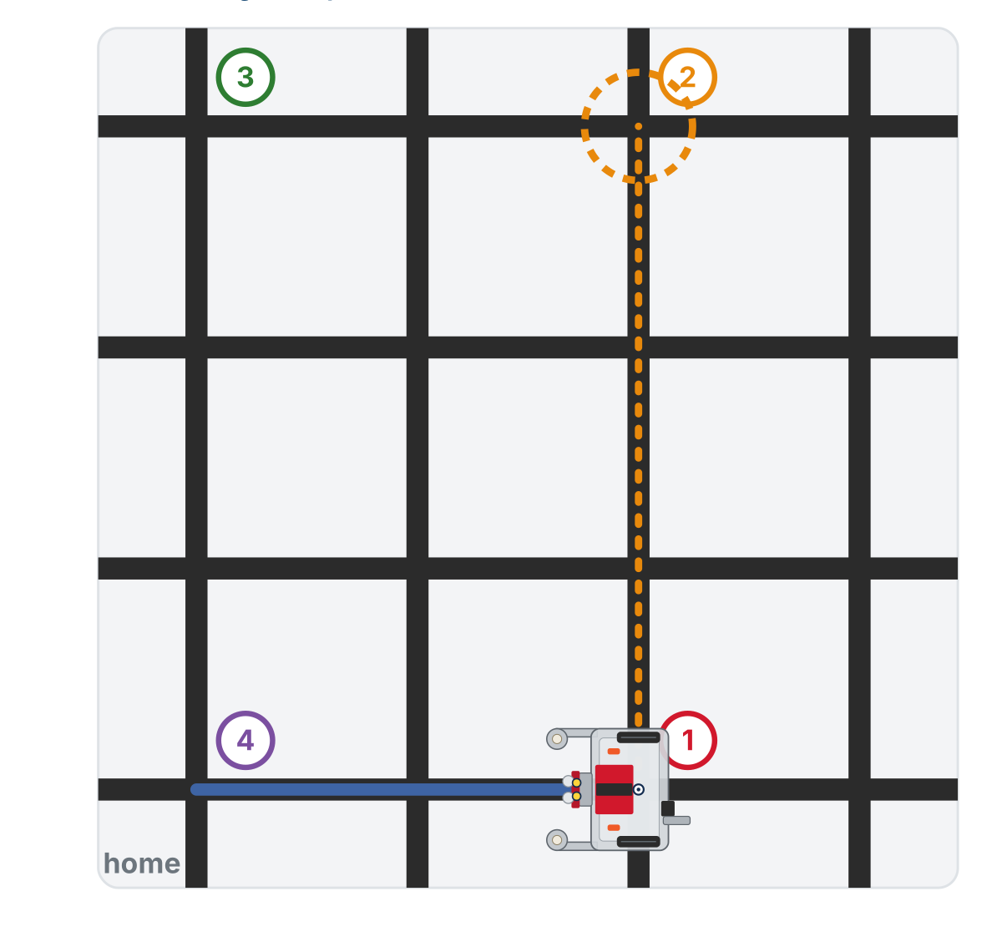
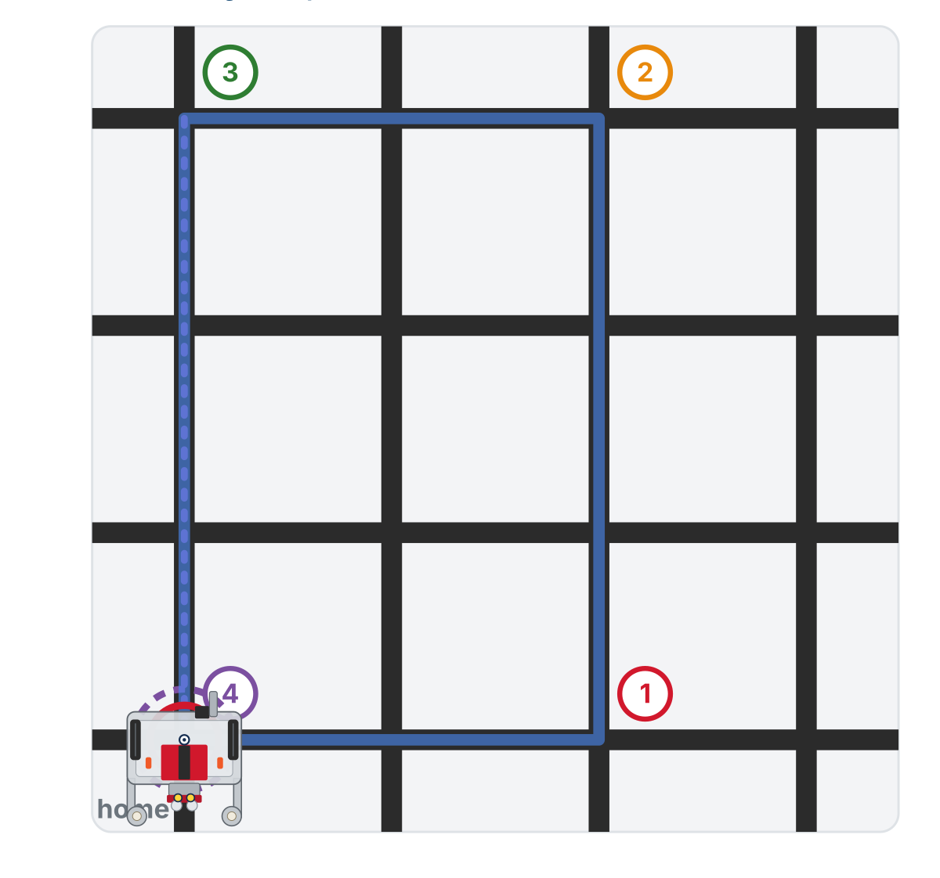
The whole run, driven
Leg 2 is planned from (2, 0), where leg 1 ended
Three right turns to face North
Leg 4 drives home
Each leg is planned from where the last one ended. turn_to() only turns clockwise, so most legs start with three right turns.
Notes:
On the lesson page this is an animation of the whole run, with the main loop in plain words beside it and the running line highlighted; these are three moments from it, with the side panel cropped off. Leg 1 is one right turn and two steps east; legs 2, 3 and 4 each start with three right turns.

Slide 7
Add to robot.py: the delivery run
Paste above RUN, at the end of the NAVIGATOR section. No new function is defined: one setting, a paper test, and the project itself.
# --- Lesson 4-9: final project, the delivery run ---
# The module project: visit DESTINATIONS in order, planning
# each leg with the MANHATTAN PLANNER from wherever the last
# leg ended and driving it with the NAVIGATOR. Nothing new is
# defined; the two sections did the work.
DESTINATIONS = [(2, 0), (2, 3), (0, 3), (0, 0)]
def test_delivery_paper():
# no robot: from (0, 0), plan the path to each destination
# in turn, print it with its step count, and move
# position on to that destination for the next leg
pass
Notes:
The skeleton continues on the next slide with test_delivery(), the graded work.

Slide 8
Add to robot.py: test_delivery()
def test_delivery():
# position and heading start at home, facing North
# plan the FIRST leg and print it; wait for the button
# for each destination:
# compute the path from where the robot is
# print it
# drive it
# ... and keep position and heading up to date
# print where the robot arrived
pass
The second-to-last comment decides whether leg 2 works. What does the main program know after drive_path() finishes, and what doesn't it, unless you ask?
Notes:
There is no student reveal for test_delivery(); the solution is the teacher copy only. The line nearly everyone gets half right: they call drive_path and throw the return value away. Leg one works perfectly, and every later leg is planned from (0,0) facing North. If a robot drives a sensible first route and then wanders, ask what position is in their main program after leg 1.

Slide 9
Check your understanding
Why must the main program write position, heading = drive_path(...) rather than just drive_path(...)?
A. Python requires return values to be assigned
B. drive_path changes only its own copies: the caller learns them only from the return
C. It resets the robot to (0,0)
D. It is not necessary
Notes:
Answer: B. position and heading inside drive_path are the function's own variables. Without the assignment, the main program's position stays (0,0) and every leg after the first is planned from the wrong place.

Slide 10
Answer
Why must the main program write position, heading = drive_path(...) rather than just drive_path(...)?
A. Python requires return values to be assigned
B. drive_path changes only its own copies: the caller learns them only from the return
C. It resets the robot to (0,0)
D. It is not necessary
position and heading inside drive_path are the function's own variables. Without the assignment, the main program's position stays (0,0) and every leg after the first is planned from the wrong place.

Slide 11
Only the first leg is printed before the button
Lesson 4-8's habit, plan, print, button, drive, with one limit
The main program prints the path for leg 1 before the button
It can't print legs 2, 3 and 4 yet: each is planned from wherever the previous leg actually finished
Instead, each leg is printed as it's planned, just before the robot drives it
In Module 5, where obstacles can appear mid-run, this becomes the only way it could work

Slide 12
Check your understanding
Why does the program print the plan for leg 1 before the button, but not for legs 2 to 4?
A. print() can only be called once before wait_for_button()
B. Later legs start where the previous leg ends, known only once the robot gets there
C. Leg 1 is the only one that uses compute_manhattan_path
D. To save battery
Notes:
Answer: B. Each leg is planned from the robot's current position. Leg 1 is the only one whose starting position is known before the robot moves.

Slide 13
Answer
Why does the program print the plan for leg 1 before the button, but not for legs 2 to 4?
A. print() can only be called once before wait_for_button()
B. Later legs start where the previous leg ends, known only once the robot gets there
C. Leg 1 is the only one that uses compute_manhattan_path
D. To save battery
Each leg is planned from the robot's current position. Leg 1 is the only one whose starting position is known before the robot moves.

Slide 14
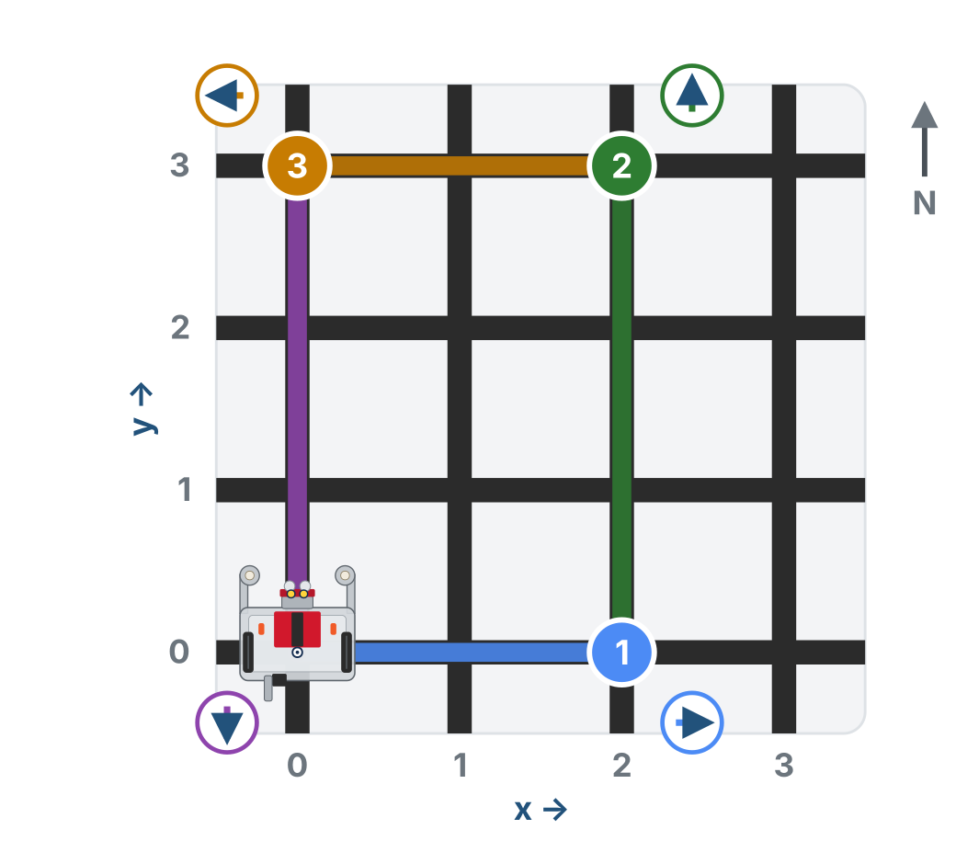
The heading carries over
heading is not reset between legs
Finished leg 1 facing East? It starts leg 2 facing East
That's what drive_path returned, and that's the truth on the floor
It's exactly why turn_to() works from the real current heading rather than assuming North
Notes:
The grid half of the delivery-run figure: the small circled arrows are the heading each leg ends with. Leg 2 starts facing East because leg 1 ended that way.

Slide 15
Check your understanding
At the start of leg 2, what is the robot's heading?
A. Always reset to 0 (North)
B. Whatever heading drive_path returned at the end of leg 1
C. Always 2 (South)
D. Random
Notes:
Answer: B. The main program keeps heading from one leg to the next by assigning it from drive_path's return. The robot begins each leg facing however it finished the last.

Slide 16
Answer
At the start of leg 2, what is the robot's heading?
A. Always reset to 0 (North)
B. Whatever heading drive_path returned at the end of leg 1
C. Always 2 (South)
D. Random
The main program keeps heading from one leg to the next by assigning it from drive_path's return. The robot begins each leg facing however it finished the last.

Slide 17
Activity · Test in three levels
Activity
Do not jump straight to the full run. If something breaks, you won't know which piece. One test on the run line at a time:
Planner alone (no robot). Write test_delivery_paper(): loop the destinations, print each path, set position = dest between them. Count the steps: 2, 3, 2, 3
1
One leg on the robot. Run Lesson 4-8's test_drive_path() with DESTINATIONS[0] as its destination. Robot at (0,0) facing North, both presses. Correct turns? Right intersection?
2
Full sequence. Write test_delivery() and run it. Read the leg-1 path before the second press. Watch the straight-through intersections and the turns
3
Notes:
Push level-by-level testing hard: the students who write everything at once and can't find the break are the ones who skipped planner-only testing. Level 1 is the Lesson 4-6 habit on today's destinations. The paper test has a closed reveal on the lesson page. Watch battery drain on long multi-turn runs and charge between attempts.

Slide 18
Check your understanding
On the second leg the robot drives a clearly wrong path. What's the first thing to check?
A. The battery voltage
B. Whether position and heading were assigned from drive_path after leg 1
C. The color of the grid lines
D. The HEADING_NAMES list
Notes:
Answer: B. A wrong path on leg 2 or later almost always means the return value was dropped, so leg 2 was planned from (0,0) facing North. The printed path for leg 2 confirms it.

Slide 19
Answer
On the second leg the robot drives a clearly wrong path. What's the first thing to check?
A. The battery voltage
B. Whether position and heading were assigned from drive_path after leg 1
C. The color of the grid lines
D. The HEADING_NAMES list
A wrong path on leg 2 or later almost always means the return value was dropped, so leg 2 was planned from (0,0) facing North. The printed path for leg 2 confirms it.

Slide 20
The rubric
You're graded on the whole system working together.
Category | Points | What it takes
Planner | 10 | compute_manhattan_path correct for any position and destination; Lesson 4-6 tests pass
Driving functions | 15 | Correct desired_heading, turn_to, drive_path; parked on the cross at every arrival; position and heading returned
Main program | 10 | test_delivery(): 4+ destinations, prints leg 1 before the button, drives each leg, assigns position, heading from drive_path
Robot demo | 10 | Physically visits all destinations with correct turns
Planning & docs | 5 | Planning worksheet, a hand-trace of one leg, testing checklist followed
Notes:
Class track: students who did the extensions run the project on their objects, navigator.drive_path(path) and planner.compute_path() if they built Manhattan. Same rubric.

Slide 21
If you finish early
Add a "return home" leg
A round trip: destinations forward, then reversed
Let the user type the destinations
Count total intersections driven and turns made across the whole journey
Or the Lesson 4-8 class extension: a Navigator object, so the main loop has nothing to pass back and forth
Notes:
Class-track students drive with navigator.drive_path(path) and read navigator.position; there is no return value to drop, which is the point of the Lesson 4-8 side-by-side. It is the first time the encapsulation pays off in a whole program.

Slide 22
Check your understanding
You want the robot to end where it began. What's the simplest change?
A. Reset position to (0, 0) at the end
B. Add (0, 0) as the final destination in the list
C. Reverse the motors
D. Restart the program
Notes:
Answer: B. The loop already computes and drives a path to each destination. Just append home (0,0) to the list and the last leg drives the robot back.

Slide 23
Answer
You want the robot to end where it began. What's the simplest change?
A. Reset position to (0, 0) at the end
B. Add (0, 0) as the final destination in the list
C. Reverse the motors
D. Restart the program
The loop already computes and drives a path to each destination. Just append home (0,0) to the list and the last leg drives the robot back.

Slide 24
Real-world connections
LOGISTICS
RIDESHARE
SPACE
Delivery routing
Multi-stop trips
Rover missions
Warehouse and delivery robots compute a route to each stop, drive it, then re-plan from the new location: exactly this loop.
Navigation apps chain legs together, recomputing from your current position at each waypoint.
Planetary rovers plan a path to a target, execute carefully, and re-plan, with the same separation of planning and driving.
Notes:
The plan-then-execute structure students just built is fundamental to real autonomous systems.

Slide 25
Wrap-up
What's the one line that makes multi-leg journeys work?
Why is only leg 1 printed before the button?
What are the three testing levels?
Next: Module 5: breadth-first search replaces the planner, and drive_path keeps driving
Notes:
Answers: position, heading = drive_path(path, position, heading), for each leg. Later legs are planned from where the robot actually ends up. Planner alone, one leg, full sequence. When a robot finishes the whole sequence, let the class watch: it is the payoff of nine lessons. Name what they built across Module 4: coordinates and tuples, lists and iteration, algorithm design, a planner and a driver that know nothing about each other, a testing discipline, hardware integration. In Module 5 BFS replaces the Manhattan planner and drive_path keeps driving unchanged: the reward for keeping the two concerns separate.

